Slide 1
Waters of the U.S. Updates and Changes
by Peter D. McKone, CWB
Weaver Consultants Group
Notes:
Jeff

Slide 2
Outline
Regulatory Background
Permits
Waters of the U.S.

Slide 3
Waters of the U.S.

Slide 4
Corps Regulatory Program
Protect Navigation: Sections 9 and 10 of the Rivers and Harbors Act of 1899
Restore and maintain the physical, chemical and biological integrity of the nation's waters: Section 404 of the Clean Water Act
Protect marine resources associated with ocean disposal of dredged material: Section 103 of the Marine Protection, Research and Sanctuaries Act of 1972
Source: USACE Fort Worth District and Rapanos guidance

Slide 5
Legal Background
USACE administers the regulatory aspects of dredge and fill activities.
EPA maintains ultimate responsibility for oversight of the USACE’s program.
Section 401 requires water quality certification from states.
Section 404 addresses permitting discharge of dredge and fill material.

Slide 6
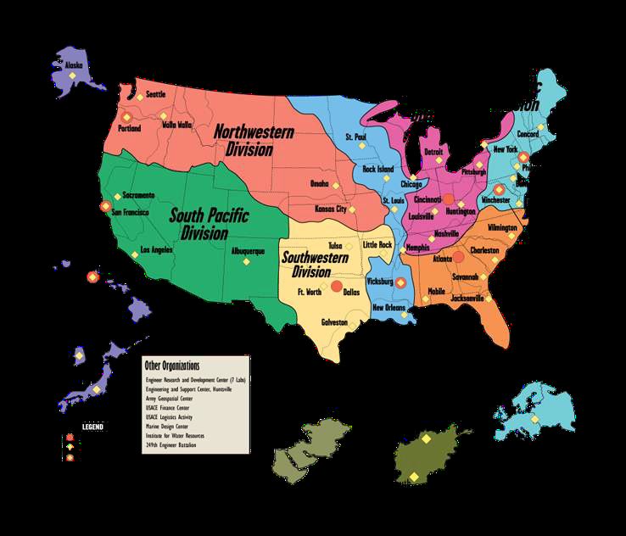

Slide 7
What is Fill?
Material that has the effect of replacing a water of the U.S. with dry land or changing the bottom elevation of a water of the U.S. Examples include rock, sand, soil, clay, plastics, construction debris, wood chips, overburden from mining, etc.

Slide 8
Types of Permits
Individual Permits
Standard
Letters of Permission
General Permits
Regional
Programmatic
Nationwide

Slide 9
Nationwide Permits
52 Nationwide Permits
Focus on environmental protection while providing timely and simplified authorizations for work in aquatic environments
Are valid for 5 years from date of issuance (effective 3/2017 to 3/2022)
Regional conditions
Some statewide
Some district specific

Slide 10
Waters of the U.S.
All waters which are currently used, or were used in the past, or may be susceptible to use in interstate or foreign commerce, including all waters which are subject to the ebb and flow of the tide
All interstate waters, including interstate wetlands
All other waters such as intrastate lakes, rivers, streams (including intermittent streams), mudflats, sandflats, wetlands, sloughs, prairie potholes, wet meadows, playa lakes, or natural ponds

Slide 11
Special Aquatic Sites
-Sanctuaries and refuges
-Wetlands
-Mud flats
-Vegetated shallows
-Coral Reefs
-Riffle and pool complexes

Slide 13
Perennial stream: well-defined channel, regular flow in years with normal precipitation
Ephemeral stream: lacks well-defined channel flows in direct response to a precipitation event, no OHWM present
Intermittent stream: wel- defined channel, seasonal flow (typically winter and spring)
OHWM
Photos from USACE

Slide 22
Latest News and Notes
Jurisdictional Determinations (JDs) have been the subject of recent as well as ongoing attention
U.S. Supreme Court and Rapanos decision
Approved vs. preliminary JDs
U.S. Supreme Court and Hawkes decision
Approved JD is final agency action
Waters of the U.S. Rule
Numerous litigation actions
Presidential Executive Order

Slide 23
Clean Water Rule
Originally issued in July 2015
Over 100 lawsuits filed against it
Sixth Circuit stayed the rule
U.S. Supreme Court ruled that the Sixth Circuit did not have jurisdiction in January 2018
Sixth Circuit dismissed the case in February 2018
President Trump Administration
EPA and USACE proposed to rescind the rule in July 2017
Both agencies suspended the rule for two years in February 2018
Federal judge ruled suspension violated the Administrative Procedures Act
Rule took effect in 26 states

Slide 24
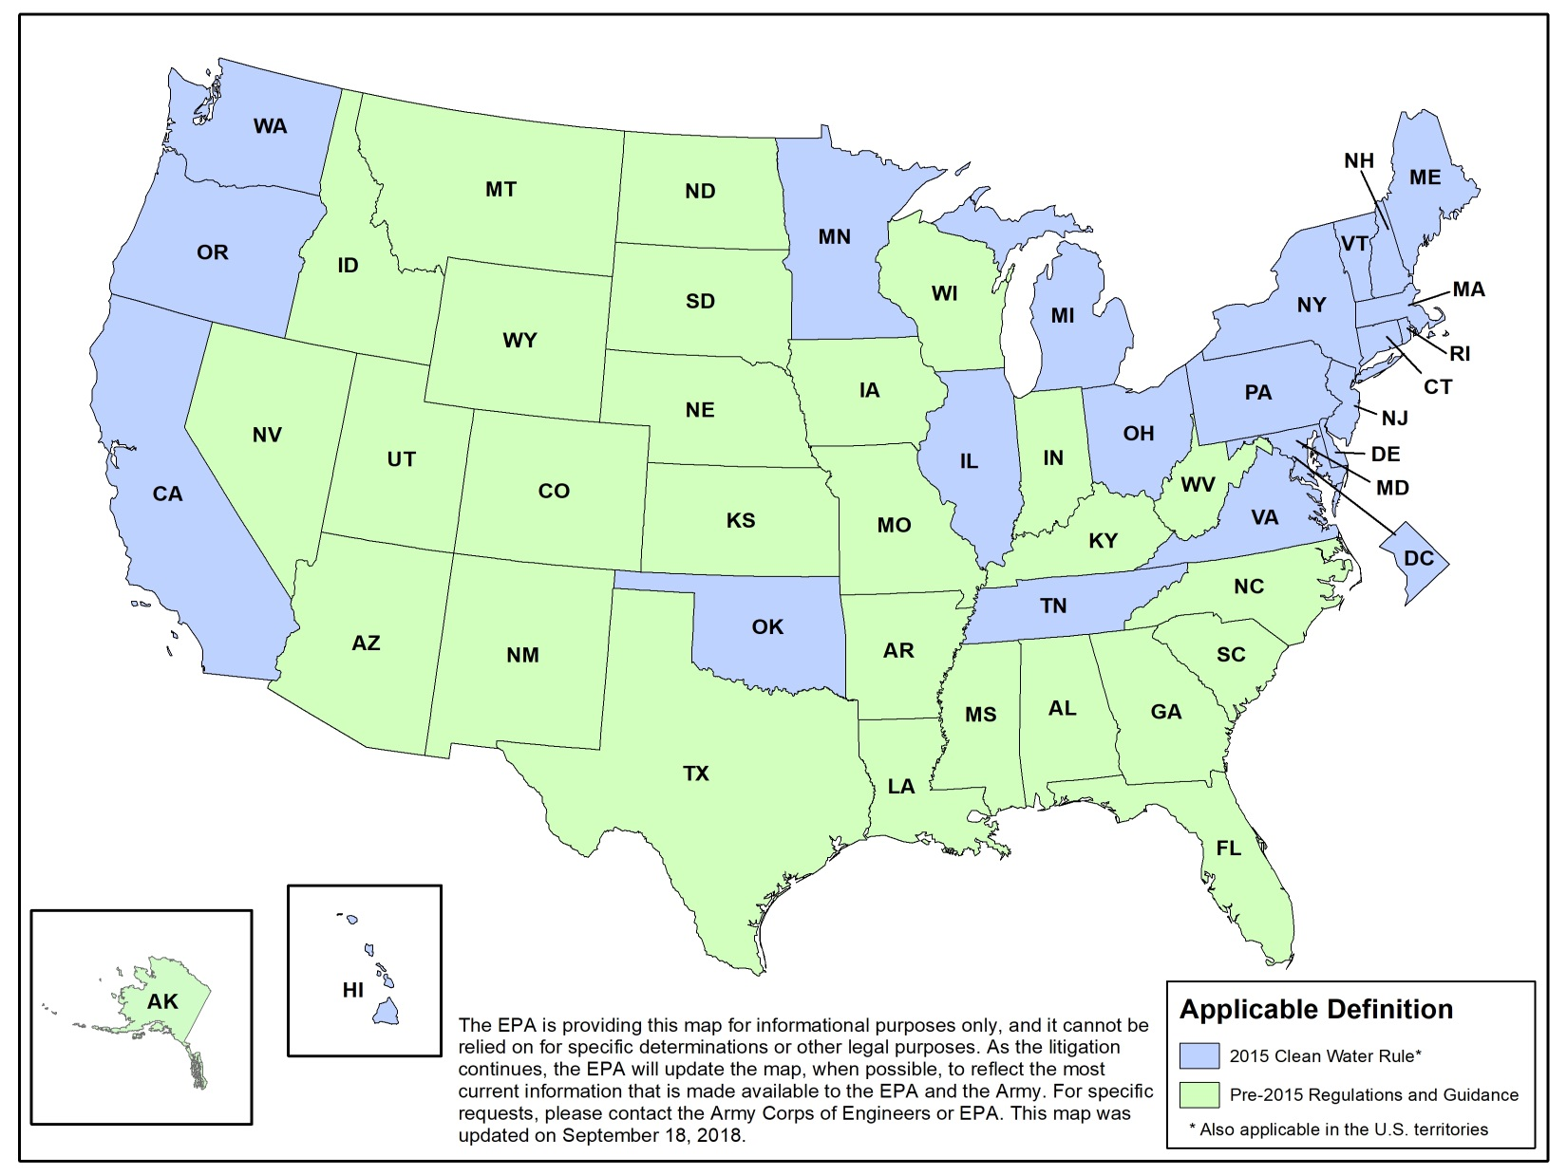

Slide 25
CWR (cont.)
Most districts are interpreting based on Rapanos
Significant nexus
Case-by-case basis

Slide 26
Questions
Peter D. McKone, CWB
Weaver Consultants Group
pmckone@wcgrp.com

