Slide 1
Water Management in the U.S. Oil and Gas Industry
by Peter D. McKone, CWB (Weaver Consultants Group) and Anthony Smith (Phoenix Services)
Notes:
Jeff

Slide 2
Outline
Waters of the U.S.
Floodplains
Water Management

Slide 3
Waters of the U.S.

Slide 4
Corps Regulatory Program
Protect navigation: Sections 9 and 10 of the Rivers and Harbors Act of 1899
Restore and maintain the physical, chemical and biological integrity of the nation's waters: Section 404 of the Clean Water Act
Protect marine resources associated with ocean disposal of dredged material: Section 103 of the Marine Protection, Research and Sanctuaries Act of 1972
Source: USACE Fort Worth District and Rapanos guidance

Slide 5
Legal Background
USACE administers the regulatory aspects of dredge and fill activities.
EPA maintains ultimate responsibility for oversight of the USACE’s program.
Section 401 requires water quality certification from states.
Section 404 addresses permitting discharge of dredge and fill material.

Slide 6
Regulated Activities
Section 404 Permits
Individual Permits
Standard
Letters of Permission
General Permits
Regional
Programmatic
Nationwide
SPCC Plans

Slide 7
Waters of the U.S.
All waters which are currently used, or were used in the past, or may be susceptible to use in interstate or foreign commerce, including all waters which are subject to the ebb and flow of the tide
All interstate waters, including interstate wetlands
All other waters such as intrastate lakes, rivers, streams (including intermittent streams), mudflats, sandflats, wetlands, sloughs, prairie potholes, wet meadows, playa lakes, or natural ponds
Does not always include waters of the state/state waters

Slide 8
Floodplains
Source of previous slides:
Oklahoma Floodplain Managers Association

Slide 9
Conflicting Regulations
Some communities are requiring too much regulation of oil and gas in their floodplains.
ex: all production sites must be elevated and anchored
Some communities are requiring too little.
not regulating at all or simply giving a permit with no oversight
These widely varying requirements are difficult for the O/G industry and are causing problems for floodplain management.

Slide 10
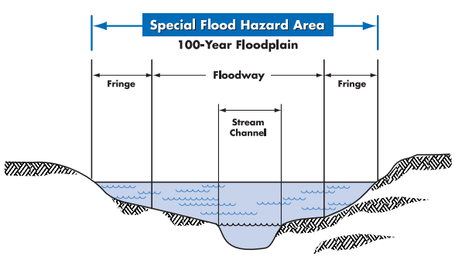
FEMA Floodplain

Slide 11
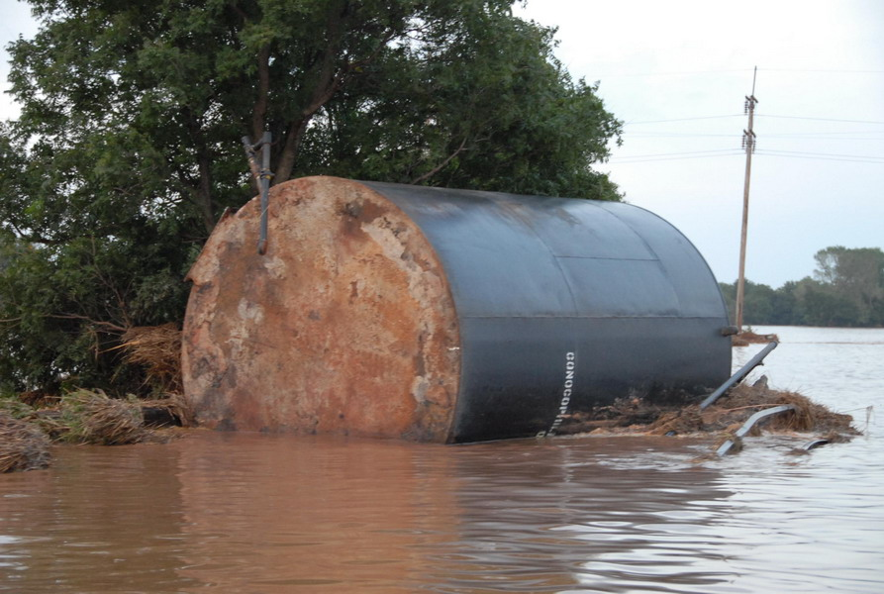
Kingfisher, OK, August 19, 2007

Slide 12
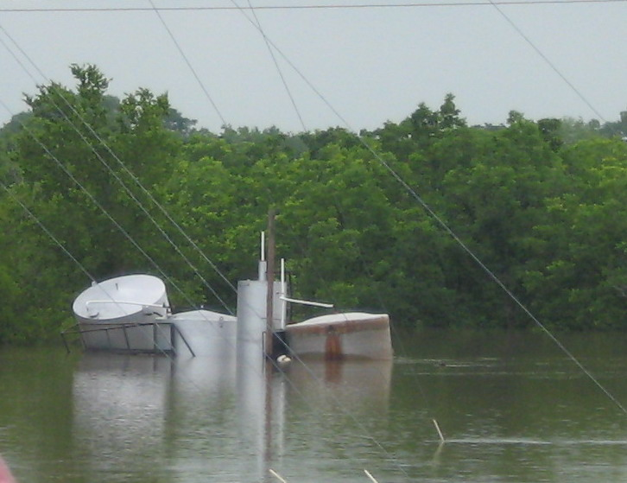
Bartlesville OK, July 3, 2007

Slide 13
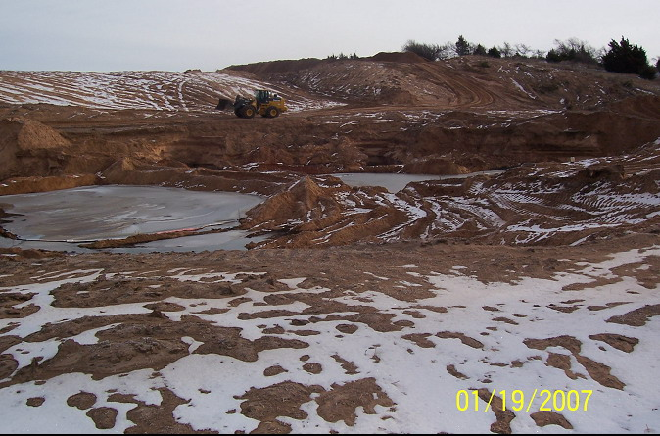
Pipeline Break, Blaine Co., OK

Slide 14
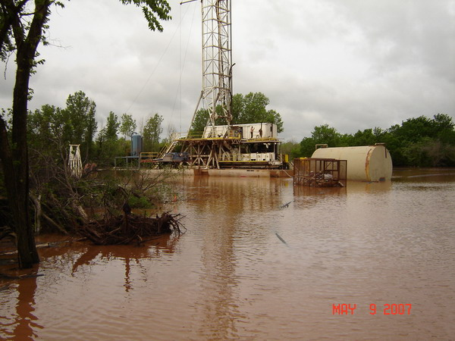
Canadian County, OK, May 9, 2007

Slide 15
Permitting Responsibilities

Slide 16
What do the O/G companies have to do to be compliant?
They must:
Obtain a floodplain permit before development (including pad construction and pipelines) begins.
Floodproof, elevate or relocate production equipment.
Have a registered engineer certify the design of the floodproofing measures.

Slide 17
Permit Steps for the FPA
Identify the site on the floodplain map.
What is the potential water velocity at the site? Or is the flood potential backwater only?
How far would companies have to go to get tanks and equipment out of floodplain? This could be an option.
Note whether lease road will be under water during flood or will impede water flow.
Know your site!
Take photos.
Note condition and location of trees and shrubs.

Slide 18
Permit Steps (cont.)
Establish a BFE
In rural A zones with no BFE’s on the maps, use the Simplified Method of Contour Interpolation – line up the floodplain boundaries over a topo map.
Found in FEMA 265: Managing Floodplain Development in Approximate A Zones.

Slide 19
Permit Steps (cont.)
The operator has 3 options:
Elevate production site above BFE, Elevation Certificate required.
Relocate production site out of floodplain.
Floodproof:
Anchor all production equipment to BFE.
Protect vulnerable equipment such as well head and gas valve with flood protection fence to prevent flood debris damage.

Slide 20
Pipelines
Determine burial depth requirement.
Recommendation:
72 inches under creeks/rivers, 48 inches in the rest of the floodplain
Company may have to sign Statement of Burial Depth Compliance after construction is complete.

Slide 21
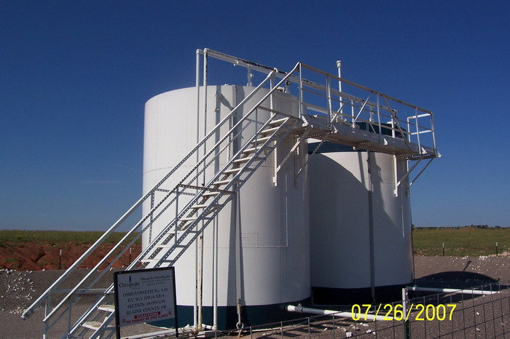
The Good
Proper anchoring

Slide 22
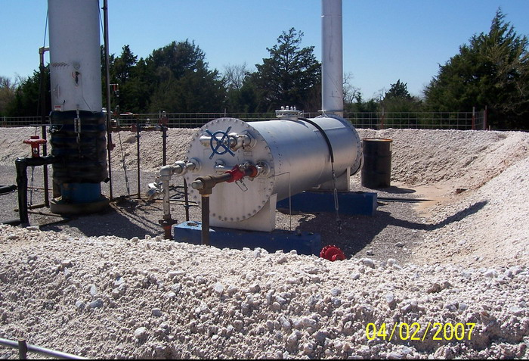
Proper anchoring on equipment other than tanks

Slide 23
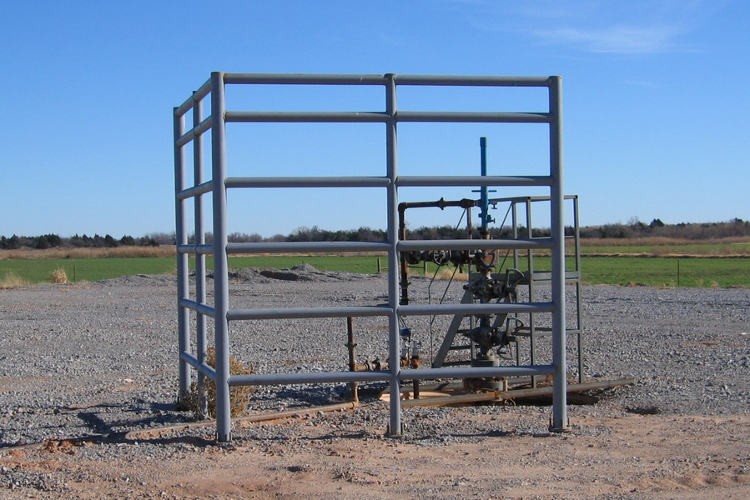
Well Head Guard

Slide 24
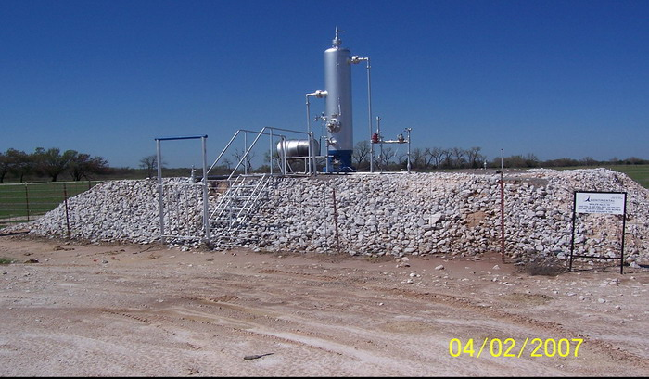
Elevation of production site

Slide 25
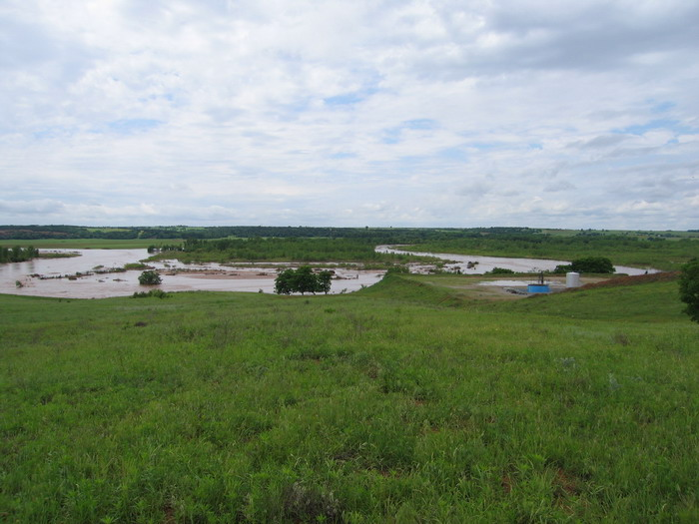
Relocated production equipment

Slide 26
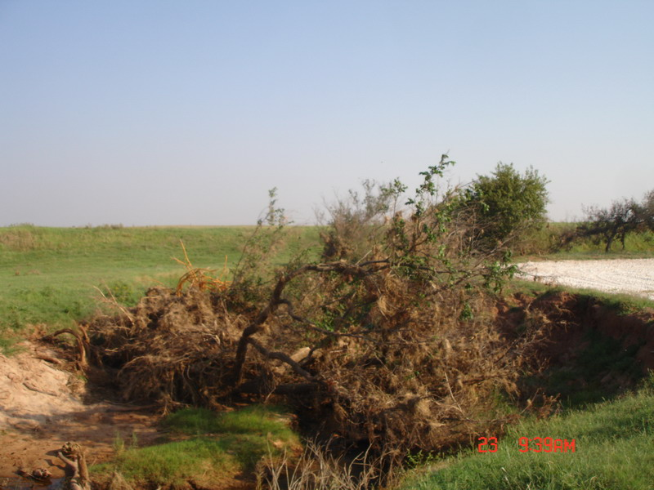
The Bad
Infringement on waterway

Slide 27
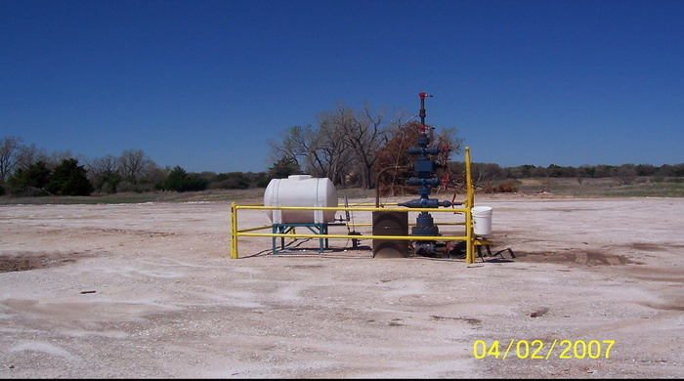
Inadequate well head guard

Slide 28
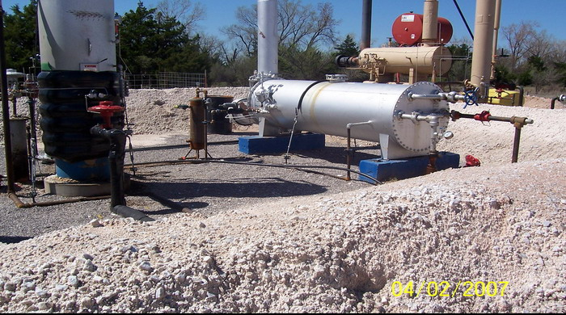
New unpermitted equipment added after final inspection

Slide 29
Water Management

Slide 30
Water Usage
A few years ago = 5 million gallons of water
Today (and in future) = up to 25 million gallons of water will be required
Most water is sourced from groundwater aquifers or from water captured from precipitation
Pipeline distribution systems are being developed to move large volumes of water more effectively
More operators are looking for ways to re-use water in areas where it is possible

Slide 31
Produced Water
Volume fluctuates widely by basin
Approximately 21 billion bbl generated each year for 900,000 wells
Increased trucks on roads
Predominately reinjected into saltwater aquifers
Re-use and evaporation ponds are also methods used to decrease produced water injection

Slide 32
Produced Water
Pipeline distribution systems being developed
One pipeline will greatly decrease the number of trucks needed to move water
Recycling being encouraged
Texas Alliance of Energy Producers and the Independent Petroleum Association of America are conducting a study to look at produced water management

Slide 33
Questions
Peter D. McKone, CWB
Weaver Consultants Group
pmckone@wcgrp.com
Anthony Smith
Phoenix Services
asmith@phoenixservices.biz

