Slide 1
Update on Environmental Oil and Gas Permitting & Litigation Issues with a focus on Seismic Claims
Presented by: Richard Bost, P.E., P.G. (Texas)
I2M Associates

Slide 2
Co-Authors and Acknowledgements
Many thanks to those who did the most
  Jennifer Warfield, ERM
  Lori Magyar, Bost Consulting
  Michael Campbell, I2M Associates
  Our clients, TCEQ, CDC, and RCT and Andrew Fono, formerly of Winstead and Haynes & Boone

Slide 3
Issues Raised in Recent Litigation
Increasing, Litigants are Filing Damage Claims
Examples of Issues Raised
  Compliance - Regulatory
  Economic
  Associated Activities: i.e.: Mining of Sand/Gravel
  Transportation
  Air Emissions & Global Warming
  Seismicity
  Surface and Ground Water Contamination
  Water Use
  Toxic Chemicals Management and Disposal
  Waste Management

Slide 4
Recent Court Decisions
Environmentalists have sometimes slowed down Trump regulatory changes in court but mostly have lost. They have also fought oil and gas companies, most losing in recent years
10th Circuit deferred on Rule re Disclosure of injected Chemical on Federal Land, since Trump administration is revocation incomplete. Trump has since revoked the rule.
Central Texas awards exceed $10 million in claims, subsequently over-turned.
Some cases dismissed after “daubert” challenge of Plaintiff expert successful.
Texas Supreme Court rules on Dish TX cases, limited by statute of limitation after local court award
Legal issues revolved around:
Whether damage covered by insurance
Standard of care
Statute of limitations
Scientific Basis and “Daubert” Test for
  Actual damages and effect on property values
  Proof of causation

Slide 5
Daubert Factors
Under Rule 702, there are factors to consider when determining whether expert testimony is admissible:
Whether the theory is generally accepted in the scientific community (testing and validation);
Whether the theory/method has been subjected to peer review and publication;
Whether the potential or known rate of error is acceptable; and
Whether the theory/method has been tested or can be tested.

Slide 6

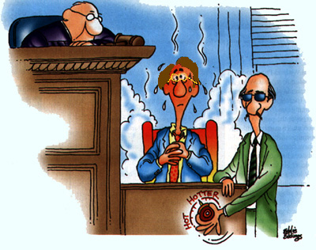
Your Witness…

Slide 7
Recent Decisions- Experts Passed Daubert Test - Awarded or Settled for Over $15 - $25 million
Since the 1974 Safe Drinking Water Act, Congress thru EPA has required regulation of underground injection of oil & gas Class II disposal wells. Several court cases have decisions in last two years affecting UIC regulation and injection liability, some involving authors as experts.
Conventional well awarded damages lost production due to nearby horizontal well.
South Texas injection well company settled with plaintiffs after releases.
East Texas plaintiffs awarded damage from seismic activity.
EPA concluded produced water migrated to water wells induced by overpressure injections.
Major cases pending in Oklahoma and Texas alleging personal injury and direct property damages associated with earthquakes totaling over $150+ million.
Recent increases in seismic events have led to more lawsuits being filed and regulatory agencies changing course.

Slide 8
SEISMICITY CLAIMS
Well-funded litigants have been filing suits to halt or interfere with oil & gas production in multiple states, arguing that production had impacted ground water or caused air pollution or health issues.
The latest suite of cases focus increasingly on injection and on induced seismicity.
In 2013 & 2016 the USGS issued reports regarding the potential association between seismicity and saltwater injection, concluding that saltwater injection in some areas likely induced small earthquakes.
Numerous lawsuits followed in multiple states aimed at halting oil & gas production.
Oklahoma Corporation Commission halted some injection in 2013, issued new rules in 2014 and has substantially reduced injection in areas of concern.
The Texas Railroad Commission has followed with increased scrutiny particularly over salt water disposal AND rejections of several disposal permit applications.

Slide 9
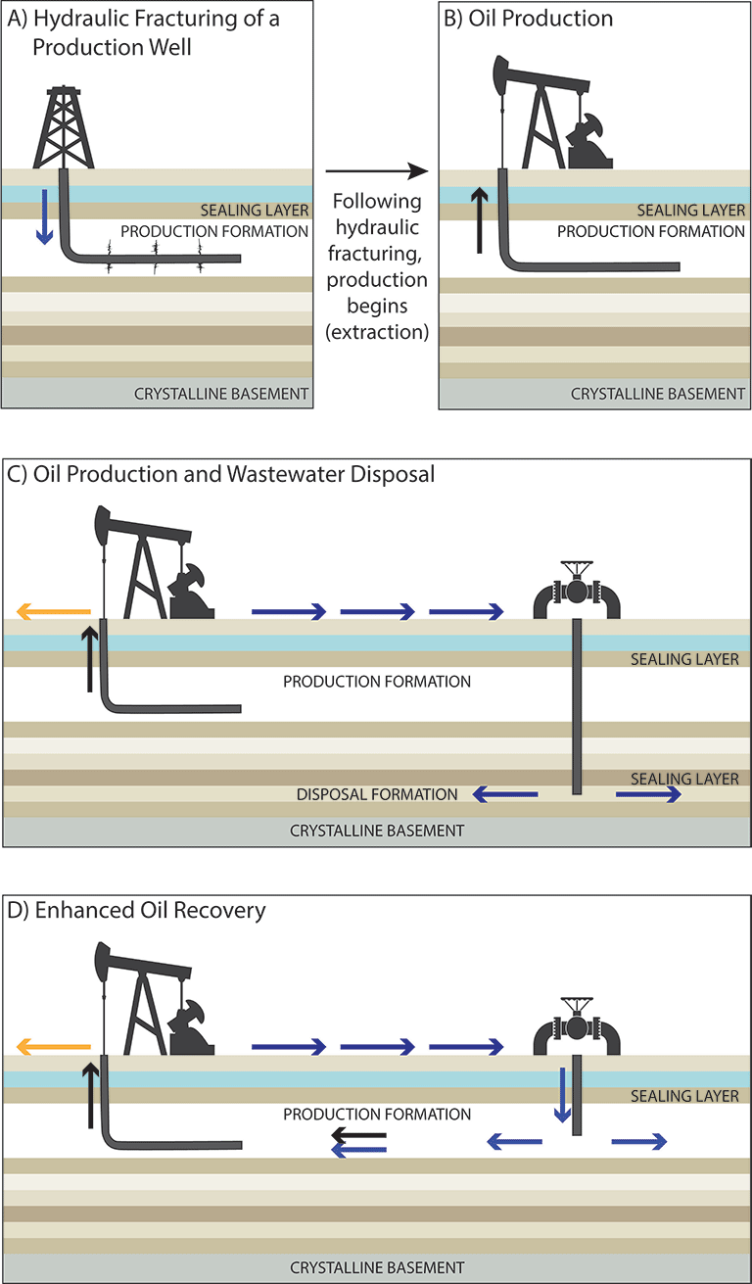
EOR Alternative to Disposal Well

Slide 10
NOTABLE INCREASE IN SEISMIC EVENTS
Since 2009, there has been a sharp increase in the incidence of earthquakes (USGS defines as seismic events >2.5) particularly in central Oklahoma and in Barnett Shale area of Texas, with larger events shaking homes in central Oklahoma and in Dallas area.
Scientists at the USGS and University of Colorado have been closely studying a rash of earthquakes in Colorado and northern New Mexico over the past decade. They say most have been caused by fluids pumped deep underground during oil and gas wastewater disposal. Oklahoma Geological Society and Texas Bureau of Economic Geology have come to similar conclusions re seismic events in Oklahoma and Texas.
An August 2017 event near Farmers Branch Texas with a
magnitude of >4 prompted the Texas Railroad [sic] Commission to add
resources to its seismic evaluation of injection permits.

Slide 11
Ranking of Earthquakes and Seismic Events
Magnitude | Earthquake Effects | Estimated Number Each Year
2.5 or less | Usually not felt, but can be recorded by seismograph. | 900,000
2.5 to 5.4 | Often felt, can cause minor damage. | 30,000
5.5 to 6.0 | Slight damage to buildings and other structures. | 500
6.1 to 6.9 | May cause a lot of damage in very populated areas. | 100
7.0 to 7.9 | Major earthquake. Serious damage. | 20
8.0 or greater | Great earthquake. Can totally destroy communities near the epicenter. | One every 5 to 10 years

Slide 12
Class of Earthquakes & Seismic Events
.
Class | Magnitude
Great | 8 or more
Major | 7 - 7.9
Strong | 6 - 6.9
Moderate | 5 - 5.9
Light | 4 - 4.9
Minor | 3 -3.9

Slide 13
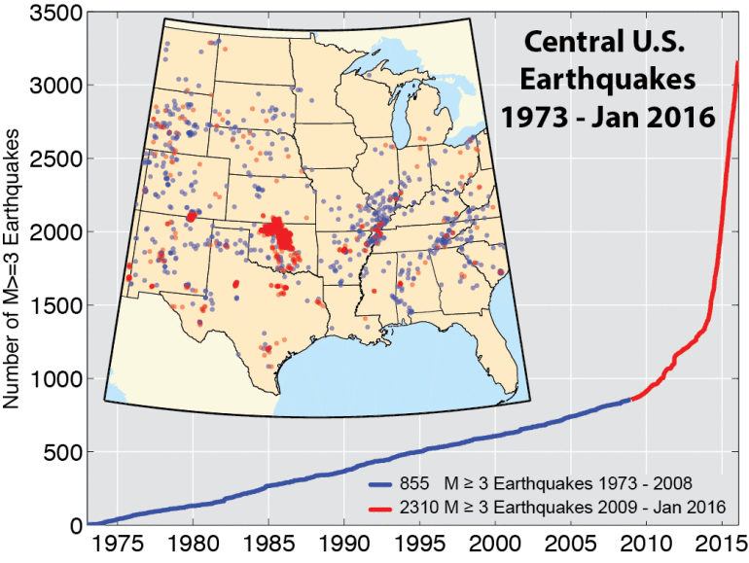
Number as well as Intensity of Seismic Events Has Increased

Slide 14

2016 One-Year Seismic Hazard Forecast for the
Central and Eastern United States from Induced and Natural Earthquakes
By Mark D. Petersen, Charles S. Mueller, Morgan P. Moschetti, Susan M. Hoover, Andrea L. Llenos, William L. Ellsworth, Andrew J. Michael, Justin L. Rubinstein, Arthur F. McGarr, and Kenneth S. Rukstales
Open-File Report 2016–1035

Slide 15
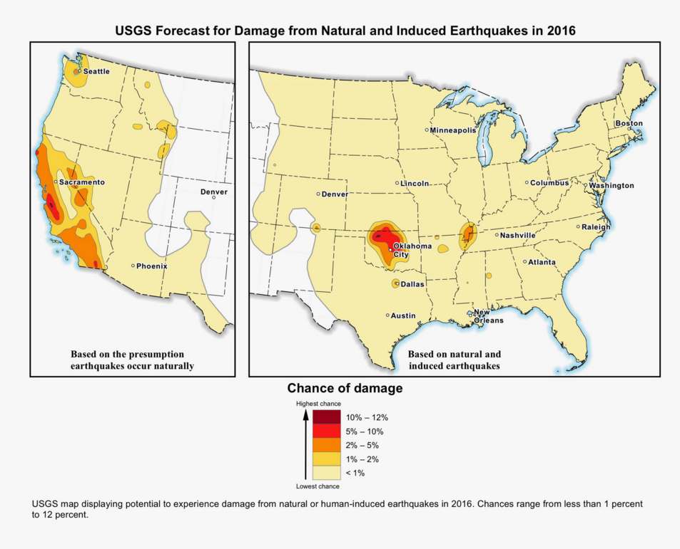

Slide 16
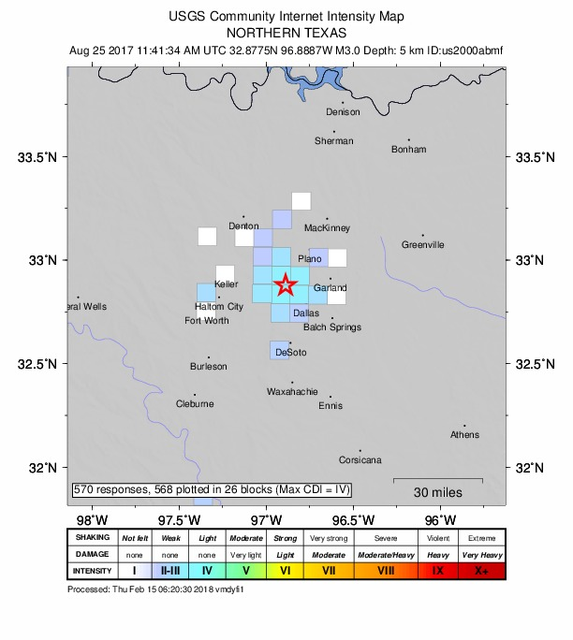
AUGUST 2017 TEXAS CHANGED

Slide 17
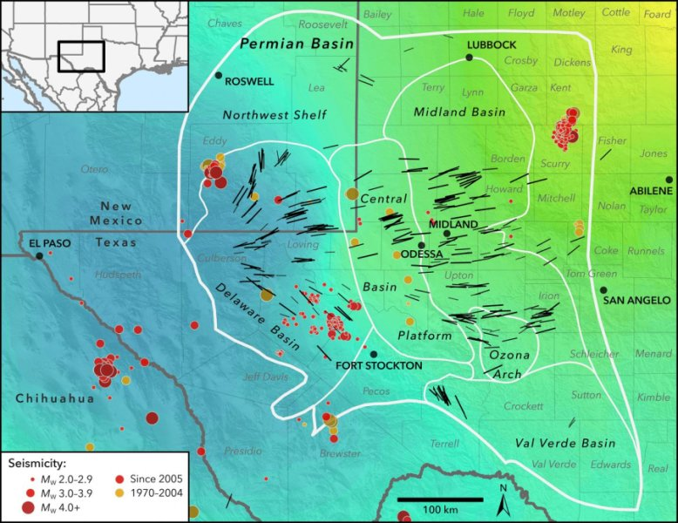
Feb 2018: New Prediction for Earthquakes in West Texas Stress Fields

Slide 18
Texas Bureau of Economic Geology runs TexNet – funded by Texas Legislature
Thanks to an interactive website hosted by TexNet, you can now see where quakes are happening and learn about them in real time. The tool could be useful for the growing number of people who’ve felt earthquakes here.
The monitoring system, made up of the 40 permanent and 40 mobile seismic-monitoring stations, provides a new level of detail and sensitivity in recording the earth's shaking.
In combination with >100 private monitors set up by major oil companies and producers, UT’s Bureau of Economic Geology can predict with much and was greater accuracy the location and depth and formation where the seismic event occurred.
Texas Railroad [sic] Commission is now using the data for permitting purposes.

Slide 19
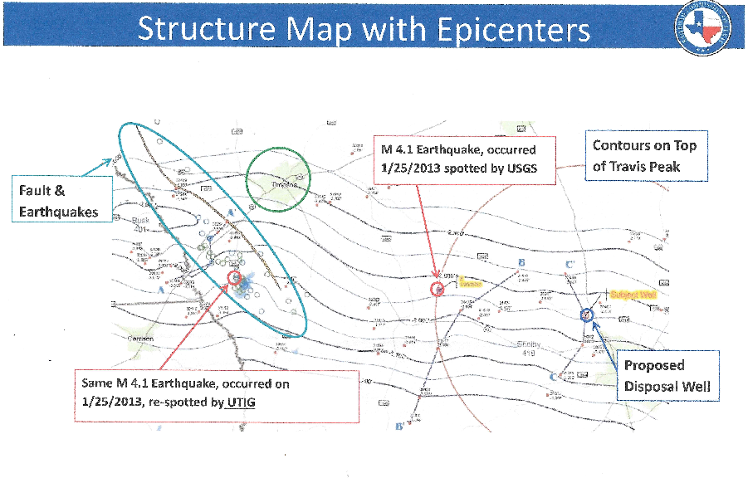

Slide 20
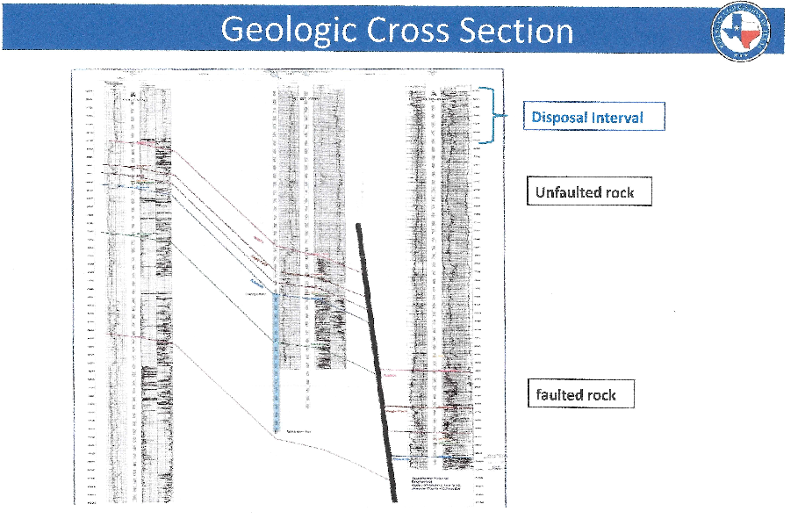

Slide 21
Regulatory Developments in
Texas & Oklahoma
The Oklahoma Geologic Society and Texas Bureau of Economic Geology have expanded seismic monitoring networks and have concluded that injection is correlated with recent seismic events.
OK issued new regulations in 2014 and Texas Railroad [sic] Commission followed.
Both states are identifying Areas of Concern, have rejected some new applicants, limited injection or modified permits. As the science around disposal wells continues to evolve, agencies are using a “traffic light” system. The “yellow light” temporary permits where concern, and rejected others based on “red light” criteria. Texas example:
Temporary (6 month) permits with shut in bottom hole testing every 60 days.
Agency can change limits with notice
Operator must monitor seismic activity
Mandatory shut down in the event of defined seismic activity
Change in injection zone to be higher above faults or basement rock.

Slide 22
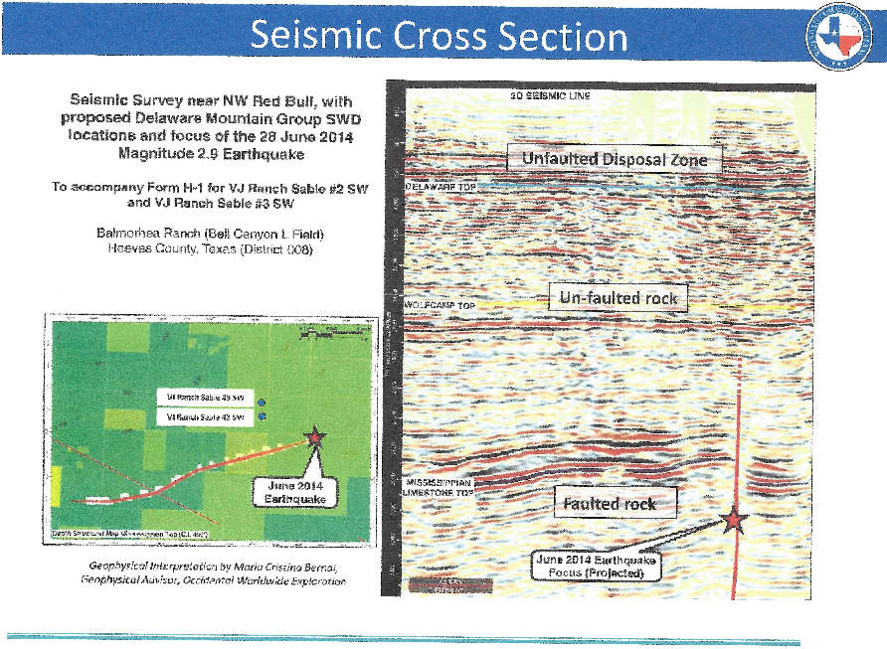

Slide 23
EXAMPLES OF EARTHQUAKES
In Mid MAY 2018 Most in W. Texas & Central OK
Date Magnitude Location Depth
May 19 2.4 OK 4.8 km
May 18 3.5 Dallas 5.0
May 18 2.7 OK 5.5
May 18 2.7 W TX 7.3
May 18 2.6 W TX 5.0
May 17 3.7 OK 6.1
May 17 2.3 OK 9.2
May 16 2.1 OK 5.0
May 16 2.5 OK 6.0
May 15 4.0 OK 6.3
plus 45 more since April 30, source USGS

Slide 24
EXAMPLES OF EARTHQUAKES
In later half of OCT 2018 Most in W. Texas & Central OK
Date Magnitude Location Depth
Oct 31 3.1 Snyder TX 1.4 km
Oct 31 2.7 Cushing OK 5.4
Oct 30 2.8
Oct 28 2.3
Oct 28 1.5
Oct 28 3.1
Oct 27 2.9
Oct 26 1.6
Oct 26 2.9
Oct 26 1.5
And 77 others since October 15

Slide 25
Example of One Permian Operator
Operator has installed closely space array of seismic monitors and coupled them with other monitors in area
Allows refinement of depth as well as location of seismic event
Events are correlating with injection and fracturing of horizontal wells
Operator shuts down if events exceed 1.5; resumes operations after events settle down
Operator shut downs have been frequent
Goal is to avoid events that exceed 3.0, that can be felt and cause damage

Slide 26
Summary
Seismicity is now an issue of importance in permitting & environmental litigation re oil & gas production, focused on injection for disposal.
SWD well applicants are now required to complete more thorough study of geology, faults, and injection zone location with respect to basement rock and faults.
Increase seismicity monitoring and research re formation pressure and stresses relative fracture movement trigger pressures is ongoing.
Incentive to treat and recycle, recharge freshwater aquifers or discharge produced water for downstream users

Slide 27

Questions and Answers
IPEC 2018 November 1, 2018 Denver, CO
Thank you for this opportunity to share my perspectives with you.
Richard C. Bost, P.E., P.G.
President and Chief Engineer
Houston, Texas

Slide 28
Example of Dish, Denton, Dallas Fort Worth Litigation
Seemingly objective study conducted to answer the following questions:
What chemicals are present at what concentrations in ambient air samples in residential areas in the DFW Metropolitan Area near shale gas wells?
Are concentrations of chemicals associated with methane, the primary product of shale gas production?
Is there a relationship among the various chemicals present in residential ambient air samples near shale gas wells?
Do patterns of correlation among particular compounds provide signatures of emissions associated with different technological equipment or processes of shale gas well extraction and production operations?

Slide 29
Plaintiff Contentions
“ Scientific study” found methane and 101 other chemicals to be present in the DFW Metropolitan Area.
Methane was present in concentrations above laboratory detection limits in 49 out of 50 sampling events.
Other chemical constituents were found to be correlated with presence of methane.
Claimed that aromatics are associated with compressor stations and that data suggests there is a signature of operations that release large amounts of natural gas, even though aromatics have many sources

Slide 30
Data Monitoring Locations

Slide 31
False Correlations

Slide 32
Flaws in Study
Monitoring failed to follow guidelines for identifying sources nor did it allow direct comparison with air quality criteria (different time periods).
Methane was used as the exclusive indicator of shale gas; a major flaw as there are numerous sources of methane.
Did not compare the air data with known chemical signatures for the shale gas nor with chemical signatures & emission data for compressors and separators. There is no statistical relationship between ambient data and shale gas operations.
Failed to consider other sources for the aromatics reported in the ambient air data; which is similar to other areas of the U.S.
Scientific studies by TCEQ and CDC/TDSHS refuted contentions.

Slide 33
Assessment of Claims
Plaintiffs failed to control for wind direction or collect upwind samples, the sources are unknown.
Many chemicals will correlate with methane; however, methane is not unique to shale gas plants and has numerous sources in urban and rural areas.
Plaintiffs reported a typical relationship among the various chemicals present in residential ambient air samples; which is similar to other urban areas - unrelated to shale gas operations.
Do data provide signatures of emissions associated with shale gas well extraction and production operations? Answer is NO.
Samples of shale gas and emissions from compressors and separators provide chemical signatures for these sources; they bear no statistical relationship with the data reported.

Slide 34
CDC TDSHS Findings
For most, blood VOC levels were similar to those for U.S. population.
For others, exposures were most likely due to smoking or disinfectant by-products in the drinking water or home care products.
The residents with benzene in their blood were smokers. Smoking was verified by survey and the biomarker of 2,5-dimethylfuran and dose response relationship with time since the last cigarette.
Urinary metabolites were similar to TxDSHS staff and published literature values.
VOCs measured in the tap water were at levels well below drinking water criteria.

