Slide 1
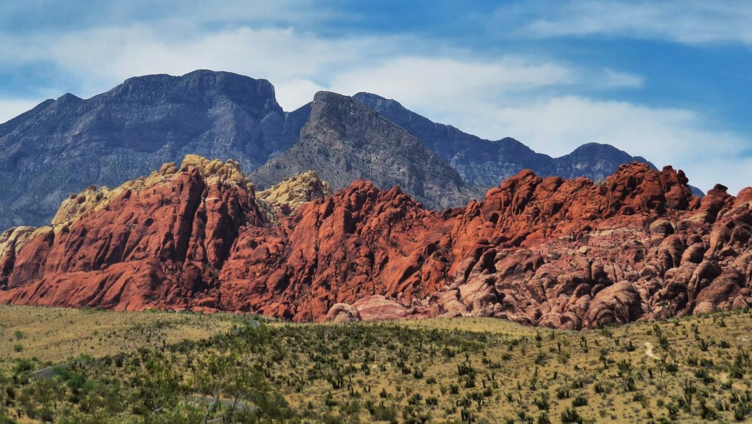
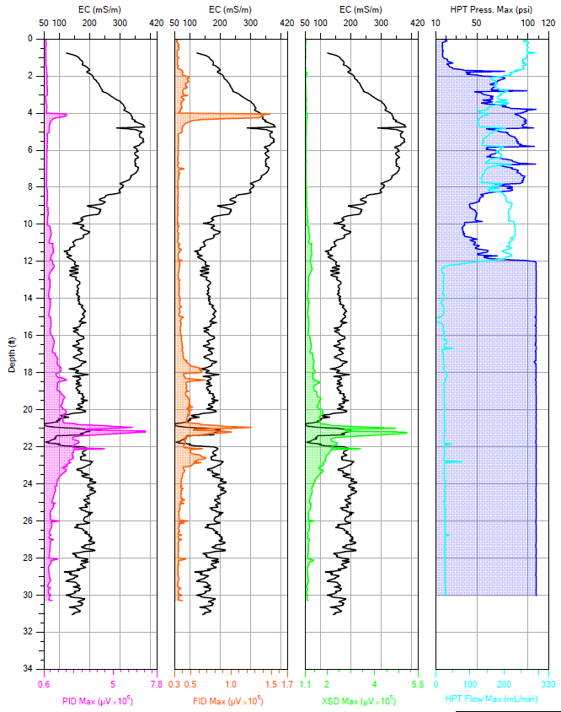
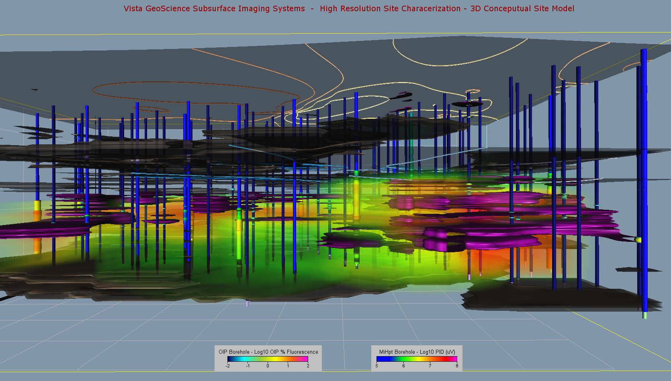


Update on Current High Resolution Site Characterization (HRSC) Technology, 3D Data Modeling, and Applying HRSC Data to Remedial Design (Part 1)
John Fontana, PG, Vista GeoScience
Jfontana@VistaGeoScience.com
25th International Petroleum Environmental Conference Denver, Colorado
Oct 30 - Nov 1, 2018

Slide 2

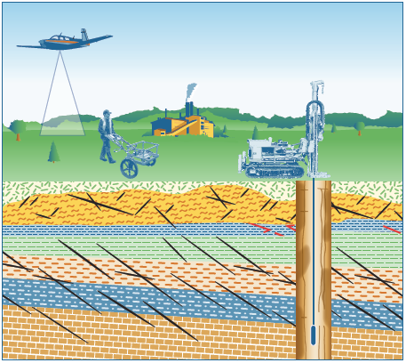
IMPORTANT: NEW ITRC TEAMS
Implementing Advanced Site Characterization Tools
Optimizing In Situ Remediation Performance & Injection Strategies
Watch for Guidance 2019/2020

Slide 3

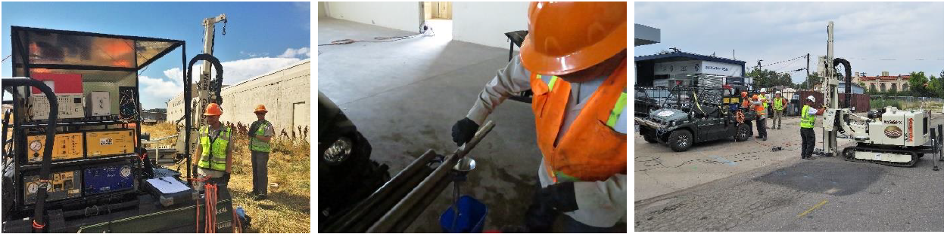
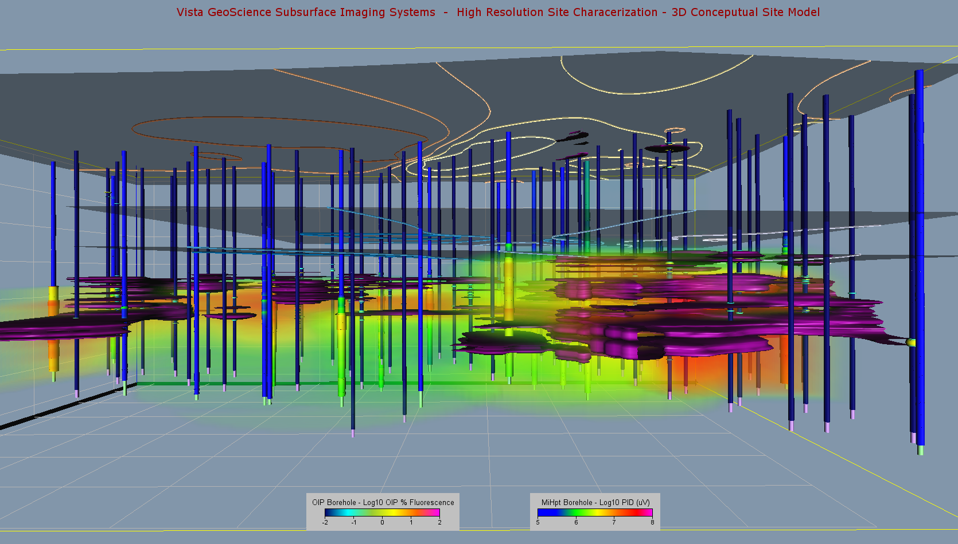
Advanced Site Characterization
The Need for Better Conceptual Site Models
Qualitative vs. Quantitative
Update on Current HRSC Direct Sensing Technologies
Quality Control & Quality Assurance
High Resolution Sampling Methods
2D & 3D Visualization for Developing Your CSM
Case Study Examples

Slide 4
Qualitative vs. Quantitative
Qualitative to Semi-Quantitative - Direct Sensing Tools
  Semi-Quantitative is probably more accurate
  MIP, HPT, EC, LIF/UVOST, OIP-UV, etc.
  High Vertical Resolution (20 pts. per foot)
Quantitative - High Resolution Sampling
  Continuous Coring - Direct-Push or HSA
    Sampling at Tight Intervals (1’ – 2’)
  Discrete Point Ground Water Sampling
    Sample Confined Zones
    Confined Zone Slug Testing
  Geoprobe HPT-GWP
    Log Hydraulic Properties & Sample in Same Boring
  Mobile Lab or Fixed Lab

Slide 5
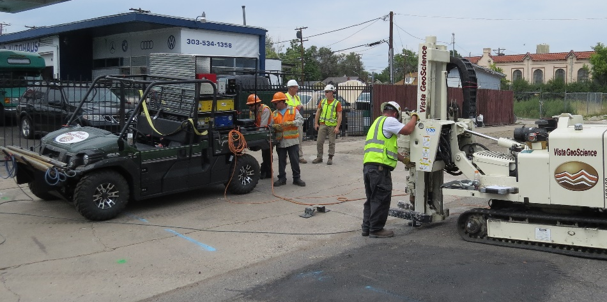
Direct Sensing/Imaging Tools
ATV Mounted OIP-UV/MiHPT/EC Imaging
System & Track Mounted Geoprobe

Slide 6
Direct Sensing/Imaging & Borehole Logging Tools for HRSC
Tools Driven by Direct-Push Technology (Geoprobe or CPT) that record continuous sensor measurements with depth.
EC - Electrical Conductivity
  Measures Conductivity of Soil + Groundwater Specific Elec. Conductance (integrated in all tools)
HPT - Hydraulic Profiling Tool
  Measures permeability and hydraulic conductivity properties
MIP - Membrane Interface Probe
  Detects Vapor, Sorbed, & Dissolved Phase VOCs (PPM Levels, or PPB with Low Level Option)
OIP – Optical Image Profiler (NAPL Fluorescence Tools similar to Laser Induced Fluorescence)
  OIP-UV – Ultra-Violet OIP – for Fuels, light oils (Similar to LIF/UVOST)
  OIP-G – Green Laser Source for Heavier Oils/PAHs (Similar to LIF/TarGOST)
NOTE: Several tools are now combined into single probe units – MiHPT, OiHPT, etc.

Slide 7
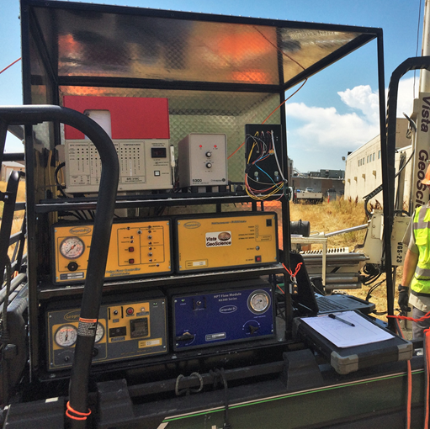
Improved Self-Contained MIP / HPT / OIP / EC Instrumentation Rack
More compact and field rugged
4’ x 4’ Pallet Rack can be freighted
Very Mobile 4WD-ATV Configurations
Powerful Ruggedized Field Computers
MIP Gas Detectors (Customized & Dedicated Gas “Chromatograph”)
  Flame Ionization (FID)
  Photo Ionization (PID)
  Halogen Specific (XSD or ECD or ELCD)

Slide 8
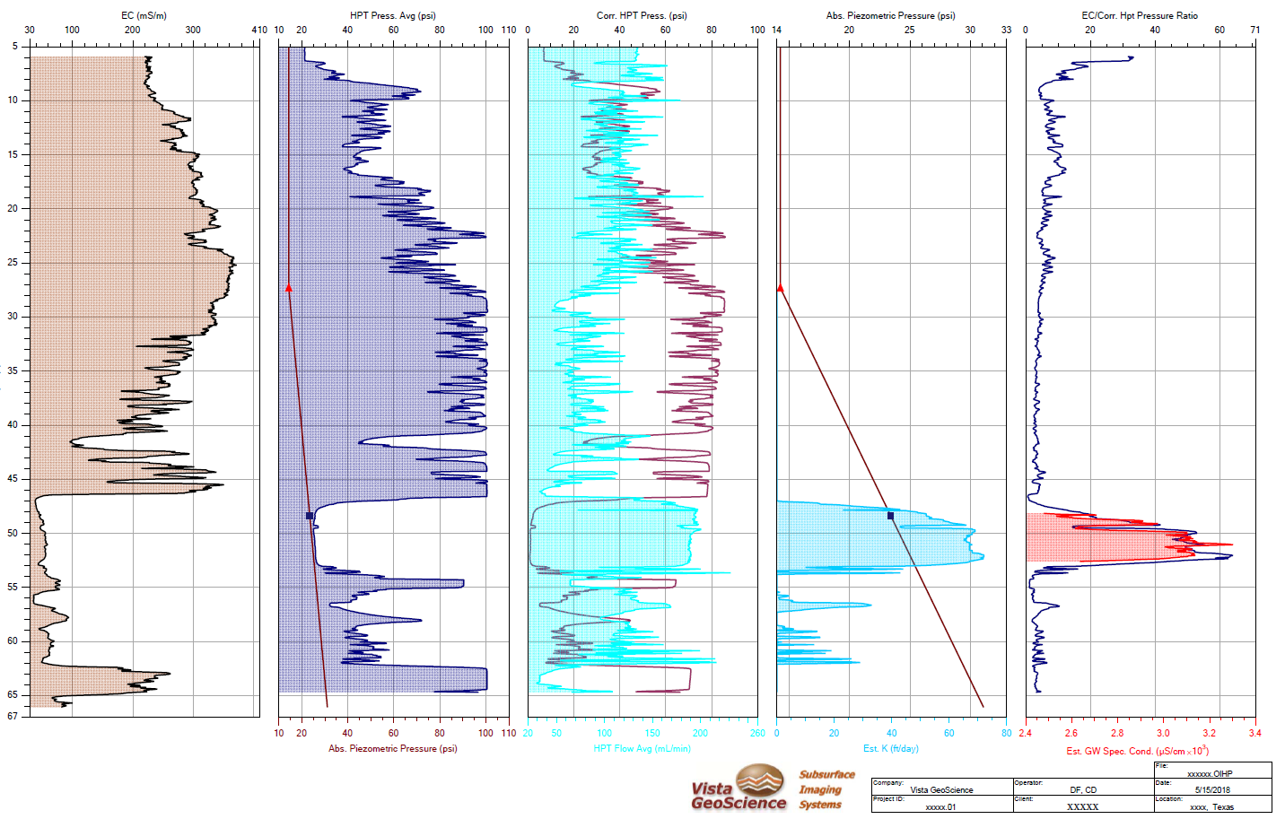
Hydraulic Profile Tool (with EC) Log
Ratio:
EC/corr. HPT Pressure
Corrected HPT Pressure
HPT Flow
Piezometric Head
Estimated Hydraulic Conductivity
Piezometric Head
HPT Pressure
Soil Electrical Conductivity
Groundwater Specific Electrical Conductance

Slide 9
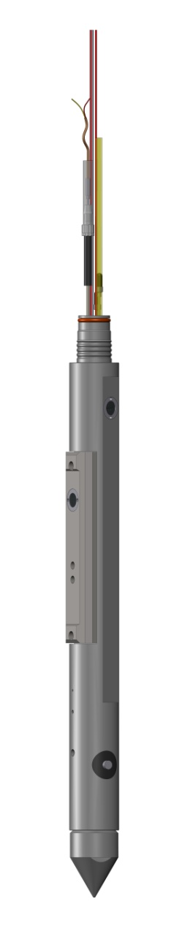
Combined MIP + HPT + EC Probe
(MIP + HPT = MiHpt)
Trunk Line Connections & Inline Pressure Sensor
HPT Injection Screen
EC Dipole
Membrane
Heater Block
1.75” Diameter Probe Body

Slide 10
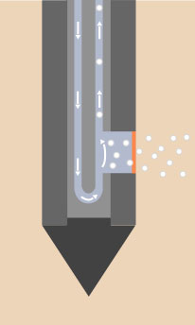
Low Level MIP vs. Standard MIP Operation
Carrier Gas
is Stopped
For increased sensitivity
Carrier flow is pulsed
VOCs move across the membrane via diffusion
VOCs accumulate behind the membrane
Carrier gas flow is resumed
Then the contaminant mass (peak) is transported to the detectors
VOCs Collect Behind the Membrane
VOCs in Soil
Probe Body
Semi-permeable Membrane

Slide 11
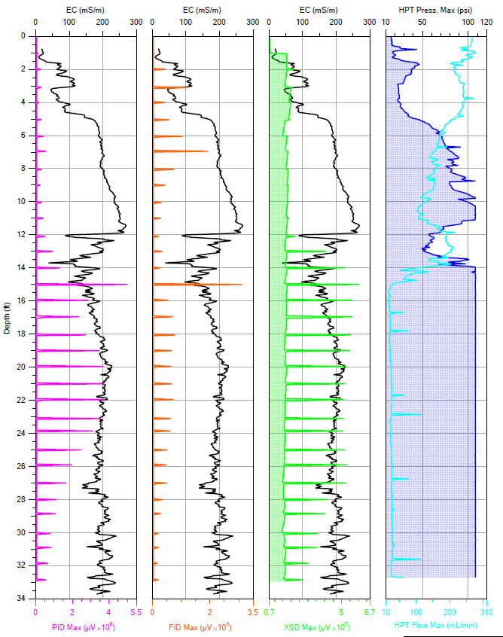
Standard MIP vs. Low-Level MIP Logs

Slide 12
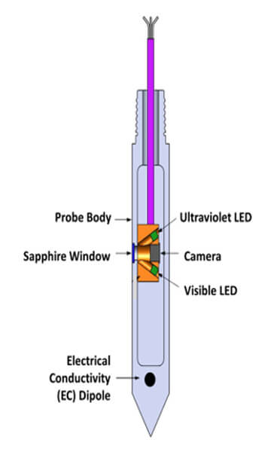
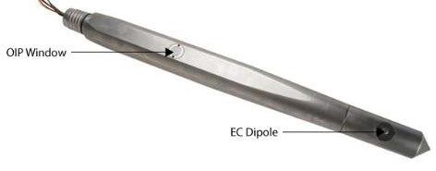
Optical Image Profiler (OIP-UV)
MFG: Geoprobe (Direct Image®)
Tool Function:
  Detect Fluorescence of Petroleum NAPLs (PAHs)
Excitation Light Source:
  Ultra-Violet (UV) LED Light Source (275nm)
  Also - Visible (White) LED Light Source
Sensor:
  CMOS Camera (Captures UV or Visible Images)
Measured Response
  % Area Fluorescence (%AF)
Visible Light LED Allows for Capturing Images of Soil Texture and Color
Software – Geoprobe DI Viewer (Free Download at Geoprobe.com)

Slide 13
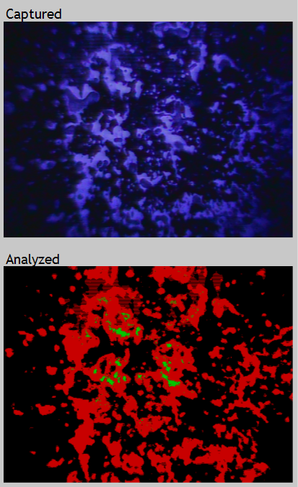
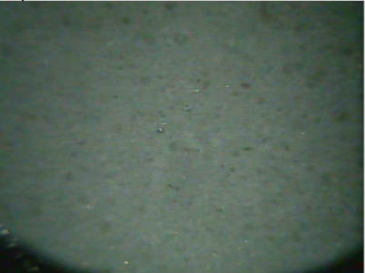
OIP Images
Captured Fluorescence Image under 275nm UV LED Light
Software Analysis of % Area Fluorescence (%AF)
Captured Soil Image under Visible (White) LED Light

Slide 14
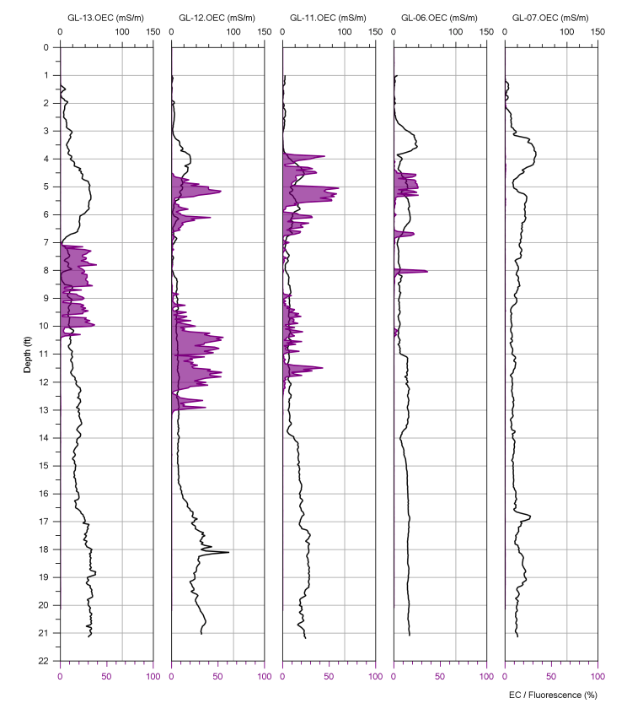
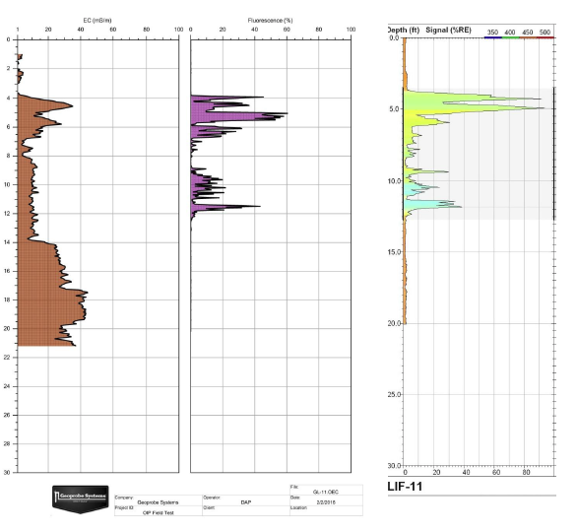
Comparison of OIP-UV and LIF/UVOST
OIP Essentially Equivalent to LIF/UVOST Response
Cross Section of EC & OIP Logs
EC OIP LIF/UVOST

Slide 15
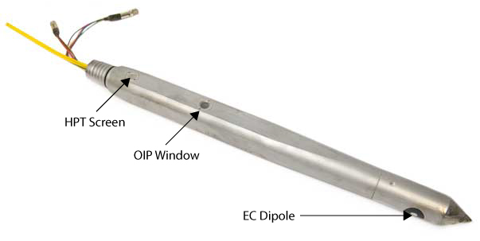
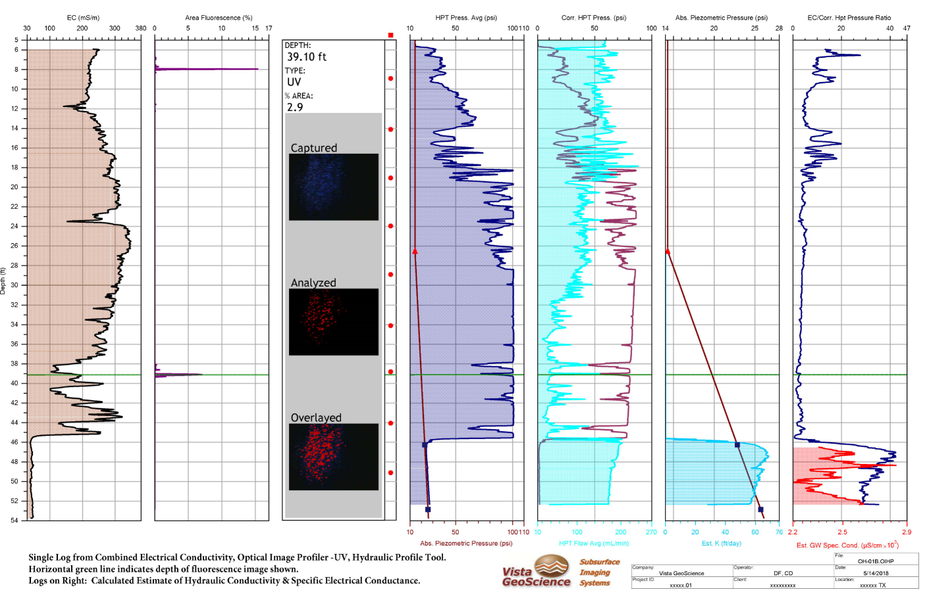
OIP + HPT =
OiHPT Probe
Percent
Area
Fluorescence (%AF)
Ratio:
EC/corr. HPT Pressure
Corrected HPT Pressure
HPT
Flow
Estimated Hydraulic Conductivity
Piezometric Head
HPT
Pressure
Groundwater Specific Electrical Conductance
Soil Electrical Conductivity

Slide 16
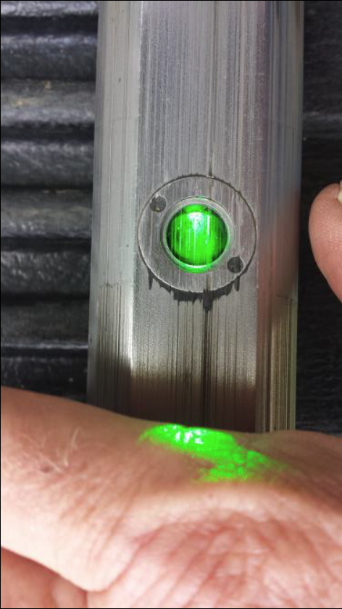

OIP-G
Green Laser Source
520nm Excitation Laser
Fluorescence (in red region)
Petroleum DNAPLS
  Heavy Crude Oil,
  Coal Tars,
  Creosote,
Same Response as LIF/TarGOST

Slide 17
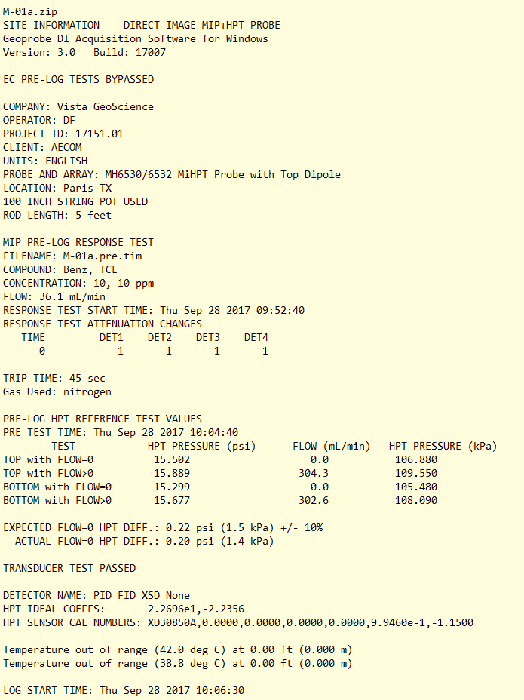
HRSC Tools Quality Control
.nfo File Log Records ALL THIS DATA for Data Review:
Software Alarm Settings:
  Flows, Pressures, Temps
Sensor Response Tests
  MIP Chemical Std. Tests
  HPT Pressure Sensor
  Electrical Conductivity
  OIP Fluorescence Tests
ASK FOR THE RAW DATA FILES FOR YOUR RECORDS!!

Slide 18
Quantitative Tools
Soil & Groundwater Sampling

Slide 19
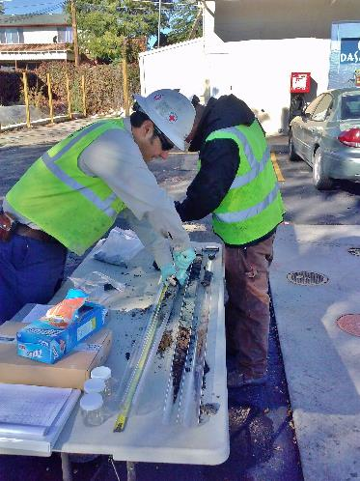
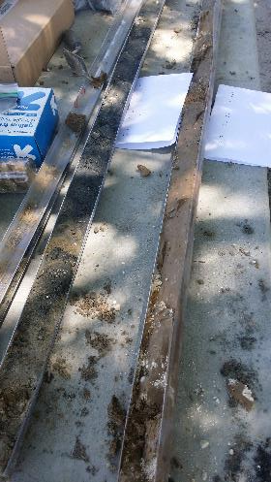
High Resolution Soil Sampling
Collect Continuous Soil Cores!
PLEASE, NO MORE…
  18” or 24” Split Spoons every 5’ = HUGE DATA GAPS!
  MACRO-CORES (smeared holes, slough)
Use Geoprobe Dual-Tube Cased Hole Coring Systems
  (2.25” or 3.25”)
or HSA Continuous (5’) Coring Systems

Slide 20
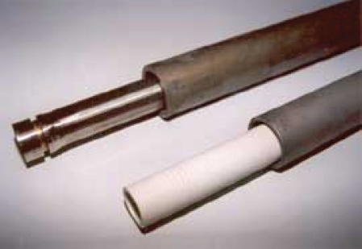
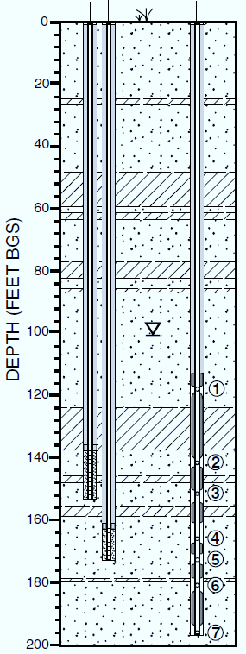
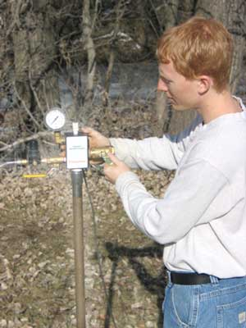

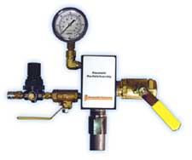
DPT Discrete Groundwater Sampling
Screen Point Samplers
Nested Wells
Pneumatic Slug Tests
The Use of Direct-push Well Technology for Long-term Environmental Monitoring in Groundwater Investigations
(SCM-2) Mar-2006

Slide 21
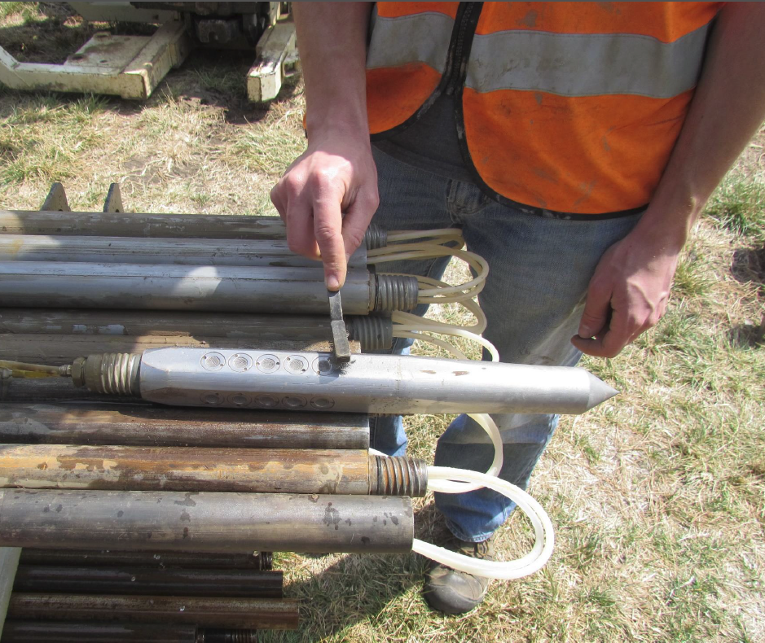
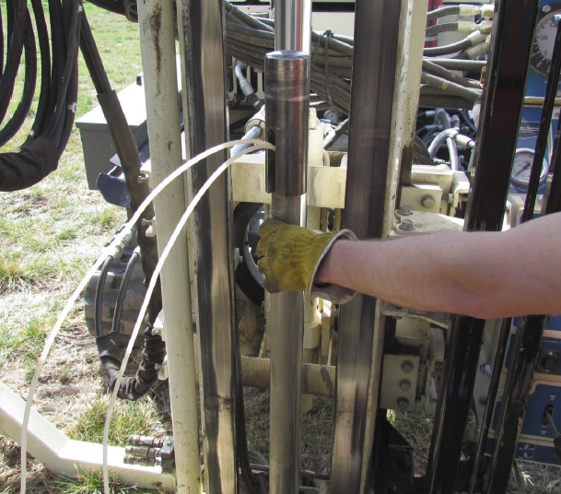
HPT-GWP – Groundwater Profiler
New! Simplified/Robust Discrete Groundwater Sampler
20 - 3/8”screen ports over 6” interval.
Only two water lines
Measures injection pump pressure and flow. (No K)
Can be driven without drive cushion.
Peristaltic Pump or Mechanical Bladder Pump
Measure GW parameters while sampling!
30-40 minutes per sample

Slide 22
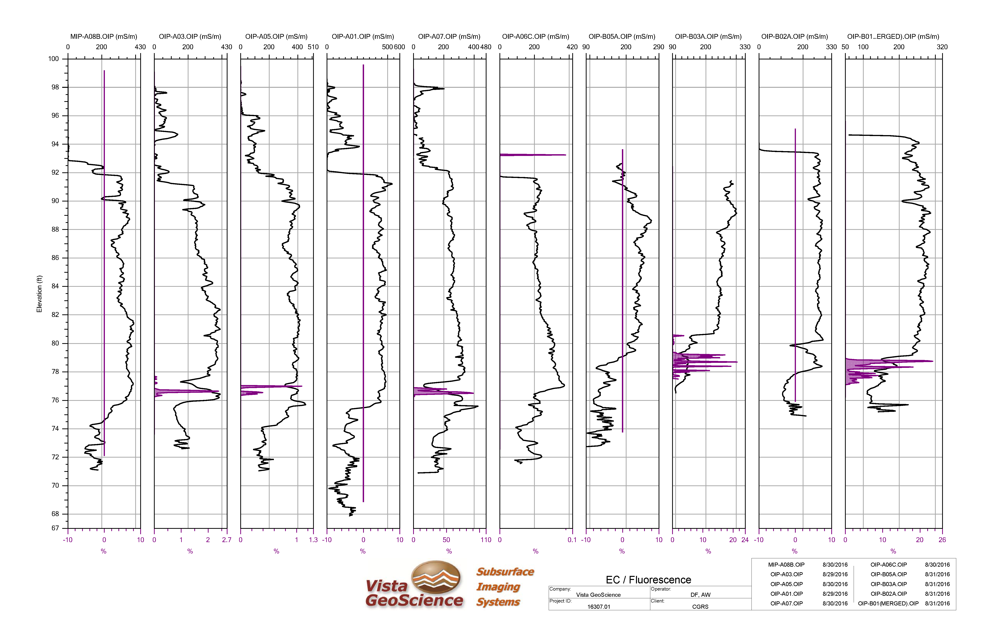
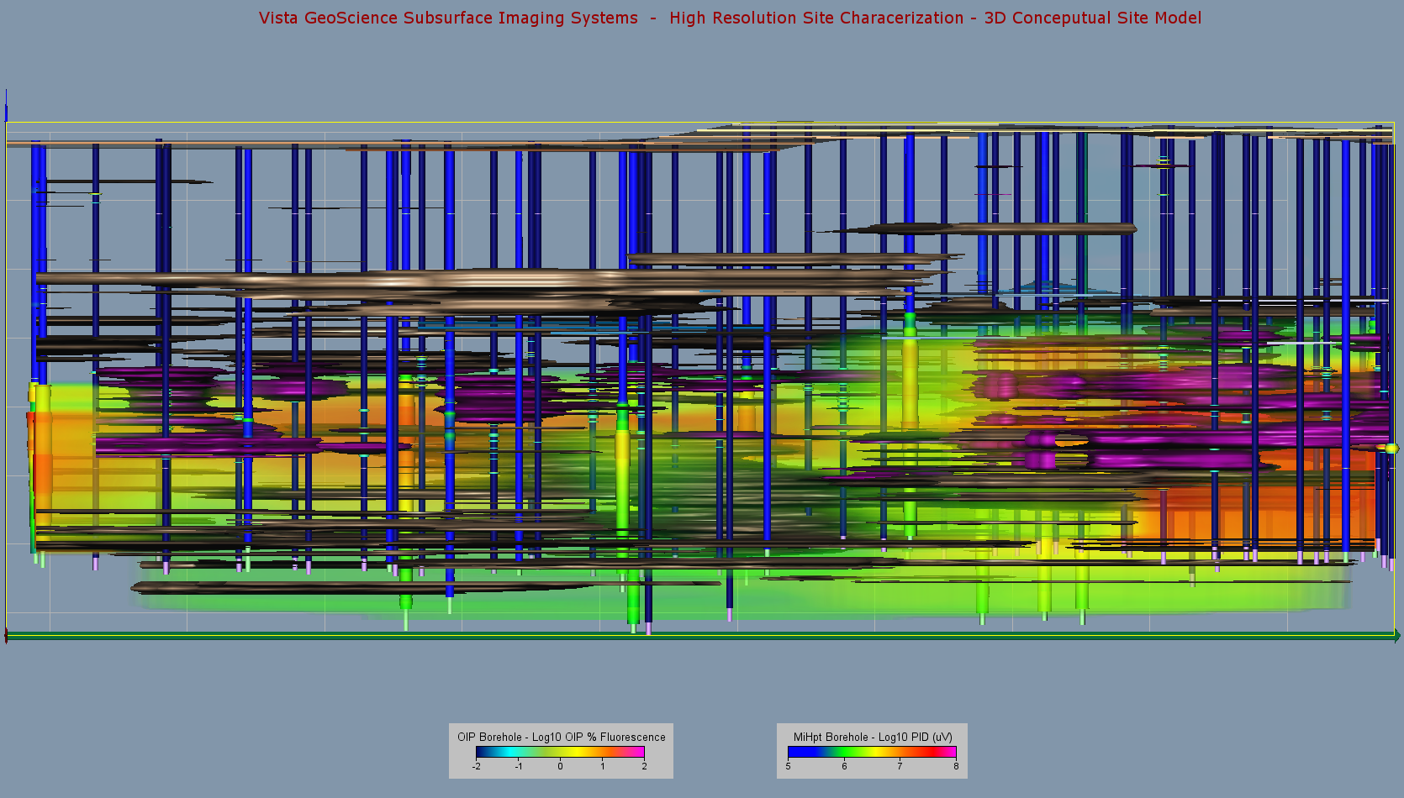
Reporting & Data Visualization

Slide 23
2D & 3D Visualization Techniques
Accurate Models Require Understanding of:
Baseline Noise vs Actual Contaminant Signal
Potential Interferences, False Anomalies
  Carry Over, Pressure Fluctuations
  Mineral Fluorescence
  Salty Water
Which Data are Logarithmically Distributed and How to use that Knowledge in Choosing the Right Surface Contouring Algorithms.
Anisotropic Nature of High Vertical Resolution Data (20 data points per vertical foot) and How to Model that into Accurate Images.
Geospatial Analysis for Optimization at Environmental Sites
https://gro-1.itrcweb.org/

Slide 24
HRSC Conceptual Site Model Case History 1: Grand Junction, CO
Unidentified Historic Gasoline Source
OIP-UV / EC Logs Identified Confining Conditions that Presented False Thickness of LNAPL in Some Monitor Wells

Slide 25
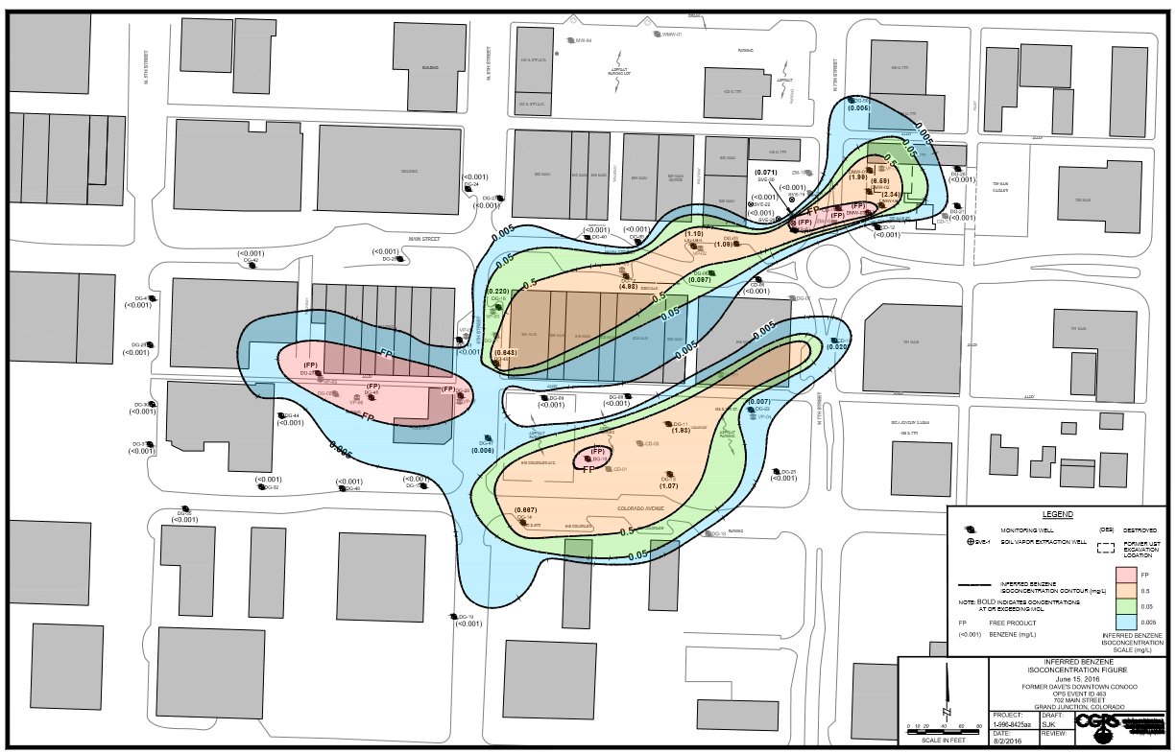


Downtown Grand Junction, CO
LNAPL discovered down gradient with leaded gasoline dating to 1930’s.
Benzene Plume
Former
Gas Station
OIP Investigation Area
1-3 feet
of LNAPL
Unrelated plume
from other source?
N
Notes:
SITE: Dave’s Downtown Conoco, Grand Junction, Colorado
A dissolved phase gasoline plume, initially assumed to be part of the

Slide 26
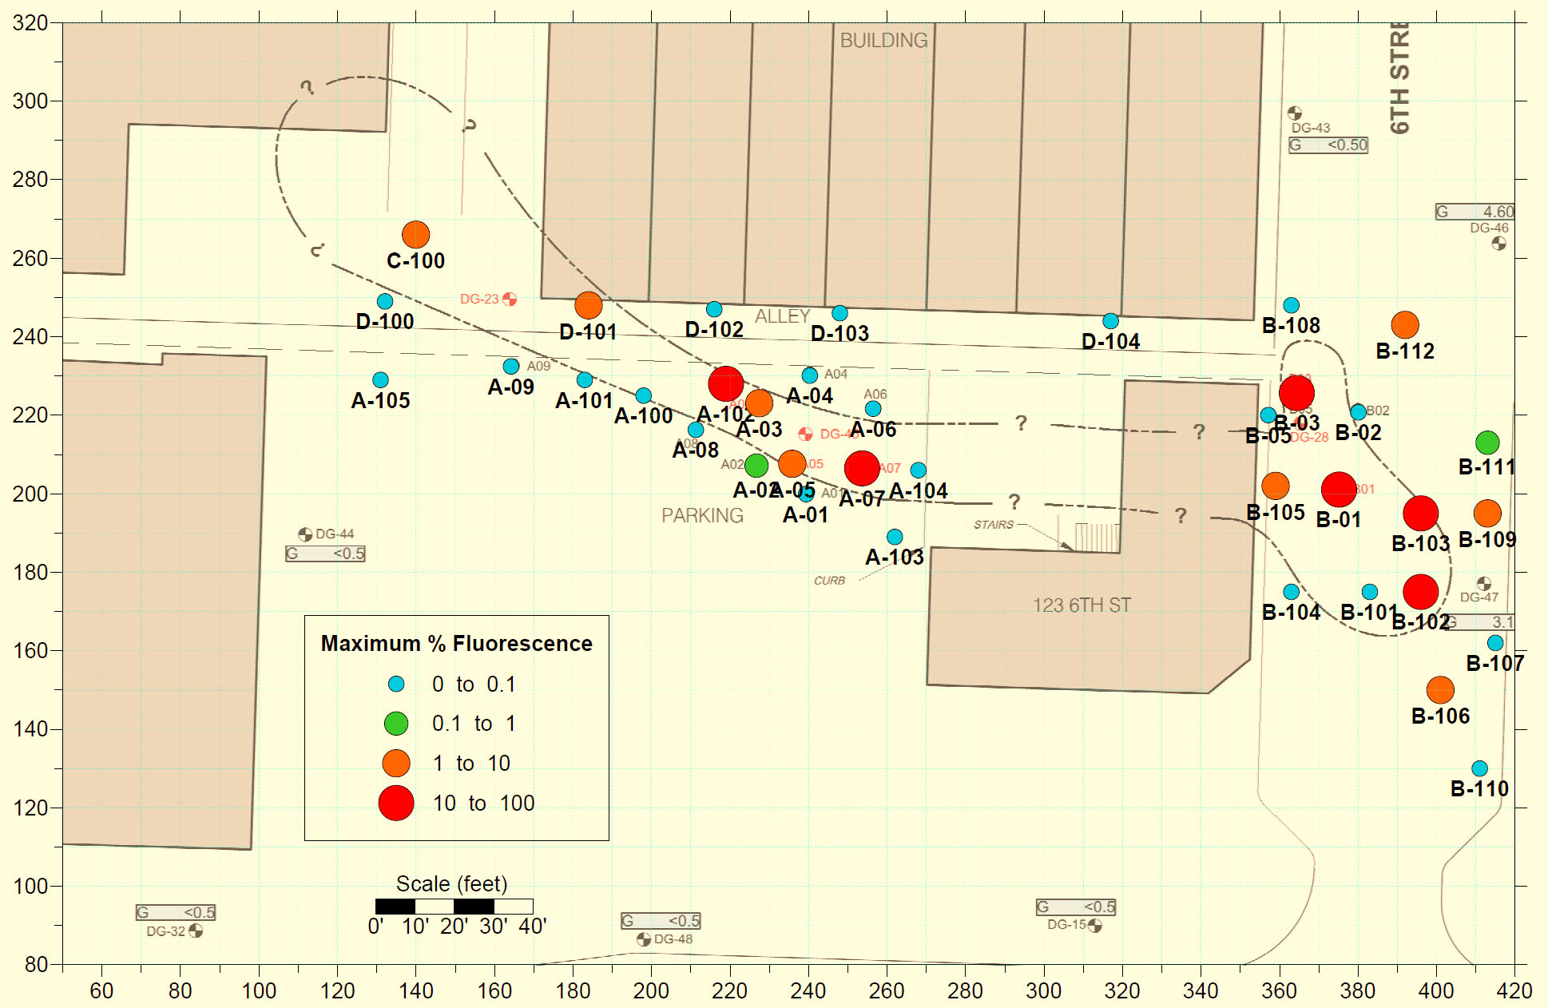

LNAPL Investigation Area - OIP-UV
Cross Section
Monitor Well w/ LNAPL
Clean Monitor Well
Monitor Well w/ GRO
N

Slide 27
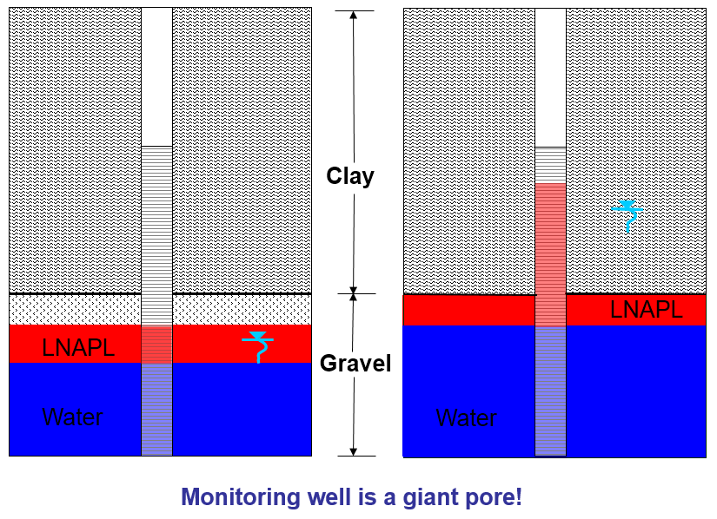

ITRC LNAPL Short Course Example
LNAPL Thickness Variation in Monitor Wells
Confined Example on Next Slide

Slide 28
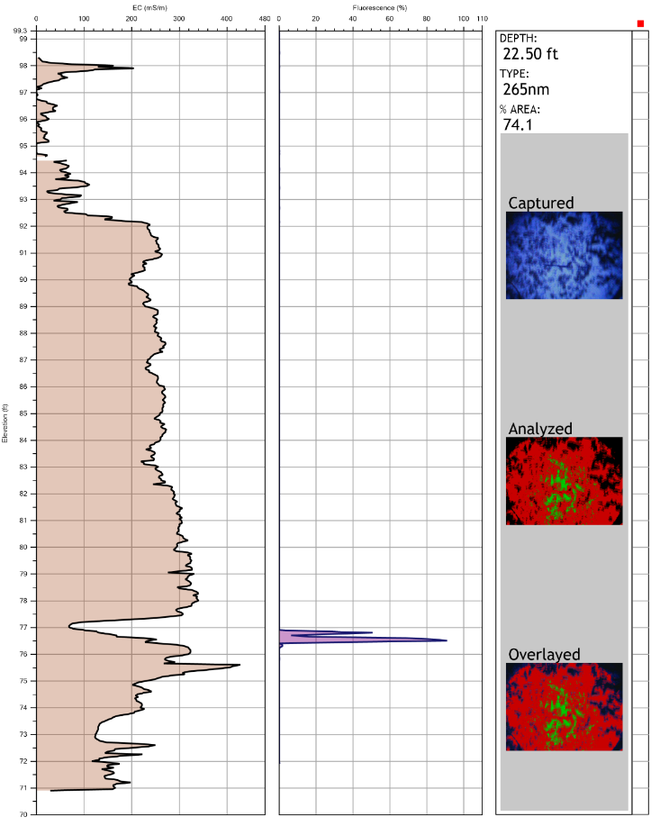
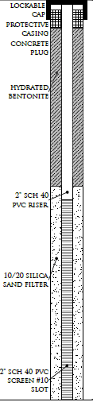
OIP-A07 Shows LNAPL Not as Bad as it Looks in Well!
Well 20’ from OIP Boring
Thick Low Perm Clay
LNAPL in Thin Sand Stringer, below water table.
LNAPL Confined in Sand
LNAPL displays false thickness in well.
Thick Clay
Layer
Top of Free Product 79.15’
Top of Water 76.73’
Thin Sand
Fluorescent LNAPL

Slide 29
West to East Cross-Section (%AF & EC)
A wells demonstrate confined LNAPL conditions. B wells base of clay is higher, LNAPL is unconfined. Could the LNAPL migrate up dip under the confined clay?
“A” Wells
“B” Wells
LNAPL Unconfined
LNAPL Confined Under Clay

Slide 30
HRSC Conceptual Site Model Case History 2: Eastern Colorado
OIP-UV and MiHpt Identified Migration of LNAPL Plume moving opposite of ground water gradient

Slide 31
2D MiHPT & OIP Survey Map
Classic 2D Bubble Map used to display maximum values at each log boring.
Max. MIP-PID (uV)
Max. OIP %Area Fluorescence
Source Area: AST & dispenser releases in the site on the north side of the highway.
Data Collected
  51 OIP Borings
  18 MiHPT Borings
  10 Confirmation Soil Core Borings
Notes:
This investigation took place at a former retail gasoline/diesel station with a significant historic release. The interesting thing here is that much of the plume has migrated counter to ground water flow. This is a conventional 2D data display using proportionally sized symbols and colors to represent the maximum reading for a particular tool parameter at each boring log location. It gives a good idea of lateral extent, but with no vertical component. The data could also be contoured using standard isopleth display.

Slide 32
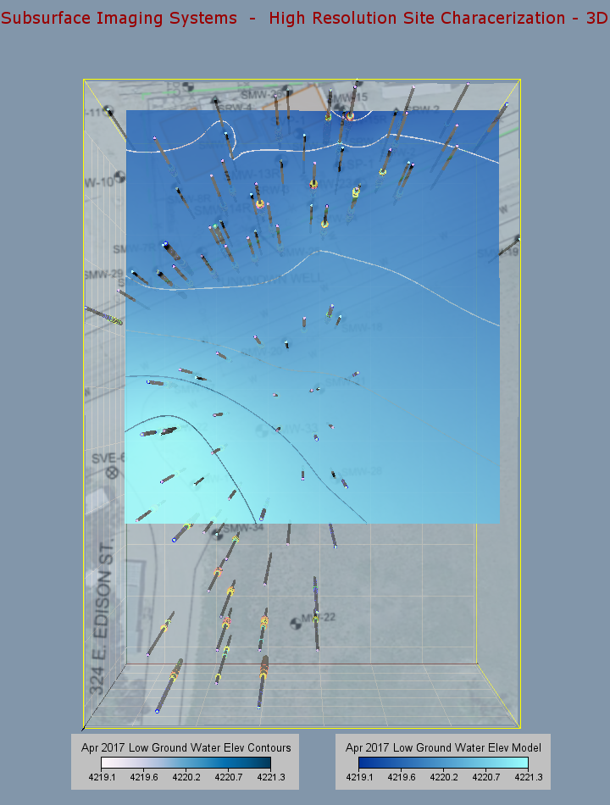
Ground Water Elevation Models
Elevation modeled at two time periods, August, and April (April shown)
Gradient on both shows north trend, towards a major river system about 2-3 miles north.
Irrigation activity in the area may have intermittent affects on direction.
N

Slide 33
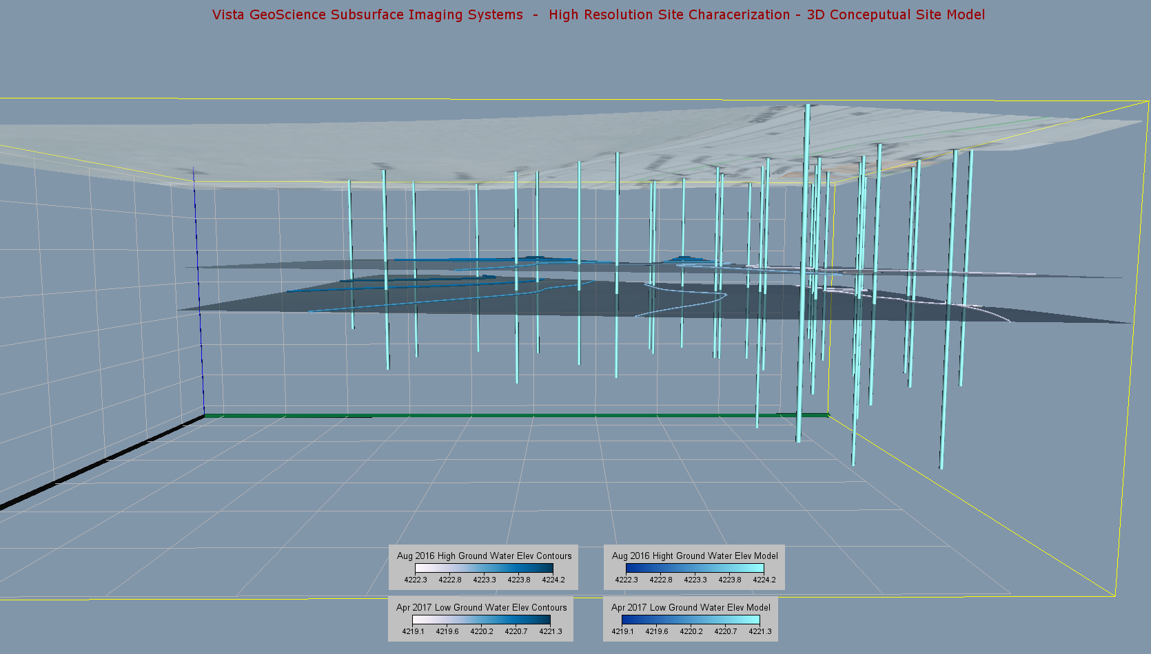
Monitor Well Renderings & Groundwater Elevation Models (High & Low Season)
High Season Water Table
Low Season Water Table
N
Notes:
This is a 3D “perspective” view with north to the right, looking west through the subsurface. Source area is in the north end of the survey. Ground surface dips gently to the south (left) and both high and low ground water tables dip gently north (right). The monitor wells did not extend all the way to the end of the study area, so the extent of the groundwater model does not extend as far to the south as the OIP and MiHpt data.

Slide 34
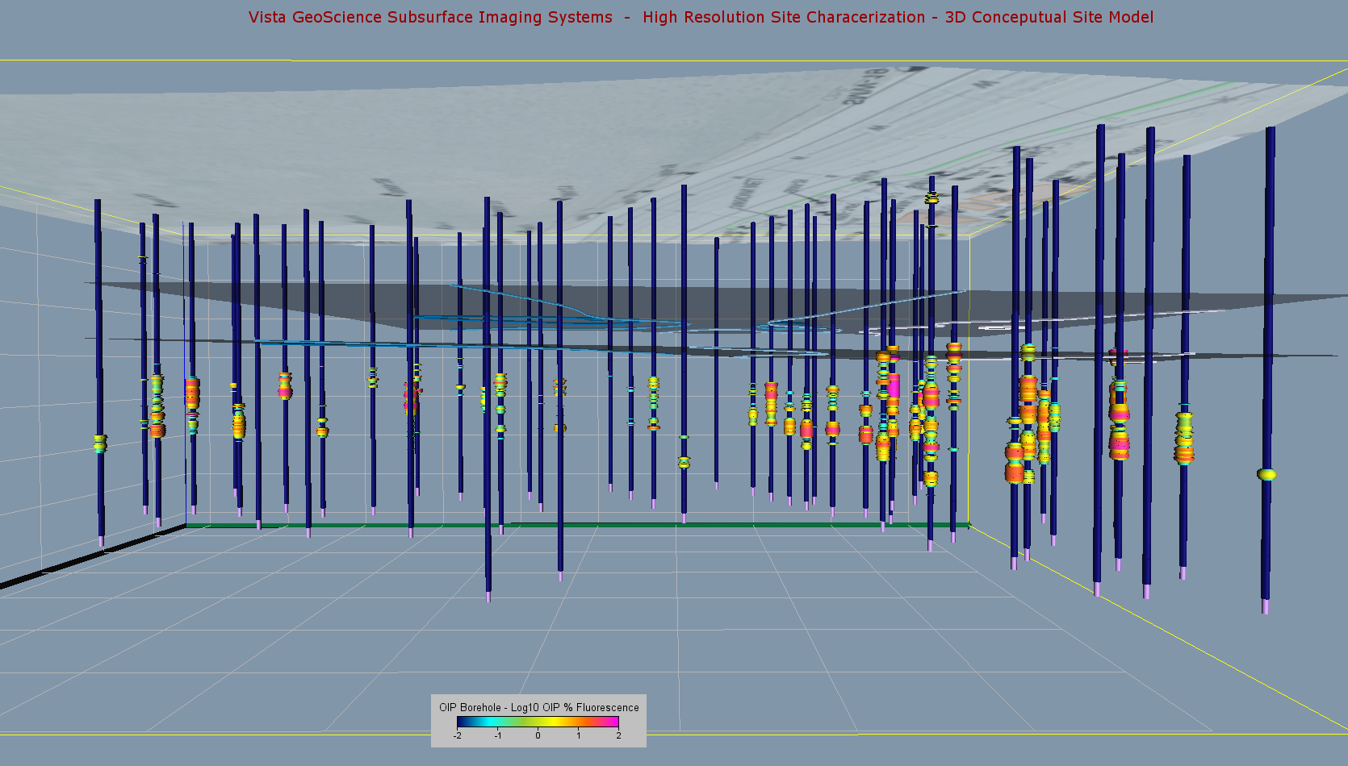
OIP-UV Boring Renderings Displaying %AF
High Season Water Table
Low Season Water Table
N
Notes:
This is a 3D “perspective” view with north to the right, looking west through the subsurface. Source area is in the north end of the survey. The 51 OIP boring renderings are dark blue with warmer colors showing increased % Area Fluorescence, which represents the presence of liquid phase hydrocarbons. Both the surface elevation model and high and low ground water table models are shown. Notice the deeper penetration of LNAPL as indicated on the OIP borings at the north end of the image, relative to the south end.

Slide 35
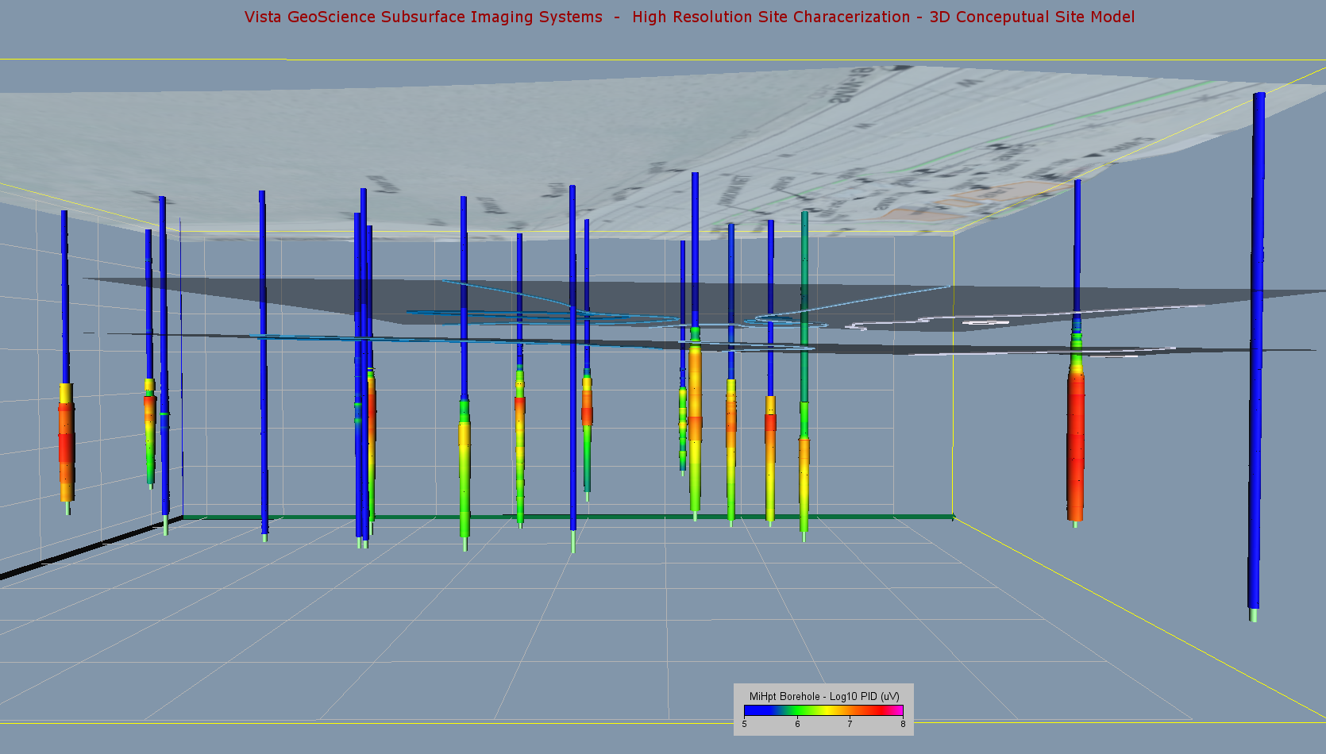
MiHpt Boring Renderings Displaying Dissolved VOCs via PID Response (uV)
High Season Water Table
Low Season Water Table
N
Notes:
The 18 MiHPT boring renderings show low PID (uV) response as blue, and higher responses in warmer colors, representing sorbed and dissolved phase VOCs (BTEX, TVPH etc.).

Slide 36
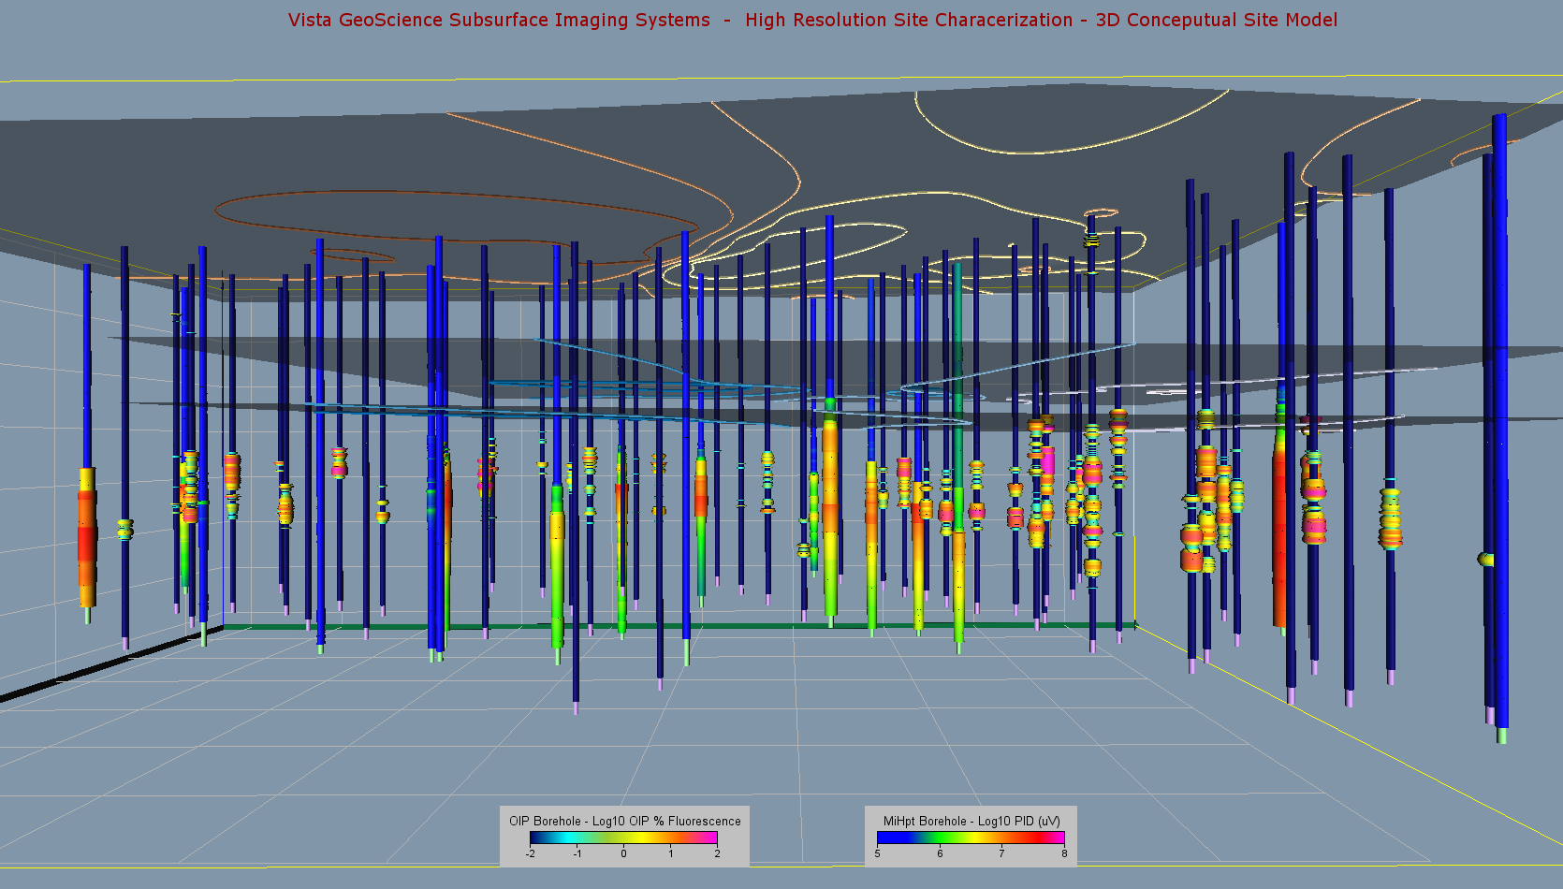
OIP-UV & MIP (PID) Boring Renderings
High Season Water Table
Low Season Water Table
N
Notes:
This is a perspective view with north to the right, looking west. Source area is in the north end of the survey. The 51 OIP boring renderings are dark blue with warmer colors showing increased % Fluorescence, which represents the presence of liquid phase hydrocarbons. The 18 MiHPT boring renderings are a brighter blue and show the PID response in warmer colors, representing sorbed and dissolved phase VOCs. Both the surface elevation model and high and low ground water table models are shown. Ground surface dips gently to the south (left) and both high and low ground water tables dip gently north (right). Notice the deeper penetration of LNAPL as indicated on the OIP borings at the north end of the image, relative to the south end.

Slide 37
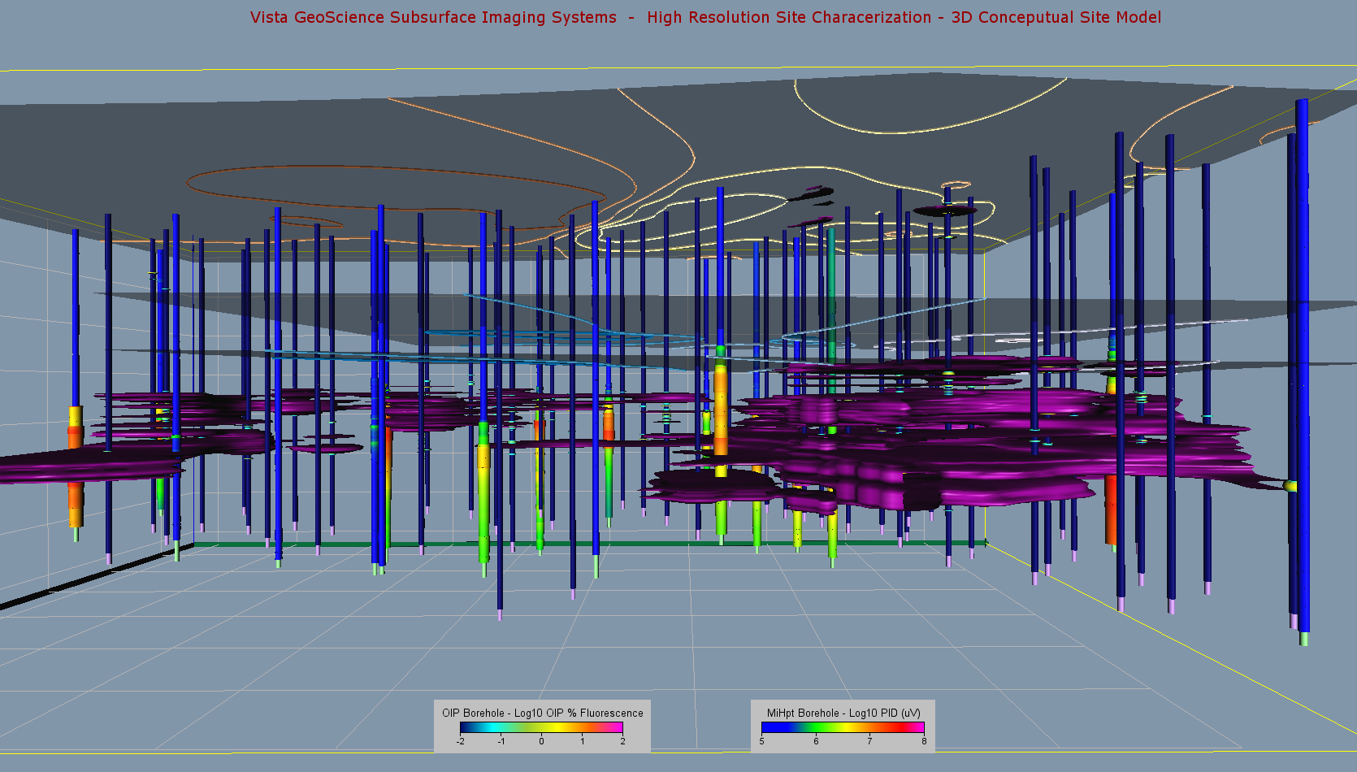
OIP-UV Fluorescence >0.1% Isosurface
High Season Water Table
Low Season Water Table
N
Notes:
This is the same view as the previous image, but we have created a 3D grid (lattice) of the fluorescence data, and contoured an isosurface for all %Fluorescence > 0.1%. In this image, you can see in the source area (right), the LNAPL is slightly above the low water table and extends to approximately 15’ below that same water table. Where it migrates south (left), it appears to be confined in a narrower horizon, a few feet below the low water table.

Slide 38
MIP-PID Volume Rendering
High Season Water Table
Low Season Water Table
N
Notes:
In this image we have created a 3D grid (lattice) of the PID response from all of the MiHPT logs. This is displayed as a Volume Rendering, a color coded “fog” with warmer colors representing higher PID values. Here we can see that the migrated dissolved phase appears to be related to the migrated LNAPL, as it also remains confined a few feet below the water table in the south end of the plume.

Slide 39
HPT – Pressure >45 psi Isosurface
High Season Water Table
Low Season Water Table
N
Notes:
Adding in the Fluorescence (LNAPL) isosurface model and the MIP-PID response volume rendering to the previous image.

Slide 40
Orthographic vs. Perspective Views
High Season Water Table
Low Season Water Table
Notes:
This is the same as the previous image, switching from a vanishing point perspective view, to an orthographic view, where everything is scaled the same front to back. This view makes is easier to see the elevation of the different components in the model, the depth of the LNAPL and VOCs below the water table, and dip of the surface and ground water tables.

Slide 41
HRSC Conceptual Site Model Case History 3: Baytown, TX
OiHpt Identified thick confining clay, perched water with LNAPL, lessor amounts of LNAPL that migrated into the deeper aquifer, possibly through monitor well screens. False LNAPL thickness resulted in monitor wells

Slide 42
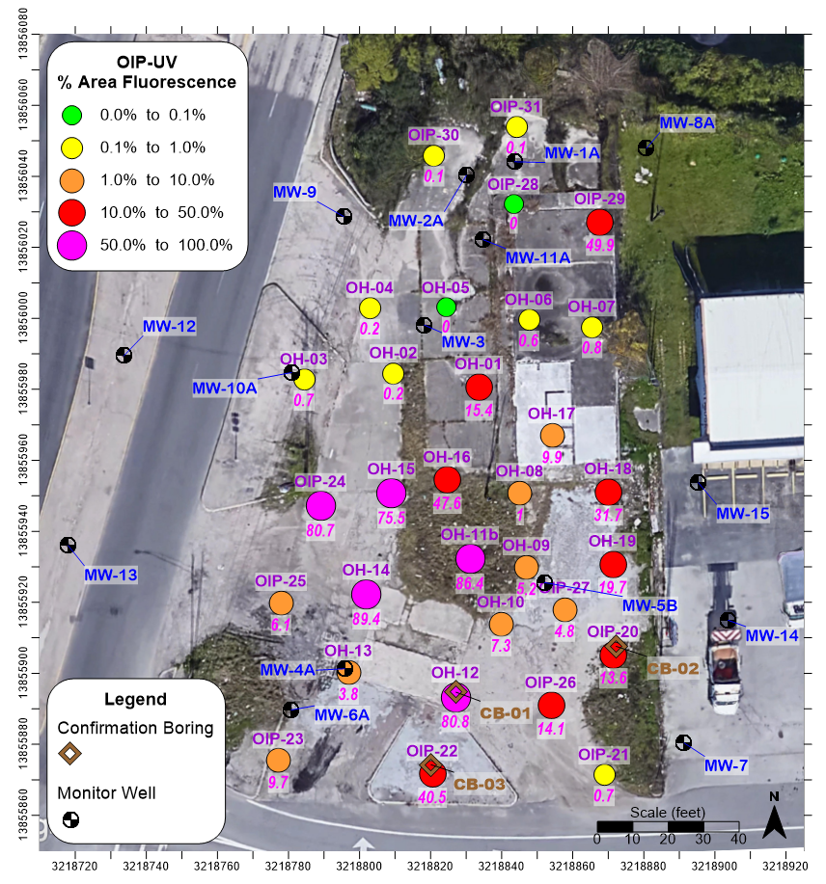
Old Abandoned Gas Station, Baytown, TX
Tanks long removed, LNAPL in scattered wells
Map of OIP-UV Maximum %AF
Original Investigation, 1997
31 OIP-UV Borings
3 Confirmation Soil Cores
Groundwater Table Modeled from MWs
All elevations relative ft.
N

Slide 43
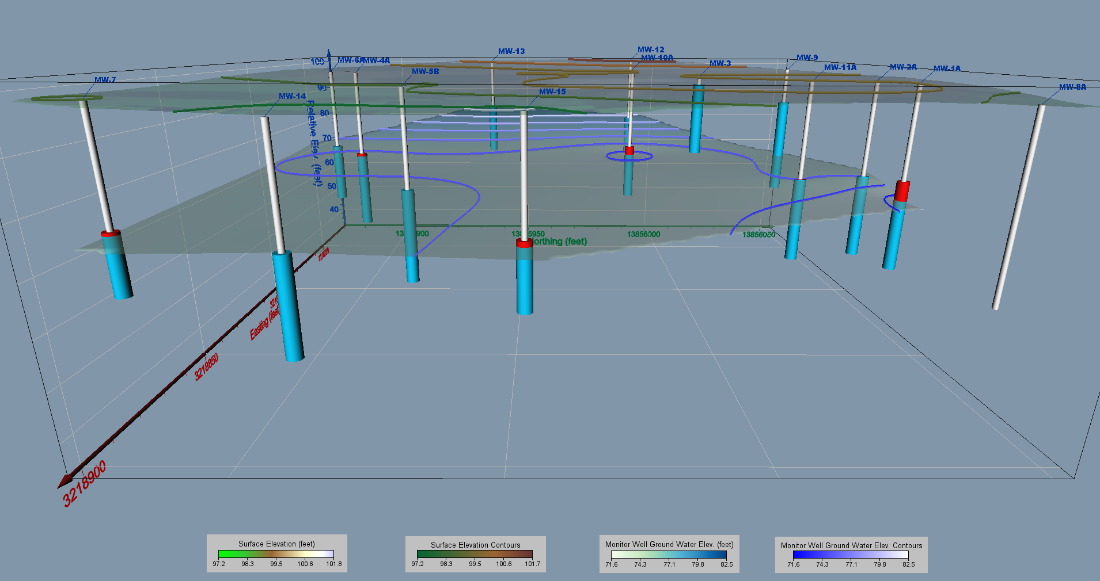
Ground water Elevation Model
Monitor wells with water and LNAPL column - View looking West
N
N

Slide 44
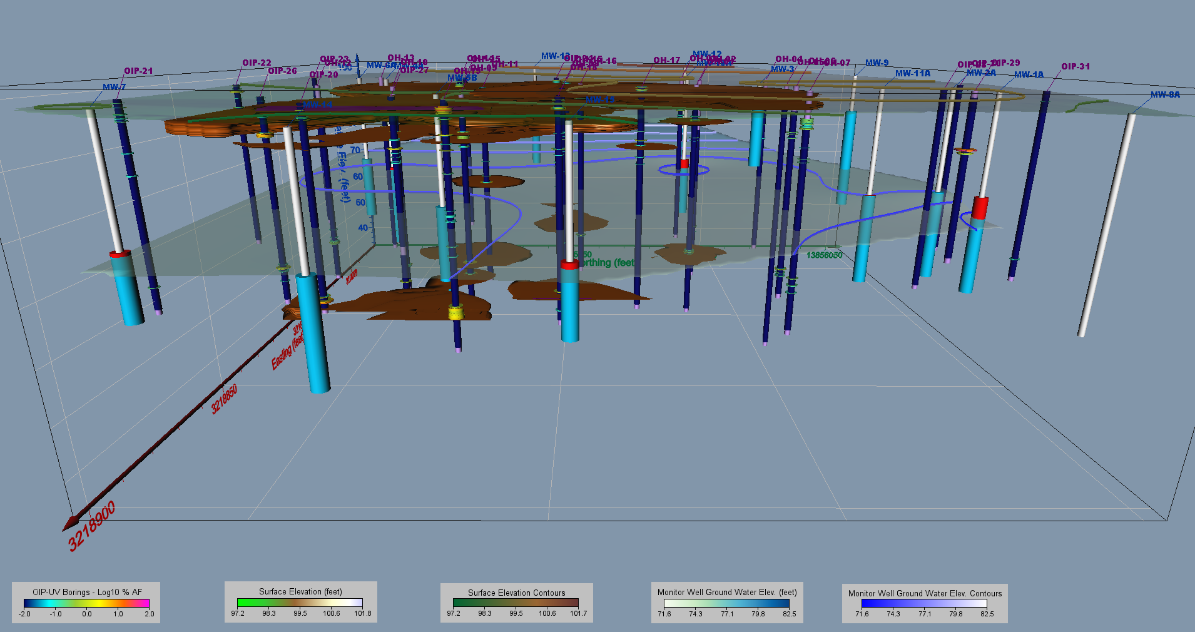
LNAPL Plume > 1% Area Fluorescence (%AF)
Shows LNAPL in perched zone above water table, and confined 15’ below water piezometric head.
N
N

Slide 45
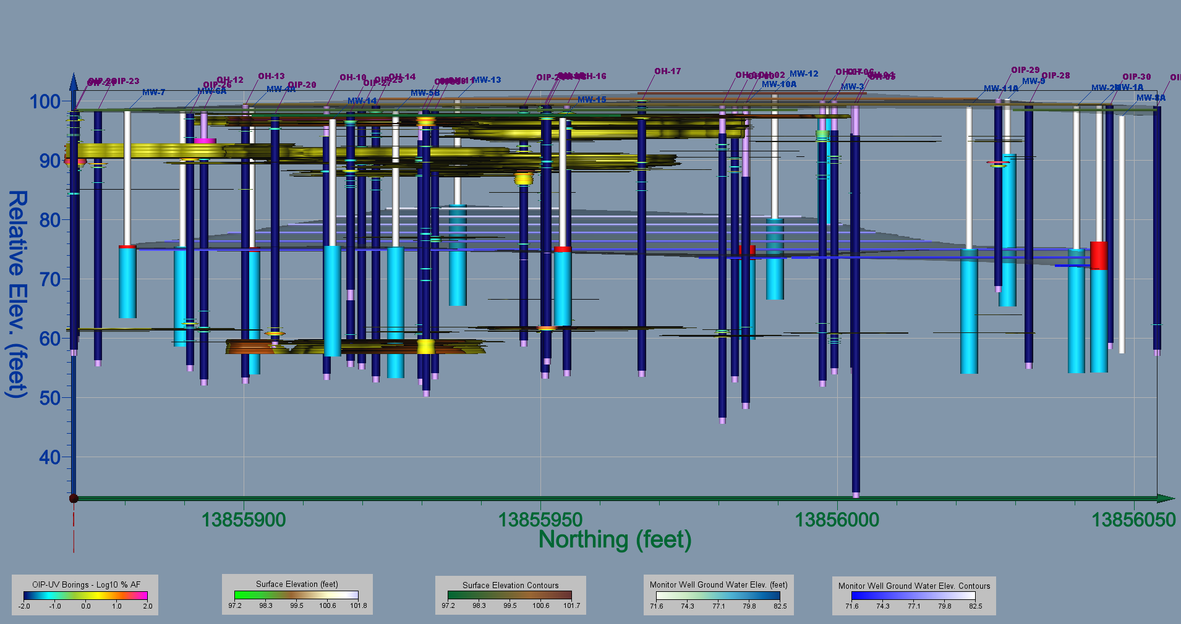
Orthographic View of Site Looking West –
Shows LNAPL in perched zone above water table, and confined 15’ below water piezometric head.
N

Slide 46
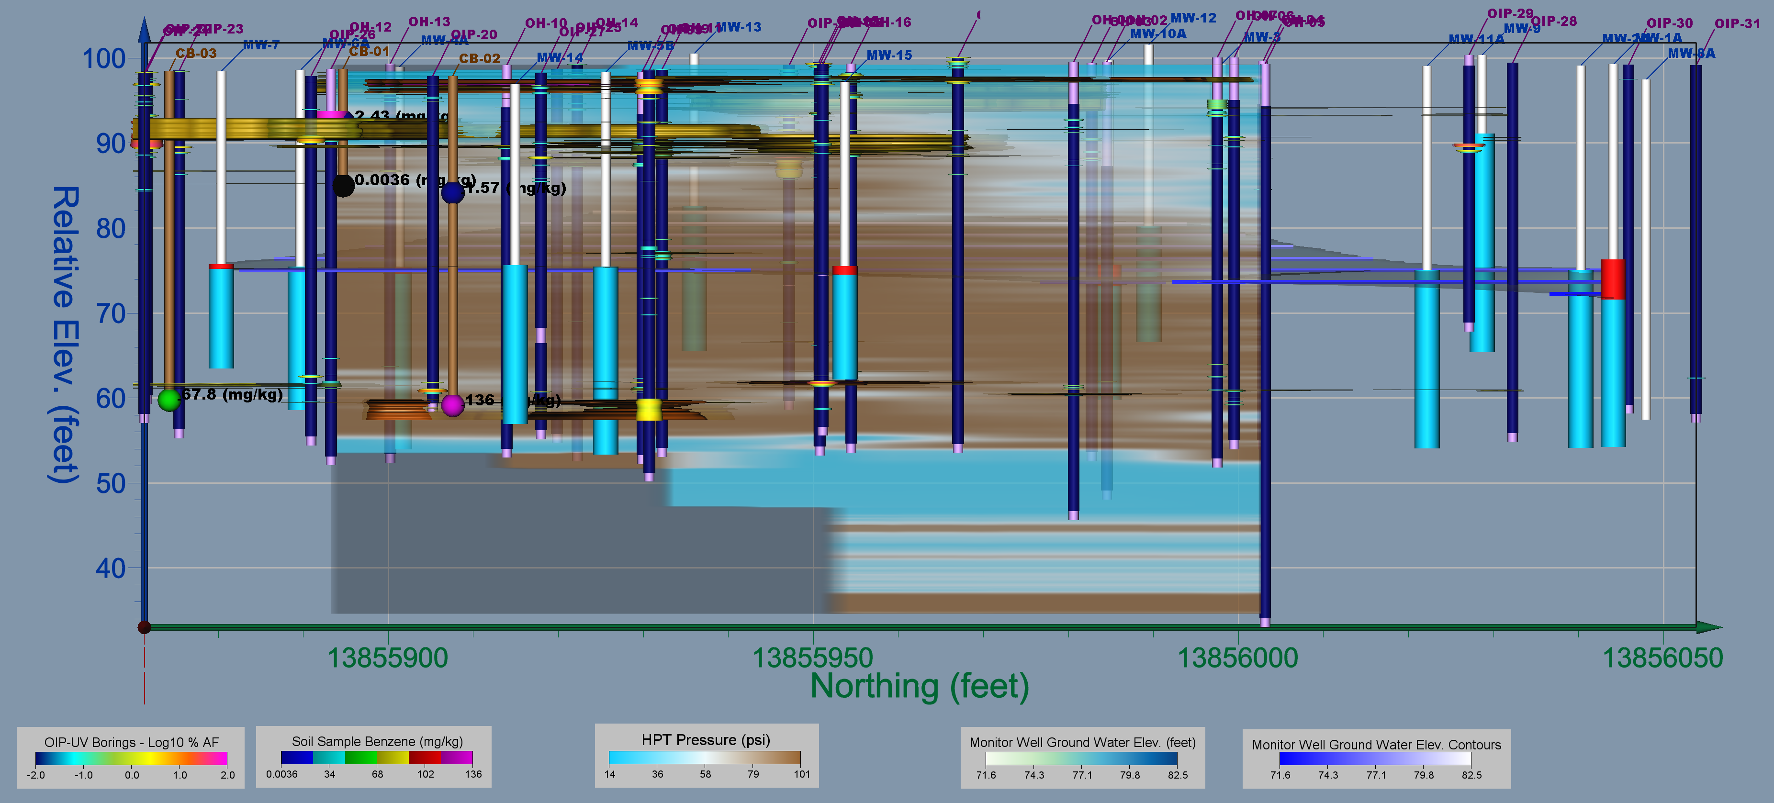
Cross Sectional View of
HPT Pressure Showing Massive Clay Layer
N
N

Slide 47
Summary
HRSC tools have advanced to include:
  New combined tools MiHpt, LL-MiHpt, and OiHpt
  More ruggedized, sensitive, mobile, and faster configurations
The HRSC equipment is complex, requires significant field troubleshooting skills, and only experienced operators should be hired that have thorough training, operating experience, understand the instrumentation, and follow all QC procedures.
2D and 3D modeling of HRSC data is the most efficient can quickly display where contaminant mass is present, moving, and why it is trapped in confining layers.
Integrating HPT data into a HRSC model is key to understanding contaminant migration.
LNAPL in confining conditions can result in erratic and false thickness in monitor wells, which does not represent the location of LNAPL in the soil.
By pinpointing where the bulk of contaminant resides, HRSC can aid in designing more effective remediation and quicker site closure solutions.
ALWAYS get the raw data/log files from your contractor for your records.

Slide 48
QUESTIONS ?
Update on Current High Resolution Site Characterization (HRSC) Technology, 3D Data Modeling, and Applying HRSC Data to Remedial Design (Part 1)
John Fontana, PG, Vista GeoScience
Jfontana@VistaGeoScience.com
25th International Petroleum Environmental Conference Denver, Colorado
Oct 30 - Nov 1, 2018

