Slide 1
UAS Applications for Environmental Monitoring, Mapping, and Survey Inspection
IPEC 2018

Slide 2
Andrew Lindemann Global Technical Marketing Leader andrewl@geotechenv.com 800-833-7958

Slide 3
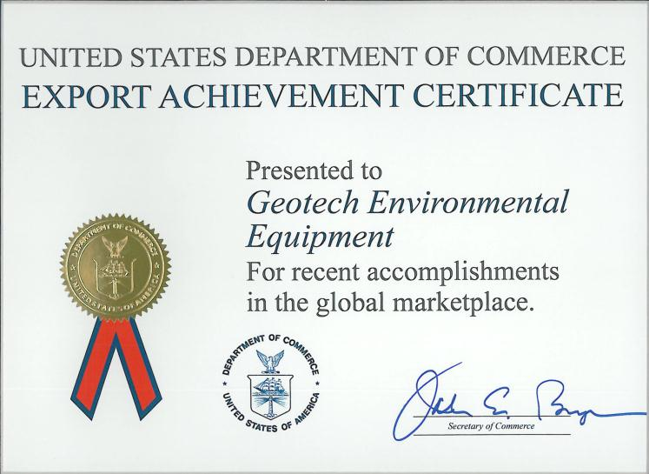
Geotech Corporate Headquarters Denver, Colorado USA
…a world leader in environmental equipment manufacturing and product training since 1978.
www.GeotechEnv.com

Slide 4
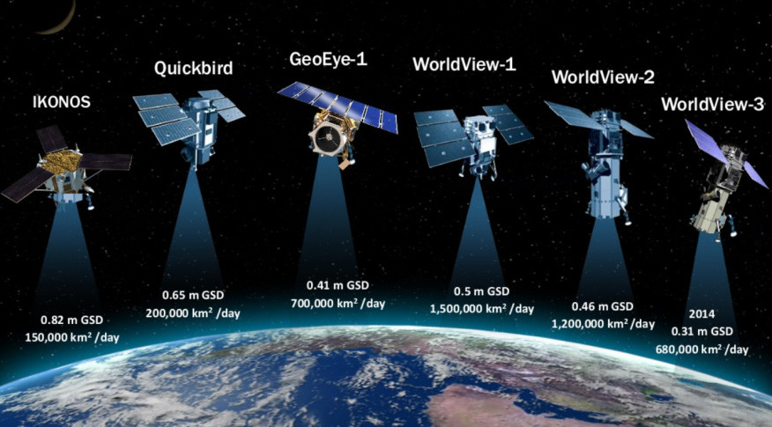
Technology

Slide 5
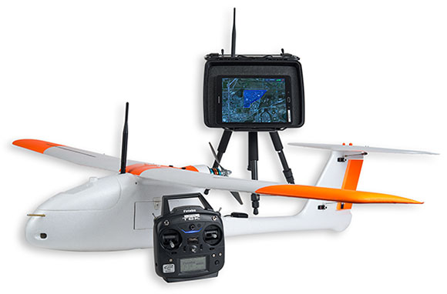
Technology
UAS – Unmanned Aircraft Systems
Compact, High Resolution Sensors
Lower Cost
Low Altitude
Geotech GeoSwift Mapper

Slide 6
Aerial Mapping

Slide 7
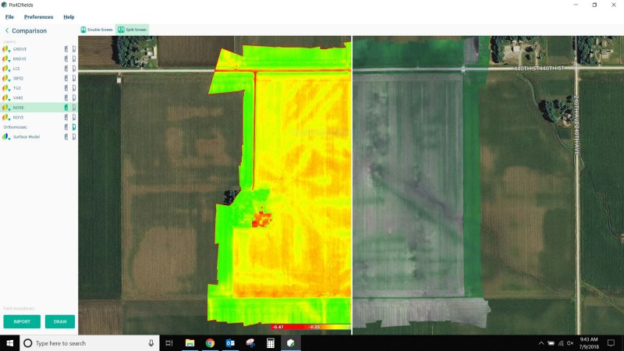
NDVI Normalized Difference Vegetation Index

Slide 8
Perry Park Golf Club
StevensWater
Geotech Environmental Equipment, Inc.

Slide 9
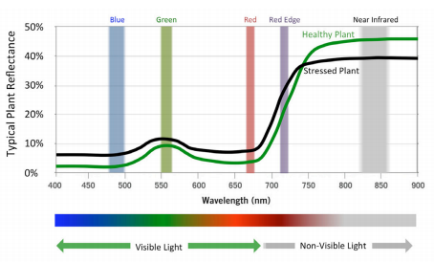
GeoSwift Mapper

Slide 10
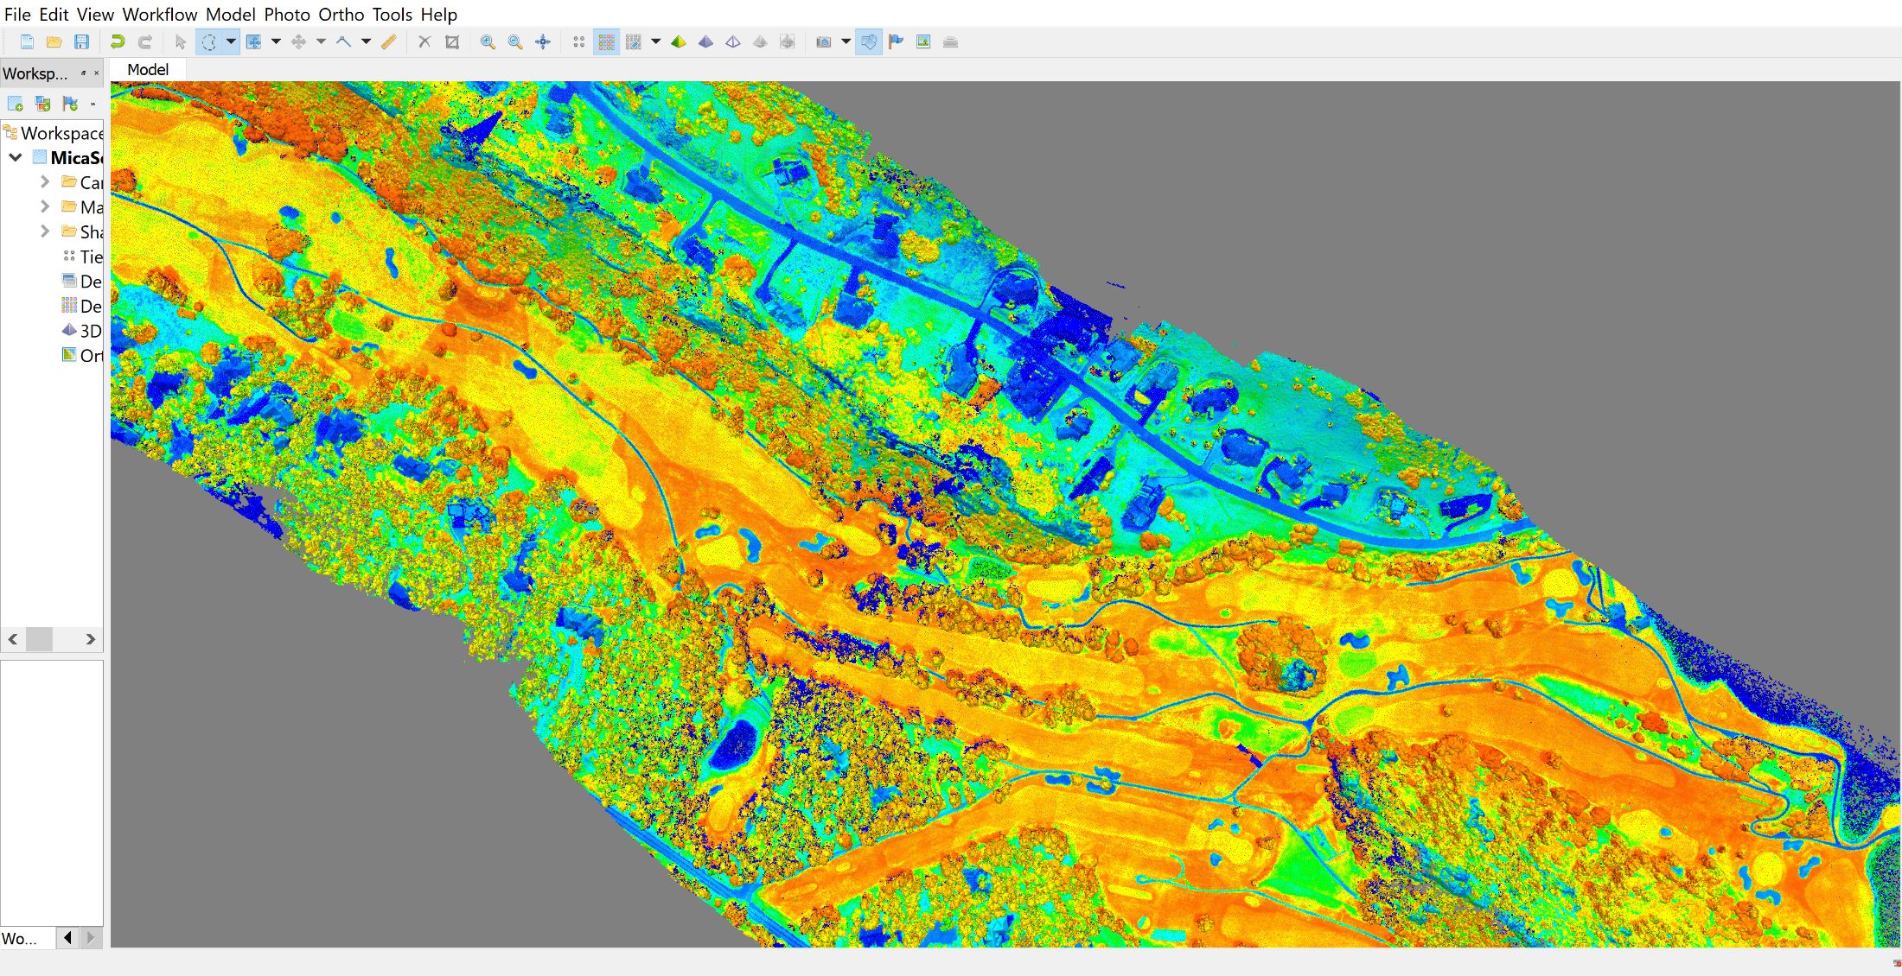
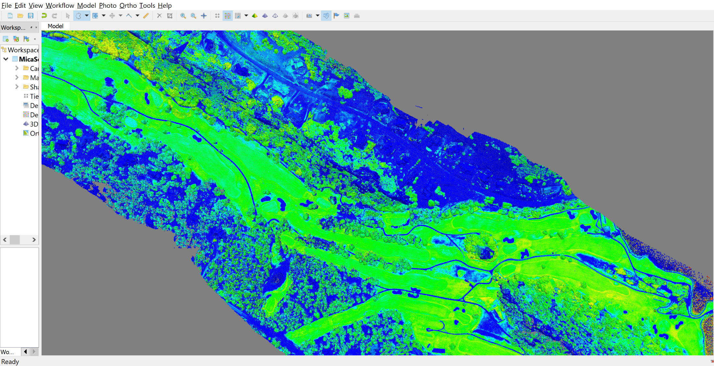
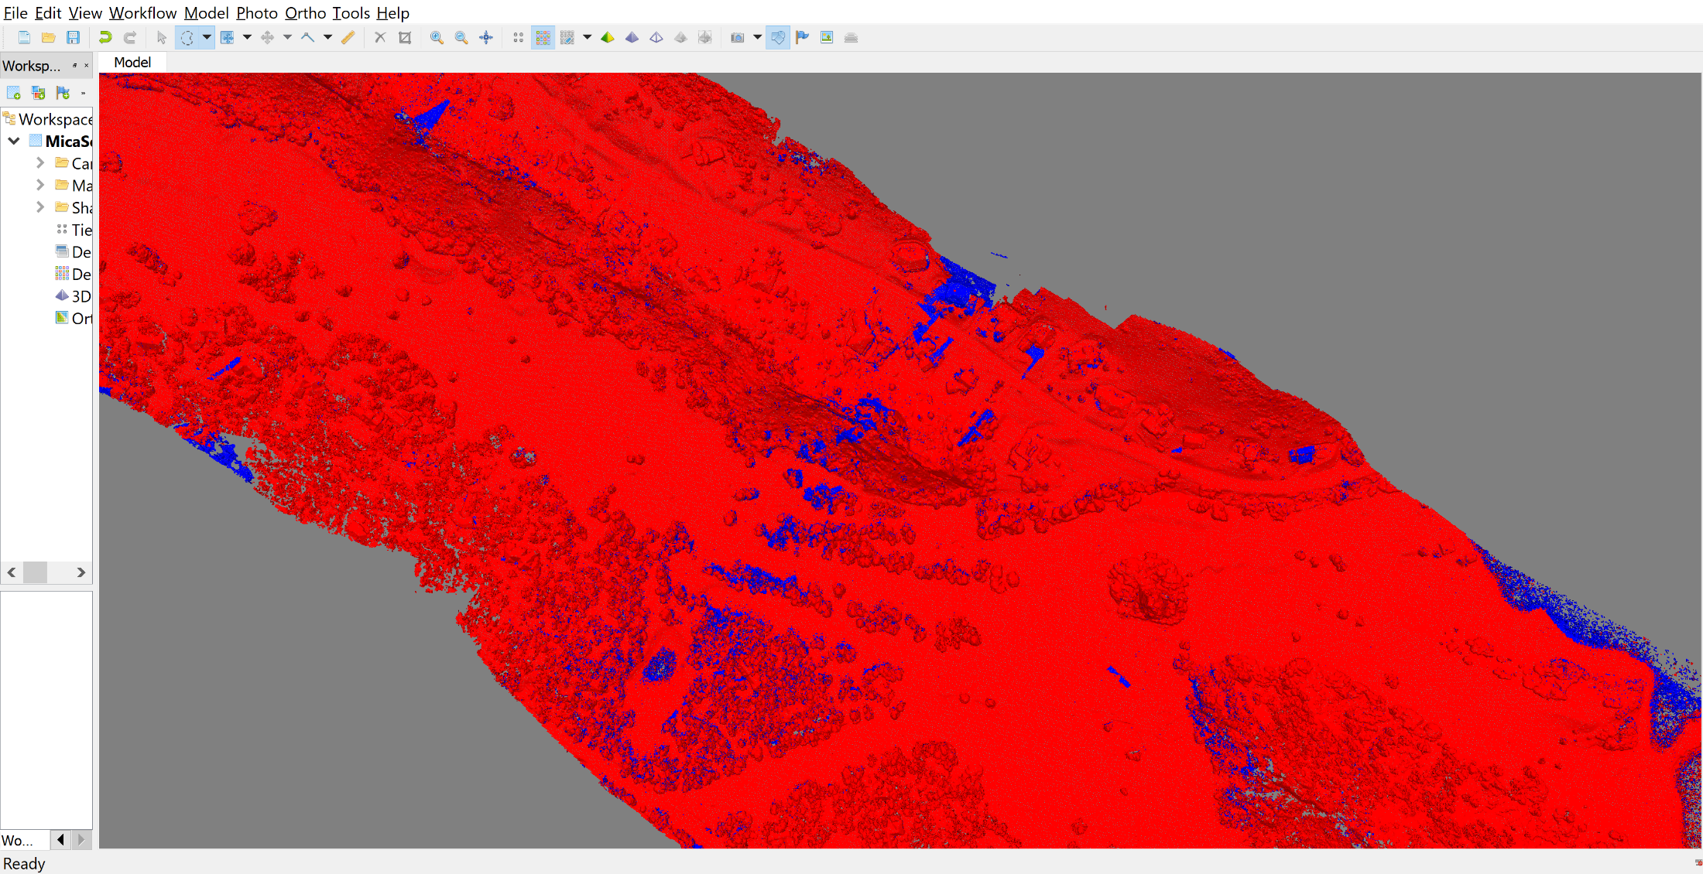

Slide 11
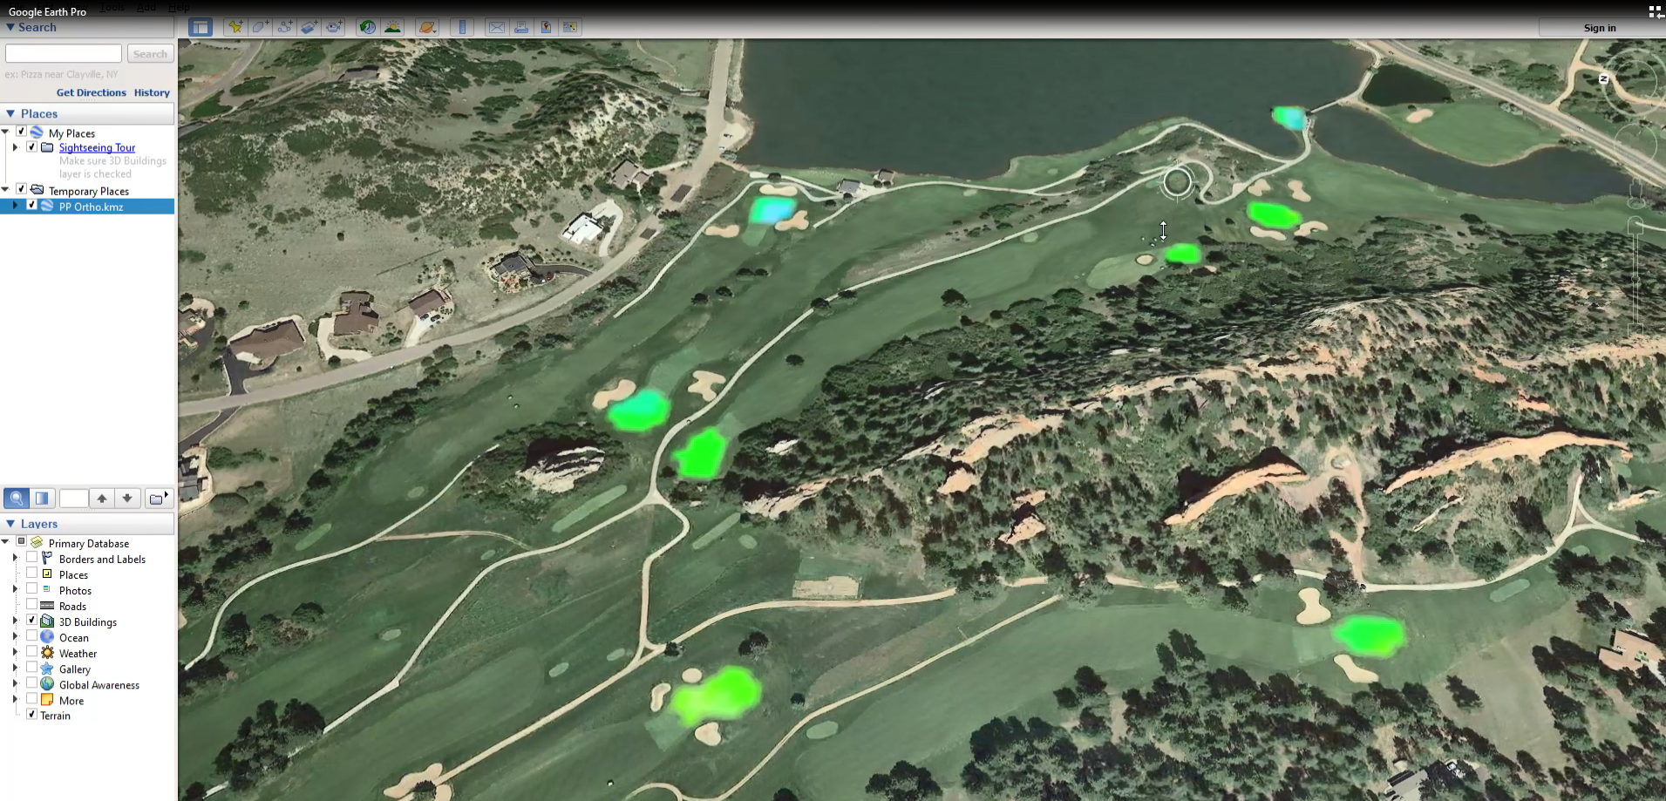
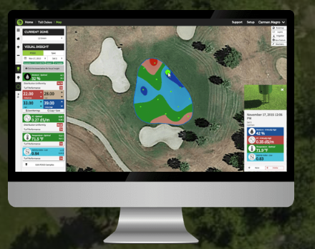
Perry Park Golf Club

Slide 12
Andrew Lindemann Technical Marketing Coordinator AndrewL@GeotechEnv.com 303.320.4764
Conclusion and Discussion
Source: http://www.geotechenv.com/pdf/white_papers/oak_ridge_national_laboratory.pdf

