Slide 1
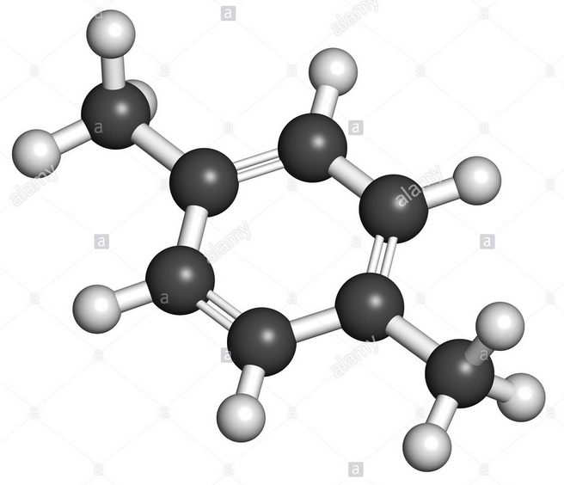
Thermally Enhanced SVE and Bioremediation
Gorm Heron, Amber Bonarrigo, Jack Wattu
TerraTherm/Cascade Thermal
Co-authors:
Justin King and Meghan Platt, CHA
Dennis Keane and Mike Marley, XDD

Slide 2
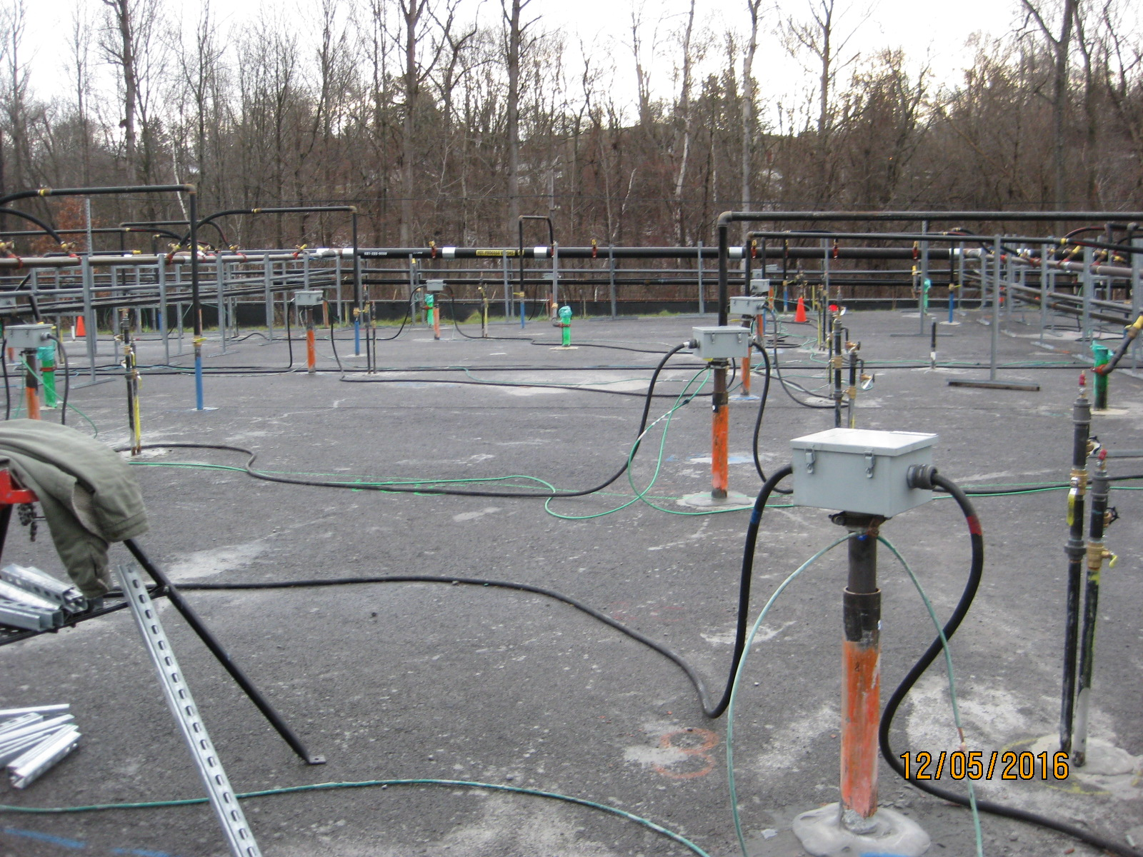

Slide 3
Can we treat sites much cheaper?
$/cy
ISTR
100
Bio
10,000
20,000
30,000
40,000
Volume (cy)

Slide 4
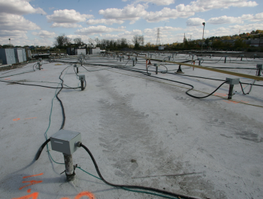
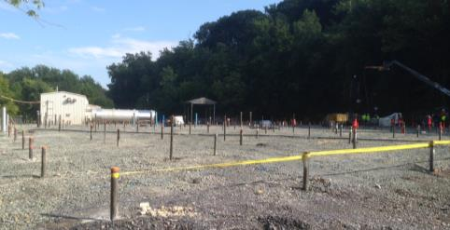
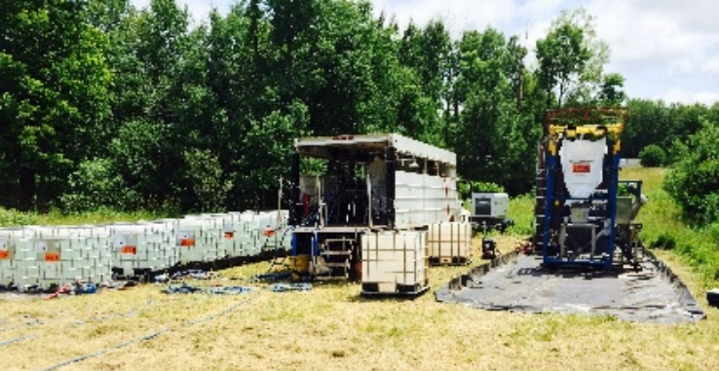
Technology Fit vs. Mass/Concentrations

Slide 5
Conceptual site model
Zone 1
Source
Zone 2
Transition zone
Zone 3
Plume core
Zone 4
Plume

Slide 6
When will bioremediation be enough?
Degradable COCs
Redox conditions favorable
Electron acceptors available
Nutrients, cultures
Xylene, BTEX
Aerobic
Oxygen to be delivered
Lab TS indicates yes
Main objective: Reduce all COCs to below 1,000 mg/kg (from 15,000 mg/kg)

Slide 7
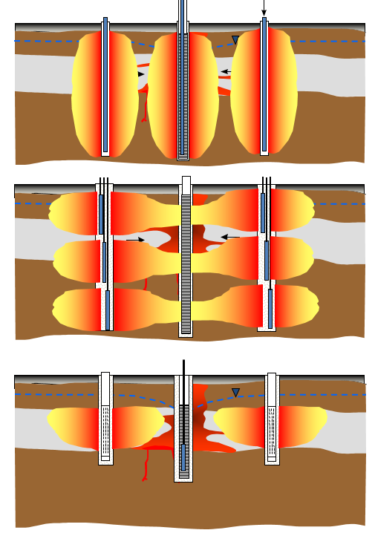
Thermal Technologies
Thermal Conduction Heating (TCH), or In-Situ Thermal Desorption* (ISTD)
Electrical Resistance Heating (ERH) – Joule Heating
Steam Enhanced Extraction (SEE) – Steam Injection

Slide 8
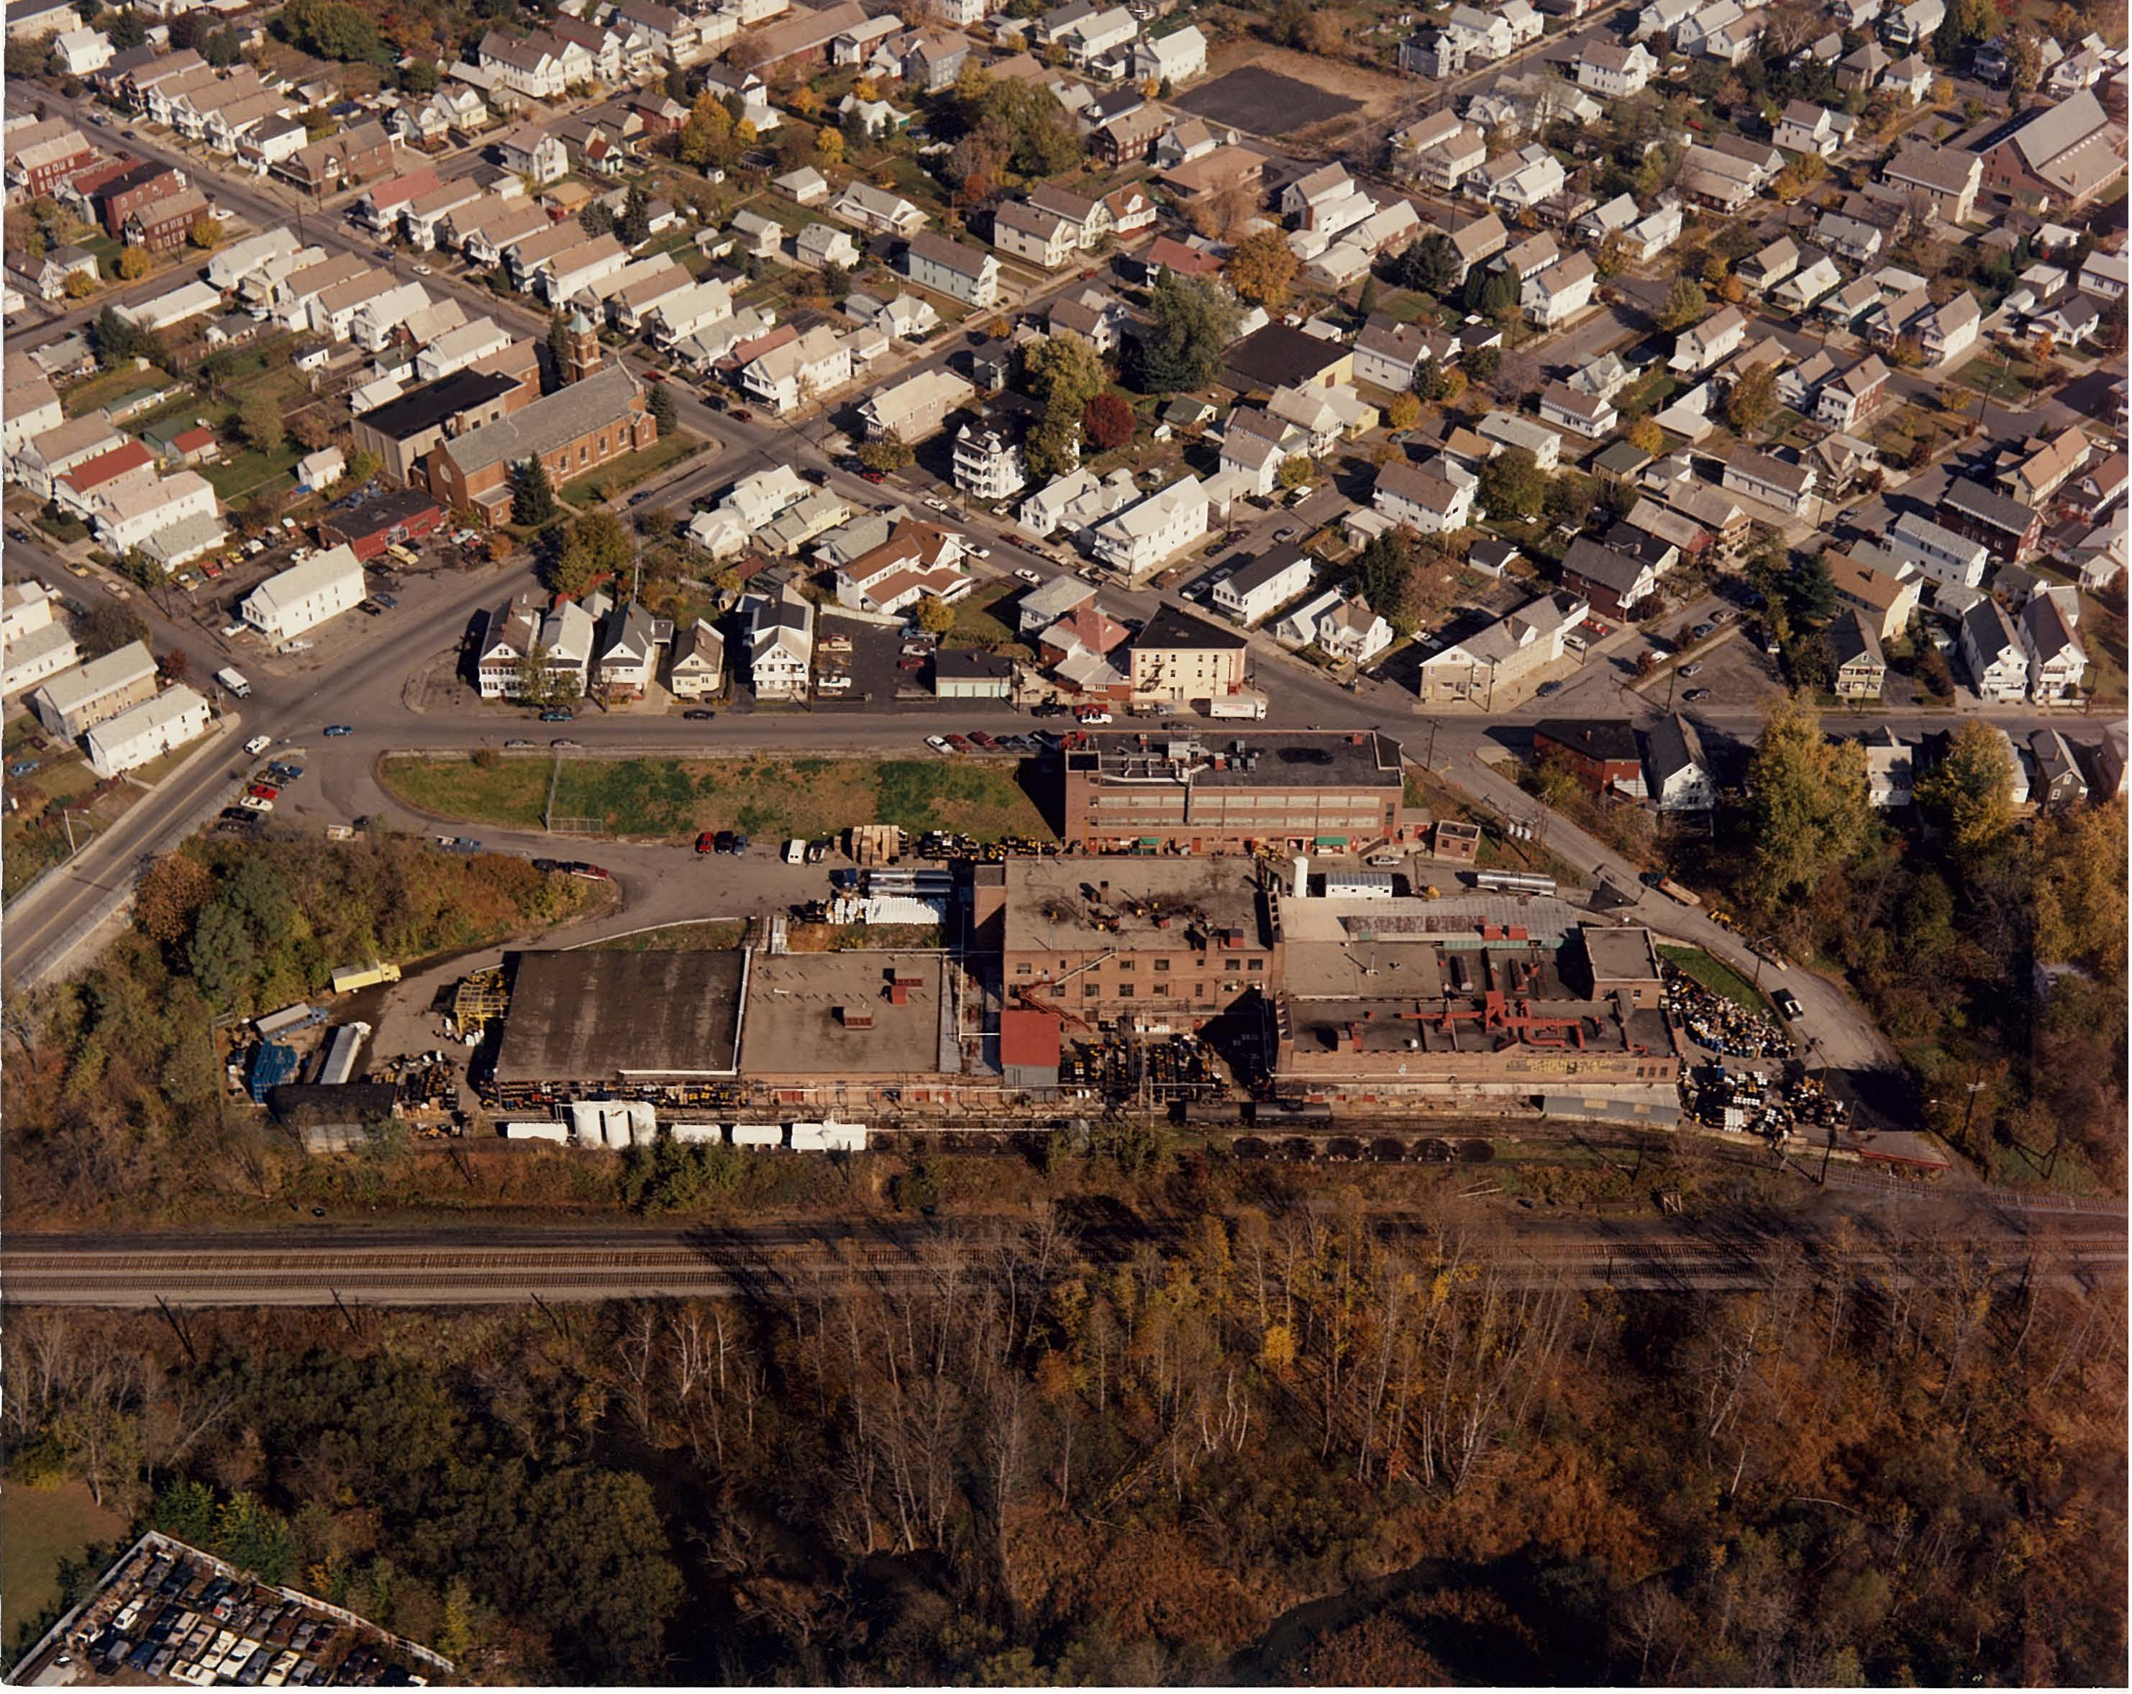
Site - Aerial, 1980s
Drums
ASTs

Slide 9
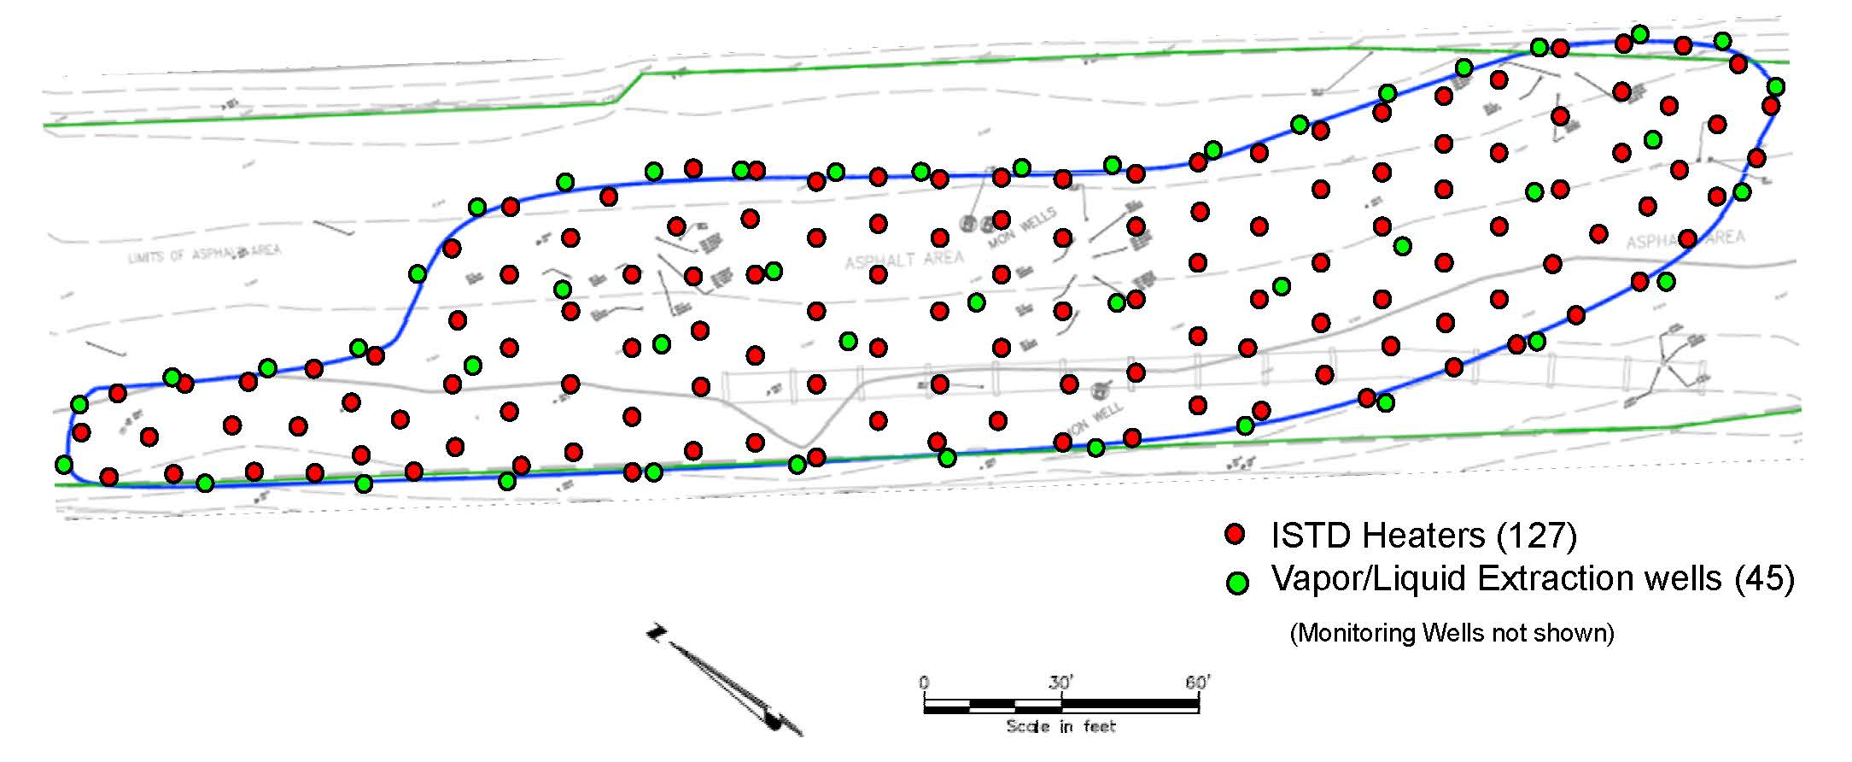
Simplified concept

Slide 10
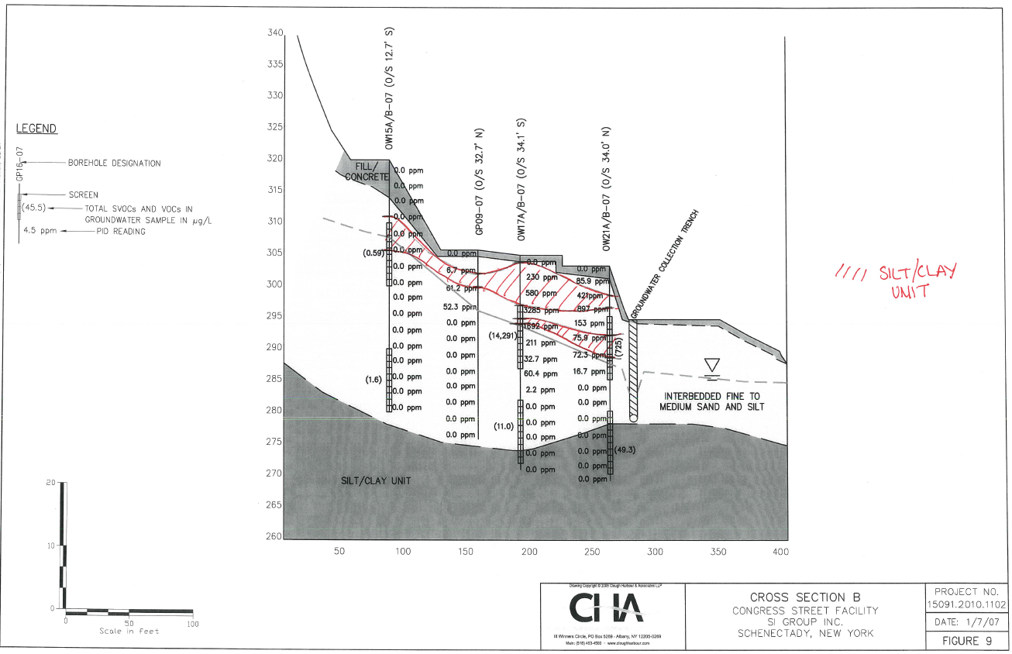
Conceptual Model: Cross Section B to B’

Slide 11
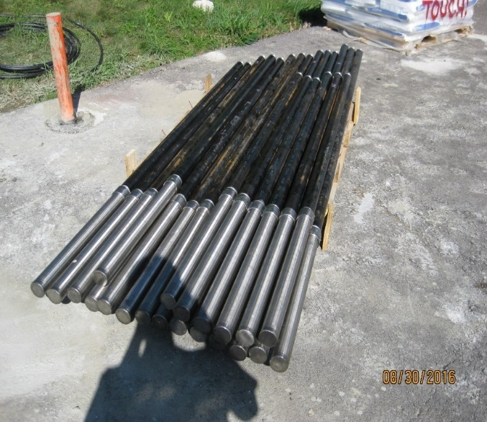
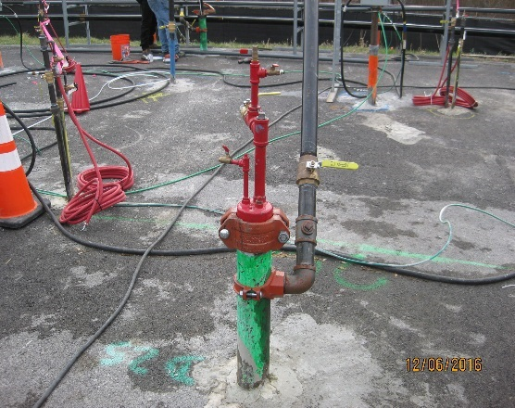
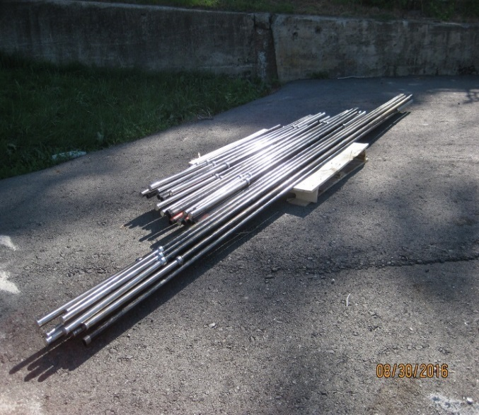
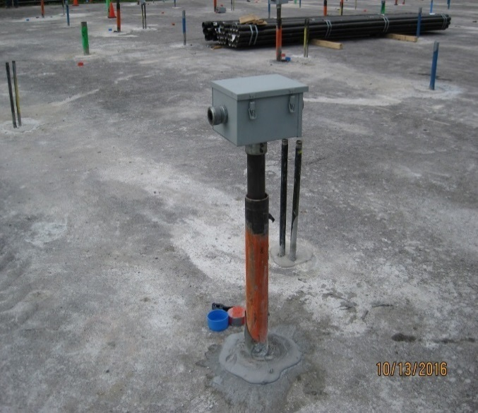
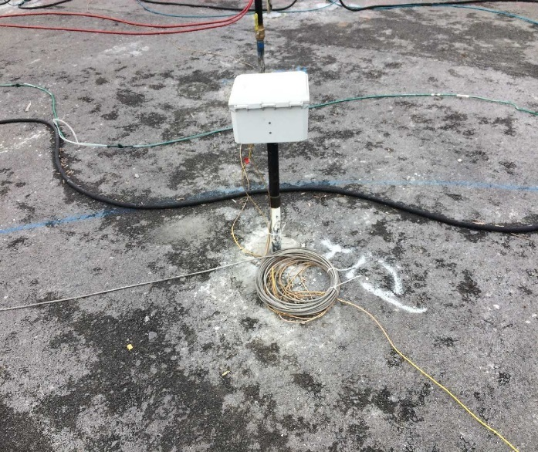
TESVE Wellfield Construction
SVE Wells: 96
DPE Wells: 56
Heaters: 143
AIWs: 286 (nested)
TMPs: 16
Notes:
SVE notes:
-General construction: 2-inch dia. by 2-foot long SS wire-wrap screen.
-Terminal depths determined by Waterloo APS® (8-foot bgs max.)
-Finished with a manual shut-off valve, vapor sample valve, and hole tap for flow measurement collection
DPE notes:
-General construction: 4-inch dia. by 10-foot long SS wire-wrap screen. (10-20 ft screen)
-All DPE wells include a pneumatic top loading pump. Intake depth at ~17 ft bgs
-Finished above grade with a water discharge head, water/vapor sample valve, and a SVE shut off valve
HO notes:
-Thermal conductive heating elements installed to 20 feet bgs *****repeat due to quiz
-Input voltage controlled by a silicon controlled rectifier (SCR) and human machine interface (HMI) panel
-Divided into 3 individually controlled separate circuits
-Several HO wells have co-located thermocouples to monitor heater temperature
AIW notes:
-General Construction: 2 co-located 1-inch dia. by 2-foot long SS wire-wrap screens.
Deep AIW: Screen set at 13-15 feet bgs
Shallow AIW: Screen set at variable depths as determined by the Waterloo APS® study or Point Perm. study
-Provide makeup air to the SVE/DPEs and aid in subsurface oxygen circulation
-Pressure adjusted via gate valves on each individual well head
TMP notes:
-General construction: Sealed 2” steel pipe set at 20 feet bgs. Thermocouple array set at various depths throughout the treatment.
-Monitors subsurface temperature between HO wells.
-Transmits data in real time to onsite computers.
Wellfield Piping notes:
-5 different wellfield piping systems
-SVE/DPE Vapor piping – 4 to 8” diameter fiberglass
-DPE Well discharge liquids – 2” carbon steel, heat traced and insulated
-DPE Pump air – 1” carbon steel
-AIW Pressurized – 3” carbon steel
-AIW Passive – 2” sch. 80 PVC

Slide 12
Waterloo^{APS} Profiling
65 borings
Sampled on a grid with uniform 25ft spacing
All borings advanced to 15 ft bgs

Slide 13
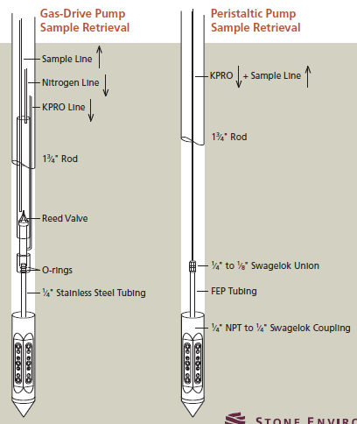
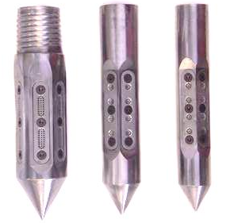
The Right Profiler for the Job
APS 225
APS 175
APS 150

Slide 14
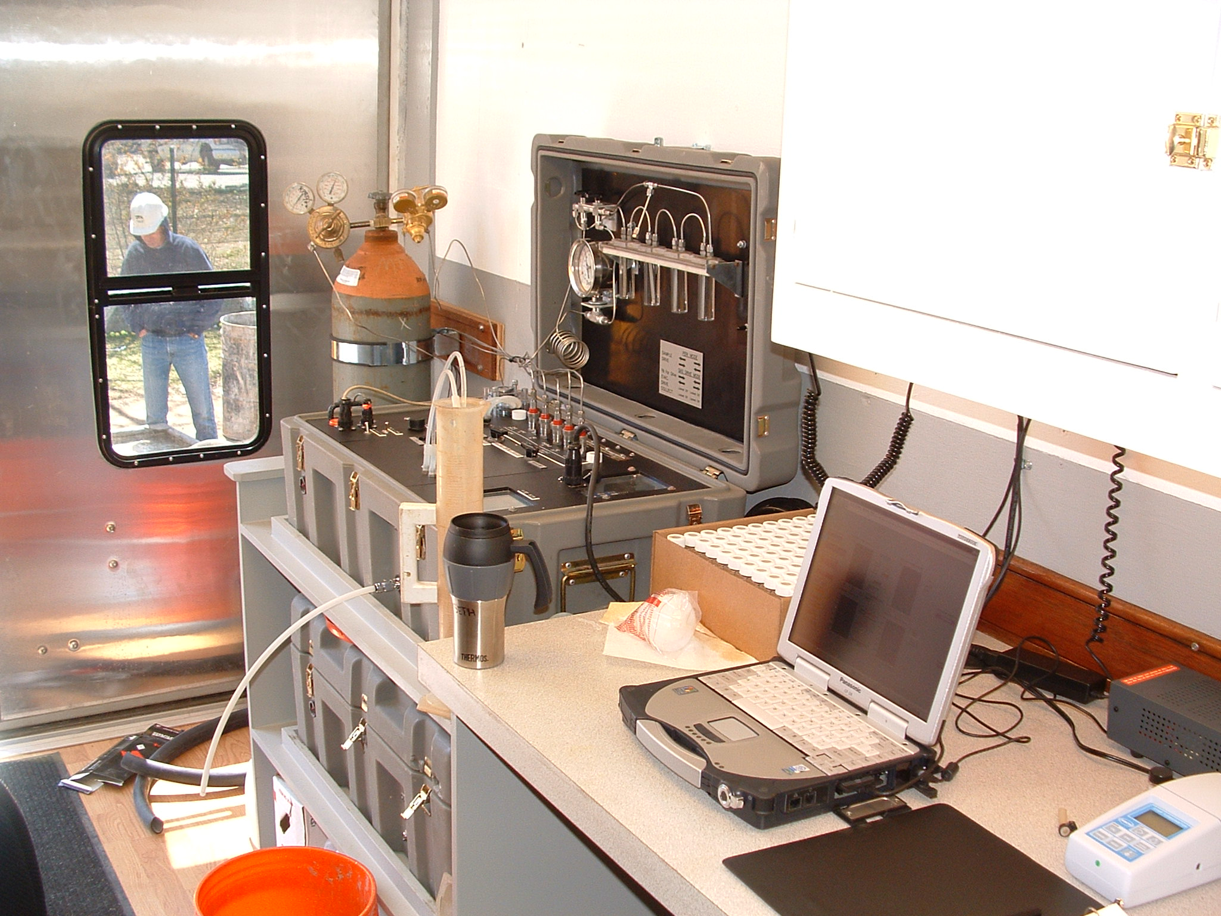
Integrated Data Acquisition
Concentration Data
Physical Chemical Data
Hydraulic Head Data
Index of Hydraulic Conductivity Data
Notes:
The profiler has been modified to allow for the collection of detailed data relative to contaminant concentrations (samples), the distribution of hydraulic conductivity and hydraulic head as well as pH, specific conductance, dissolved oxygen and oxidation reduction potential in a single push.

Slide 15
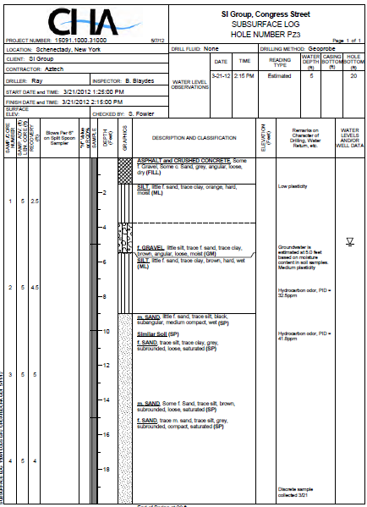
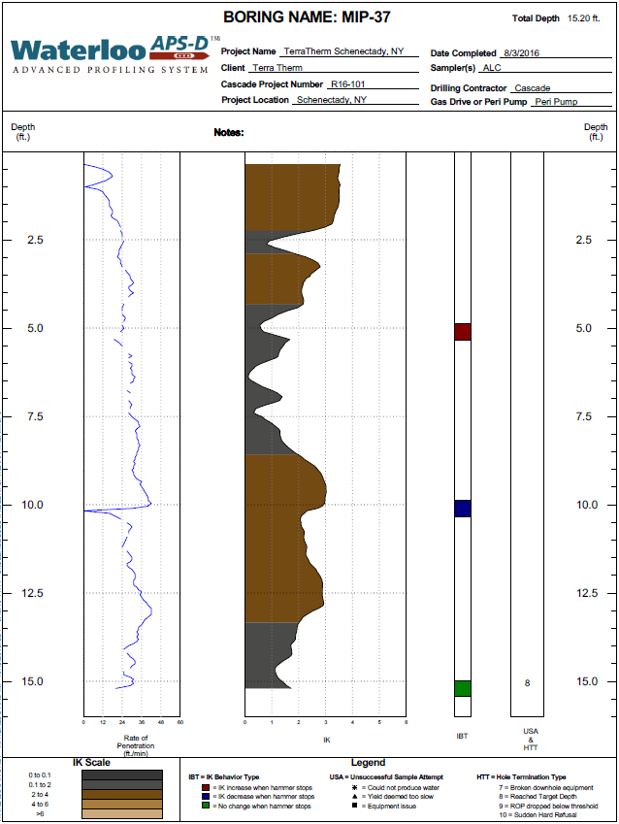
Top of native soil on soil boring/15 ft bgs
Soil Boring shows a transition to a lower permeability soil
Soil Boring shows a transition to a higher permeability soil

Slide 16
Interpolating Screen Locations from Waterloo^{APS} Boring Logs – Results
Bottom of Screened Interval and/or Boring over MIP Layout
Key | Bottom of Boring [ft bgs]
 | 5.0
 | 5.5
 | 6.0
 | 6.5
 | 7.0
 | 7.5
 | 8.0

Slide 17
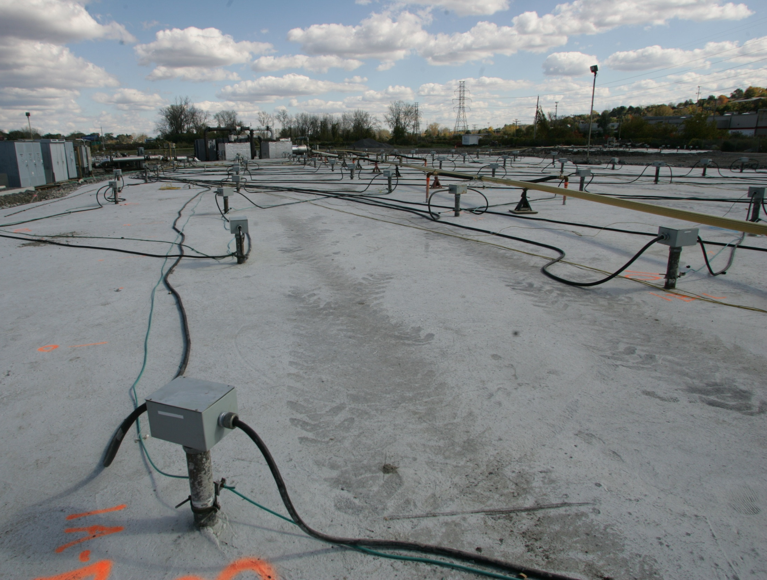
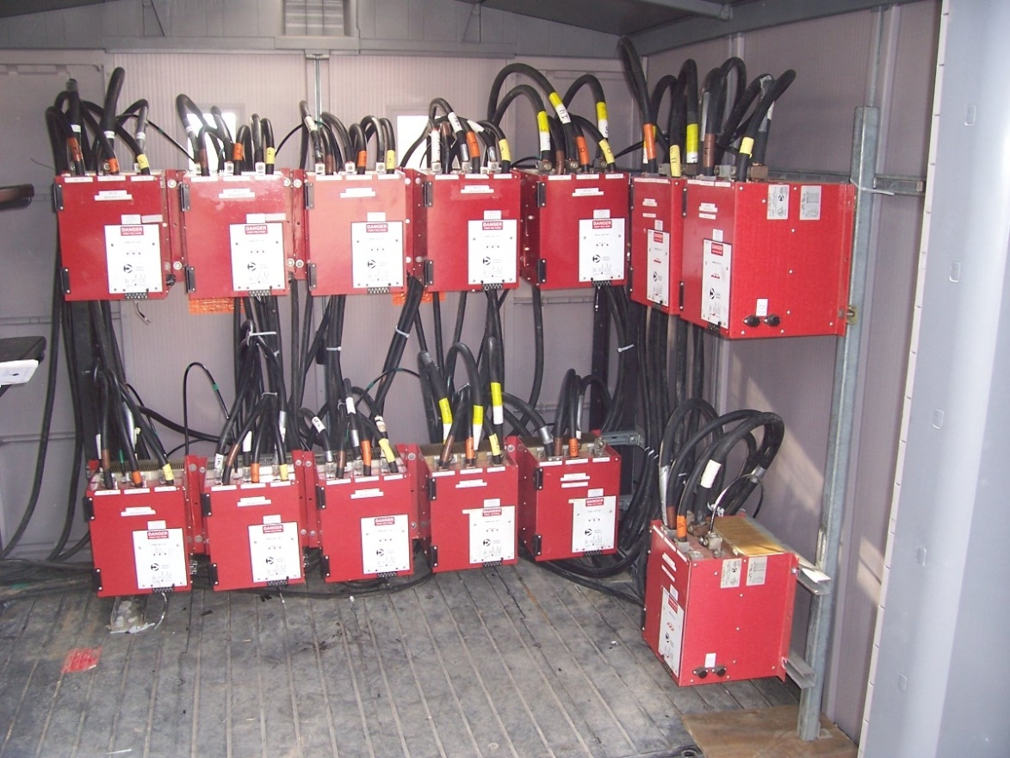
Thermal Conduction Heating

Slide 18
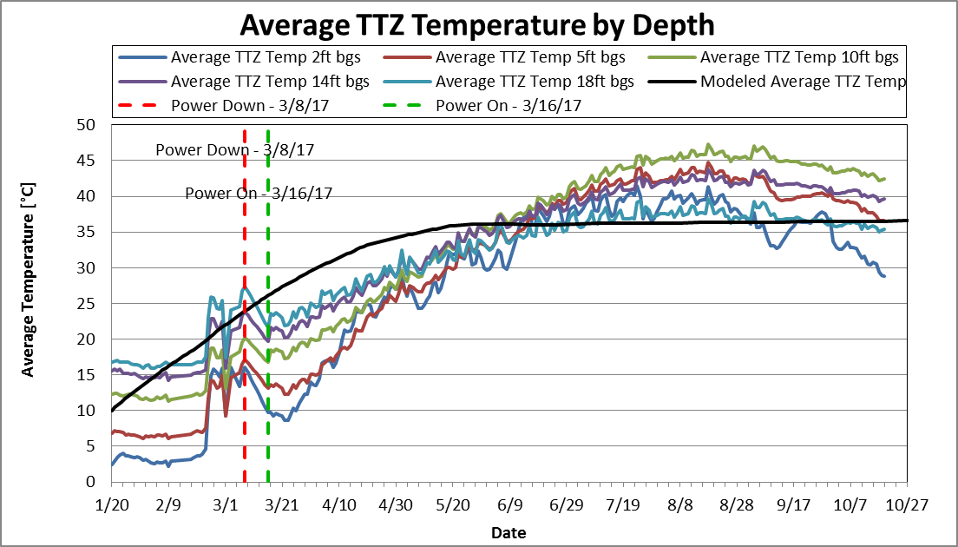
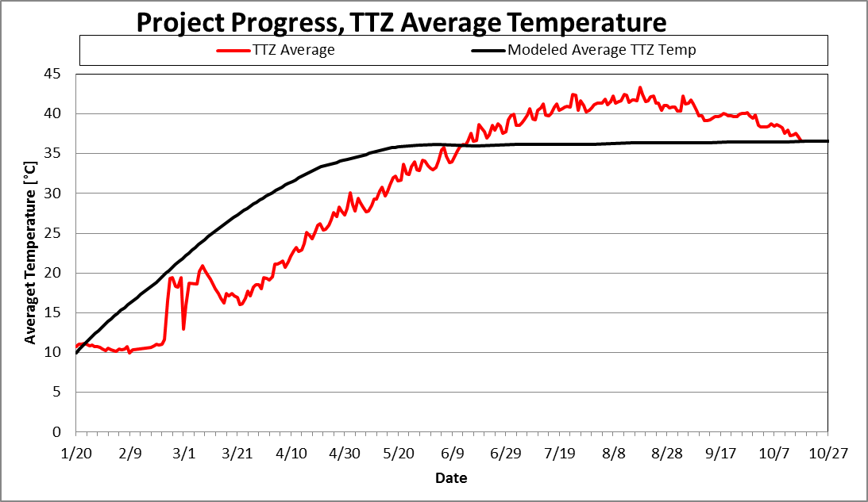
Average TTZ Temperature
Average Temperature at Centroid Locations: 36.5°C

Slide 19
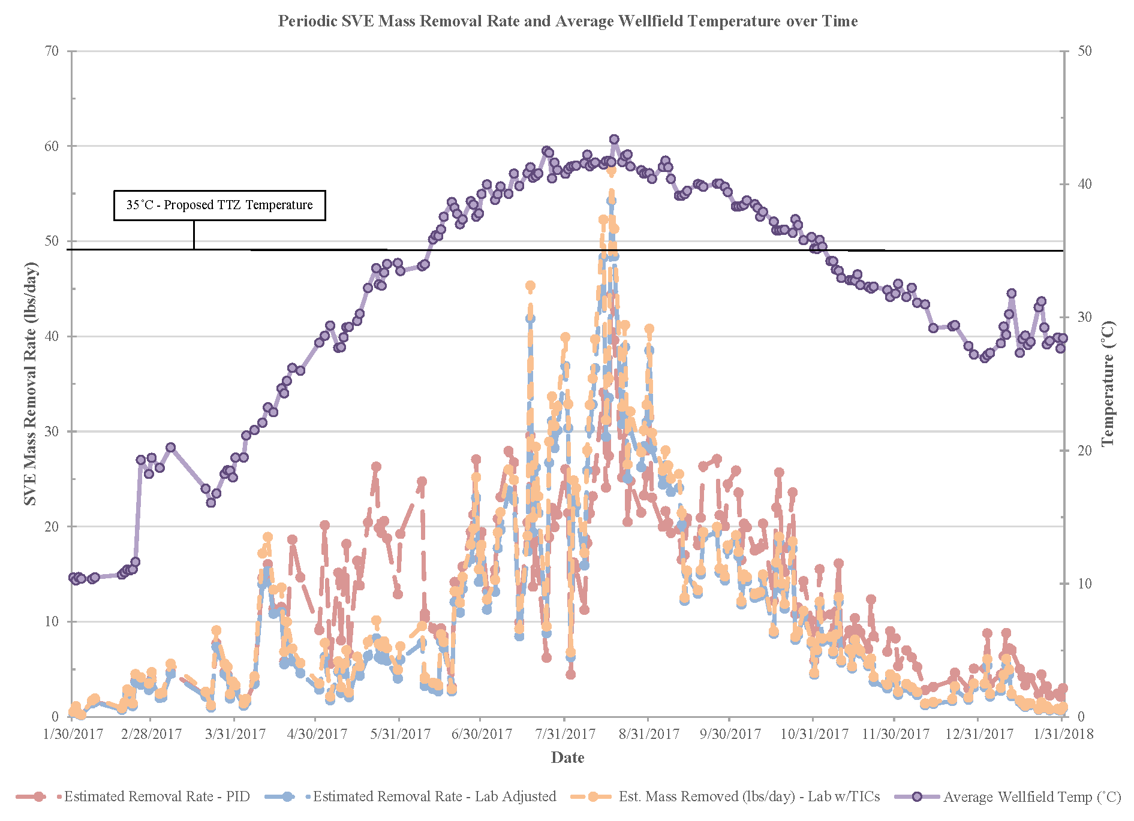
Mass removal

Slide 20
TESVE System Progress – Wellfield SVE Vapor Contours
January 2017 – Pre Startup (Avg. TTZ Temp: 11.09 C)
August 2017 – 7 Operational Months (Avg. TTZ Temp: 42.11 C)
January 2018 – 12 Operational Months (Avg. TTZ Temp: 30.25 C)
Notes:
General notes:
-Contours are generated through Civil3D software
-Although not shown, colors generally represent the following intervals:
0-400 ppm = green
400-1200 ppm = light blue
1200-2000 ppm = blue to dark blue
2000+ = purple
Exception is pre startup contours. Those are on 200 ppm intervals

Slide 21
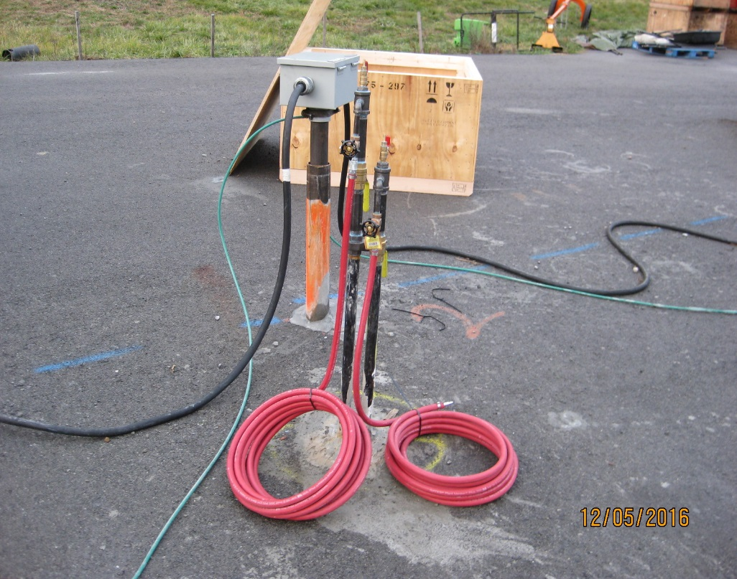
TESVE System Progress – Air Injection
Notes:
Notes
-Shallow/deep AIWs modifications are made following wellfield chemistry data collection. AIWs pressurized if adjacent SVEs/DPEs have lower O2 (<13%)
-All wellfield perimeter AIWs (shallow/deep) on passive air line. Current and historical pressure measurements are zero or slight negative pressure.

Slide 22
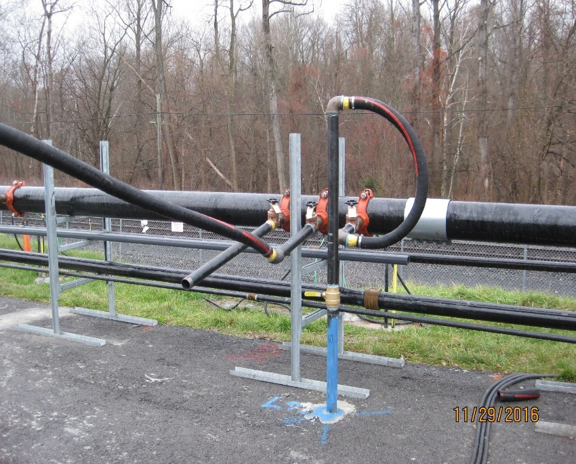
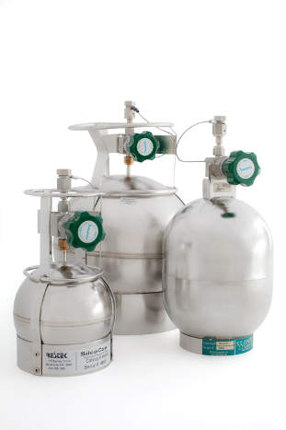
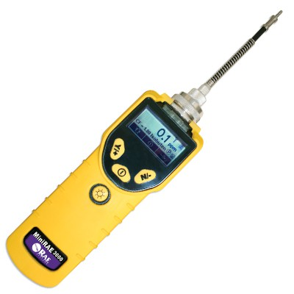
TESVE System Progress – SVE Vapor
Persistent compounds in vapor analytical include: BTEX, carbon disulfide, heptane, styrene, 4-ethyltoluene, 1,2,4 and 1,3,5 trimethylbenzenes, and naphthalene

Slide 23
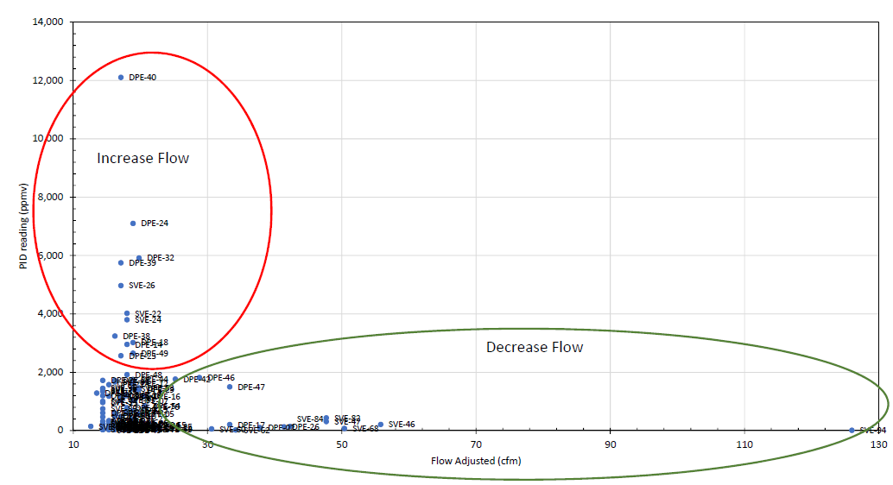
Vapor extraction line screening
PID (ppmv)
Flow (scfm)

Slide 24
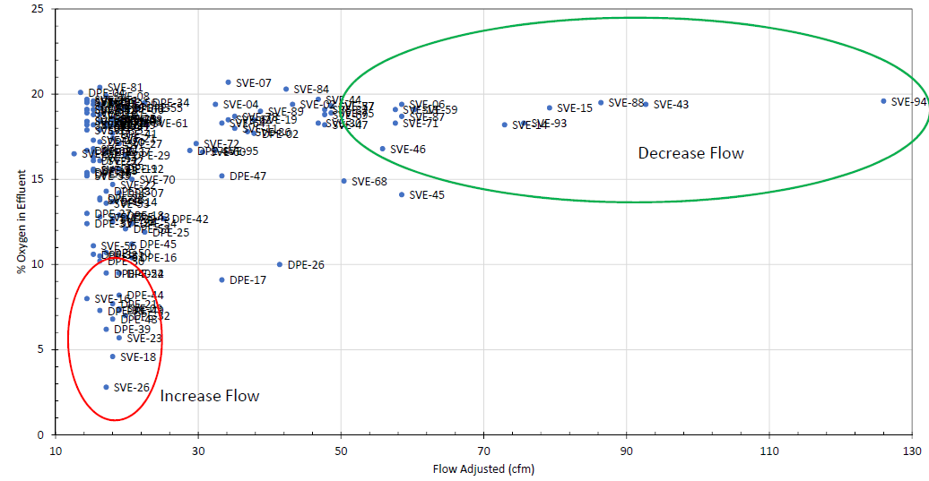
Vapor extraction line screening
Oxygen in vapor (%)
Flow (scfm)

Slide 25
TESVE Enhancement Areas
Notes:
Notes:
Blue areas – above Unrestricted Use SCOs but below Industrial Use SCOs
Red areas – above Industrial Use SCOs (various depths)

Slide 26
Conclusions
Thermally enhanced bio can work
Need degradable COCs
Redox conditions must match
Much easier when it is aerobic
gheron@cascade-env.com
Phone 978-855-3516

