Slide 1
The Three R’s
Refineries, RCRA, Recycling
IPEC
October 30, 2018

Slide 2
Outline
Brief description of DSW rule history
Recent litigation of DSW revisions
Discussion of final rule exclusions
State adoptions
Refinery recycling examples

Slide 3
Definition of Solid Waste Rule
History (1)
1976 - the Resource Conservation and Recovery Act (RCRA) was enacted to create hazardous and non-hazardous waste management programs
1987 – 1994 – various litigation activities ruled on specific wastes being excluded from DSW
1998 – mineral processing/mining industry litigation regarding reclamation of HSMs (TC by-products and sludges)
Materials reused within an ongoing industrial process are neither disposed of nor abandoned
2003 – HSMs used to make fertilizers are not discarded/SW

Slide 4
Definition of Solid Waste Rule
History (2)
2003 – DSW proposed rule excluding HSMs reclaimed in continuous process within same industry – genesis of current rule
2007/2008 - EPA published a proposed/final rule revising the definition of solid waste adding exclusion for recycling of secondary material and generator controlled exclusions and to codify legitimate recycling
2015 - 2008 rule was re-visited replacing transfer-based recycling with verified recycler exclusion and strengthened the definition of legitimate recycling
2018 – Litigation further revised 2015 Rule
Notes:
2008 rule did not require mandatory adoption bc it was less stringent than the existing rules
4 “factors” to be considered to support a “legitimate recycling” claim to exclude from DSW
Useful contribution
Produces valuable commodity
Is managed as a product
Consider whether it is comparable to a “standard” product

Slide 5
Recent Litigation (2017-2018)
D.C. Circuit Court of Appeals
Vacated verified recycler exclusion and reinstated the transfer based exclusion from 2008
Upheld containment and emergency preparedness requirements
Vacated Factor 4 (product of recycling must be comparable to a legitimate product or intermediate)
Reinstated 2008 version of Factor 4 (must be “considered”)
Effective Immediately!

Slide 6
Verified Recycler
RCRA Permitted reclamation Facility
Verified recycler of HSM Qualifications
Demonstrate legitimacy
FA for closure
No formal enforcement in 3 years
Proper equipment and training
Handing procedures
ERP
Transfer-based Exclusion
No RCRA Permit required for reclamation facility
Reasonable efforts to ensure “legitimate” recycling
“Contained” standard
Emergency Preparedness

Slide 7
Transfer-based Exclusion (TBE) - Specifics
40 CFR 261.4(a)(24)
261.4(a)(vi)(D) specifies “…must be contained”
Both generator and 3rd party recycler are subject to revised “containment” standard in 260.10
K171/172 spent catalyst being reclaimed is again eligible for this exclusion
40 CFR 261.4(a)(25) reinstated
Allows exporting of HSM for reclamation
Notes:
Under verified recycler exclusion, K171/172 would be excluded, bc of potential self-heating properties
EPA did not agree that these catalysts posed a risk of fire; and performance-based containment standard that would apply to transfer-based exclusion, would be sufficient to address potential fire risks

Slide 8
Legitimacy Factors
The hazardous secondary material provides a useful contribution to process
Produces a valuable product or intermediate
Is managed as a valuable commodity
CONSIDER whether the product is comparable to a “legitimate” product
does not (i) Contain significant concentrations of hazardous constituents not found in analogous products (App VIII) or (ii) If it does contain App VIII constituents, they are not significantly elevated from those found in analogous products, or (iii) Exhibit a hazardous characteristic
Notes:
Factor 4: Vacated and reverted to 2008 version which only needs to be “considered”
does not (i) Contain significant concentrations of any hazardous constituents found in appendix VIII of part 261 that are not found in analogous products; or (ii) Contain concentrations of hazardous constituents found in appendix VIII of part 261 at levels that are significantly elevated from those found in analogous products, or (iii) Exhibit a hazardous characteristic (as defined in part 261 subpart C) that analogous products do not exhibit.” [§260.43(b)(1)]

Slide 9
Generator Controlled Exclusion
Remained from the 2008 rule and strengthened:
Definition of “Contained” HSM (260.10)
Making notification prior to operation and every year
Record keeping
Demonstration of legitimacy
Additional emergency preparedness and response requirements (261 subpart M)
Notes:
260.10
Contained means held in a unit (including a land-based unit as defined in this subpart) that meets the following criteria:
(1) The unit is in good condition, with no leaks or other continuing or intermittent unpermitted releases of the hazardous secondary materials to the environment, and is designed, as appropriate for the hazardous secondary materials, to prevent releases of hazardous secondary materials to the environment. Unpermitted releases are releases that are not covered by a permit (such as a permit to discharge to water or air) and may include, but are not limited to, releases through surface transport by precipitation runoff, releases to soil and groundwater, wind-blown dust, fugitive air emissions, and catastrophic unit failures;
(2) The unit is properly labeled or otherwise has a system (such as a log) to immediately identify the hazardous secondary materials in the unit; and
(3) The unit holds hazardous secondary materials that are compatible with other hazardous secondary materials placed in the unit and is compatible with the materials used to construct the unit and addresses any potential risks of fires or explosions.
(4) Hazardous secondary materials in units that meet the applicable requirements of40 CFR parts 264 or 265 are presumptively contained.

Slide 10
Speculative Accumulation Prohibition
Documentation must be maintained to show 75% turnover on a calendar year basis
Label containers similar to 90 day storage; or
Develop inventory logs to track turnover.
Scrap metal and used oil are not subject to speculative accumulation requirements
Managed as a valuable product.

Slide 11
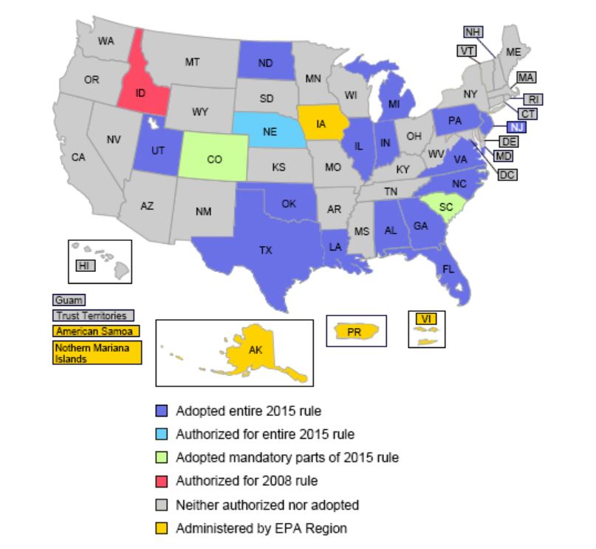
Where is it in effect?
https://www.epa.gov/hw/where-2018-definition-solid-waste-rule-effect

Slide 12
What Do States Do Now?
State authorized programs are required to be at least as stringent as federal program
Legitimate recycling definition (260.43) – states must adopt a definition at least as stringent as 2018 version
States not required to adopt Transfer-based exclusion because it is less stringent than verified recycler
Similarly, the generator-controlled exclusion (40 CFR section 261.4(a)(23), and the remanufacturing exclusion (40 CFR section 261.4(a)(27)) are optional because they are less stringent than the federal regulations
State programs that adopted 2015 will be broader in scope than the federal program
Notes:
States that did not promulgate similar rules—States that have RCRA authorization but did not adopt the 2015 verified recycler exclusion (and therefore were not authorized for the exclusion) are not required to adopt or become authorized for the reinstated TBE, because it is less stringent than the pre-existing Subtitle C hazardous waste regulations. However, states that have RCRA authorization but have not adopted the 2015 version of §260.43 are required to adopt and become authorized for a definition of legitimate recycling that is equivalent to, and at least as stringent as, the §260.43 definition promulgated in the May 30, 2018 revisions.
States that adopted similar rules but are not yet authorized for them—For states that have adopted rules similar to the 2015 verified recycler exclusion and the 2015 definition of legitimate recycling, but have not yet been authorized for them, the authorization status that was established prior to the adoption of the state counterpart rules remains in effect. Deletion of certain 2015 federal regulations and subsequent reinstatement of the 2008 federal regulations (as discussed above) will result in state provisions that are broader in scope than the federal program as it pertains to those specific provisions.
States that adopted similar rules and have been authorized for them—For states that have previously been authorized for rules similar to the 2015 verified recycler exclusion and the 2015 definition of legitimate recycling, and have been authorized for them, the effect of the federal deletions/reinstatements (as discussed above) is that those previously-authorized state provisions will be considered broader in scope than the federal program as it pertains to those specific provisions.

Slide 13
Refinery Recycling Scenarios
Material | Citation | Recycling Activity | New DSW
Oil-bearing HSMs inserted into refining process | 261.4(a)(12)(i) – not a SW | API sludge, DAF float, other oils materials sent to crude unit via slop oil system and/or tankage | Comply with speculative accumulation requirements
HW into coker | 42 USC 6924(q)(2) | Coke production | NA - Not a RCRA waste-derived product
Other oily residuals | 261.4(a)(12)(ii) – not a SW | Recovered oil inserted into refining process | Comply with speculative accumulation requirements
Used oil into refining process | 261.6(a)(4) - SW and HW even though recycled | Regulated under Part 279 | No speculative accumulation reqs apply

Slide 14
Refinery Recycling Scenarios
Material | Citation | Recycling Activity | New DSW
Centrifuge cake and other residuals (TC/ listed HWs) | 261.2(c)(2)(i) – SW and HW even though recycled | Sent off site for energy recovery (cement kilns) | Not excluded so no speculative accumulation requirements. >5,000 BTUs/lb preferred
Spent caustics | 261.4(a)(19) | Sent off site to produce product | Comply with speculative accumulation requirements
Sour water, spent KOH, spent amines | 261.4(c) – SW/HW but not regulated while “in process’ | Closed-loop recycling within process units | No speculative accumulation requirements

Slide 15
Refinery Recycling Scenarios
Material | Citation | Recycling Activity | New DSW
Spent K171/172 catalyst | Listed HWs regulated until they reach reclamation facility | Regenerated for reuse or reclaimed | Comply with speculative accumulation requirements
Catalyst inert support media | 261.3(c)(2)(ii)(E) – SW but not HW unless TC | Reuse or scrapping | No speculative accumulation requirements
Losses of CCPs or K-wastes to sewer upstream of API separator | 261.3(a)(2)(iv)(C) and (D) – SW but WW is not HW | Hydrocarbons are recovered through WWTP | No speculative accumulation requirements

Slide 16
What else can we do to minimize waste?
F037 – don’t use the sewer system for “disposal” of washwater, street sweepings, general cleanup
Asphalt – install a closed loop sampling system
Lab Inventory Control – manage your “off-spec” chemicals through careful inventory control
Carefully use “contained in/out” determinations for excavated soil from spills and leaks
GET INVOLVED!
Environmental should be part of all planning for projects to review waste generation activities.

Slide 17
Catriona V. Smith
P: 512.230.7597
E: cvsmith@trcsolutions.com
www.trcsolutions.com

