Slide 1
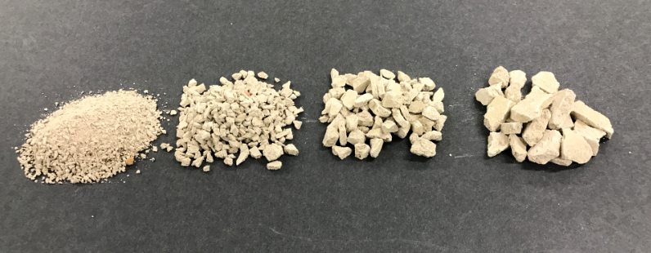
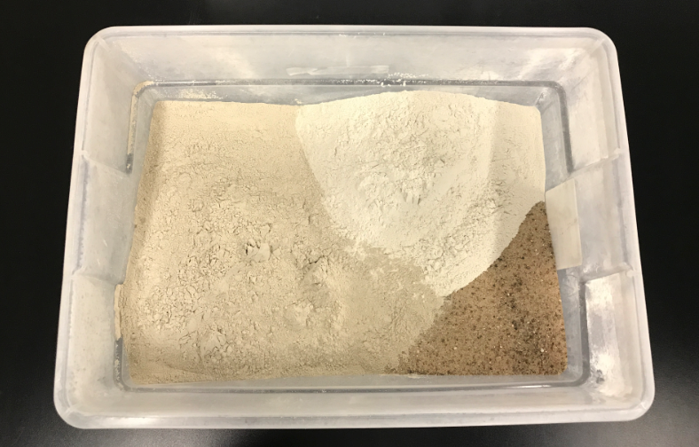
Techniques and Evaluation for the Creation of Simulated Drill Cuttings for Environmental Studies
Patrick Tyczynski
M-I SWACO, a Schlumberger company

Slide 2
Simulated Drill Cuttings - Media to incorporate into environmental studies for drilling fluids in the laboratory
Bioremediation
TCLP
WBM Tox Studies
Consistency
Ecological Relevance
Practicality
History | Mixing | Drying | Sizing | Uses

Slide 3
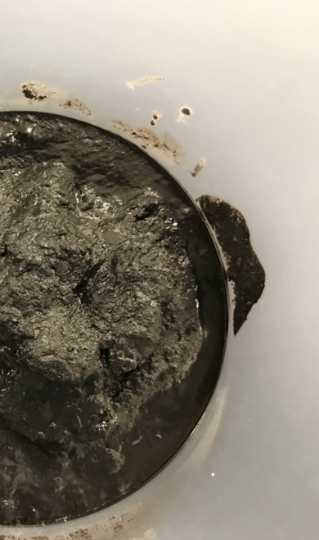
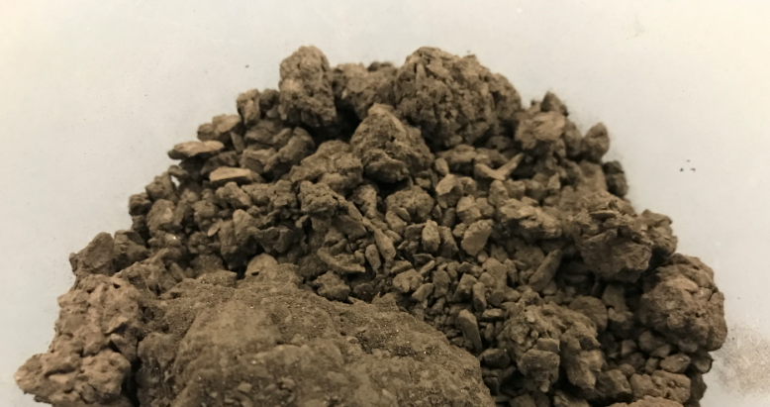
Simulated Drill Cuttings - Media to incorporate into environmental studies for drilling fluids in the laboratory
Consistency
History | Mixing | Drying | Sizing | Uses

Slide 4
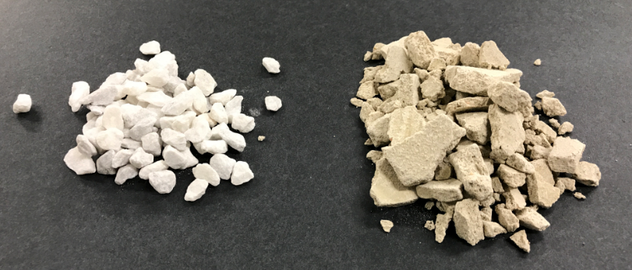
Simulated Drill Cuttings - Media to incorporate into environmental studies for drilling fluids in the laboratory
Consistency
Uncontaminated
Non toxic
Support plant growth
Practical
History | Mixing | Drying | Sizing | Uses

Slide 5
Previously Published Examples of simulated cuttings Focus on limestone, clay, and sand
SPE-156637
AADE 01-NC-HO-11
Recipe
Technique
Used as a test media for toxicity and remediation
History | Mixing | Drying | Sizing | Uses

Slide 6
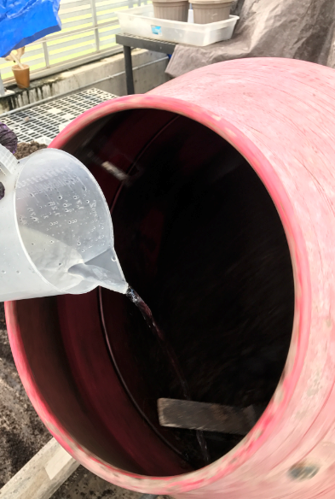
Mixing:
Cement Mixer
Large Batch
History | Mixing | Drying | Sizing | Uses

Slide 7
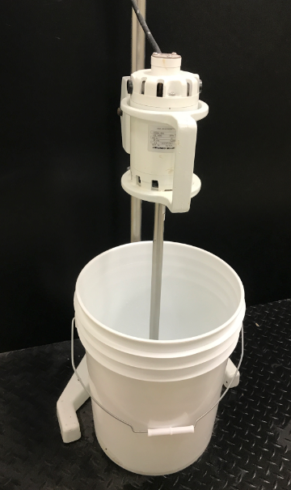
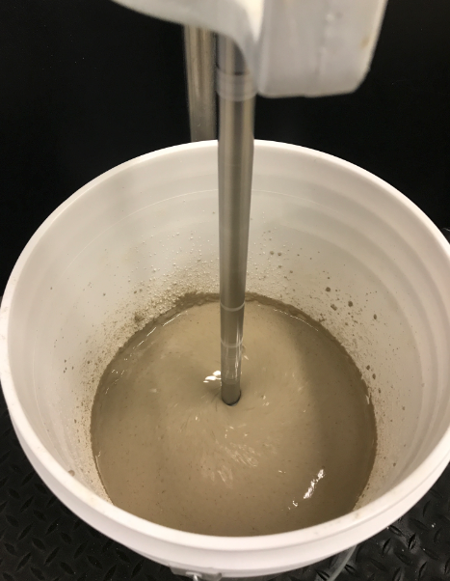
Mixing:
Floor Mixer
Varied Batch
History | Mixing | Drying | Sizing | Uses

Slide 8
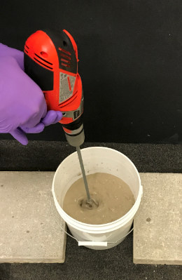
Mixing:
Power Drill
Varied Batch
History | Mixing | Drying | Sizing | Uses

Slide 9
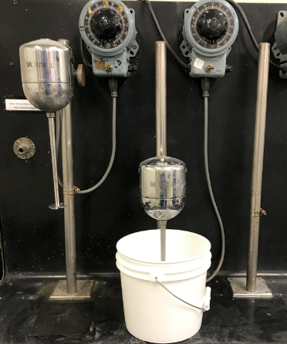
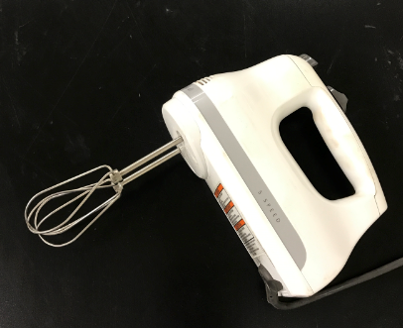
Mixing:
Bench and Handheld
Small Batch
History | Mixing | Drying | Sizing | Uses

Slide 10
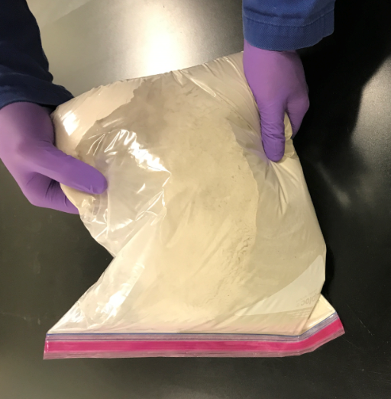
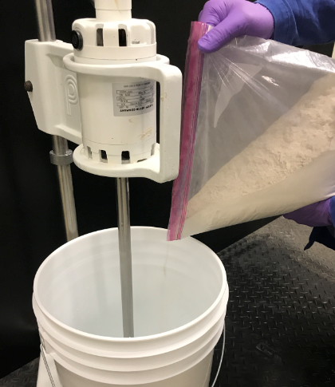
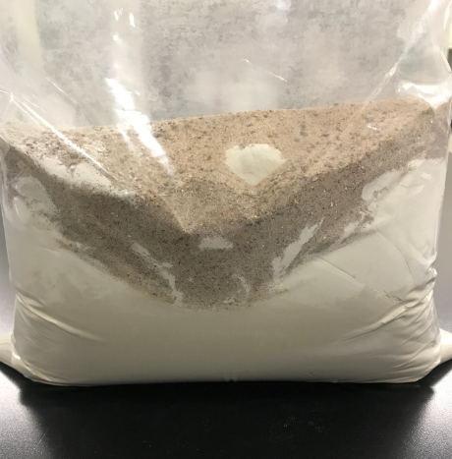
Mixing:
Bagging
History | Mixing | Drying | Sizing | Uses

Slide 11
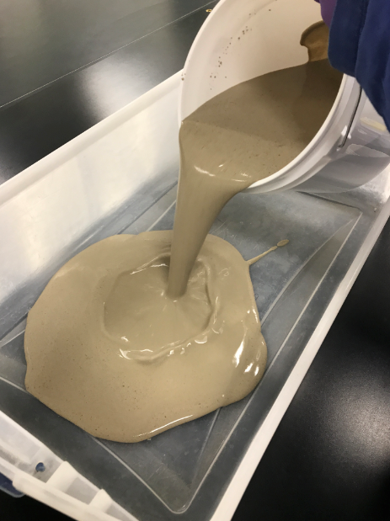
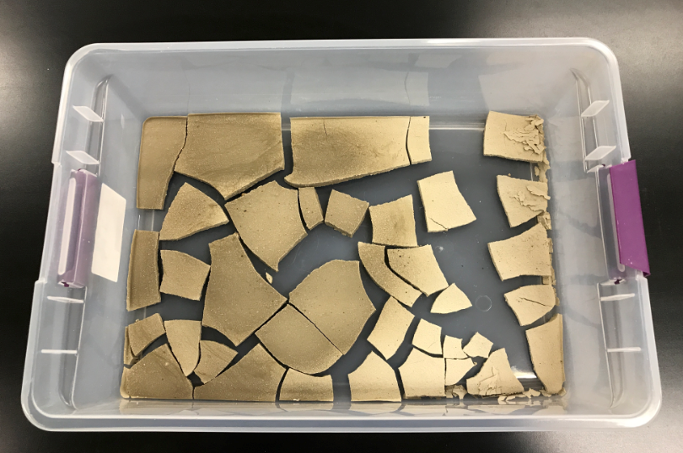
Drying:
Bins
History | Mixing | Drying | Sizing | Uses

Slide 12
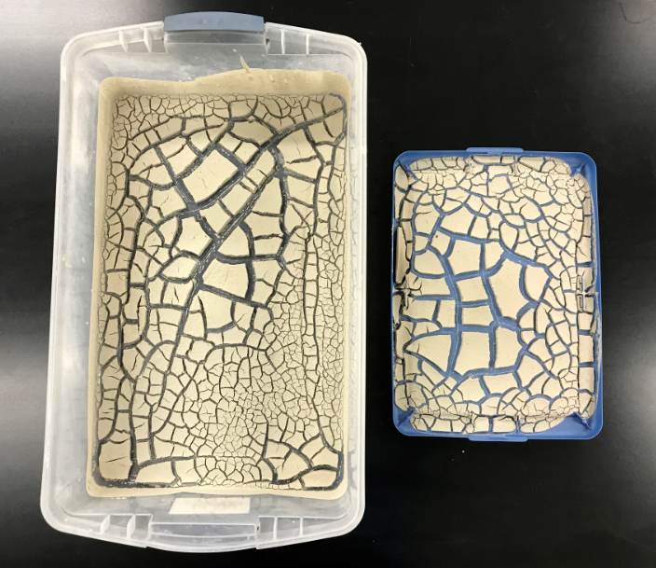
Drying:
Bins
History | Mixing | Drying | Sizing | Uses

Slide 13
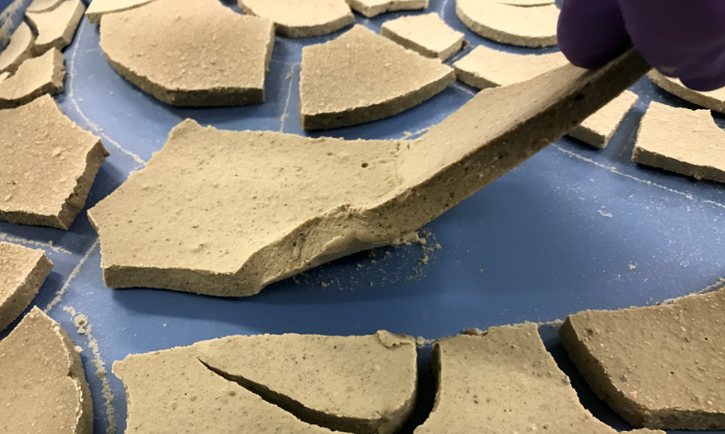
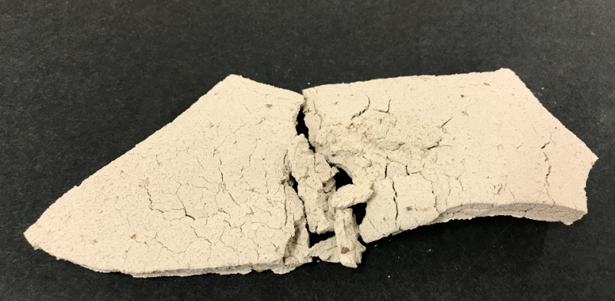
Drying:
Oven
History | Mixing | Drying | Sizing | Uses

Slide 14
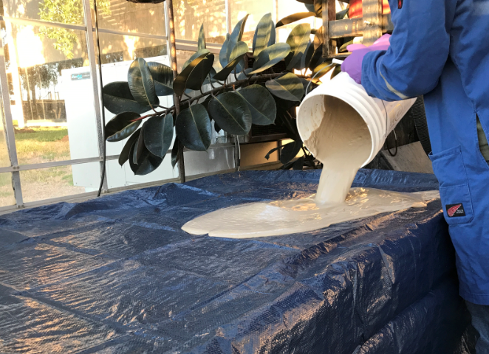
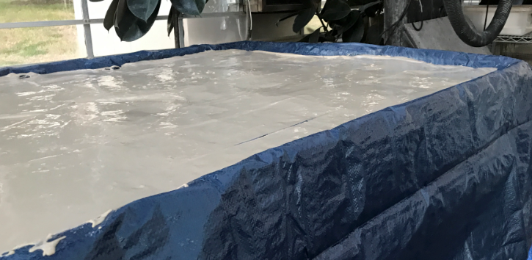
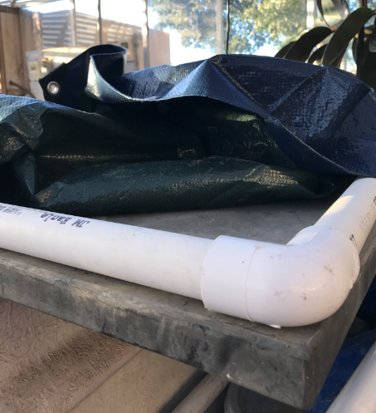
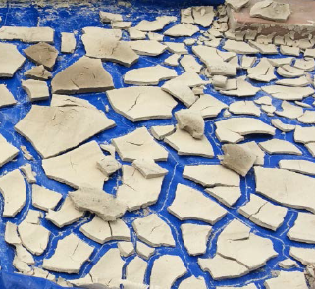
Drying:
Tarp
History | Mixing | Drying | Sizing | Uses

Slide 15
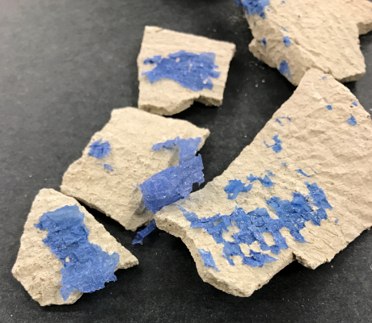
Drying:
Tarp
History | Mixing | Drying | Sizing | Uses

Slide 16
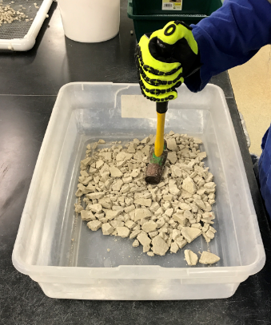
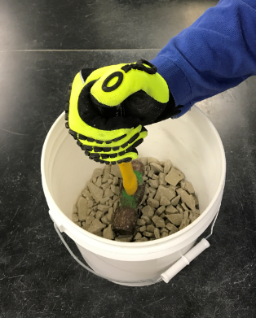
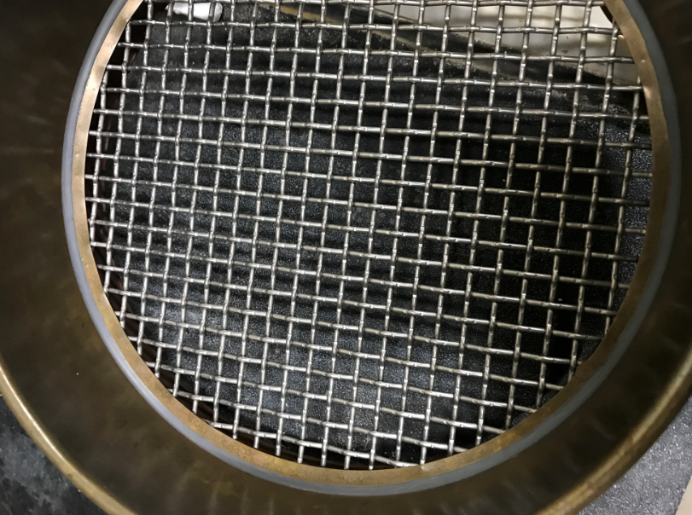
Sizing:
Bins and Screen
History | Mixing | Drying | Sizing | Uses

Slide 17
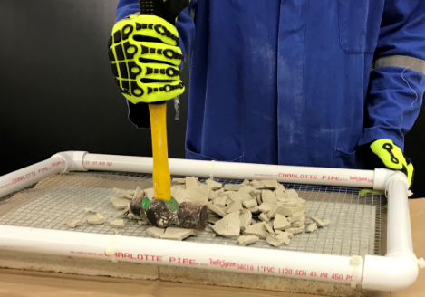
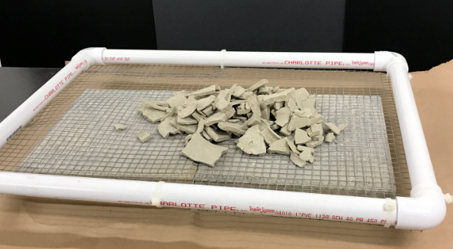
Sizing:
Bins and Screen
History | Mixing | Drying | Sizing | Uses

Slide 18
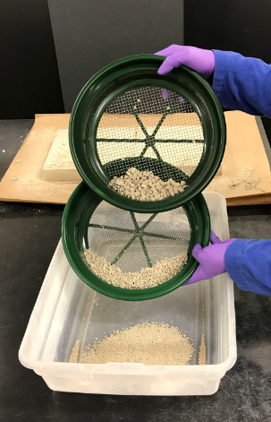
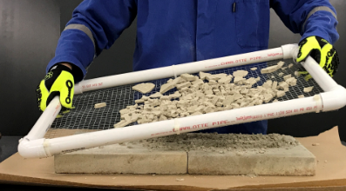
Sizing:
Bins and Screen
History | Mixing | Drying | Sizing | Uses

Slide 19
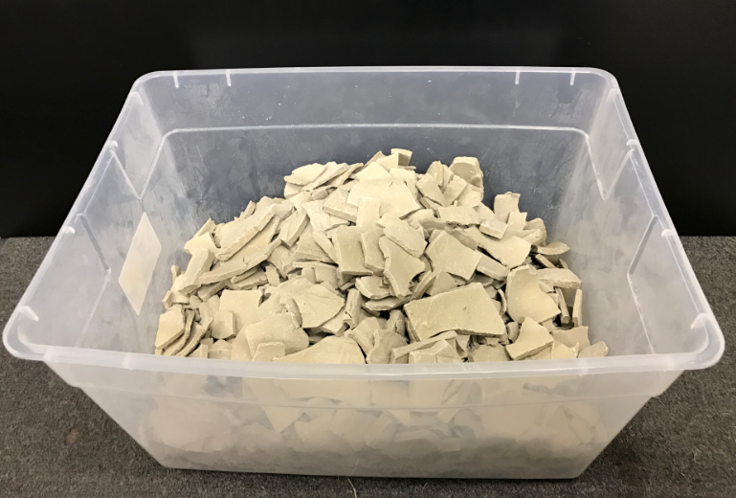
Sizing:
Bins and Screen
History | Mixing | Drying | Sizing | Uses

Slide 20
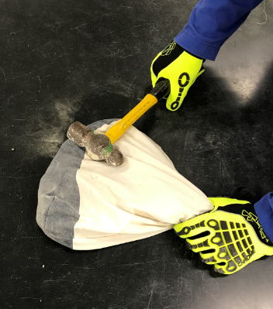
Sizing:
Small Batch
History | Mixing | Drying | Sizing | Uses

Slide 21
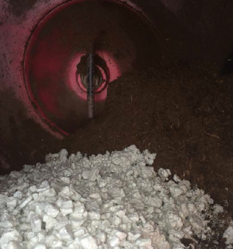
Uses:
Bioremediation
History | Mixing | Drying | Sizing | Uses

Slide 22
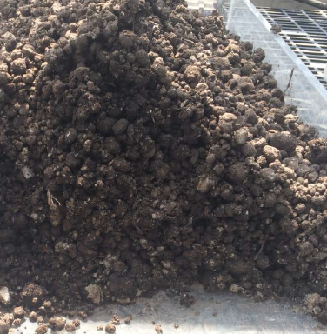
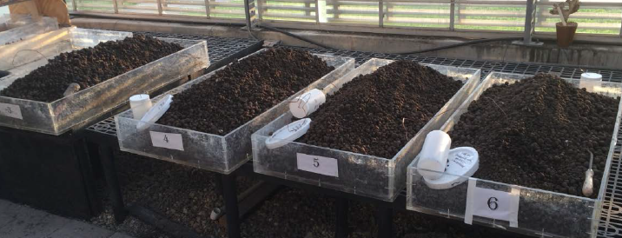
Uses:
Bioremediation
History | Mixing | Drying | Sizing | Uses

Slide 23
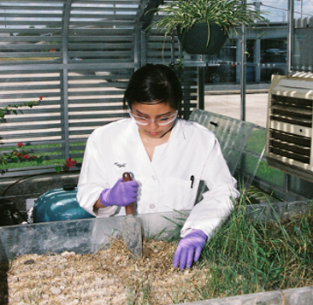
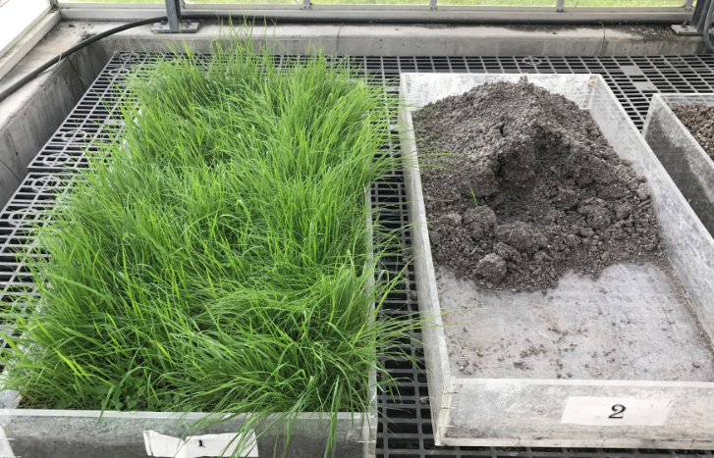
Uses:
Plant Growth
History | Mixing | Drying | Sizing | Uses

Slide 24
Uses:
Customize
Particle Size
Minerology
Organic Content
History | Mixing | Drying | Sizing | Uses

