Slide 1
Synthesis of iron nanoparticles in graphitized carbon matrices using cellulose biochar as a carbon support for removal of heavy metals from aqueous solutions
by
Sai Teja Neeli
Hema Ramsurn
Russell school of Chemical Engineering
The University of Tulsa
Thursday, November 1, 2018
Nov 1, 2018

Slide 2
Why should we care about heavy metals?
Heavy metals are any element in the d-block of periodic table
Exposure to heavy metals is known to be toxic to both human and living forms
Non-biodegradable and tend to accumulate overtime causing damages to the kidney, liver and reproductive system
US EPA enforced laws to regulate the maximum level of heavy metals in drinking water
Among the many technologies available, adsorption has been proven to be economical and efficient for removal of heavy metals

Slide 3
Research Objectives
Synthesize carbon encapsulated iron nanoparticles (CEINP) using biochar from cellulose as the carbon support
Characterize the as synthesized CEINP using analytical techniques like XRD, SEM, HRTEM, BET surface area analyzer
Utilize these magnetic CEINP for the removal of Cr (VI), Cu (II) & As (V) from aqueous solutions
Determine the concentrations of heavy metals using Inductively Coupled Plasma Optical Emission Spectroscopy (ICP-OES)
Investigate the effect of pH on the adsorption process of selected heavy metals
Notes:
Based on the characterization results a detailed reaction mechanism was postulated for the synthesis of CEINP using the biochar from each of the biomass model compounds i.e. lignin, cellulose and hemicellulose as the carbon support.

Slide 4
Synthesis of CEINP
Cellulose
(biomass model compound)
HTC
(300 ºC)
30 min
Biochar
Nitric acid reflux
Pretreated biochar
Fe(NO₃)₃ solution and dried at 110 ºC for 7 days
Iron Impregnated Biochar
1000 ºC, 3 °C/min
N₂ flow, 2 hr
Carbon encapsulated iron nanoparticles (CEINP) *
* Neeli, S. T., & Ramsurn, H. (2018). Synthesis and formation mechanism of iron nanoparticles in graphitized carbon matrix using biochar from biomass model compounds as a support. Carbon, 134, 480-490.
Notes:
This slide outlines the steps we have incorporated in synthesis of catalytic iron nanoparticles using the biochar of biomass model compounds as the carbon support.
As this is the first time we are impregnating the biochar with iron we wanted to understand the effect of drying on the impregnation. We removed the sample from each day, which was further thermal treated and characterized.

Slide 5
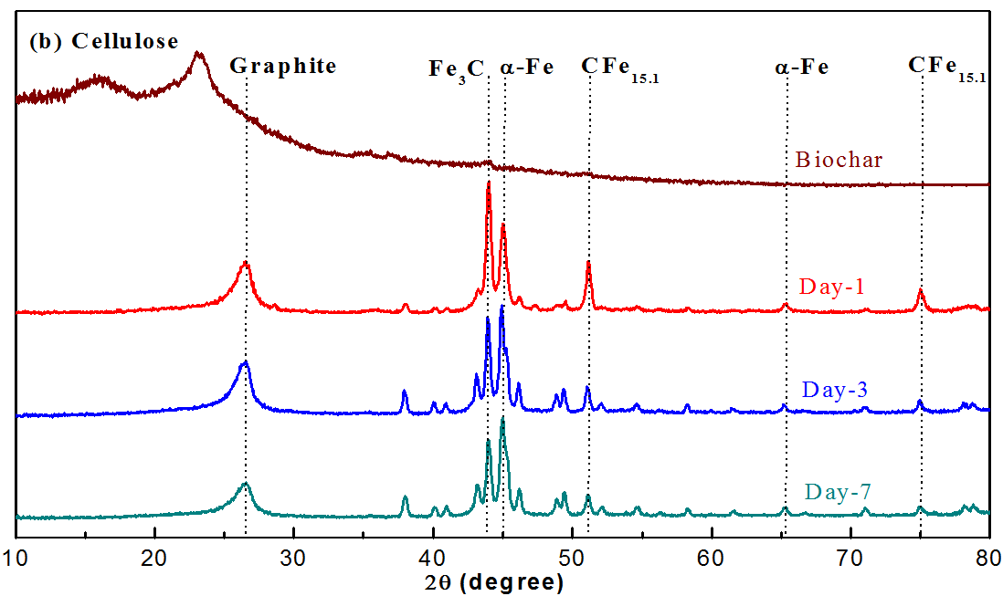
XRD Analysis: Cellulose biochar

Slide 6
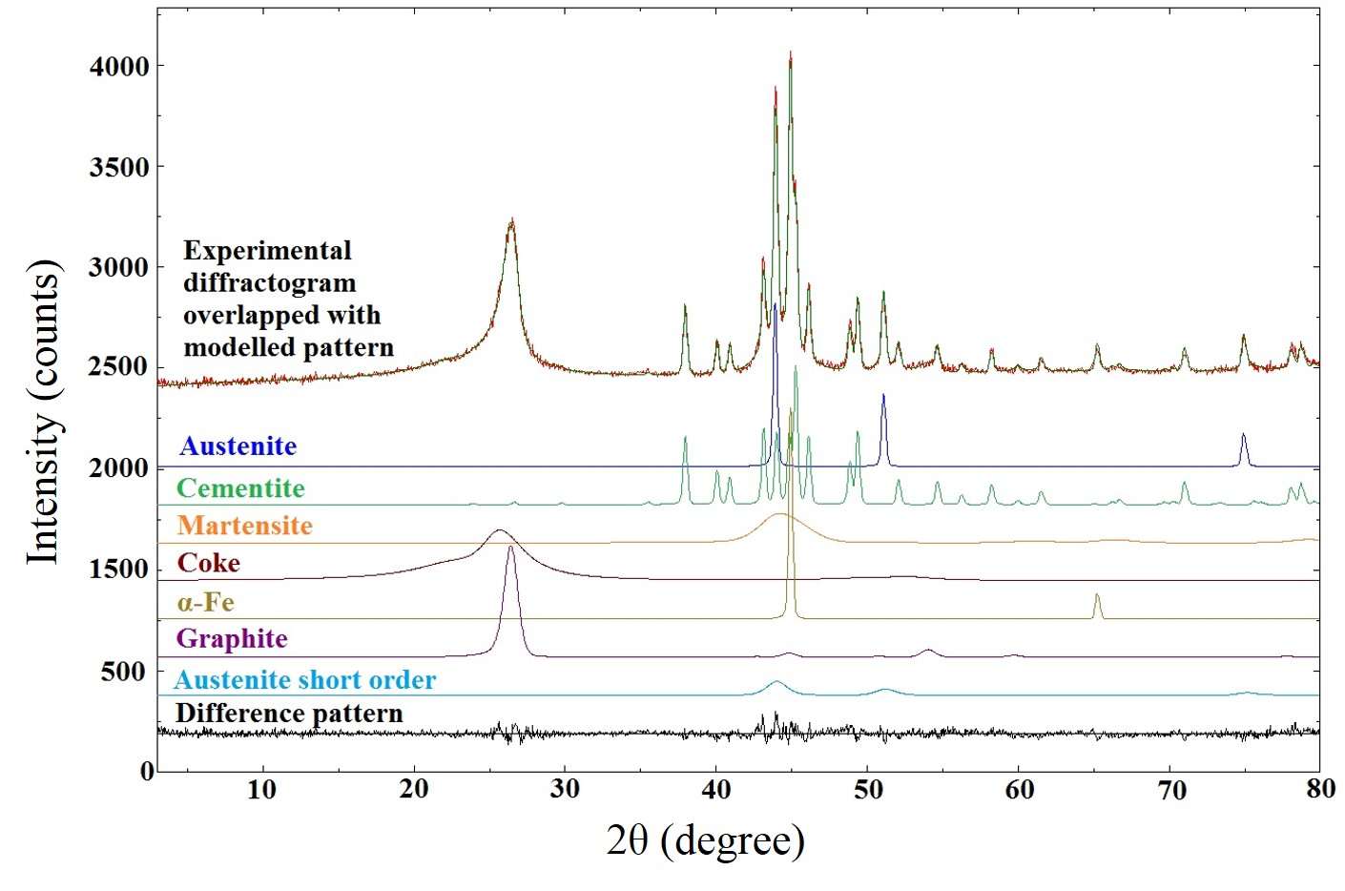
Rietveld Analysis
(CFe_{15.1})
(Fe₃C)
(CFe_{21.2})
Notes:
Rietveld analysis is a powerful profile fitting/modeling tool which can be used to detect the unaccounted amorphous phases as they are typically asymmetrical peaks located in the XRD diffractogram.

Slide 7
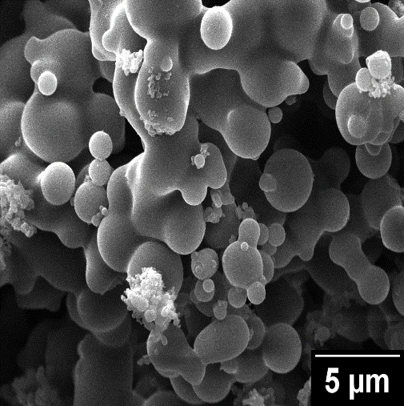
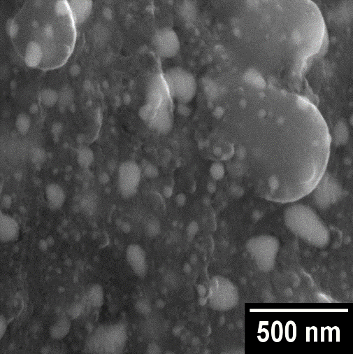
Scanning Electron Microscopy (SEM)
Cellulose biochar
CEINP
Notes:
Scanning electron microscopy was used to understand the surface morphology, crystal shape and size of the biochar and its supported iron nanoparticles.
Lignin biochar formed after hydrothermal carbonization has a rough surface, few vesciles adhered to the surface and pores formed due to the release of volatiles.
cellulose biochar has very low porosity while hemicellulose biochar had islands of spherical particles.

Slide 8
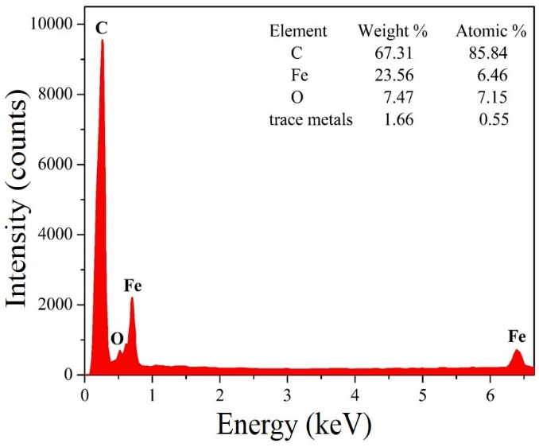
SEM-Energy Dispersive X-Ray Spectroscopy (EDS)
Point analysis on different iron particles proves that the core is mainly composed of carbon and iron
From XRD, core is a mixture of iron and iron carbide phases
Notes:
The elemental composition of the iron cores was obtained using Energy dispersive spectrometer (EDS).

Slide 9
High Resolution Transmission Electron Microscopy (HRTEM)
Core-shell structure
Dark quasi-spherical cores surrounded by concentric shells of porous material
Notes:
Further morphological and structural details of the CEINP were investigated by TEM.

Slide 10
Surface Area Analysis
Sample | Surface area (m² g⁻¹) | Type of porosity
Refluxed cellulose biochar before impregnation | 13.2 | -
Annealed cellulose biochar at 1000 ºC without Fe | 210 | Micro-porous
Day-3 CEINP from cellulose biochar | 183 | Meso-porous
Notes:
The fundamental characteristic of a catalyst particle is the total surface area and pore structure, which are likely to favor uniform dispersion of metal particles and stabilize these against sintering/agglomeration.
When the biochars from the model compounds were annealed at a temperature of 1000 ºC, most of the volatiles were released from the biochar matrix which facilitated the enlargement of the existing pores and the generation of new ones.
As a result, surface area and pore volume of the annealed biochar without Fe from all the three model compounds increased significantly exhibited a type I physisorption isotherm indicative for a microporous material. In comparison, CEINP from cellulose and hemicellulose biochars showed characteristic type IV isotherms which are typical for mesoporous materials while type I isotherm was still observed in CEINP from lignin biochar indicating microporous nature.

Slide 11
Postulated Mechanism
H₂O
CO
CO₂
Carbon matrix
1000 °C
Carbon matrix
1000 °C
Carbon matrix
1000 °C
Cooling
Carbon matrix
Carbon matrix
Graphite shell

Slide 12
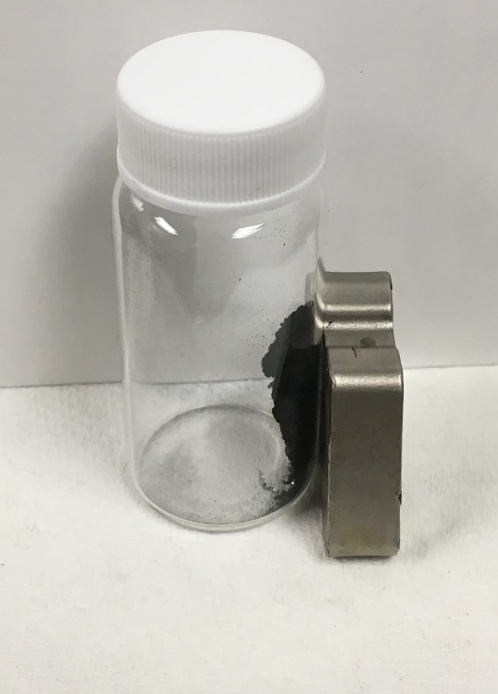
CEINP – adsorbent for heavy metals
Heavy metals tested: Cr (VI), Cu (II) and As (V)
Operating parameters:
Concentration: 25 ppm
Mass of adsorbent/CEINP: 25 mg
Equilibration time: 14 hrs
Temperature: ambient
pH: 3 to 10
Magnetic nanoparticles can be easily removed under external magnetic field
Magnet

Slide 13
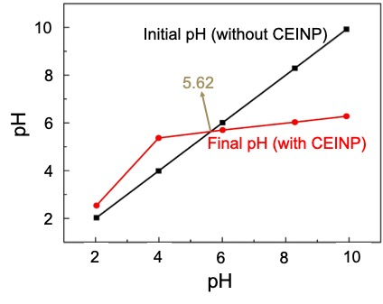
Point of zero charge (pH_{zpc})
pH_{zpc} – pH value at which the surface of adsorbent is electrically neutral.
pH< pH_{zpc} : adsorbent surface is positively charged
pH> pH_{zpc} : adsorbent surface is negatively charged

Slide 14
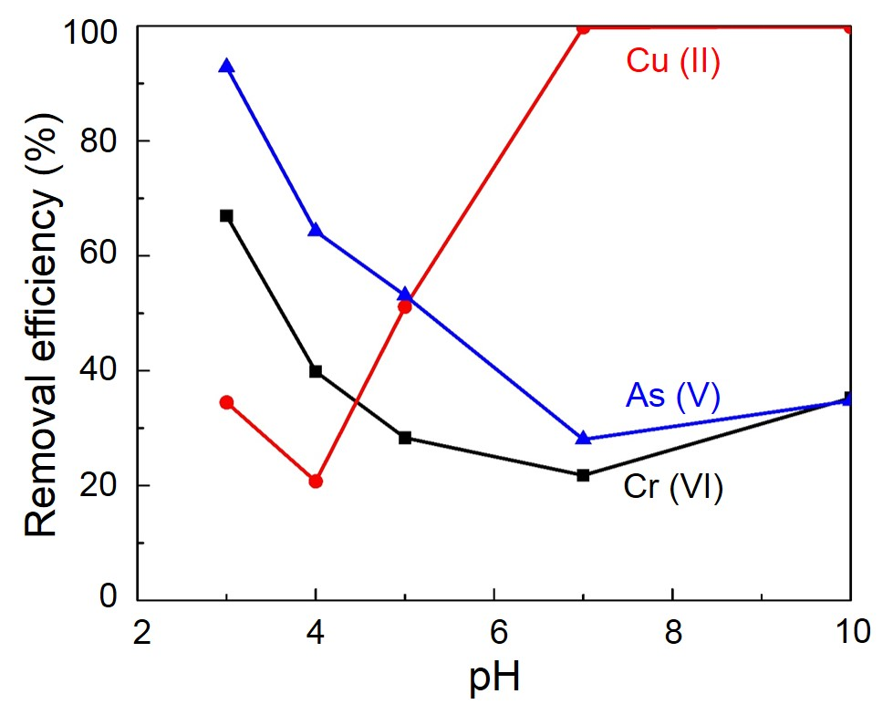
Effect of pH on Cr (VI), Cu (II) & As (V)
Higher removal efficiencies were obtained at pH: 3 for Cr (VI) and As (V) while at pH: 7 Cu (II) was removed completely
Cellulose biochar alone without Fe annealed at 1000 ºC was less efficient (<20% efficiency) in removing Cr (VI) and As (V)
Notes:
Hydrogen chromate
Chromate
Dihydrogen arsenate

Slide 15
Conclusions
Carbon encapsulated iron nanoparticles containing magnetic iron species were synthesized using cellulose biochar as the carbon support
XRD results along with Rietveld analysis showed the presence of (bcc) α-Fe, orthorhombic Fe₃C, CFe_{15.1}, CFe_{21.2} as the major phases in the iron core of CEINP
CEINP showed greatest affinity towards Cu (II) with nearly 100% removal efficiency
Acidic medium favored higher removal efficiencies for Cr (VI) and
As (V)

Slide 16
Future Work
Optimize experimental parameters:
Adsorbent dosage
Heavy metal concentration
Contact time
Explore potential reusability of these adsorbents after heavy metal treatment
Fit experimental data using equilibrium isotherm models (Langmuir, Freundlich and Temkin models) to better understand the adsorption mechanisms
Use characterization techniques such as SEM-EDS, XPS on the CEINP after adsorption to investigate the surface composition and oxidation states of the elements

Slide 17
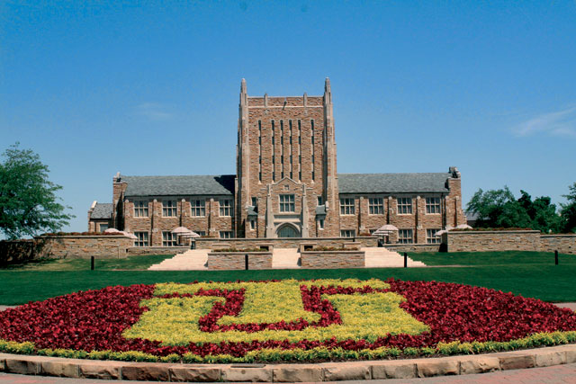
Acknowledgements
Dr. Hema Ramsurn
Group Colleagues :
Dr. Winton Cornell
(XRD analysis)
Rahul
Anand
Nick Biasetti
Allan Kallapura
Russell school of Chemical Engineering,
The University of Tulsa

Slide 18
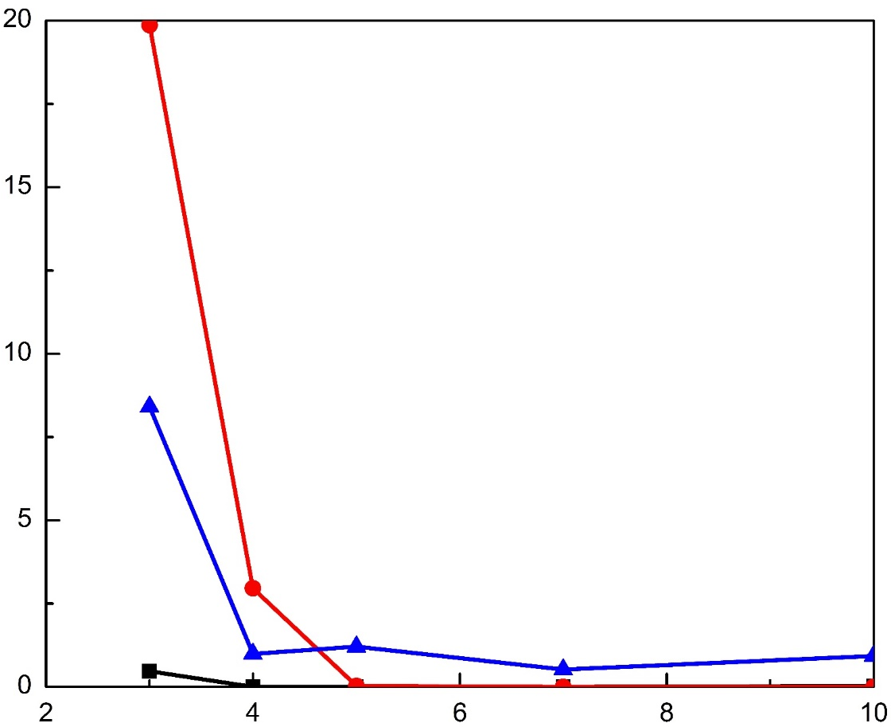
Iron leaching during adsorption of heavy metals
20
Iron in Cu (II) solution
Iron in As (V) solution
15
Iron in Cr (VI) solution
10
Concentration (ppm)
5
0
2
4
6
8
10
pH

Slide 19
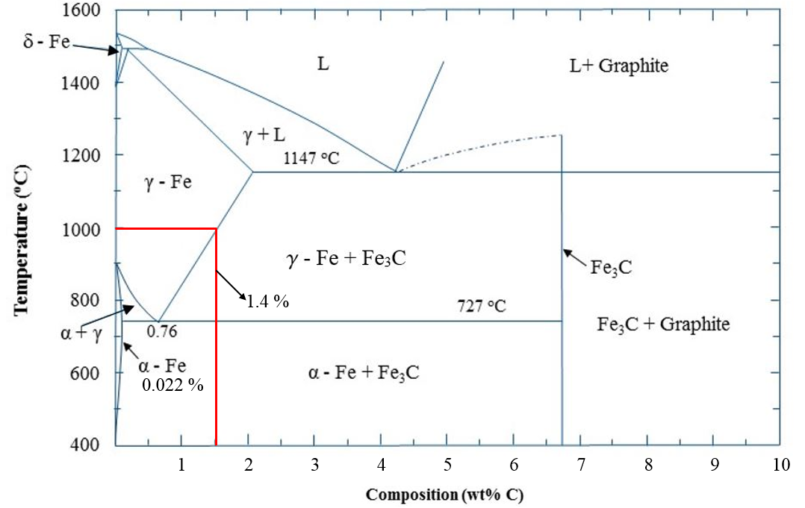
Iron- Carbon Phase Diagram
Notes:
Cementite phase/Fe3C was absent in the CEINP from lignin biochar which can be attributed to the formation of α-Fe phase from α-Fe during the rapid cooling process.

Slide 20
SUBCRITICAL WATER
2 H₂O(l) H₃O⁺(aq) + OH⁻ (aq)
K_{w} = [H₃O⁺][OH⁻ ]
pK_{w} = pH + pOH
The decrease in dielectric constant (ε) increases the solubility of hydrophobic
organic compounds
The ionic product of water (K_{w} ) is high in subcritical range
The high levels of H⁺ and OH⁻ implies that acid- or base- catalyzed reactions,
such as biomass hydrolysis, are accelerated

Slide 21
HYDROTHERMAL CARBONIZATION
Gases
Lignin
250 – 300 °C
Water
Biochar (Solid)
Cellulose
Liquid
Hemicellulose
HTC – biomass to carbon-rich solid product
Biochar from HTC is rich in oxygen and hydrogen functional groups

Slide 22
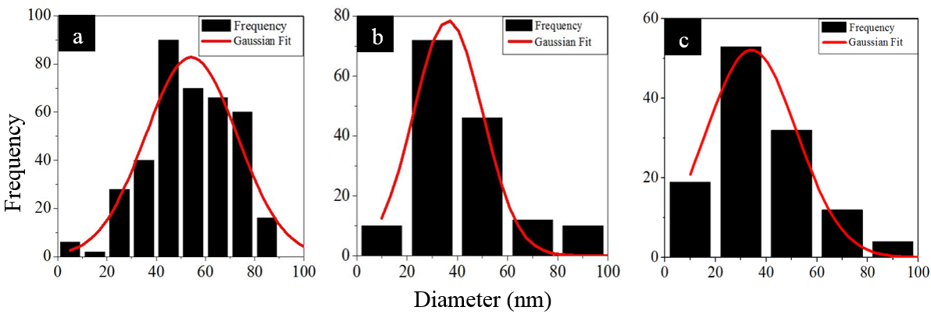
Particle size distribution
Lignin
Cellulose
Hemicellulose
Mean particle size
CEINP from lignin biochar: 54.3±1.89 nm
CEINP from cellulose biochar: 36.34±1.34 nm
CEINP from hemicellulose biochar: 36.34±1.71 nm

Slide 23
Ash content in biochar from different model compounds
Sample | Ash content (%)
 | before reflux | after reflux
lignin biochar | 9.2 | 0.4
cellulose biochar | 0.15 | 0
hemicellulose biochar | 0.2 | 0.09

Slide 24
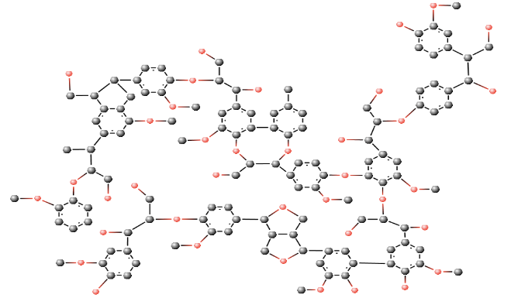
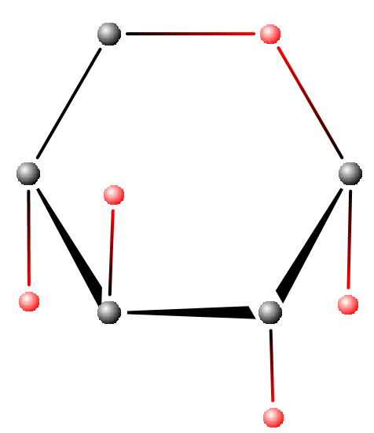
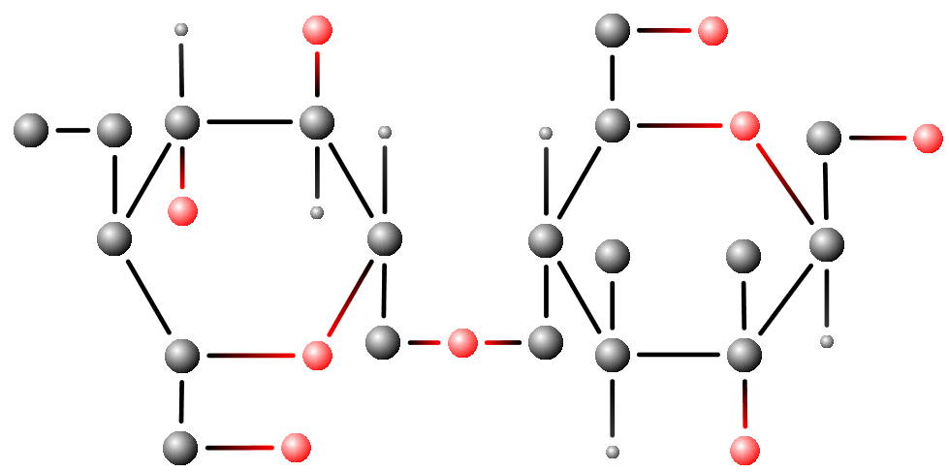
COMPOSITION OF BIOMASS
Lignin
(15-20 %)
Hemicellulose
(25-35 %)
Cellulose
(40-50 %)
Notes:
Cellulose (C6H10O5)n, the main constituent of biomass (40-50 %), is a polysaccharide consisting of a linear chain of β-linked D-glucose units. Hemicellulose (C5H8O4)m, is a heterogeneous branched polymer mostly made of xylose while lignin [C9H10O3(OCH3)(0.9-1.7)]n is a complex aromatic cross-linked phenolic polymer, covering about 25-35 % and 15-20 % of biomass respectively.

Slide 25
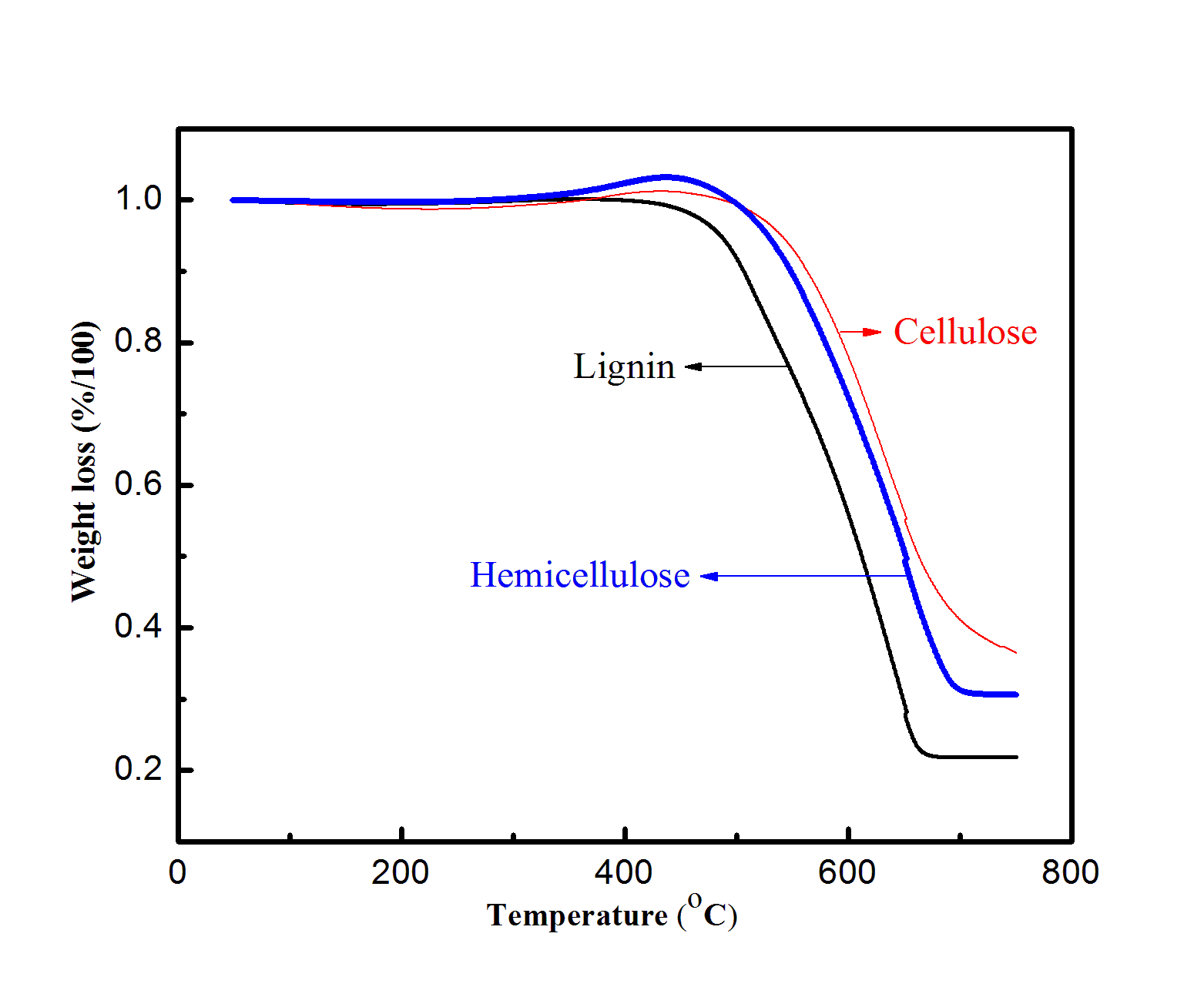
TGA

Slide 26
Metal loading from TGA
CEINP of day-3 biochar | Oxidized in air |  | Weight of Fe in Fe₂O₃ (mg) | Wt % of Fe in CEINP | Wt % of Fe in iron impregnated biochar
 | Initial weight (mg) | Final weight (mg)
Lignin | 18.57 | 4.36 | 3.05 | 16.42 | 8.99
Cellulose | 7.30 | 2.20 | 1.54 | 21.09 | 9.80
Hemicellulose | 21.30 | 6.53 | 4.57 | 21.45 | 10.53
Notes:
For example, 18.57 mg of CEINP (lignin) was obtained by annealing 33.9 mg of iron impregnated lignin biochar. Since all the carbon support had oxidized, 4.36 mg of Fe₂O₃ was left as residue. This residue had 3.05 mg of Fe, accounting for 16.42 wt% in CEINP but when corrected (3.05/33.9) corresponds to 8.99 wt% of Fe.

Slide 27
Quantitative Phase Analysis: Day-3 CEINP
Phases | Quantities by Rietveld Analysis, wt. % (Estimated Standard Deviation)
 | CEINP-cellulose biochar | CEINP-hemicellulose biochar
Cementite (Fe₃C) | 10.24 (0.2) | 3.80 (0.1)
Austenite (CFe_{15.1}) | 4.57 (0.1) | 6.27 (0.1)
Martensitic carbon (CFe_{21.2}) | 4.37 (0.2) | 4.34 (0.1)
α-Fe | 2.69 (0.1) | 7.41 (0.1)
Graphite | 26.03 (0.2) | 21.43 (0.2)
Coke like carbon | 52.07 (0.8) | 56.72 (0.9)

Slide 28
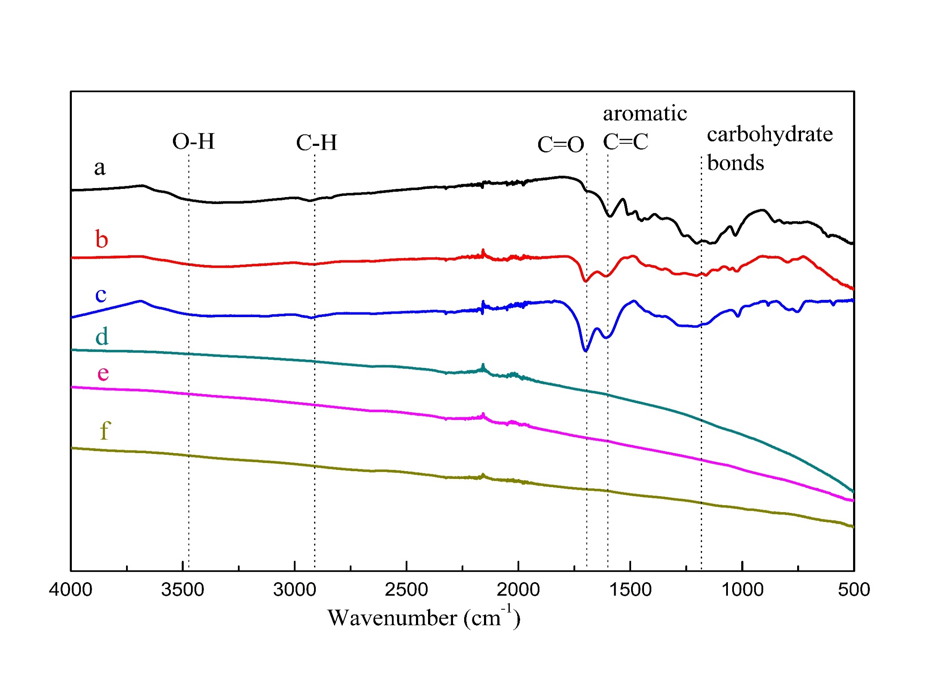
FTIR
Lignin biochar
Cellulose biochar
Hemicellulose biochar
Day-3 CEINP from lignin biochar
Day-3 CEINP from cellulose
biochar
Day-3 CEINP from hemicellulose biochar

Slide 29
EQUATIONS
$$C+CO2→2CO$$
∆H° = 172.4 kJ/g-mole
$$C+H2O→H2+CO$$
∆H° = 131.3 kJ/g-mole
$$3Fe2O3+CO↔2Fe3O4+CO2$$
∆H° = -52.8 kJ/g-mole
$$Fe3O4+CO↔3FeO+CO2$$
∆H° = -36.2 kJ/g-mole
$$FeO+CO↔Fe+CO2$$
∆H° = -17.3 kJ/g-mole
$$3Fe2O3+H2↔2Fe3O4+H2O$$
∆H° = -11.7 kJ/g-mole
$$Fe3O4+H2↔3FeO+H2O$$
∆H° = 77.4 kJ/g-mole
$$FeO+H2↔Fe+H2O$$
∆H° = 23.8 kJ/g-mole

Slide 30
Elemental Analysis
Sample | Elemental analysis (wt %)
 | C | H | N | S | O | Feª
Lignin biochar | 63.71 | 4.75 | 0.45 | 3.21 | 27.88 | -
Cellulose biochar | 65.47 | 3.39 | 0.07 | 0.80 | 30.27 | -
Hemicellulose biochar | 70.72 | 4.80 | 0.05 | 1.08 | 23.35 | -
Day-3 CEINP from lignin biochar | 84.20 | 0.69 | 0.37 | 0.03 | 5.71 | 8.99
Day-3 CEINP from cellulose biochar | 86.06 | 0.89 | 0.52 | 0.01 | 2.72 | 9.8
Day-3 CEINP from hemicellulose biochar | 85.16 | 0.77 | 0.32 | 0.05 | 3.17 | 10.53
ª determined by TGA

Slide 31
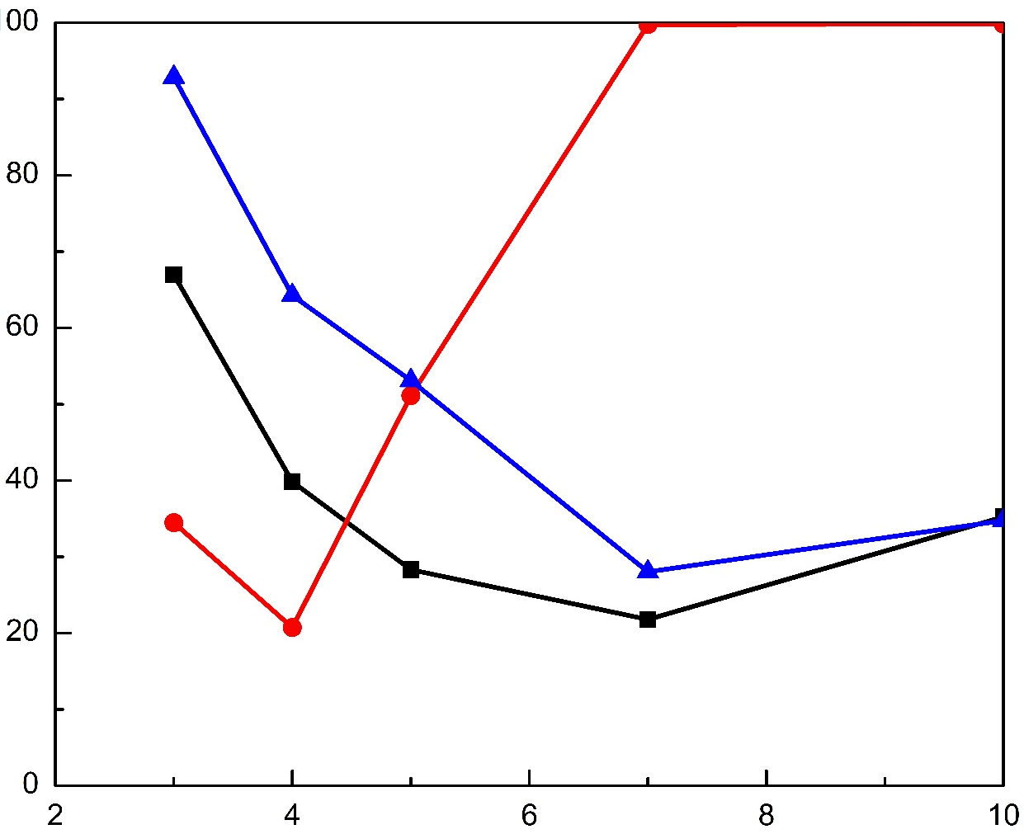
100
Cu (II)
80
60
Removal efficiency (%)
40
As (V)
20
Cr (VI)
0
2
4
6
8
10
pH

Slide 32
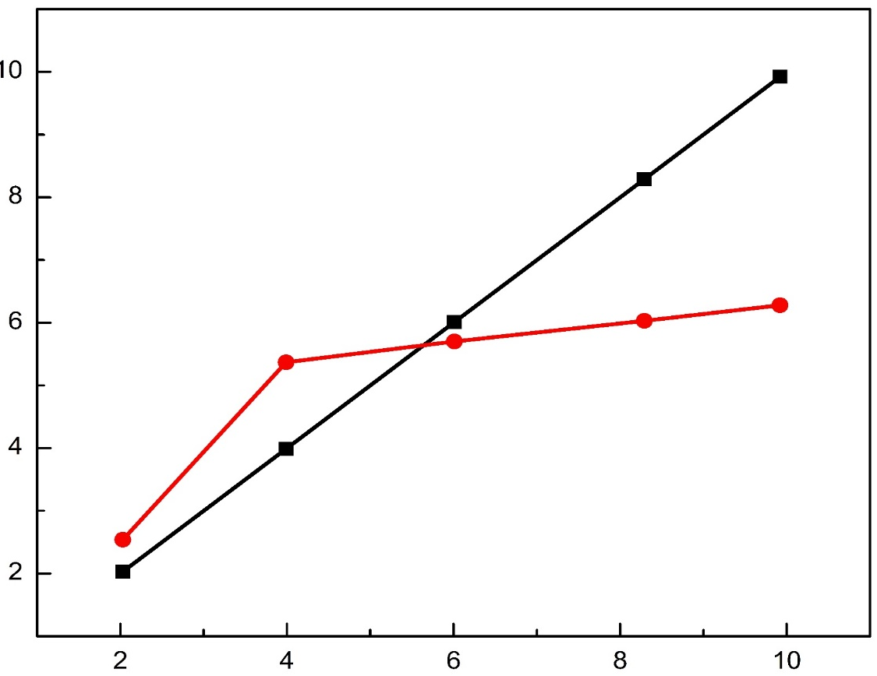
10
Initial pH (without CEINP)
8
5.62
pH
6
Final pH (with CEINP)
4
2
2
4
6
8
10
pH

