Slide 1

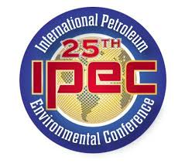
Surfactant Enhanced Extraction to Expedite Remediation of Carbon Tetrachloride Source Zone at an Active Grain Elevator Facility
Eric Dulle, PE
2018 IPEC Denver CO
October 2018

Slide 2
Site Remediation Presentation Overview
Active Grain Elevator Facility - Kansas City, Kansas
80/20 Fumigant Mixture – Carbon Tetrachloride and Carbon Disulfide – Used in 70s and 80s
(>27 Million Pounds of Fumigants used Nationally in 1978 alone)
Leaks from AST Discovered in 90s – Groundwater and Soil Impacts
Site Enters KDHE Voluntary Cleanup Program: 2000
DPVE System Installation & Operation: Dec. 2007 to Current
Surfactant Enhanced Extraction (SEE) Pilot Study: Spring 2015
SEE Full-Scale: Fall 2016
Observations Continue into 2018
Notes:
The source of the contamination was the 80/20 grain fumigant mixture

Slide 3
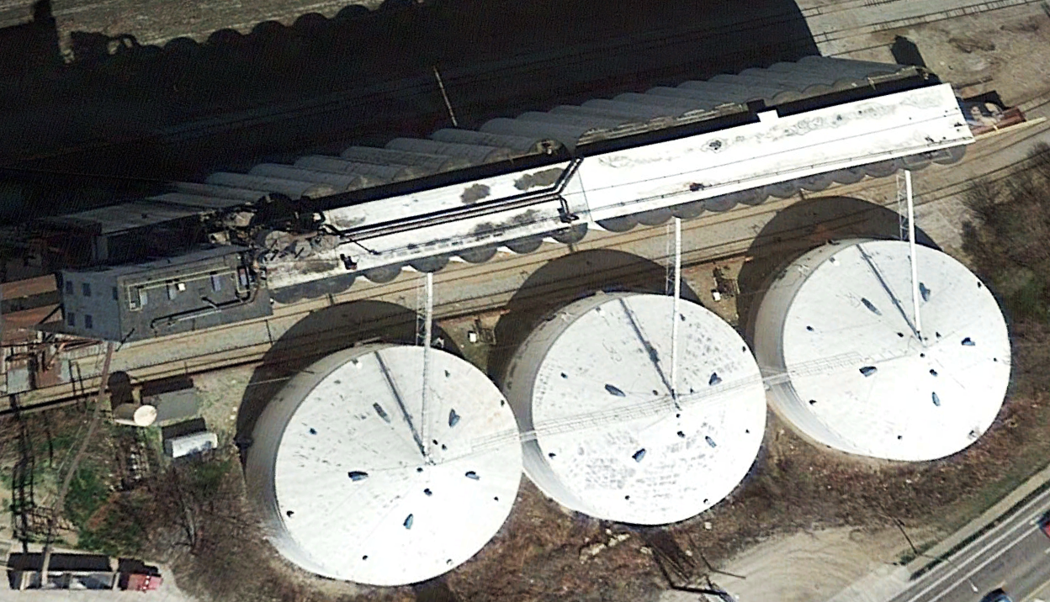
Site Layout
Groundwater Flow
DPVE (MPE) System

Slide 4
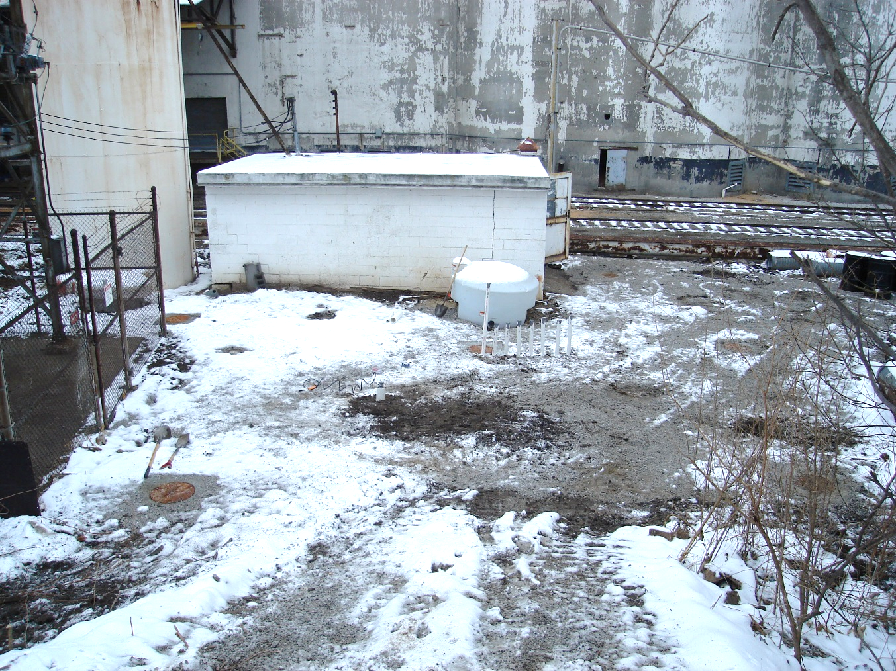
Site Challenges
Limited vehicle access led to creative equipment placement
Former AST Location
Notes:
There were a number of challenges right from the start. The source area is located in an area bound by an active substation, active rail line, elevator infrastructure, and a steep embankment. We had to get creative to install the DPVE system.

Slide 5
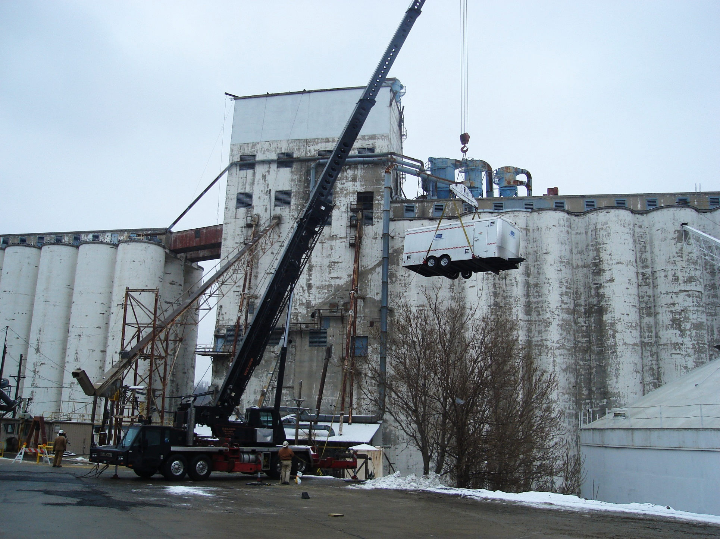
Site Challenges
DPVE system installed by crane

Slide 6
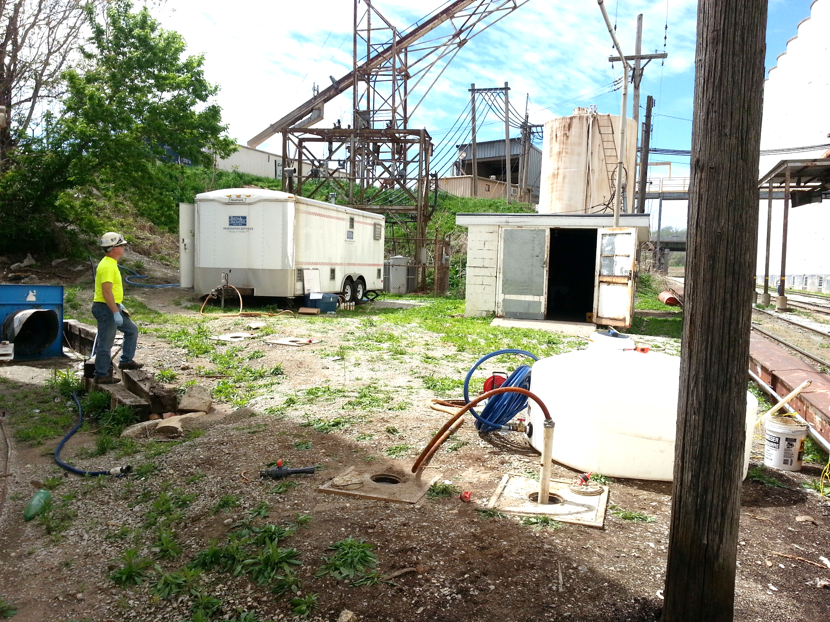
Site Challenges
DPVE system situated adjacent to substation, railroad tracks, and elevator infrastructure
Notes:
This is the system as it looks today. The concrete pads visible in the photos are source area monitoring and DPVE extraction wells.

Slide 7
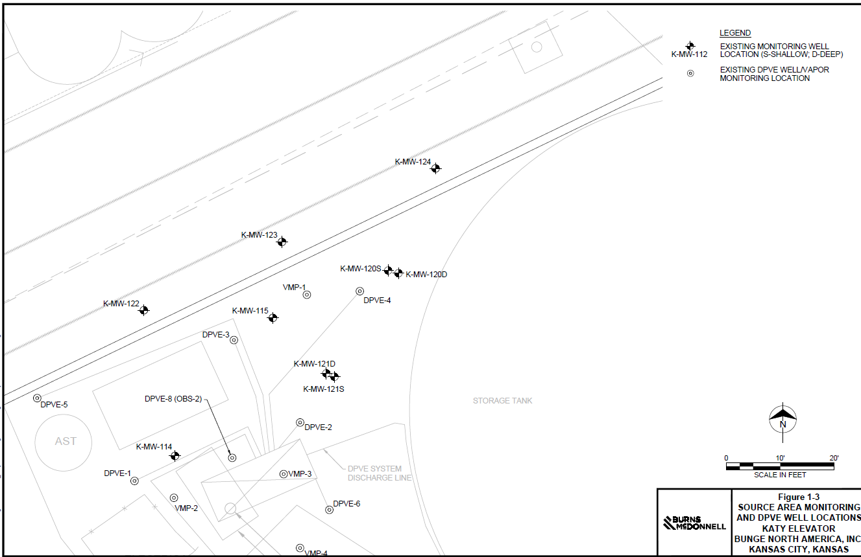
Site
Layout
Groundwater Flow
Former AST Location
Notes:
This is an illustration of the site layout. The wells circled green are extraction wells. The extraction wells were focused near the former AST where the highest groundwater and soil impacts were observed. The highest CT concentrations have been historically observed near DPVE-2 through 4, downgradient of the AST.

Slide 8
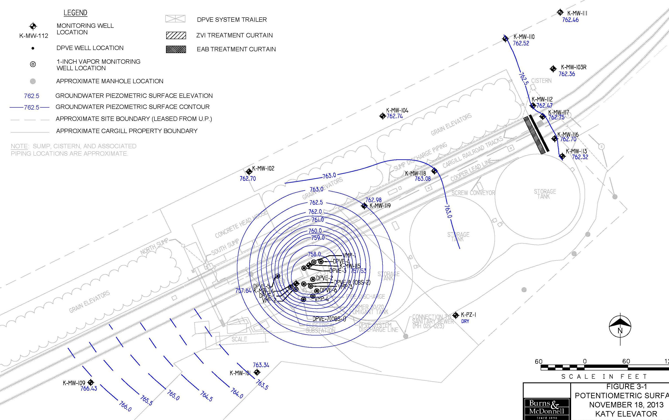
DPVE Performance – Hydraulic Control and Capture
Notes:
One of the objectives of the DPVE system was hydraulic control. Due to the relatively flat natural gradient, a significant hydraulic influence could be achieved.

Slide 9
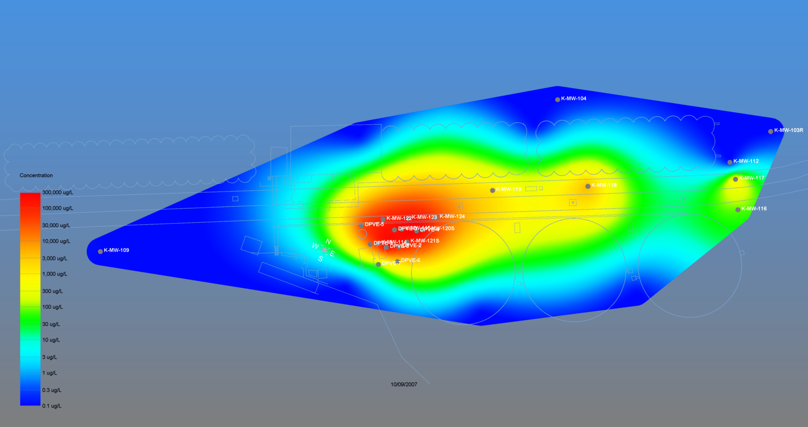
DPVE Performance – Summary (2007 – 2014)
Notes:
This is a CT groundwater concentration depiction generated using Earth Volumetric Studio (EVS). This represents conditions PRIOR to DPVE system operation. The red indicates concentrations up to 300k, yellow is up to 3k, green up to 300, and blue and white are near or below the MCL of 5. As you can see, concentrations over 1k were observed downgradient near the property boundary.

Slide 10
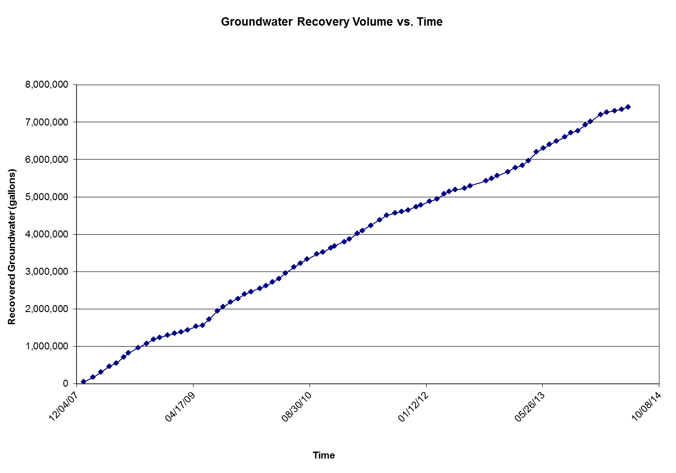
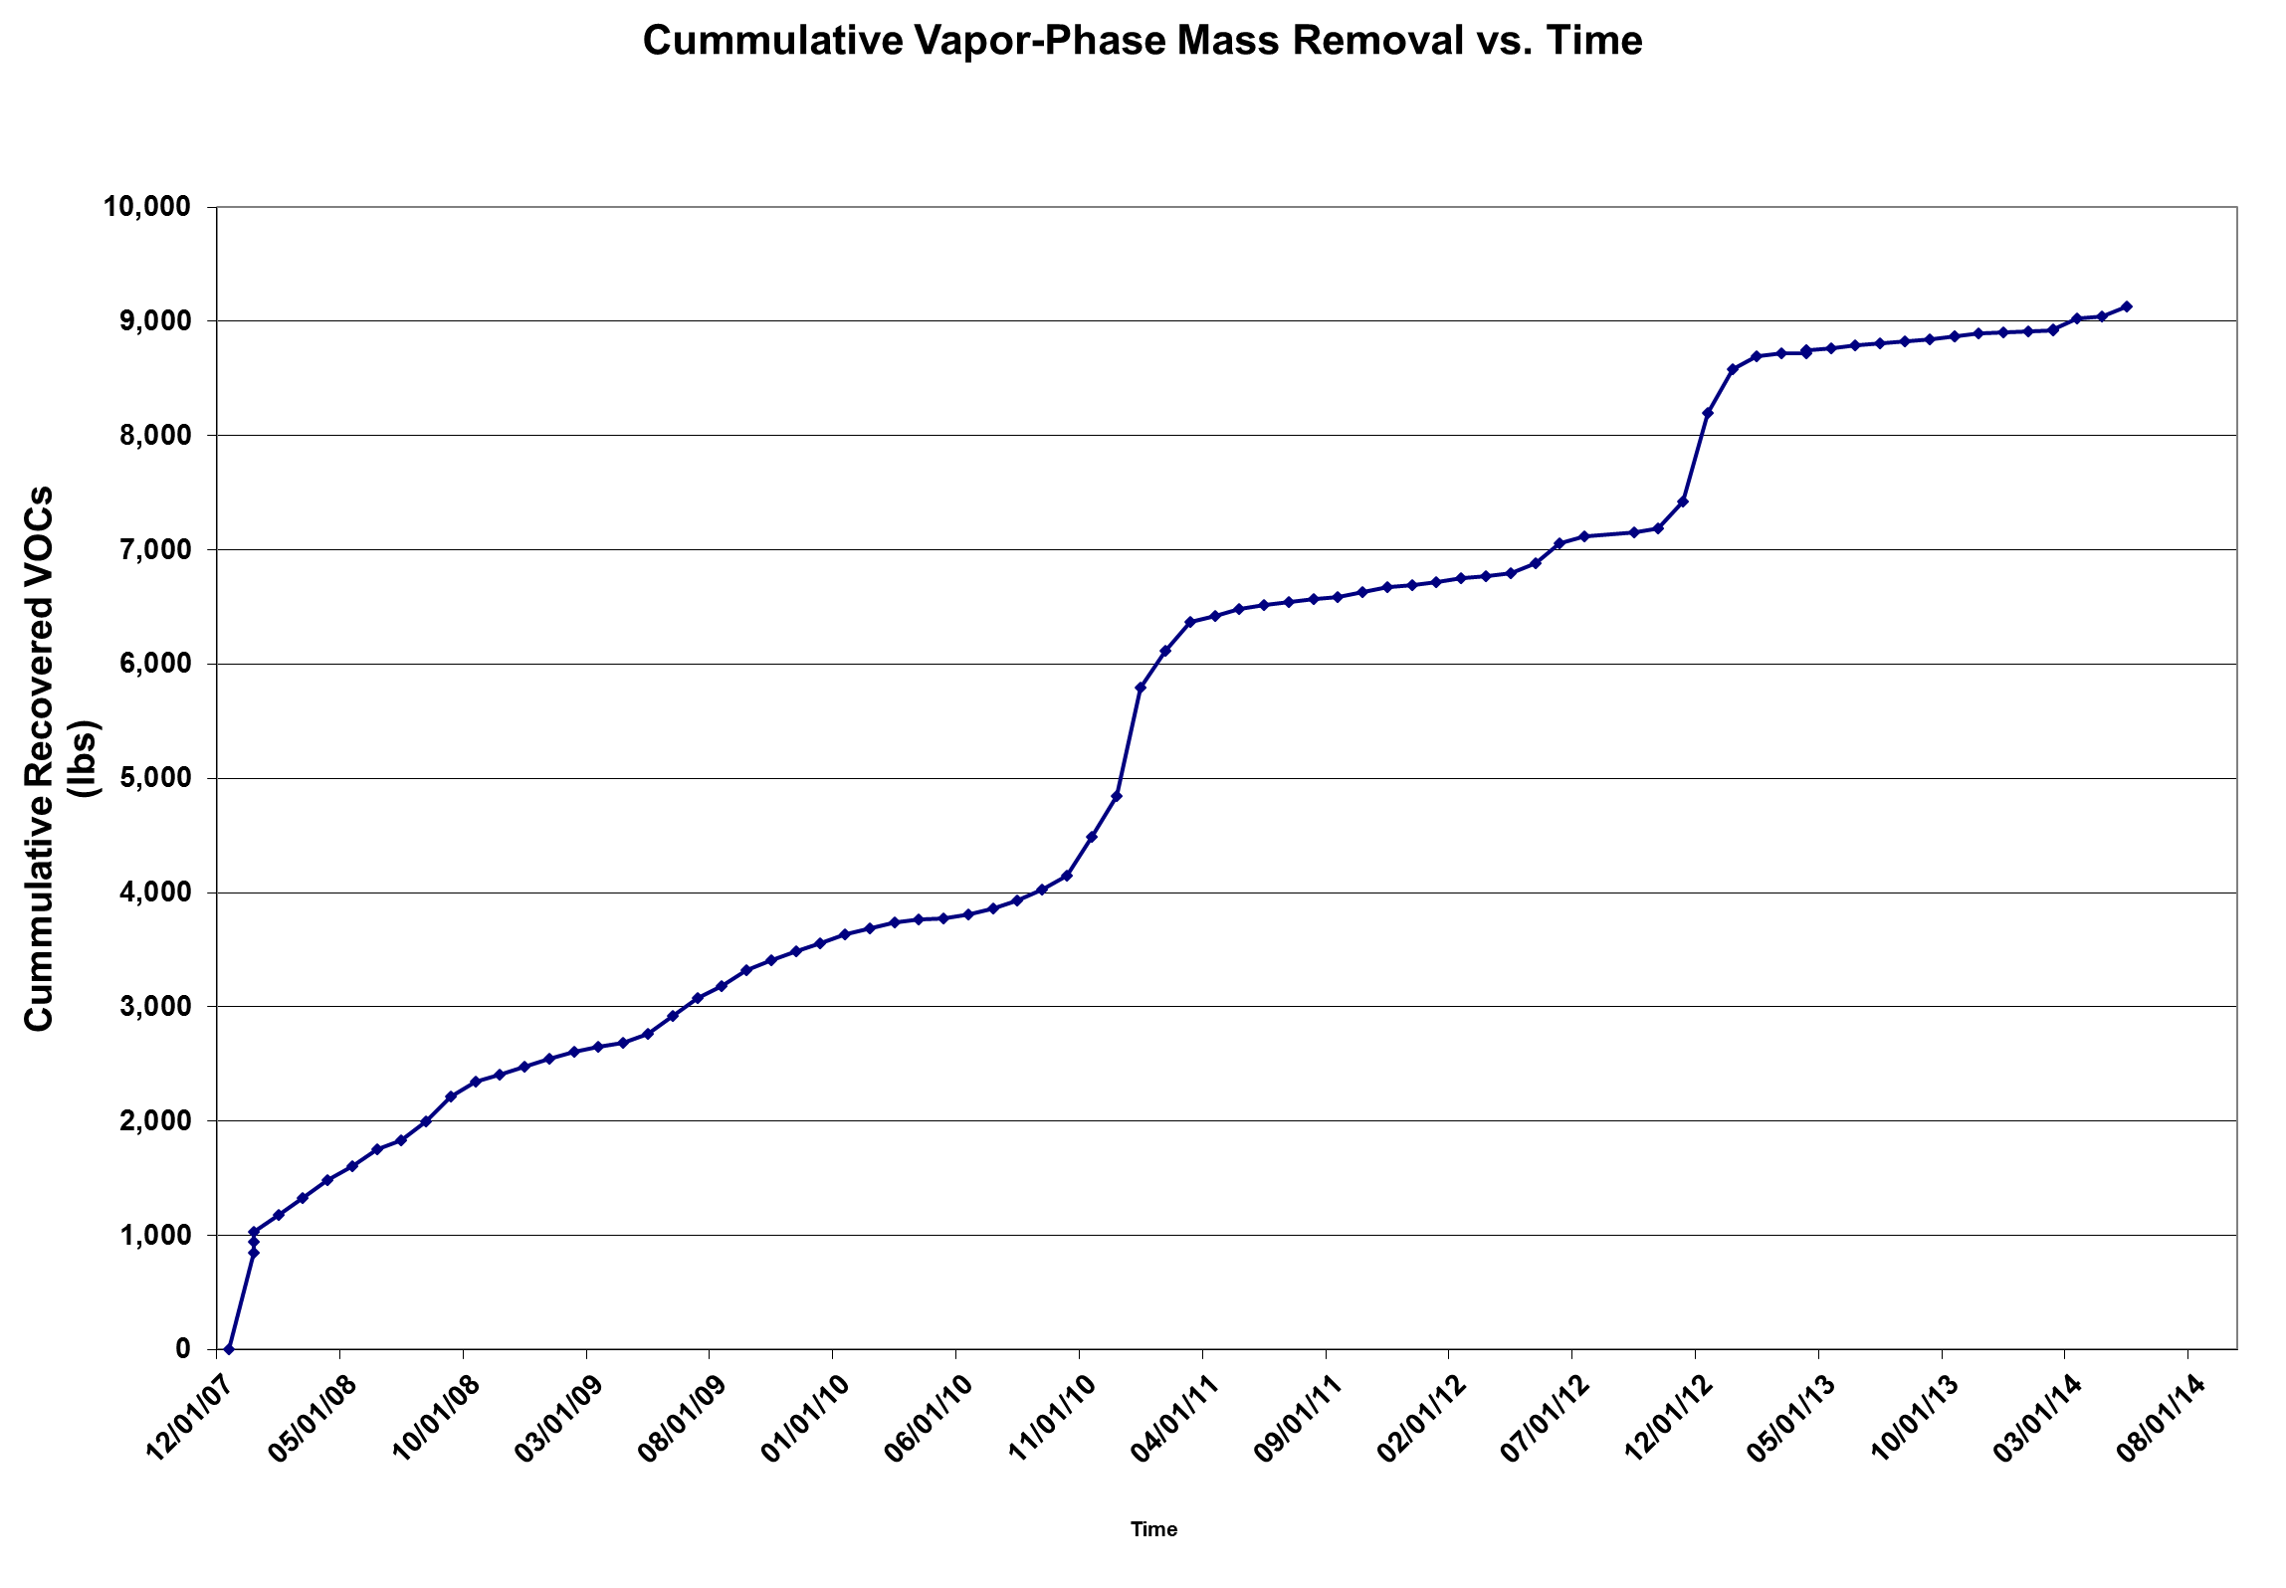
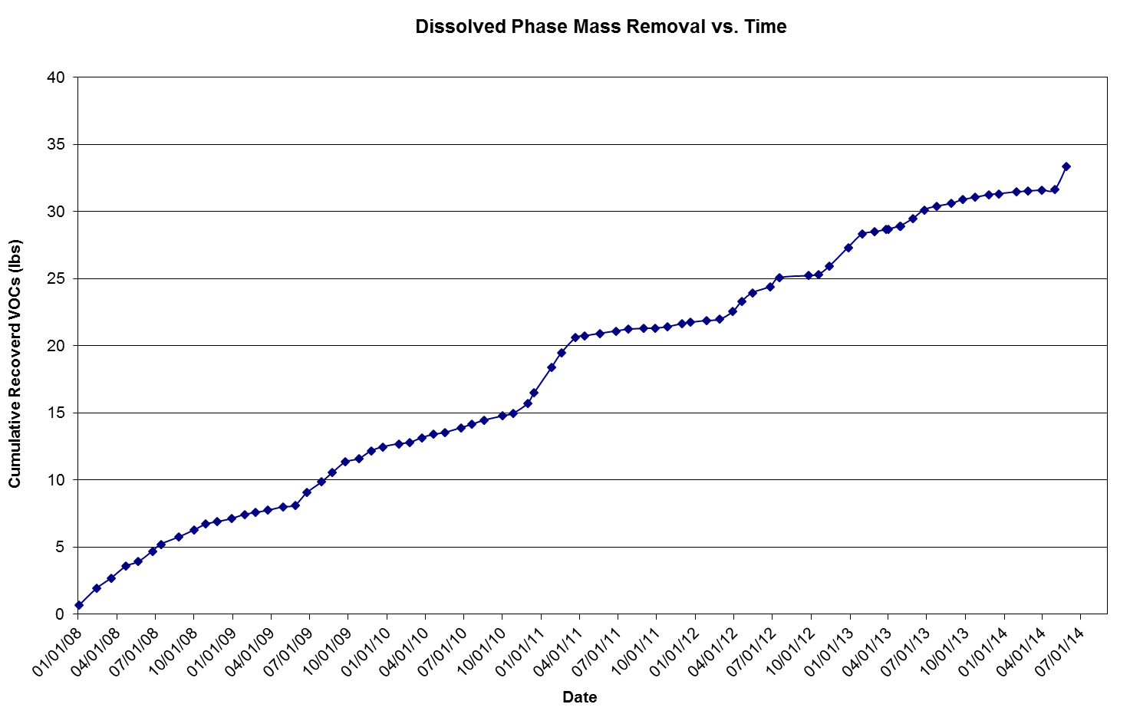
DPVE Performance – Summary (2007 – 2014)
Plume size and concentration reduction
  Vapor-Phase Removal:
    9,100 pounds (4,136 kg) - 690 gal. (2,608 L) as CT
  Dissolved-Phase Removal:
    33 pounds as CT (15 kg)
  Groundwater Recovered/Treated:
    7.5 million gallons (28,350,000 L)
Notes:
Between 2007 and 2014 we made significant progress in terms of mass removal and overall plume reduction. During that time period, we……

Slide 11
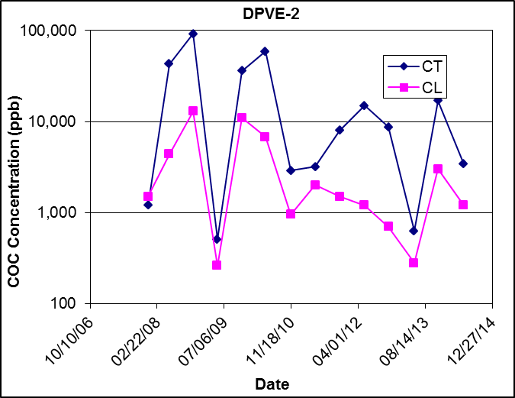
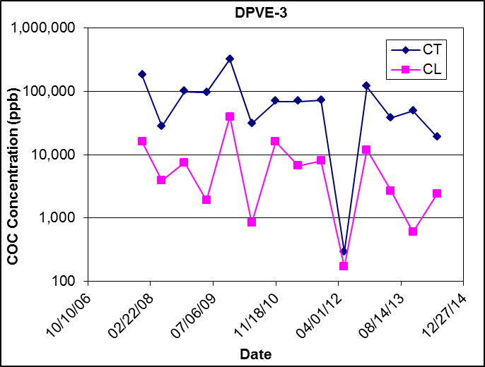
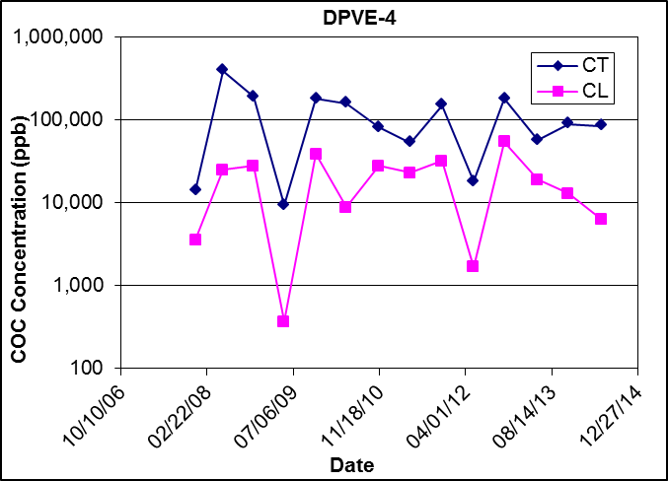
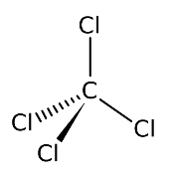
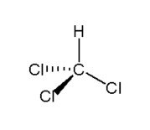
Source Area Conditions (2006 – 2014)
Continued variability and persistence in source area DPVE wells
Could significant mass remain in the soil?
CT – Carbon Tetrachloride
CL - Chloroform
Notes:
However, we continue to observe significant variability and persistence in concentrations in our primary source area extraction wells DPVE-2 through DPVE-4.

Slide 12
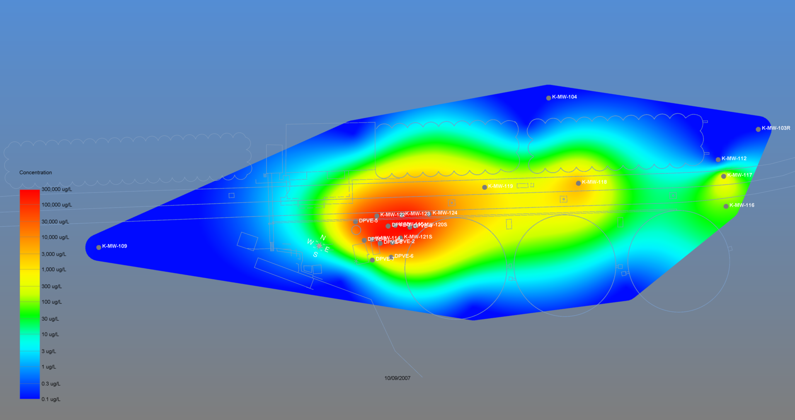
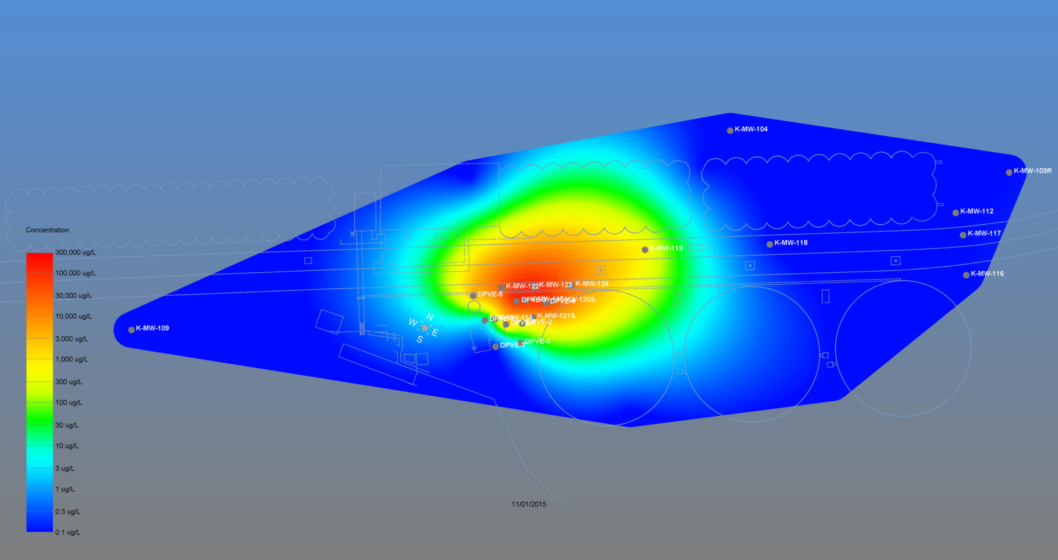
DPVE Performance – Summary (2007 – 2014)
Notes:
As you can see, we significantly reduced the overall extents of the plume; however, significant mass continues to remain within the primary source area.

Slide 13
2014 Investigation Soil Results
Notes:
As a result, in 2014, we conducted a source area direct-push investigation to update our conceptual site model. What we discovered was significant sorbed-phase CT concentrations remaining within the shallow saturated source zone soils.

Slide 14
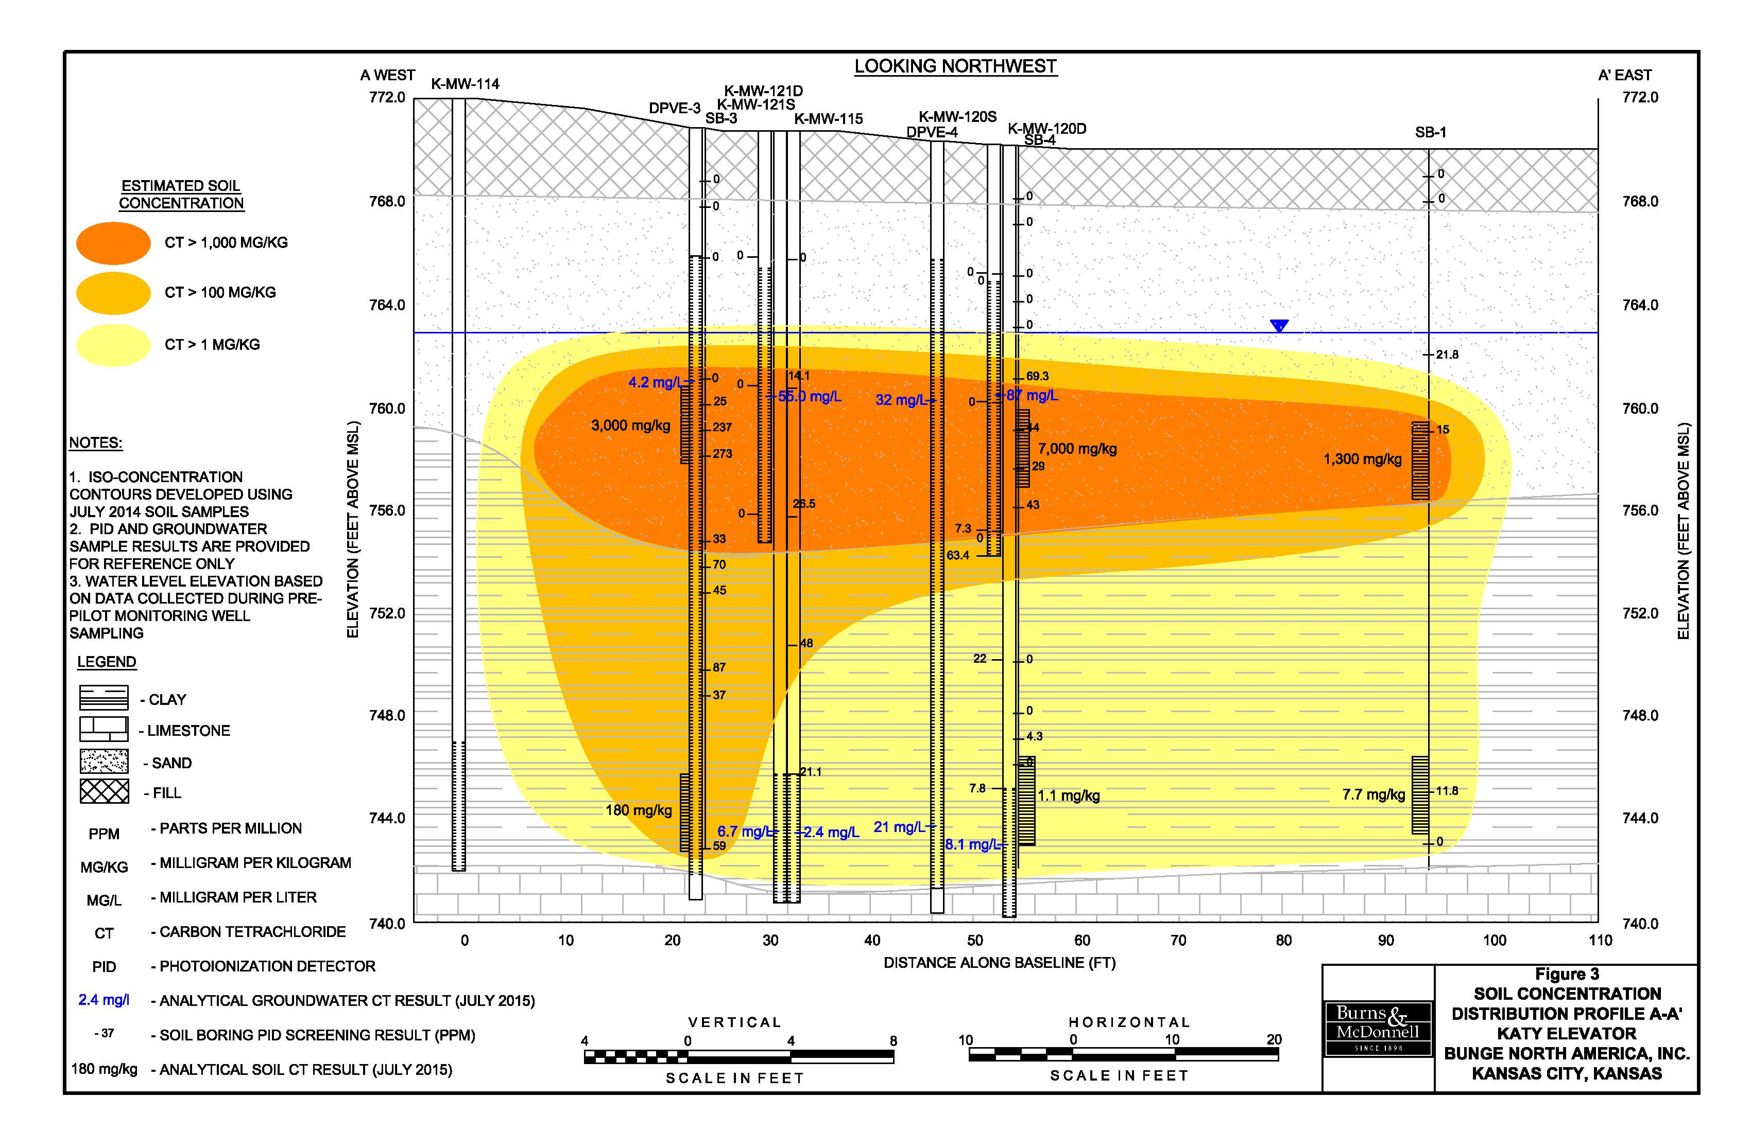
2014 Soil Investigation Results
Notes:
This is a depiction of the source area distribution. The remaining mass primarily resides at and above the clay-sand interface.

Slide 15
Why does significant mass remain?
CT discontinued in the 1980s
  Contact time increases sorption (30 to >40years since spill)
  Desorption rate is < adsorption rate
  Koc (CT soil organic carbon-water partitioning coefficient): 251 L/Kg
    Compare to vinyl chloride: 8.5 L/Kg Sorption: CT > DCE > VC
Elevated organic carbon concentrations in sand zone
Elevated CT discovered in LNAPL (Diesel contamination)
Source zone periphery rapidly remediated by DPVE
  Minimal contact time in these areas
Notes:
There are several reasons why it makes sense so much mass remains. First, the fumigant releases occurred 40 years ago, allowing significant contact time. Additionally, elevated organic carbon concentrations were observed, likely a result from the site’s close proximity to the Kansas River floodplain. Also, a historical fuel oil LNAPL is present at the site. We did a fingerprint analysis early on in the project and demonstrated that it was not from our clients operations, so it has not been targeted for remediation. However, we submitted a sample of the LNAPL to the lab and discovered significant amounts of CT adsorbed to the LNAPL. So although the LNAPL remediation was not our responsibility, it was likely contributing to the persistent CT concentrations we have been observing.

Slide 16
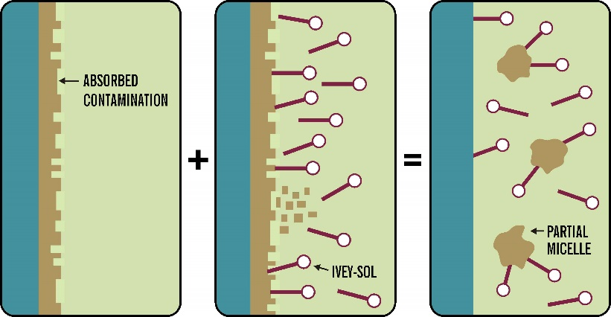
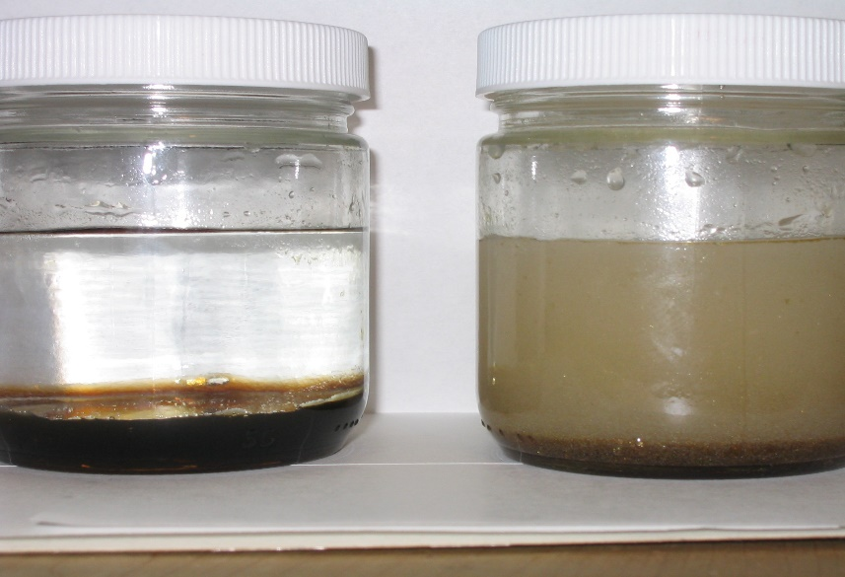
Ivey-sol Surfactant Enhanced DPVE
How It Works
Surfactants are structured with a hydrophilic head and hydrophobic tail
Hydrophobic tail attracts and attaches to organic portion of CT (carbon)
Hydrophilic head attracted to groundwater making CT miscible = more Available
Lowers surface tension by reducing H₂0 cluster size (73 to < 30 Dynes) improves ‘apparent’ K
Notes:
It was at this time we evaluated the use of surfactants. High level, surfactants work by physically attaching to the carbon molecule of CT while also lowering the surface tension of the groundwater. This increases the mobility and recoverability of our targeted contaminant. Additionally, surfactants would work very well with recovery our CT-impacted LNAPL. And with the infrastructure to facilitate recovery and treatment of the impacted groundwater already in place, this alternative could be implemented for a relatively low cost.

Slide 17
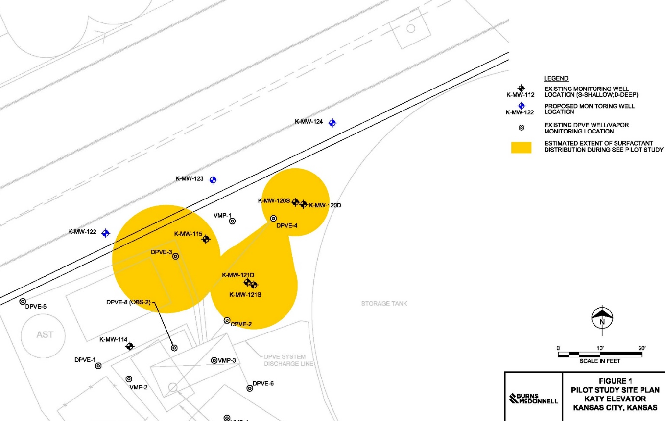
Ivey-sol SER Pilot Study Overview
SEE Pilot Limited To:
DPVE-3
DPVE-4
K-MW-120S
K-MW-121S
Notes:
In 2015, we conducted an SEE pilot study at 4 source area wells. The pilot study consisted of both push-pull (injecting and extracting from the same well) and point to point tests to assess the most effective way to mix the surfactant with the aquifer.

Slide 18
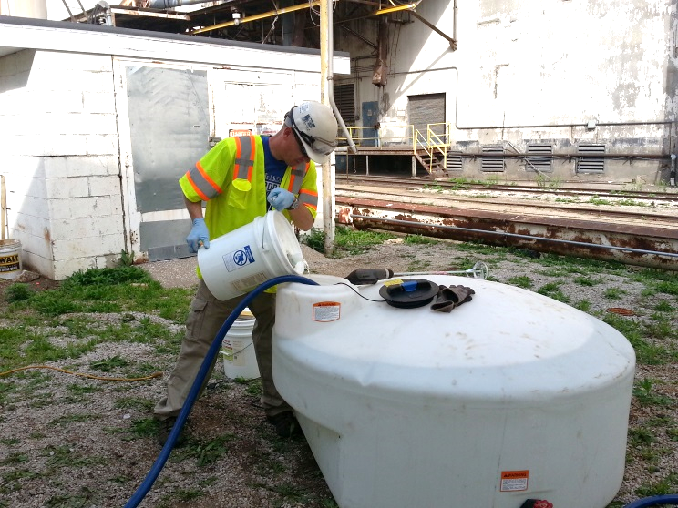
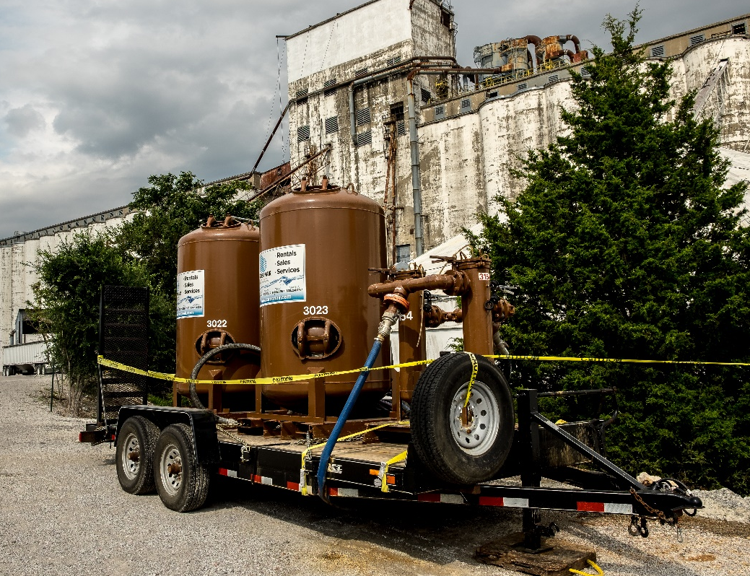
Ivey-sol SEr Pilot Study Overview
Mixing 5 gal (20 L) Ivey-sol into 250 gal (1000 L) of Water
1:50 Ratio For Application (2 %)
Installed temporary GAC
Notes:
We used Ivey-sol surfactant specifically formulated for CT. We delivered the surfactant-water mixture in batches via gravity flow. 5 gallons of ivey-sol surfactant was mixed with 250 gallons of water. A granular activated carbon unit was temporarily installed to treat the discharge stream prior to permitted disposal at a POTW sewer line.

Slide 19
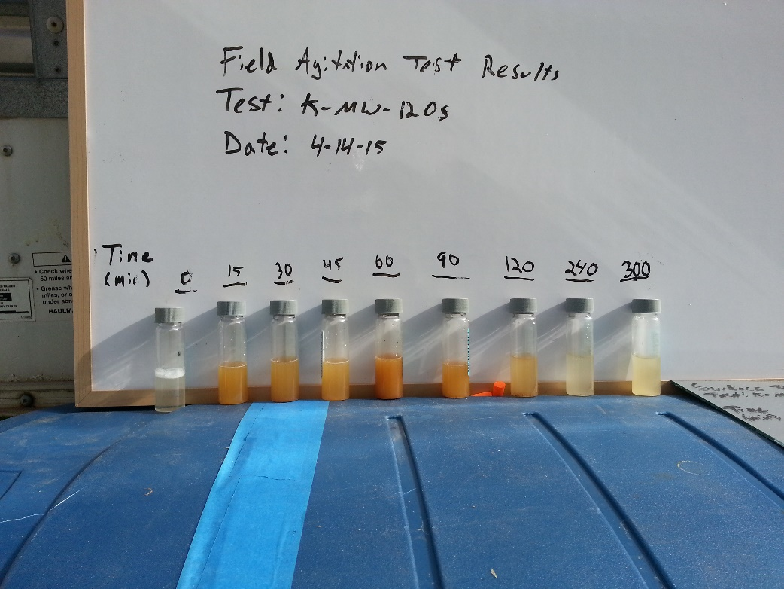
SEE Pilot Study Overview
Ivey-sol SER Pilot Test Begins Spring 2015 - Approx. 30 days
Tests conducted at K-MW-120s, K-MW-121s, DPVE-3 and DPVE-4
1 Drum (55 Gal.) Ivey-sol Surfactant Used
Notes:
The pilot study lasted approximately 30 days and we injected about 55 gallons of iveysol surfactant. During each testing phase, we conducted field testing to help identify surfactant presence at the DPVE influent as well as observation wells. Additionally, the field data was used to help determine when samples should be collected for lab analysis. Photo: Field agitation testing - measuring the bubbles that form at the surface.

Slide 20
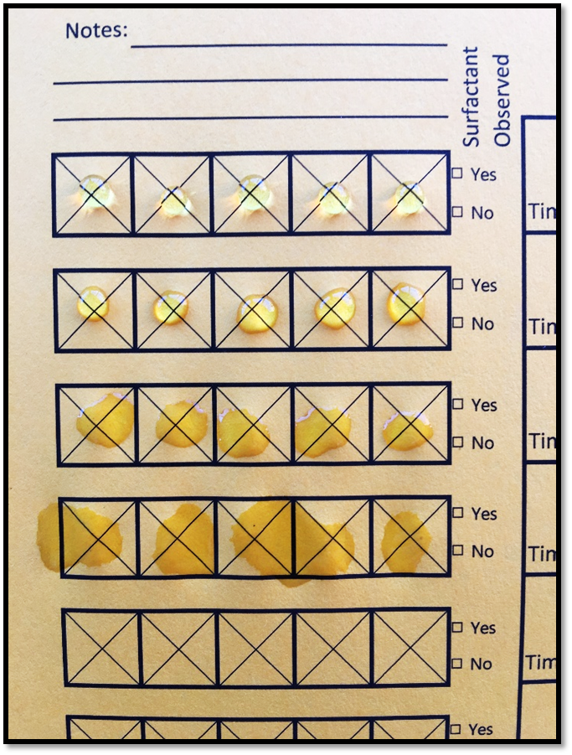
Real-Time
Field Surfactant Test
Real-time field surfactant testing - measuring water surface tension
Takes < 30 seconds
Cost is <0,1 € / Test
Notes:
We also measured surface tension in the field. Photo: top indicates no surfactant – surface tension keeping the form of the droplet. As surfactant concentrations increase it becomes very apparent as the droplet spreads out.

Slide 21
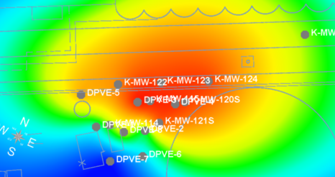
Ivey-sol Pilot Study Results
Test 1 and 2
Push-Pull Tests at shallow monitoring wells
Modest increase in mass removal observed
Notes:
The first 2 tests were push-pull tests in the source area. We injected 275 to 500 gallons of surfactant water mixture at each well, allowed up to 24 hour residence time, and then began the recovery phase. Increases in vapor and dissolved phase mass removal were observed; however, not as high as we were expecting to see.

Slide 22
Ivey-sol Pilot Study Results
Test 3 and 4
Point-To-Point Tests
Influent groundwater concentrations (8,100 ug/L) highest ever recorded by over 50%
Influent groundwater concentrations 4x greater than average
Notes:
Injected 1,000 gallons into the same 2 wells, but extracted from a different well to facilitate a point to point test. The idea here was to maximize surfactant mixing with the aquifer. During the recovery phase, we saw significant increases in mass removal. Influent groundwater concentrations were some of the highest we had ever seen by.

Slide 23
Ivey-sol Pilot Study Results
Highly elevated and highly variable influent concentrations
Recovery of high concentration “slugs” over short periods of time
Notes:
Overall, highly elevated yet highly variable influent groundwater concentrations were observed. It appeared that we were recovering high concentration slugs over short periods of time, making timing of analytical samples critical, because that is what we use to evaluate mass removal. Photo: Decreased from 4,400 to 570 within a matter of hours. Potential we missed even higher concentration events. Part of that was due to the relatively small volume we injected. This was a pilot study, and so we wanted to test implement ability and the potential for increased mass removal. We felt the results of the pilot showed significant potential at a relatively low cost.

Slide 24
Full-Scale Ivey-sol SER application
August through November 2016
275 Gallons Ivey-sol 106 (Cl) Surfactant Formulation
  Mixed with conservative tracer for distribution observation
Applied Push-Pull (Single-Well) and Point-to-Point (Multi-Well) Flushing Techniques
Monitored recovery progress via real-time tracer testing and using the Ivey-sol field surfactant test sheets
Notes:
In 2016 we conducted full-scale SEE. We injected a total of 275 gallons of Ivey-sol’s 106 surfactant formulation. We designed the full-scale such that we incorporated the most successful aspects of the pilot study. We used a combination where we would start with point to point flushing, and then finish each test by pulling from the wells we injected in.

Slide 25
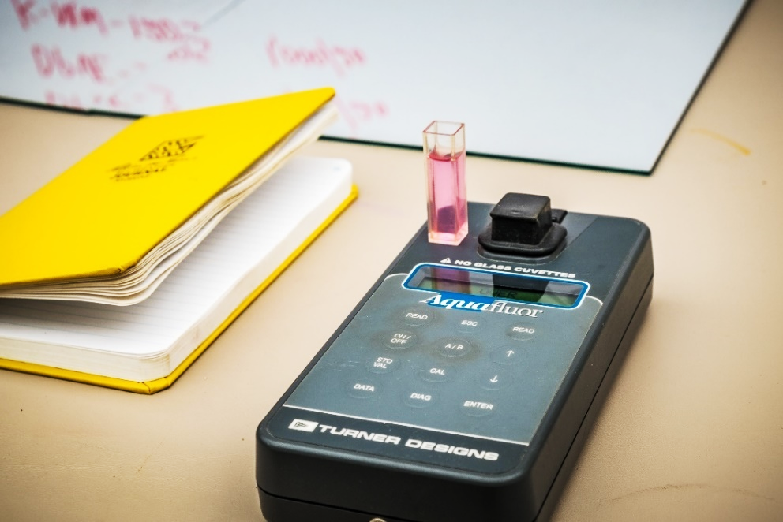
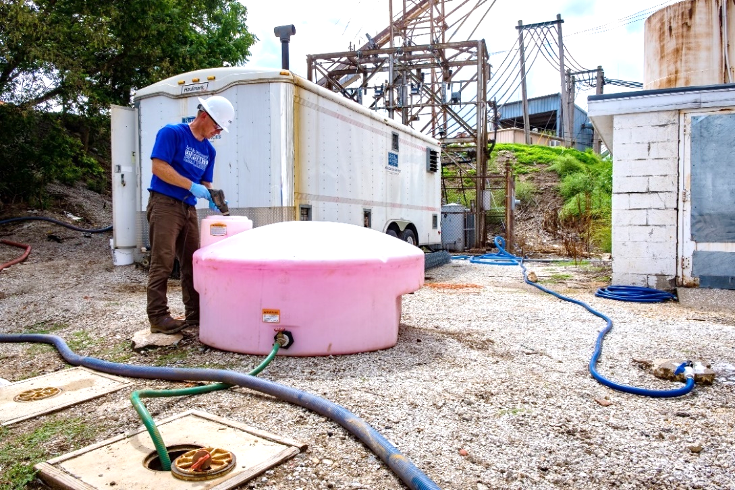
Full-Scale SEE
Aquafluor Meter: Measures intensity of fluorescence
Diluted Ivey-sol in water with tracer added – pre-injection mixing.
Notes:
We used the same surfactant field testing techniques used during the pilot, only we added a conservative tracer to provide a more quantitative assessment of surfactant distribution.

Slide 26
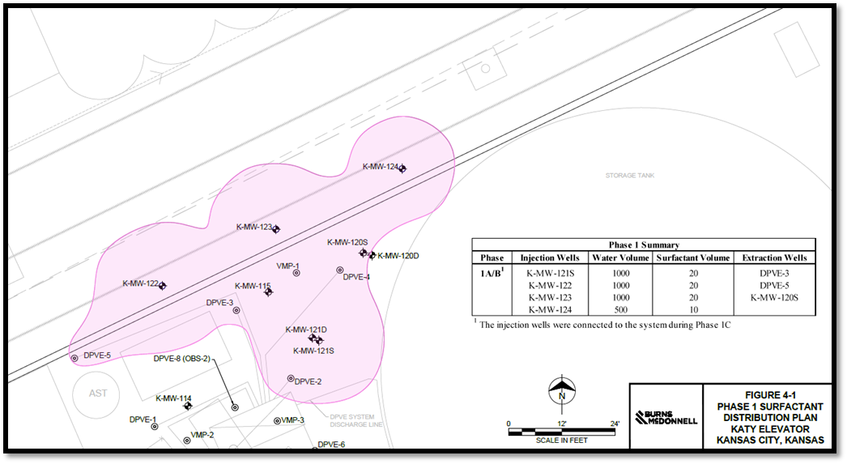
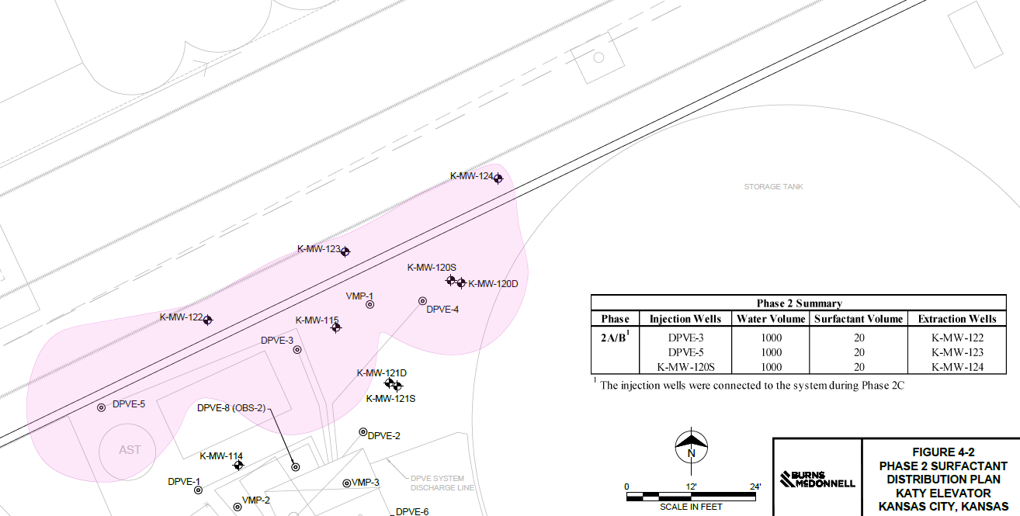
Full-Scale Ivey-sol SER
Three additional wells – K-MW-122 through 124 – Installed to facilitate surfactant delivery to the northern portion of the source area
A total of 5 Ivey-sol SER phases were conducted to target the most heavily impacted portion of the source area
Notes:
Installed 3 additional shallow monitoring wells along the northern-most portion of the source area to increase our injection area. In total, we conducted full-scale SEE in 5 phases, blanketing the entire source area.

Slide 27
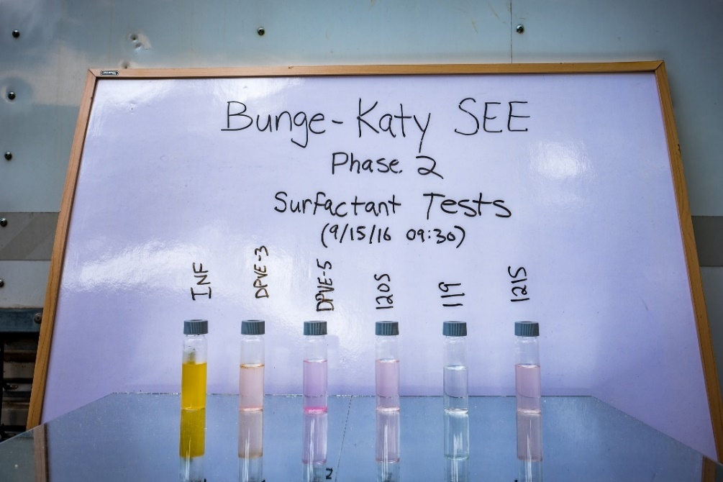
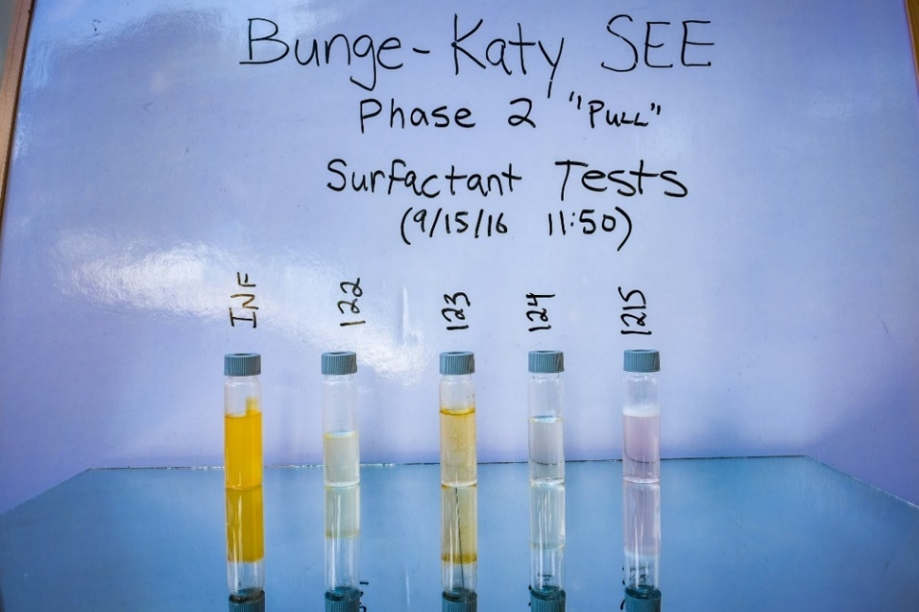
Full-Scale ivey-sol SEr
Influent samples indicative of LNAPL which was heavily concentrated with COCs.
Note: 119 was downgradient, lack of tracer confirmed hydraulic control of SER treatment area.
Notes:
Overall, observations during full-scale were similar to the pilot. Very high and variable mass removal rates were observed. As we had hoped, we did observe more LNAPL recovered by the system, as circled here. We also monitored downgradient well 119 to make sure we didn’t have any unanticipated migration of the surfactant.

Slide 28
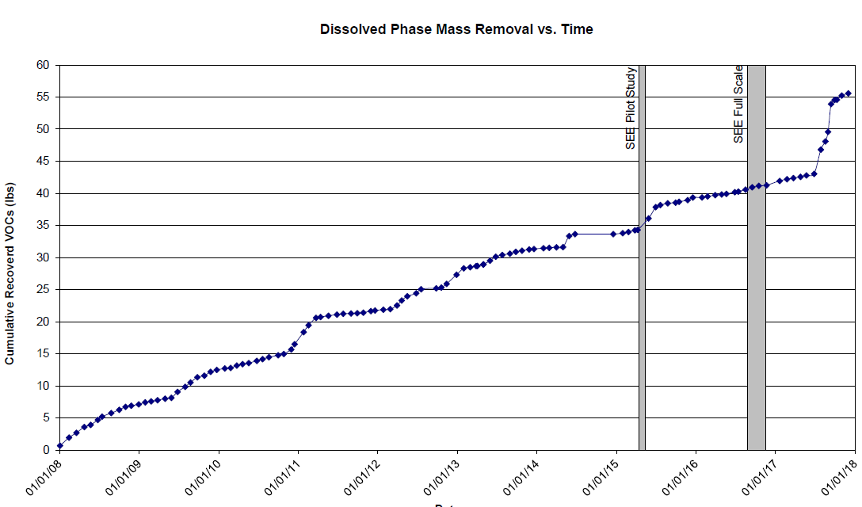
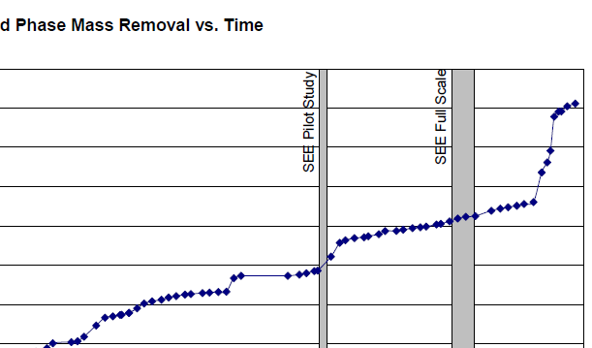
Full-Scale ivey-sol SEr
25% of the total mass recovered since 2007 was during the 12-month post-SEE period.
Influent groundwater concentrations up to 30,000 ug/L observed – 5x the highest concentrations ever observed during DPVE operations.
Notes:
We knew there was likely mobilized mass that would continue to be recovered after we completed full-scale activities, so we continued to operate and monitor the DPVE system. About 6 months after the conclusion of full-scale activities, we saw extremely high and sustained increases in our dissolved phase mass removal. Concentrations up to 30,000 ug/l were observed, over 5x the highest ever observed. Because of that, the mass recovered after the full-scale SEE activities accounted for over 25% of the total mass recovered by DPVE operations.

Slide 29
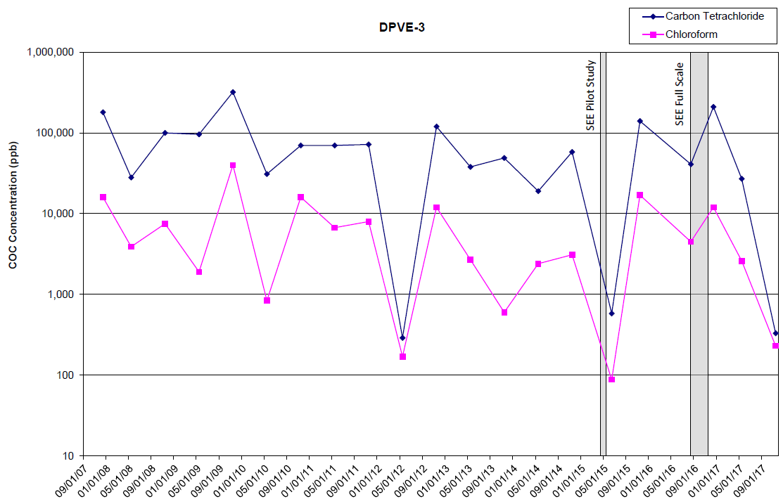
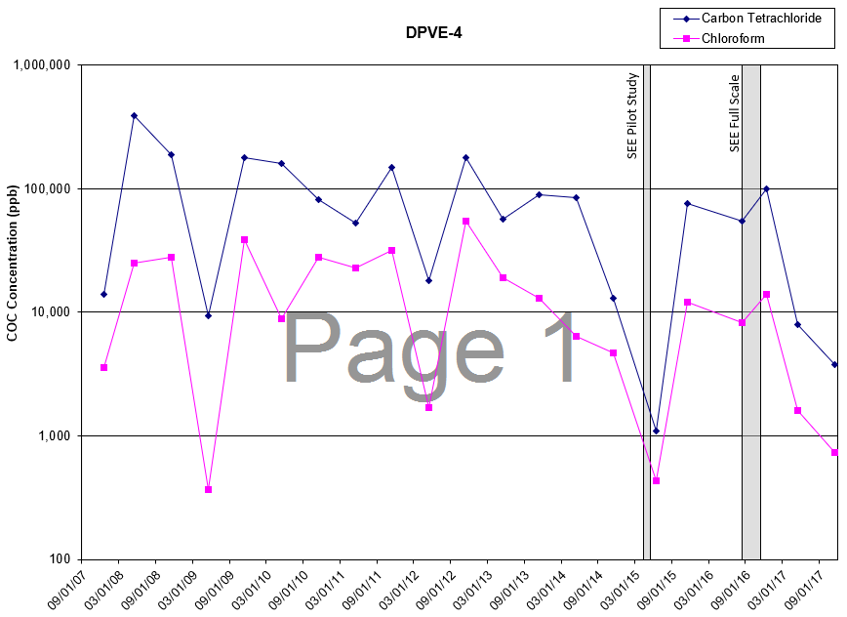
Full-Scale ivey-sol SEr
DPVE-3 demonstrated 3 order of magnitude COC reduction following full-scale SEE
DPVE-4 demonstrated 2 order of magnitude COC reduction following full-scale SEE
Notes:
Real measure of success is the monitoring/DPVE well concentrations. We saw significant decreases in source area monitoring and DPVE wells during the semi-annual groundwater sampling events following the full scale activities.

Slide 30
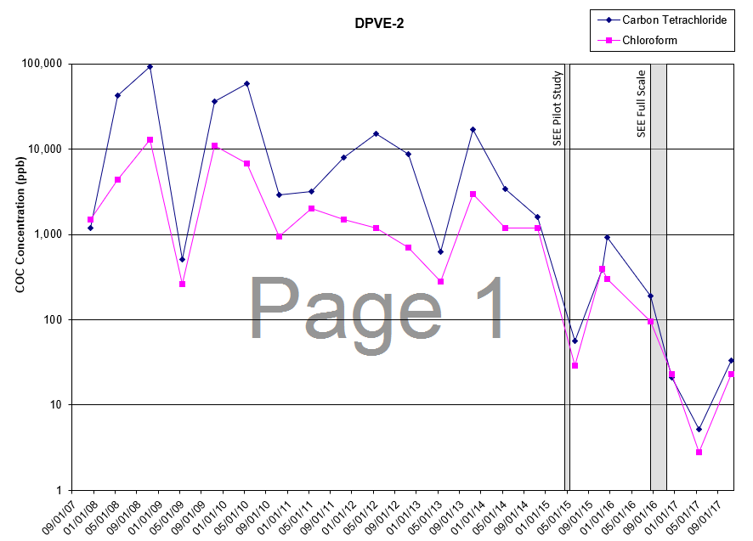
Full-Scale ivey-sol SEr
DPVE-2, located in the southern portion of the source area, demonstrated 2 order of magnitude COC reduction following the SEE pilot scale
Notes:
DPVE-2 CT concentrations consistently above 1,000 ug/l until the SEE pilot study. Since then we have seen concentrations as low as the MCL of 5.

Slide 31
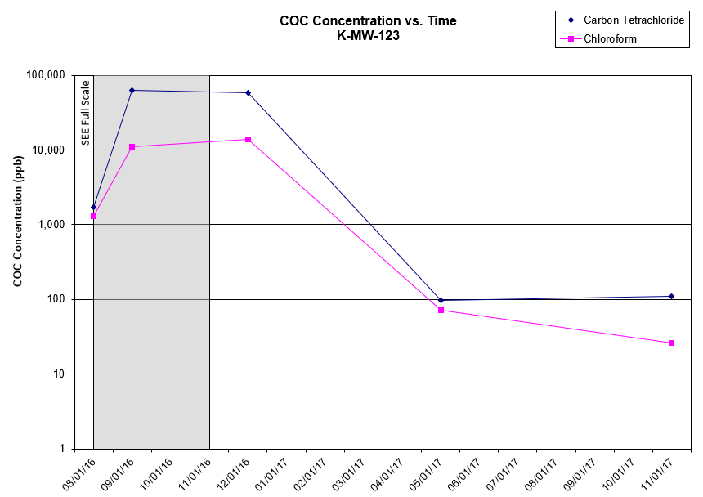
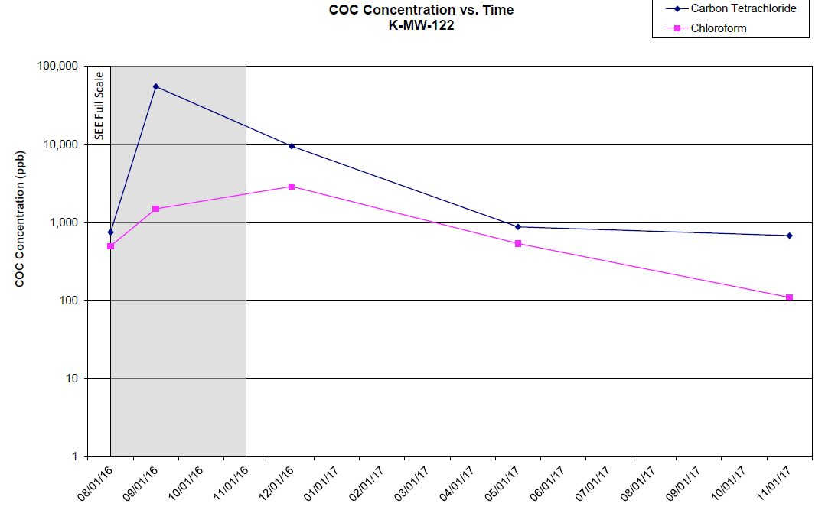
Full-Scale Ivey-sol SER
K-MW-123 demonstrated 3 order of magnitude COC reduction following full-scale SEE
K-MW-122 demonstrated 2 order of magnitude COC reduction following full-scale SEE
Notes:
Similar results for the shallow, source area monitoring wells.

Slide 32
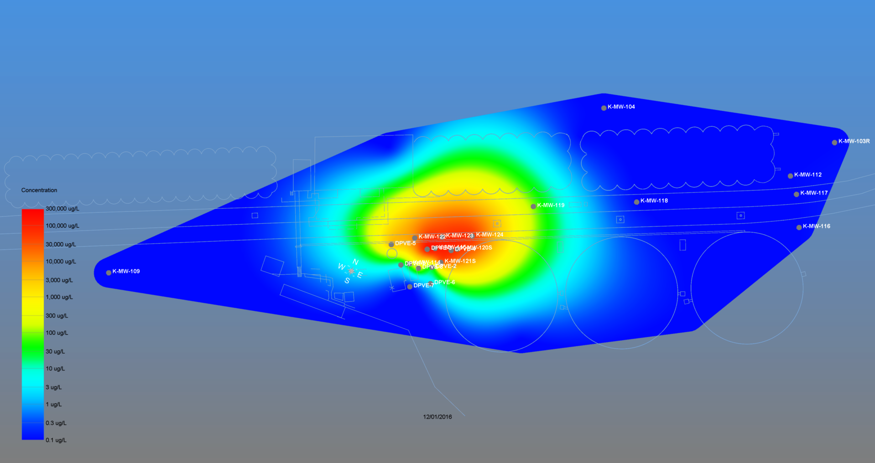
Condition in 2015
(Pre Ivey-sol Application)
Notes:
Like I showed earlier, this image represents pre-full scale plume conditions. This illustrates plume conditions today. Overall we have reduced the plume to a much more manageable size, and this opens the door for additional remedial alternatives to get us to our ultimate goal of ending active remediation.

Slide 33
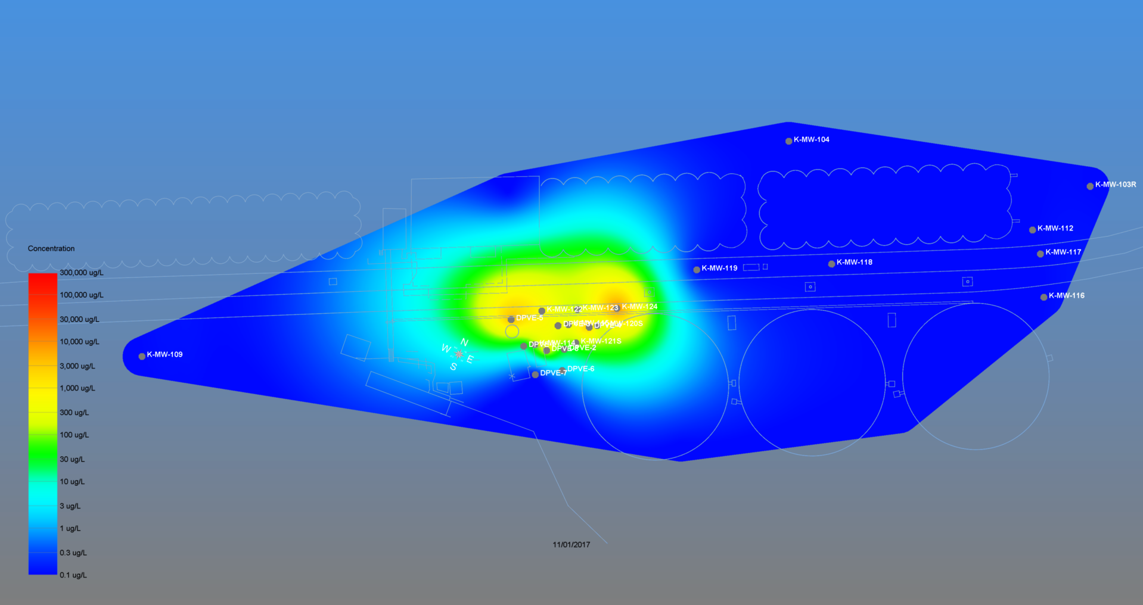
Condition in 2017
(Post 3 Pilot + 5 Full-scale Ivey-sol Applications)

Slide 34
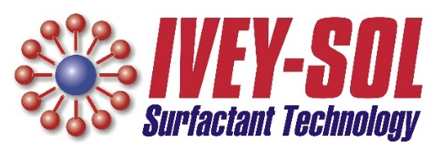
Full-Scale ivey-sol SEr Results
98% CT Reduction in Source Area Shallow Monitoring Wells
  K-MW-120S, 121S, 122 through 124
92% CT Reduction in Source Area DPVE wells
  DPVE-3 and 4
Significant reductions in LNAPL thickness
  No measurable LNAPL in March 2018
Notes:
In summary, over 90% reductions in source area wells. Additionally, no measurable LNAPL last month.

Slide 35

Get in touch with Us
Eric Dulle, PE
Burns & McDonnell
Phone: 314-682-1657
Email: edulle@burnsmcd.com
Web: www.burnsmcd.com
George (Bud) Ivey, P.Chem.
Ivey International Inc.
Phone: 250-203-0867
Email: budivey@iveyinternational.com
Web: www.iveyinternational.com
John Hesemann, PE
Burns & McDonnell
Phone: 314-682-1560
Email: jhesemann@burnsmcd.com
Web: www.burnsmcd.com

