Slide 1
Successful On-Site Treatment of Oil-Impacted Soil and Oil Sludge Using STAR_{x}/Hottpad™ (Ex Situ Smoldering)
Presented by: Gabriel Sabadell, Ph.D., PE

Slide 2

Overview
Smoldering Combustion Basics
Case Study
  Full-scale application to treat oil-impacted soils and sludge at an active terminal facility in SE Asia
Summary
Acknowledgments:
  Savron – Cody Murray, Grant Scholes, Gavin Grant, & Dave Major
  Chevron ETC – Dave Thomas & Paul Bireta

Slide 3
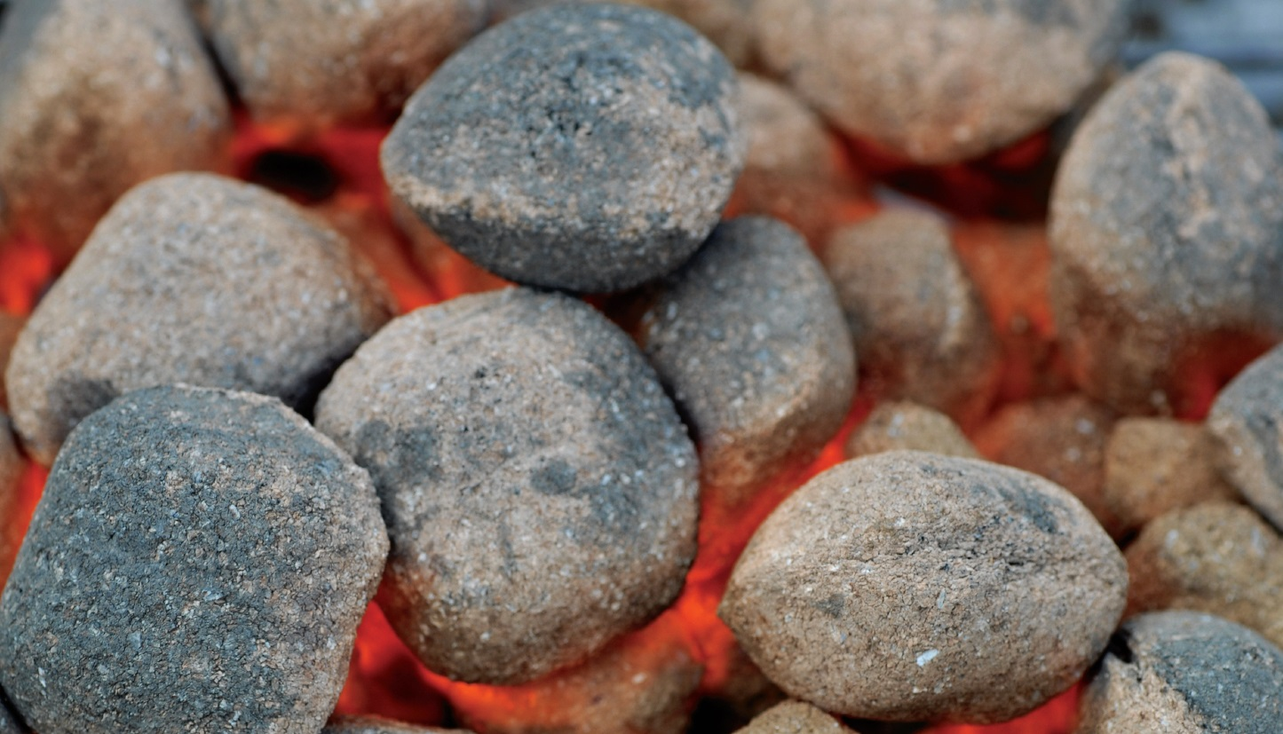
Smoldering Combustion
Exothermic reaction converting carbon
compounds to CO₂ + H₂O
Fuel
Heat
Oxidant
Oil-Impacted Soil or Organic Waste
Combustion
Injected
Air
Heater Element (for ignition only)
Smoldering is possible due to large surface area of organic liquids
(e.g., NAPL) within the porous matrix

Slide 4
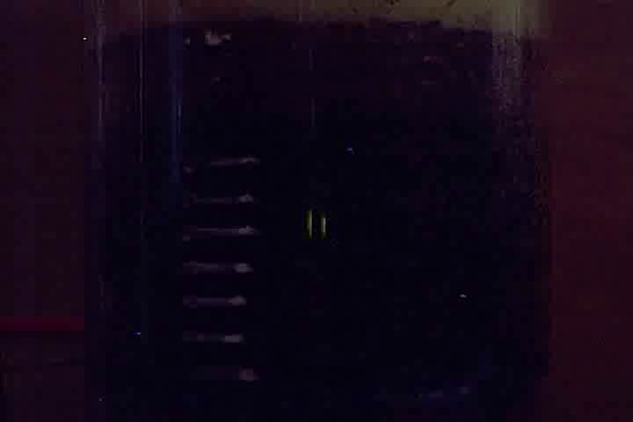
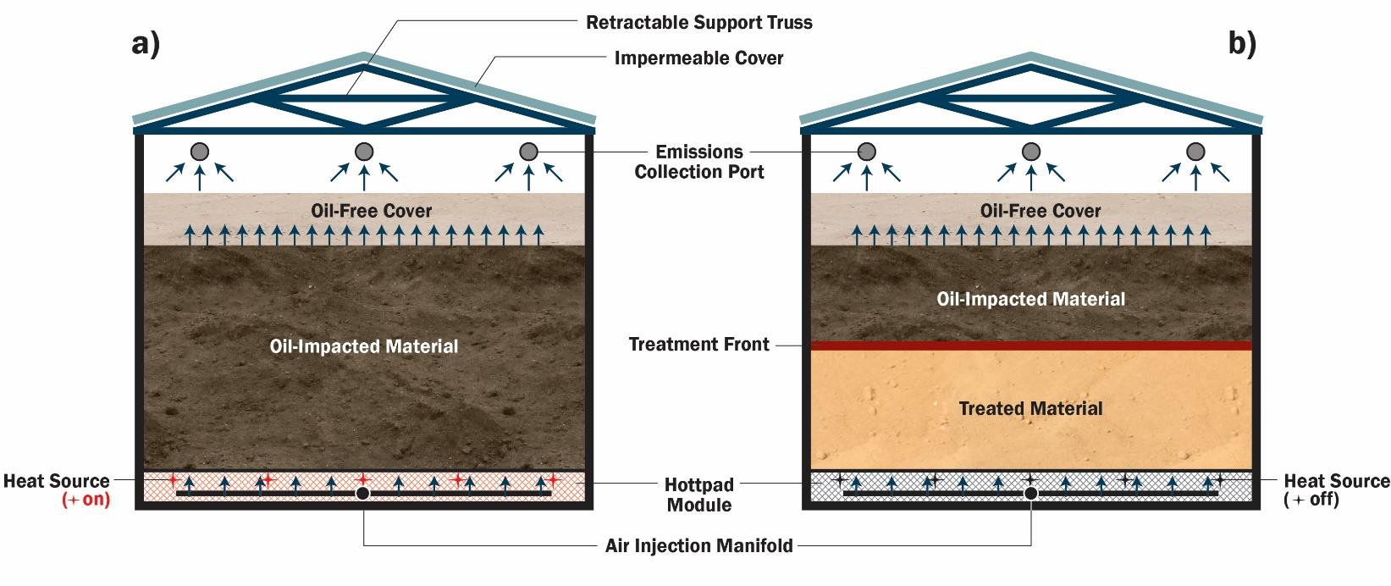
Overview of Hottpad Treatment
Video accelerated 50 times

Slide 5
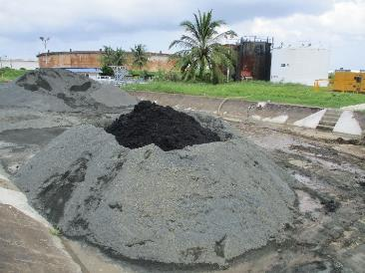
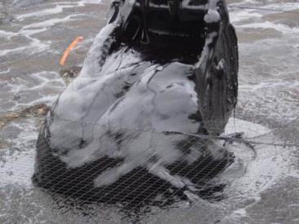
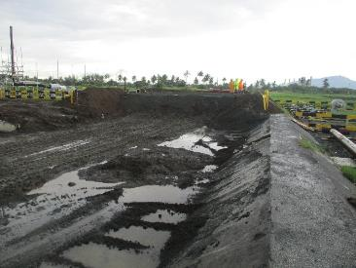
Case Study
Active terminal facility in south east Asia
Designed to treat 3,500 m³ of
stockpiled API separator sludge
Co-treatment with Oil-impacted site soils
5

Slide 6
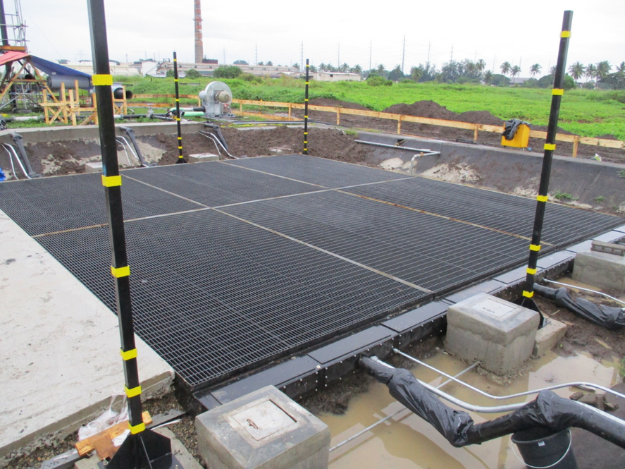
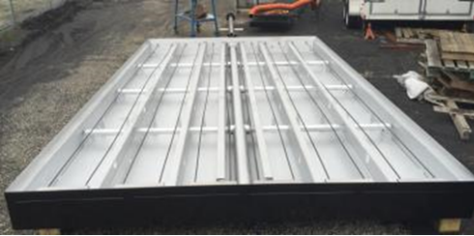
System Overview
  Fixed 6 pad system
      78m² surface area
Air Injection Pipe
Heating
Element
4.2 x 2.8 m

Slide 7
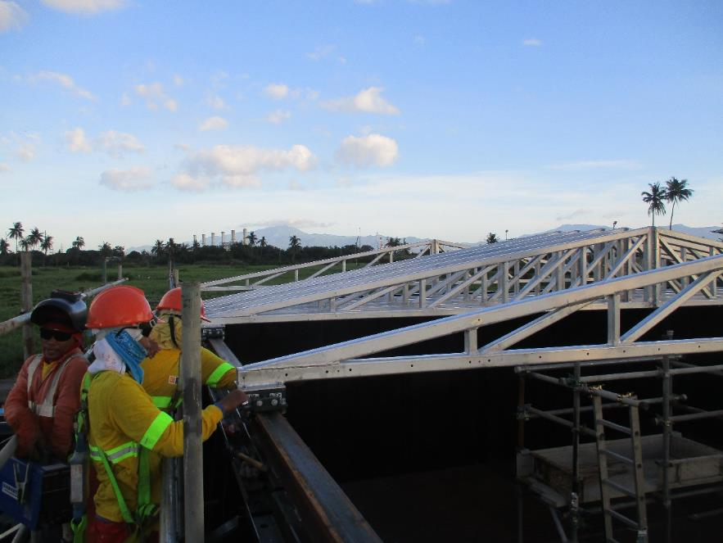
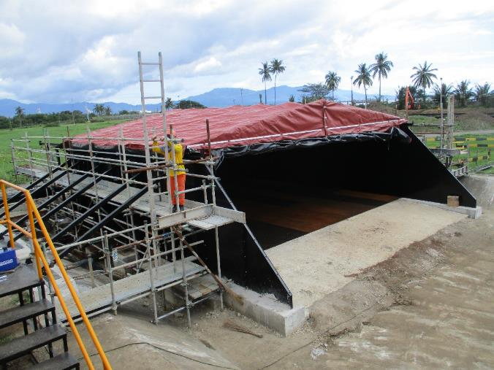
System Components
System Overview
Fixed, 3 m walls
Deployable cover system

Slide 8
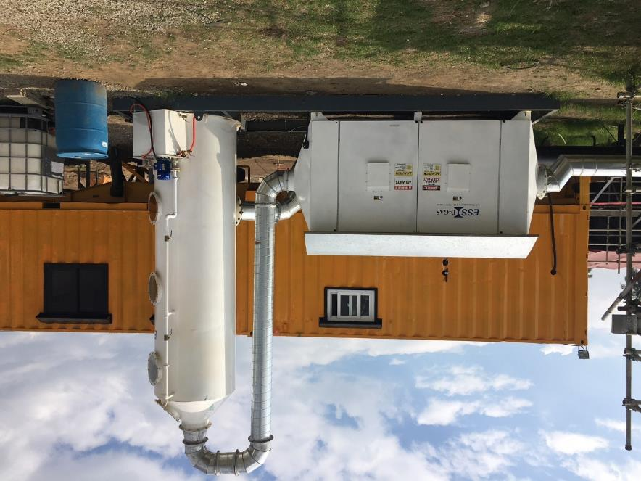
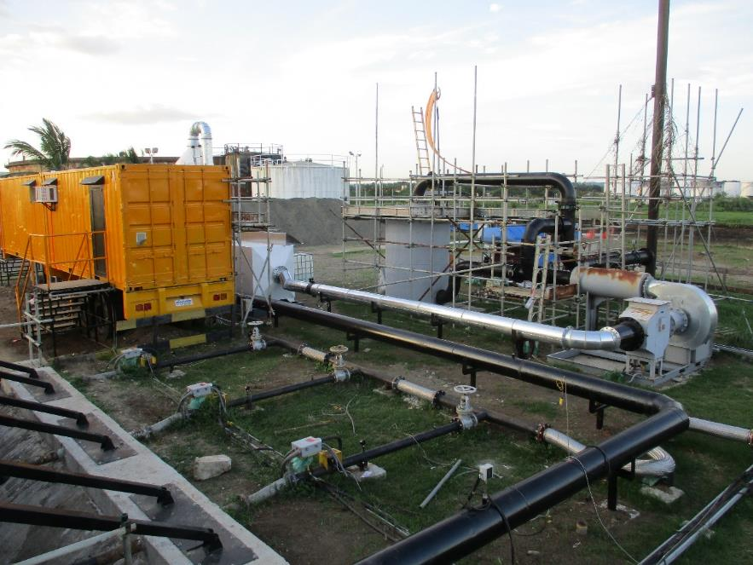
Emissions Collection

Slide 9

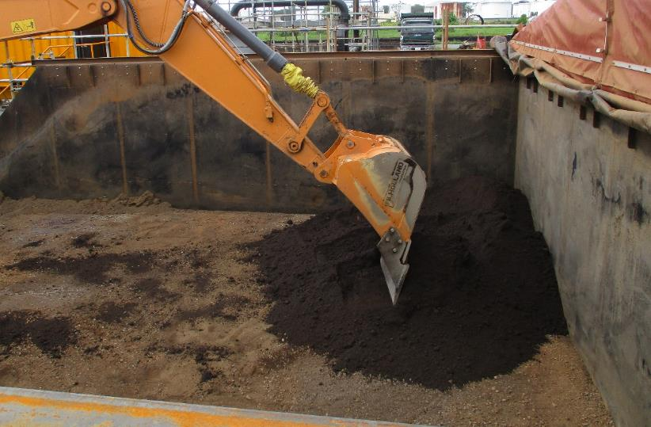
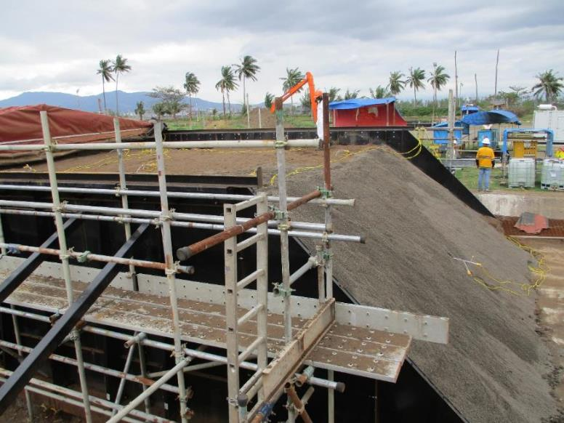
Mixing/Loading
System Loading
  >25% sludge by volume
  2 m high (160 m³)
  0.5 m cover material

Slide 10
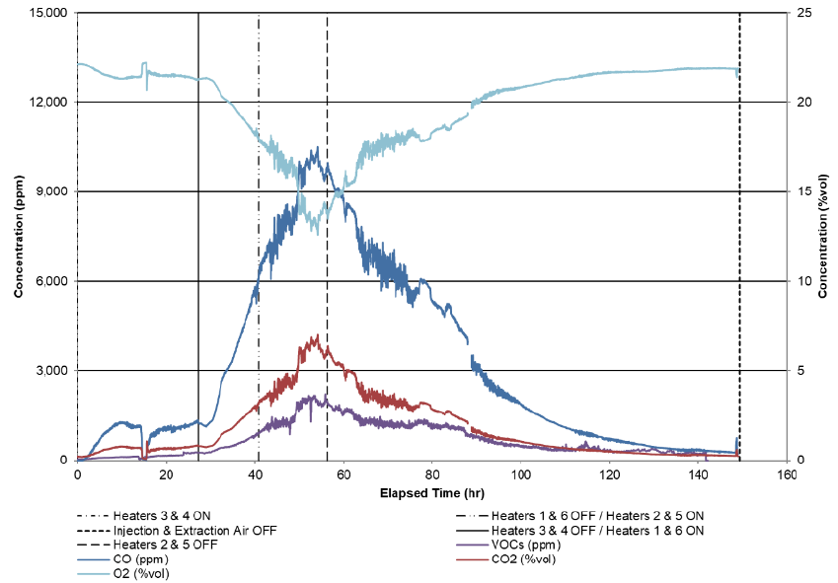
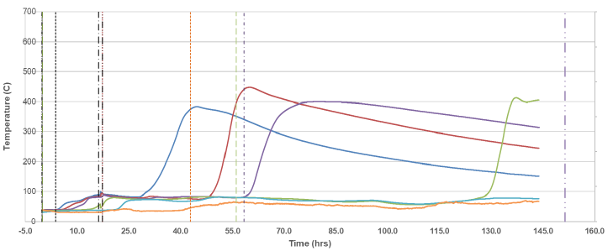
Process Monitoring
Hottpad Full-Scale Operations - Processing
O₂ (%)
Ignition and Combustion Tracking
  Real time thermocouple and combustion gas analysis
Process Equipment Monitoring
  Flow and pressure monitoring
  Vapor treatment system monitoring
  Power and control system monitoring/optimization
Treatment Monitoring/Efficiency
  Pre/post laboratory analysis
CO (ppm)
CO₂ (%)
THC (ppm)

Slide 11
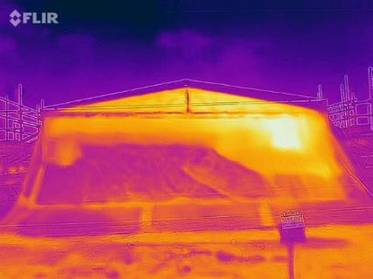
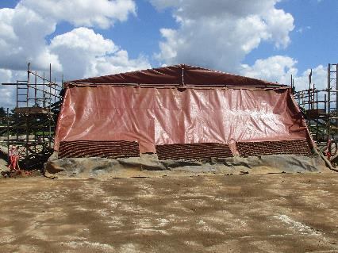
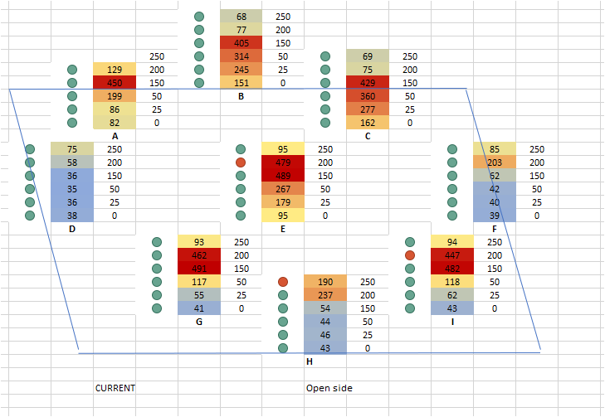
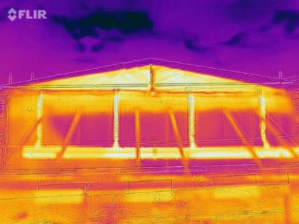
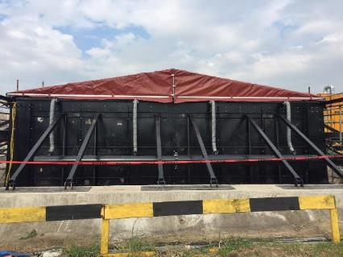
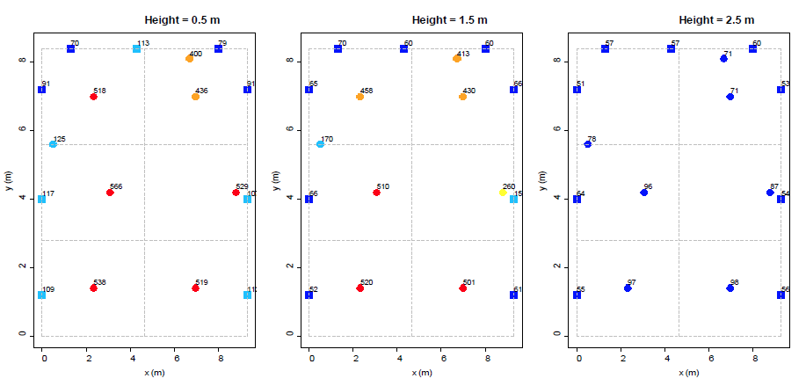
Process Monitoring

Slide 12

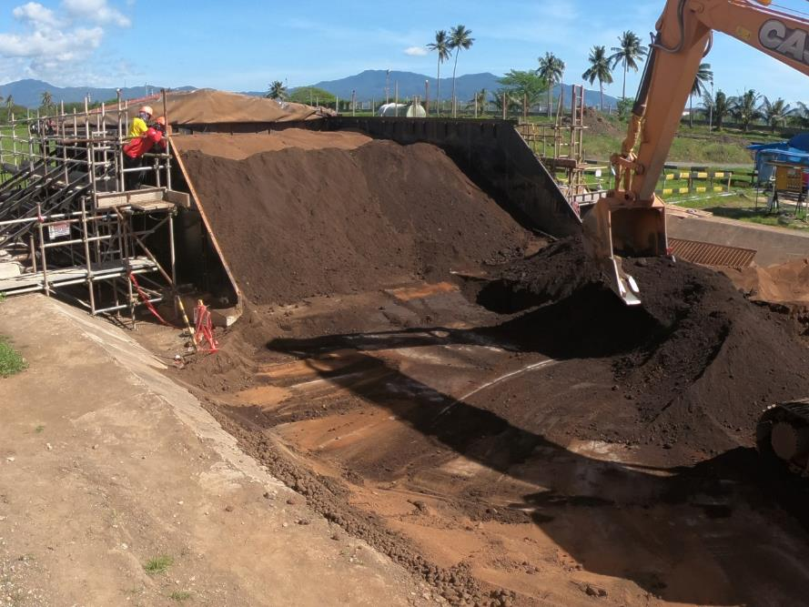
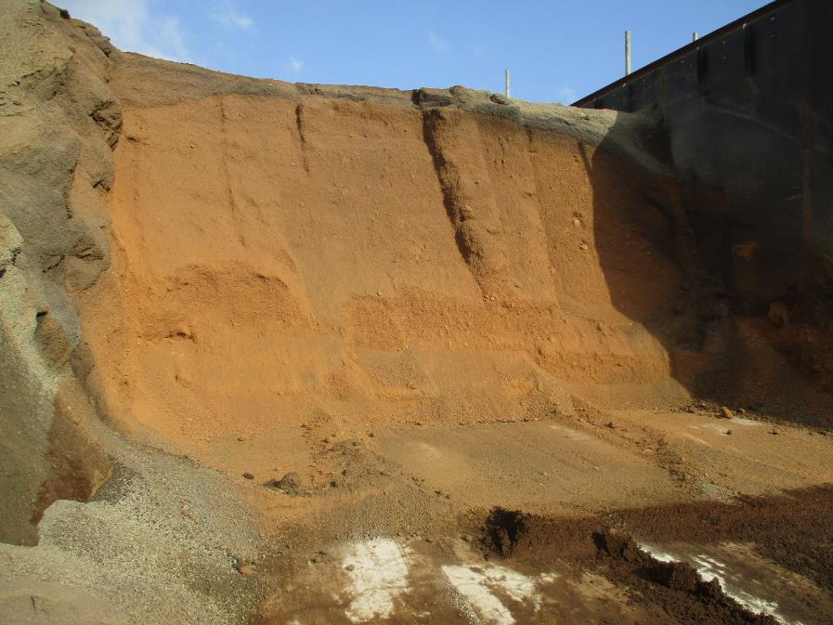
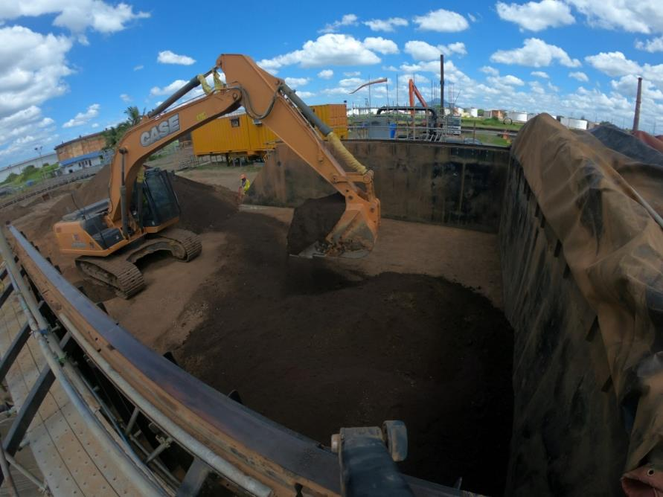
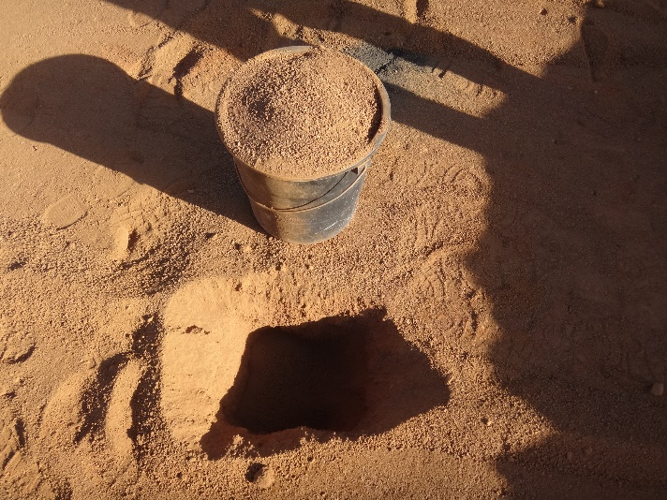
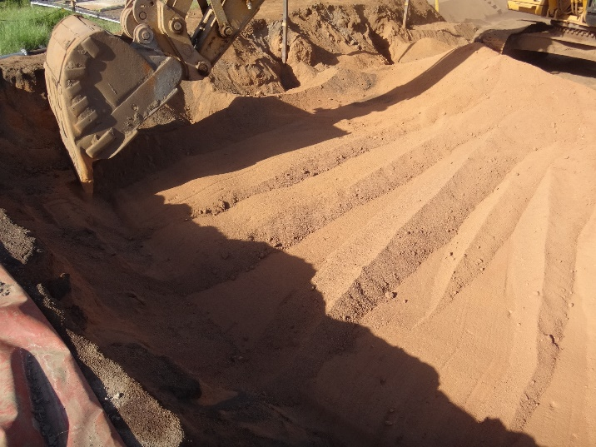
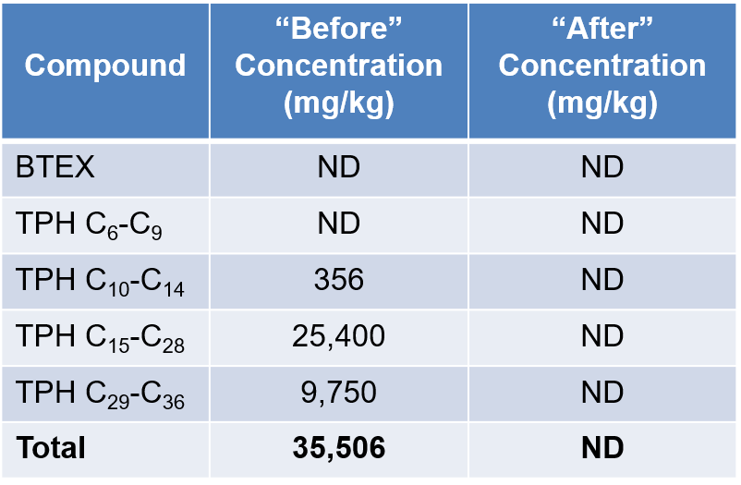
Treatment Results
Before
After

Slide 13
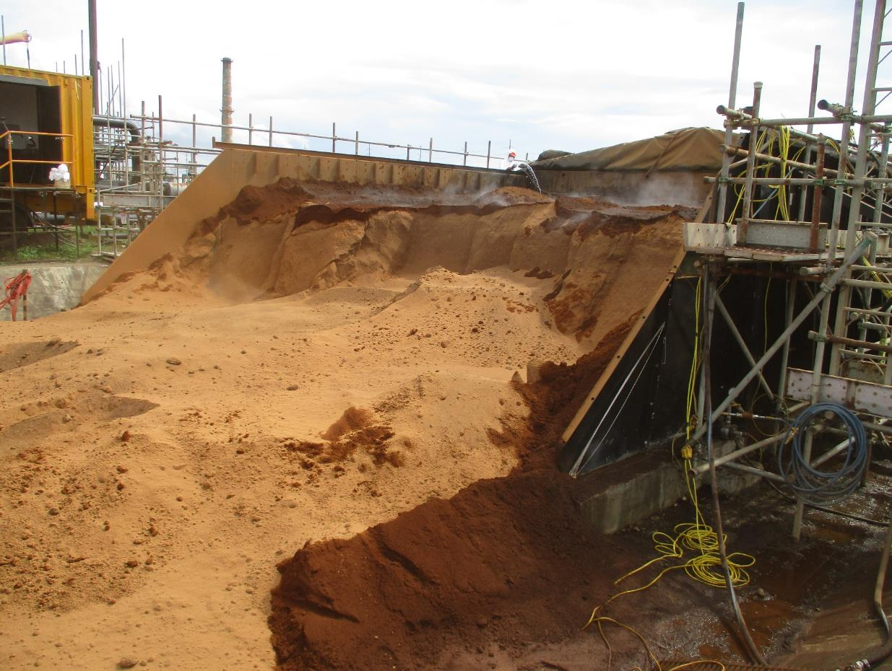
Treatment Results
Compound | “Before” Concentration (mg/kg) | “After” Concentration (mg/kg)
BTEX | ND | ND
TPH C₆-C₉ | ND | ND
TPH C₁₀-C₁₄ | 356 | ND
TPH C₁₅-C₂₈ | 25,400 | ND
TPH C₂₉-C₃₆ | 9,750 | ND
Total | 35,506 | ND
Controlled emissions capture
  Extraction ~ 1.25 times Injection rate
4-4.5 days for treatment
  Includes ignition time
No issue with wall temperatures
Wet areas from water spray for dust suppression

Slide 14
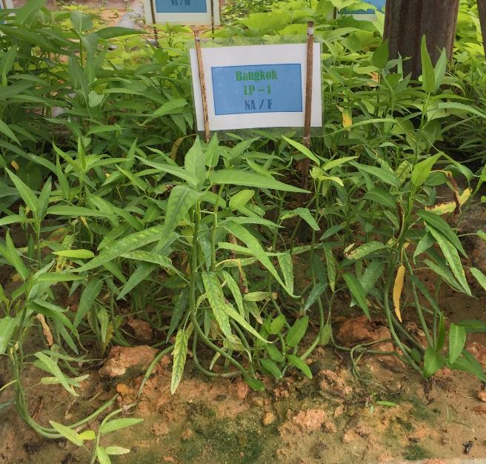
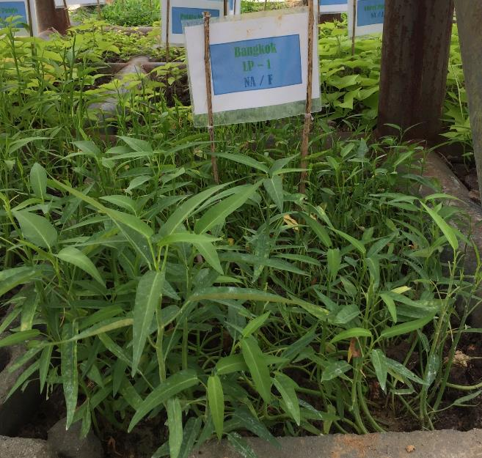
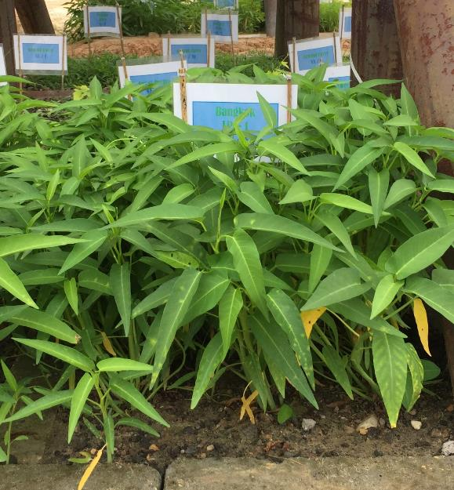
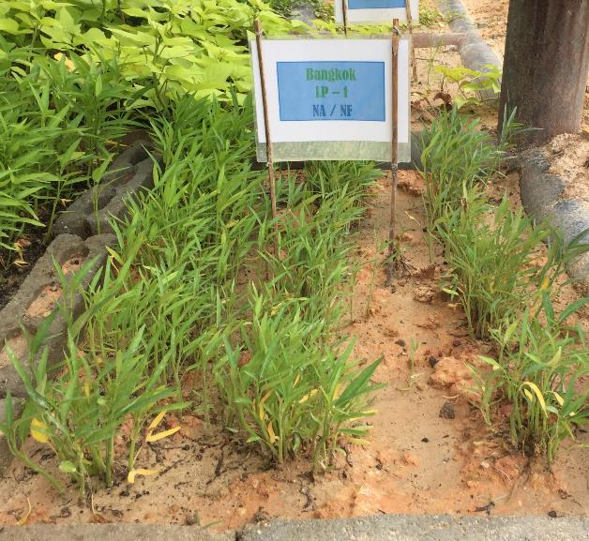
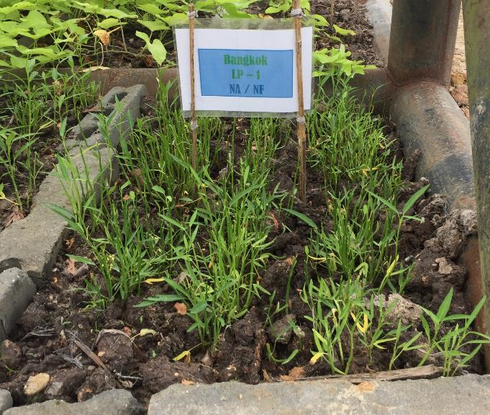
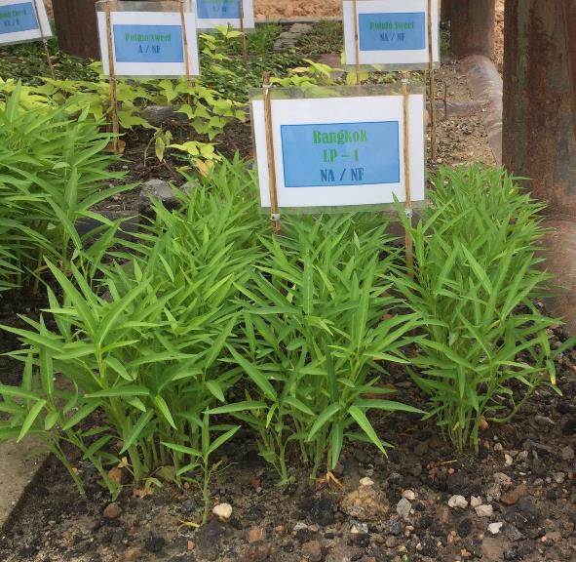
Plant Growth
Clean Soil
Oil-Impacted Soil
Hottpad Treated Soil
Fertilizer
No Amendments

Slide 15
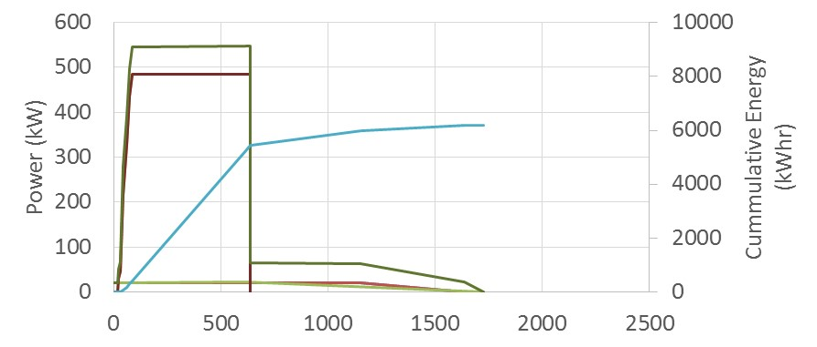
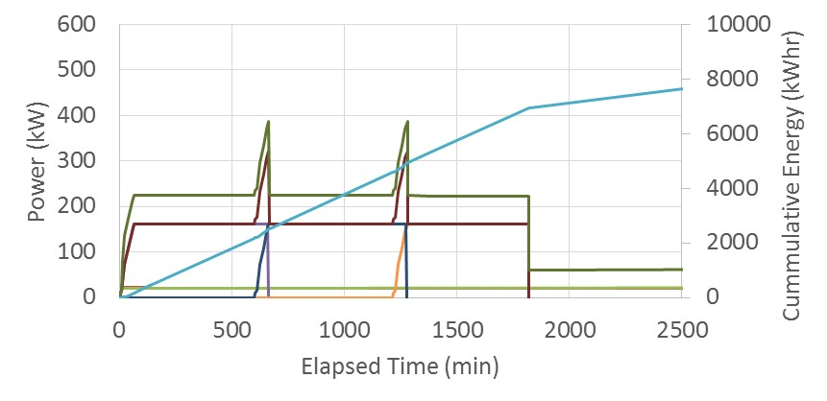
Example – Process Optimization
Base Case
  Operate all pad heaters simultaneously
  High peak load during heating, followed by low demand for duration of process
“Rolling Start”
  Sequenced heater operation
  Reduced peak power
  Steadier power load
  More efficient service sizing

Slide 16
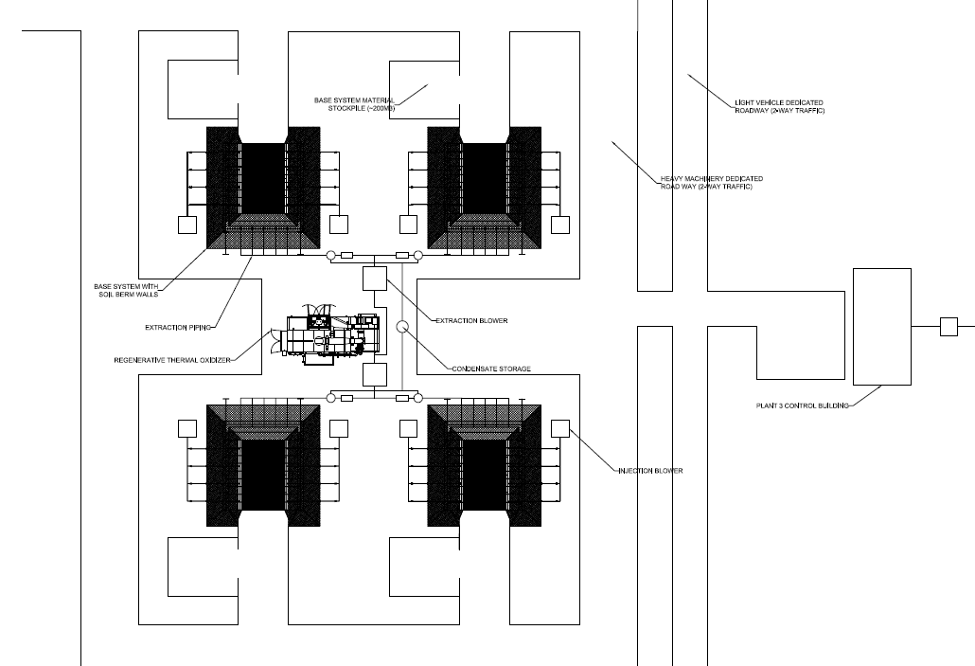
Conceptual Plant with 4 Base Systems
Gained Efficiencies
  Continuous operations
  Centralized controls
  Single emissions collection system

Slide 17
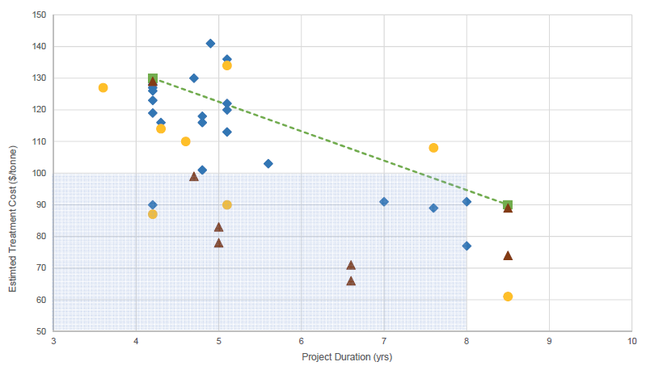

Technology Cost Drivers
Capital
  Hottpad system
  Emissions treatment system
Throughput
  Treatment propagation rate
  Size of system (scalable)
Energy Requirements
  Heaters
    Electric or gas
    Peak demand vs total demand
  Blowers
  Emissions treatment
    Additional fuel
Project Cost Analysis

Slide 18
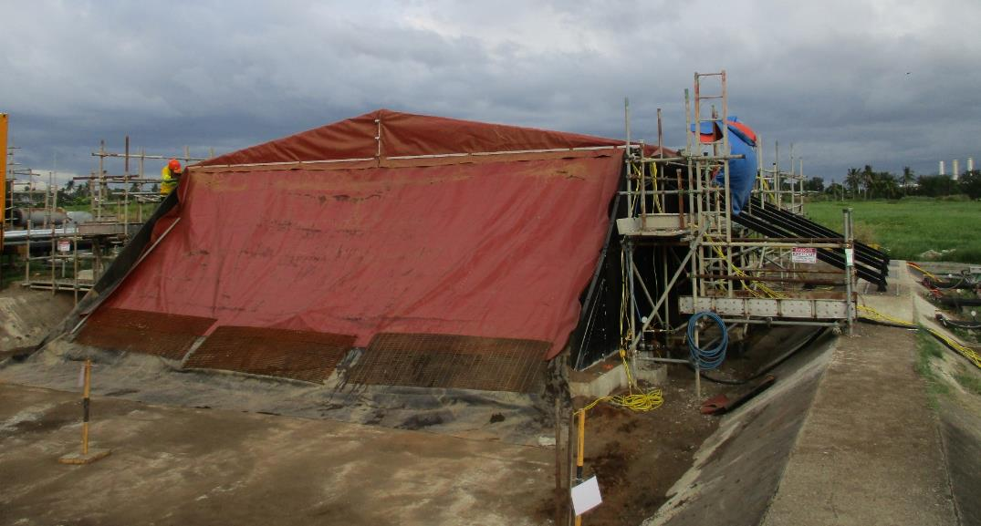

Summary
Technology works well for a wide range of materials
  Can combine sludge with contaminated soil
  Contaminant destruction
Cost-effective as compared to other alternatives
Scalable for on-site remediation
  Reduce/eliminate truck transport
More environmentally friendly
  Soil reuse (construction backfill or revegetate)
  Smaller GHG footprint
  Limited waste by-products
From Prototype to Full-Scale

Slide 19
Questions?
gsabadell@savronsolutions.com

