Slide 1
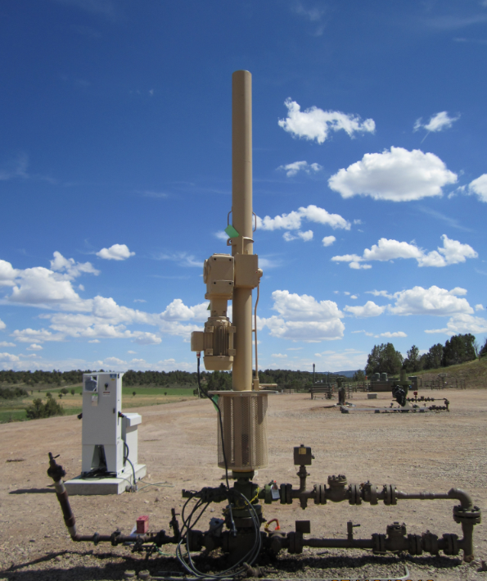
Small Footprint LRP® Pumping Unit
Jordan Hanson, Control Solutions, Unico Oil & Gas
Ron Peterson, Control Solutions, Unico

Slide 2
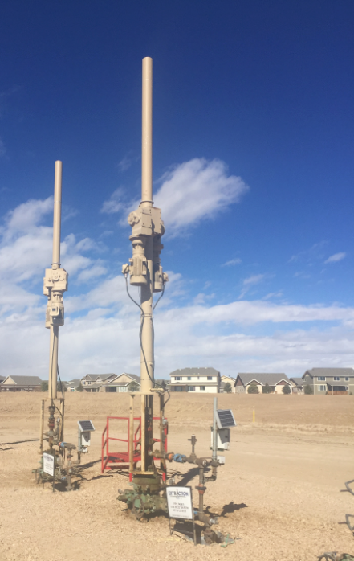
Unico LRP® Pumping Unit
Pumping Unit for Sucker Rod
Replaces Traditional Horse Head
Electromechanical (Not Hydraulic)
Small Size and Weight
Safety: No Exposed Moving Parts or Pinch Points
Ease of Transportation / Installation
Visual Appeal
Quiet Operation
Reduced Environmental Impact

Slide 3
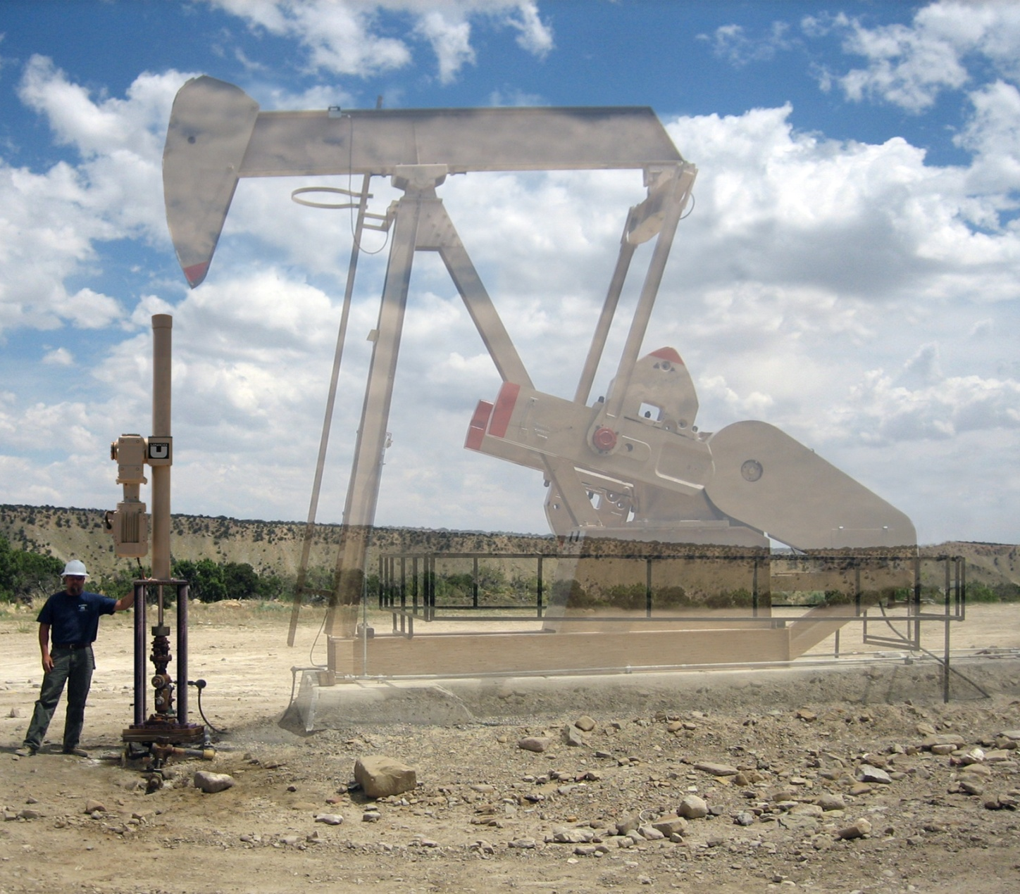
Unico LRP® Pumping Unit
Replaces Traditional Pumping Unit

Slide 4
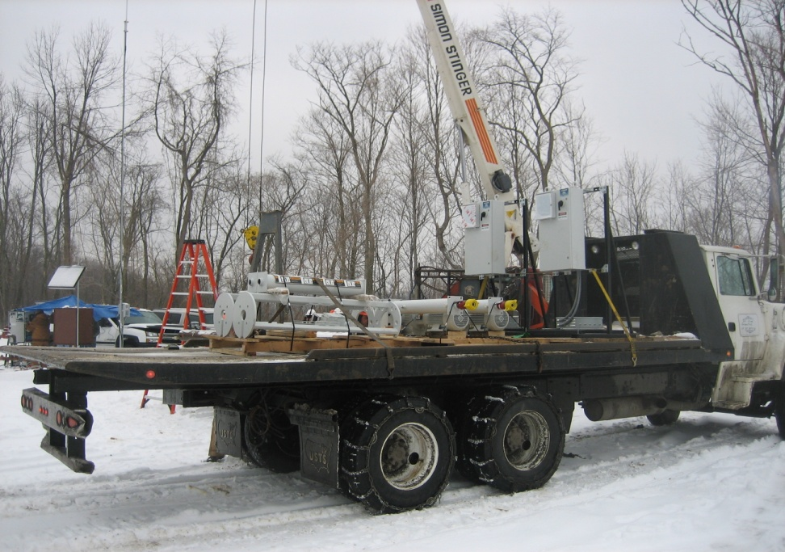
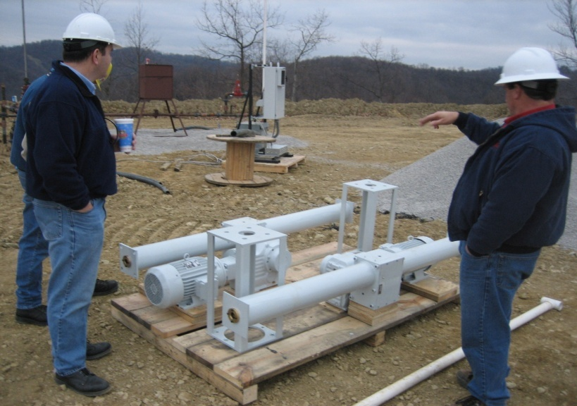
Unico LRP® Pumping Unit
Minimal Environmental Impact during Installation and Operation
Two Units Transported on a Flat Bed

Slide 5
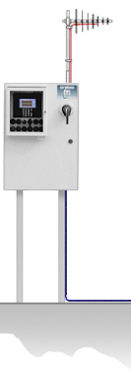
Unico LRP® Pumping Unit
LRP® System Comprises:
Reversing AC Motor
Gear Reducer
Rack and Pinion Drive Assembly
Mounting Stand
Control System

Slide 6
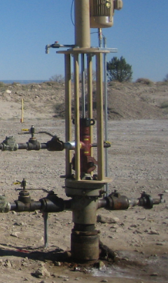
Conventional Well Completion
Conventional Well Completion / Traditional Downhole Sucker Rod Pump
Conventional Wellhead
Conventional Stuffing Box
Casing and Tubing Mount Options Available
Mounting Stand Provides Access to Stuffing Box and Tree
Polished Rod Optionally Enclosed (Screened)

Slide 7
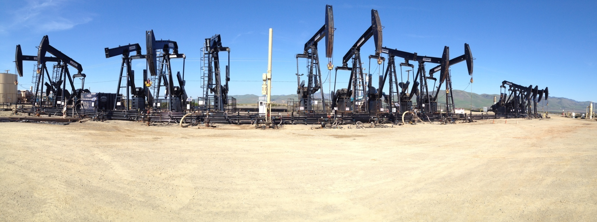
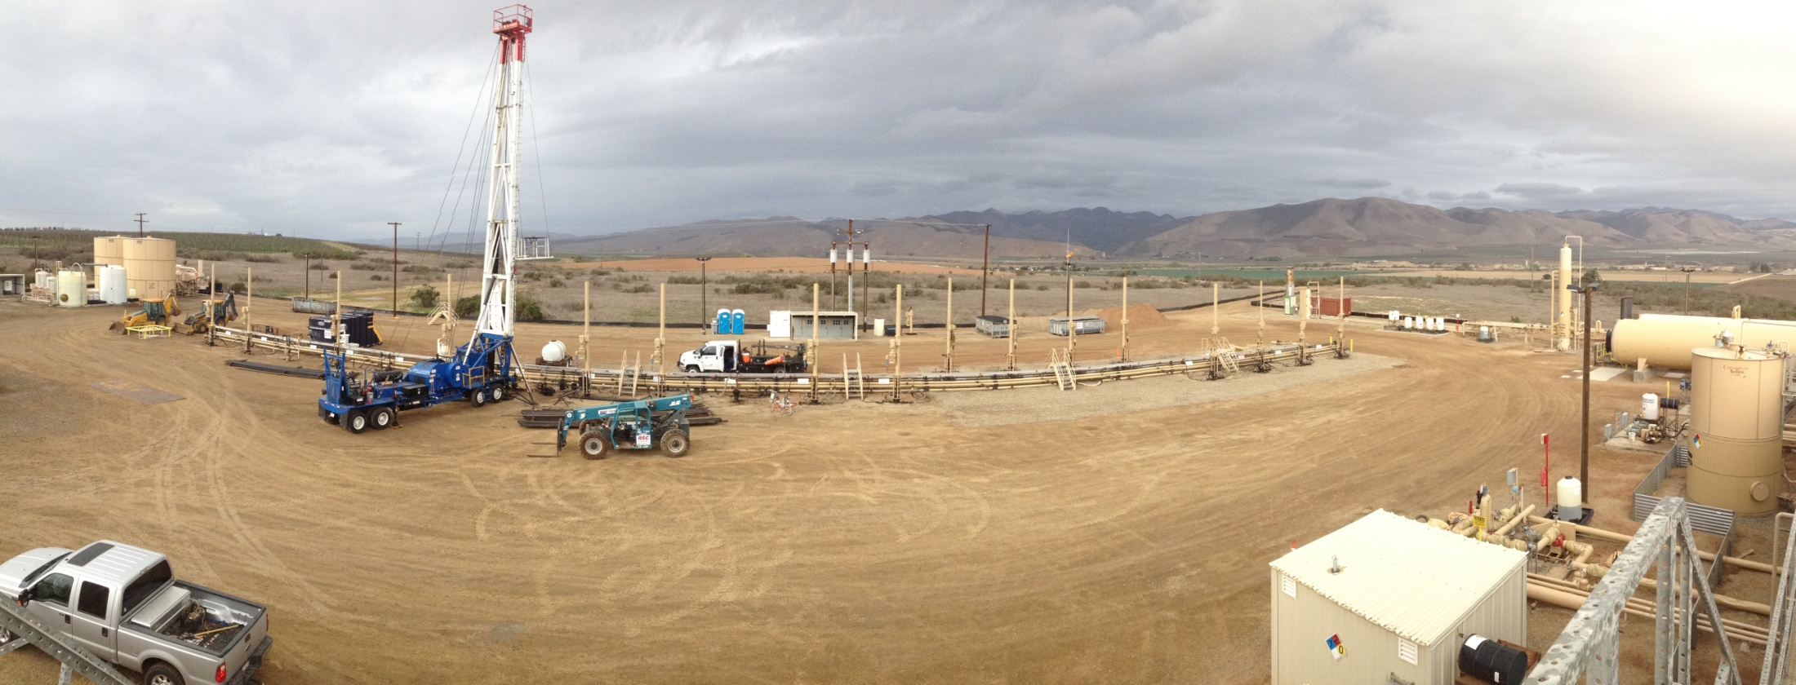
Unico LRP® Pumping Unit
Before
After

Slide 8
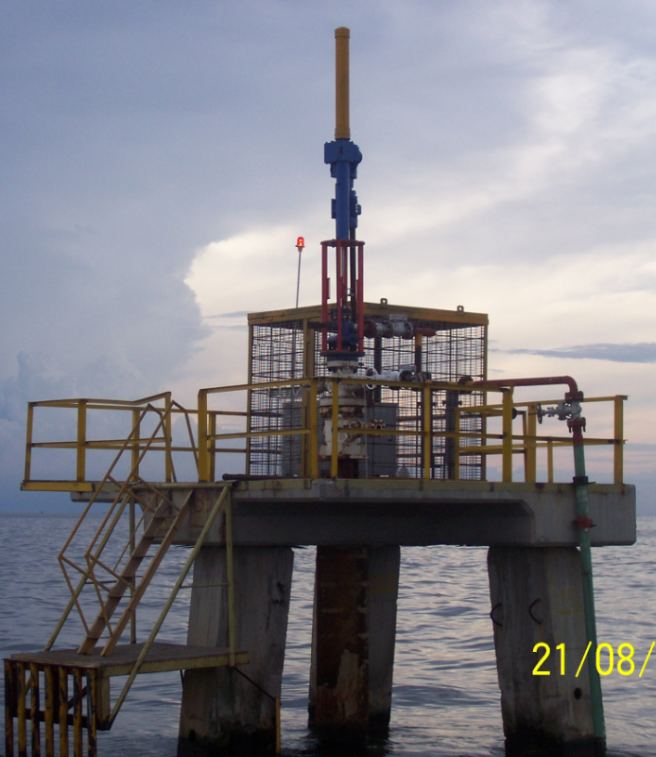
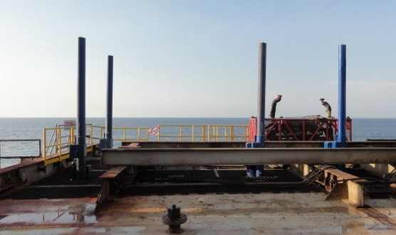
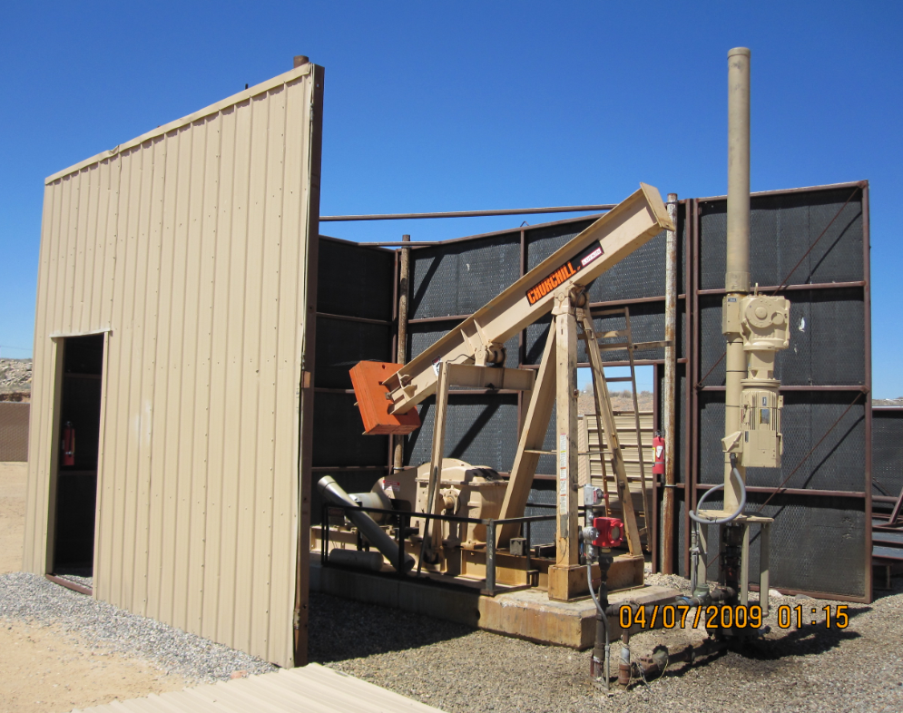
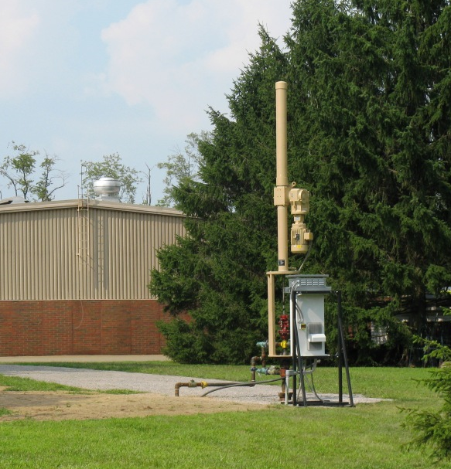
Example Installations / Environmentally Sensitive Sites

Slide 9
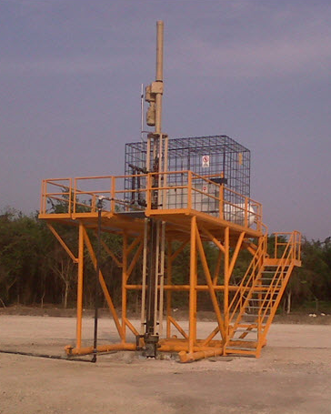
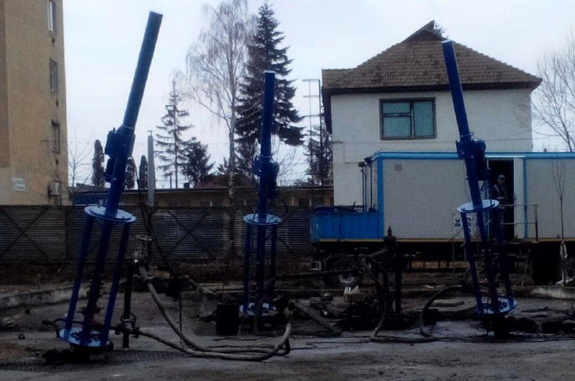
Example Installations / Environmentally Sensitive Sites

Slide 10
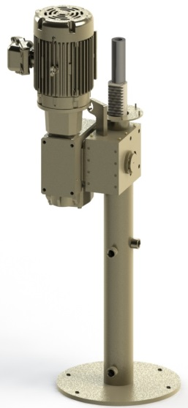
Technical Specifications
Light Duty
Rated Lifting Capacity: 4,800 lbs.
Rated Gearbox Torque Capacity: 8,500 in-lbs.
Rated stroke (in.) | 12 | 24 | 36
Weight (lbs.) | 511 | 534 | 566
Overall height above stand (in.) | 75 | 99 | 123

Slide 11
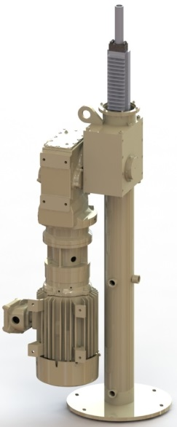
Technical Specifications
Standard Duty
Rated Lifting Capacity: 12,000 lbs.
Rated Gearbox Torque Capacity: 23,900 in-lbs.
Rated stroke (in.) | 20 | 32 | 44 | 56
LRP weight (lbs.) | 806 | 1197 | 1232 | 1272
Overall height above stand (in.) | 95 | 120 | 143 | 166

Slide 12
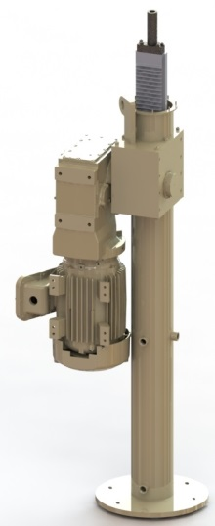
Technical Specifications
Heavy Duty
Rated Lifting Capacity: 19,000 lbs.
Rated Gearbox Torque Capacity: 38,100 in-lbs.
Rated stroke (in.) | 32 | 44 | 56
Weight (lbs.) | 1823 | 1923 | 2023
Overall height above stand (in.) | 144 | 186 | 197
Rated stroke (in.) | 64 | 86
Weight (lbs.) | 2325 | 2735
Overall height above stand (in.) | 299.5 | 339.5

Slide 13
Technical Specifications
Tandem Heavy Duty
Rated Lifting Capacity: 38,100 lbs.
Rated Gearbox Torque Capacity: 76,200 in-lbs.
Rated stroke (in.) | 86 | 100 | 120 | 144
Weight without motors (lbs.) | 2500 | 2630 | 2810 | 3035
Maximum clamp height above stand (in.) | 237.6 | 266.9 | 306.0 | 354.9

Slide 14
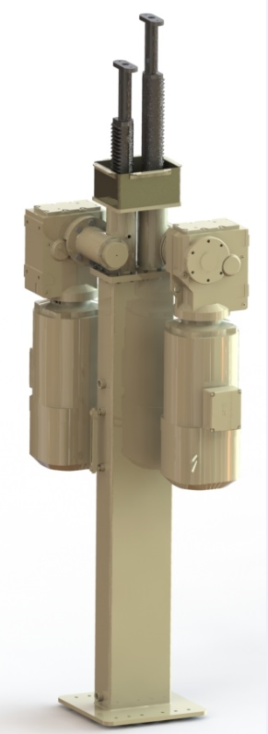
Dual Completion
Independent Production from Two Zones
One Wellhead
Dual Tubing / Rods
Dual Pumps
Packer Isolation

Slide 15
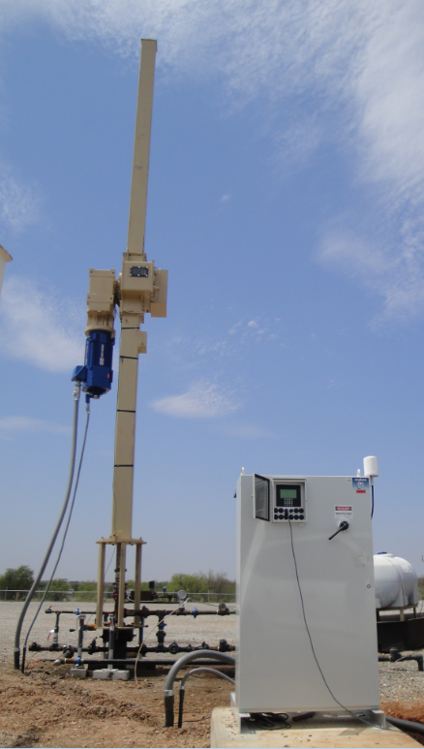
Automation / Controls
Near Unity Power Factor
IEEE-519 Harmonic Compliant Options
Optimization Controls for Efficiency:
Controls from Down-Hole States / Potential Energy Savings as Unit Runs No Faster than Necessary to Match Well Inflow – No “Extra” Strokes for Improved Efficiency.
Remote Telemetry / Operation and Surveillance / Troubleshooting:
Reduced Pumper Visits to Wellsite
Efficiently Dispatch Appropriate Service Personnel to Wellsite

Slide 16
Automation / Controls
Rapid Fault Detection with Alarm / Callout:
Well Fluid Leak Detection
Tubing Pressure
Casing Pressure
Overload
Underload
Etc.

Slide 17
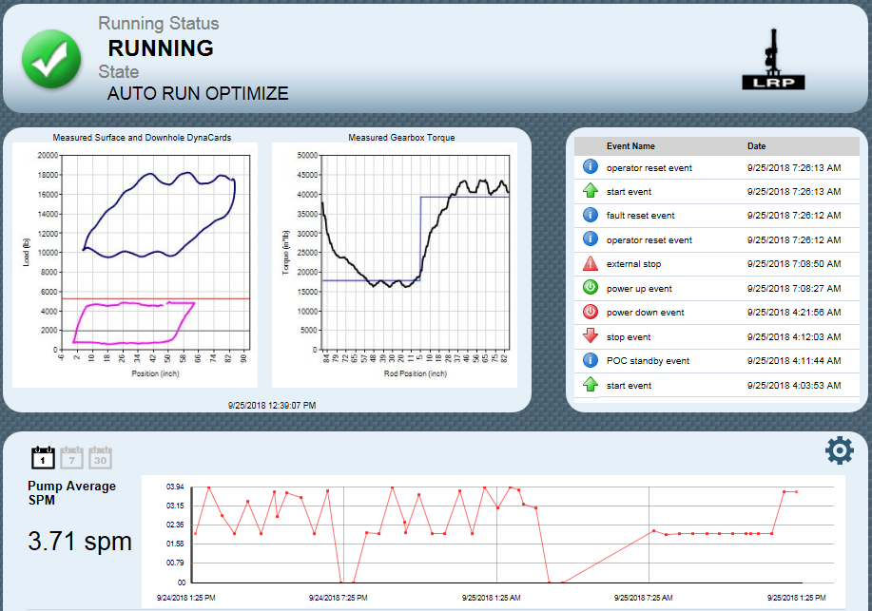
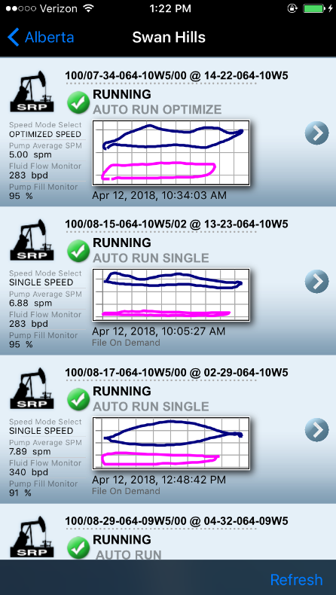
GMC™ Remote Telemetry

Slide 18
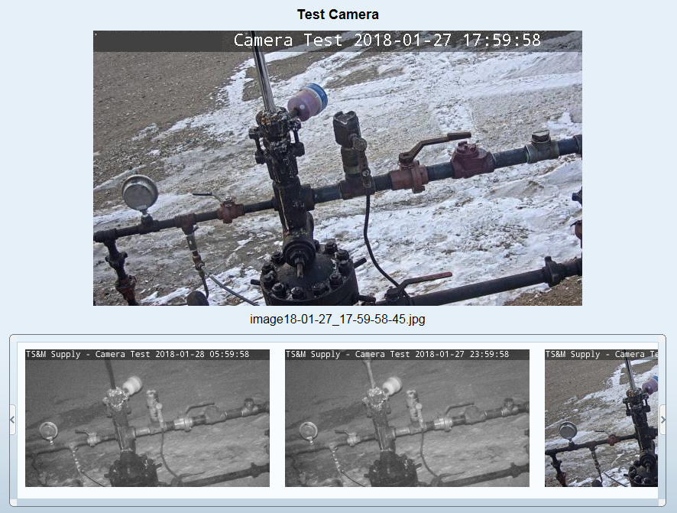
Camera Surveillance

Slide 19
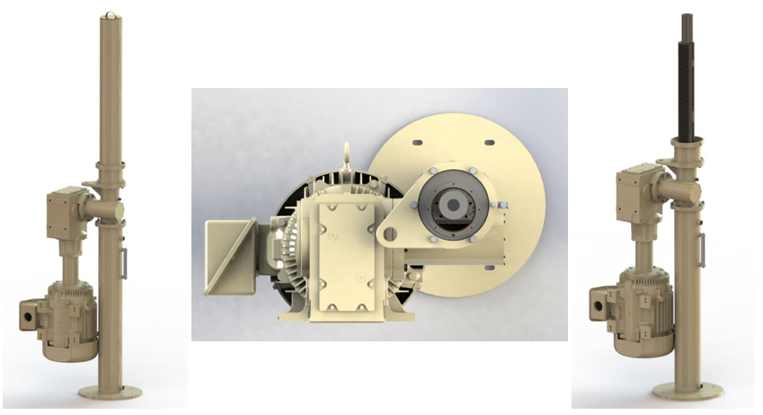
Gen III
Next Generation Design for Added Durability and Leak Resistance:

Slide 20
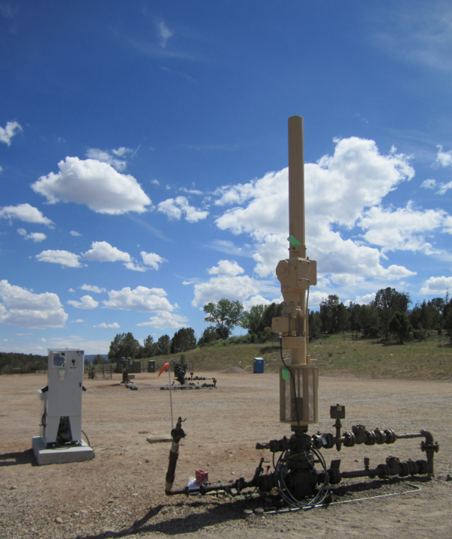
Thank you. Questions?

