Slide 1
Quantification of LNAPL Transmissivity in fractured porous media
Camille Carter (GEI)
J. Michael Hawthorne, PG (GEI)
Lisa Reyenga, PE (GEI)
October 31, 2018
CL:AIRE, 2014)

Slide 2
outline
FRACTioN™ Process
Test Case
Introduction
Review

Slide 3
FRACTioN™ (patent pending)
Fracture Permeability NAPL Transmissivity (T_{n}):
NAPL transmissivity quantifies hydraulic recoverability
Existing granular porous media methods for T_{n} fail in fractured media
T_{n} for fractured media requires individual fracture geometries and discharge rates
Integrates with and enhances conceptual site models (CSM) with high resolution mobile NAPL interval (MNI as fractures) data
Provides discharge rates and T_{n} for individual fractures and well aggregate
Applicable to both LNAPL and DNAPL

Slide 4
BENEFITS OF FRACTioNTM
Apply Latest Science with Precedents
Close Sites
Quantify Recoverability
Design Better Remedies
Save Money

Slide 5
NAPL transmissivity tells us…

Slide 6
NAPL Transmissivity uses
Initial Assessment
Measure T_{n} (ASTM)
Remedial Objective
MEP
Remedy Selection
Remedy Design
Remedy Implementation
Threshold Evaluation
Model Calibration
Model Calibration
Threshold Evaluation
Design Calculations
Progress Metric
Proximity to Residual /EUR
Time to Threshold /RTA
Technology Decision Pt.
Hydraulic Recovery Complete
Other Pathways May Require Remedy(ies)
CSM Development
Migration Risk
Dissolved / Vapor Risks
Direct Contact
PREDicT™
FRACTioN™
ASTM E2856
PREDicT™
FRACTioN™

Slide 7
FRACTioN™ PROCESS
patent pending
Notes:
I’m going to talk about the FRACTioN process, which will include the theory behind FRACTioN, and how we analyze data, and ending with some test cases.

Slide 8
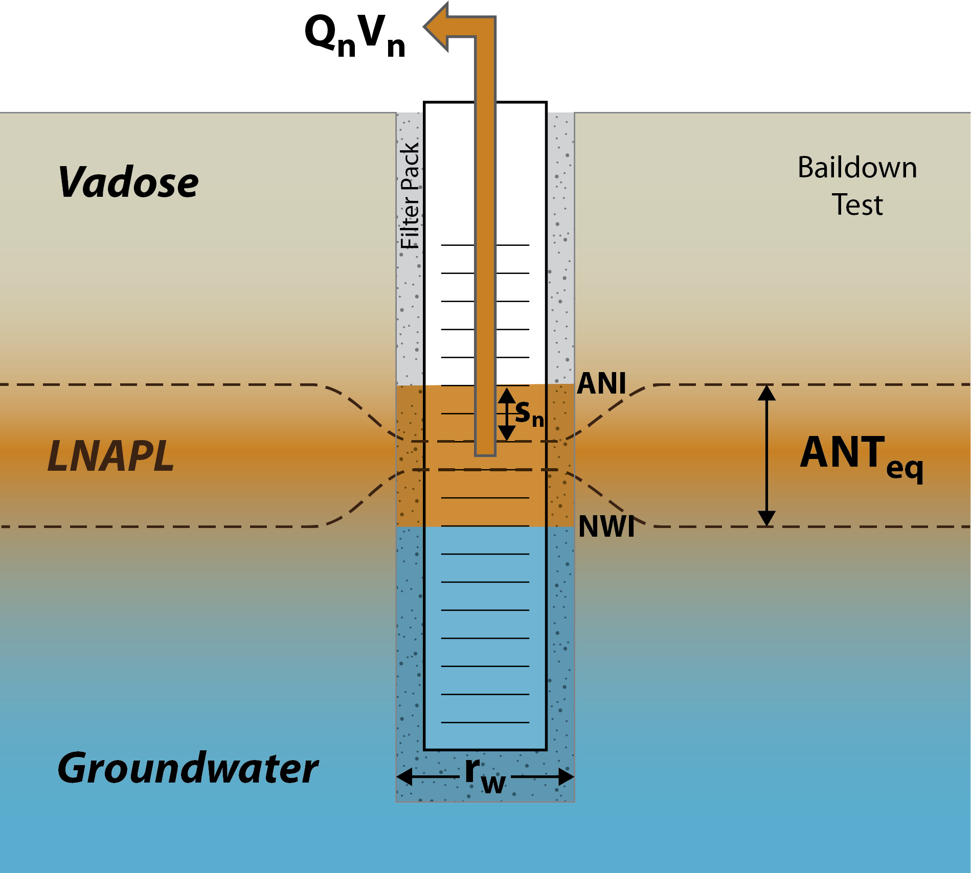
Baildown test (LNAPL Example)
Remove NAPL from the well
Monitor fluid elevations over time
Test concludes when NAPL in the well is in equilibrium with NAPL in the formation
Modification of ASTM E2856 for LNAPL
Notes:
So, how do you implement FRACTioN, and what is the theory behind it? As an overview, the first step is to remove NAPL from the well. This is just like you are starting a baildown test. Then, you need to monitor fluid elevations over time, as the well recovers. The test is complete when the NAPL returns to equilibrium – which is, the fluid in the well is in equilibrium with the fluid in the formation. The concept is a modification of the ASTM standard for calculating LNAPL transmissivity, which tells you how to conduct a LNAPL baildown test, and is ASTM standard E2856.

Slide 9
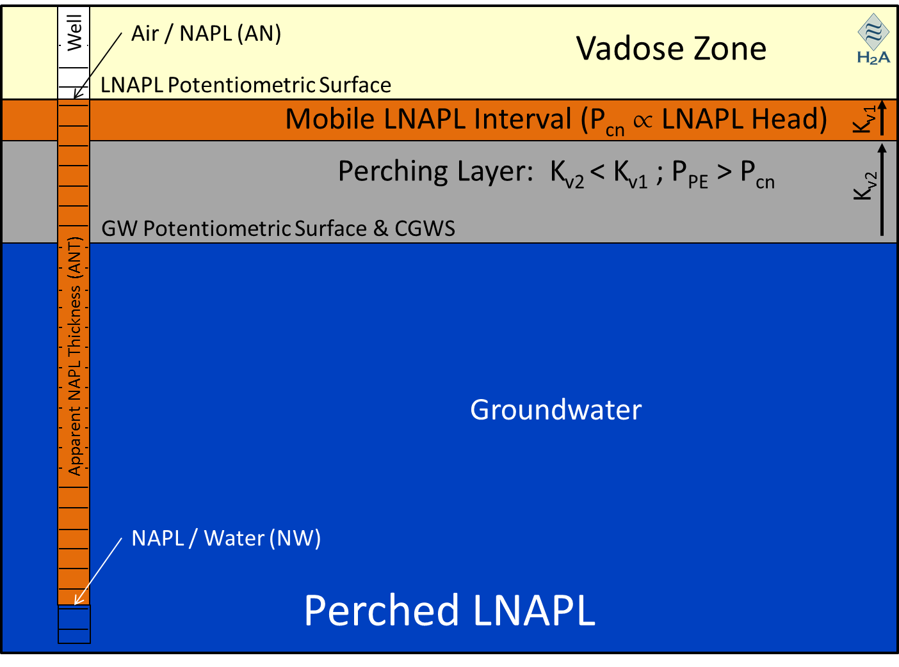
DvD INTERPRETATION LNAPL
Notes:
The key to FRACTioN is constructing a drawdown vs discharge plot, or DvD. The rate of discharge from the formation into the well is plotted on the X axis, and the drawdown in the well is plotted on the Y axis. For a standard baildown test in an unconsolidated formation, the DvD for unconfined LNAPL looks like the second chart. The green line represents filter pack discharge at the start of the test, and at the inflection point of the line the formation discharge begins. For unconfined LNAPL, the formation discharge will trend towards zero discharge, zero drawdown, which is the chart origin, with no periods of constant discharge. The graphic on the bottom left shows unconfined LNAPL – the key points in this graphic are that the LNAPL thickness in the well is the same as the mobile NAPL interval, or MNI, in the formation. The NAPL is also not perched above, nor confined below, any fine-grained layers. During a test, as the LNAPL in the well recovers and the drawdown decreases, the LNAPL discharge into the well also decreases, giving you the unconfined DvD chart.
For confined LNAPL, which is represented in the bottom middle graphic, the NAPL is trapped beneath a confining layer. The water table squeezes the NAPL up against the fine grained layer, and in response to the pressure, the NAPL moves into the well, often equilibrating at greatly exaggerated thickness. The DvD for confined NAPL shows a period of constant discharge, where NAPL moves into the well at a constant rate, as the NAPL in the well continues to recover and the drawdown decreases. The constant discharge is followed by sloping discharge, that correlates with the MNI in the formation. Once the fluid in the well recovers to the mobile NAPL interval, the constant discharge ends and the pattern trends to zero discharge, zero drawdown.
For Perched LNAPL, the DvD actually looks exactly the same. There is no way to tell from a DvD if the NAPL is confined or perched. For perched NAPL, the NAPL is trapped above a confining layer, this is the graphic on the bottom right, and when NAPL is removed from the well the well becomes a sump, and the perched NAPL discharges into the well as the drawdown decreases.
OK, so how does the DvD chart help distinguish multiple mobile NAPL intervals? I’ll show you in the next three slides.

Slide 10
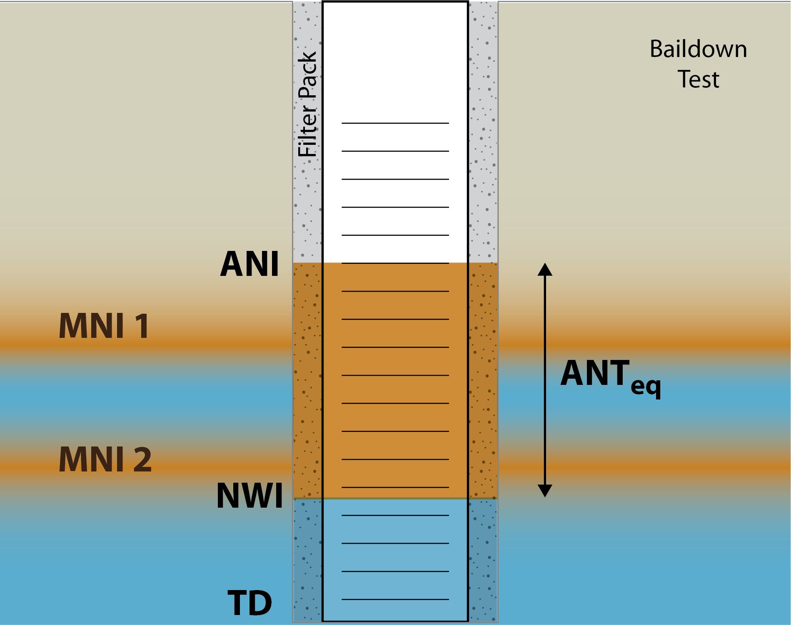
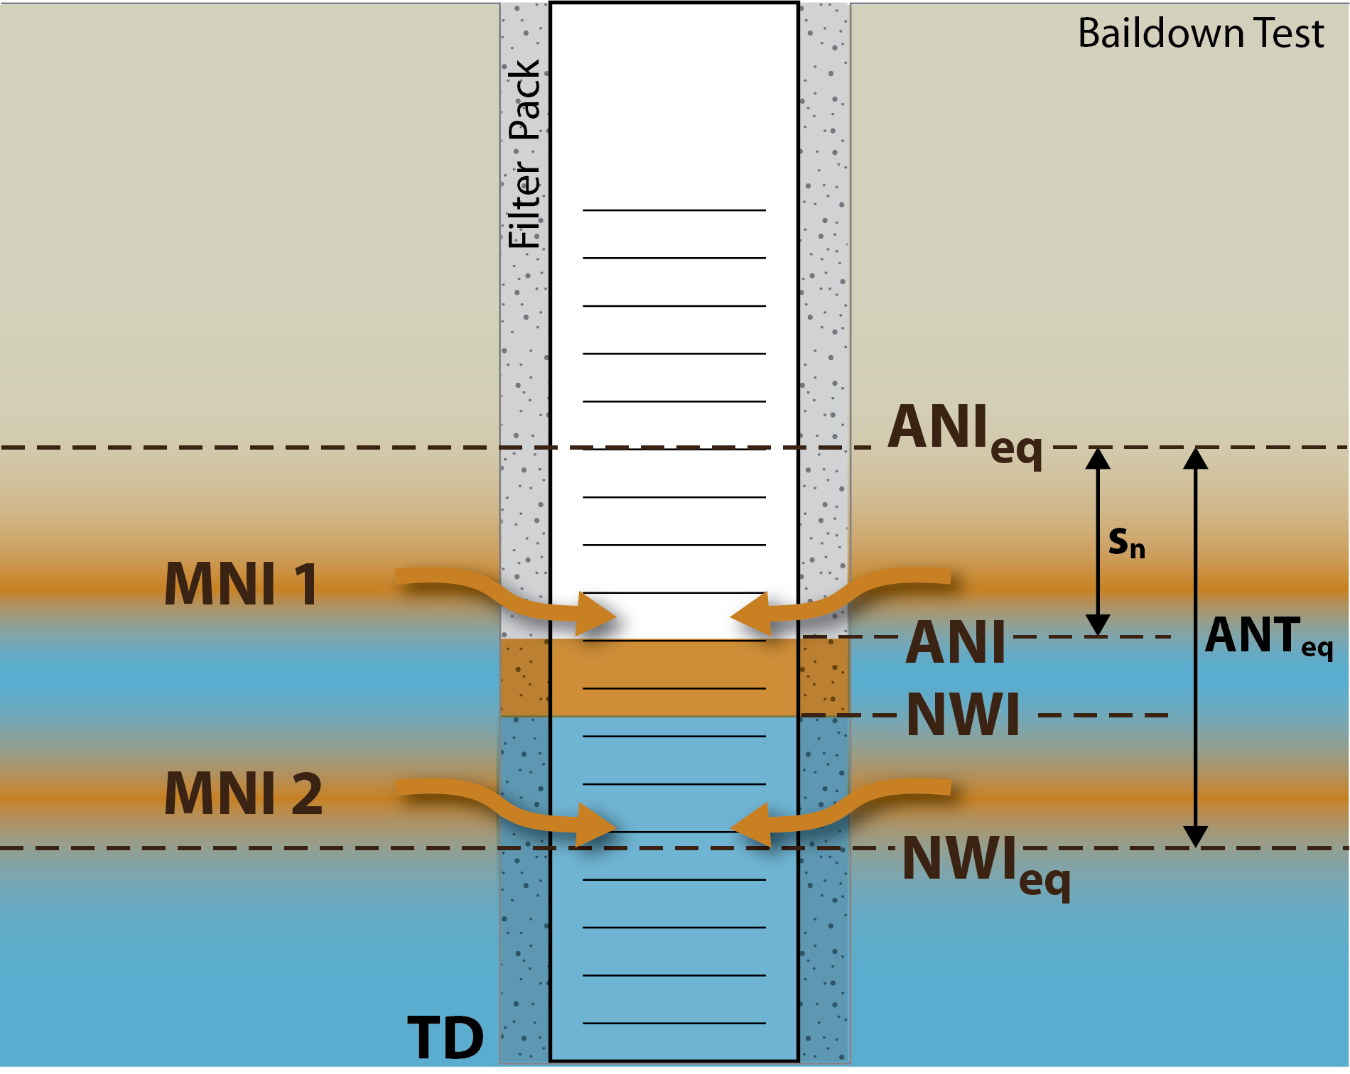
DvD INTERPRETATION LNAPL
Equilibrium
Initiate baildown test
Notes:
Multiple MNIs perched on fine grained intervals
NAPL comes into the well from all MNIs
On the left is a well with multiple mobile NAPL intervals, and the fluids in the well are in equilibrium with the fluids in formation. ANI is the air/NAPL interface, NWI is the NAPL/water interface, TD is the total depth of the well, and ANT EQ is apparent NAPL thickness in equilibrium. On the right is what the well looks like when a baildown or FRACTioN test is initiated. At maximum LNAPL drawdown, which is at the beginning of the test immediately after NAPL removal, both mobile NAPL intervals discharge into the well. The arrows with Sn represent the drawdown. So what does this look like on a DvD chart?

Slide 11
DvD INTERPRETATION LNAPL
NAPL from both MNIs entering the well.
Filterpack Recharge
Apparent NAPL Drawdown (s_{n})
Constant Discharge from MNI 1 and MNI 2
MNI 1
Constant Discharge from MNI 2 Only
MNI 2
NAPL Discharge into the Well (Q_{n})
Notes:
On a DvD chart, initially there might be filterpack recharge, represented by the green line. The first period of constant discharge is representative of both, or all if more than 2, mobile NAPL intervals discharging into the well. With the drawdown below the MNIs, the graphic shows you how this first period of constant discharge represents both MNIs. You can see how NAPL freely flows into the well when drawdown is high.

Slide 12
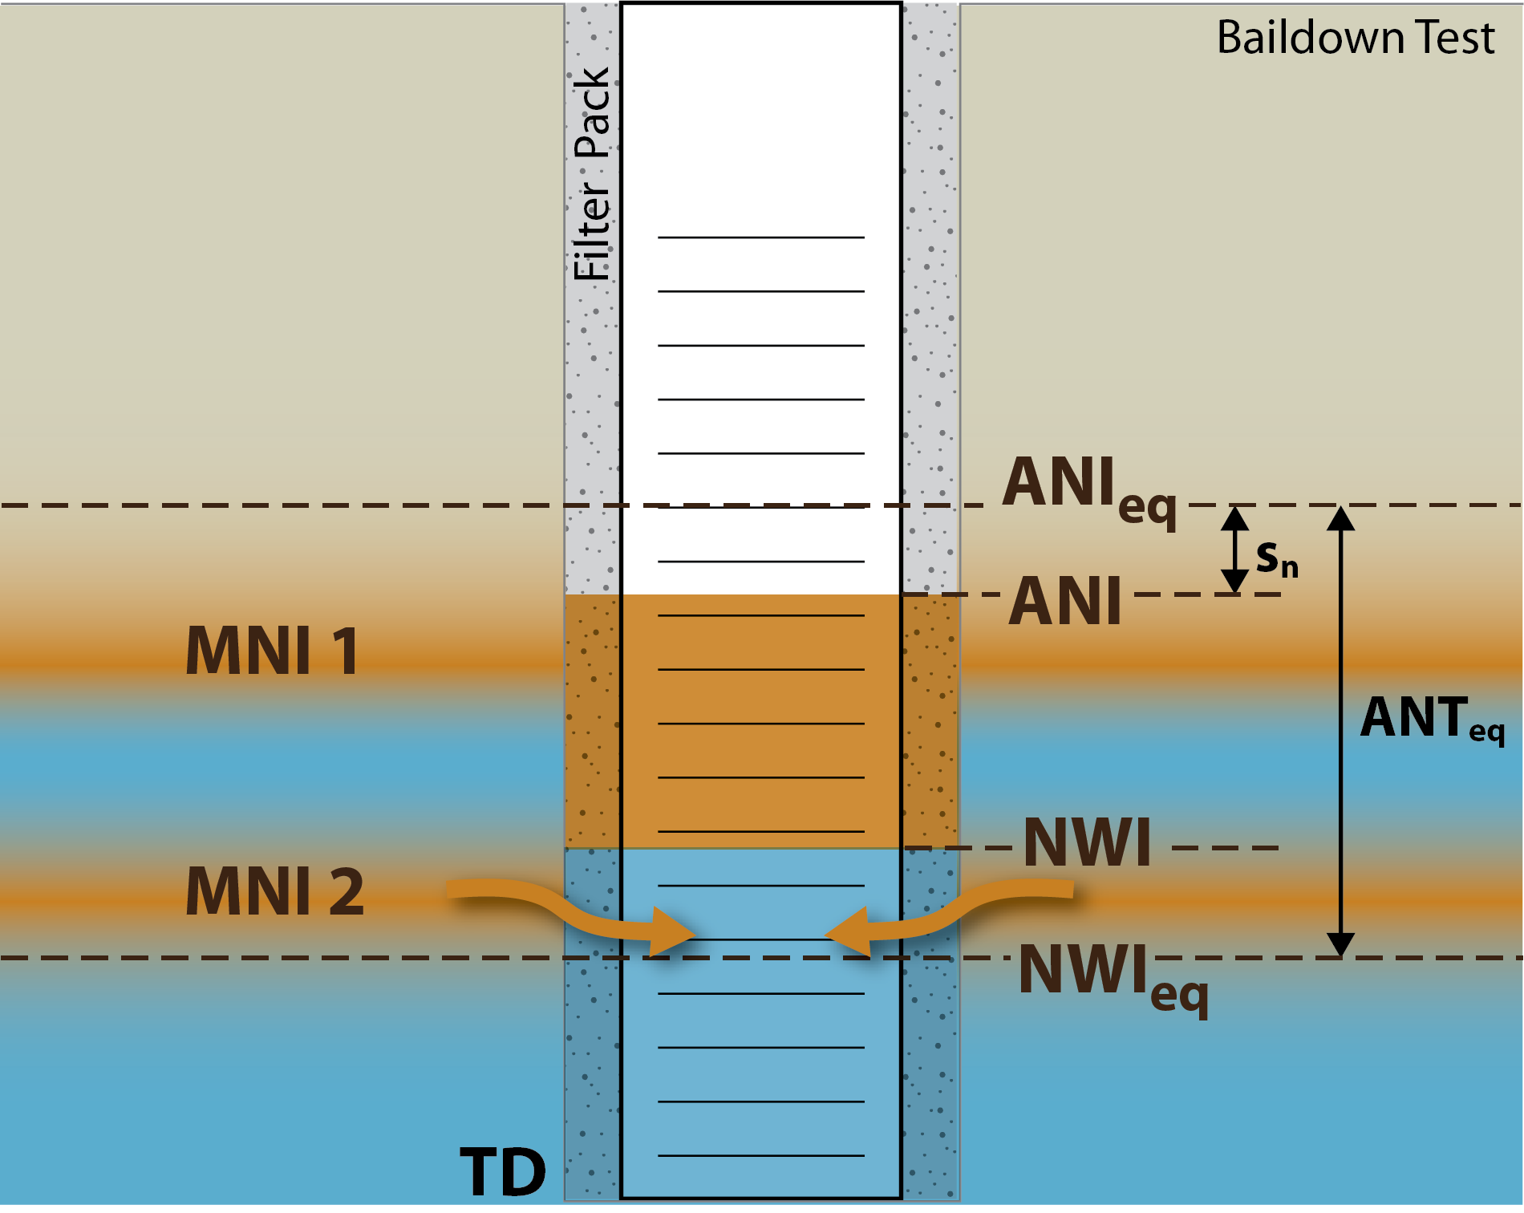
DvD INTERPRETATION LNAPL
MNI 1 is in equilibrium, but NAPL from MNI 2 still entering the well.
Filterpack Recharge
Constant Discharge from MNI 1 and MNI 2
Apparent NAPL Drawdown (s_{n})
MNI 1
Constant Discharge from MNI 2 Only
MNI 2
NAPL Discharge into the Well (Q_{n})
Notes:
As the test progresses, the upper MNI in the formation equilibrates with the fluid in the well. At this point, just the lower MNI is discharging into the well. The second period of constant discharge, in red on the chart, is discharge from the lower MNI only, and the sloping red line is the lower MNI equilibrating. So that’s the DvD chart and how it helps you identify multiple MNIs.

Slide 13
ESTIMATE NAPL TRANSMISSIVITY
Estimated based on ASTM E2856(13) Equation 16 and constant discharge rates
Use MNI to estimate NAPL drawdown based on ASTM Standard
Notes:
Alright, so that’s how it works, how does this test allow us to calculate LNAPL transmissivity? In the ASTM standard for calculating LNAPL transmissivity, we use equation 16, which is the skimming equation. An important component of that equation is drawdown. We use the thickness of the mobile NAPL intervals that we identify on the DvD, and where they are located in the formation, to estimate that NAPL drawdown, and use that skimming equation.

Slide 14
Test case
Notes:
Alright, now I’d like to go over a test case. This one is from a refinery site.

Slide 15
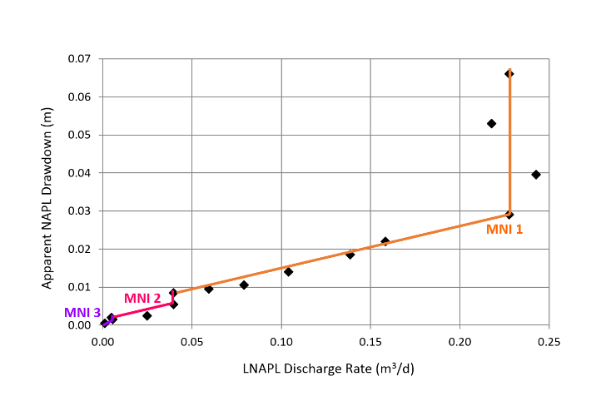
DvD INTERPRETATION
Constant Discharge from MNI 1, 2 and 3
Constant Discharge from MNI 2 and 3
Constant Discharge from MNI 3
Notes:
At this refinery, the wells are set in a fractured rock environment. First up, here’s the DvD chart. There are three mobile NAPL intervals identified in this chart, they are drawn in orange, then pink, and finally purple. The first period of constant discharge, in orange, occurs at about 0.23 cubic meters per day on the X axis. This is at the beginning of the test, when at maximum drawdown, all the MNIs flow freely into the well, and so this constant discharge rate represents all three MNIs. As the well recovers and drawdown decreases, MNI 1 equilibrates and is represented by the sloping orange line. The second period of constant discharge is MNI 2 at about 0.04 cubic meters per day of discharge, again along the X axis. MNI 2 also equilibrates as drawdown continues to decrease, that’s the sloping pink line, until finally MNI 3 is identified at less than 0.02 cubic meters per day. When the well has returned to equilibrium, we are back at zero drawdown zero discharge. You can also see the relative sizes of the MNIs in this graph. Starting with MNI 1, we can tell from the span of drawdown from the beginning of the sloping orange line to the end of the sloping orange line that it is clearly larger than the other two. The same can be done for the other two MNIs – and MNI 3 is clearly the smallest.

Slide 16
Results
Interval | Discharge Rate (m³/day) | MNI Top (m bgs) | MNI Bottom (m bgs) | MNI (m) | Transmissivity (m²/day)
MNI 1 | 0.18 | 4.968 | 4.953 | 0.015 | 9
MNI 2 | 0.03 | 4.947 | 4.946 | 0.001 | 25
MNI 3 | 0.01 | 4.945 | 4.942 | 0.003 | 1.3
Aggregate | 0.22 | NA | NA | 0.019 | 9
Notes:
So what were our results? We identified the discharge rate for each of the three MNIs, 0.18, 0.03, and 0.01 cubic meters per day, respectively. These are different than the constant discharge rates from the DvD graph, since remember that those rates represent multiple MNIs except for the last one. So MNI 2 & 3 get subtracted from MNI 1, and MNI 3 gets subtracted from MNI 2. We identified the depth and thickness of each MNI, based on the drawdown observed during the test. The difference in the drawdown where constant discharge ends and where the next one begins identifies the thickness of the MNI. Finally, we calculate transmissivity. Our results for this test were an aggregate LNAPL transmissivity of 9 meters squared per day, and a total mobile NAPL interval thickness of 0.019 meters.

Slide 17
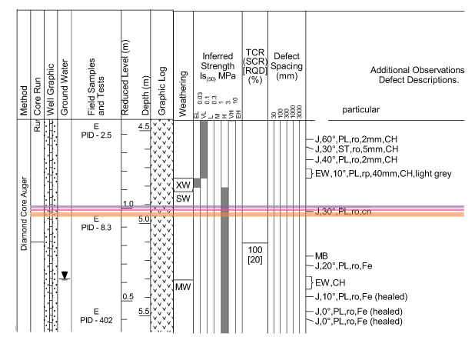
Well conceptual model (WLCM)
Notes:
And finally, this next slide shows on the well conceptual model, or WLCM, where these intervals are located and their thicknesses in the orange, pink, and purple lines.
Total thickness of about 0.5 feet
Located in the SP-SM soil
Location consistent with highest impacted depth from visual observations
PID response was elevated, but shallower zones that are not mobile have similar response

Slide 18
FRACTioNTM (patent pending)
Apply Latest Science with Precedents
Close Sites
Quantify Recoverability
Design Better Remedies
Save Money
Fracture Permeability NAPL Transmissivity (T_{n}):
NAPL transmissivity quantifies hydraulic recoverability
Existing granular porous media methods for T_{n} fail in fractured media
T_{n} for fractured media requires individual fracture geometries and discharge rates
Integrates with and enhances conceptual site models (CSM) with high resolution mobile NAPL interval (MNI as fractures) data
Provides discharge rates and T_{n} for individual fractures and well aggregate
Applicable to both LNAPL and DNAPL
Notes:
To summarize, FRACTioN can be used to quantify NAPL transmissivity in environments where standard methods are not applicable, such as fractured rock environments or formations with multiple NAPL intervals. The method results tell you the geometry of each individual fracture and their respective discharge rates. Armed with that information, the site conceptual model can be improved, and this, in turn, will help you quantify recoverability, design better remedies, close sites, set precedents with regulators, and finally, save money.

