Slide 1
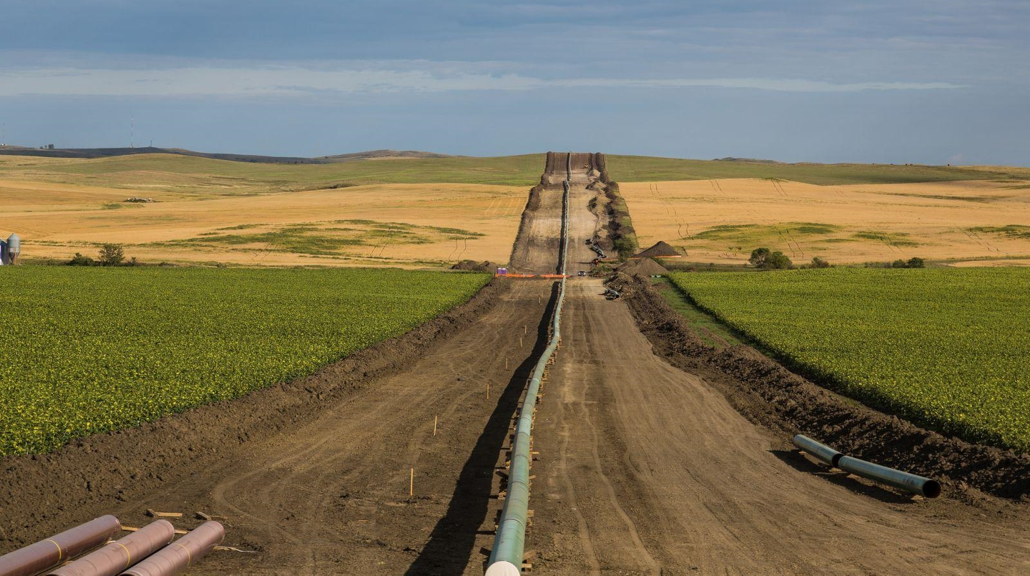
Plume Stability Analysis Using Surfer and API’s Interactive LNAPL Guide
By Boyd Breeding P.Hg., P.E., P.G.
AECOM
Slide 1 of 26

Slide 2
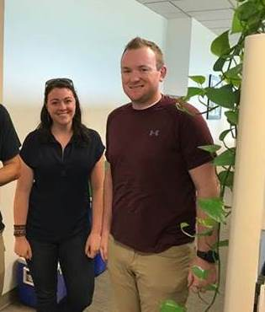
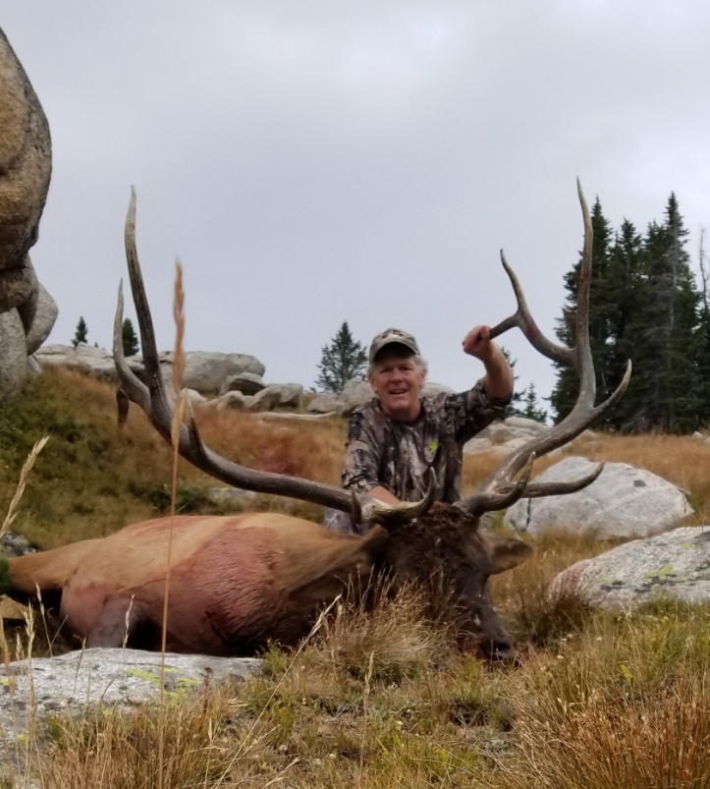
Colleagues
McLean Carpenter
Lyndsey Anderson
Lawrence Cannon P.G.
AECOM Geologists
Scott Forister P.E.
District Supervisor
Wyoming DEQ
Storage Tank Program
Slide 2 of 26

Slide 3
Presentation Is Broken Up Into Two Parts
Part 1: Surfer - Plume Stability Analysis - Dissolved Phase Plume.
Slides 5 - 14
Part 2: Surfer & API LNAPL Tools Software – Plume Stability Analysis Free Product Plume.
Slides 15 - 26
Slide 3 of 26

Slide 4
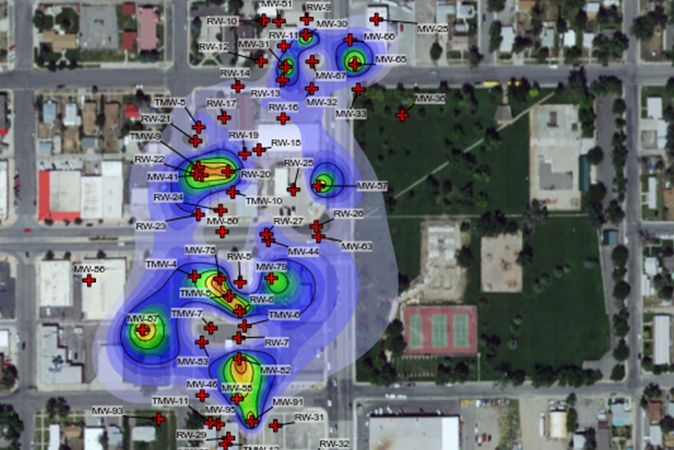
Riverton 1 Plume
Weathered Diesel and Gasoline Plume Riverton, Wyoming
1100 feet long
Dissolved and Free Product Plume Commingled from Multiple UST Releases
1993 – 7 feet of free product in wells MW-30 and MW-41
Slide 4 of 26

Slide 5
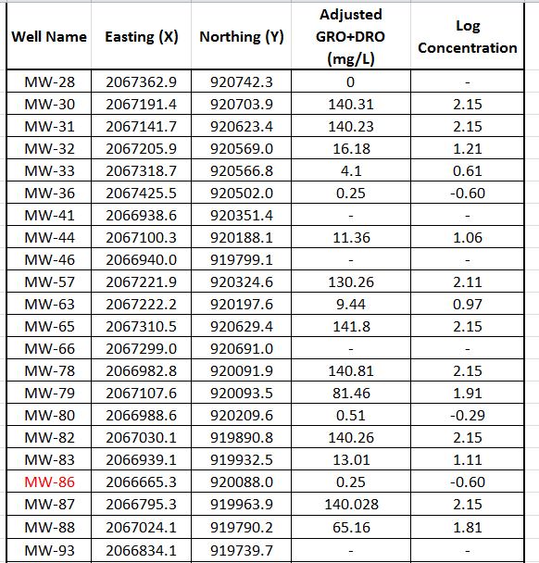
Plume Stability - Dissolved Phase Plume Step 1: Decide which years you are going to evaluate. 2002 and 2016. Step 2: Create your EXCEL spreadsheet of data 2002 Data
Slide 5 of 26

Slide 6
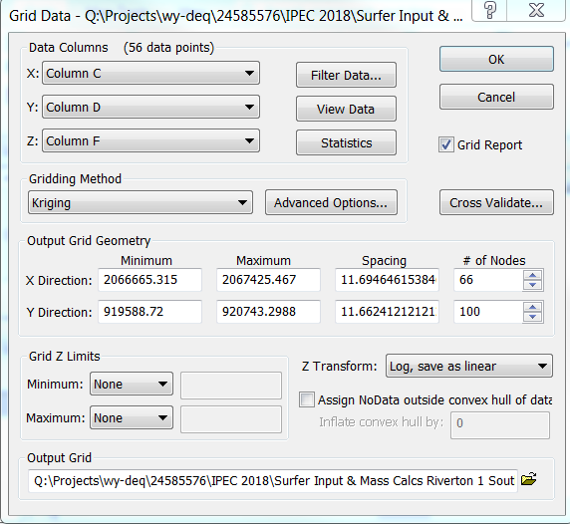
Step 3: Startup SURFER and Select the Grid Data Tab Navigate to the EXCEL Spreadsheet Fill in Dialog Boxes
Slide 6 of 26

Slide 7
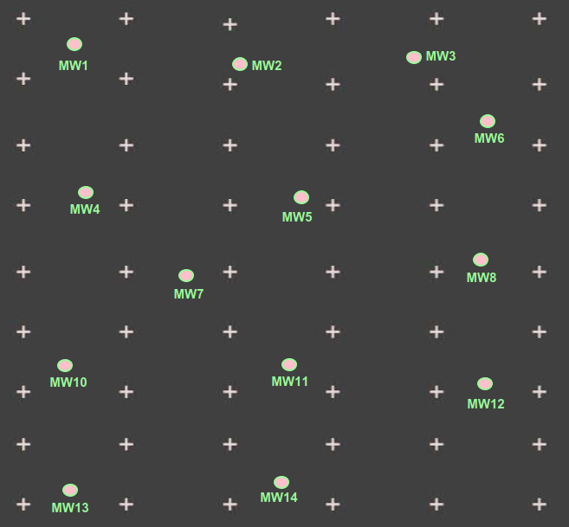
Gridding - “Log… Save Linear”
Surfer 1st estimates log (concentrations) at each grid point.
Then “transforms” the logarithm values back to a concentration.
Saves final Grid File with estimated concentrations at each grid point.
Slide 7 of 26

Slide 8
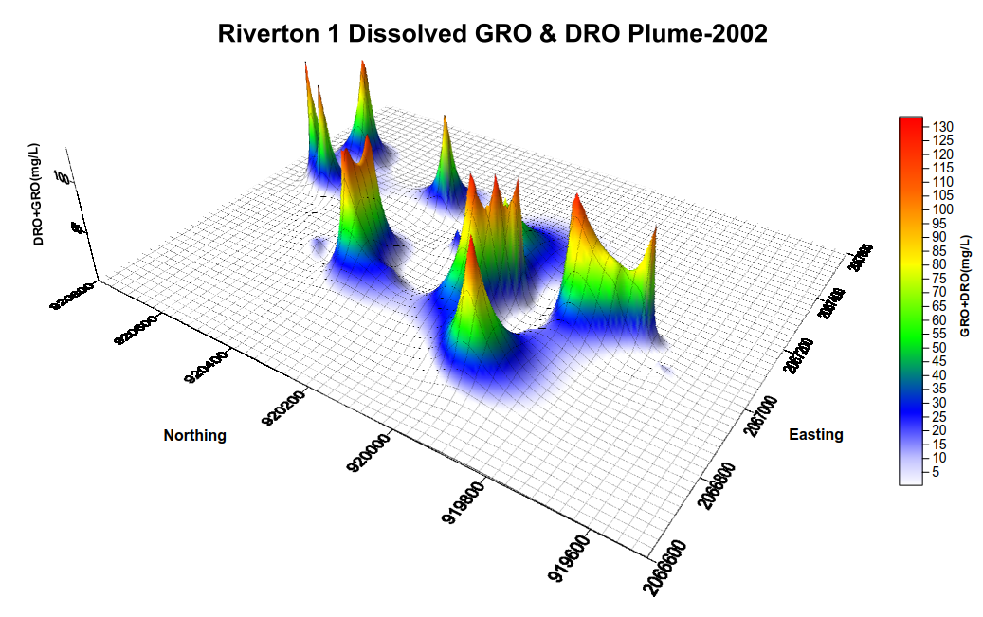
Step 4: Contour your Grid File
Next step: Calculate volume under the curve
Slide 8 of 26

Slide 9
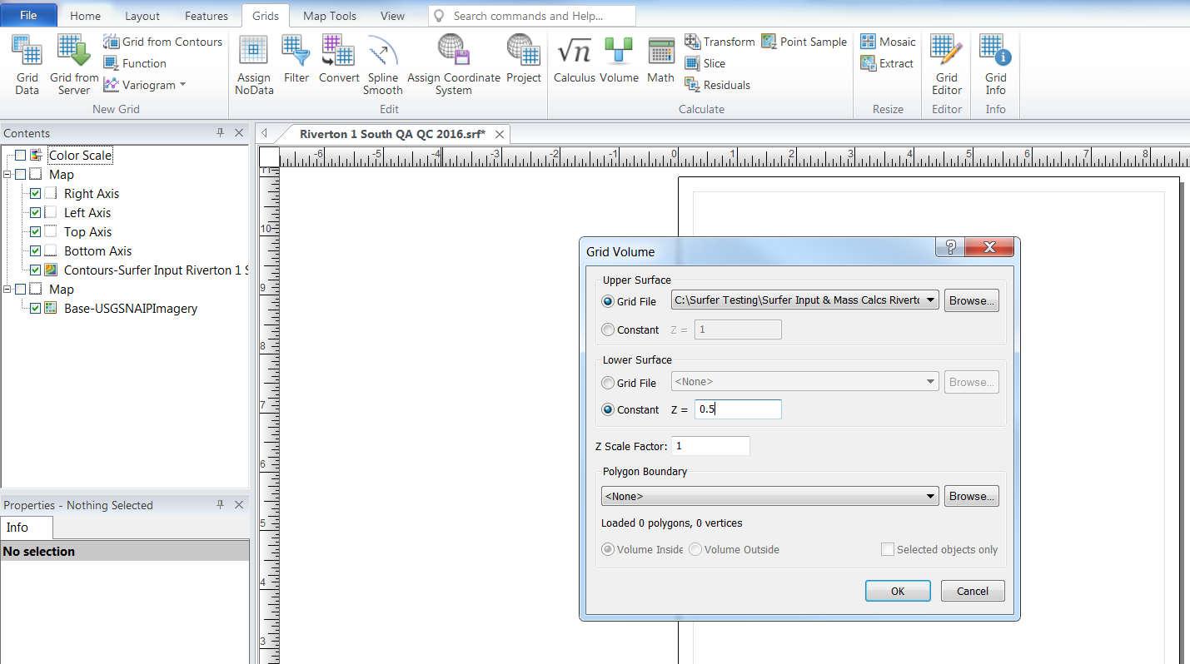
Surfer Version 14
On the Grid Tab select Volume.
Lower horizontal surface = lab reporting limit
Slide 9 of 26

Slide 10
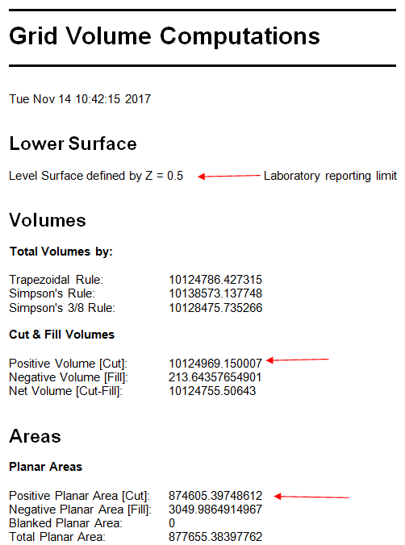
Riverton 1 Grid Volume Report
GV = Grid Volume units (mg/L) ft²
PA = Planar Area = Plume Footprint units ft²
Slide 10 of 26

Slide 11
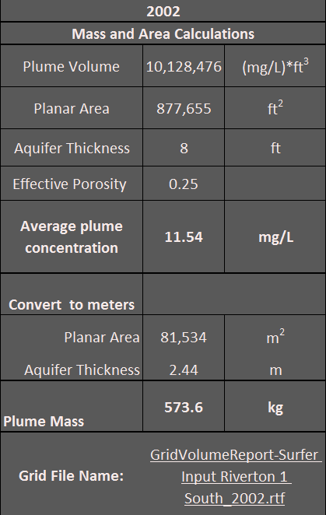
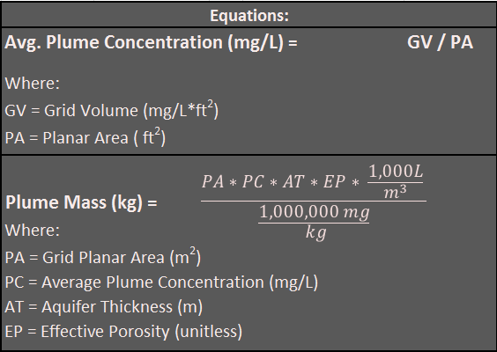
Riverton 1 2002 Plume Stability Analysis – EXCEL Spreadsheet
Slide 11 of 26

Slide 12
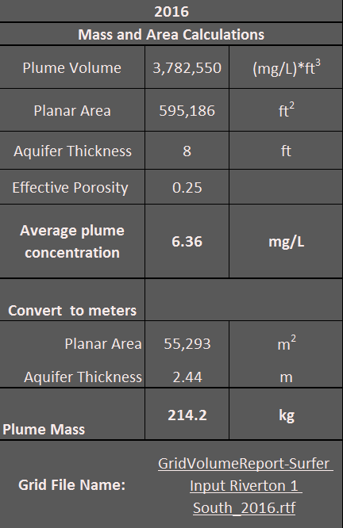
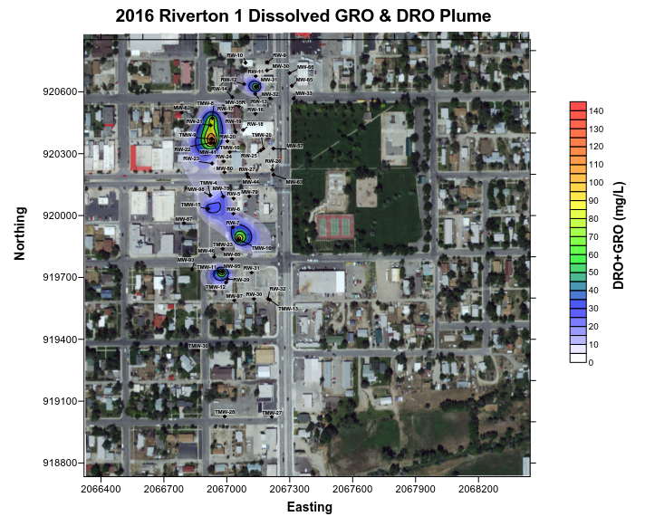
Repeat the Process for 2016 Data Set
Slide 12 of 26

Slide 13
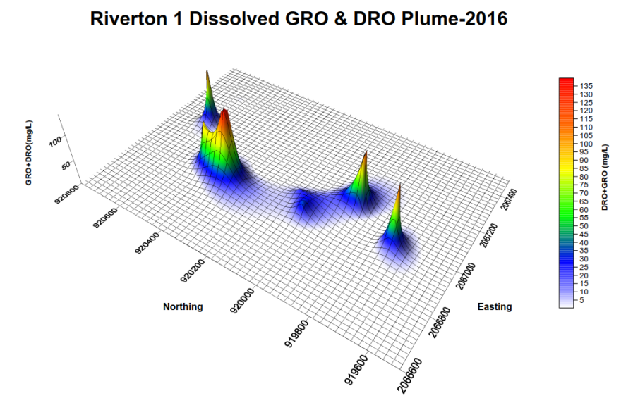
Compare the 2002 & 2016 Results
Slide 13 of 26

Slide 14
Surfer Does the Calculus For You
Very easy to use.
Slide 14 of 26

Slide 15
Part 2 Surfer and API Software to Estimate Mass of Free Product in the Plume
Step 1
Select the years you want to evaluate.
1993 and 2016.
Step 2
Setup EXCEL spreadsheet of x,y coordinates and product thickness measurements for 1993.
Well Name | Easting (X) | Northing (Y) | Free Product Thickness (ft)
MW-23 |  |  | 0.02
MW-30 | 2067191.4 | 920703.88 | 6.77
MW-31 | 2067141.74 | 920623.44 | 2.01
MW-35 | 2067058.19 | 920529.14 | 0.34
MW-37 | 2067098.94 | 920483.66 | 0.02
MW-38 | 2066989.67 | 920475.54 | 2.11
MW-41 | 2066938.65 | 920351.39 | 7.85
MW-51 | 2067125.7 | 920738.348 | 0.04
MW-78 | 2066982.83 | 920091.88 | 0.63
MW-88 | 2067024.07 | 919790.23 | 0.33
MW-91 | 2067060.8 | 919733.775 | 0.06
MW-92 | 2067142.96 | 919794.31 | 0.01
MW-95 | 2066979.14 | 919726.59 | 0.55
MW-100 | 2067184.64 | 919602.55 | 0.13
MW-28 | 2067362.90 | 920742.33 | 0.000001
MW-32 | 2067205.88 | 920568.99 | 0.01
MW-33 | 2067318.67 | 920566.82 | 0.000001
MW-36 | 2067425.47 | 920502.04 | 0.000001
MW-39 | 2067206.55 | 920474.01 | 0.000001
MW-40 | 2067053.30 | 920379.46 | 2.96
MW-44 | 2067100.30 | 920188.10 | 0.000001
MW-46 | 2066939.99 | 919799.08 | 0.000001
MW-50 | 2067094.16 | 920296.95 | 0.000001
MW-55 | 2067209.52 | 920781.62 | 0.000001
MW-57 | 2067221.94 | 920324.56 | 0.000001
MW-63 | 2067222.20 | 920197.60 | 0.000001
MW-65 | 2067310.53 | 920629.36 | 0.000001
MW-66 | 2067298.95 | 920691.02 | 0.000001
MW-67 | 2067206.95 | 920636.56 | 0.000001
MW-74 | 2067019.07 | 920669.31 | 0.000001
MW-79 | 2067107.60 | 920093.54 | 0.000001
MW-80 | 2066988.64 | 920209.64 | 0.000001
MW-81 | 2066857.72 | 920081.75 | 0.000001
MW-82 | 2067030.10 | 919890.85 | 0.000001
MW-83 | 2066939.13 | 919932.53 | 0.000001
MW-84 | 2067053.91 | 920733.73 | 0.000001
MW-87 | 2066795.30 | 919963.94 | 0.000001
Step 3
Use Surfer to grid and contour your product thickness measurements.
Slide 15 of 26

Slide 16
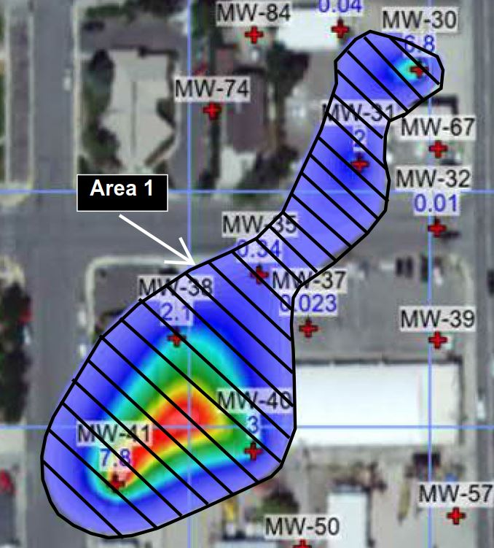
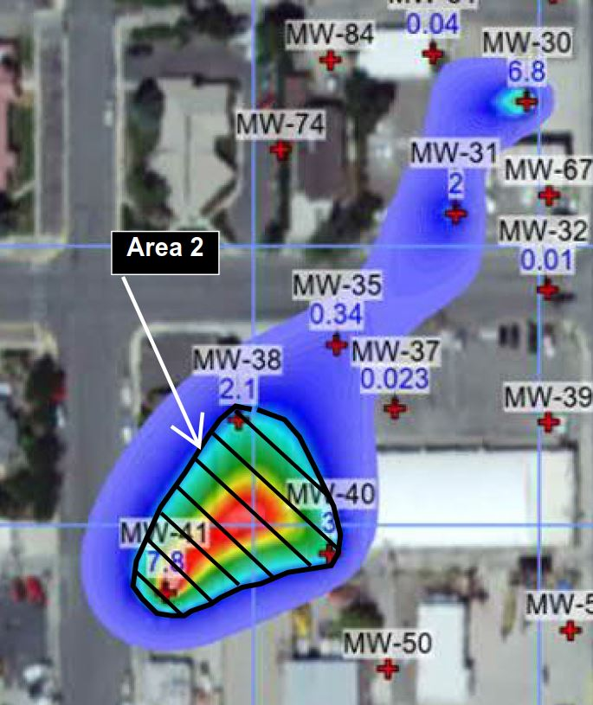
Plume Stability Analysis – Free Product
Step 4 - Use “Volume Tab” to calculate planar area within each free product contour
(0.25’, 1’,2’,3’,4’,5’,6,7’)
Area of 1993 Free Product Area of Free 1993 Product
Contour 0.25’ Contour 1’
Slide 16 of 26

Slide 17
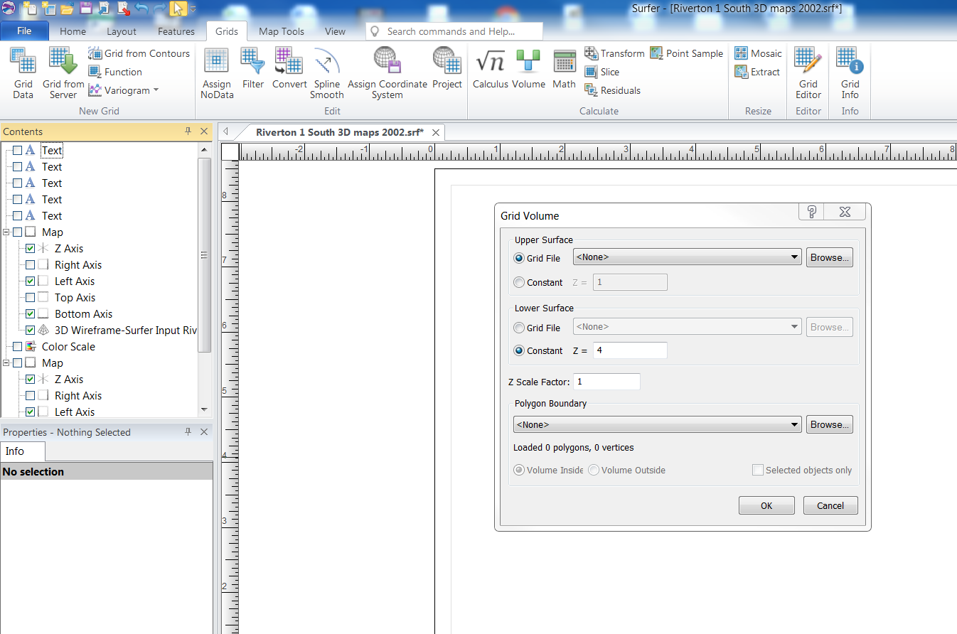
Surfer Version 14
Go back to the Volume tab.
Q: Surfer Grid File
Set Z equal to the free product thickness contour values. (0.25’,1’,2’,3’,4’,5’,6’ and 7’)
Create at Grid Volume report for each contour. Save these reports … Will use them later.
Switch over to the API Software.
Slide 17 of 26

Slide 18
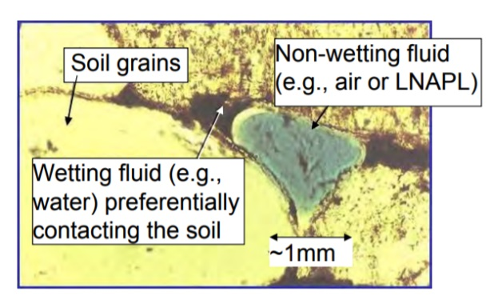
API Software
Step 5: Download and startup the API software
https://www.api.org/oil-and-natural-gas/environment/clean-water/ground-water/lnapl
Use API Software to estimate the average free product saturation in the formation at each free product contour.
Slide 18 of 26

Slide 19
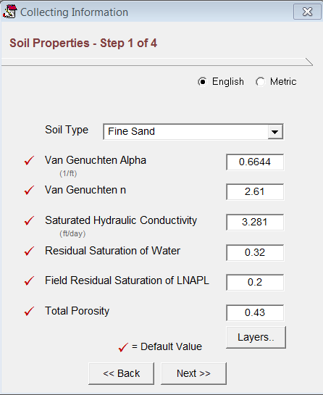
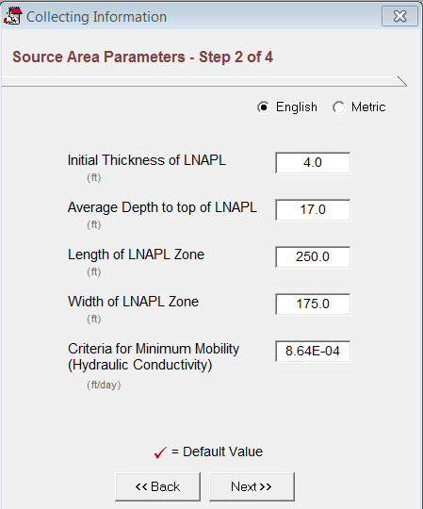
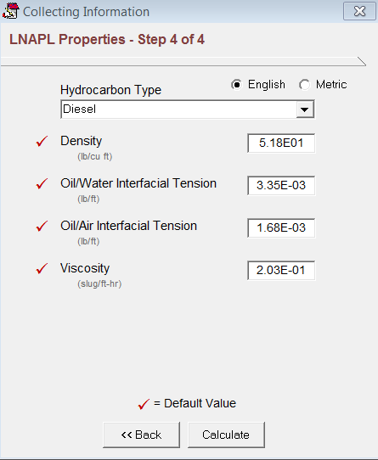
Example: Estimated NAPL Saturation When free product Thickness = 4 feet.
Step 6: Enter Soil type, LNAPL Thickness, Hydrocarbon Type.
Slide 19 of 26

Slide 20
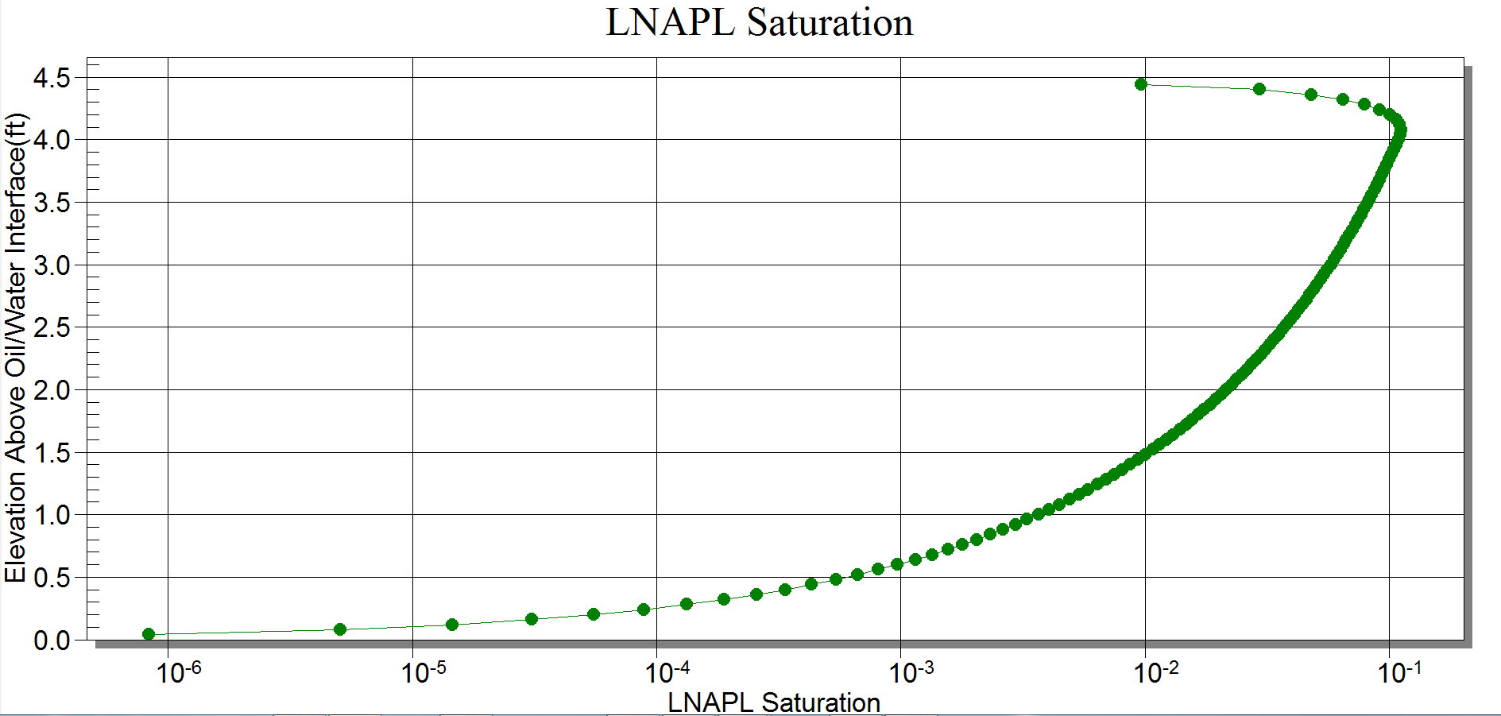
Free Product Saturation Curve
Example: where the free product thickness = 4 feet
Oil water interface (OWI)
Max of 10% (10⁻¹) at 4.2 ft above OWI
Min of 0% free product at OWI
Slide 20 of 26

Slide 21
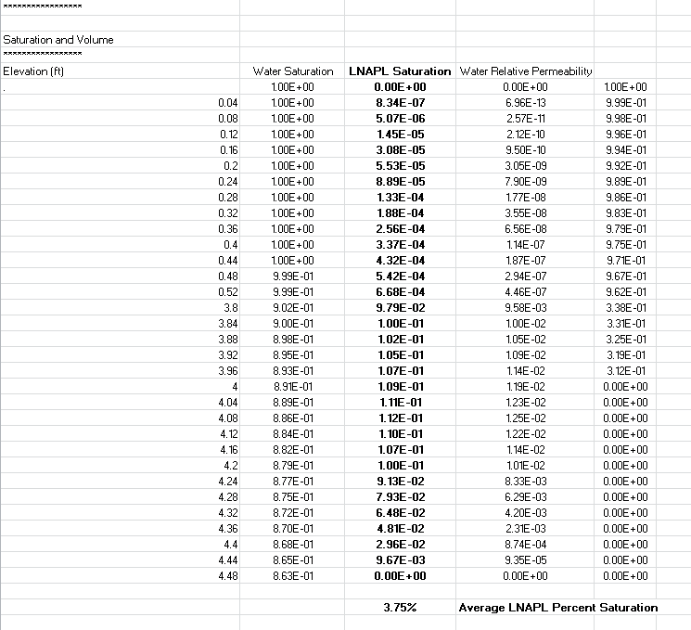
API software also produces an EXCEL spreadsheet of free product saturation values.
=AVERAGE(C100:C130)
Slide 21 of 26

Slide 22
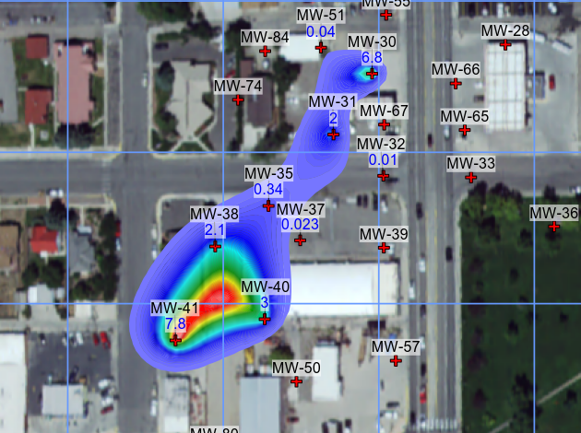
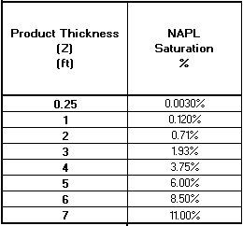
LNAPL Saturation in Soil Pores
1993 free product thickness contours API Estimate
Slide 22 of 26

Slide 23
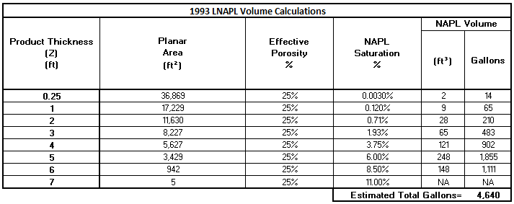
USE EXCEL to Estimate Free Product Volume for 1993
Volume of Free Product
((PT 1 + PT 2)/2) * (SA1-SA2) * EP * ((PS1 +PS2)/2) = within each contour interval
average product thickness Planar area between effective average free product saturation
within contour interval contours porosity within each contour interval
Measured in Field SURFER On-line API
Slide 23 of 26

Slide 24
Next Step: Repeat the entire process using 2016 free product data.
Findings
1993 – 4640 gallons of free product
2016 – 1.7 gallons of free product
99 percent reduction in free product volume over the past 23 years.
Slide 24 of 26

Slide 25
Overall Summary for the Riverton 1 Plume
Findings :
60 percent reduction in the dissolved phase plume mass
30 percent reduction in the foot print of the dissolved phase plume.
99 percent reduction in free product volume
Shrinking plume with no complete exposure pathways.
Lower priority plume
Provides solid justification for Scott Forister and the Wyo DEQ to focus funding on other higher priority sites.
Slide 25 of 26

Slide 26
Final Take Aways 1. Surfer and API Software programs are quick and easy to use. Cost effective. 2. Surfer takes into account the entire plume. 3. Results are very visual and easy to communicate to the public. 4. Graphics provided by Surfer are easily imported in to your reports.
Joseph Ricker Fall 2008 Ground Water Monitoring & Remediation Journal.
Questions
Slide 26 of 26

