Slide 1
Planning, Design, and Installation of a Successful Water Management System to Support a Development Drilling and Completion Campaign
D. Steven Tipton, P.E., SPEC; J. Daniel Arthur, P.E., SPEC; and Mark Faucher
Presented at:
25th International Petroleum
Environmental Conference,
Denver, Colorado
October 30 – November 1, 2018

Slide 2
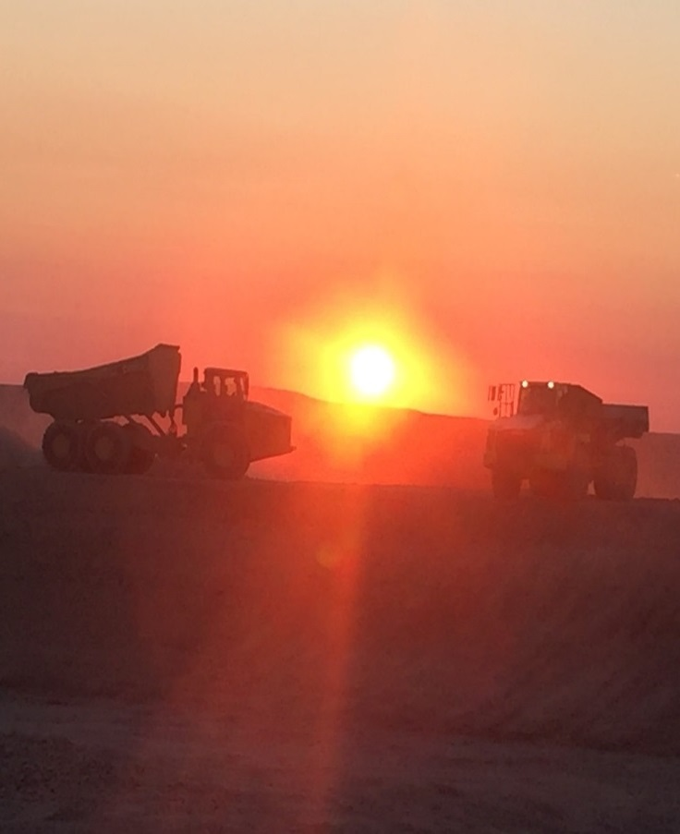
Introduction
Water Management Planning and Infrastructure:
Move from exploration to development
Pad drilling w/longer laterals
Move to mostly slickwater fracs
Increased demand for water for completions
Water availability
Induced seismicity
States limiting disposal capacity
Environmental concerns
ALL’s holistic approach
Proven successful and cost effective
Source: ALL Consulting, 2016

Slide 3
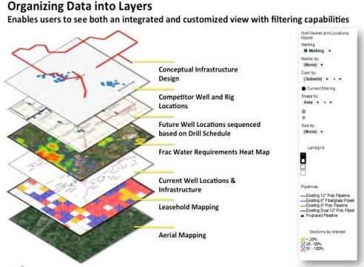
Water Management Plan Components
Water Management Plan
Company’s acreage position
Water sources
Regulatory constraints
Environmental constraints
Cultural constraints
Fracturing fluids
Water volumes required
Storage capacity required
Refill time required
Layout infrastructure
Perform ESA
Geotechnical investigation
Design storage, treatment facilities, and pipeline
Construction plan
Construction execution
Source: B. Pribish, 2015 private communication

Slide 4
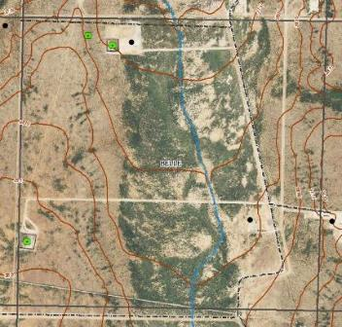
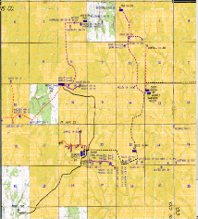
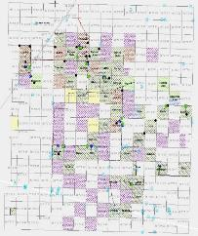
Infrastructure
Infrastructure planning
Plan placement of
Fresh water storage
Produced water treatment facilities
Disposal facilities
Buried HDPE pipelines
Practical limit of lay-flat is about 3 miles
Flexibility
Move fresh water to any storage facility
Move treated and produced water from any treatment and disposal facility to any other
Delivery to and from each facility by both pipelines and trucks
14 miles
14 miles

Slide 5
Water Needs and Costs
Drilling
Laterals 5,000 to 12,000 ft.
Pad drilling
Fracture fluid volumes
300,000 to 1,000,000 bbls.
Fresh water cost
Permian
$0.50 to $0.75 per bbl.
Anadarko
$0.25 to $0.50 per bbl.
Costs for produced water treatment
$0.25 to $1.00 per bbl.
Lower-cost treatment systems
More interest in recycling

Slide 6
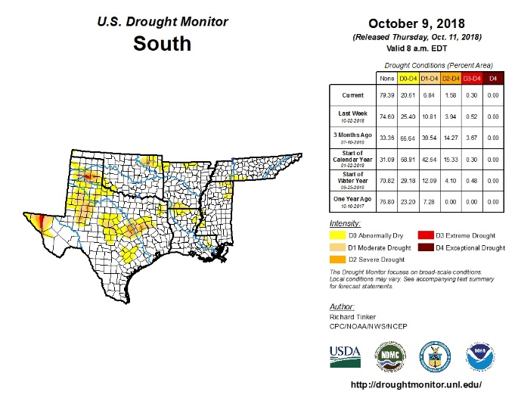
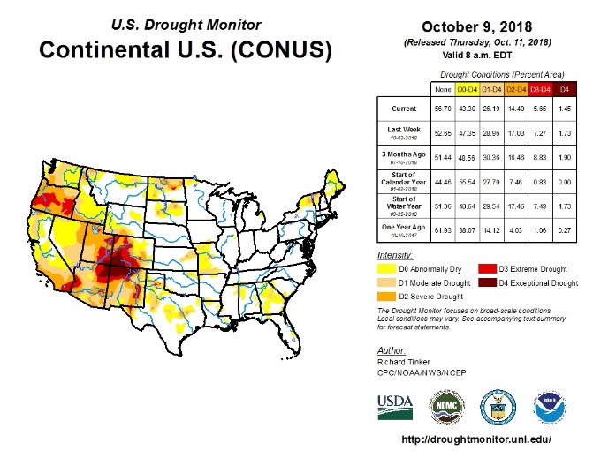
Fresh Water Availability
Anadarko and Permian Basins typically experience high or extremely high levels of fresh water stress
Permian Basin
Surface water non-existent
Productive ground water wells ( 20 – 50 bbl./min)
Anadarko Basin
Surface water primary source
Ground water is typically limited
Recycling reduces demand on freshwater

Slide 7
Baseline Water Stress

Slide 8
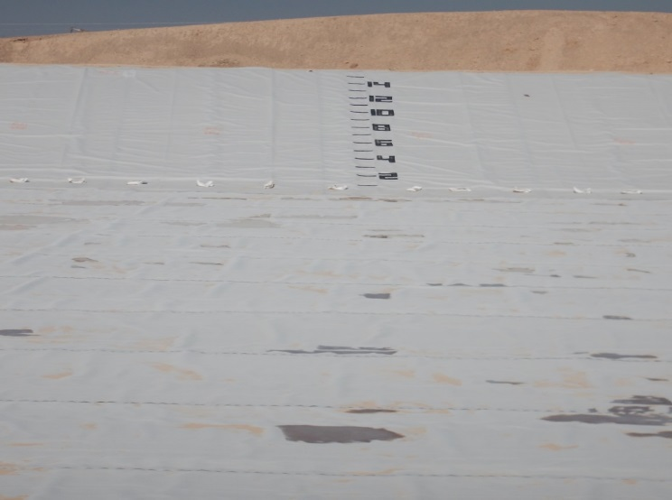
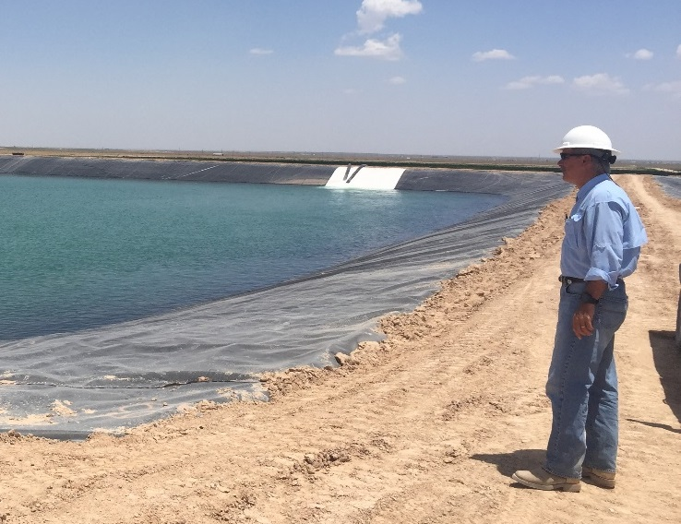
Impoundments
Preferred designs - 1 to 6 lined impoundments
Impoundment liners:
Geotextile layer with gas vent strips
Secondary liner
Geotextile layer
Leak detection system
Geocomposite layer
Sump with washed pea gravel
Pipe
Primary liner
Connected by equalization pipes
Suction pipes installed in the clean brine impoundment

Slide 9
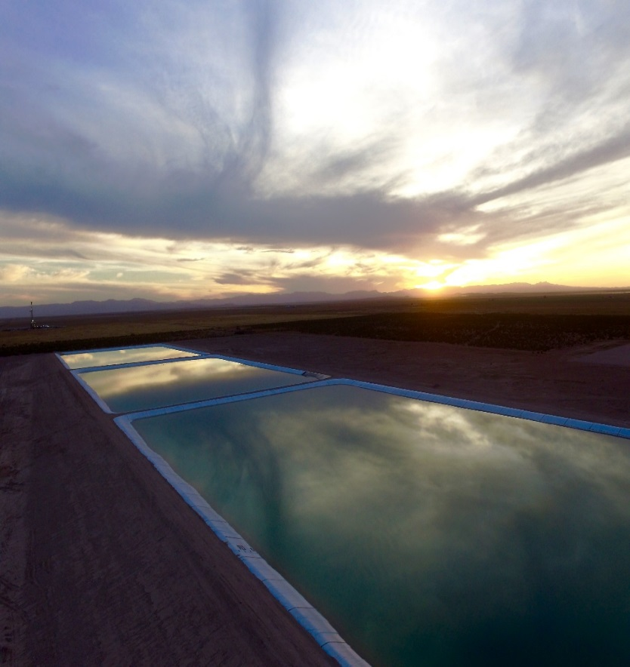
Impoundment Sizing and Design
Impoundment designs based on operators needs:
Type of water stored
Completion schedule/water forecast
Water volume from production
Water recycling/treatment plan
Disposal capacity
Ideal Design:
Can store fresh and produced water
Effective solids and bacteria removal
Designed for lowest cost
Combined storage volume from 1 to 2 million bbl.

Slide 10
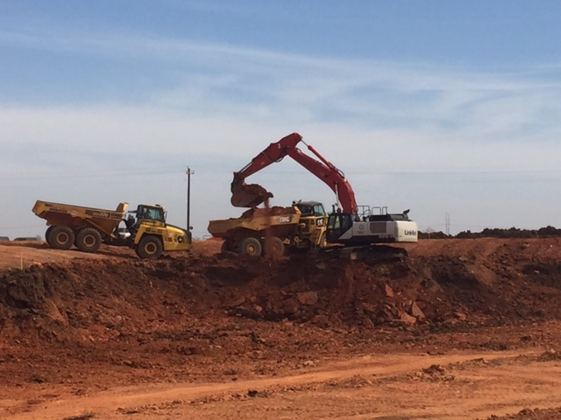
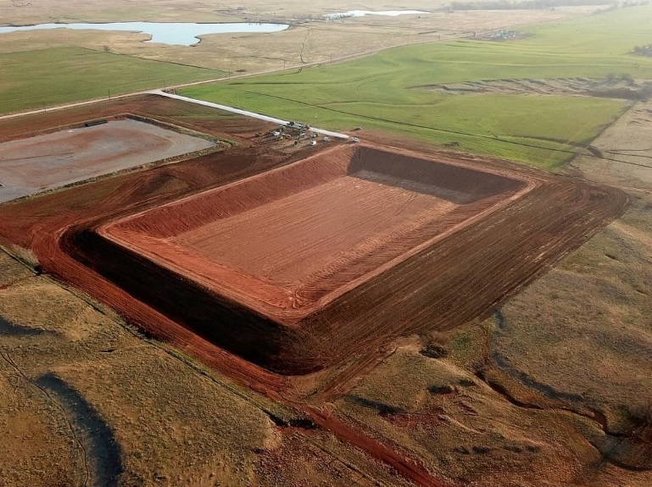
Impoundment Construction

Slide 11
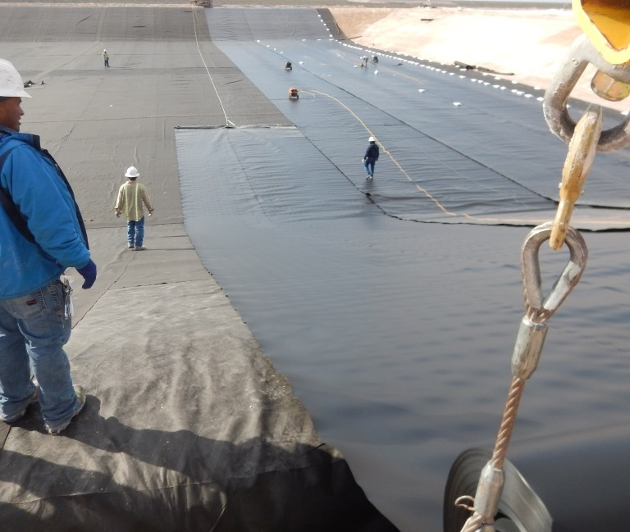
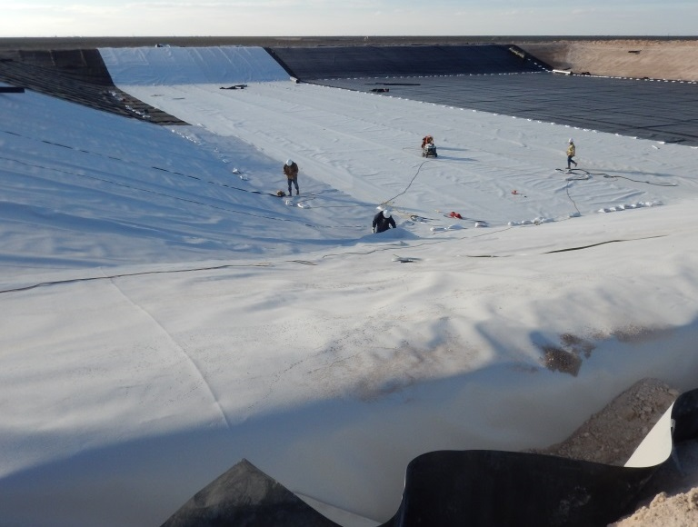
Water Pit Liner Installation

Slide 12
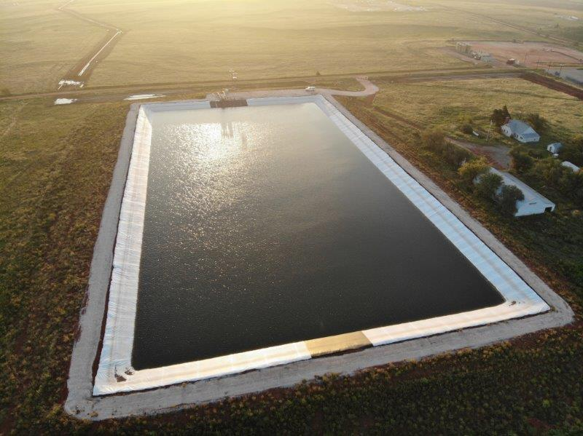
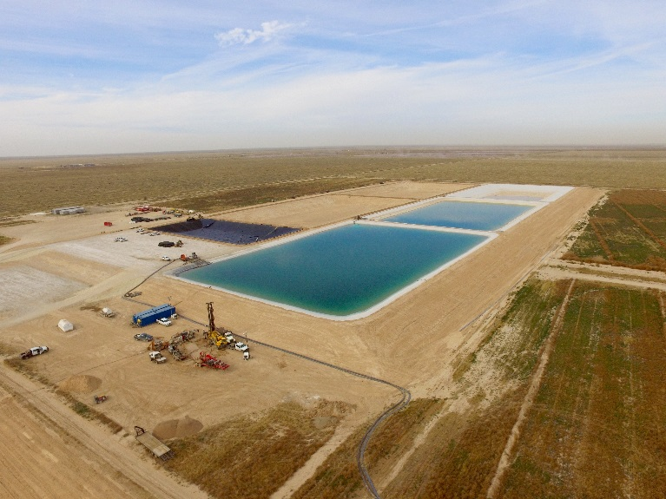
Liner Installation/Completed Pits

Slide 13
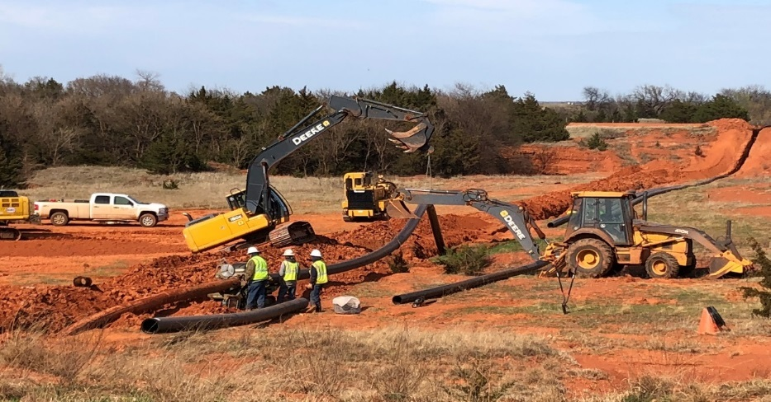
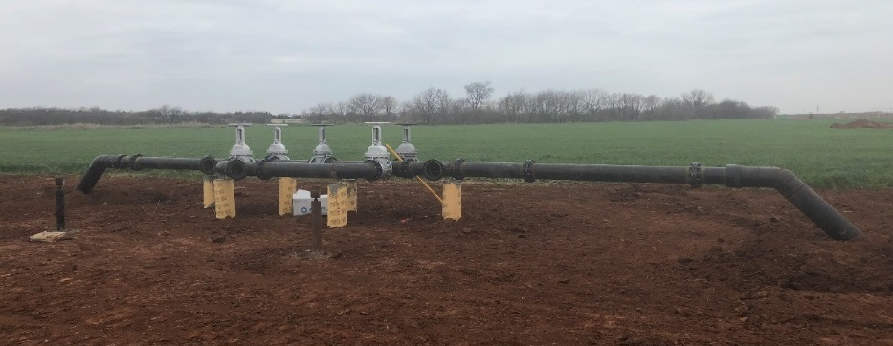
Pipeline Design and Installation
Pipeline to transport water
From water source(s)
Existing water storage
Planned storage and treatment facilities
Provide ability to connect lay flat
SWD
Multidirectional water flow is a necessity
50 bbl./min. through 12” HDPE SDR 11
Transport water from multiple facilities
Developed pipeline system benefits
Decreases long-term cost
Increased safety & reduced risk of spills
Automation
Control of water from the office
Decrease in-field man power
Notes:
.

Slide 14
Pipeline Installation
October 2018
Copyright © 2018 ALL Consulting

Slide 15
Pipeline Installation

Slide 16
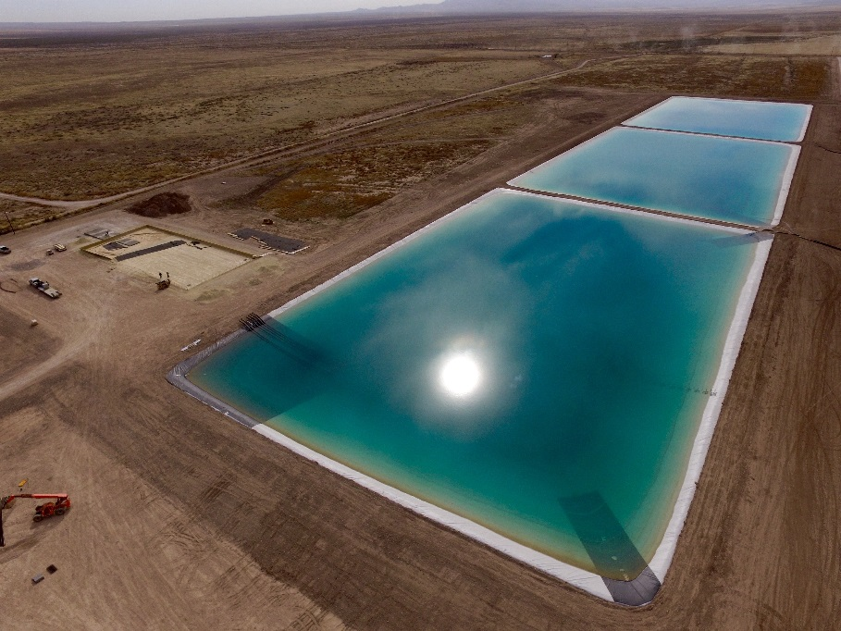
Drivers for Recycling
Demand for recycling of produced water is expanding
Reduce demand on limited freshwater resources
Reduce injection volumes
Reduce injection costs
Limited disposal zones for Class II wells
Induced Seismicity concerns
Reduce costs of fresh water
Source: ALL Consulting, 2018

Slide 17
Recycling Objectives
Produced water that can be used as a base fluid for hydraulic fracturing
Produce clean brine
Economical
Treatment process must be able to remove
Hydrocarbons
Metals
H₂S
Iron sulfide
Bacteria
Suspended solids
Treatment process must be able to handle variable qualities of inlet water
Treatment must be economical compared to the acquisition and disposal of fresh water

Slide 18
Recycling Challenges
Produced water
Produced water use must be economically feasible
Minerals in the water can interfere with friction reducers or frac gel
Water quality varies widely
Minerals in the water can cause scale
Environmental regulations
More stringent
In most states flowback, recycle or produced water pits have to be permitted in some fashion
OK requires design, certification, permitting, and construction supervision by a registered professional engineer

Slide 19
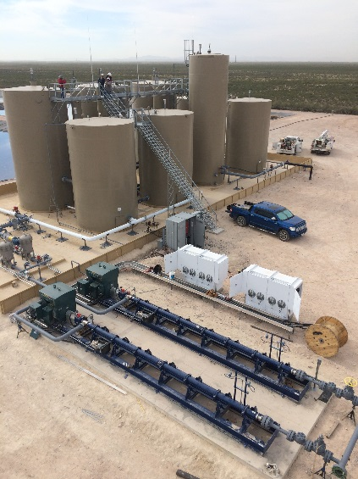
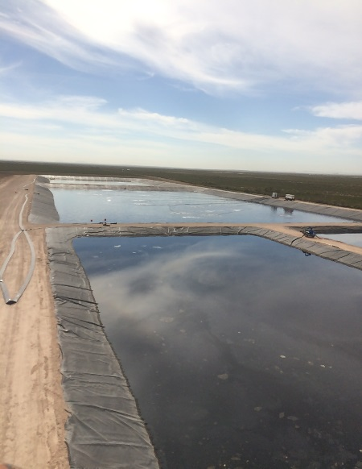
A Basic Approach that Works
Combine at the same facility
Produced water treatment
Class II SWD well
Multiple facilities strategically placed
Separate pipelines
Fresh water
Produced water
Clean brine
Tank battery to remove solids and separate oil
Treatment system to provide a clean brine
Injection well for produced water that cannot be recycled
Source: ALL Consulting, 2017
Source: ALL Consulting, 2017

Slide 20
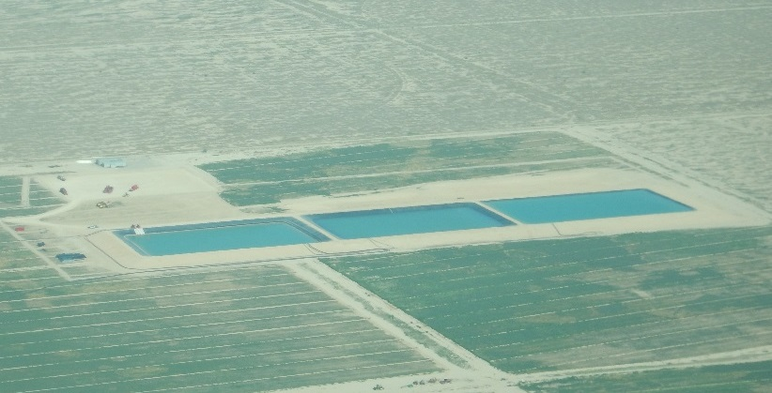
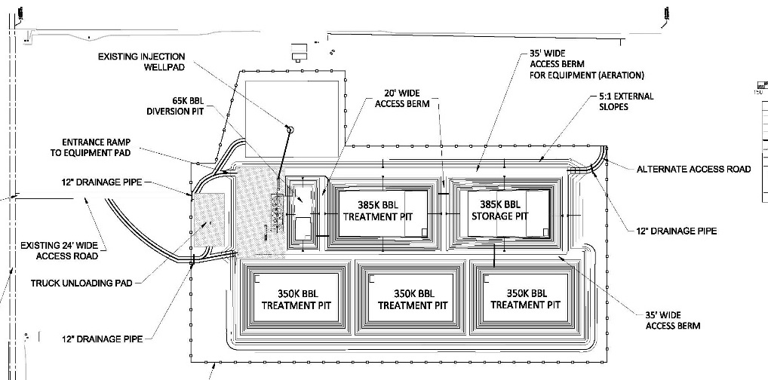
Treatment System
Treatment system consists of:
Series of lined impoundments
Aeration and microbial treatment
Equalization pipes
Multiple impoundments
Improve treatment
Provide ample storage
Results in a clean brine suitable for reuse
Source: ALL Consulting, 2016

Slide 21
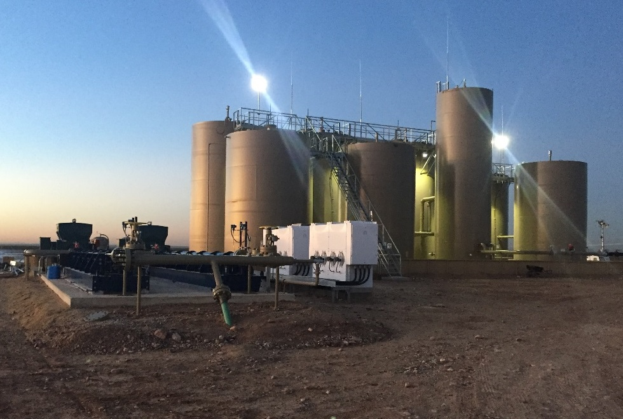
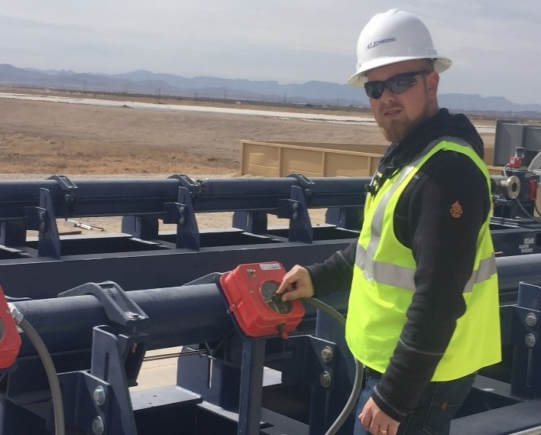
Tank Batteries
Located adjacent
Injection wells
Treatment pits
Remove
Solids
Separate oil (30 ppm)
Automated to send water
Treatment pits
Injection well
Both
Typically coupled with 2 H-pumps
H-Pumps controlled by variable speed drives (VSDs)
Source: ALL Consulting, 2017
Source: ALL Consulting, 2017

Slide 22
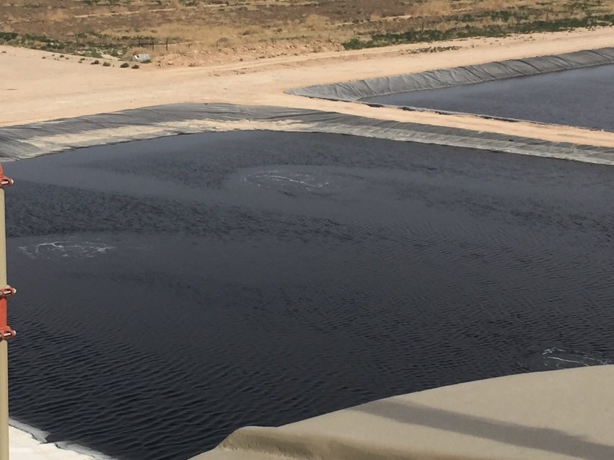
Impoundment Aeration / Biological Treatment
Aeration
Increases dissolved oxygen (DO) levels in water water
DO + food source (hydrocarbons) sustain aerobic bacteria
Eliminates hydrocarbons and other organics from the water
Prevents water from “Flipping”
Reduces the proliferation of Anaerobic Bacteria
Aerobic bacteria
Control anaerobic bacteria
Manage with biocides during frac operations
Anaerobic bacteria
More problematic (e.g., SRB’s create H2S / Souring)
More expensive to manage with biocides

Slide 23
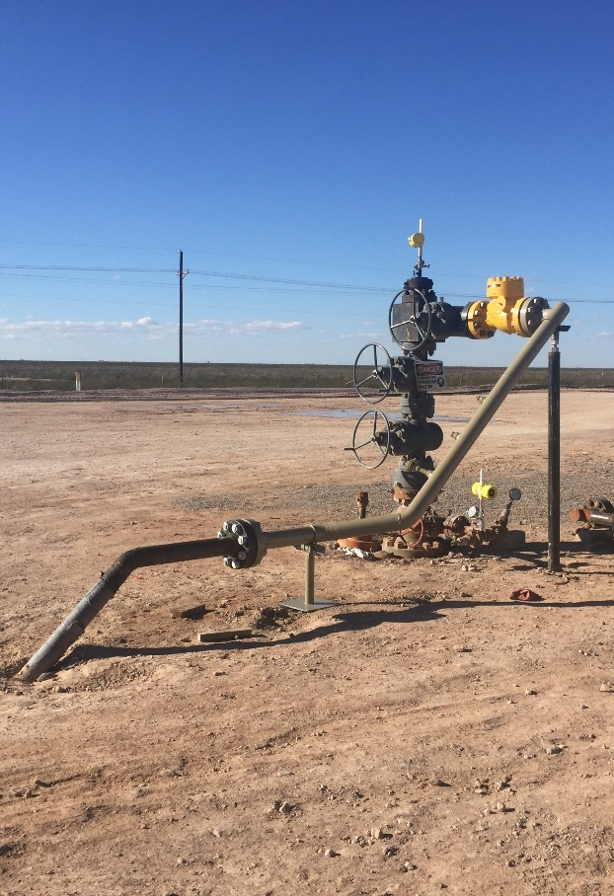
Disposal Considerations
Increase in seismicity
Decreased injection allowables
Operators are choosing to limit injection
Alternate disposal zones are limited
Trucking produced water for disposal
Expensive
Can create adverse community impacts
Operators explore recycling as a way to reduce injection volumes

Slide 24
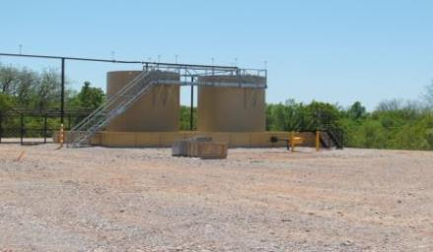
Typical Water Disposal Facility
October 2018
Copyright © 2018 ALL Consulting

Slide 25
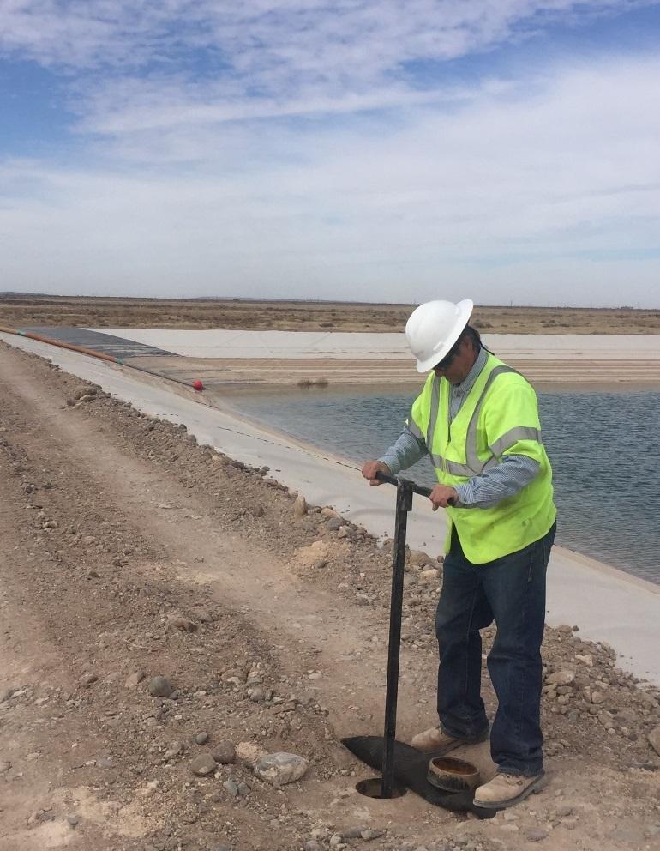
Benefits of the Approach
Ensures adequate water for completions
Allows for
Unexpected changes in the completion schedule
Changes in frac water volumes
Reduces fresh water demand
Provides options for managing produced water
Reduces SWD well injection volumes
Limits trucking for produced water disposal

Slide 26
Keys to Success
Provide a cost-effective holistic approach to water management by
Reducing fresh water demand
Sufficient water supply for completions
Recycling produced water
Disposal of excess water
Provide flexibility to respond to unexpected changes
Schedules
Move water from one facility to another
Injection well problems
Equipment failures
Simple operations
Automated controls
Uncomplicated treatment system
Limit operator involvement in day-to-day operations
Minimal operator training required
Capital investment costs are typically recovered in three years or less.

Slide 27
Questions?

Slide 28
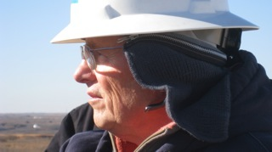
Contact Information D. Steven Tipton, P.E., SPEC Senior Engineer ALL Consulting Tulsa, OK stipton@all-llc.com
Citation Information:
Tipton, D. Steven; J. Daniel Arthur; and Mark Faucher. “Planning, Design, and Installation of a Successful Water Management System to Support a Development Drilling and Completion Campaign.” Presented at the 25th International Petroleum Environmental Conference, Denver, Colorado, October 30 –November 1, 2018.

