Slide 1
Pipeline Planning and Construction: Environmental Considerations
by Peter D. McKone, CWB (Weaver Consultants Group) and Caleb Watkins (Summit Midstream)
Notes:
Jeff

Slide 2
Outline
Regulatory Background
Permitting
Issues

Slide 3
Waters of the U.S.

Slide 4
Corps Regulatory Program
Protect navigation: Sections 9 and 10 of the Rivers and Harbors Act of 1899
Restore and maintain the physical, chemical and biological integrity of the nation's waters: Section 404 of the Clean Water Act
Protect marine resources associated with ocean disposal of dredged material: Section 103 of the Marine Protection, Research and Sanctuaries Act of 1972
Source: USACE Fort Worth District and Rapanos guidance

Slide 5
Legal Background
USACE administers the regulatory aspects of dredge and fill activities.
EPA maintains ultimate responsibility for oversight of the USACE’s program.
Section 401 requires water quality certification from states.
Section 404 addresses permitting discharge of dredge and fill material.

Slide 6
Types of Permits
Individual Permits
Standard
Letters of Permission
General Permits
Regional
Programmatic
Nationwide

Slide 7
Nationwide Permits
52 Nationwide Permits
Focus on environmental protection while providing timely and simplified authorizations for work in aquatic environments
Are valid for 5 years from date of issuance (effective 3/2017 to 3/2022)
Regional conditions
Some statewide
Some district specific

Slide 8
Nationwide Permits (cont.)
Pre-Construction Notification (PCN) required in many cases
Potential to impact cultural resources
Potential to impact threatened or endangered species
Presence of wetlands/special aquatic sites
Resource agency coordination required in some cases
If project meets scope & conditions of NWP & does not involve or exceed PCN triggers and/or thresholds, project may be completed w/o a written authorization
NOTE: If PCN required but not submitted & work initiated, activity is unauthorized

Slide 9
NWP 12 Utility Line Activities
Construction, maintenance, repair, and removal of utility lines and associated facilities
Impacts limited to < 0.5 acres
Utility Lines
No change in pre-construction contours
Sidecasting limited to < 3 months
Top 6-12” of trench should be backfilled with topsoil from the trench
Cannot drain waters of the U.S.

Slide 10
NWP 12 (cont.)
PCN
Mechanized land clearing in a forested wetland for the utility line ROW
Section 10 permit is required
Utility line in WOUS, excluding overhead lines, exceeds 500 feet
Utility line is placed within a jurisdictional area (i.e., WOUS), and it runs parallel to a stream bed that is within that jurisdictional area
Losses of >0.10 acres of WOUS
Permanent access roads are constructed above-grade in WOUS for a distance of >500 feet
Permanent access roads are constructed with impervious materials
Note: Temporary losses of WOUS will no longer trigger a PCN requirement on their own

Slide 11
Waters of the U.S.
All waters which are currently used, or were used in the past, or may be susceptible to use in interstate or foreign commerce, including all waters which are subject to the ebb and flow of the tide
All interstate waters, including interstate wetlands
All other waters such as intrastate lakes, rivers, streams (including intermittent streams), mudflats, sandflats, wetlands, sloughs, prairie potholes, wet meadows, playa lakes, or natural ponds

Slide 12
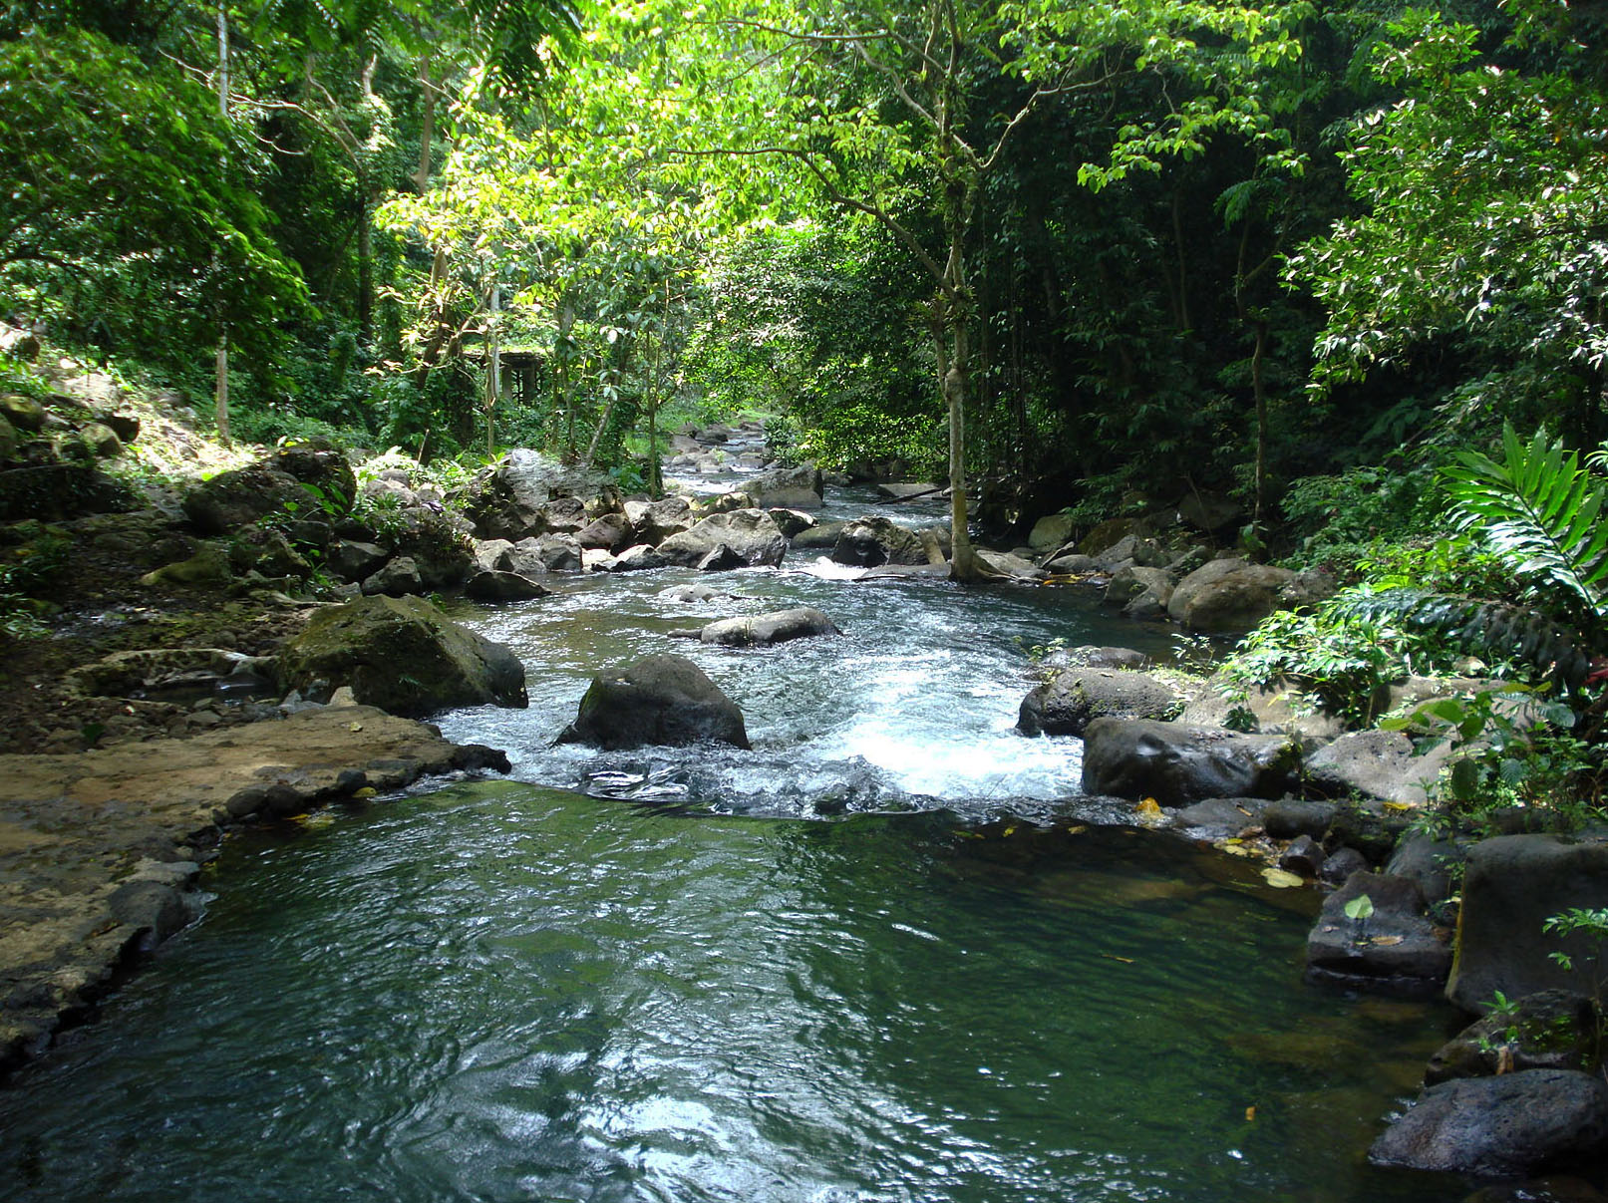

Slide 14
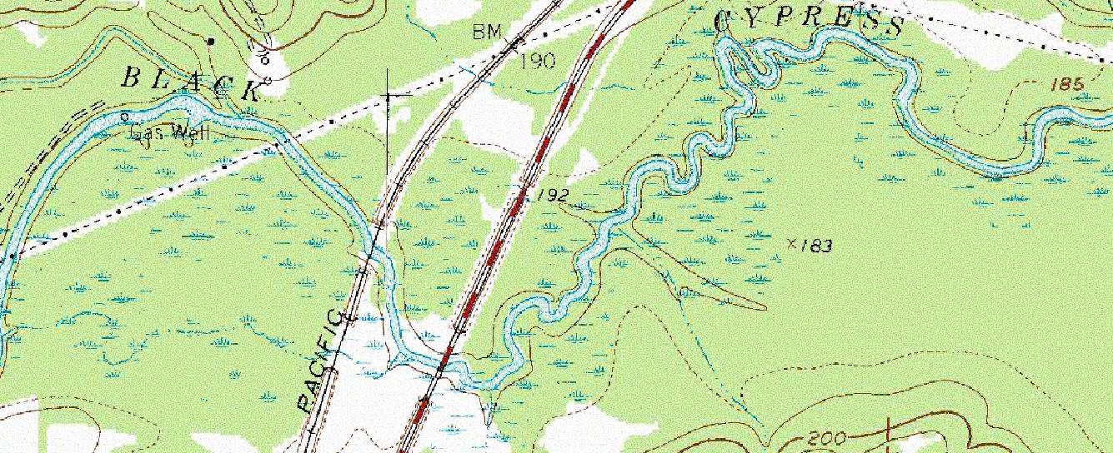
Sample USGS Topographic Maps – Marion County, Texas
Perennial River
Submerged wooded marsh or swamp

Slide 15
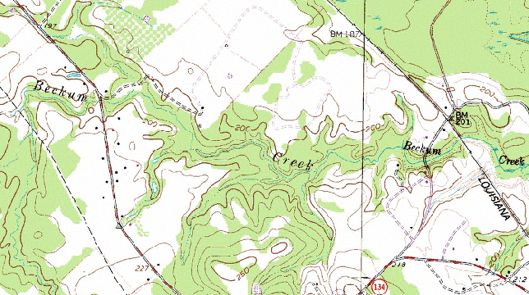
Sample USGS Topographic Maps – Marion County, Texas
Perennial stream

Slide 16
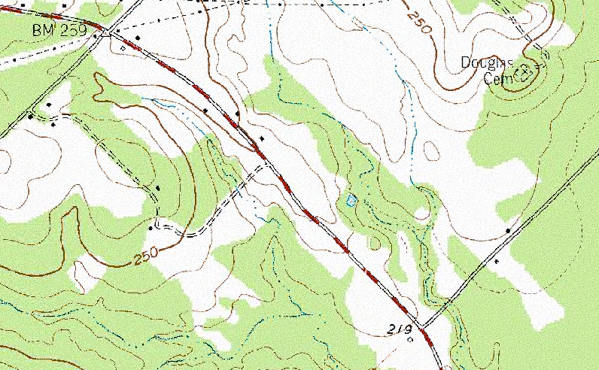
Sample USGS Topographic Maps – Marion County, Texas
Intermittent Stream

Slide 17
Common JD Problems
Inconsistent data
Wetland delineation only (no streams)
Stream delineation only (no wetlands)
Unclear maps and exhibits
Incorrect coordinates
Wrong form; missing data; incomplete form
Wrong or no stream classification
No photographs; incorrectly labeled photographs

Slide 18
Problems (cont.)
No delineation of waters of the U.S. conducted
Incorrect delineations
Incorrect determination on permitting options
Pipelines
Roads
Small projects
Didn’t take into account threatened and endangered species or migratory birds
Didn’t take into account cultural resources

Slide 19
Questions
Peter D. McKone, CWB
Weaver Consultants Group
pmckone@wcgrp.com
Caleb Watkins
Summit Midstream
cwatkins@summitmidstream.com

