Slide 1
Opening the pathway for onshore beneficial reuse of drill cuttings with bioremediation
John Candler M-I SWACO, Patrick Tyczynski M-I SWACO

Slide 2
Beneficial Reuse
Opportunities
Challenges
Reduce the cost
Reduce resource consumption
Improve overall environmental performance
Enhance community relationships
Avoiding environmental or human health damage
Technical
Regulatory
Liability
Sham recycling threats
Finding a market for reuse

Slide 3
Management Options
Waste?
Product?
It may be harmful
We have to test it
We must dispose of waste properly
We must be in compliance
We must protect human health and the environment
We must find a market for it
We must test it to prove it meets requirements
We must store and transport it safely
We must be in compliance

Slide 4
Targets for Beneficial Reuse of Drill Cuttings
Beneficial reuse of drill cuttings as a soil or soil amendment
Integration of reusable drilling fluids design in operations
Identification of chemical and physical soil science targets
Identification of regulatory closure targets

Slide 5
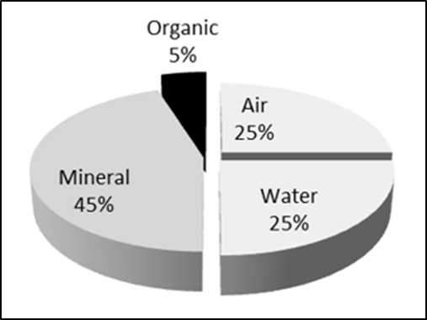
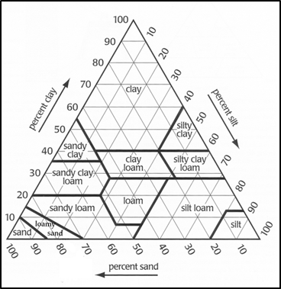
Soil Science Targets
Texture
Essential Mineral Elements of Soil
Soil pH and Liming
Sodium Adsorption Ratio
Mineral Composition of Soil

Slide 6








Regulatory Requirements
State NOW discharge limits
TX RRC - Rule 8
CO GCC - 900 Series
State Risk Based Closure limits and water protection limits
LA DEQ - RECAP
OK DEQ - RAGS
LA DNR 29-B
OK CC - Chapter 10
TX TCEQ - TRRP
CO CDPHE

Slide 7
Background on Base Fluid Design
Chemistry drives biodegradation performance.
  (Rate and completeness of removal)
Chemistry drives drilling performance.
  (Viscosity & resistance to contamination)
Chemistry drives health and safety performance.
  (Flashpoint, skin irritation, vapor generation and toxicity)

Slide 8
Base Fluid Selection to Optimize Aerobic Biodegradation Performance
Carbon Distribution
Hydrocarbon Structures
C10- C12
C12-C16
C16-C21
C21-C35
Paraffins
Olefins
Cyclic Structures
Branched Structures
Biodegradation Rate

Slide 9
Control Points
Moisture
ASTM
Holding capacity
Nitrogen
PHPA Digestion Test
Carbon
TPH
Phosphate
Colorimetric
Porosity
Volume displacement

Slide 10
Performance Monitoring
Temperature
Manual or Temp Logger
TPH Removal
Retort and TPH
Texture and Holding Capacity
(Screen Technique)
Plant Growth and leachate analysis

Slide 11
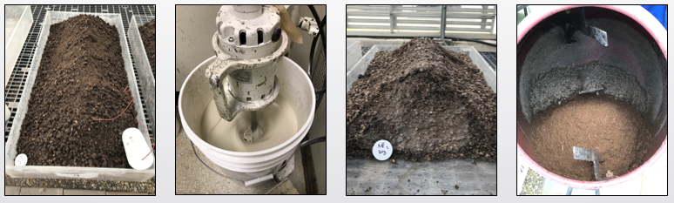
Preparation and Monitoring of Lab Scale Compost

Slide 12
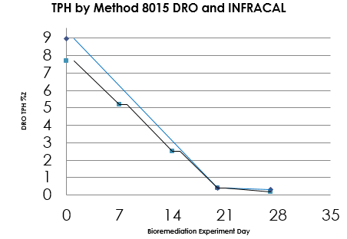
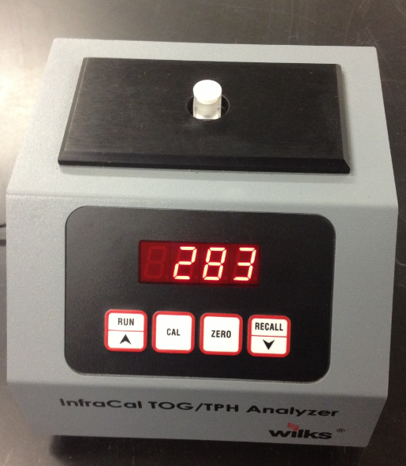
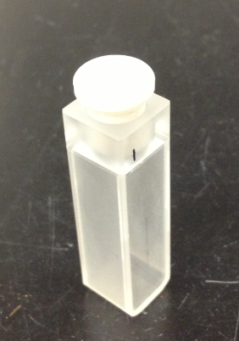
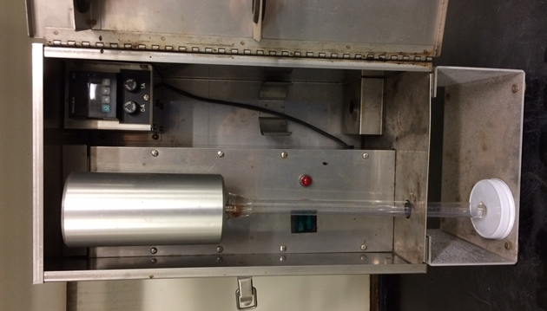
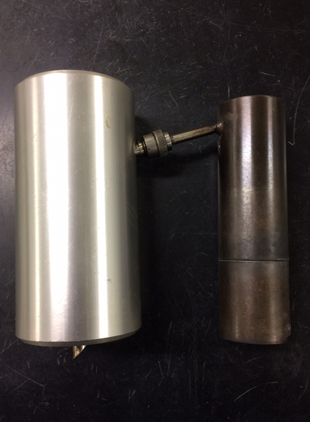
TPH
Performance
Retort
INFRACAL
DRO

Slide 13
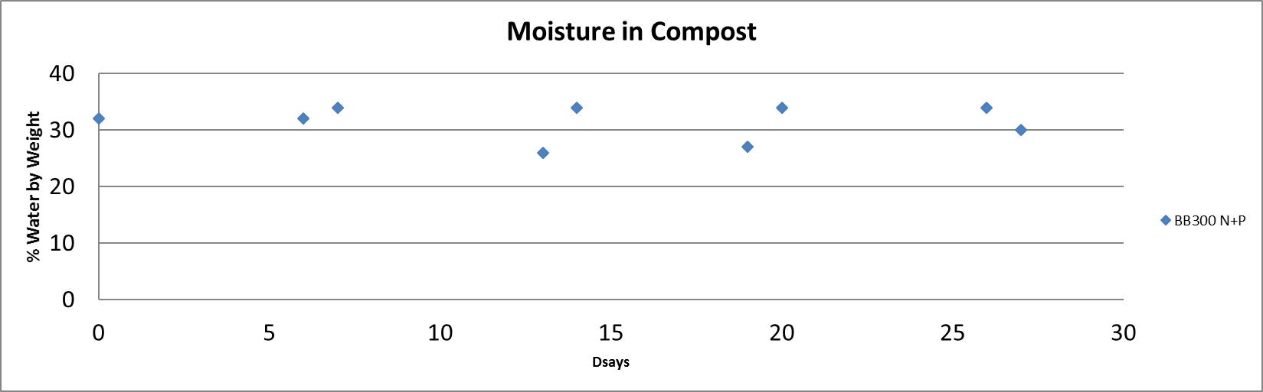
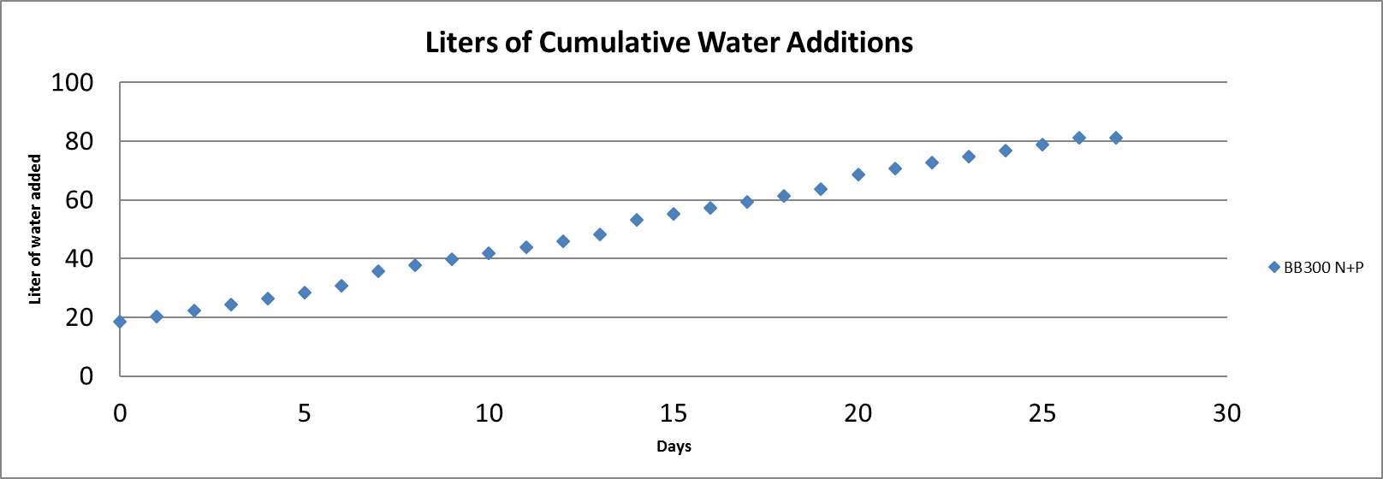
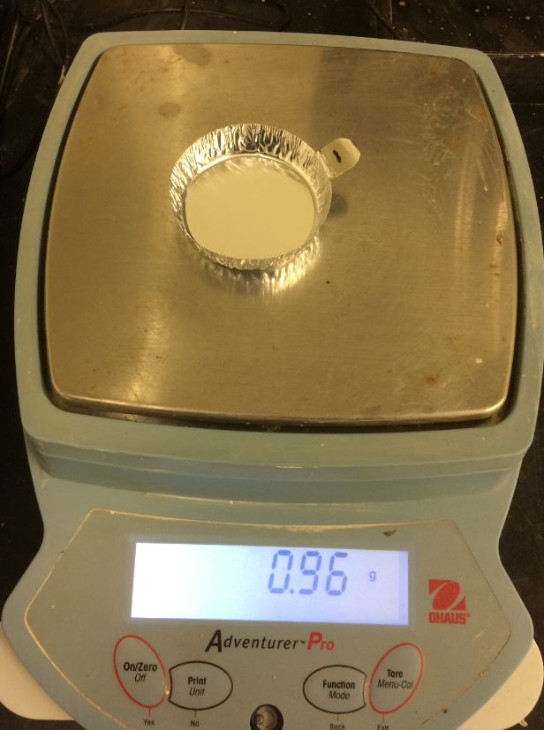
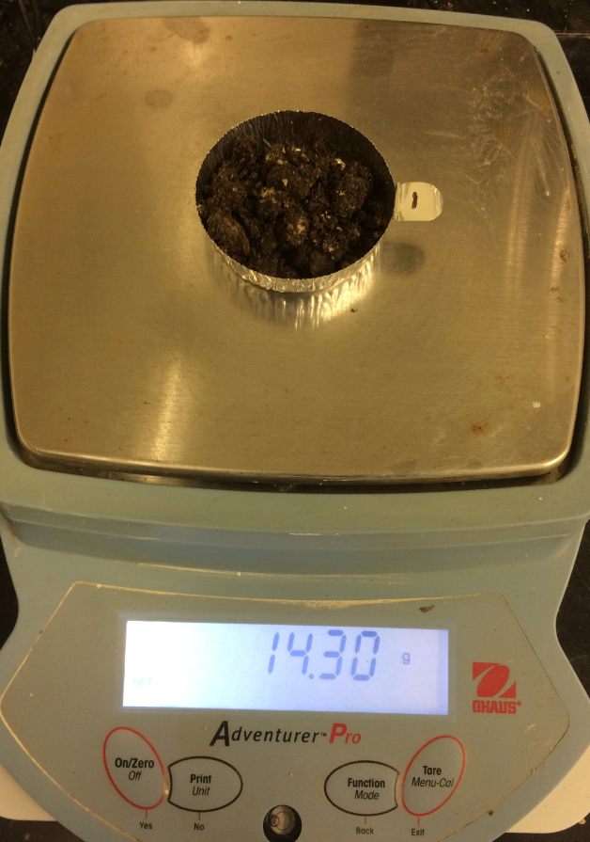
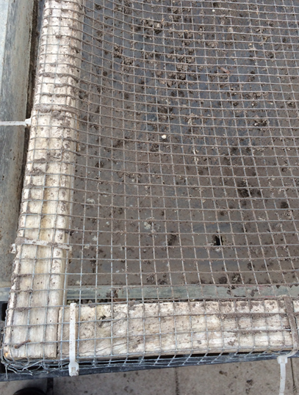
Moisture
Moisture content
Target – 25 – 35%
ASTM

Slide 14
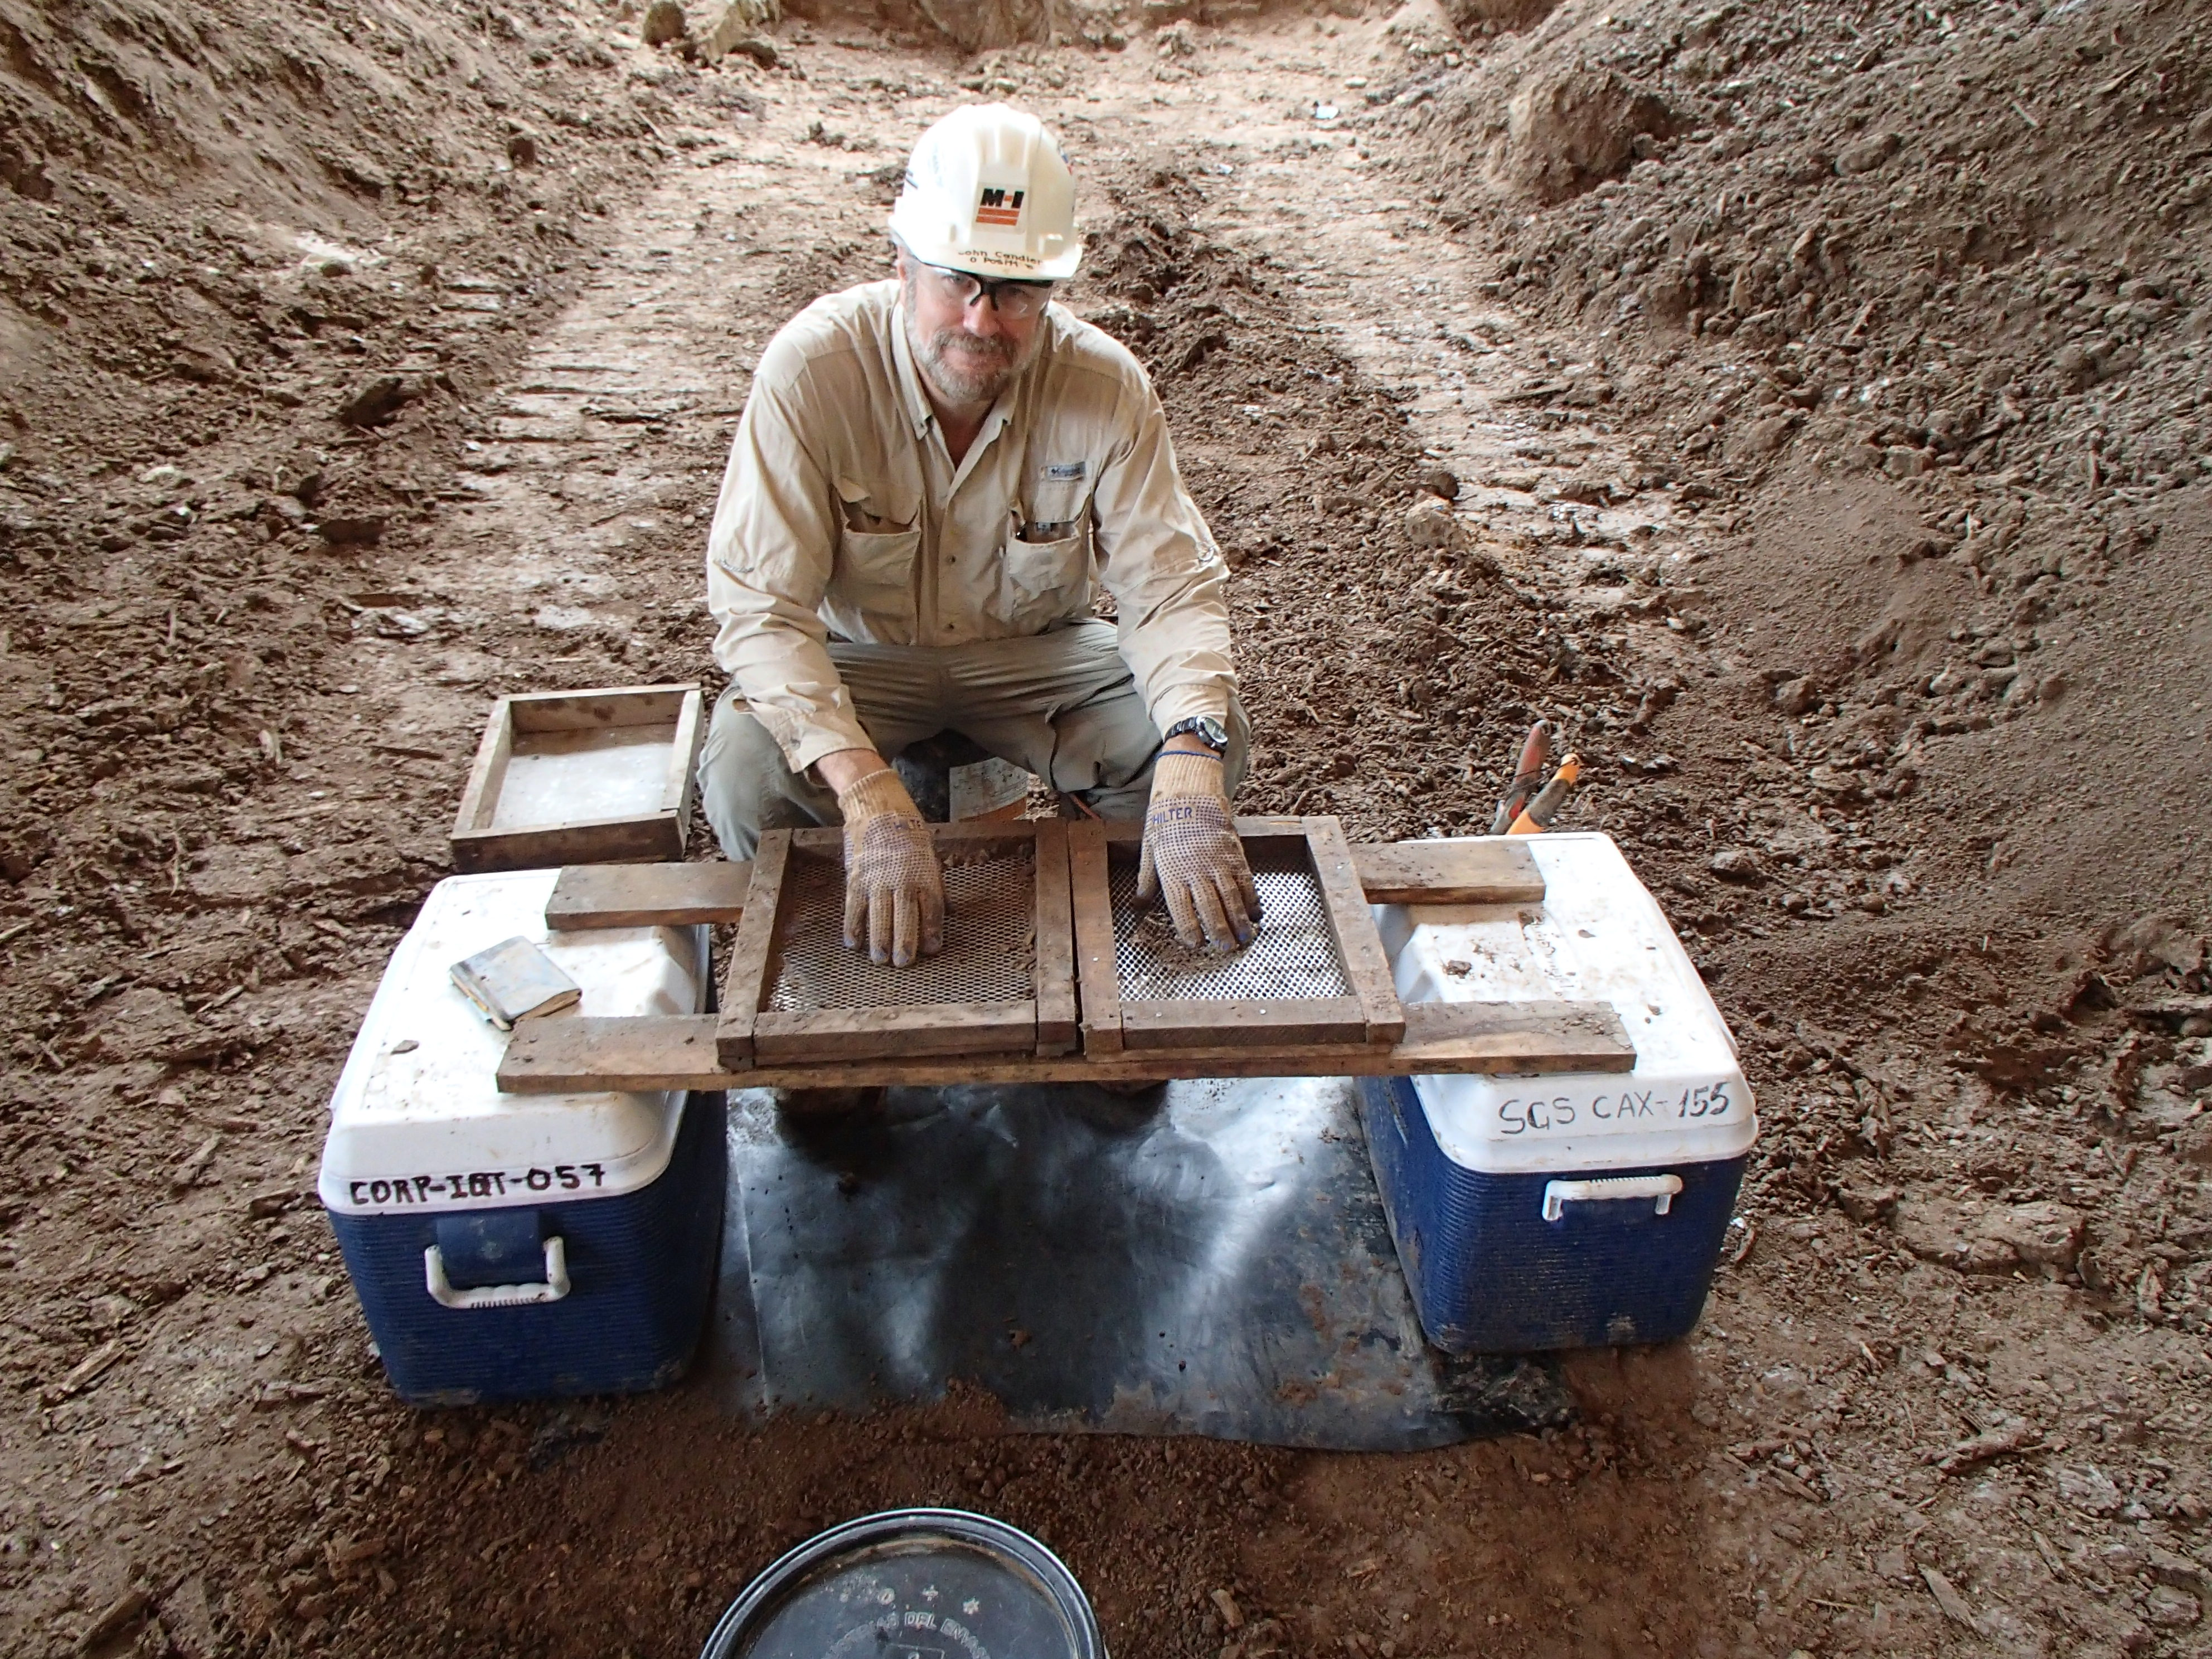
Water Holding Capacity
Traditional techniques based on ribbon test
New technique based on screening and sample preparation

Slide 15
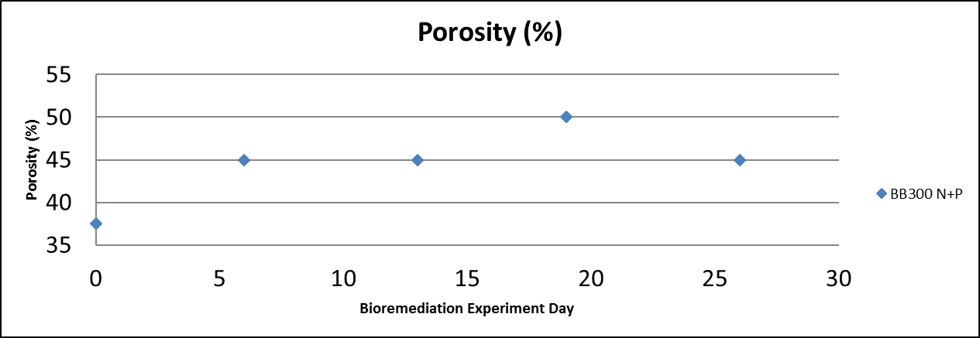
Porosity
Volume displacement

Slide 16
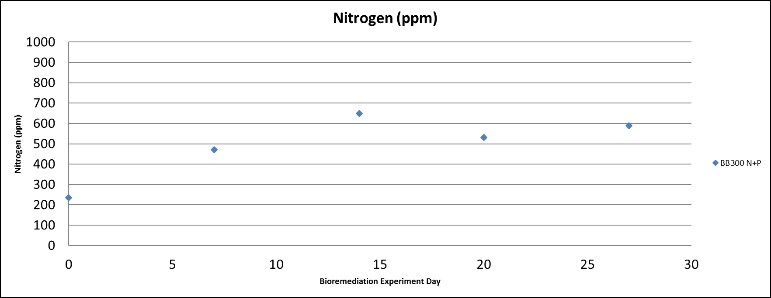
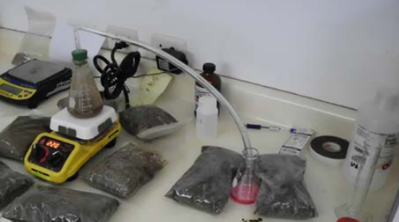
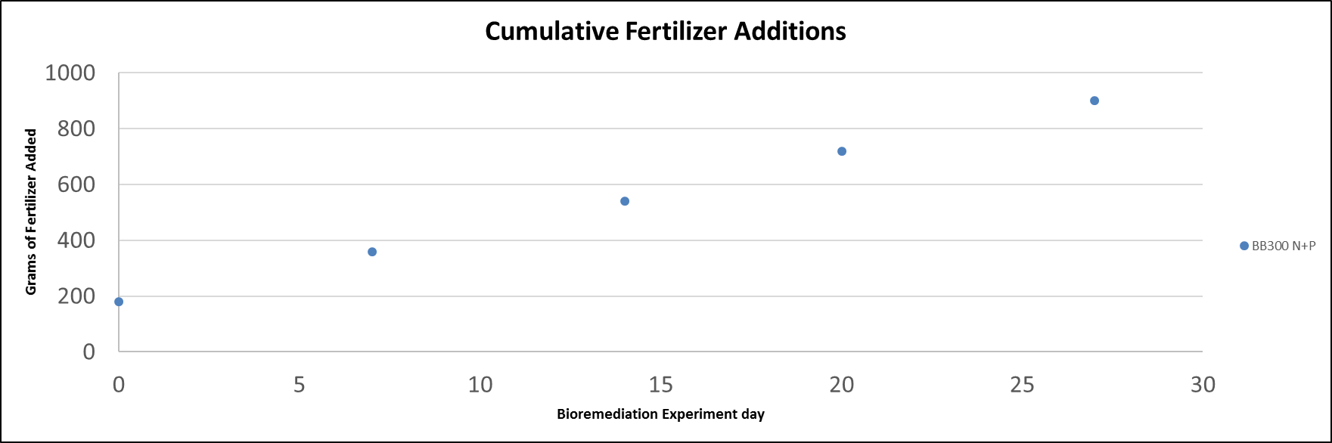
Nitrogen
PHPA Digestion Test

Slide 17
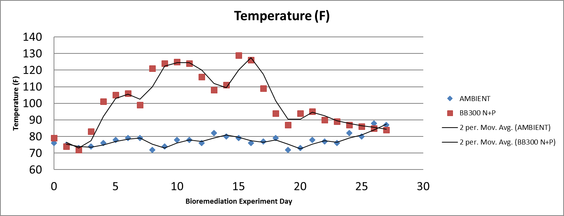
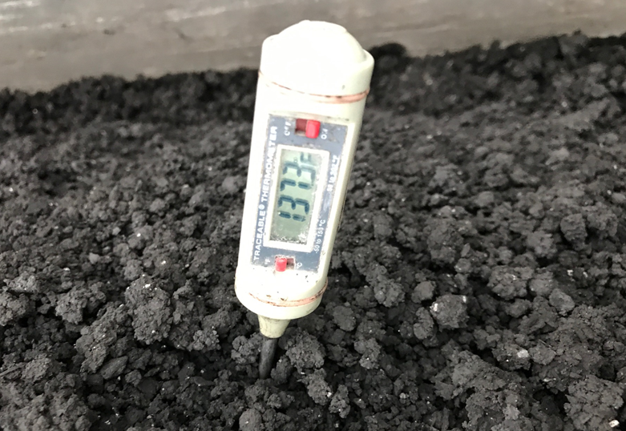
Temperature
Direct measurement
Datalogger

Slide 18
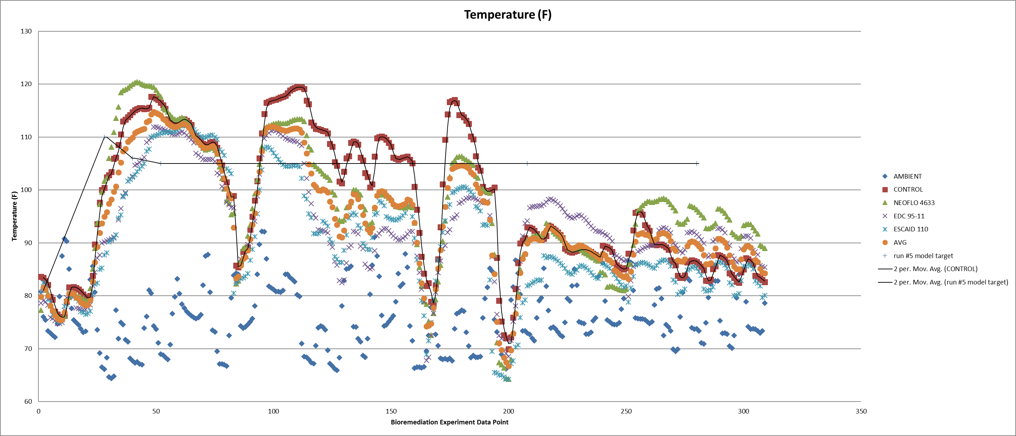
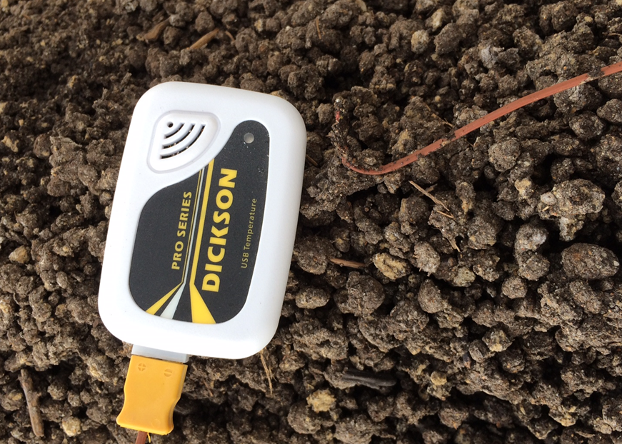
Temperature
Direct measurement
Datalogger

Slide 19
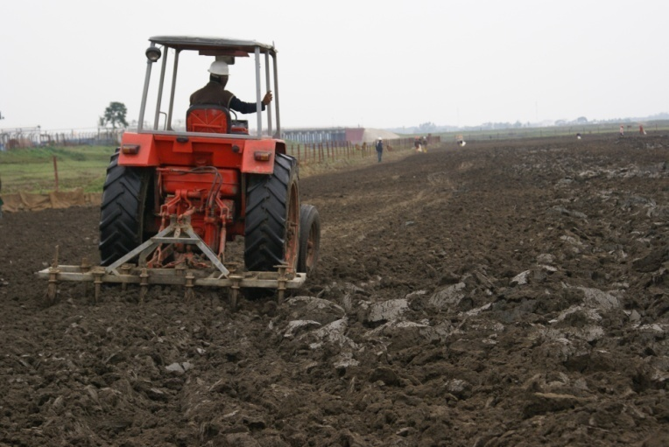
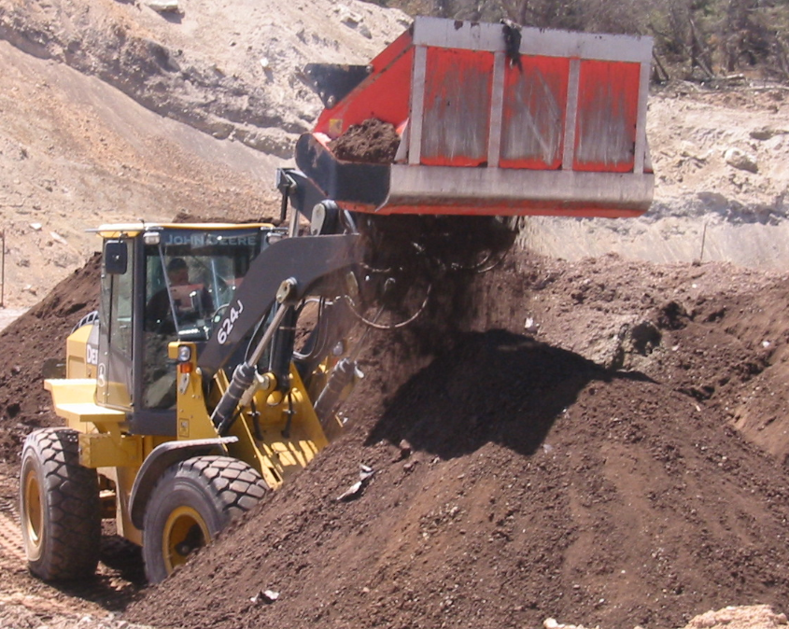
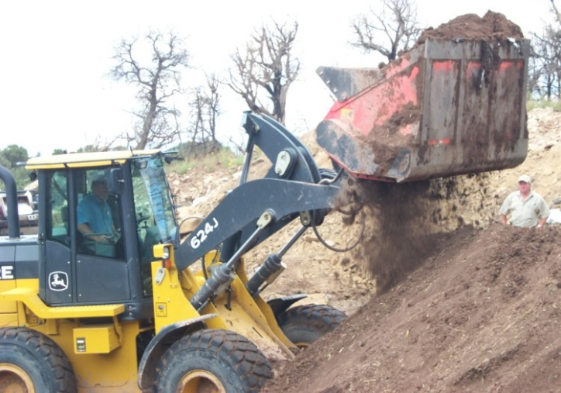
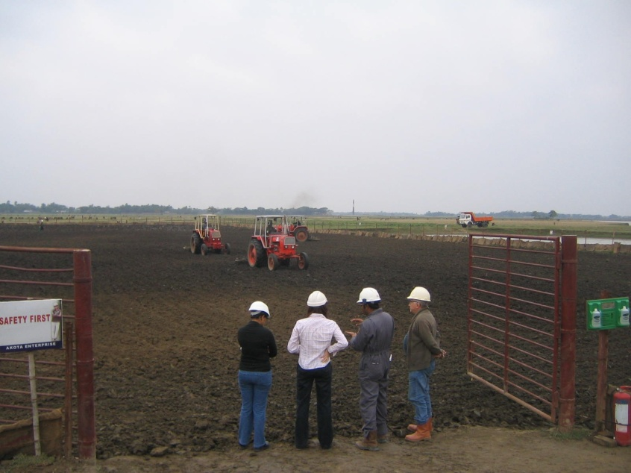
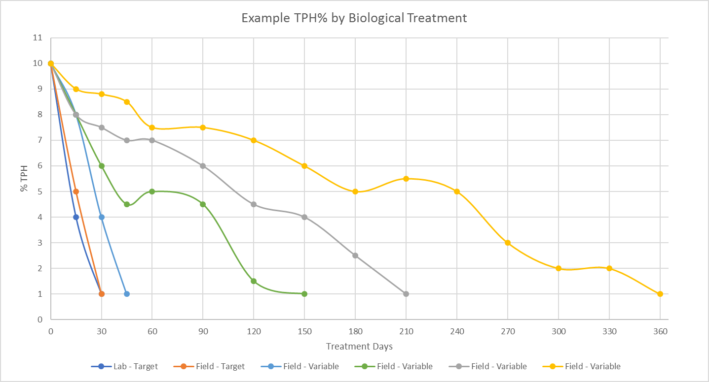
Transition from the lab to the field…….

Slide 20
Elements of a opening the pathway
Training and competency assurance for office team, technical team, and field team on bioremediation/composting in the greenhouse
Development of an effective infrastructure to support bioremediation under field conditions
A good business plan that sets us up for success

Slide 21
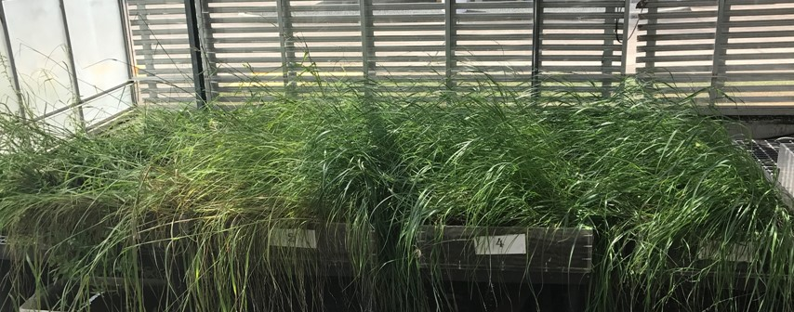
Opening the pathway for onshore beneficial reuse of drill cuttings with bioremediation
Equivalent technical performance
Equivalent or Lower cost when waste and mud costs are considered
Less Trucks on the road hauling cuttings
Less waste disposal
Ecosystem enhancement opportunities

