Slide 1
THE REGULATION OF OIL AND GAS UNDER THE TRUMP ADMINISTRATION
25th International Petroleum Environmental Conference
Denver, Colorado
October 30, 2018 – November 1, 2018
Presented by:
John B. King
Breazeale, Sachse & Wilson, LLP
Baton Rouge, Louisiana

Slide 2
THE REGULATION OF OIL AND GAS UNDER THE TRUMP ADMINISTRATION
Oil and Gas
Compliance and Enforcement
Other Rules Impacting Oil and Gas
Questions
Pipelines
Offshore and Onshore
Methane NSPS
Climate
Presidential Actions
Clean Water Rule

Slide 3
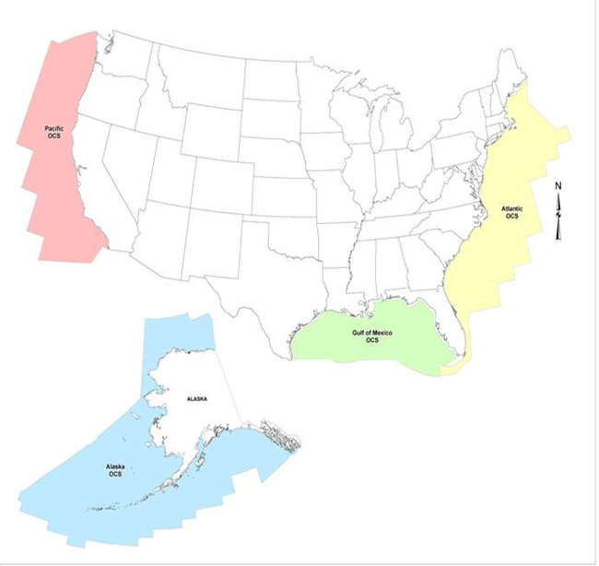
Oil and Gas – Presidential Actions
Promoting Energy Independence and Economic Growth
-Executive Order No. 13783, March 28, 2017
-Ordered review all existing regulations that potentially burden the development or use of domestic energy
Final reports due 180 days after order
-Rescinded multiple climate-related policies and guidance, such as …
President’s Climate Action Plan
Climate Action Plan Strategy to Reduce Methane Emissions
-Ordered review of …
Clean Power Plan
Social Cost of Carbon
Multiple EPA and Interior rules on oil and gas
Implementing an America-First Offshore Energy Strategy
-Executive Order No. 13795, April 28, 2017
-Policy “to encourage energy exploration and production,
including on the Outer Continental Shelf”
-Interior ordered to give full consideration to revising the schedule
of proposed oil and gas lease sales so that it includes
previously off-limit areas
-Ordered review of two final rules and one proposed rule that applied
to off-shore operations

Slide 4
Oil and Gas – Offshore
Department of Interior – Order 3350, May 1, 2017
Implements EO 13795, April 28, 2017
Ordered development of new 5-Year OSC leasing program (for 2019-2024)
-To include Alaska, Mid-Atlantic, South Atlantic, and Gulf of Mexico
-Noted that 2017 – 2022 Program (Jan. 2017) excluded Atlantic and parts of Alaska
-Forgoes tens of billions barrels of oil and 100 trillion cubic feet of gas
Addressed several rules that applied to off-shore operations
-Offshore Air Quality Rule
Proposed at 81 Fed. Reg. 19717 (April 5, 2016)
Ordered that all activities to finalize rule be stopped
-Well Control Rule
Final rule at 81 Fed. Reg. 25888 (April 29, 2016)
Ordered review to suspend, revise, or rescind
Revision proposed at 83 Fed. Reg. 22128 (May 11, 2018)
Final rule sent to OMB?
-Offshore Artic Drilling Rule
Final rule at 81 Fed. Reg. 46478, (July 15, 2016)
Ordered review to suspend, revise, or rescind
Changes considered but not yet proposed

Slide 5
Oil and Gas – Offshore
Draft National OSC Program 2019-2024, January 4, 2018
-Implements EO 13795 and Order 3350
-Will replace the 2017 – 2022 Program
-Covers 90% of OSC
-47 potential lease sales in 25 of 26 planning areas
-Comment period ended on March 9, 2018

Slide 6
Oil and Gas – Onshore
Department of Interior – Order 3354, July 6, 2017
-Steady decline in leases on federal lands between 2009 – 2016
-BLM had 2,802 pending applications to drill as of Jan. 31, 2017, with 257 days average to process
-Order 3354 to ensure quarterly lease sales are held and ensure faster permitting
Tax Cuts and Jobs Act, Dec. 22, 2017
-Opened up ANWR – 1002 Area for drilling
-1.5m acres of 19M acres in ANWR
-Lease to occur within 4 years and a second lease within seven years

Slide 7
Oil and Gas – Onshore
Hydraulic Fracturing Rule, 80 Fed. Reg. 16128 (March 26, 2015)
-Applicable on Federal/Indian lands
-Stayed and on appeal in Tenth Circuit
-Rescinded by BLM, 82 Fed. Reg. 61924 (December 29, 2017)
Waste Prevention Rule, 81 Fed. Reg. 83008 (November 18, 2016)
-Applicable on Federal/Indian lands
-Limits amount of flaring, adds leak detection, reduces venting
-Interior ordered to review the rule by EO 13783 (March 28, 2017)
-BLM attempted to suspend or stay the rule for one year, 82 Fed. Reg. 58050 (Dec. 8, 2017)
US District Court (ND CA) enjoined implementation of ‘Suspension Rule’ on Feb. 22, 2018
-Certain portions of rule stayed by district court in Wyoming on April 4, 2018
California, New Mexico, and NGOs seeking review of stay in Tenth Circuit
-Interior proposed to rescind and/or revise, 83 Fed. Reg. 7924 (Feb. 22, 2018)
-Final rule issued on September 18, 2018, 83 Fed. Reg. XXXX (XXX, 2018)
Rescinds requirements on LDAR, waste minimization plans, gas capture percentages
Revising to reflect BLM’s venting and flaring policies that pre-date 2016 rule

Slide 8
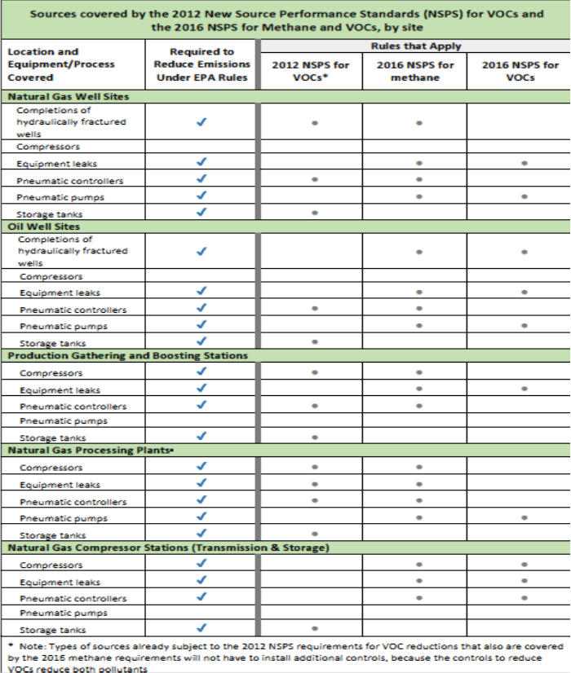
Oil and Gas – Methane NSPS
The 2012 NSPS Rule
-77 FR. 49490 (Aug. 16, 2012)
-40 CFR 60, Subpart OOOO
-New facilities as of Aug. 23, 2011
-Targets VOCs
-RECs or ‘green completions’
-Storage tanks
-Equipment leaks
The 2016 NSPS Rule
-81 FR 35824 (June 3, 2016)
-40 CFR 60, Subpart OOOOa
-New facilities as of Sep. 18, 2015
-Targets methane and VOCs
-Subpart OOOO applies between Aug. 23, 2011 and Sept. 18, 2015
-Owners/operators to find and repair leaks
-Next Generation Enforcement, such as optical gas imaging
-General duty added at 40 CFR 60.5370a(b) and to Subpart 0000

Slide 9
Oil and Gas – Methane NSPS
Attempts to stay, delay, and revise
-EPA announces it will review rule pursuant to EO 13783, 82 Fed. Reg. 16331 (April 4, 2017)
-EPA convenes proceeding to reconsider the rule, Pruitt Letter dated April 18, 2017
Mentions the fugitive emission monitoring requirements
-EPA issues Notice of Reconsideration and Partial Stay, 82 Fed. Reg. 25730 (June 5, 2017)
Stay issued for three months
Fugitive emission requirements, well site pneumatic pump standards, and certification by PE
Vacated on July 3, 2017 (Clean Air Council v. EPA)
-EPA issues proposes stay of two years, 82 Fed. Reg. 27645 (June 16, 2017)
Fugitive emission requirements, well site pneumatic pump standards, and certification by PE
-EPA Notice of Data Availability
82 Fed. Reg. 51788 (Nov. 8, 2017), 82 Fed. Reg. 51794 (Nov. 8, 2017)
-EPA issues final rule on some of the proposals, 83 Fed. Reg. 10628 (March 12, 2018) – relates to figutive emissions
Amends requirement that leaking components be repaired during unplanned/emergency shutdowns
NOTE: Still required to repair during next shutdown or two years, whichever is earlier
Amends monitoring survey requirements for well sites on the Alaskan North Slope
Otherwise, Methane NSPS is in effect, including
-Initial monitoring survey of fugitive emissions was required by June 2, 2017
-Reporting
Initial Semi-annual Report and Semi-Annual Report under 60.5422a(b)
Annual Report under 60.5420a(b)
90 days after initial compliance period (one year from start-up or August 2, 2016)

Slide 10
Oil and Gas – Methane NSPS
EPA issues proposal to substantially amend rule on September 11, 2018
-83 Fed. Reg. 52056 (October 15, 2018)
Three types of amendments
-Amendments for provisions on which reconsideration was granted
Fugitive emission requirements
Well site pneumatic pumps standards
PE certification of closed vent systems
AMEL (alternative means of emission limitations)
-Amendments to clarify and streamline implementation
Well completions (location of a separator during flowback, screenouts and coil tubing cleanouts)
Onshore natural gas processing plants (definition of capital expenditure and monitoring)
Storage vessels (maximum average daily throughput)
General clarifications (certifying official and recordkeeping and reporting)
-Technical amendments

Slide 11
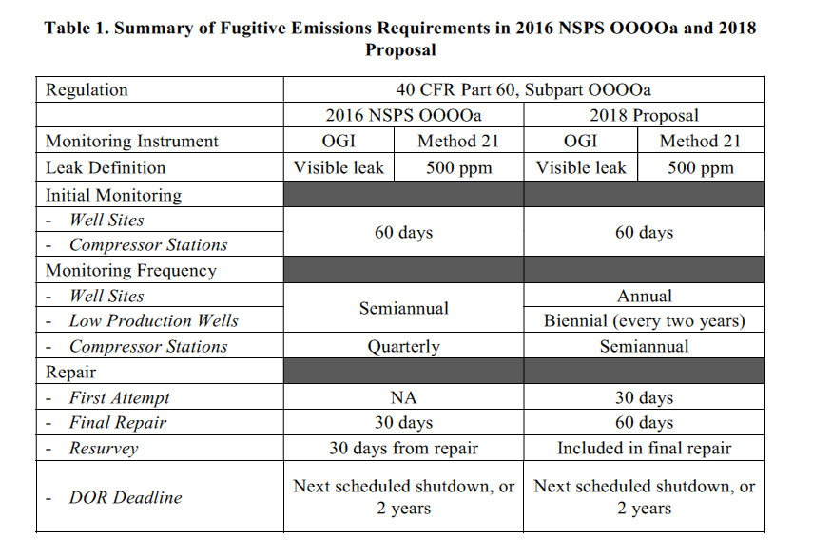
Oil and Gas – Methane NSPS
Source: EPA Memo, April 12, 2018

Slide 12
Oil and Gas – Methane NSPS
Well site pneumatic pumps standards
-Technical infeasibility of control installation or use was categorically unavailable at ‘greenfield’ (or new) sites
If new, operator could incorporate proper controls into design
-Proposed to expand technical infeasibility provision to all sites and eliminate categorical distinction between sites
PE certification of closed vent system (CVS)/ pneumatic pump technical infeasibility
-Proposed to allow certification by PE or in-house engineer with expertise on design/operation of CVS/pump
AMEL (alternative means of emission limitations)
-AMEL available by submitting data demonstrating alternative will achieve at least equivalent emission reductions
-Proposed to incorporate emerging technologies and existing state programs
Well completions (location of a separator during flowback, screenouts and coil tubing cleanouts)
-Separator may be located at or near the well site so that it is able to commence separation flowback
‘Near’ may include a centralized facility or well pad that services the well
-Screenouts and coil tubing cleanouts are not part of the flowback period

Slide 13
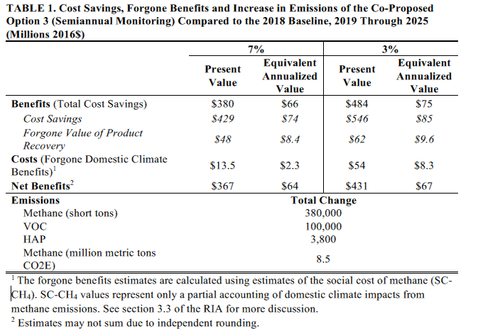
Oil and Gas – Methane NSPS
Source: EPA Proposed Rule

Slide 14
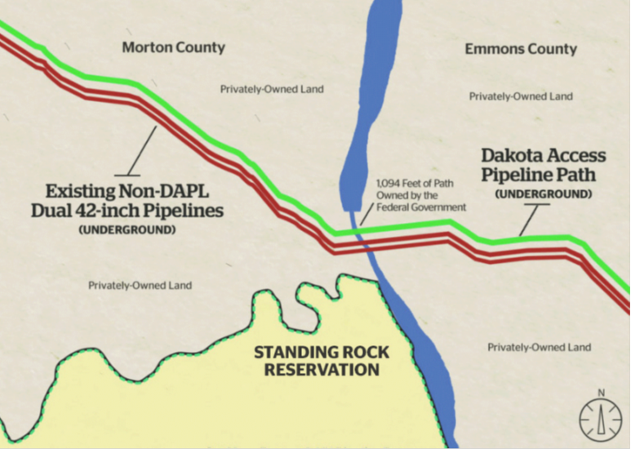
Oil and Gas - Pipelines
Both subject of Presidential Memoranda, January 24, 2017
Keystone XL Federal permits issued
Suits filed over EIS
Dakota Access Easement granted by Corps on Feb. 8, 2017
Drilling completed and in service
Corps ordered to review its permit decision
Corps reaffirmed its decision on August 31, 2018

Slide 15
Other Rules - Clean Water Rule
Clean Water Rule, 80 Fed. Reg. 37054 (June 29, 2015)
Legal proceedings
-Numerous suits filed in numerous district courts and appellate courts
-Nationwide stay issued in State of Ohio, et al v. U.S. Corps of Engineers, et al, 803 F3d 804 (6th Cir. 2015)
-National Assoc. of Manufacturers v. DOD, US Supreme Court, Jan. 22, 2018 - appellate courts have no jurisdiction
Administrative proceedings
-Executive Order #13778 , dated February 28, 2017 - ordered review of Clean Water Rule
Seek to define ‘navigable waters’ as per Justice Scalia’s opinion in Rapanos
-EPA Intention to Review and Rescind or Revise the Clean Water Rule, 82 Fed. Reg. 12532 (March 6, 2017)
Announced two-step process
Step 1: Re-establish status quo in place prior to 2015 Rule
Step 2: Propose new rule to replace 2015 Rule
-Step 1 Reinstated prior rule, 82 Fed. Reg. 34899 (July 27, 2017)
Applicability date of 2015 Rule is Feb. 6, 2010, 83 Fed. Reg. 5200 (February 6, 2018)
The Applicability Rule was challenged and overturned in 22 states
-Step 2 Public meetings, received written recommendations, but no proposed rule at this time
EPA announced on October 3 that proposed rule to be issued in 30 days

Slide 16
Other Rules - Clean Water Rule

Slide 17
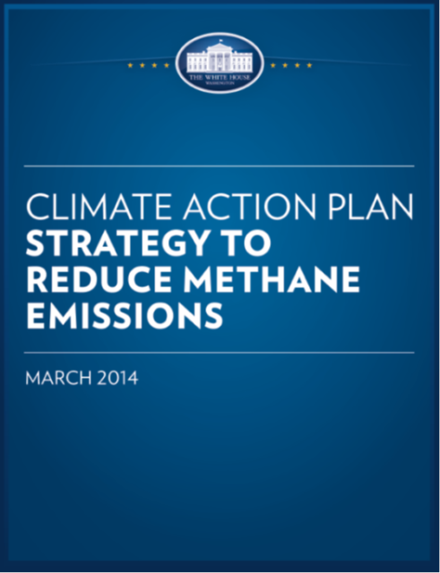
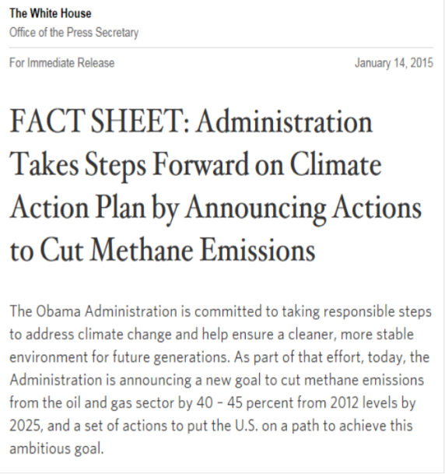
Other Rules - Climate
The Trump Administration
-Removed WH climate page within minutes of inauguration
Executive Order 13783, March 28, 2017
-Revokes/rescinds most Obama-area climate policies
Paris Agreement
-President Trump announced withdrawal on June 1, 2017
-Based decision on:
Economic hardship on United States
Payments to Green Fund
Lack of reductions by China and India
Clean Power Plan
-Proposal to repeal, 82 Fed. Reg. 48035 (October 16, 2017)
-Proposed Affordable Clean Energy (ACE) Rule to replace CPP
83 Fed. Reg. 44746 (August 31, 2018)
Mid-Term Evaluation of GHG Emissions
-83 Fed. Reg. 16077 (April 13, 2018)
-Model Year 2022 – 2025 Light-Duty Vehicles
-Standards based on outdated information or too stringent
-Will consider appropriate standards for these model years
-California and other states suing

Slide 18
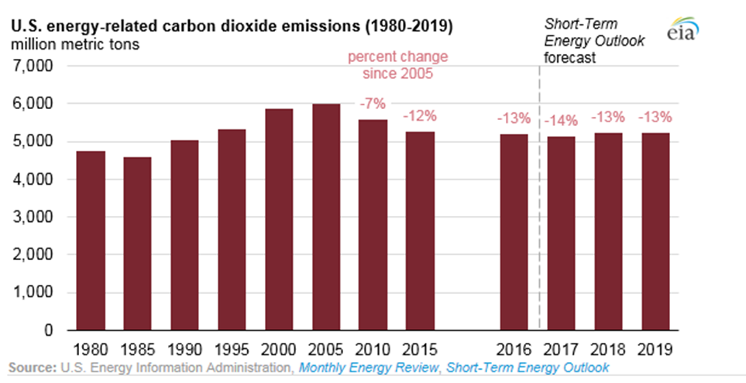
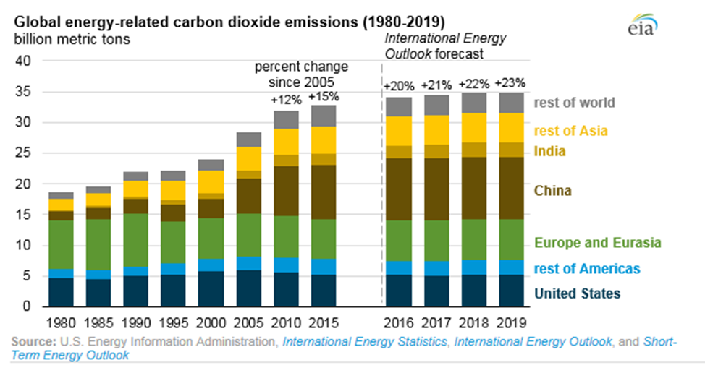
Other Rules - Climate
Source: EPA

Slide 19
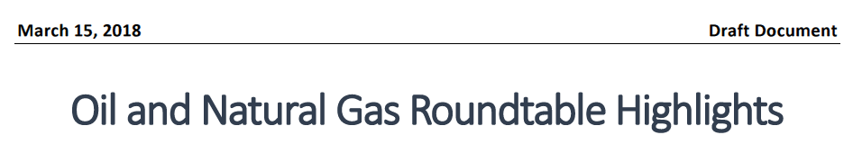
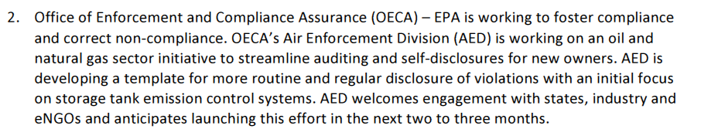
Compliance and Enforcement – Oil and Gas

Slide 20
Compliance and Enforcement – Oil and Gas
Prior audit policies
-General Audit and Self-Disclosure Policy, April 2000
EPA still had to collect economic benefit portion of penalty
-General New Owner Audit Policy, August, 2008
EPA could waive all of economic benefit portion of penalty in certain circumstances
New Owner Clean Air Act Audit Program
-EPA seeking feedback on the program
-Applies to upstream oil and gas exploration and production sector
-Well sites, including associated storage tanks and pollution control equipment
-EPA observed significant emissions and noncompliance at these facilities
Issued Compliance Alert in September, 2015
Emissions from tank batteries due to undersized and poorly maintained vapor control systems
Implemented by a Draft Agreement
-New owner
Cannot be responsible for environmental compliance prior to the date of acquisition
New owner and seller cannot have the largest ownership share of each other
New owner and seller cannot have a common corporate parent
New owner must notify EPA with six month of the date of acquisition
-Scope of audit
Must assess engineering and design of vapor control system for all facilities included in the audit
Includes detailed instructions and guidelines for reviewing these systems
Can be broader than the vapor control systems
-Must correct in a timely manner
-Must provide semi-annual report(s) and a final report
-If all done, EPA agrees to resolve civil penalty liability by not imposing a civil penalty
Includes the gravity and economic incentive portions of the civil penalty

Slide 21
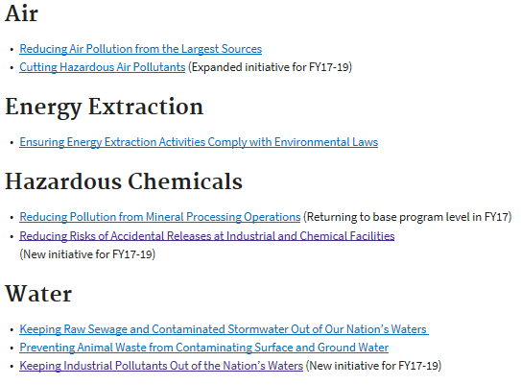
Compliance and Enforcement – Oil and Gas
National Enforcement Initiatives (2017 – 2019) – begun in October, 2016
Ensuring Energy Extraction Activities Comply with Environmental Laws
-Need to assure that energy sources are developed in an environmentally protective manner
-Some techniques for NG extraction pose a significant risk to public health and environment
-Continue to address pollution through greater use of …
Advanced pollution monitoring
Reporting techniques
Next Generation technologies (infrared cameras to make the ‘invisible visible’)

Slide 22
Compliance and Enforcement – Oil and Gas
Transition from NEIs to National Compliance Initiatives
-EPA Memorandum, August 21, 2018 from Susan Bodine
-Will rename NEIs to NCIs in FY 2019
-Sends message that “increased compliance is the goal” and that enforcement is not the only tool
-Discusses NCIs for FY 2020-2023
Discusses how current NEIs will be addressed in next cycle
-Currently seeking input from stakeholders
Ensuring Energy Extraction Activities Comply with Environmental Laws
-For FY 2019, work to focus on significant health and environmental problems
Exposure to significant releases of VOCs
Reducing non-attainment
Reducing water quality impairment
-For FY 2020-2023, EPA will consider …
Merge into the ‘Cutting Hazardous Air Pollutants’ NCI, or
Focus this NCI on …
-Significant sources of VOCs that have substantial impact on air quality (without regard to sector) , and
-Returning other work in this sector to core program and regional priorities

Slide 23
Questions?
John B. King
Breazeale, Sachse & Wilson, LLP
225/381-8014
jbk@bswllp.com
www.bswenviroblog.com

