Slide 1
Nuclear Magnetic Resonance Geophysical Investigations How to Quantify Aquifer Properties and Hydrocarbon Saturation Using Existing Monitoring Wells
Presented by: Brad Cross, ERM
October, 2018

Slide 2
Goal: Closure of Contaminated Sites Problem: Heterogenaity vs Simplyfing Assumptions Solution: Resolve & understand the true aquifer fabric and multi-domain mass flux, mass storage systems
HRSC Tools
EC
CPT
Televiewers (acoustic/optic)
Heat-Pulse Flow Meter
HPT
MIP
LIF
Traditional Borehole Geophysics

Slide 3
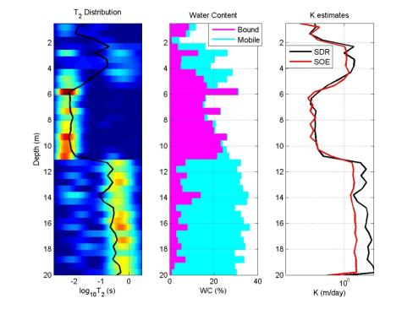
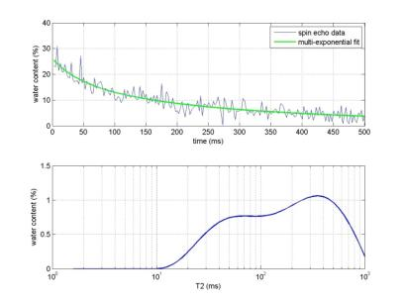
NMR builds on other HRSC tools:
Total porosity (no equivalent push-tool method)
Mobile & immobile pore volumes and pore size distribution (no equivalent push-tool method)
Hydraulic conductivity
Hydrocarbon (LNAPL) detection
Can be Acquired in Existing PVC-cased Wells

Slide 4
Some Potential Applications:
High resolution conceptual site model development:
Perched water identification/residual (irreducible) water saturation
Aquifer mass flux and mass storage zones
Pore volume and pore size distribution characterization
Mass flux estimation
Quantification of changes in properties over time:
Infiltration, dewatering, residual saturation
Pore-space reduction (biofouling, subsidence)
Hydrocarbon (LNAPL) saturation reduction
Water supply/extraction well design/efficiency:
Optimize screen intervals
Assess redevelopment/rehabilitation

Slide 5
NMR Measurement Physics
Properties of fluids that effect echo trains:
hydrogen index (HI)
longitudinal relaxation time (T1)
transverse relaxation time (T2)
diffusivity (D, the extent to which molecules move at random in the fluid).
T2 decay is proportional to pore size.
Porosity and pore size can be used to estimate permeability and the free fluid index (moveable fluids)

Slide 6
Hydrologic Properties from NMR
MRI directly measures the density of hydrogen nuclei in fluids
Since density of hydrogen nuclei in water is known, data can be directly converted to an apparent water-filled porosity
Can also determine the presence and quantities of different fluids

Slide 7
Relaxation rates strongly correlate with pore size
T2 relaxation time increases with pore size

Slide 8
Mobile versus Immobile Porosity
Using inverse modeling, composite echo trains are converted to porosity distributions.
Modeling is based on substantial laboratory calibrations to various soil/rock matrices
Irreducible & Clay Bound Fluid
Mobile Fluid
T2 cutoff

Slide 9
Hydrologic Properties from NMR

Slide 10
Multi-Phase Porosity Distribution

Slide 11
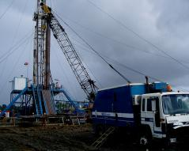
Downhole NMR Logging
Used in oil & gas for decades
Porosity, saturation, permeability
Fluid-type oil/water (based on diffusion)
Oil field tools
Operated by oil services companies
Engineered for deep logging: high-P, high-T
Very large: > 50 ft long & 5.75” diameter
Very expensive: single well >$50,000

Slide 12
Downhole NMR Logging

Slide 13
Downhole NMR Logging

Slide 14
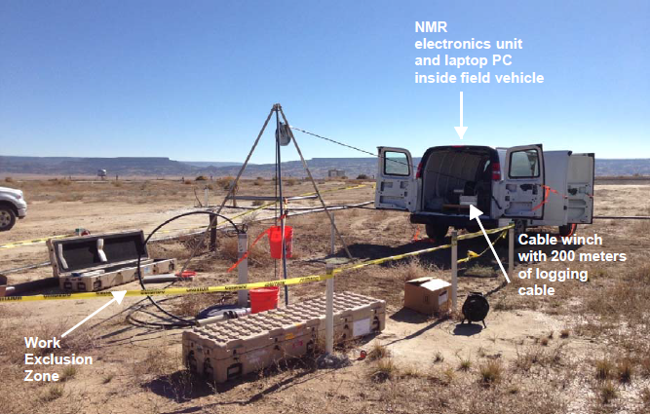
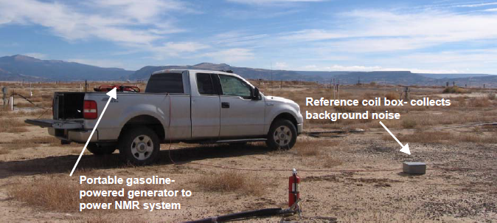
Javelin System (VistaClara, Inc.)

Slide 15
Javelin System (VistaClara, Inc.)
Can be deployed with Geoprobe Systems® equipment (direct-push tool)

Slide 16
Straightforward Interpretation
Vertical resolution determined by length of coil in probe and pore size distribution
Processing automated in packaged software
Interpretation yields detailed characterization of aquifer structure and properties (bound/mobile water content, permeability)

Slide 17
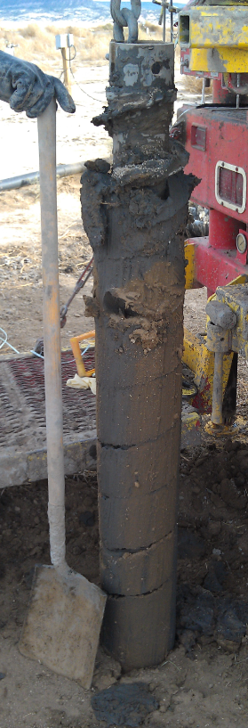
Case Study: Mill Tailings

Slide 18
Mill Tailings Impoundment

Slide 19
Hydrocarbon Detection Pilot Test Results

Slide 20
Surface NMR

Slide 21
Comparison of Logging and Surface NMR

Slide 22
Summary
NMR is a viable technology for environmental and water supply practitioners
Cost savings and reduced risk to human health and safety
Improved site characterization and CSM refinement
Strong potential to optimize remedial designs

Slide 23
Thank you
Brad Cross
Partner:
Pacific West
brad.cross@erm.com
+01 480 869 0604
Scottsdale, Arizona

