Slide 1
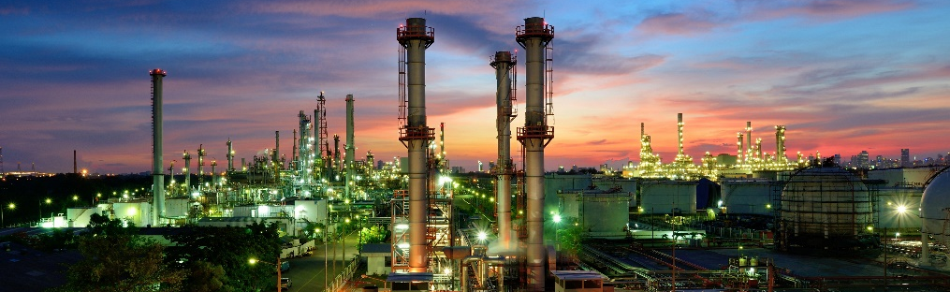
Natural Source Zone Depletion for Long Term LNAPL Site Management
International Petroleum Environmental Conference, Denver, Colorado
November 1, 2018

Slide 3
Agenda
OBJECTIVE: This tool allows sites to continue effectively
History
NSZD Conceptual Site Model
Typical NSZD Rates
Overview of NSZD rate quantification methods
  Flux Chamber
  Trap
  Gradient
  Biogenic Heat
  Compositional Change
Case study – railroad fueling yard
  Implications on other projects

Slide 4
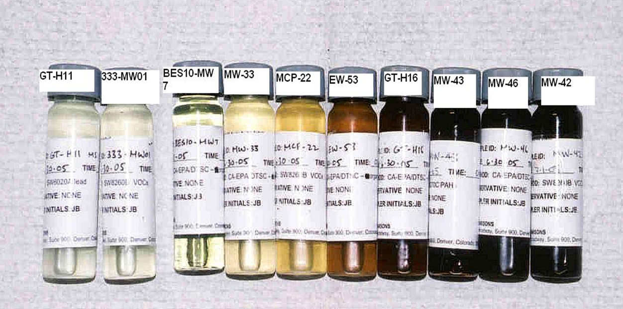
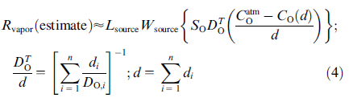
Evolution in understanding of source degradation
LNAPL Compositional Changes
Source zone longevity study, Williams AFB and source zone natural attenuation (SZNA)
  LNAPL stability assessment (T.Sale, CSU)
CRC Care Technical Report 44
LNAPL weathering efforts
Vadose zone monitoring/respiration testing
Source zone longevity study, Williams AFB
(2004) and source zone natural attenuation (SZNA)
  Johnson, Lundegard, et al., 2006
  Development of the gradient method
Flux studies at Bemidji crude oil site (Mayer et al., 2009)
Technology overview for NSZD (ITRC, 2009)
LNAPL stability assessment (T.Sale, CSU, 2012)
Commercialization of passive CO₂ flux traps (E-Flux, 2013)
  Bemidji Crude Sites
API Guidance Document (2017)
1980
1990
2004
2006
2009
2012
2013
2018
LNAPL Weathering
Evaluation
  (Gradient Method) Johnson, Lundegard, et al., 2006
Commercialized CO₂ Trap Testing
  ITRC NSZD
ITRC LNAPL-3
Vadose Zone monitoring/respiration testing
Excerpt from P.Johnson et al., 2006

Slide 5
Paradigm shift in understanding of natural attenuation
Evolution of thought started in 2006 by P.Johnson, Arizona State University
Shift in analytical focus from aqueous/dissolved to vadose/gaseous
Former efforts guided by US EPA, ASTM, and NRC and models such as BIOSCREEN and REMFuel
New efforts guided by literature, and CRC CARE guidance forthcoming
Site | Aqueous (lb/yr) | CO₂ Efflux (lb/yr)
Large Railroad Yard | 0 – 70 | 60,000 - 360,000
Pipeline Release | 70 - 150 | 9,000 – 19,000
Natural Gas Well Pad | 1 – 10 | 4,000 - 10,000
Highway Maintenance Yard | 90 – 200 | 170 - 520
Our field measurements confirm literature findings that NSZD rates are most often multiple orders of magnitude higher using vapour monitoring than with aqueous electron acceptor data.

Slide 6
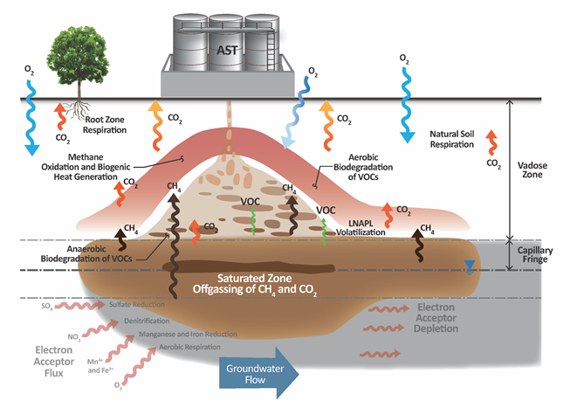
New conceptualization of petroleum NA
Depletion processes manifested as aqueous and gaseous changes
NSZD accounts for biodegradation occurring in both saturated and vadose zones
Gaseous changes a result of methanogenesis and hydrocarbon oxidation
Total NSZD = Aqueous Processes + Vadose Zone Processes
Vapor-based losses >> aqueous-based losses (at most sites)
Gas flux can be used to
estimate bulk LNAPL losses

Slide 7
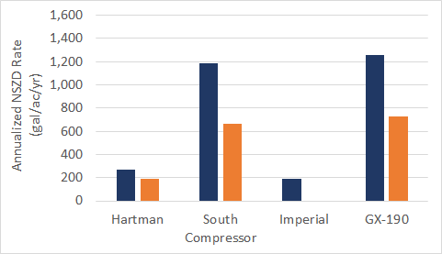
Typical NSZD rates and timeframes
Middle 50% of 25 sites in one study ranged from 700 to 2,800 gal/ac/yr, median of 1,700 gal/ac/yr (Garg et al. 2017)
Diverse project objectives and outcomes
  Refined LCSM useful for remedy design purposes
  Demonstration of effectiveness, and transition to NSZD remedy
  Regulatory approved remedy and long-term care solution
LNAPL longevity is on the order of multiple decades given typical LNAPL subsurface mass estimates
NSZD rates could be expected to decrease over time as LNAPL mass is significantly depleted, biomass drops, and hydrocarbons become progressively more difficult to biodegrade
Recent studies show a zero order rate at high TPH soil concentrations (more research)
By LI-COR DCC
Fall ‘15
By CO₂ Traps
Fall ‘15
Spring ‘16
Spring ‘16
Fall ‘15
Site A
Site B
Site C
Site D

Slide 8
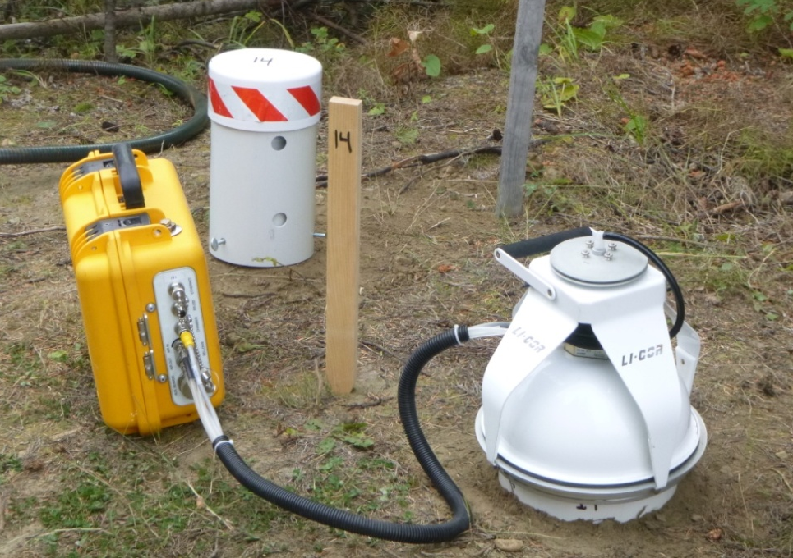
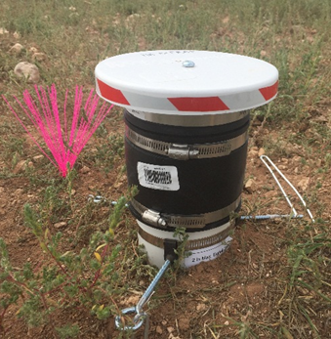
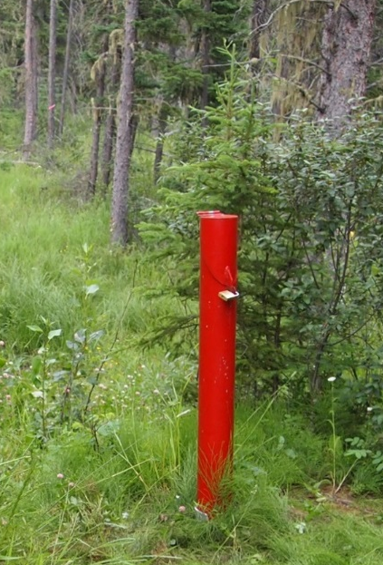
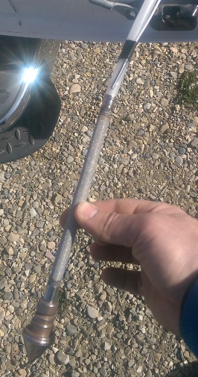
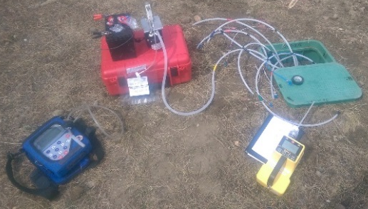
NSZD measurement methods
LNAPL Compositional Changes
Soil Flux Chamber
CO₂ Trap
Liquid-based Methods
Biodegradation Process Mass Budgeting
Vapour-based Methods
Gradient Method
Thermal Method

Slide 9

Aqueous method
Traditional method uses groundwater samples
Natural attenuation indicator parameters (O₂, NO₃, SO₄, Fe²⁺, Mn²⁺, diss. CH₄ and CO₂,
and alkalinity)
Stoichiometric
mass budgeting
analysis
Pending publication by CRC CARE in 2018

Slide 10
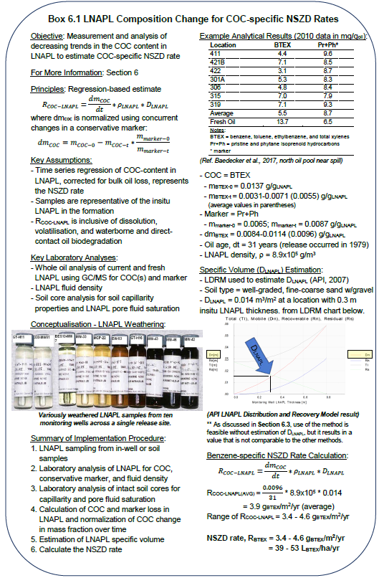
LNAPL compositional change method
Back to the basics, uses whole oil analysis of LNAPL
Trends changes in chemical concentrations within LNAPL
COC concentrations in LNAPL corrected for bulk oil depletion using conservative markers
Chemical-specific NSZD rate (g_{benzene}/m²/yr) – can be integrated across site using specific volumes
Emerging method for NSZD
Pending publication by CRC CARE in 2018

Slide 11
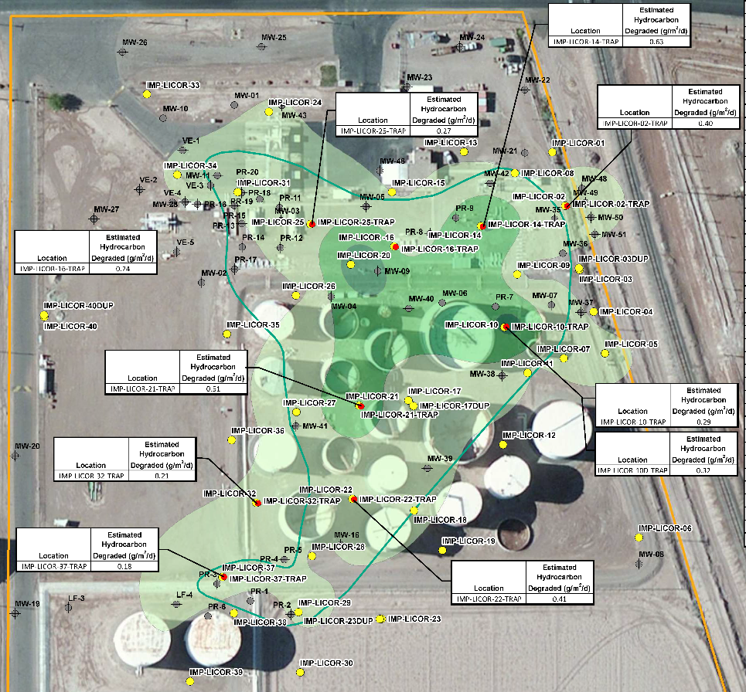
CO₂ efflux measurements and NSZD rates
CO₂ efflux measurements are made using ground surface-based methods
Background levels are subtracted from the total CO₂ efflux measurements to obtain a subsurface LNAPL-derived value
NSZD rates (gallons per acre per year) are back-calculated based on stoichiometric conversion of corrected CO₂ efflux measurements. For example:
NSZD rates can be integrated over pervious areas to estimate a sitewide NSZD rate (gallons per year)

Slide 12
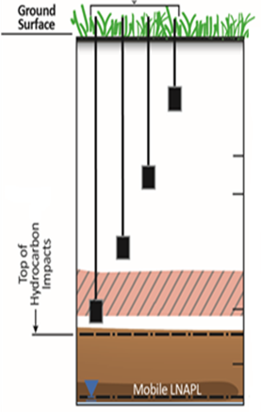
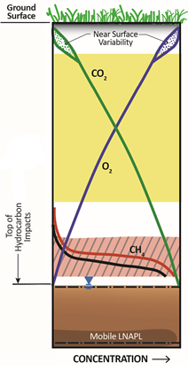

Gradient method
Equipment
  Vapor monitoring probes
  Air sampling pump
  Landfill gas meter (O₂, CO₂, CH₄)
Theory
  Based on Fick’s first law of diffusion:
  Fixed gas concentration profile(s)
  Effective vapor diffusion coefficient(s)
  Calculate upward flux of CO₂

Slide 13
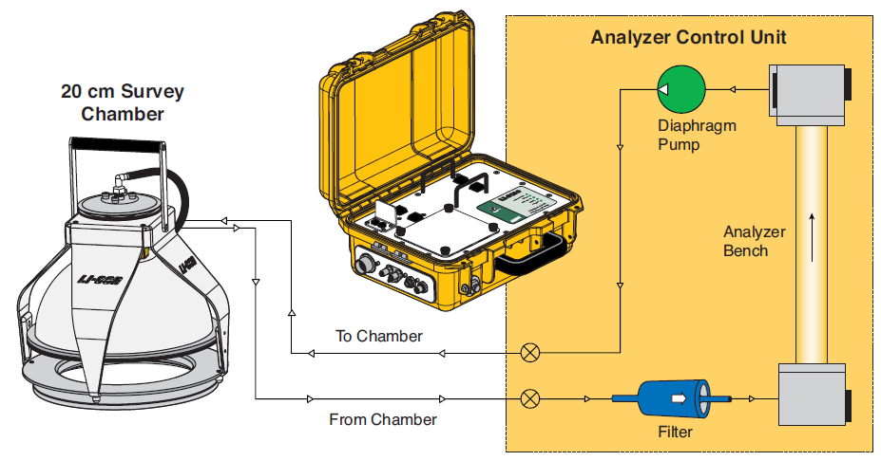
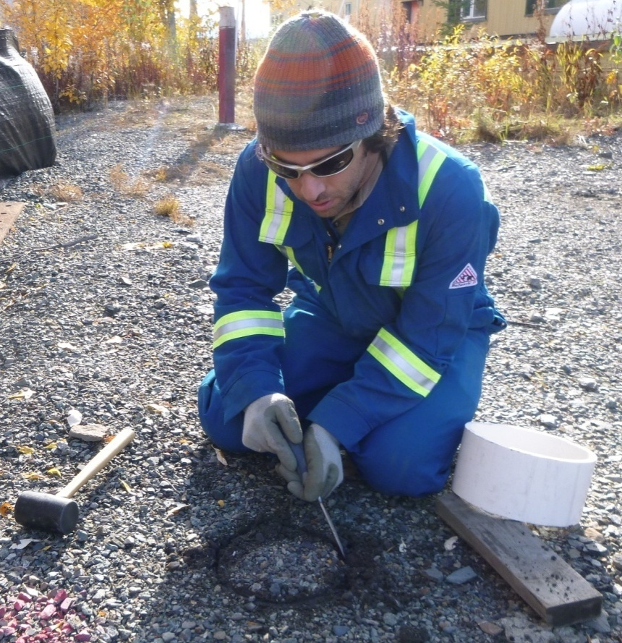
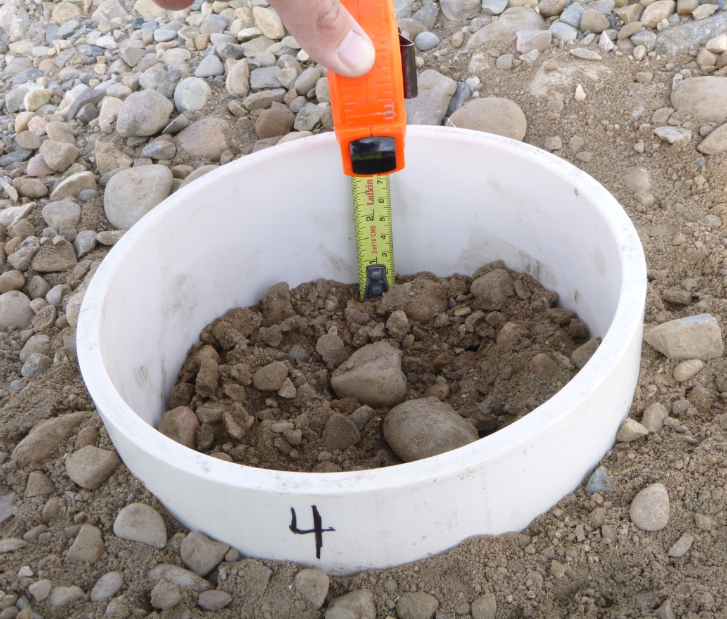
Dynamic closed chamber
Theory
  20+ years old methodology used extensively in ecosystem-related and climate change fields
  The rate of change of CO₂ concentration inside a vented flux chamber is equated to flux
  Uses early time data before chamber accumulation effects occur
Equipment
  PVC collar
  Vented, bellows-controlled flux chamber
  Application software controls chamber and analyzer unit (including infrared gas analyzer and pump)
http://licor.com/env/products/soil_flux/

Slide 14
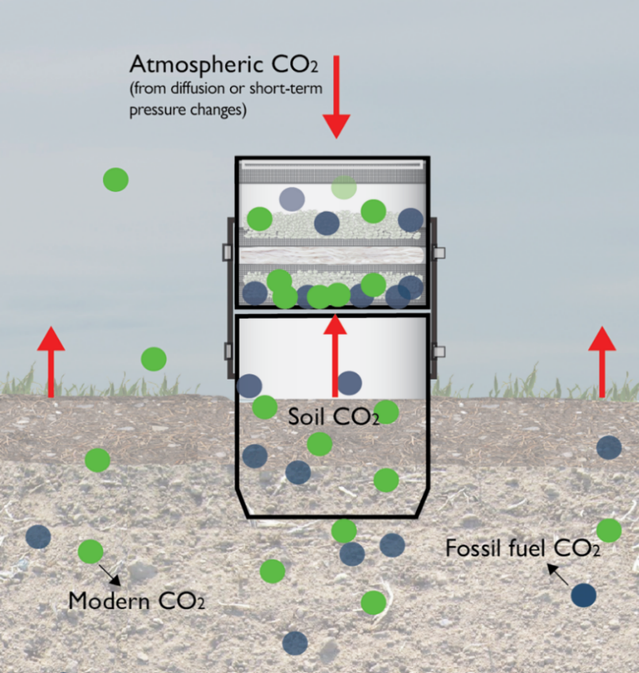
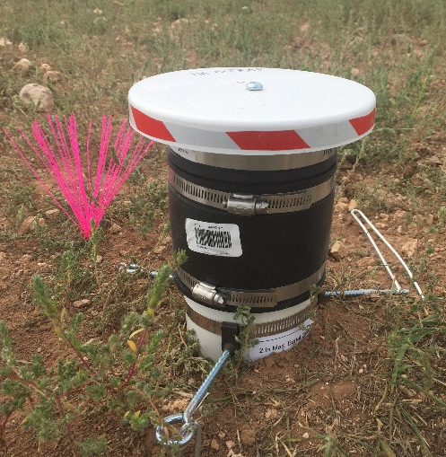
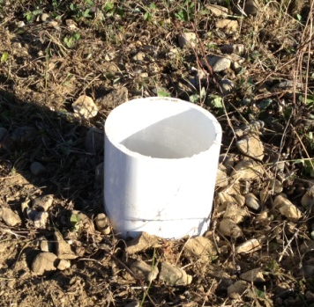
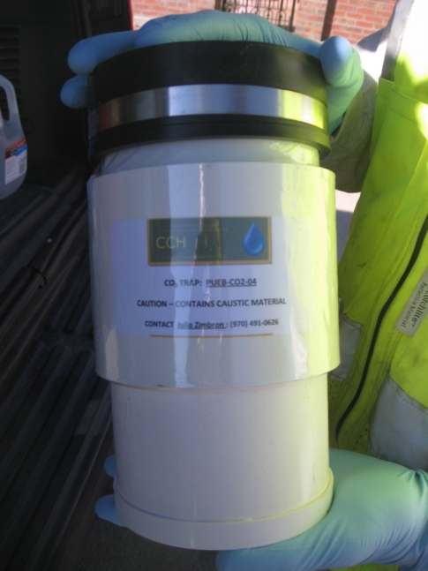
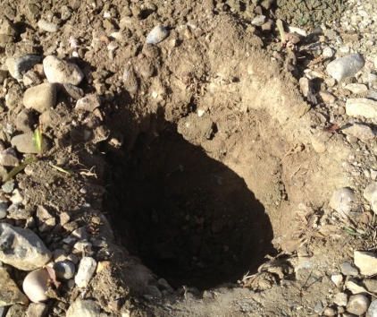
Passive flux trap
Theory
  Flow-through sorbent trap method
  Time-averaged CO₂ flux, 2-week deployment
  Background correction through ¹⁴C removal since LNAPL is depleted in ¹⁴C.
Equipment
  Receiver pipe with anchors
  CO₂ trap with dual sorbent pucks
  Vented protective cover
Rain Cover
CO₂ Trap Body
Receiver Pipe

Slide 15
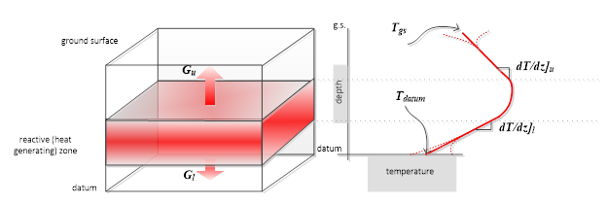
Biogenic heat method
Based on Fourier’s law,
Thermal signature of oxidation in vadose zone can be thermodynamically converted to an NSZD rate using heats of reaction and thermal conductivity
With permission from Julio Zimbron, presentation to RemTEC on 8Mar17

Slide 16
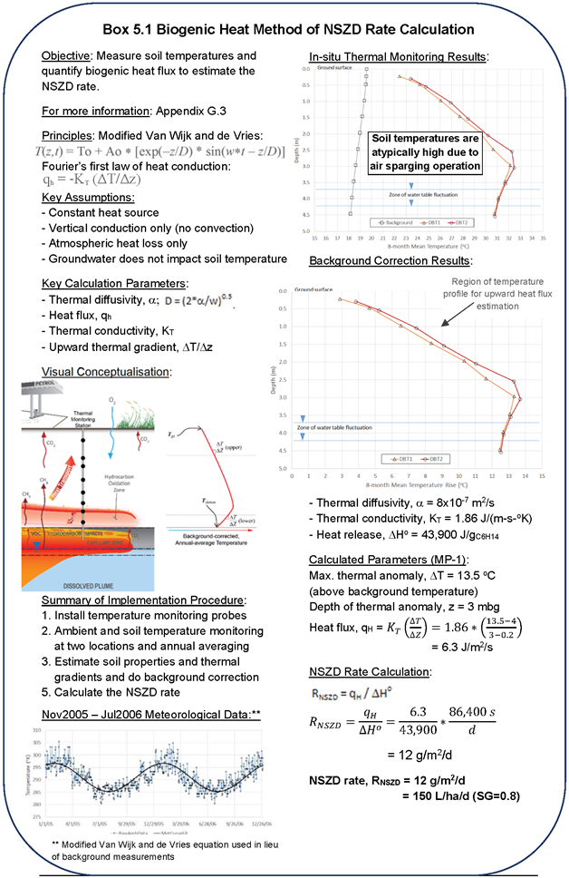
Biogenic heat method
Install temperature monitoring probes (wells or borings)
Subsurface temperature measurements in at least two locations (source area and background) – take annual average
Estimate soil properties and thermal gradient, do background correction, to calculate heat flux
Divide heat flux by heat of reaction from microbial biodegradation for NSZD rate
Pending publication by CRC CARE in 2018

Slide 17
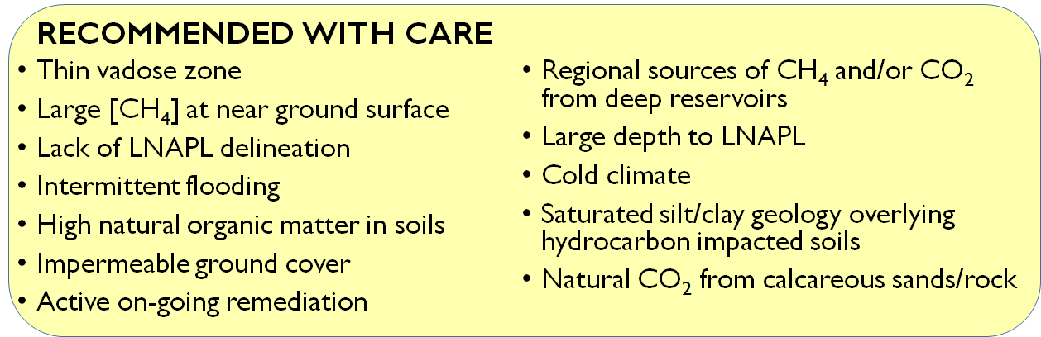
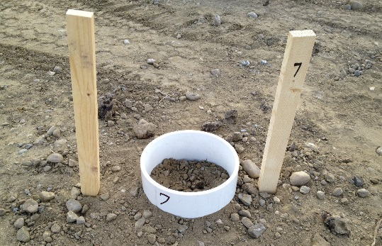
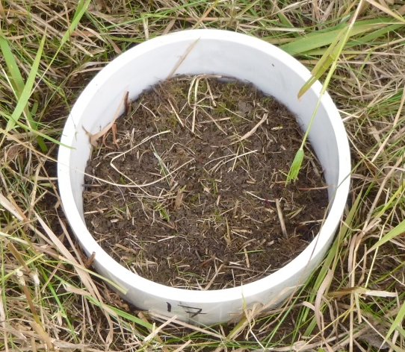
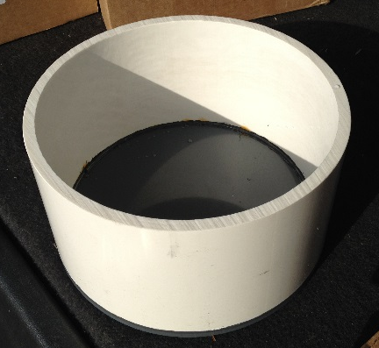
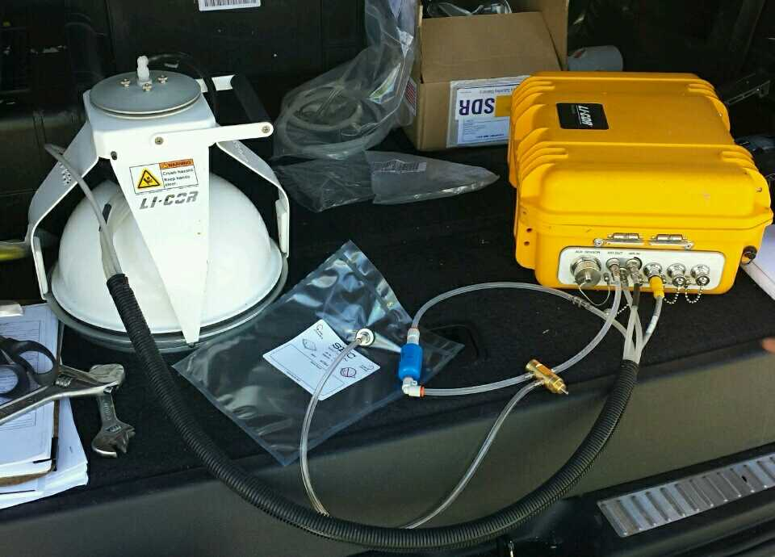
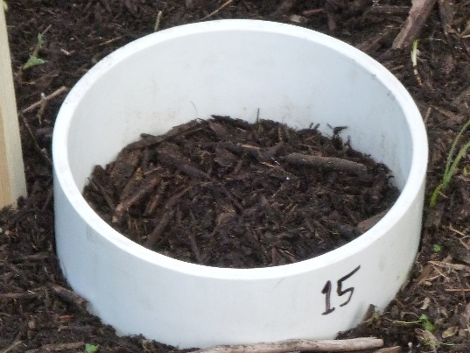
Lessons Learned with CO2 efflux based methods
Careful planning
Background correction:
Quality assurance/quality control
Low Background
Higher Background
Too high Background?

Slide 18
Which method do I choose?
Each method has pluses and minuses
API and CRC CARE guidance documents have comprehensive comparisons to determine best site applicability
In general, gradient method is best for sites with existing soil gas probes
Flux chamber and trap methods most widely used, but have drawbacks, particularly with background correction and spatial coverage, respectively
Biogenic heat and compositional change methods are newest and have distinct advantages, but not best for every site

Slide 19
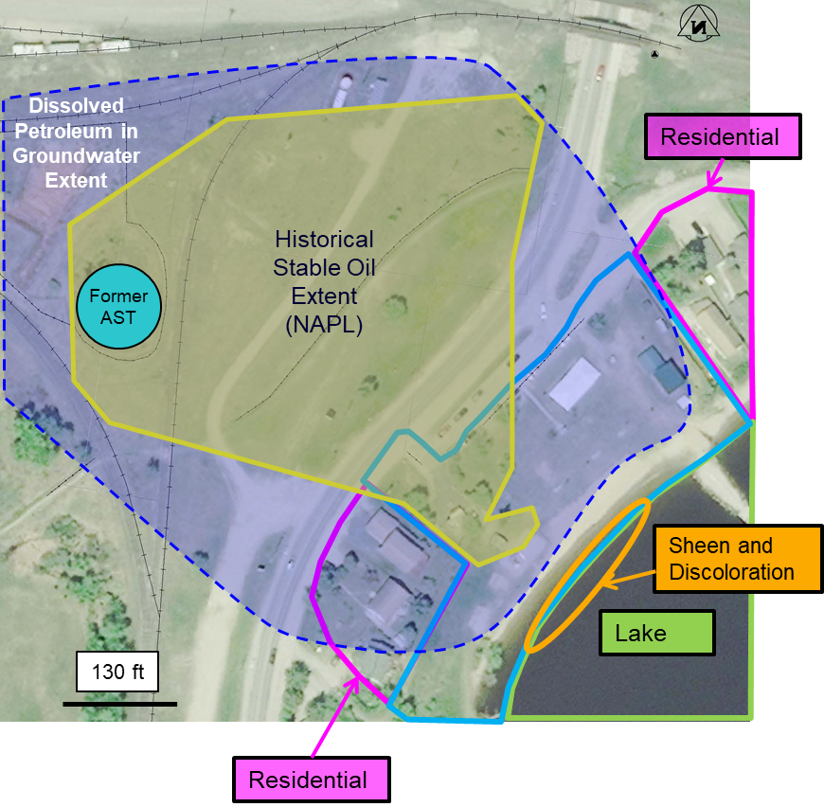
Case Study – Diesel Fuel AST Release
Diesel fuel storage tank release
LNAPL at the site is delineated/characterized
LNAPL footprint is stable/decreasing
LNAPL thickness in wells not exaggerated
Dissolved phase plume is stable, but may be contributing to sheen on the lake
Dissolved Petroleum in Groundwater Extent

Slide 20
Case Study continued
Product recovery system operated 1996 – 2015
Recovered ~160,000 gallons of LNAPL
NSZD study conducted in 2018 to quantify NSZD rate using DCC and CO₂ trap methods
NSZD contours lined up with release history and able to extrapolate annual NSZD rate

Slide 21
Comparison between Recovery and NSZD Rates
Active recovery rates initially >50k gal/yr
After 2008, active recovery rates dropped to 50-300 gal/yr
Site-wide integrated NSZD rate = ~700 gal/yr (assumed constant)
Stakeholders wanted something done, only option seemed to be NAPL recovery

Slide 22
Conclusions
Natural losses via NSZD can be large
Can play a role in remedial decision and regulatory support
  Recognized as a remedial technology
  Methods are credible
  Component of LCSM
  Used as an endpoint for stalled remediation
Allows owners to prioritize resources to greatest risk (i.e., dissolved phase)
Integrating NSZD into management strategy sooner can save money on O&M, capital, and reporting costs

Slide 23
Thank you!
Helpful Links:
ITRC: https://lnapl-3.itrcweb.org/appendix-b-natural-source-zone-depletion-nszd-appendix/
API Publication 4784 – Quantification of Natural Source Zone Depletion Rate Processes: http://www.techstreet.com/standards/api-publ-4784?product_id=1984357
CRC Care: Technical Report Number 44 – in publication
Jeffrey Fitzgibbons, PG
Jacobs
Jeff.Fitzgibbons@jacobs.com
+1 (720) 286-2129

