Slide 1
Produced Water recycling in the Delaware Basin of new Mexico
Presented by:
Nate Alleman
Prepared by:
Nate Alleman, J.D. Arthur P.E. SPEC, Gavin James P.E., Bill Hochheiser (ALL Consulting)
Presented at:
2018 International Petroleum Environmental Conference
October 31, 2018
Denver, CO

Slide 2
Increasing Disposal Demand
Data Source: NMOCD 2018

Slide 3
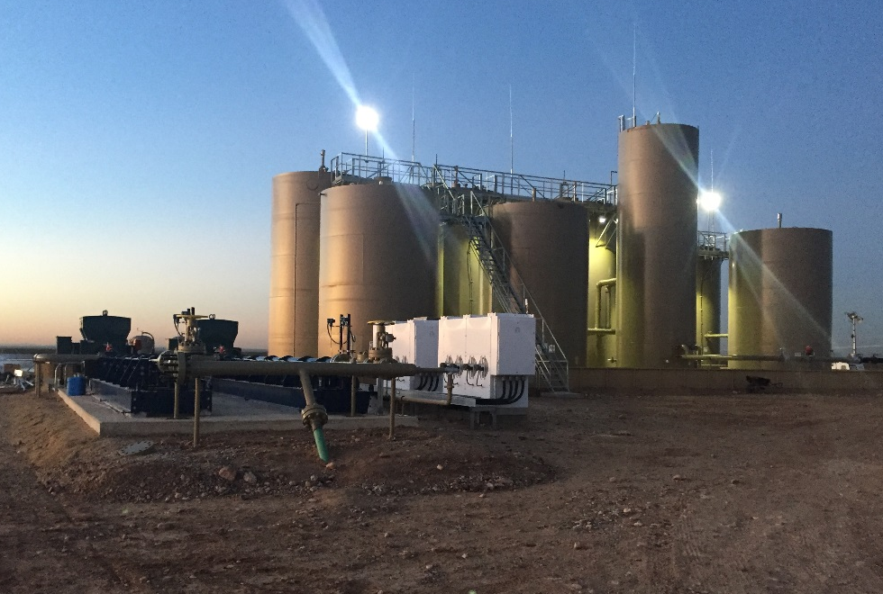
Why recycle??
Motivation to recycle varies from basin to basin and company to company.
  Cost
  Operational Flexibility
  Public Relations
  Investors
  Regulations
ALL Consulting 2018

Slide 4
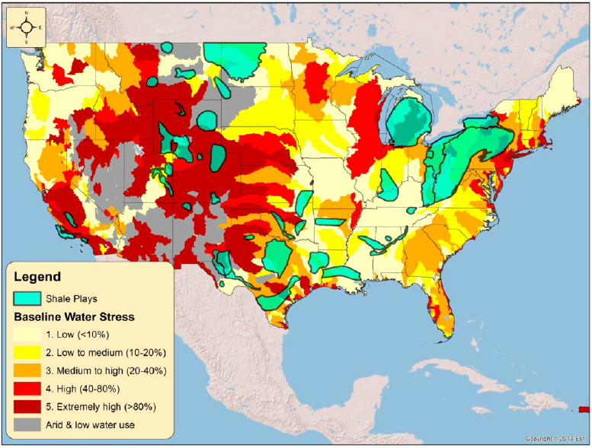
Water Constraints

Slide 5
Recycling Approval
Operators may recycle/reuse their water in a Multi-Well Fluid Management Pit without requiring a recycling permit.
  Encourages recycling
Commercial Recycling requires a permit (C-147)
  Long Form (Containment)
  Short Form (No Containment)
Commercial Facilities have various permit requirements including:
  Siting criteria (municipalities, surface/groundwater, water wells, residences, etc.)
  Karst Geology
  Construction and operation
  Closure
  Financial Assurance

Slide 6
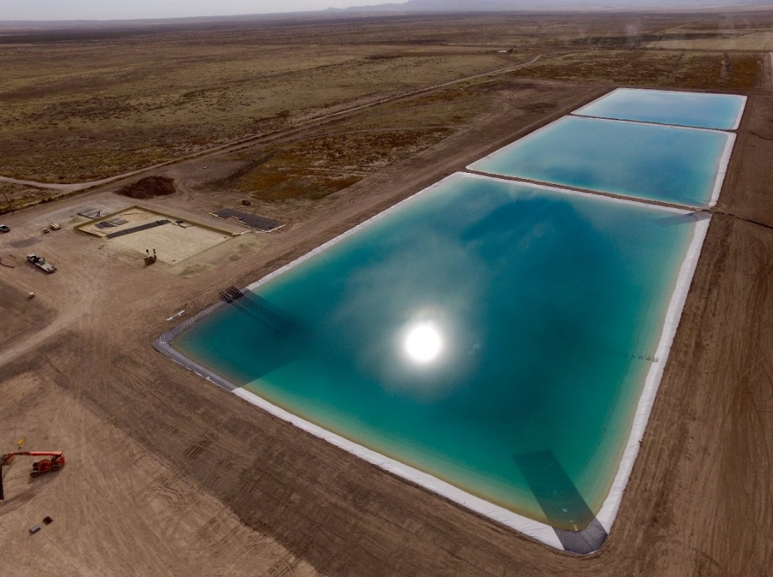
Facility Operation
Standard Treatment:
  Settle out solids
  Skim oil and grease
  Prohibit Sulfate Reducing Bacteria
  Take out iron, aeration
Regs require that 20% of capacity be recycled every six months
Recycling facilities cannot be used for disposal (Evaporation)
ALL Consulting 2018

Slide 7
General Facility Design

Slide 8
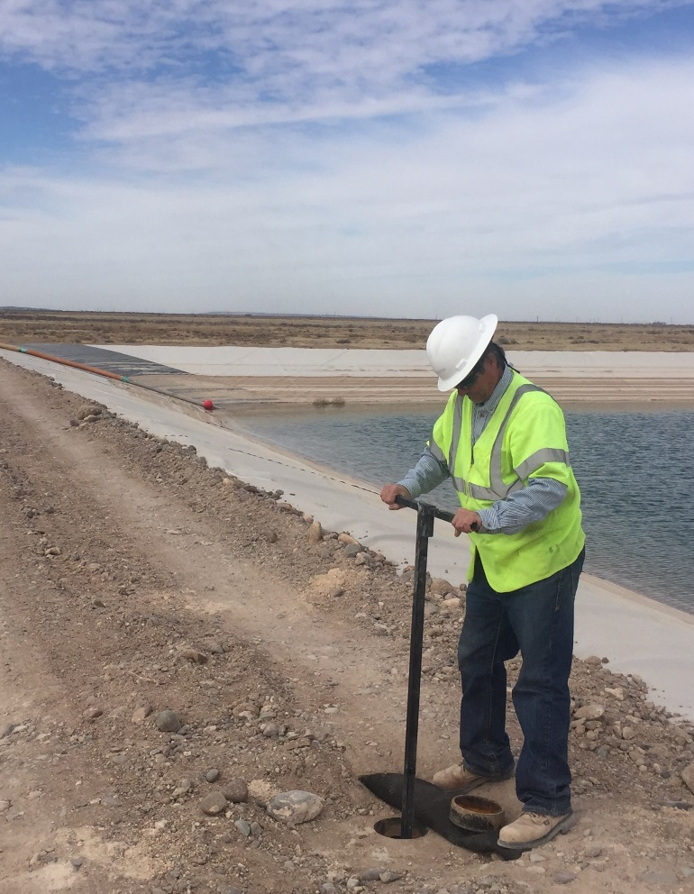
Containments
Preferred design typically includes 6 lined impoundments
Impoundment liners consist of:
  Geotextile layer with gas vent strips
  Secondary liner (40 mil smooth black geomembrane)
  Leak detection system
  Primary liner (40 mil textured white geomembrane)
Impoundments connected by equalization pipes that can be opened and closed for isolation or transfer.
Suction pipes are installed in the clean brine impoundment.
ALL Consulting 2016

Slide 9
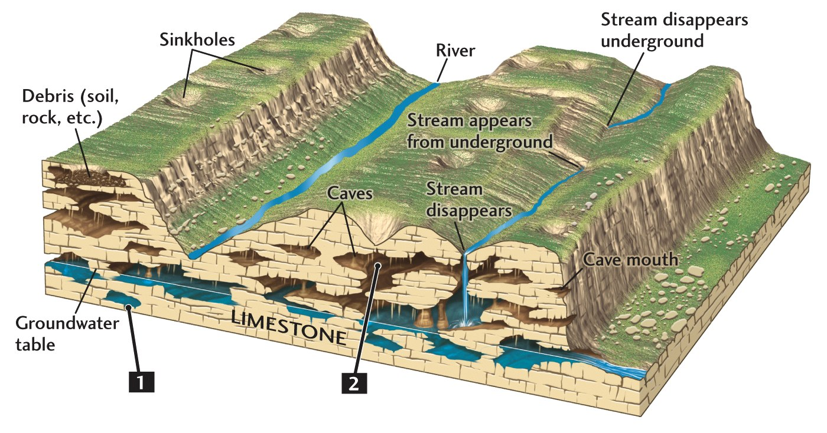
Karst Geology is a concern

Slide 10
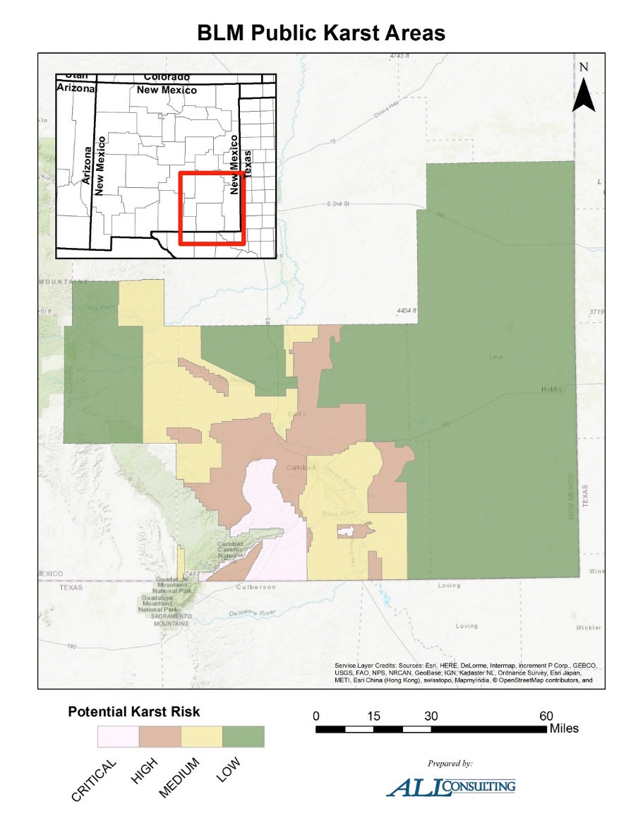
Karst Implications

Slide 11
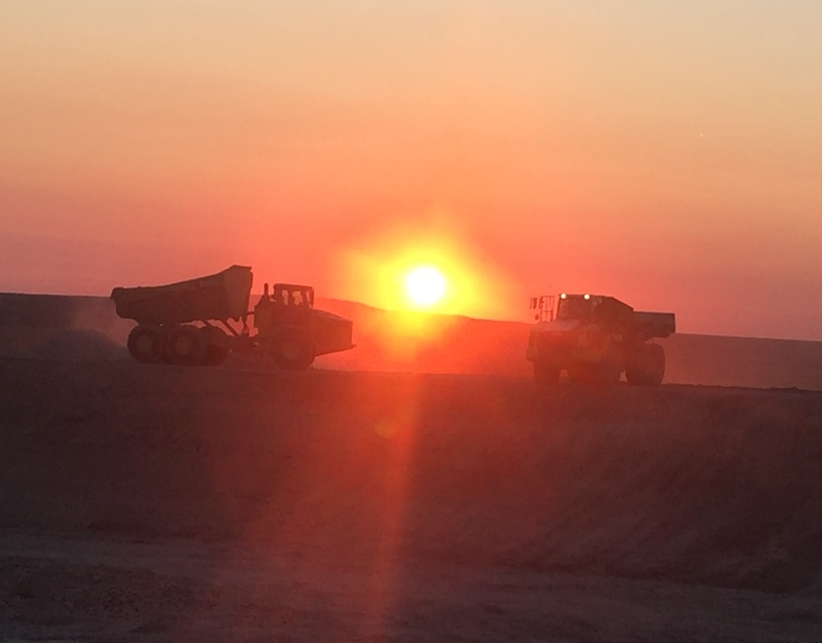
Surface Ownership Factors
Fee Land – work with landowner
State Trust Land (State Land Office)
  Application for Business Lease
  Easement
  NEPA Issues (cultural and T&E)
Bureau of Land Management
  Notice of Staking/Staking Meeting
  Right of Way
  NEPA EA
ALL Consulting 2016

Slide 12
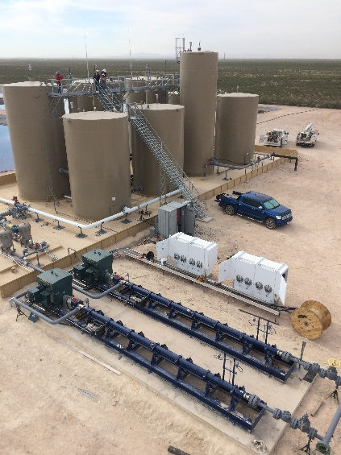
Lowering Costs
Coordinate with regulators early and often.
Reduce or eliminate leak detection media (gravel and piping)
Proper balance of cut/fill to eliminate need for disposal of material.
Use onsite material for road surface (as available)
Reduce outside slopes to increase slope stability and decrease maintenance costs.
ALL Consulting 2018

Slide 13
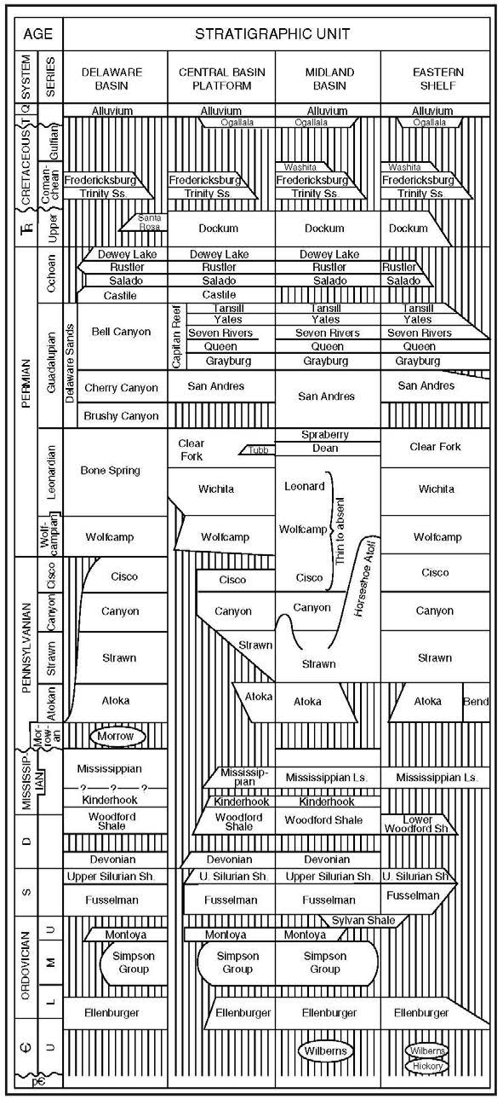
Disposal Wells in the Delaware basin
Delaware Sands
  230 active disposal wells
  Average injection rate of 11,500 BWPD
  AOR Issues
  Over-pressurization
Devonian/Silurian
  162 active disposal wells
  Average injection rate of 13,300 BWPD
  Maximum injection rate of 42,500 BWPD
  Fewer AOR issues
  More wells being planned
No injection into the Ellenburger.

Slide 14
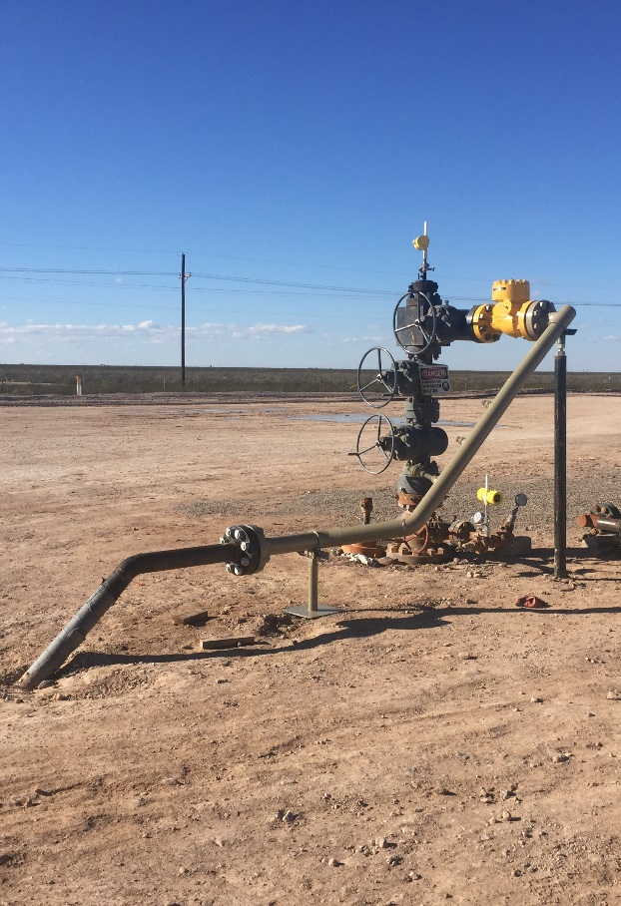
High disposal rate considerations
Threshold of 25,000 bpd triggers increased scrutiny
  1 mile AOR
  1 mile notification
  Seismicity analysis (faults and seismic events)
ALL Consulting 2016

Slide 15
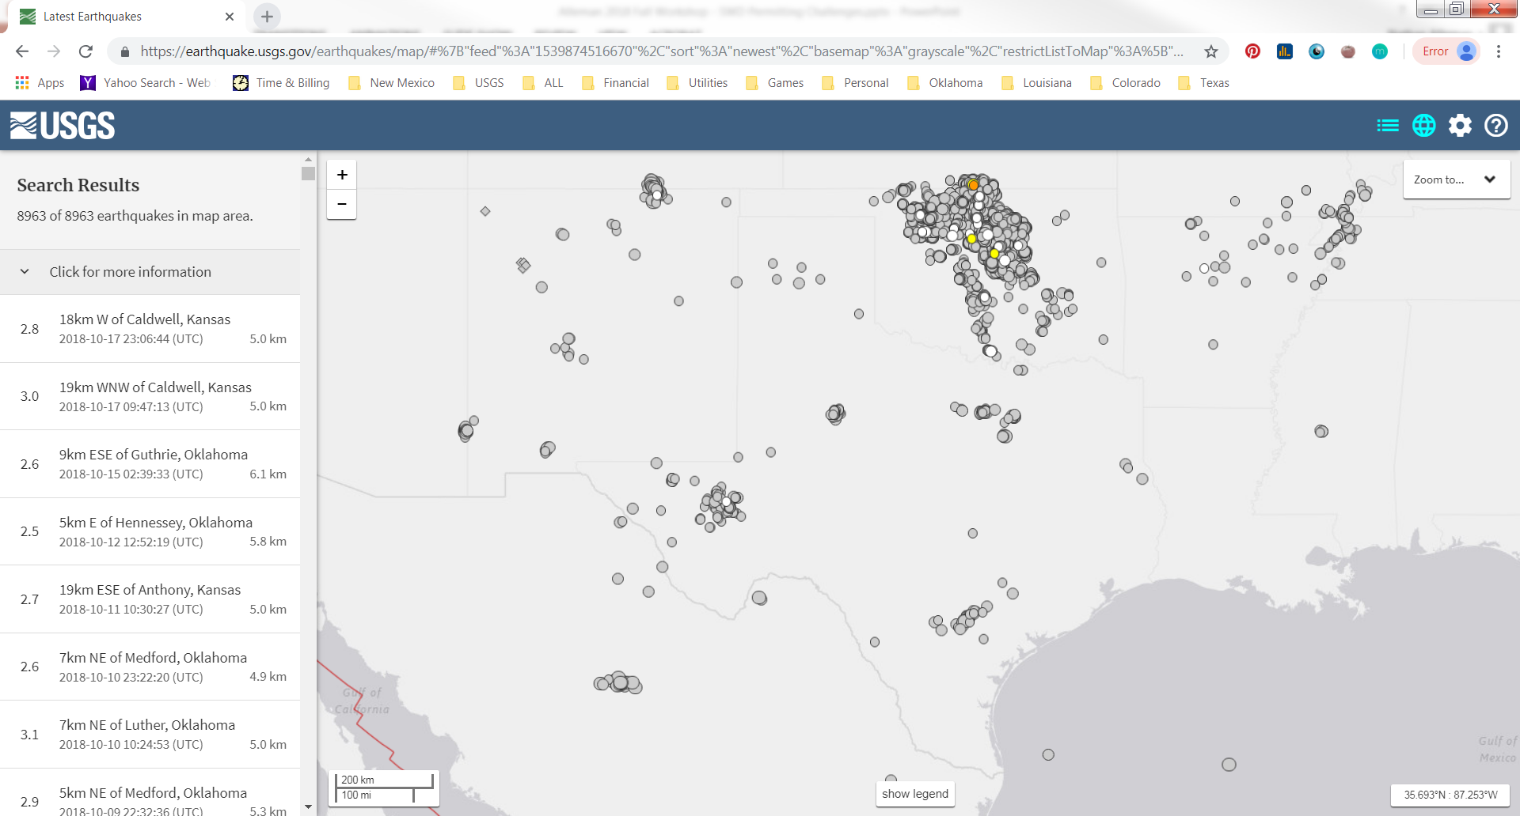
Seismicity Concerns
STACK
SCOOP
Barnett
Permian/Pecos
Eagle Ford

Slide 16
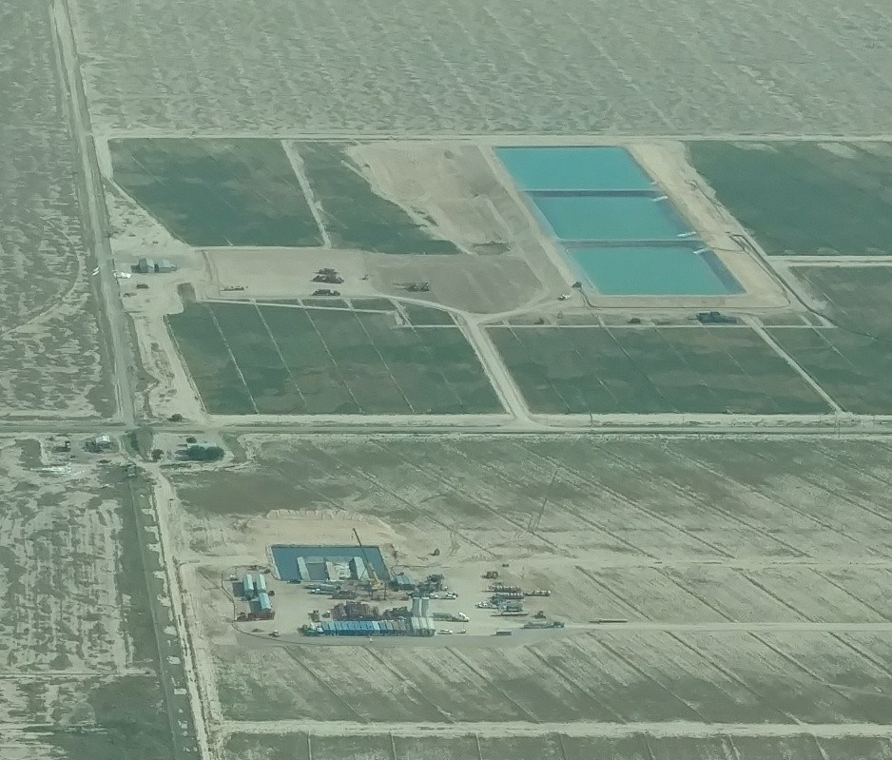
State comparison
Many states are encouraging recycling.
Overall permitting processes and considerations are similar.
Texas:
  Permit required for Commercial Treatment Facility Permits
  Non-Commercial Fluid Recycling pits (NCFRs)
Oklahoma
  Permits required for both Commercial and Non-Commercial Recycling facilities.
ALL Consulting 2018

Slide 17
Summary
High level of O&G activity in SE New Mexico has increased demand for recycling and disposal.
States, including New Mexico, are encouraging recycling.
Recycling is cost-effective for operators in the long-term.
While New Mexico encourages recycling, regulations impose numerous, complex permitting requirements for recycling facilities.
Need to work closely with the state agency for smooth permitting.

Slide 18
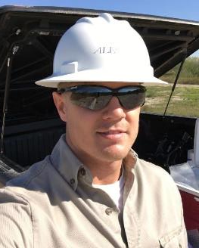
Contact Information
Contact Information:
Nate Alleman
Project Manager
nalleman@all-llc.com
ALL Consulting
1718 S. Cheyenne Ave.
Tulsa, OK 74119
www.all-llc.com
Citation Information: Nate Alleman, J.D. Arthur P.E. SPEC, Gavin James P.E., Bill Hochheiser (ALL Consulting). “Produced Water Recycling in the Delaware Basin of New Mexico”. Presented at the 2018 International Petroleum Environmental Conference. Tulsa, OK. October 31, 2018.

