Slide 1
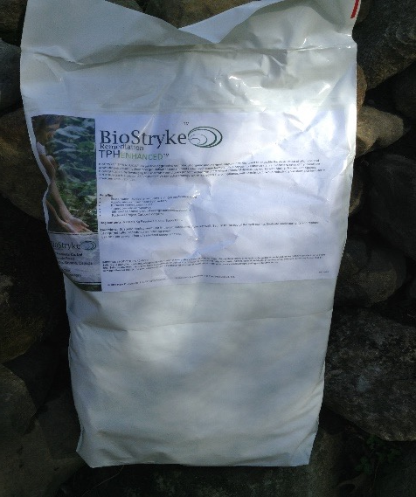
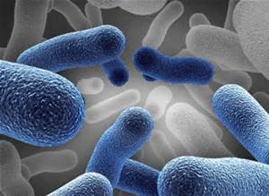
Kent C. Armstrong, President
TerraStryke Products, LLC
284 Depot Street / P.O. Box 254
Andover, New Hampshire USA
—————————-
950 Fennell Avenue, Suite 105
Hamilton, Ontario CDN
L8V 1X2
Cost-Effective In-Situ Remediation Biostimulation as a Residual Source Mass Remediation Strategy

Slide 2
What is Biostimulation
Provision of a microbial food or source of respiration i.e. ‘breathing’
Goal is to enhance native microbial populations to sustainably destroy contaminants with minimal impact
What is Contamination
Excessive source of food or respiratory support
Petroleum Hydrocarbons are food (Carbon C⁺)
Chlorinated Solvents represent sources of respiration (electrons Cl⁻)
Minimal Site Impacts Maximum Performance Cost-Effective Remediation

Slide 3
TPHenhanced™
Biostimulation additive
Includes alternative respiratory sources (electron acceptors)
i.e. does not contain oxygen (O₂)
Contains proprietary blend of macro-micro nutrients
Patent-Pending formulation which assists all stakeholders chance to:
realize contaminant destruction under anaerobic conditions
eliminate long-term above-ground equipment
maximize smear zone destruction
expedited solubilization (flux) of residual source mass

Slide 4
TPHenhanced™
Application: Petroleum Hydrocarbon Contaminants (PHCs)
PHCs - GRO/DRO, JP Fuel, Stoddard Oil, MEK
BTEX Contaminants
MtBE
Carbon tetrachloride
Compound Benzene Contaminants
chlorobenzenes
trimethyl benzene

Slide 5
Specifically, PHC^{s}
Massive influx of Carbon
Oxidant load ‘scavenges’ available respiratory sources
Causes geochemistry in impacted area to become reducing
Drives groundwater geochemistry anaerobic, even methanogenic
Conditions which limit microbial populations ability to ‘breathe’

Slide 6
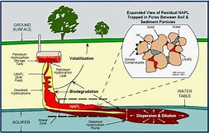
Petroleum Hydrocarbon Contamination (PHC^{s})
PHCs also bring with them
smear zone, residual source mass concerns
Rebound
Vapors, indoor ambient air concerns, even LEL issues
Sorbed and/or gangliatic (‘bleb’) contaminant mass not available to microbes
Traditionally, we re-supply respiratory source using Oxygen (O₂)
Limited in terms of loading capacity and length of availability
O₂ has a limited ‘effect-residency time’

Slide 7
PHC Remediation using TPHenhanced™
Provides respiratory support
Replaces scavenged respiratory sources (electrons)
Drives groundwater geochemistry out of methanogenesis
Keeps treatment zone anaerobic, leveraging existing conditions
Proprietary, patent-pending Macro-Micro nutrient forlulation
Enhances growth and ‘fitness’ of native microbial communities

Slide 8
What will we observe?
Initial decrease in dissolved-phase groundwater concentrations
Increase in microbial densities
If residual mass is present
increase in [dissolved-phase] = expedited residual mass solubilization
due to natural biosurfactant production
allows greater microbial performance and communications
eliminates rebound up-front
Superior dissolve phase destruction – long-term site compliance

Slide 9
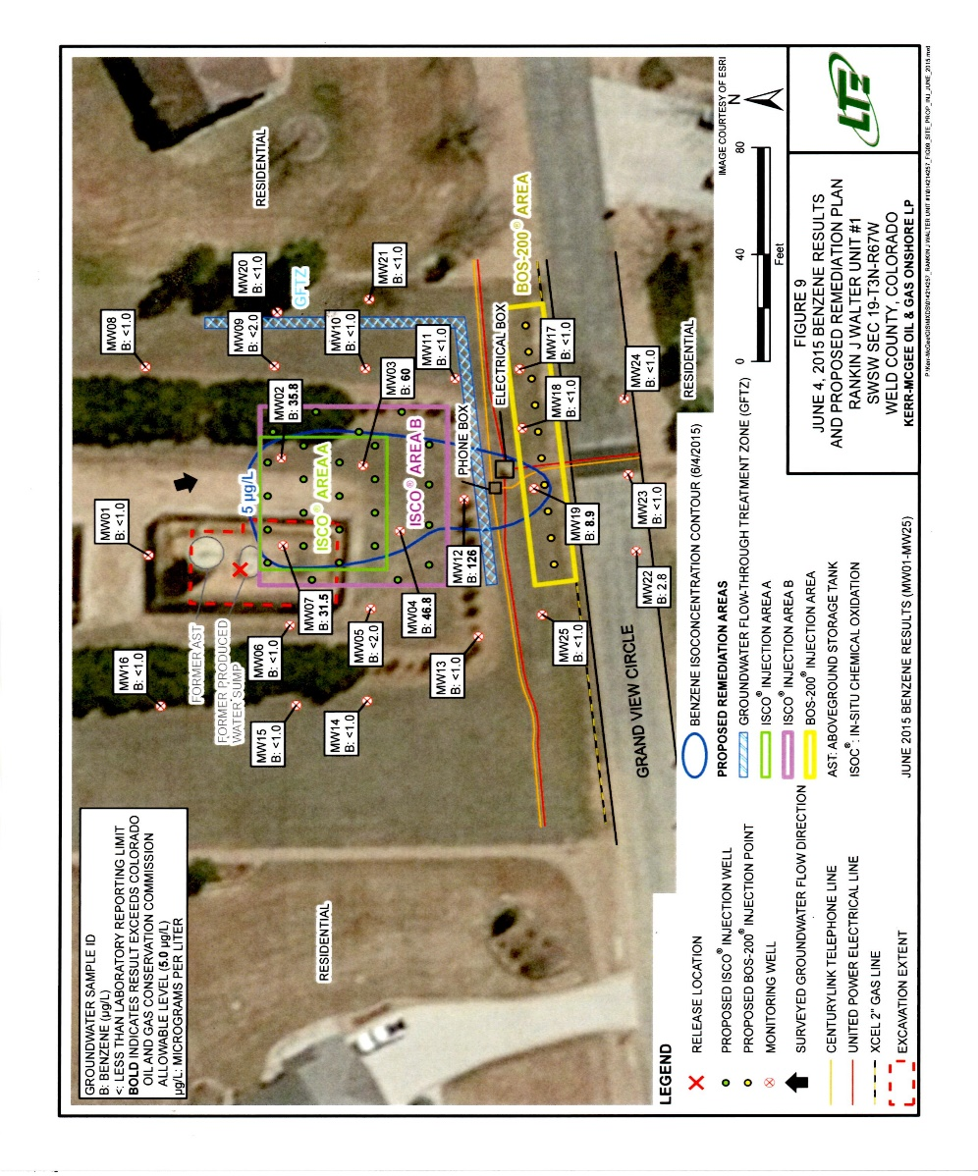
TPHenhanced™ - Petroleum Case Study
Upstream Production-Water Collection Pond
Legacy upstream oil-gas production site
Treatment zone = footprint of former produce water pond
Dissolved-phase and residual source mass BTEX constituents primary contaminants-of-concern
BTEX contaminants-of-concern

Slide 10
TPHenhanced™ - Petroleum Case Study
Upstream Production-Water Collection Pond
June 2014 Initial Remedial Action
Source removal excavated ≈400 c.y.
Vacuum truck removed ≈65 barrels impacted gw
[BTEX] on excavation floor remained above standards
Carbon ‘trap-and-linger’ product applied (≈100 lbs)
Addressed initial dissolve-phase contaminant issue
Unable to address rebound

Slide 11
TPHenhanced™ - Petroleum Case Study
Upstream Production-Water Collection Pond
Network of 25 monitoring wells installed Fall 2014
June 2015 monitoring results indicate [BTEX] remain above remediation objectives (Benzene 5.0 ug/L)
2015 Carbon based deployment repeated
using >5,000 pounds
Secondary treatment included persulfate injections
4-events
26 injection locations
using >3,500 pounds per event
>14,000 pounds persulfate
Cha-ching………..
Results – continued rebound and asymptotic [BTEX] exceedances

Slide 12
TPHenhanced™ - Petroleum Case Study
Upstream Production-Water Collection Pond
2017 Amended treatment zone with TPHenhanced™
Used Passive Release Sock (PRS) deployment units
Utilized existing 26 ‘injection’ node network
50 lbs additive over 5,600 square foot area
Three replacement events over 9-month period
Total additive volume approaches 150-pounds

Slide 13
PRS Pilot Study Schematic
Ground surface
Additive filled Passive Release Sock (PRS)
Deployed into existing 2-inch gw monitoring well

Passively amend saturated screened interval
Create 3-5 foot area-of-influence
Replace PRS units every 10-14 days
Typically 5-8 replacement events
Groundwater Flow Direction
Monitoring Program
Baseline
Each replacement event
Non-purge
Low-flow
6-8 replacement events typical
Area of Influence
Not for compliance testing
Reproducible, not scalable

Slide 14
PRS Pilot Study Groundwater Monitoring Metrics
Field Parameters
ORP, DO, pH, Temperature
Geochemistry
Nitrates (NO3)
Diss. Iron/Manganese (Fe/Mn)
Sulphates (SO₄)
Ethane/Methane/Ethene (MEE) - optional
Chloride (Cl⁻) - cVOC sites only
Analytical
Contaminant of Concern (EPA 8260)
Indicator Metrics
Additive efficacy is determined by comparing baseline data to performance data results
Analysis for bacterial populations is also recommended

Slide 15
TPHenhanced™ - Petroleum Case Study
Upstream Production-Water Collection Pond
Results: MW-4 (downgradient)
84%↓ reduction realized in <4 months; then,
>1,000%↑ increased (solubilization); followed by,
>98%↓ [Benzene] 5-months later…….
>83%↓ Ethyl-benzene
>97%↓ Xylenes

Slide 16
TPHenhanced™ - Petroleum Case Study
Upstream Production-Water Collection Pond
2017 Amended treatment zone with TPHenhanced™
Used Passive Release Sock (PRS) deployment units
Utilized existing 26 ‘injection’ node network
50 lbs additive over 5,600 square foot area
Three replacement events over 9-month period
Total additive volume approaches 150-pounds

Slide 17
TPHenhanced™ - Petroleum Case Study
Upstream Production-Water Collection Pond
MW-04 downgradient, residual mass present
Initially dissolved-phase reductions as additive availability increases
Additive exhausted as mass solubilized
Reductions continued without additive

Slide 18
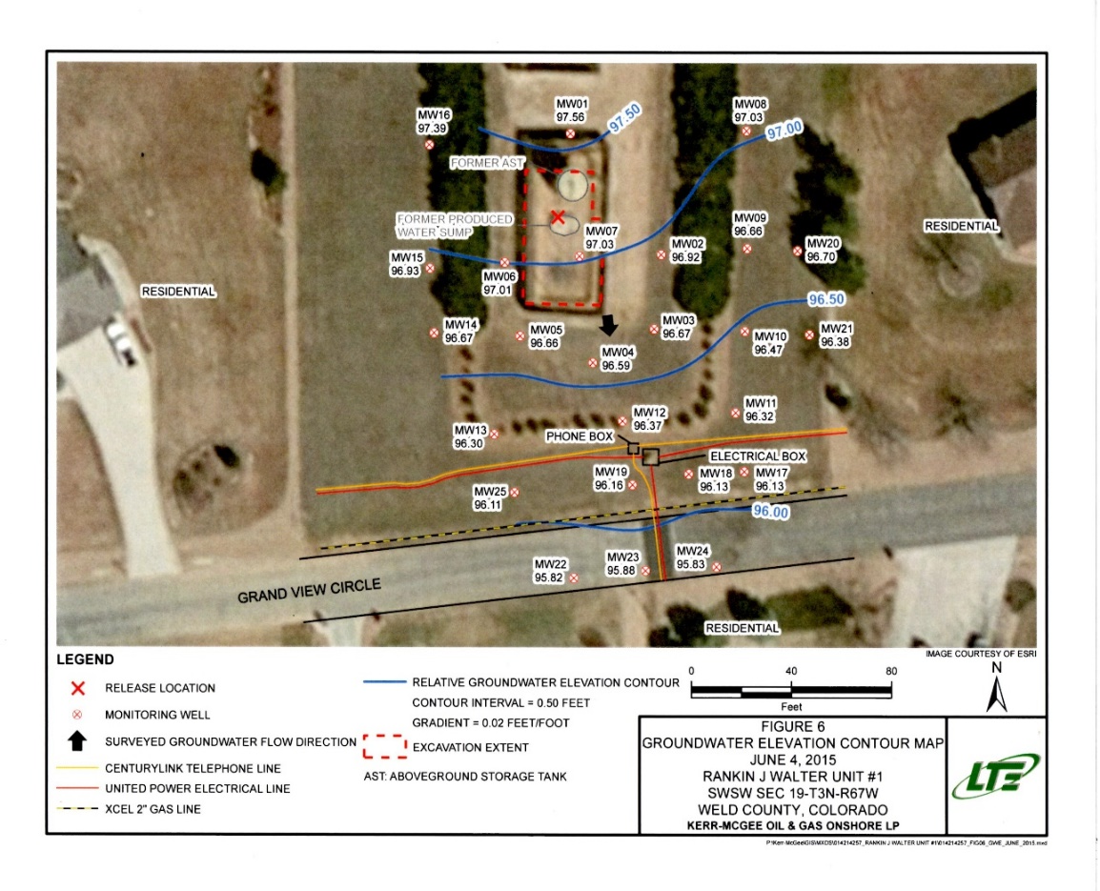
TPHenhanced™ - Petroleum Case Study
Upstream Production-Water Collection Pond
MW-07 within retention pond
Significant residual mass present
Dissolved-phase reductions with availability
Additive exhausted as mass solubilized
[BTEX] increase without additive

Slide 19
TPHenhanced™ - Petroleum Case Study
Upstream Production-Water Collection Pond
2018
Both MW-4 and MW-7 [BTEX] reached BDL
Slight rebound occurring at MW-7 within pond area
Residual mass remains
Second PRS deployment event initiated October 2018
Utilizing same 26 ‘injection’ node network
≈50 lbs additive over 5,600 square foot area per event
Three replacement events over 9-month period
Total additive cost to date < $20,000.00
Treatment cost approaching $15 per treated ton

Slide 20
Maine DEP
Searsport Pipeline Argyle Pump Station
TPHENHANCED™
Observations
Increase Additive Availability
Enhance Microbial Respiration
Expedite Dissolve Phase Contaminant Assimilation
Exhaust Additive Availability
Return to Methanogenic Conditions; No Biotic Activity
Rebound
More Additive
Increased microbial activity
Realize 97% Reduction [PHC] =Passive Aggressive Destruction

Slide 21
Microcosm Study Comparing Various Aerobic/Anaerobic Strategies
Aerobic
Anaerobic
TPHenhanced
Control

Slide 22
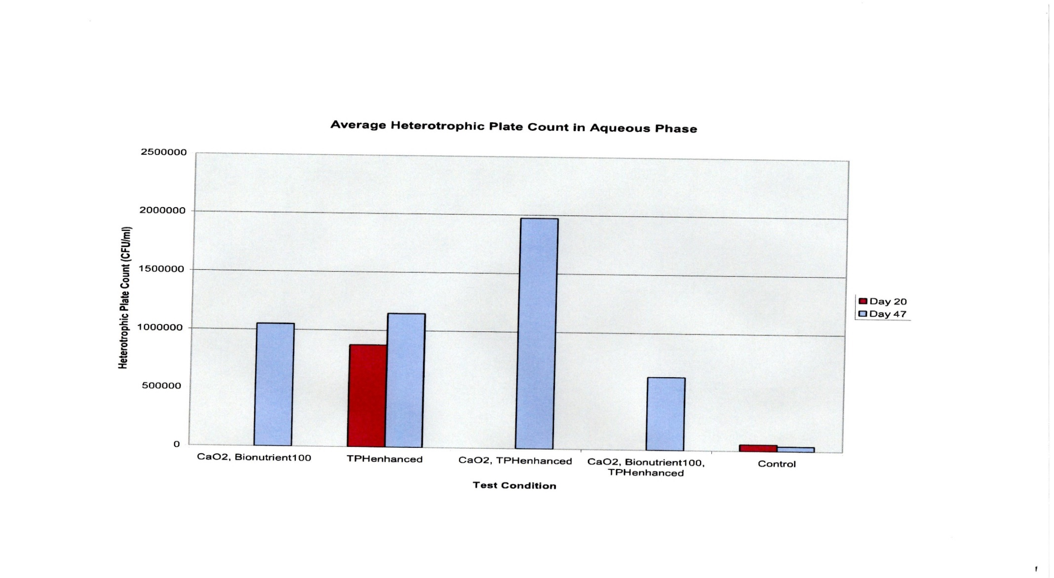
Microcosm Study Comparing Various Aerobic/Anaerobic Strategies
Realize twice the microbial growth
Achieves population thresholds
Greater Bulk Fraction of Degrader Community
Aerobic
Anaerobic
TPHenhanced
BioNutrient100
Control

Slide 23
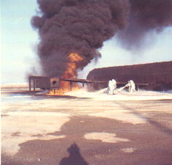
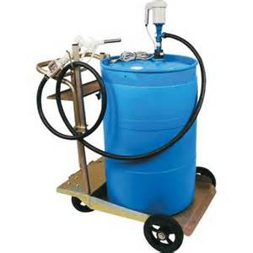
Proof of Concept Evaluation ‘Drum Test’ Former Chanute USAFB Fire Training Area
Consultant Amended each Drum According to Vendors Instructions
Drum 1 - TPHenhanced® by TerraStryke
Drum 2 - Oxygen Release Agent
Drum 3 – Control
Dosing Rate Equal to that Established for Full Scale Deployment
[PHCs] in TPHenhanced® amended drum
Decreased > 99% in 8-9 weeks
With Greater Molar Destruction

Slide 24
Drum Study – Results Former Chanute USAFB Fire Training Area
TPHenhanced® | April 4 (μg/L) | April 18 (μg/L) | May 2 (μg/L) | May 21 (μg/L) | %Reduction
Benzene | 606 | 1,780 | 8,350 | 24.6 | 99.7%
Naphthalene | 197 | 178 | 302 | 2.02 | 99.3%
Toluene | 2,360 | 3,620 | 8,370 | 13.4 | 99.8%
1,2,4-TMB | 282 | 224 | 843 | 4.13 | 99.5%
pH | NT | 5.7 | 5.3 | 6.1 | NA
Oxygen Based | April 4 (μg/L) | April 18 (μg/L) | May 2 (μg/L) | May 21 (μg/L) | %Reduction
Benzene | 1,970 | 471 | 362 | 241 | 87.8%
Naphthalene | 213 | 76.7 | 34.1 | 8.36 | 96.1%
Toluene | 6,320 | 1,130 | 651 | 385 | 93.9%
1,2,4-TMB | 349 | 80.7 | 37.8 | 17.1 | 95.1%
pH | NT | 9.4 | 9.8 | 10.3 | 11.0

Slide 25
TPHenhanced® vs. Oxygen
USAF [Benzene] Drum-Test Data
TPHenhanced based [PHC] µg/L
Dissolve Phase Destruction
No Solubilization
Enhanced Biotic Degradation
> 99.7% destruction of solubilized mass
Enhanced Solubilization
>9x the molar mass Benzene destroyed
Enhance Long-Term Compliance

Slide 26
Important TPHenhanced™ Talking Points
Majority of PHC impacted groundwater plumes are anaerobic & chemically reducing
We maintain existing geochemical conditions rather than try and ‘turn the Titanic’
Reduce the amount of inertia needed to overcome
Allows more energy for microbial populations to grow, ‘breathe’ and eat
Projects typically incur lower effort, less impact, less costs
E.g. aqueous solubility of TPHenhanced™ is ≥ 3 orders-of-magnitude other additives
Greater loading ability helps diffusion propagate additive-slurry further into GW system
Enhances additive distribution over and above advection for additive-slurry transport
Particularly important in ‘tight’ less hydraulically conducive zones

Slide 27
In Summary
TPHenhanced™
Will facilitate the realization of dissolved-phase and residual mass contaminant destruction
Will maintain anaerobic conditions
Will eliminate long-term above-ground equipment, nuisance noise, vapors, & emissions
Will increase the bulk fraction of petroleum degraders
Will expedite the microbial solubilization (flux) of residual source mass
Will expedite smear zone contaminant destruction
Is a Sustainable, Long-Term Solution for Site contaminant destruction
TPHenhanced™ minimizes site impacts, reduces overall remediation costs, and represents the next generation of on-site remediation strategies using biostimulation

Slide 28
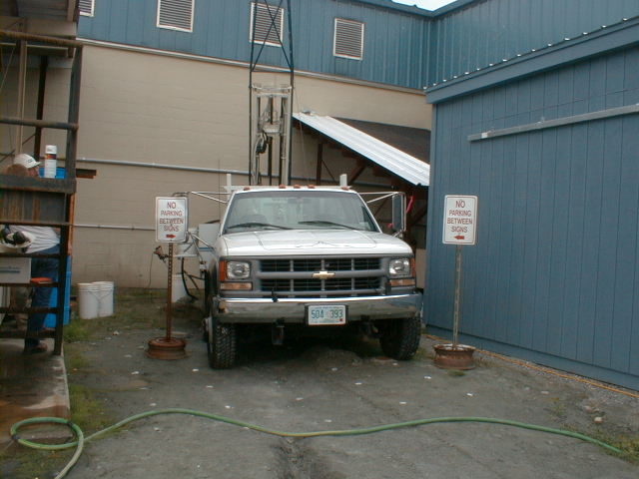
QUESTIONS??
TerraStryke Products, LLC
P.O. Box 254, Andover NH
www.terrastryke.com
603.731.3159 karmstrong@terrastryke.com

Slide 29
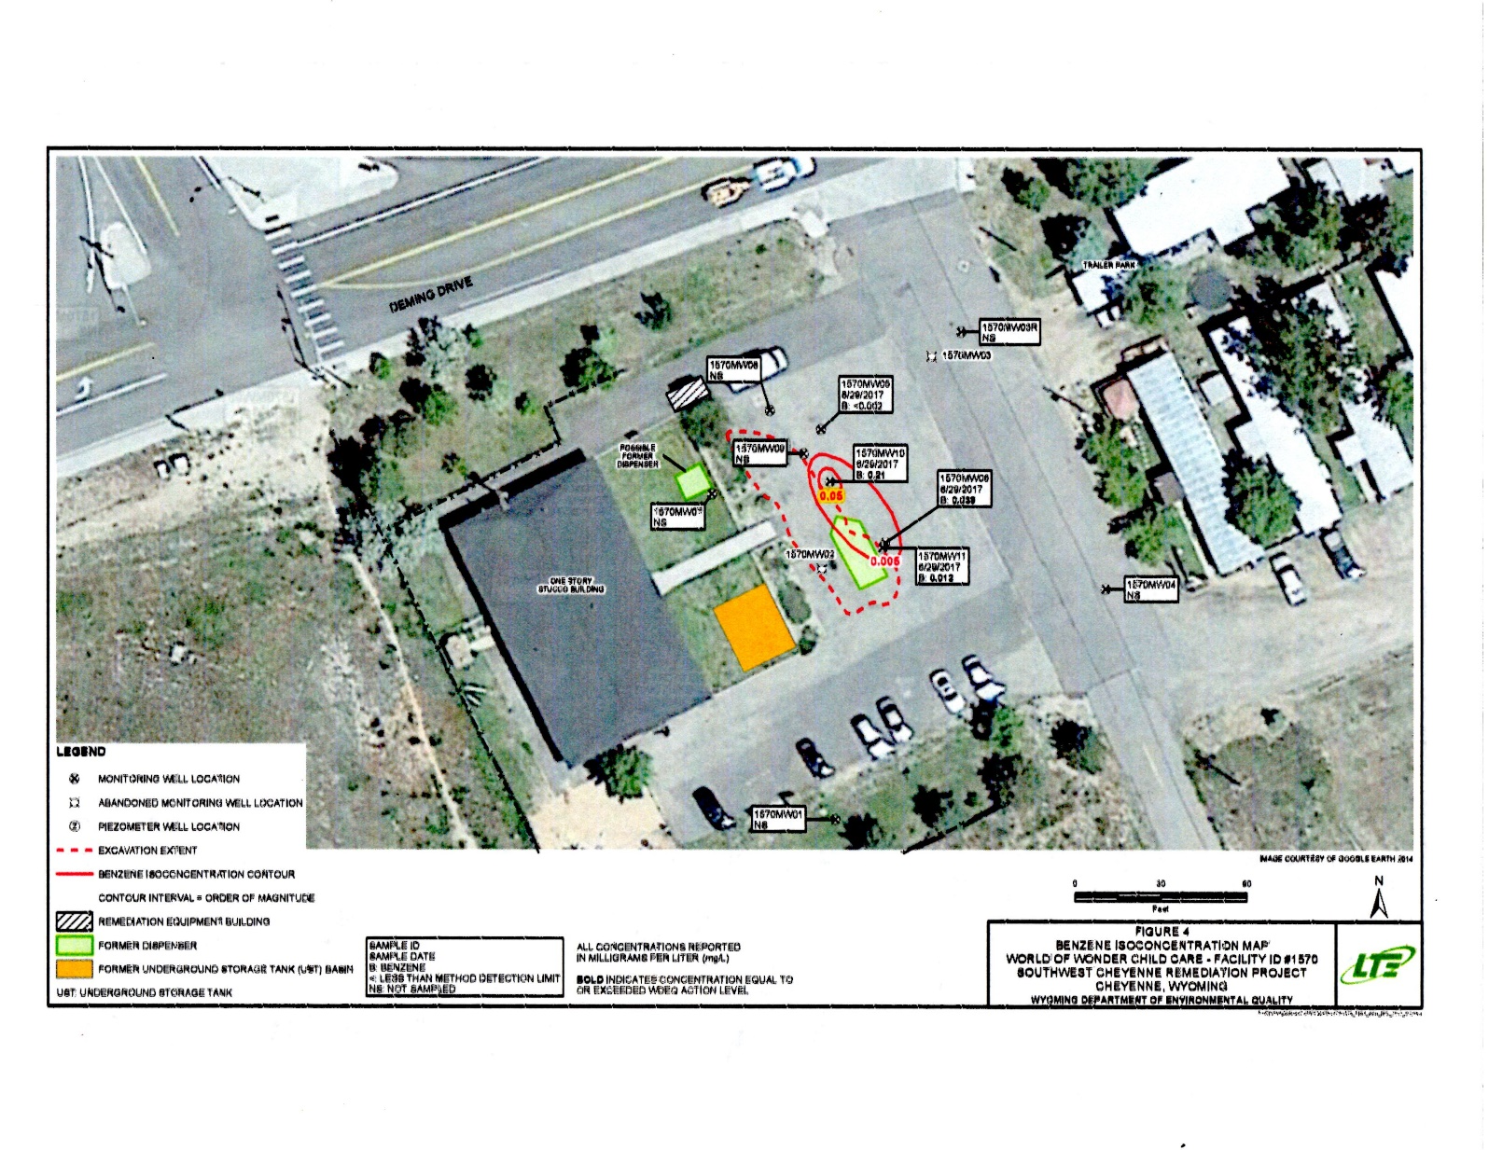
TPHenhanced™ - Petroleum Case Study
Former Service Station – Current Day Care Facility
Site former Service Station, now active Day Care
Under-ground USTs removed many years back
Long-term groundwater issues remain
Historical data indicates very low ORP
indicative of methanogenic conditions
No respiratory sources available [NO₃] BDL

Slide 30
TPHenhanced™ - Petroleum Case Study
Former Service Station – Current Day Care
PHC dissolved-phase and residual mass
4-month evaluation period
Dec 2017 – March 2018
Minimal additive deployed using PRS deployment units filled w/ TPHenhanced
2nd PRS deployment event April 2018
Benzene = contaminant of concern
>99% reduction in Benzene from peak bioavailability in <4 month period

Slide 31
TPHenhanced™ - Petroleum Case Study
Former Service Station – Current Day Care Facility
Period One: positive response w/regards to ORP as additive availability increases
Period Two: additive availability begins steady decline as availability is diminishing; ORP continues to climb out from methanogenesis
Period Three: additive availability declines sharply, and over time, ORP declines too
Period Four: new additive deployment increases availability sharply; and, ORP responds renewing favourable conditions
Note additive utilization is much quicker since microbial populations have increased; more folks needing to breathe!

Slide 32
TPHenhanced™ - Petroleum Case Study
Former Service Station – Current Day Care Facility
Additive availability increases
Significant increase in dissolved-phase concentration = enhanced solubilization
With additive available, assimilation of dissolved-phase PHCs outpaces solubilization
Additive availability parallels decreasing [PHCs]
Renewed additive availability, additional solubilization, subsequent destruction
>99% reduction in < 3-months
February 2018

Slide 33
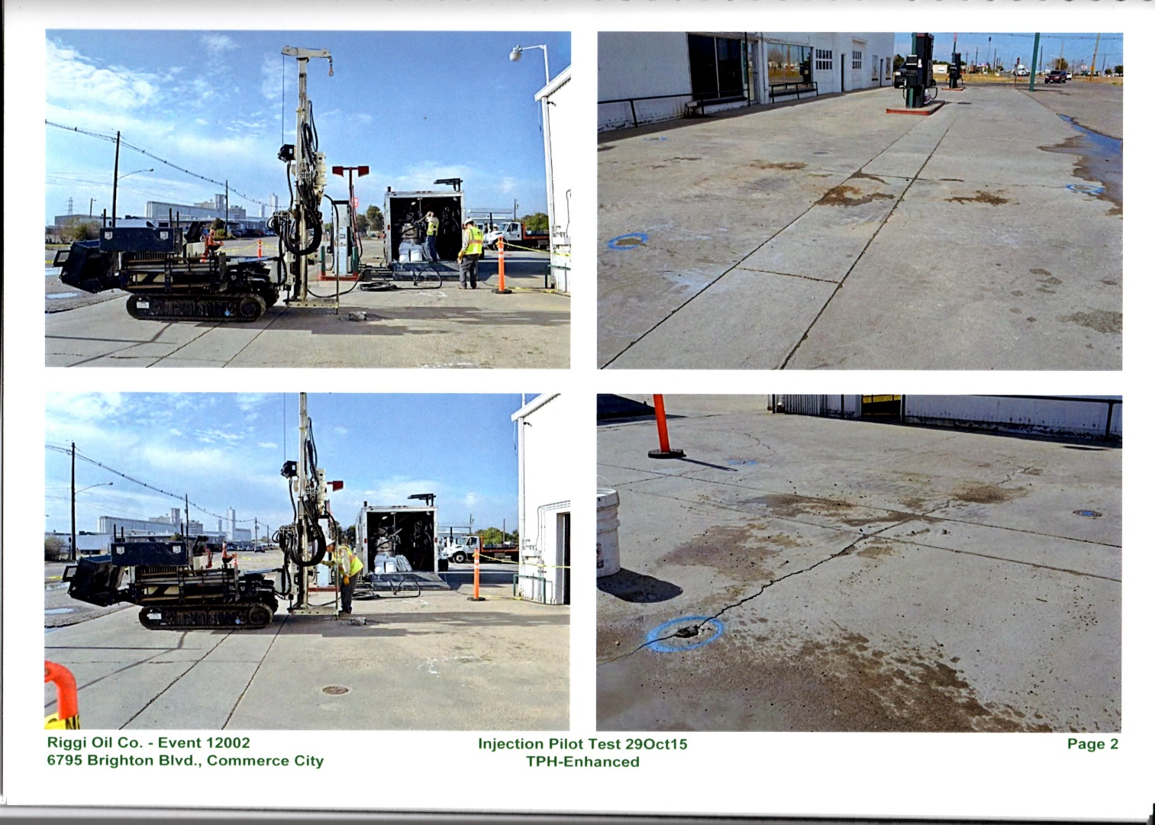
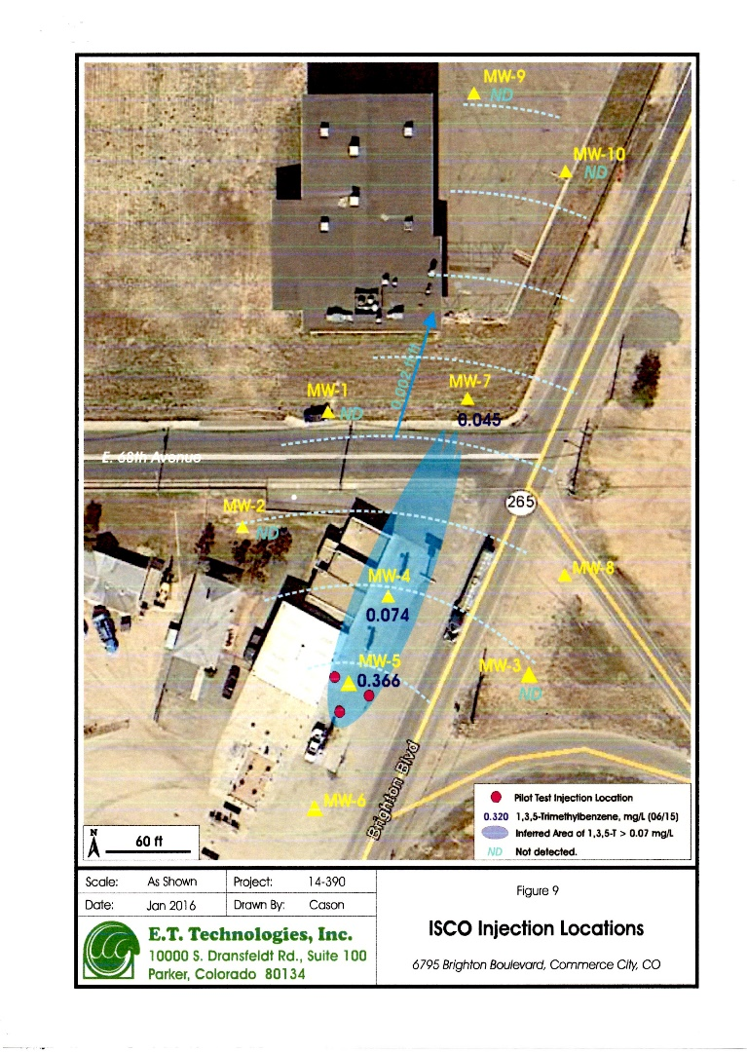
Parker Colorado – Remedial Strategy - Approach
TPHenhanced® Biostimulation for 1,3,5-Trimethybenzene
Baseline groundwater sampling performed June 2015
[1,3,5-TMB] in groundwater ranged from:
474 micrograms per Liter (µg/L) at MW5 (source)
168 µg/L at MW-4 (proximate center)
195 µg/L MW7 (off-site)
Four rounds performance monitoring and sampling through June 2016.

Slide 34
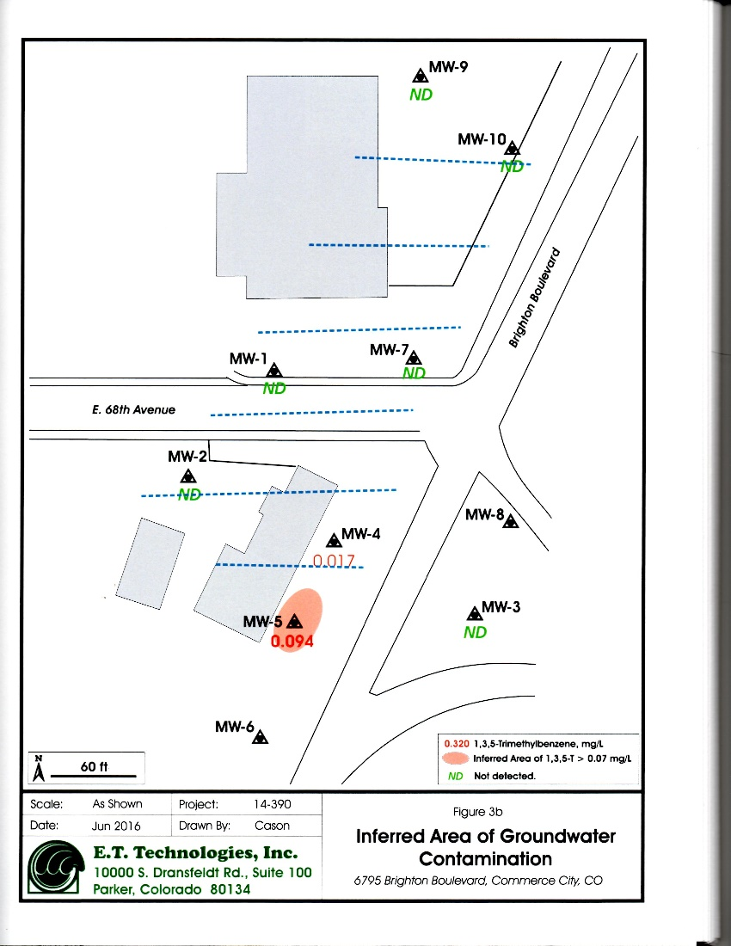
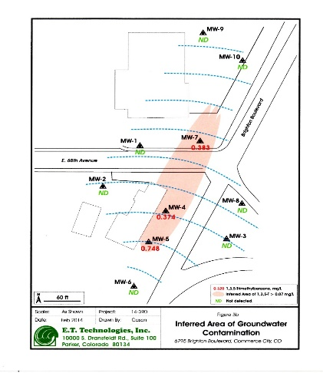
Parker Colorado – Bulk Tank Storage Facility
TPHenhanced® Biostimulation for 1,3,5-Trimethybenzene
Treatability Evaluation Results September 2016
Downgradient Location MW-7
>99.5% Overall reduction [1,3,5-TMB]
Mid Location MW-4
89.9% initial reduction
Followed by 104% increase due to enhanced solubilization
76.9% reduction overall
Source Location MW-5
80.3% initial reduction
Followed by 28.3% increase due to enhanced solubilization
83.5% reduction from peak bioavailability

Slide 35
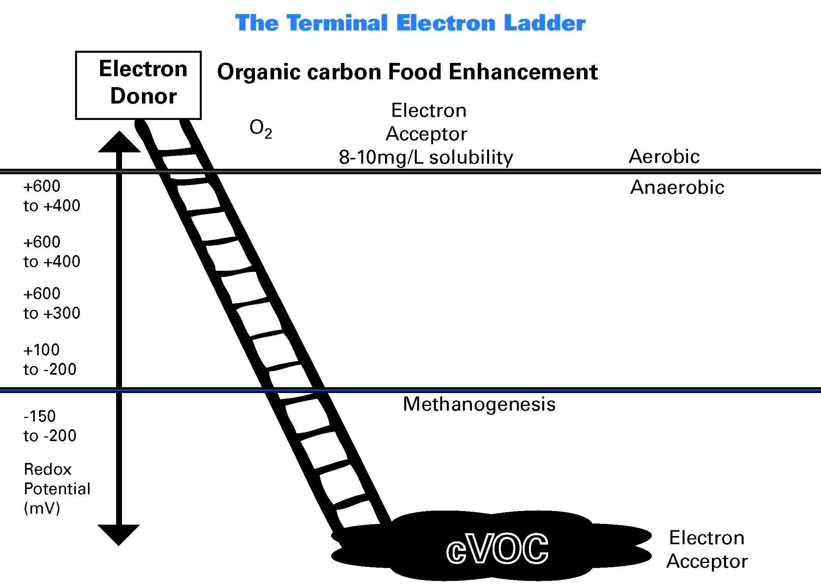
Nitrate Reduction/Respiration
NO₃⁻
⁽⁺⁵⁾
NO₂⁻
⁽⁺³⁾
NO
⁽⁺²⁾
N₂O
⁽⁺¹⁾
N₂
Manganese/Iron(III) Reduction/Respiration
Mn⁴⁺
Mn²⁺
Fe³⁺
Fe²⁺
Sulfate Reduction/Respiration
SO₄²⁻
H₂S
C₆H₆
CO₂
Ethene, Ethane, Methane Production
Presence of Free Cl⁻
Enhanced Reducing Conditions

Slide 36
Aerobic Respiration
O₂ e⁻ consumption complete
Anaerobic Conditions
Nitrate Respiration
Iron – Manganese Respiration
Sulphate Respiration
Methanogenic Conditions
CO₂ Respiration
Complete cVOC Biotransformation

Slide 37
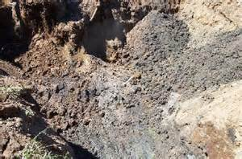
Aerobic Conditions
What In-Situ Amendment To Use??
TPHenhanced™
Provide Alternative Respiratory Pathways for Native Heterotrophic Microbial Populations
Alternative to O₂ plus proprietary macro-micro nutrient formulation allowing respiration under anaerobic conditions
Nitrate Reduction/Respiration
ORP
NO₃⁻
⁽⁺⁵⁾
NO₂⁻
⁽⁺³⁾
NO
⁽⁺²⁾
N₂O
⁽⁺¹⁾
N₂
Increase ORP
Enhance the Utilization of Naturally Occurring Respiratory Pathway Sources
Manganese/Iron(III) Reduction/Respiration
Mn⁴⁺
Mn²⁺
Fe³⁺
Fe²⁺
Sulfate Reduction/Respiration
SO₄²⁻
H₂S
Methanogenic Conditions
C₆H₆
CO₂
Electron Donor
Little to No Biotic Activity
Ethene, Ethane, Methane Production
Presence of Free Cl⁻
PHC, VOC, sVOC Contaminants
Low-Cost Low-Impact Safe Effective Sustainable

