Slide 1

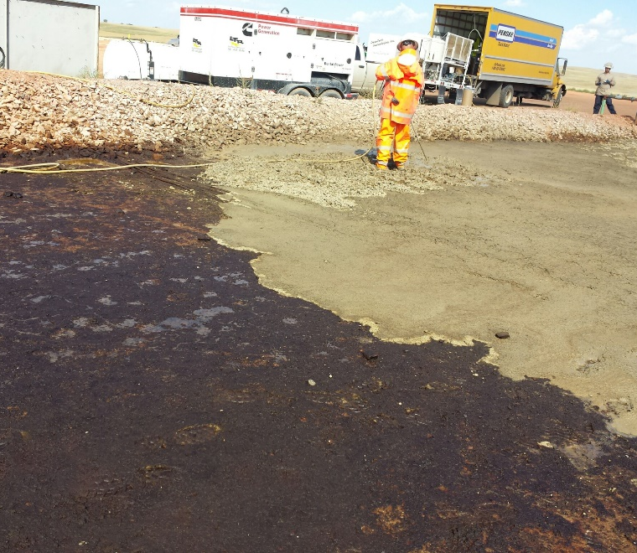
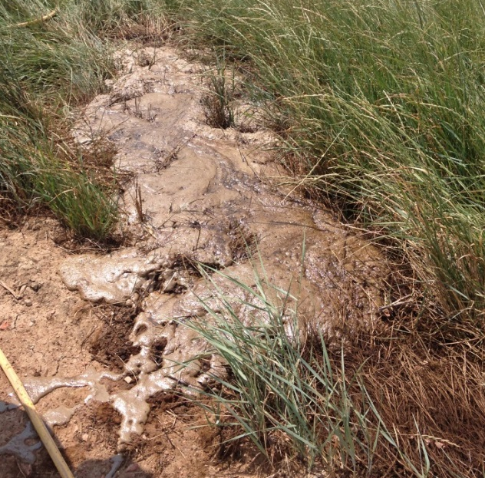
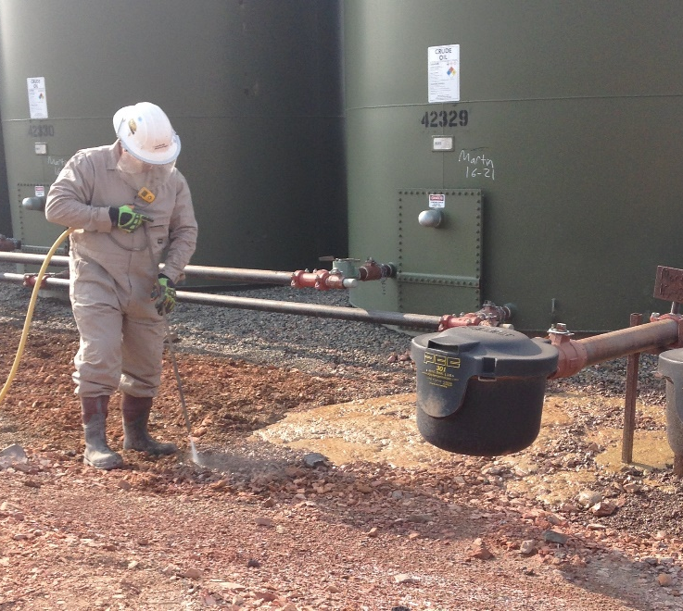
In-Place Treatment of Hydrocarbon Releases
Signals a Breakthrough in the Conservation of
Topsoil & Vegetation
Cool-Ox®
“Where Science & Technology Meet”
William L. Lundy Sr. | wlundy@cool-ox.com | (708) 396-0100

Slide 2
Who is DTI?
DeepEarth Technologies, Inc. was chartered to bring new innovation in chemical oxidation to the environmental remediation marketplace.
Unlike most companies that simply sell products, DTI is a total
turn-key operation offering:
    Proven Technology
    Experienced Personnel
    Innovative Application Machinery
Resulting in:
    Abbreviated life cycle costing
    Accelerated Site Closures (NFA Tombstone Remedies)

Slide 3
Focus of Presentation
Cost Effective Proven Alternatives
Point up Alternative to Conventional Remediation of Hydrocarbons
Lift and Remove – Destruction of Top Soil
Defining Total Petroleum Hydrocarbons (TPH)
Characteristics – Carbon Groups – Toxicity
Need for Revised Regulations & Attitudes
Currently Focused Upon TPH (Costly Mistake)
Should be Based Upon Actual Risk to Real Receptors
Scientific Bases for Suggested Revisions
Studied – Practiced - Field Proven
Change Possible
Discovery of Differential Reactivity of TPH Fractions

Slide 4
Origin of Problems
Releases From Petroleum Operations
Up-Stream (E & P)
Mid-Stream (Distribution)
Refining
Retail

Slide 5
Current Practices
Lift & Remove Impacted Soil
  Major Concerns
  Destruction of Land (Top Soil)
  Public (& Employee) Safety
  Public Opinion (Good Stewards of Industry)
  Awareness of Concerns
    Neighbors
    Production Partners (Land Owners)
    Public Officials
    Environmentalists

Slide 6
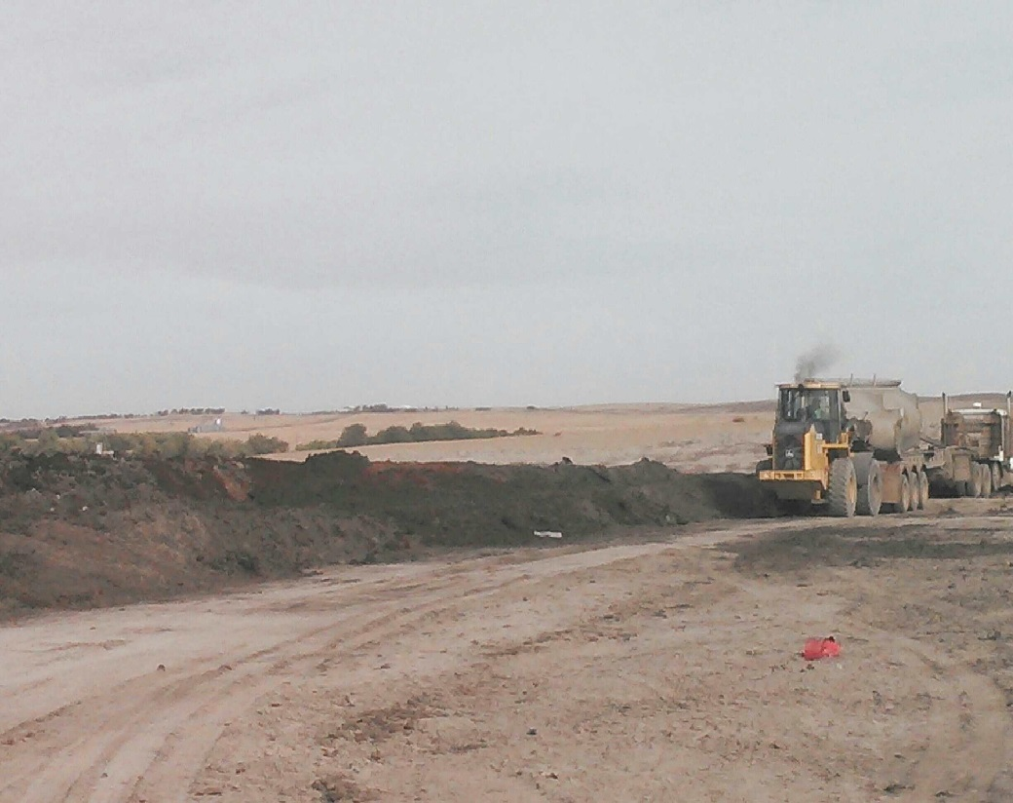
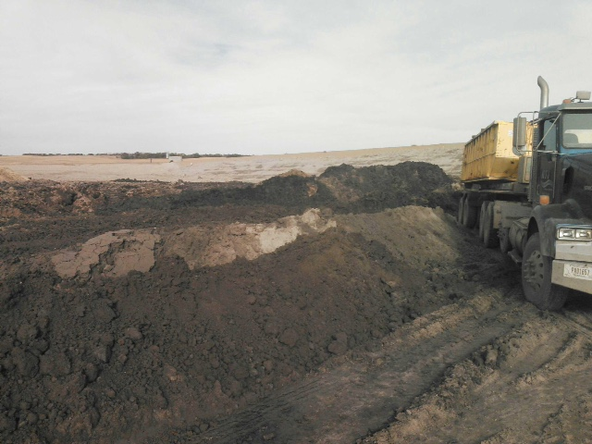
A nation that destroys its soils, destroys itself.
President Franklin D. Roosevelt, Feb. 26, 1937.

Slide 7
Saving our Soils
From Excavation to Education
New Application of Technology
Destroys the Most Toxic Fraction (Crude Oil)
      BTEX / PAHs (Aromatics)
      Converted to non-Toxic Fractions
          Aliphatics to Useful Bio Enhancers
        TPH - The Focus of Current Regulations

Slide 8
What is TPH?
Total Petroleum Hydrocarbons (TPH)
Term used to describe several hundred HC compounds
Almost all come from crude oil.
Almost all are composed from carbon & hydrogen.
Most will bum.
Some evaporate easily (Risk of Flammability)
Others are thick, dark liquids or semi-solids that do not evaporate.

Slide 9
TPH Characteristics (General)
Odorous
Gasoline, Kerosene, Fuel Oil, Mineral Oil and Asphalt
Very Widely Used (Worldwide)
Widespread in the Environment (Contaminants)
Contamination will contain a variety of hydrocarbons
Not practical to measure each one individually
Useful to measure the total amount (as TPH)
TPH tells us little about the particular hydrocarbons
How each may affect people, animals, and plants

Slide 10
Characterized by Families (Fractions)
Fractions - Groups of HC that Behave Alike Chemically
  Molecular Structure (Aromatics/Aliphatics/More)
  Boiling Points
  Melting Points
  Specific Gravity
  Solubility – Water / Solvents / Other HCs / Soaps
  Toxicity
  More

Slide 11
Toxicity – Aliphatic and Aromatic Fractions
U. S. - Agency for Toxic Substances and Disease Registry (ATSDR)
Canada – National Science & Research Council (NSERC)
Defined Four Aliphatic & Four Aromatic TPH Fractions (Cuts)
F1 (C₆-C₁₀) Most Toxic
F2 (C₁₁-C₁₆) Less Toxic
F3 (C₁₇-C₃₄) Non Toxic
F4 (>C₃₄) Not Toxic
Oral - Inhalation - Dermal
Information based upon: TOXICOLOGICAL PROFILE FOR TOTAL PETROLEUM HYDROCARBONS (TPH)
U.S. DEPARTMENT OF HEALTH AND HUMAN SERVICES
Public Health Service Agency for Toxic Substances and Disease Registry September 1999

Slide 12
Aromatic EC₆-EC₁₀ Indicator Compounds (Most Toxic)
All BTEXs Cause Neurological Effects
  Central Nervous System Depression
Reproductive
  Embryo/Fetus Developmental Effects
Carcinogenic to Humans
  Nonlymphocytic Leukemia
Systemic Renal and Hepatic Effects
  Hematological and Immunological

Slide 13
Aliphatic EC_{>6}-EC₈ Fraction (Non Toxic)
(All Aliphatic Data Based upon Dearomatized Aliphatic Mixtures)
Peripheral Neuropathy
Depression of the Central Nervous System
Irritating to the Skin and Eyes,
Not Classified as Human Carcinogenicity)
No Systemic Toxicity from Dermal Exposure

Slide 14
Aromatic EC_{>9}-EC₁₆ Combined Fractions (Less Toxic) PAHs
Hemolytic anemia / possible human carcinogen
Possible Ocular effects, including cataracts

Slide 15
Aliphatic EC_{>8}-EC₁₆ Combined Fractions (Non Toxic)
(All aliphatic data based upon dearomatized aliphatic mixtures)
Mainly Inhalation Exposure - particularly central nervous depression

Slide 16
Aromatic EC_{>16}-EC₃₅ Combined Fractions (Not considered Toxic)
Non-volatile – Inhalation Exposure limited
Aplastic anemia & Immunological / lymphoreticular from dust (mining operations)

Slide 17
Aliphatic EC_{>16}-EC₃₅ Combined Fractions (Not Toxic)
No Effects Listed

Slide 18
Toxicity – Aliphatic and Aromatic Fractions
U. S. - Agency for Toxic Substances and Disease Registry (ATSDR)
Canada – National Science & Research Council (NSERC)
Defined Four Aliphatic & Four Aromatic TPH Fractions
F1 (C₆-C₁₀) Most Toxic
F2 (C₁₁-C₁₆) Less Toxic
F3 (C₁₇-C₃₄) Non Toxic
F4 (>C₃₄) Not Toxic
Now that we Know --- What can we do?

Slide 19
Turn to Chemistry
Scientific Bases for In-Place Remediation*
Partial Oxidation of Hydrocarbons
  HC Converted to Surfactants
      (Organic Acids – Alcohols)
  CO₂ Produced
* Ndjou’ou & Cassidy, “Surfactant Production Accompanying the Modified Fenton Oxidation of Hydrocarbons in Soil,”
U. S. Patent (6,843,618) Canadian (2,684,856) Willi am L. Lundy

Slide 20
Major Findings
Modified Fenton (MF) Oxidation*
Converts HC to Surfactants (Amphiphilic)
Produces CO₂
Soap + Gas (CO₂) + Water = Foam
Surface Tension (ST) Decrease
~74 dy/cm to < 34 dy/cm
* “clear evidence of surfactant accumulation in the reactors treated with MF oxidants”

Slide 21
Major Findings
Concentrations and removals of the individual
hydrocarbon fractions for each treatment in the study
Treatment | F1 (C₆-C₁₀) | F2 (C₁₁-C₁₆) | F3 (C₁₇-C₃₄) | F4 (>C₃₄)
Concentrations (mg/kg)
Untreated ª | 861 ± 104 | 3,944 ± 339 | 3,120 ± 302 | 2,679 ± 271
Biological ^{b} | 124 ± 61 | 1675 ± 309 | 2954 ± 420 | 2712 ± 571
Liquid HP ^{b} | 52 ± 17 | 455 ± 79 | 885 ± 243 | 1393 ± 222
Cool-Ox^{® b} | 14 ± 9 | 49 ± 21 | 98 ± 36 | 304 ± 88
Percent Removal
Biological | 85.6% | 57.5% | 5.3% | 1.2%
Liquid HP | 94.0% | 88.5% | 71.6% | 48.0%
Cool-Ox® | 98.4% | 98.8% | 96.9% | 88.7%

Slide 22
Conclusions
Differential In-Place Remediation of TPH Possible
F1 (C₆ -C₁₀) Most Complete (Most Toxic)
  Fastest - Most Complete Destruction (98.4%)
F2 (C₁₁-C₁₆) Complete (Less Toxic)
  Same as F1 (98.6%)
F3 (C₁₇-C₃₄) Slower (Non Toxic)
  Slower (96.9%)
F4 (>C₃₄) Slowest (Not Toxic) (88.7%)
Bio can be a co-contributing factor in the remedial process.

Slide 23
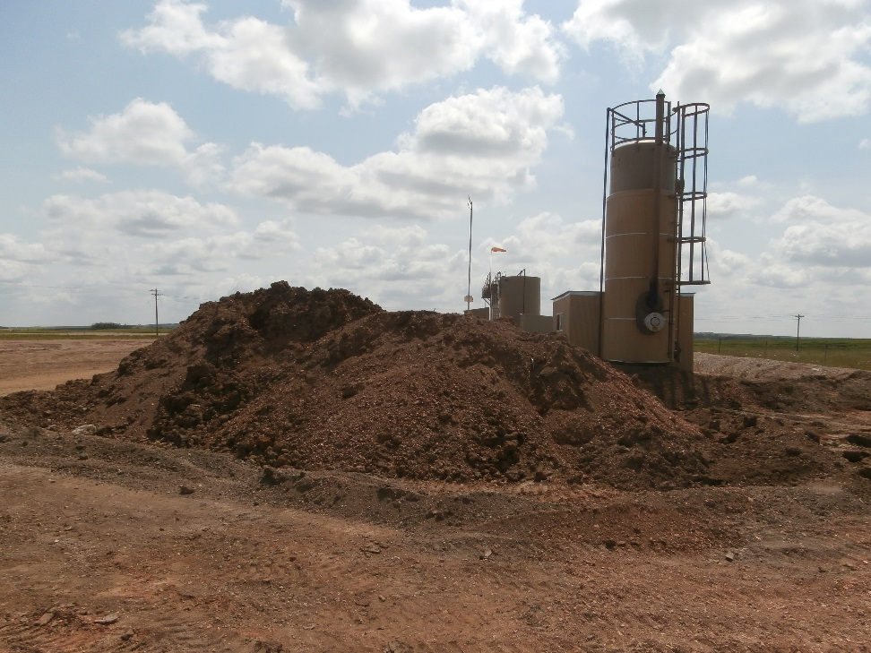
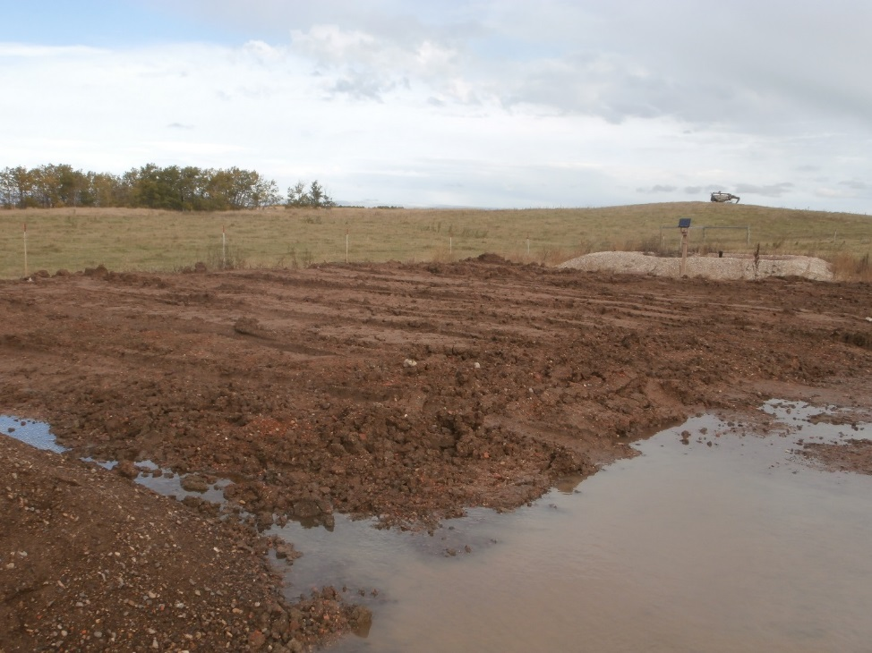
Pre-Dug Soil
Hydrocarbon impacted berm material
Treated material used on site

Slide 24
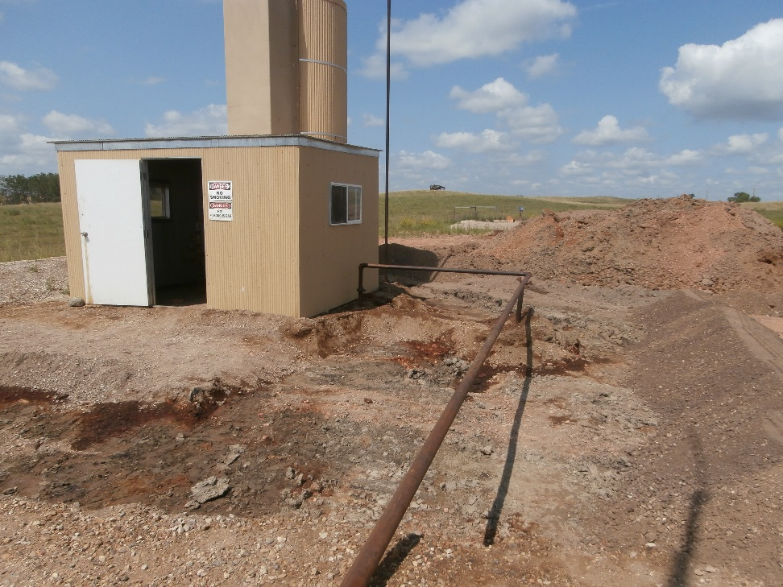
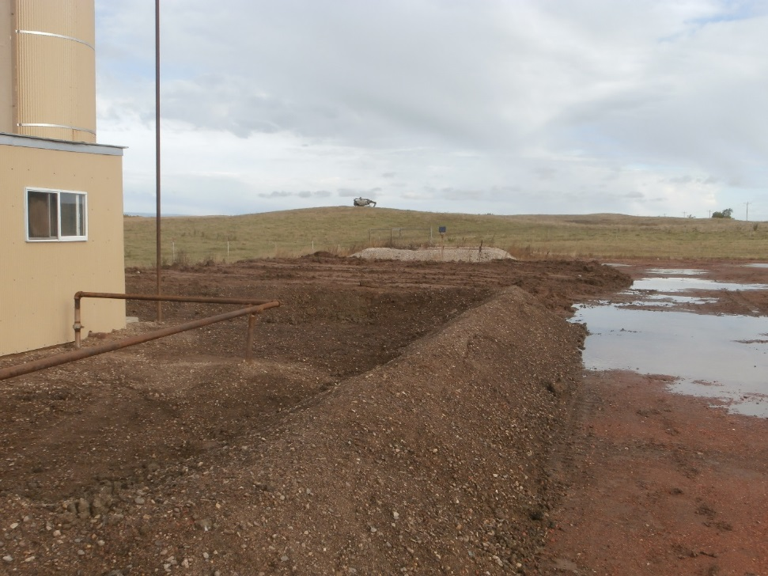
Pre-Dug Soil
Released produced fluids saturated the primary containment berms inside the treater building and 12 inched below ground surface within the containment berms.

Slide 25
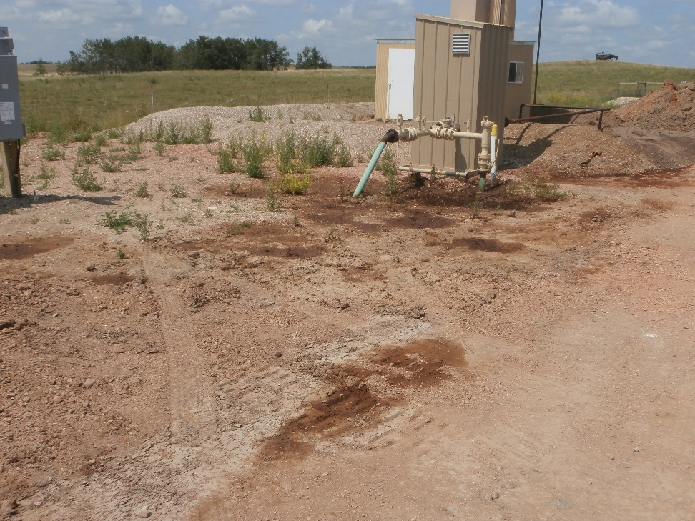
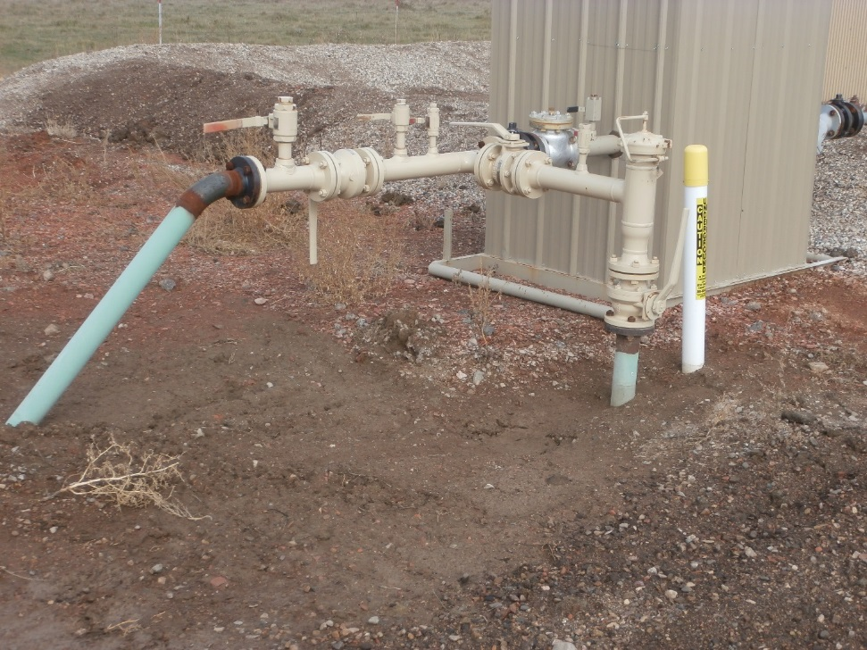
Pre-Dug Soil
Because the Cool-Ox® reaction is noncorrosive, we are able to treat near pipelines.

Slide 26
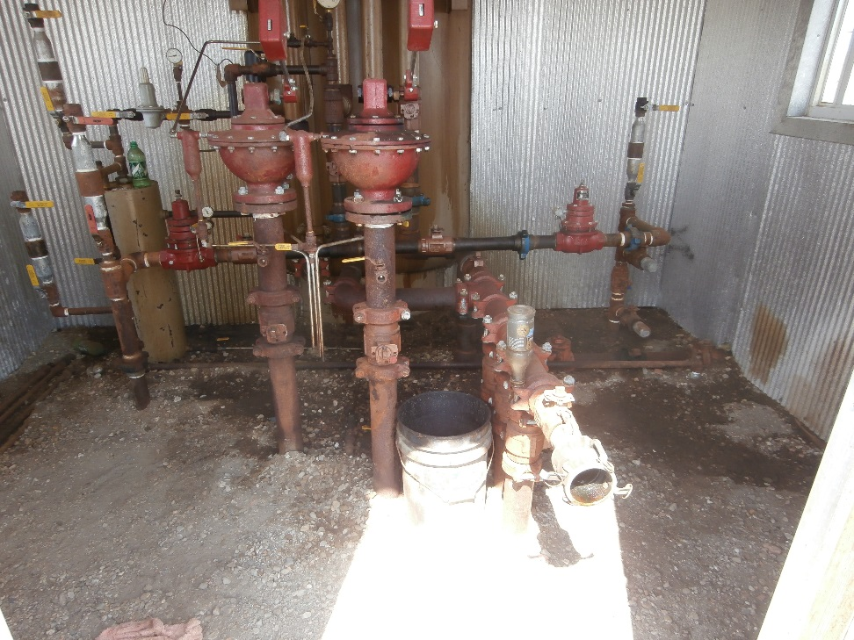
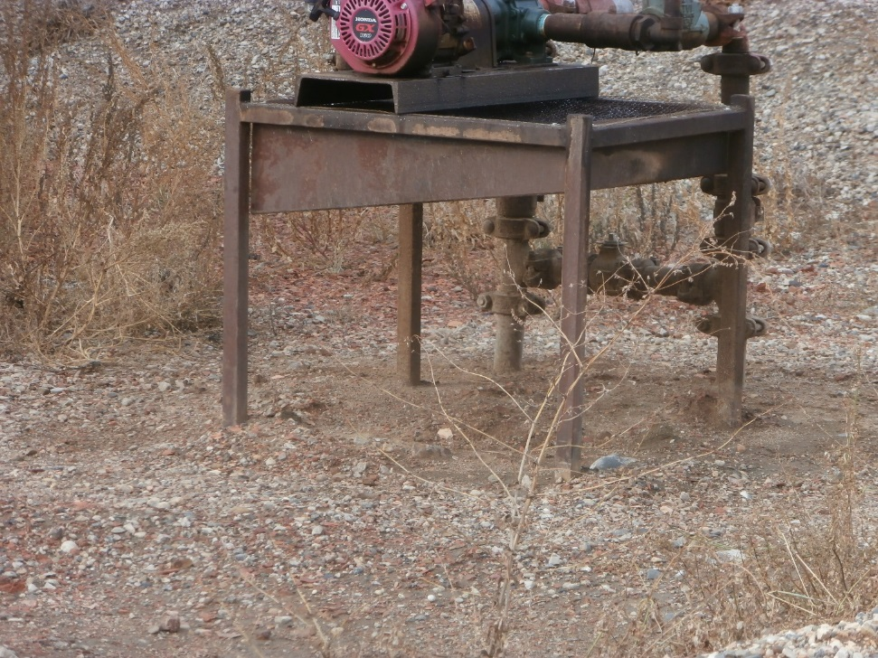
Pre-Dug Soil
Because the chemical is applied employing a high pressure wand we are able to treat in confined spaces.

Slide 27

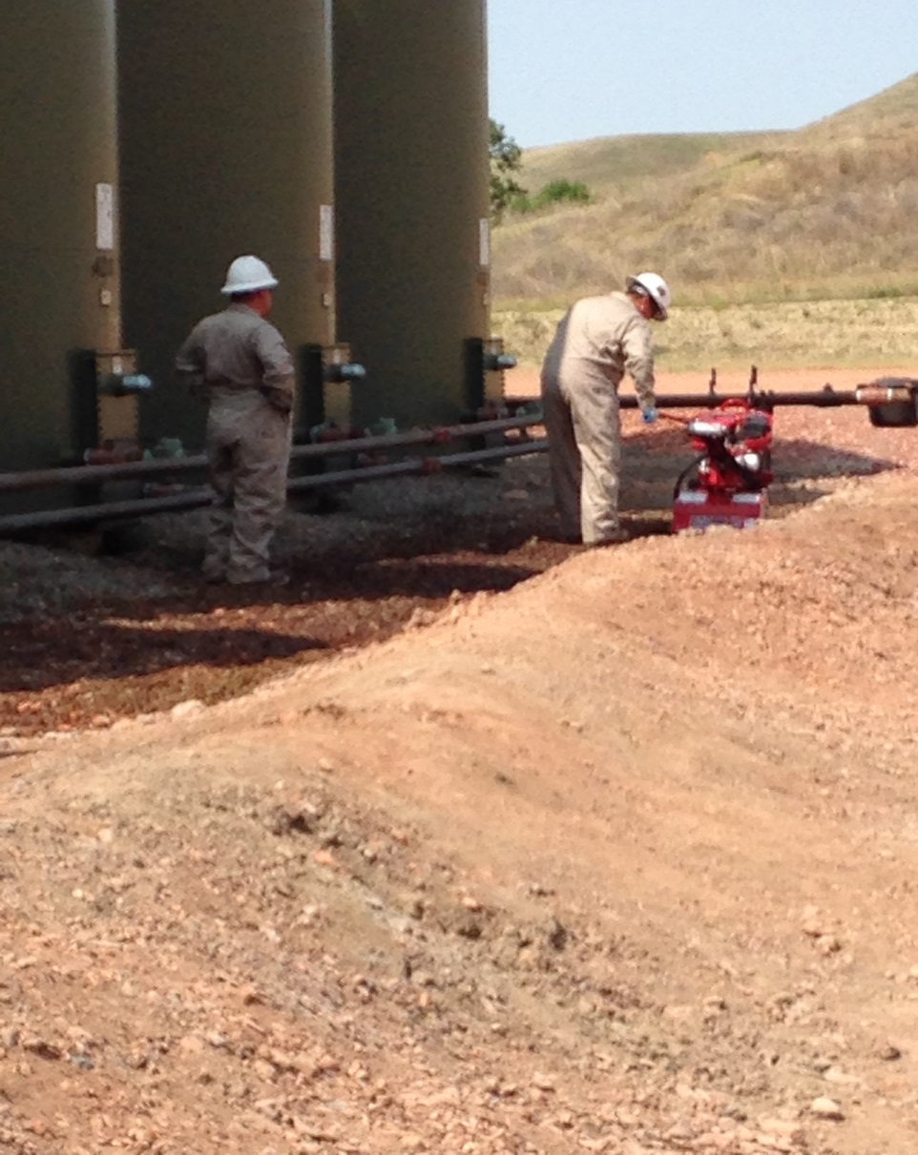
Undisturbed Soil
The impacted area was tilled the treated with Cool-Ox®

Slide 28
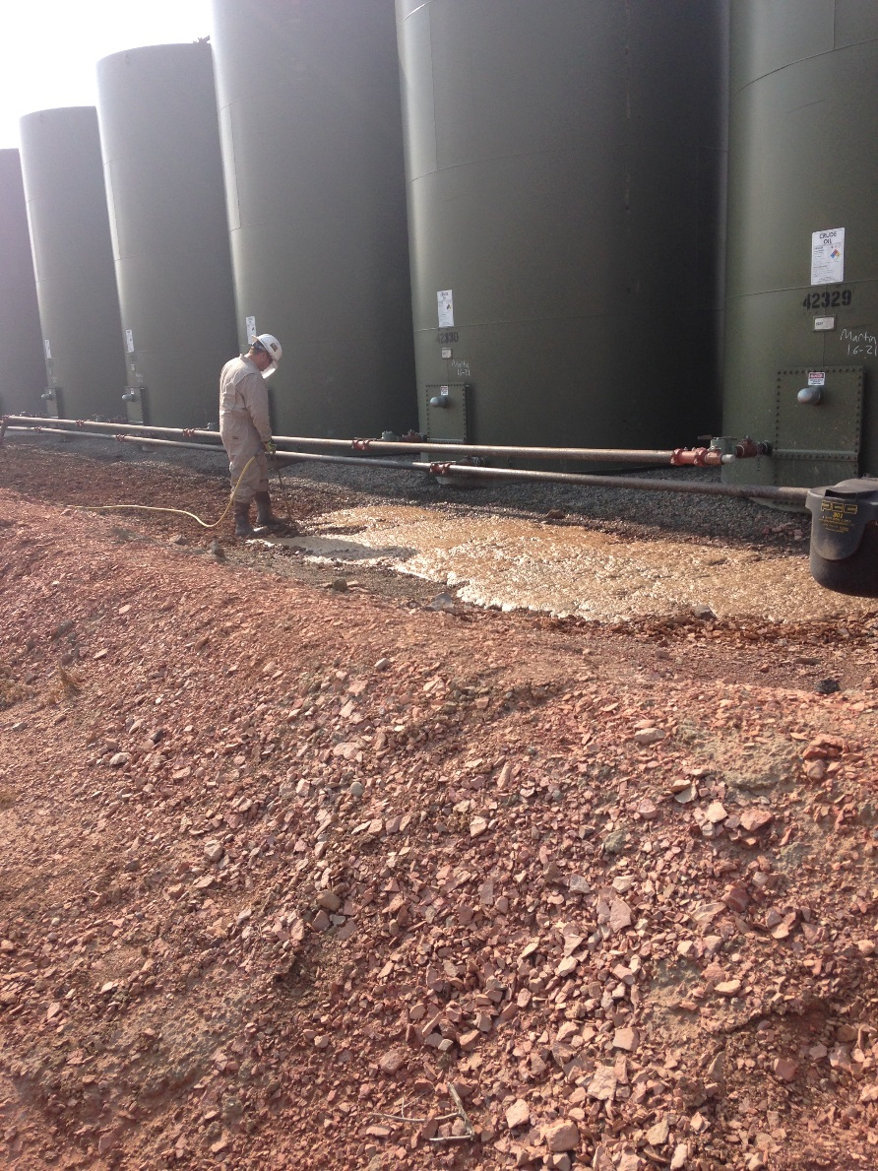
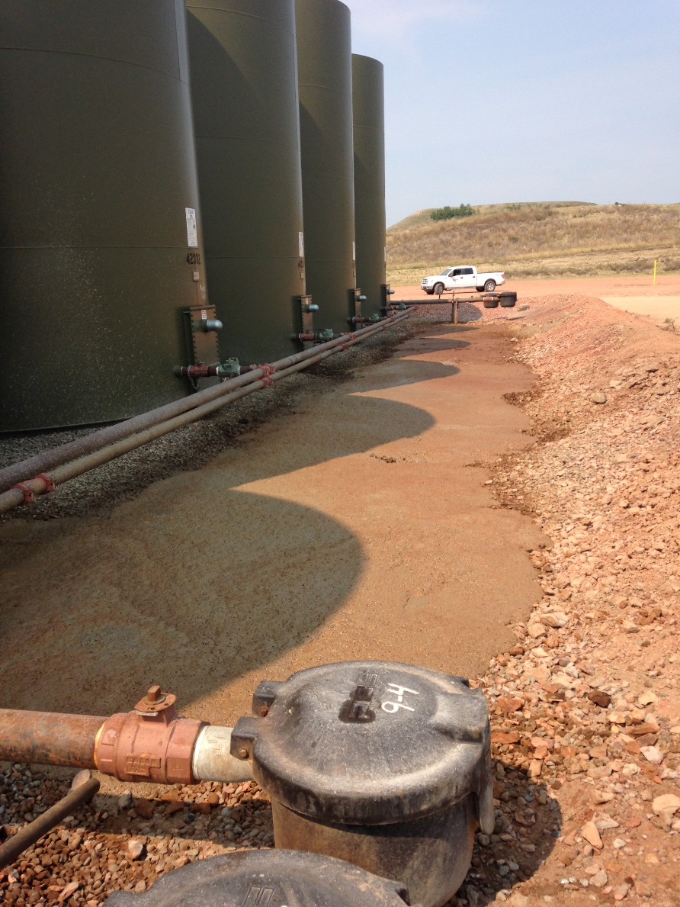
Undisturbed Soil

Slide 29
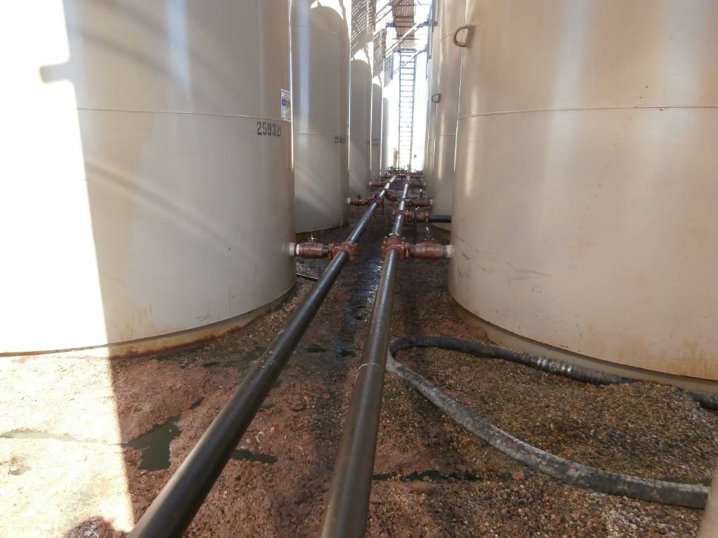
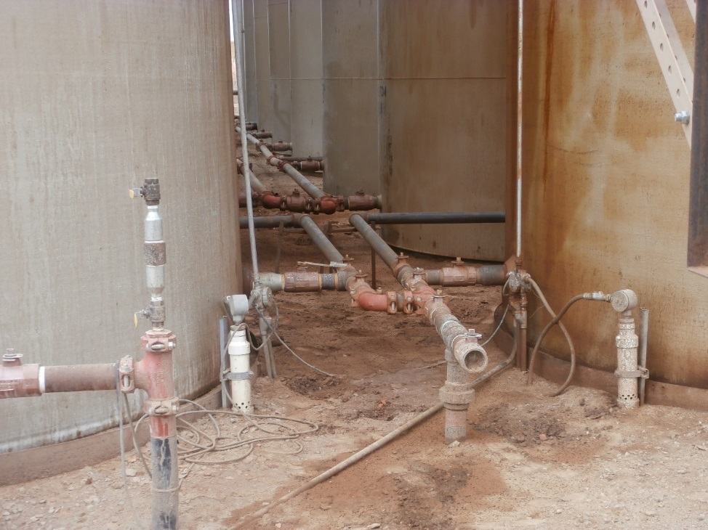
Free Product Tank Battery
Note, free product puddled
Post treatment view

Slide 30
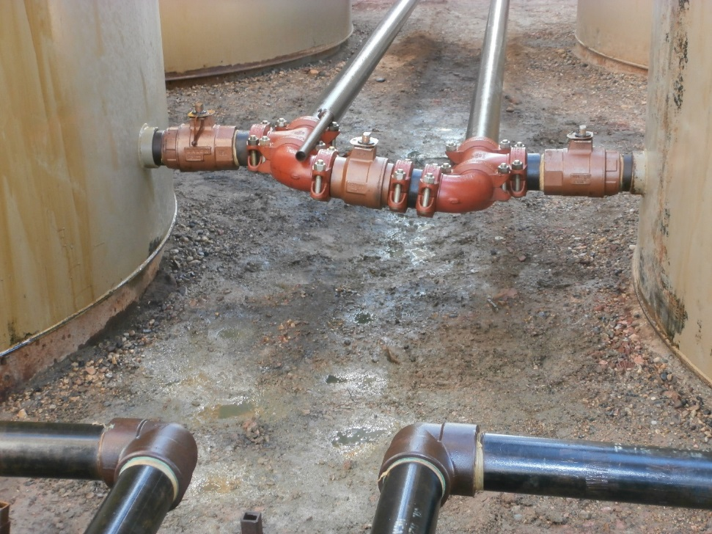
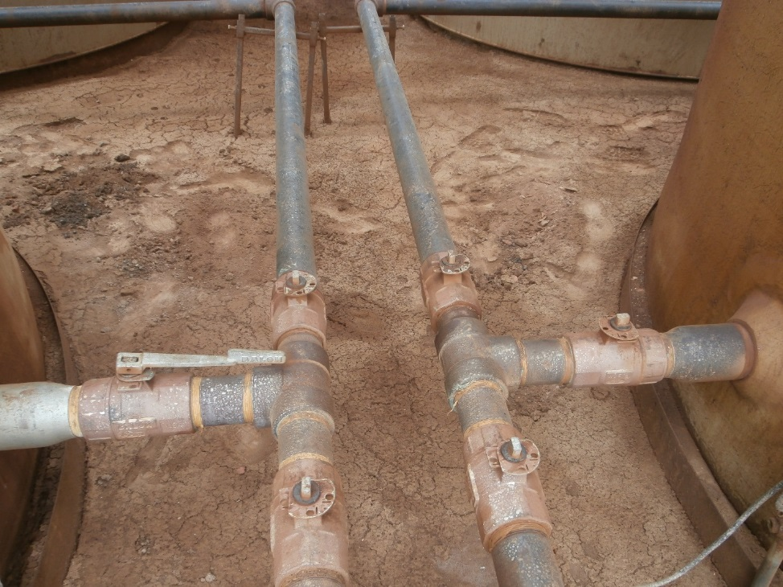
Free Product Tank Battery
Again puddled free product
Post treatment view

Slide 31
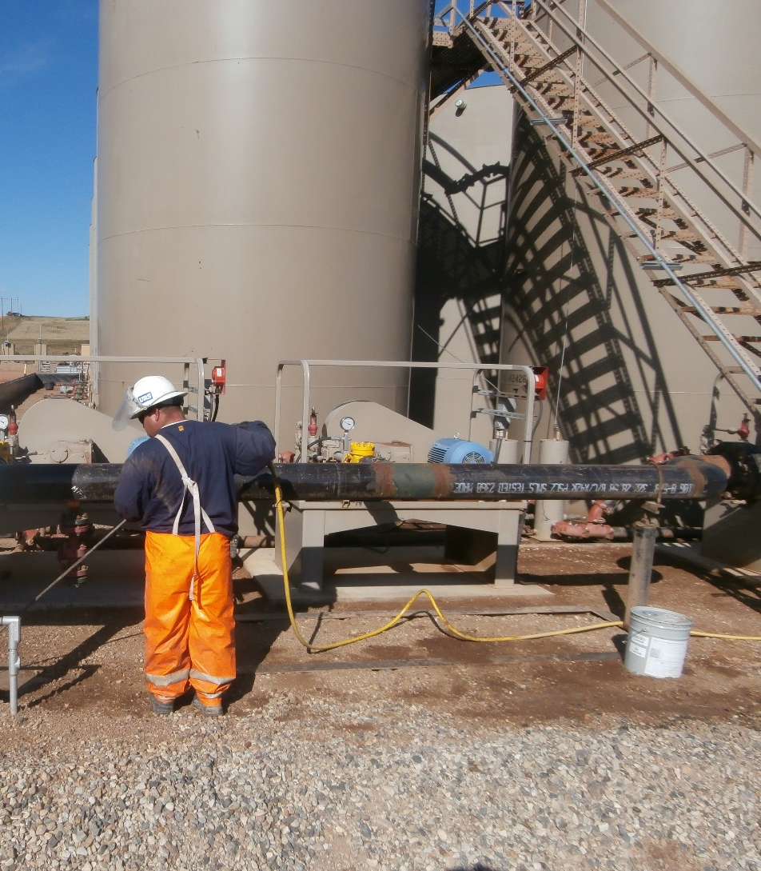
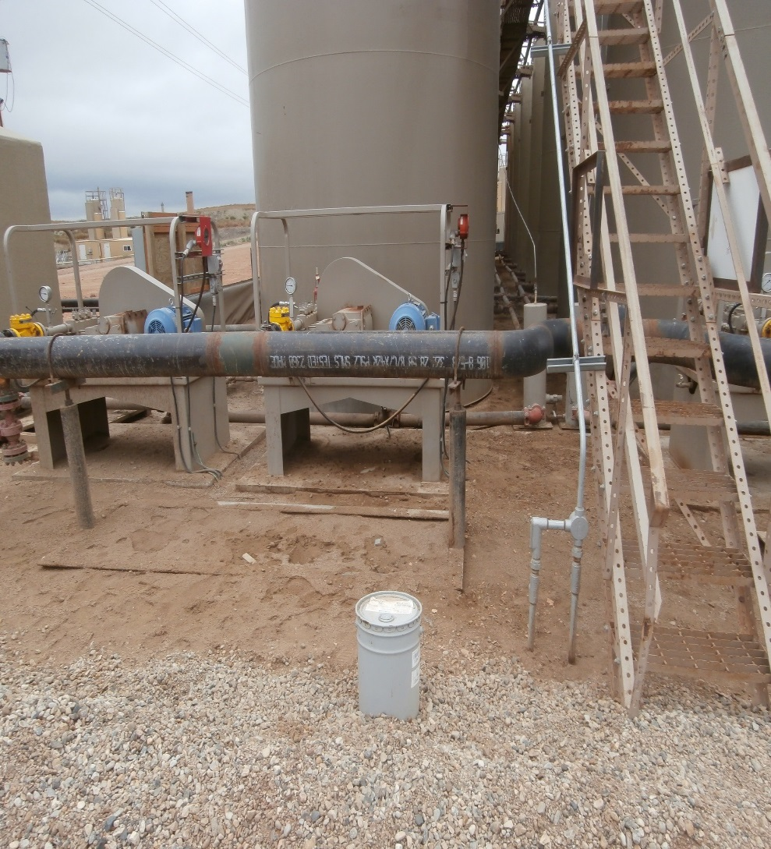
In-Situ & Around Equipment

Slide 32
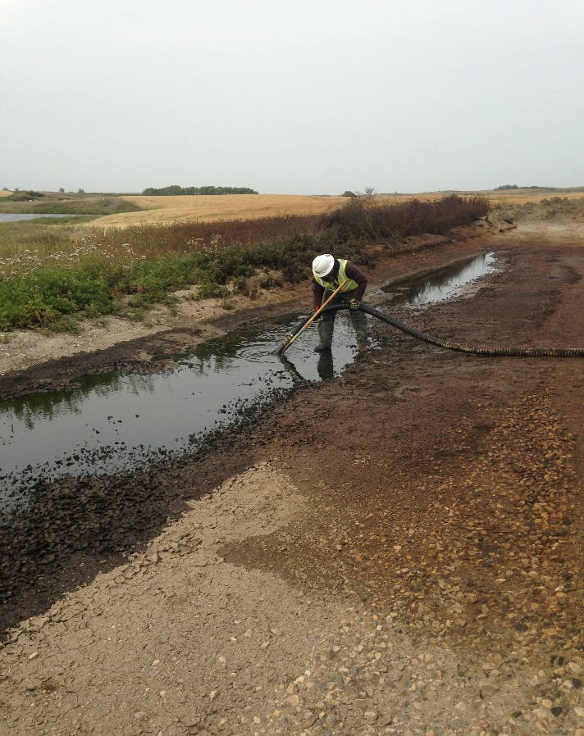
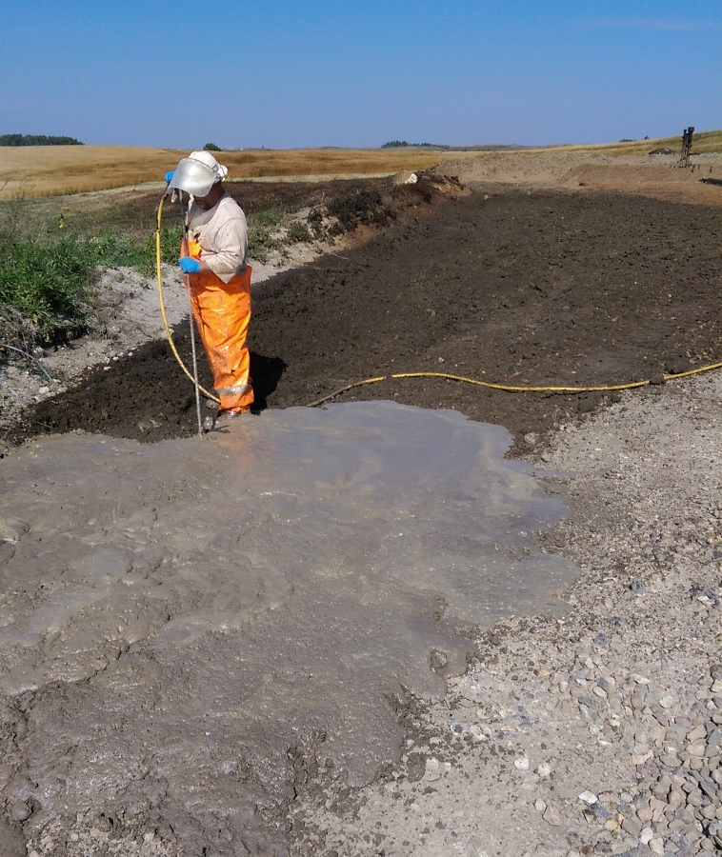
Phased Cleanup
Removal of free product
Application of Cool-Ox®

Slide 33
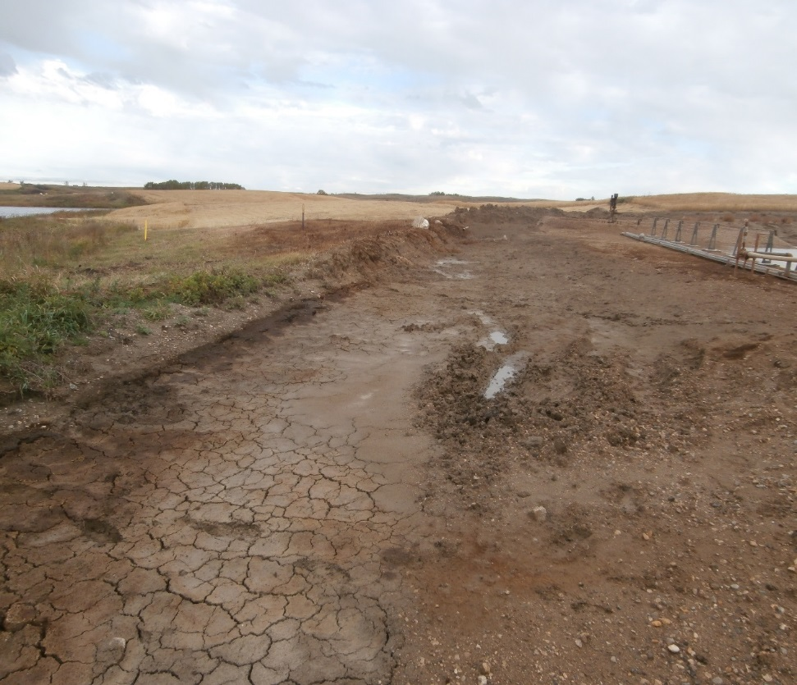
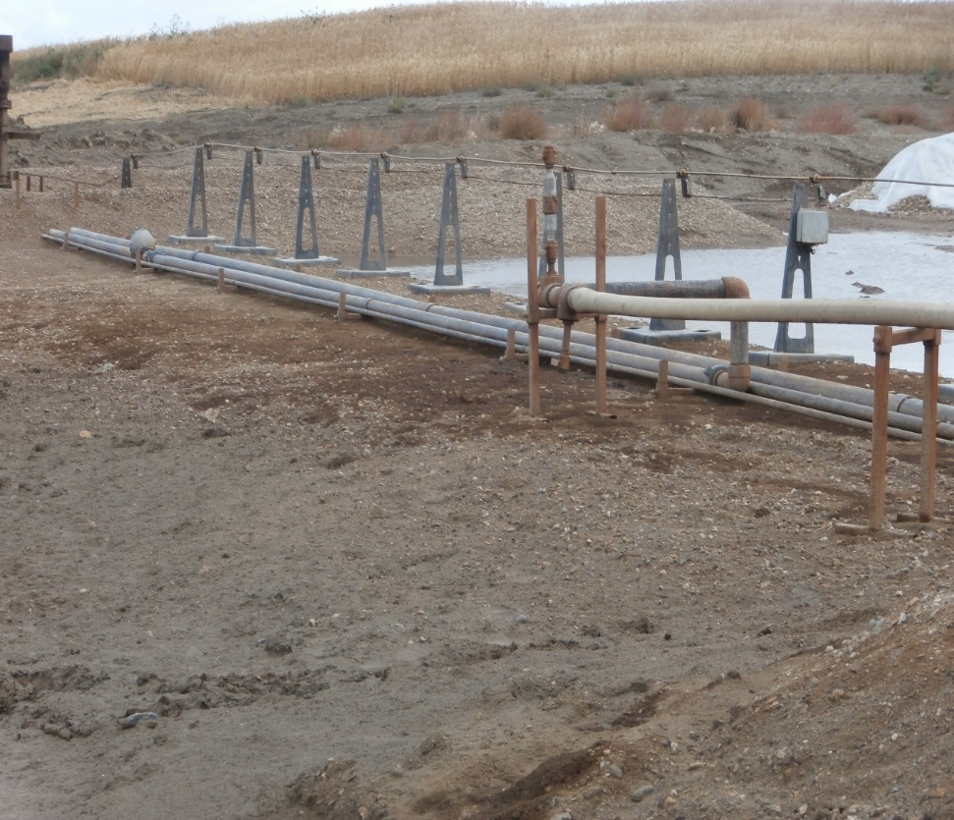
Phased Cleanup Results
Photographs taken 12 days following treatment of the impacted area with Cool-Ox®.

Slide 34
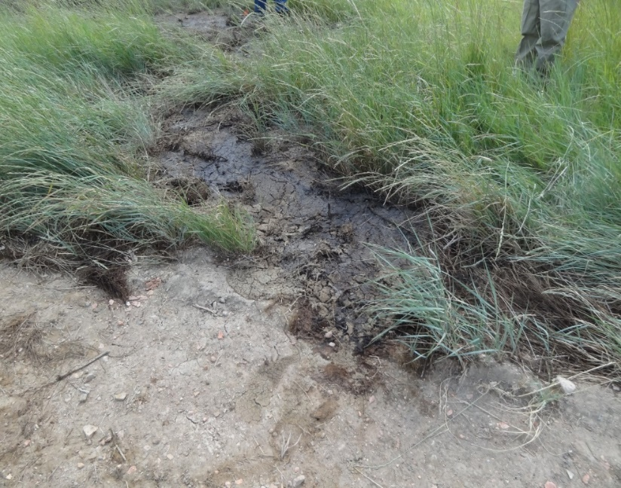
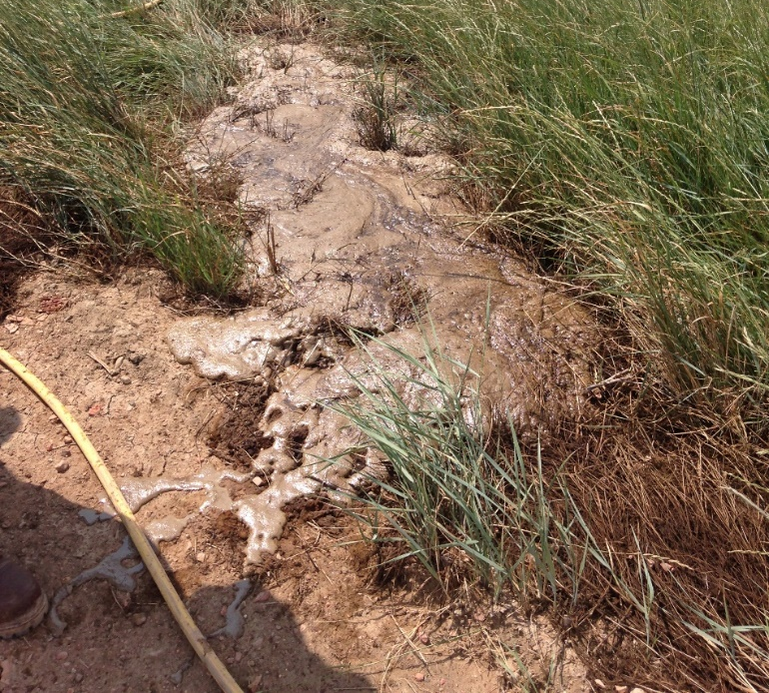
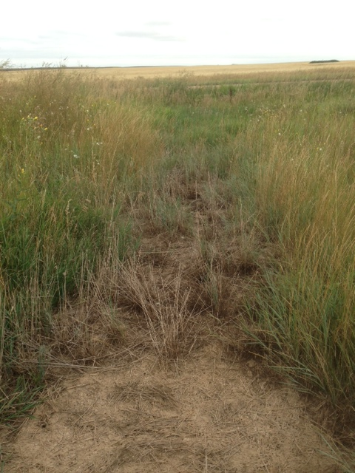
Non-Toxic to Plants

Slide 35
In-Place Advantages
Scientifically Based
Economical
Treats Most Toxic TPH Fractions - Quickest & Most Completely
Immediate Odor Elimination
Heavy Crawler Equipment Not Required*
Realtime Proof of Efficacy (Foam)
Complete Penetration & Mixing
Allows Grab Sampling
Soil Preserved in Place

Slide 36
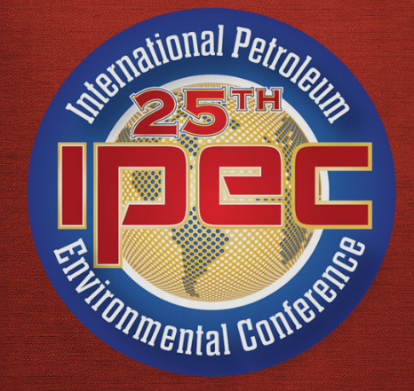
Questions?
Thank You !
Bill Lundy
DeepEarth Technologies, Inc.
www.deepearthtech.com
wlundy@cool-ox.com
*Photos provided by Dustin Anderson – Oasis Petroleum

