Slide 1



Improved Results for In-Situ Remediation Projects by Utilizing High Resolution Data, Injection, and Hydraulic Placement Treatment Methods –
It’s a Contact Sport (Part 2)
John Fontana, PG, Vista GeoScience
JFontana@VistaGeoScience.com
25th International Petroleum Environmental Conference Denver, Colorado
Oct 30 - Nov 1, 2018

Slide 2

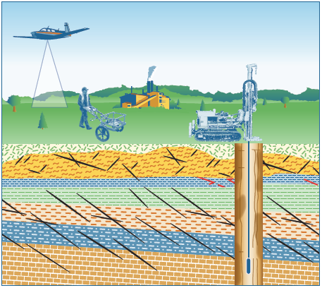
IMPORTANT: NEW ITRC TEAMS
Implementing Advanced Site Characterization Tools
Optimizing In Situ Remediation Performance & Injection Strategies
Watch for Guidance 2019/2020

Slide 3

Outline
Part 1: Better CSM Development for Remedial Design
Part 2: In-Situ Treatment Application Phase
  Why In-Situ Remediation
  Updating the CSM for Remedial Design & Filling Data Gaps
  Selecting the Right Tools and Methods for Treatment
  Applying Higher Resolution Targeted Application Methods
  A Short Case History
  Summary & Conclusion
Vista Optimized In-Situ Remediation, AIPG, September 2018
Notes:
An outline of the topics discussed are included in this slide. The discussion includes a brief history of how traditional ex-situ methods and more complex in-situ methods are often replaced by in-situ injection technologies, and why this change has occurred.

Slide 4
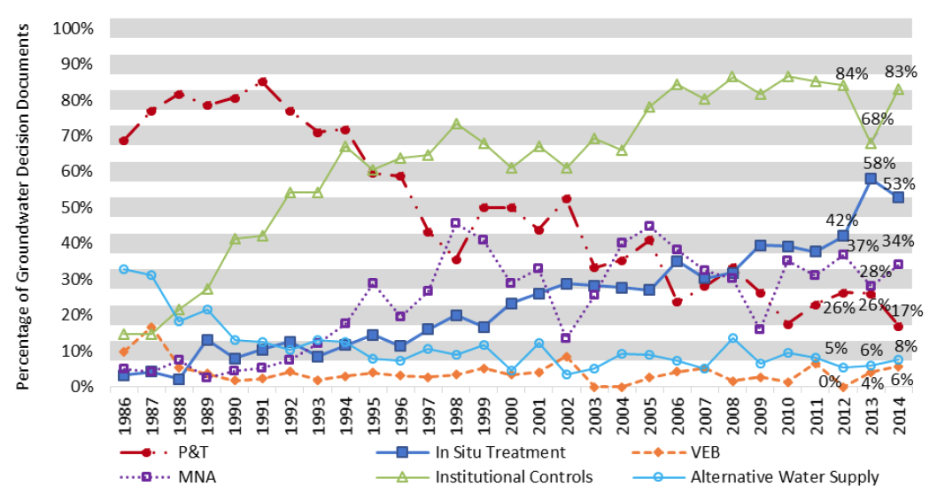
Selection Trends for Decision Documents with Groundwater Remedies (FY 1986-2014 NPL Sites)
EPA-Superfund Remedy Report (SRR) 15th Edition (EPA 542-R-17-001), July 2017

Slide 5
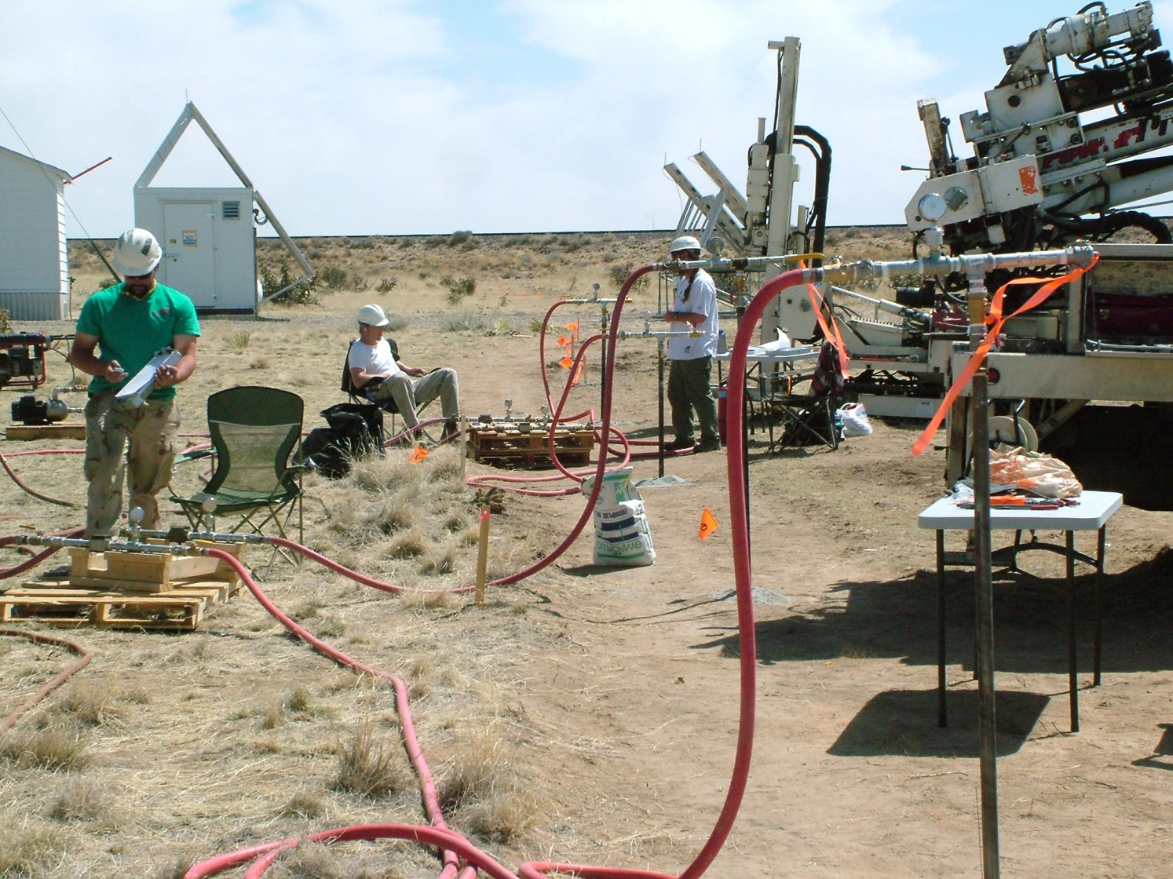
The In-Situ Treatment Revolution!
Brought About by Innovation
Amendment Injections
  In-Situ Chemical Oxidation (ISCO)
  In-Situ Chemical Reduction (ISCR)
  In-Situ Bio-Remediation or Bio-Reduction (ISBR)
  Surfactants & Combined Remedies
Hydraulic Fracturing / Emplacement
  Similar Amendments & Treatments
  Enhanced Permeability (Sand Proppants)
Too Often are Improperly Applied!
Notes:
In-situ technologies include the methods listed in the slide. Some of these methods, such as the permeable reactive barriers, also require significant surface access and disturbance. There are many chemical and bio-chemical applications that can be applied using injections and hydrofracturing methods.

Slide 6

Why In-Situ Injection of Treatments?
Limited or No Disposal Issues
In Place Destruction of Contaminants
Less Invasive - Works Around Infrastructure
Many Work with Natural Environment
Direct Push Injection Advancements
Improved Understanding of Hydraulic-Fracturing
Improved Monitoring Methods,
So….. Seen as Faster, Cheaper and it’s……
Greener & Sustainable Technology!
Notes:
In-situ injection and hydrofracturing technologies have applicability in a greater range of depths, lithology types, and are easier to do around infrastructure, buildings, and active sites. This makes them more attractive to the site owner and consulting engineer. The methods typically have a relatively small energy/carbon foot requirement. There are no disposal issues and destruction of the contaminant is done in place most leaving behind completely innocuous breakdown compounds. Many treatments are simply nutrients and supplements to accelerate natural breakdown of the contaminants while other chemically oxidize the contaminants. Advancements in injection technology, hydrofracturing and monitoring of these systems has significantly improved the success of in-situ methods.

Slide 7
In-Situ Remediation:
It’s a Contact Sport!
HOME TEAM: Contaminated Soil & Ground Water
VISITING TEAM: Treatment Reagents

Slide 8
Trivia #1: Adsorbed Phase vs. Dissolved Phase Contaminant Loading
Soil and Ground Water Concentration (ppm)
Contaminant Load
(mg / cu. ft.)
If you design to only treat the dissolved phase contaminant, you get REBOUND

Slide 9
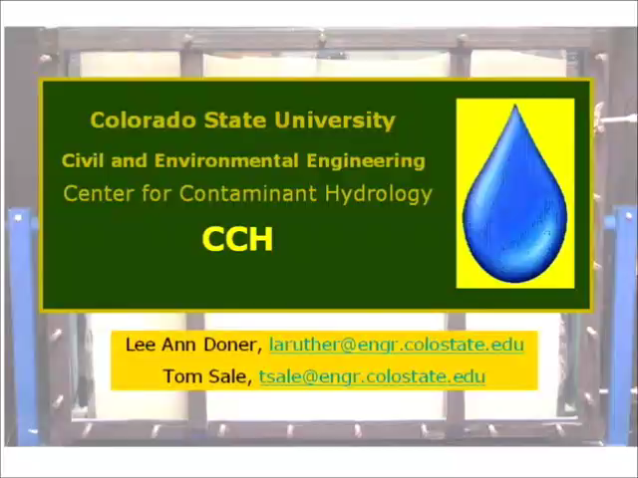

Trivia #2: Back Diffusion from Clays = REBOUND (Consider Mass Flux Discharge in RDC)
Courtesy Tom Sale, PhD, Colorado State University (Go RAMS!)

Slide 10

Remedial Design Characterization –
Critical for Success
Don’t Go In Blindfolded and Miss the Target
But… My Site is Already Characterized!
  Yes, in 2-D, but we need to fill DATA GAPS for the Remedial Design!
Most Important: 3-D Contaminant Distribution and Mass
Lithologic & Hydrologic Parameters in greater detail
Chemical Compatibility for certain treatments is unknown
  Natural Oxidant or Reductant Demand, e⁻ Donors & Acceptors
  Geochemistry/Biochemistry – Bug Populations/Nutrients
Errors result in significant under- or over-dosing – or both!
A vertical and horizontal 3-D image of the site contaminant, geology and geochemistry is required!
Notes:
Quite often the initial site characterization data is used to design the remediation. While this data is adequate to characterize the shape and extent of a plume, its often does not provide the 3-D data required to accurately calculate the total mass of contaminant, the total amount of treatment chemicals required to attack it, and the distribution of the mass to be targeted. This will result in significant over-dosing or under-dosing of the treatment or missing key hot spots. There are other considerations such as chemical oxidant demand of the soils and chemical compatibility of certain soil or rock types.

Slide 11
The Goals of a RDC
Determine:
Where the Contamination is Located
  Vertical and Horizontal Distribution
How Much Mass is There to Treat (Dosing)
Physical, Chemical & Biological Parameters as Needed for Specific Treatments. (SOD, COD, etc.)
If Back Diffusion Affects the Reagent Type
Delivery Methods Based on Soil/Rock Types & Degree of Heterogeneity

Slide 12
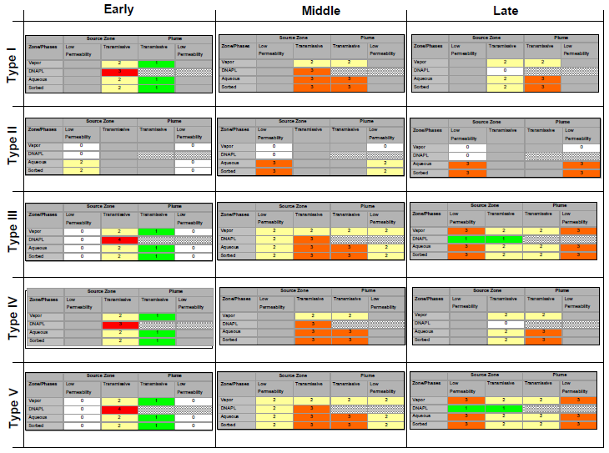
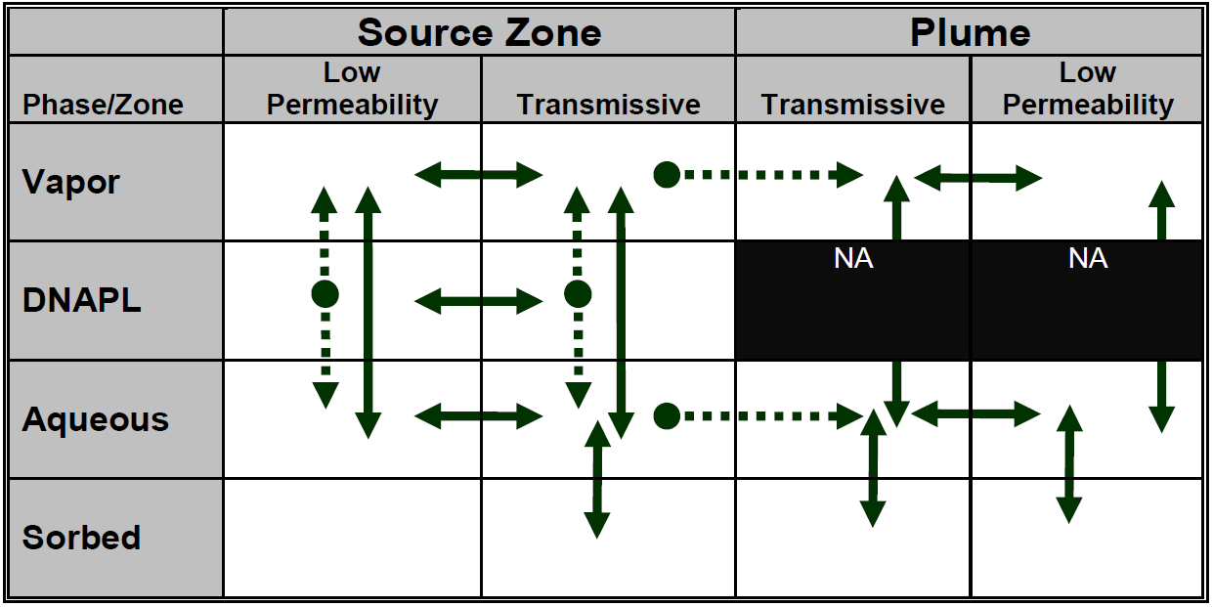

The 14 Compartment Model
http://estcp14cmodel.com/
SERDP – ESTCP Tools
Where contaminant mass is present
Where its going
Take this into account when designing a treatment program.

Slide 13
Applying RDC Data to In Situ Remediation Treatments
Now we know where the contaminants are and how much is there, so now we need properly targeted & applied treatments.
Old vs. New Application Methods
Conventional Injections vs. Hydraulic Fracturing Methods

Slide 14
Use High Resolution Data to Create “Decision Units” for Treatment Dosing
Injection Depth | Area A 500 sq. ft, 5 pts. | Area B 1,500 sq. ft, 15 pts | Area C 4,000 sq. ft. 40 pts.
12’
14’ | 10 lbs | 25 lbs | 10 lbs
16’ | 40 lbs | 40 lbs | 25 lbs
18’ | 25 lbs | 25 lbs | 25 lbs
20’ | 10 lbs | 10 lbs | 10 lbs
22’ |  |  | 10 lbs

Slide 15

“Early” In-Situ Injection Methods
New Treatments on the Market
Existing Monitoring Well Network
  Socks
  Gravity Feed
  Injections in it’s Infancy
Open Auger Bore Holes, Open Pits, Trenching
Dedicated Injection Wells using HSA
We used what we had!
Notes:
When chemical treatments first came on the market, the method of in-situ applications were crude and had limited effectiveness. The most common issue with in-situ treatment is not making contact between the contaminant and treatment. Many methods were simply based in using what was already available such as putting the treatment in an open pit, or pouring it down a well. Dedicated injection wells installed using HSA were considered too expensive and as a result spacing was not adequate to make physical contact.

Slide 16


Bottom Up Injections in
Non-Ideal (Common) Conditions
Less Porous & Permeable Soils
Preferential Bedding Planes
Fracturing May Occur
Coarsening Downward
Path of Least Resistance
Clayey Formation
Sandy Formation
Notes:
Quite often, the heterogeneity of the formation will cause the injected fluids to take the path of least resistance and the most of the treatment may be applied to the zone with the least amount contaminant, wasting the treatment chemicals.

Slide 17
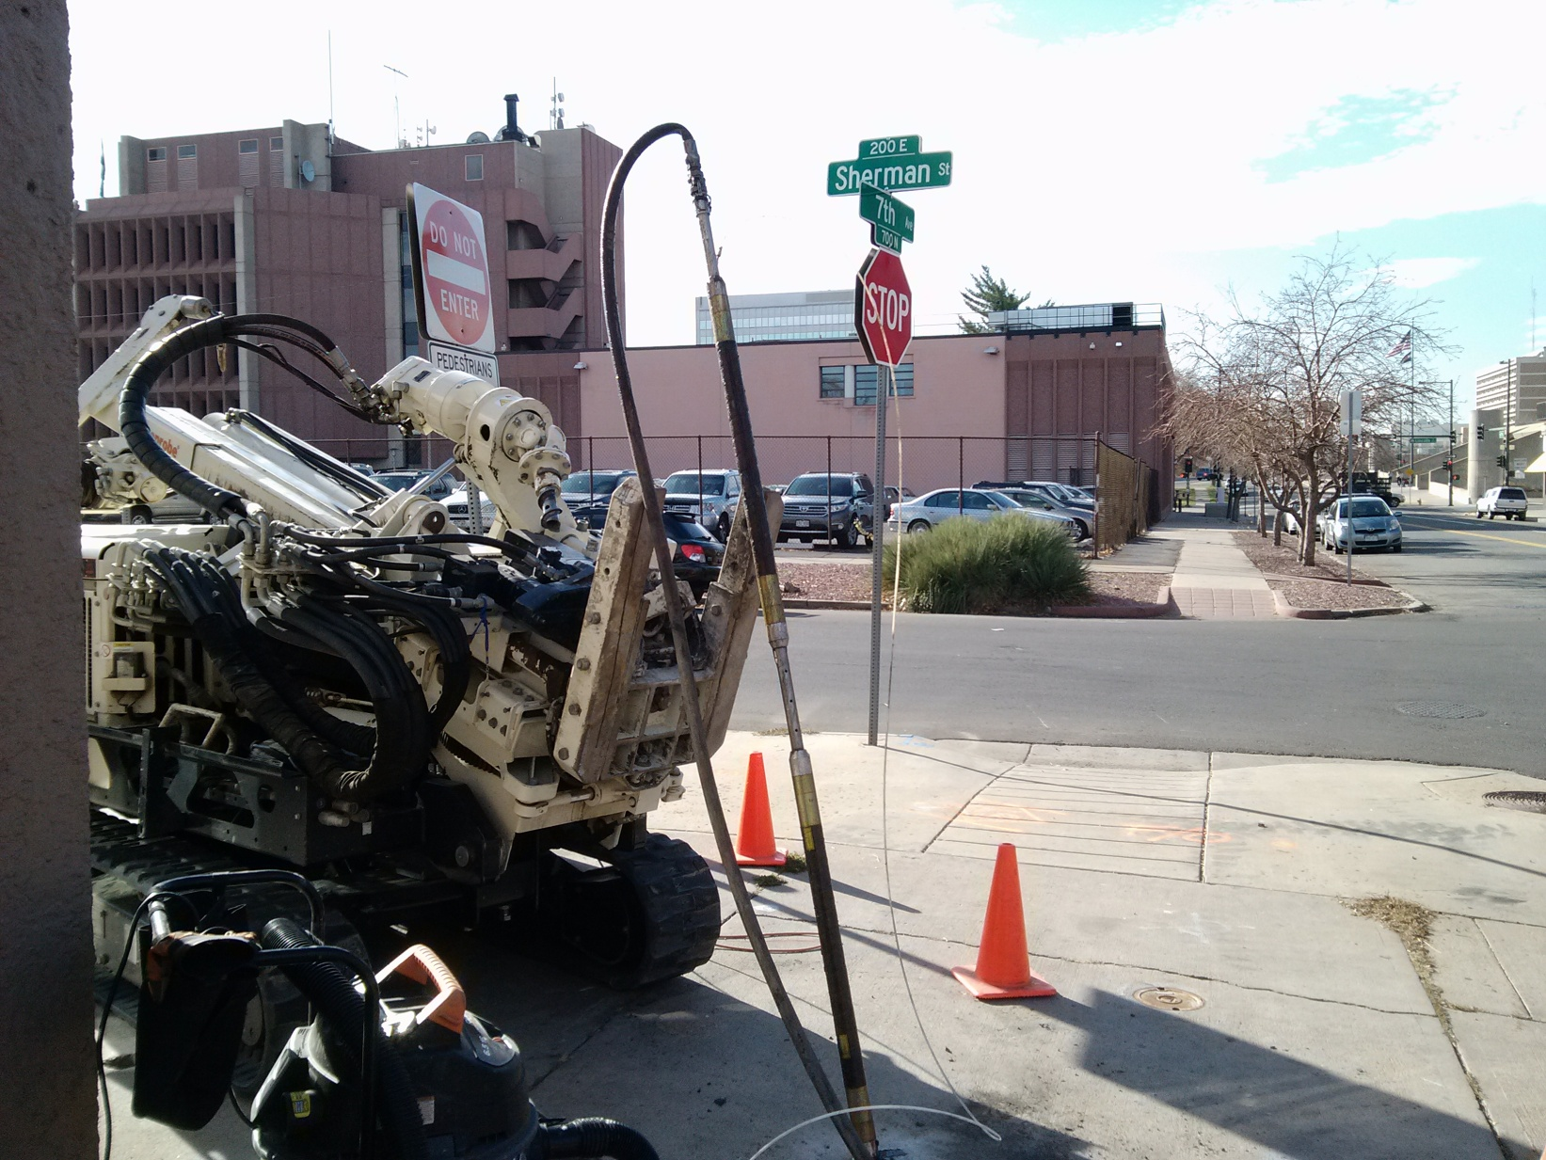
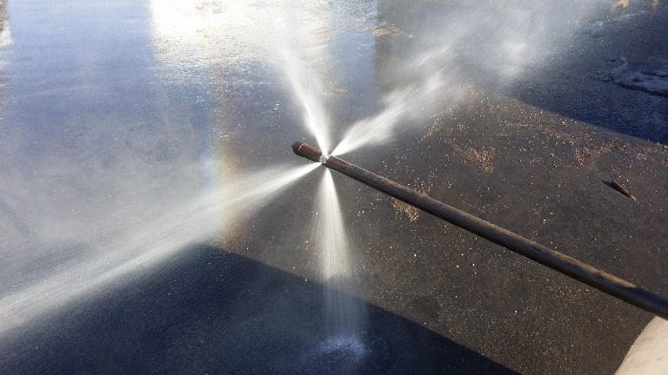
SOLUTIONS: Surgical Injection Methods
Top-Down Injections Tools
High Pressure, High Flow
Straddle Packers
Isolated Intervals

Slide 18
SOLUTIONS: Improved Injection Methods
Top Down Injection or Discrete Placement Tooling
Seals Off Intervals
Precise Placement
Slower Application
= BETTER CONTACT!
Clayey Formation
Sandy Formation
Notes:
These improvements now allow the injection into these more heterogeneous formations and improve the contact between the treatment and contaminant.

Slide 19
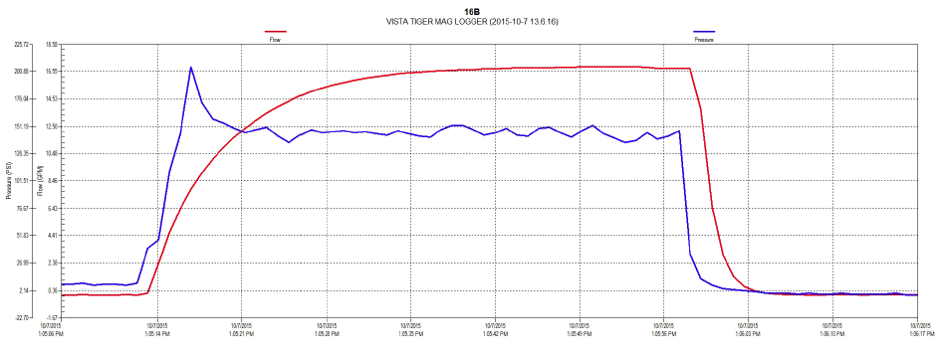
Exceeding Overburden Pressures
(Low Perm Formations / Bedrock)
Permeable Formation take higher flows at lower pressures
Tight Formations will require higher pressures to gain flows and will more likely create horizontal fractures with a larger ROI.
Clayey Formation
Sandy Formation
Notes:
In tight formations or bedrock where injections require higher pressures than the overburden, fracturing of the formation will result and will generally follow a horizontal plane and preferential bedding planes. This can be used to an advantage as long as the applicator is aware of this situation. This also causes the remediation to fall under certain patents that cover hydrofracturing for the purpose of remediation.

Slide 20
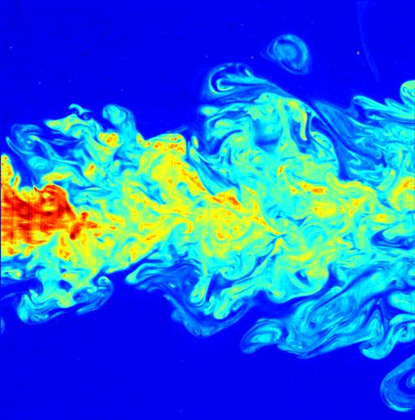
Injection of Slurries (Solids) into Unconsolidated Coarse Sand/Gravels
Liquids follow granular pore space paths.
Slurries may filter out or “block off” porosity at low flow, solids drop out.
High Velocity Injections can create additional mixing and extend ROI
Coarse Sand Formation
20

Slide 21
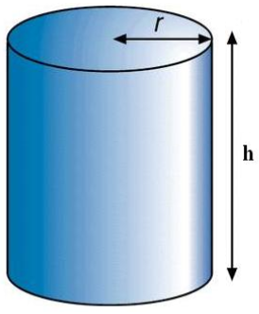
Radius of Influence (ROI) Calculations;
(Displacement vs. Pore Flow)
10’ Injection Grid:
  Radius = r = 5’
  Area = πr²
  Vertical Treatment Interval = h = 2’
  Assuming Effective Porosity ≈ 20%
  Volume conversion: 1 ft³ = 7.48 gallons
Therefore:
  Volume = π(5’)² x (2’) x (0.2) = 31.42 ft³
  Pore volume = 31.42 x 7.48 = 235 gallons
  A 50 gallons injection = about 21% of pore volume.
HOWEVER: ROI is more a function of what % of the formation fractures during injection (displacement) vs. fluids that move through pore spaces.

Slide 22
Triangular vs. Square Injection Grids
(Surface View)
Square Grid Triangular Grid

Slide 23
Staggered Top-Down Injection Intervals

Slide 24
Will We Move Contaminants?
Yes, but not far from empirical evidence.
Remember: Most of the mass is generally sorbed.
Start injections from outer edge of plumes.
Bounces around injection grids, do not move from one point to the next, or one side to the other.
Possible Exceptions? High volume dilute injectates such as diluted emulsified vegetable oils. NAPL

Slide 25
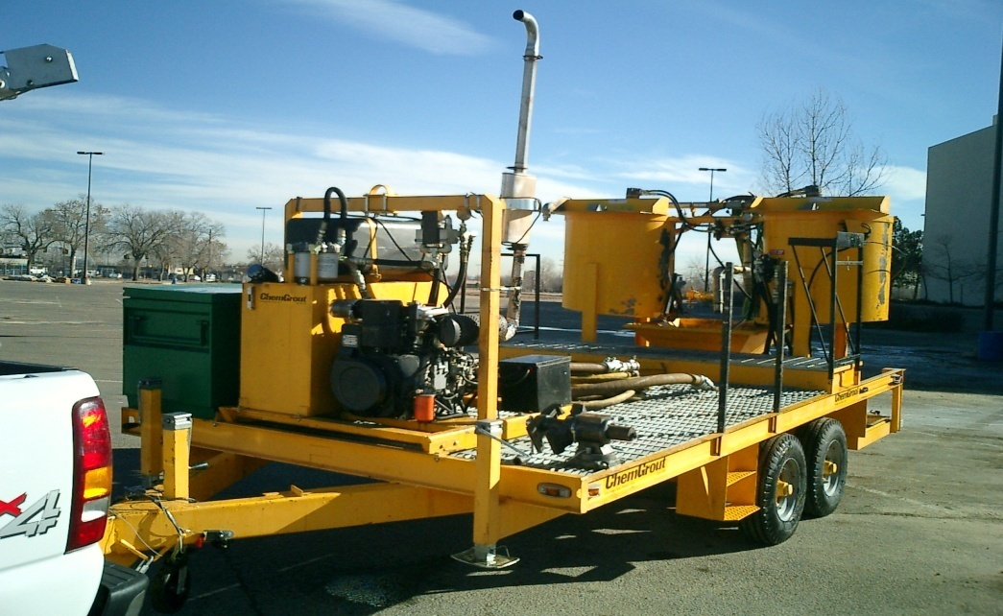
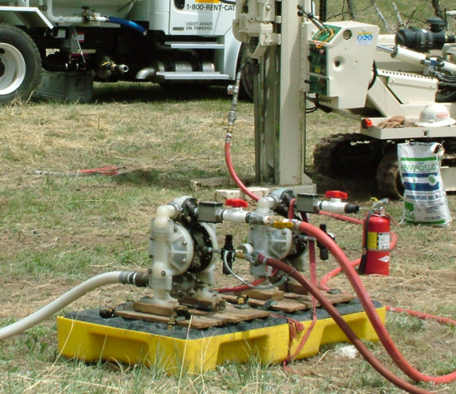
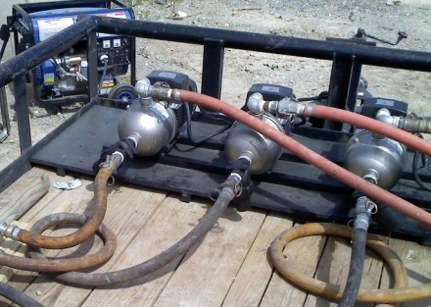
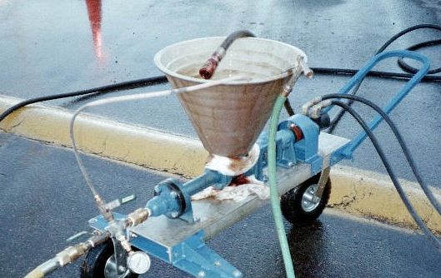
Optimized Pumping & Mixing Systems
Use the right system for the right job!
High-Pressure/Low Volume?
High-Volume/Low Pressure?
Liquids vs. Slurries/Solids?
Corrosive Chemicals
In-Line Activator Mixing
Many Pump Types (Progressive Cavity, Piston, Diaphragm, Centrifugal, to name a few)
Experiment with flow rates and pressures to reduce surfacing of product.
Lower flows may INCREASE surfacing.
Notes:
A wider variety of pump types are now available for injecting anything from a thin liquid to a suspended sand. Higher volumes can be achieved where the formation allows it and higher pressures can be applied where the formation requires it. Some pumps are able to handle more corrosive chemicals. Some treatment activators require in-line mixing because they cannot be premixed in advance of injections.

Slide 26
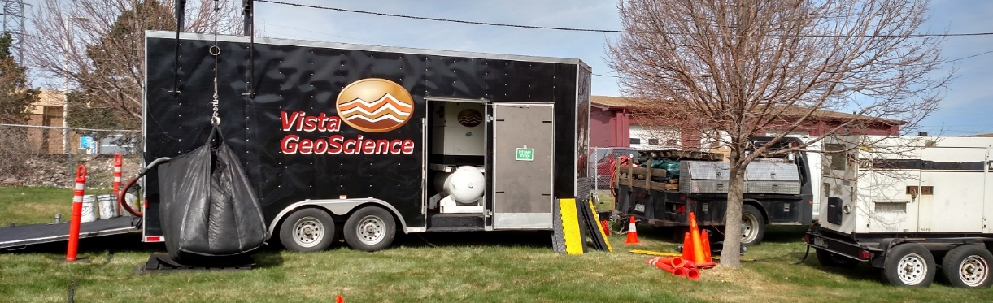
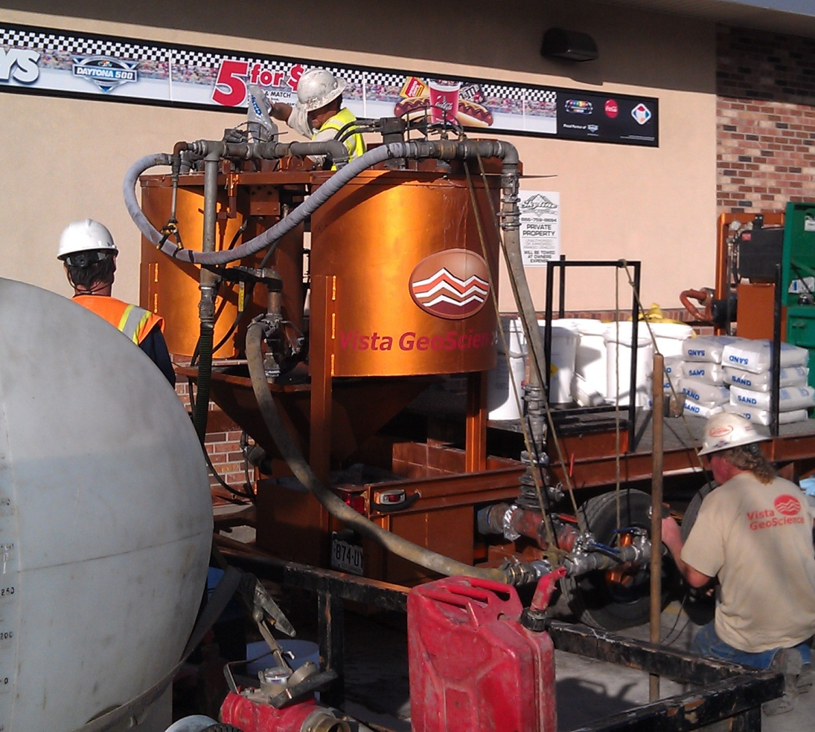
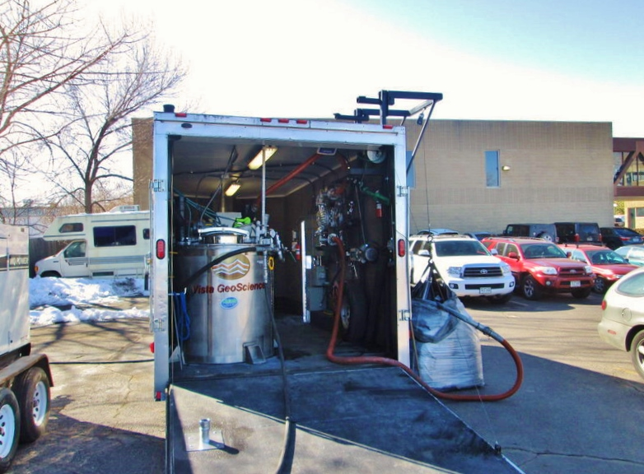

Slurry (Powders & Solids)
Mixing & Pumping Systems

Slide 27
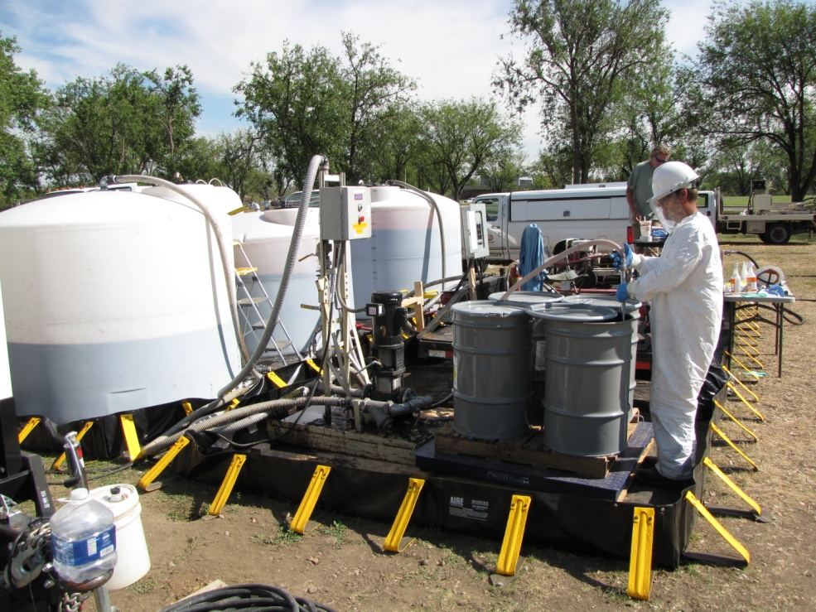
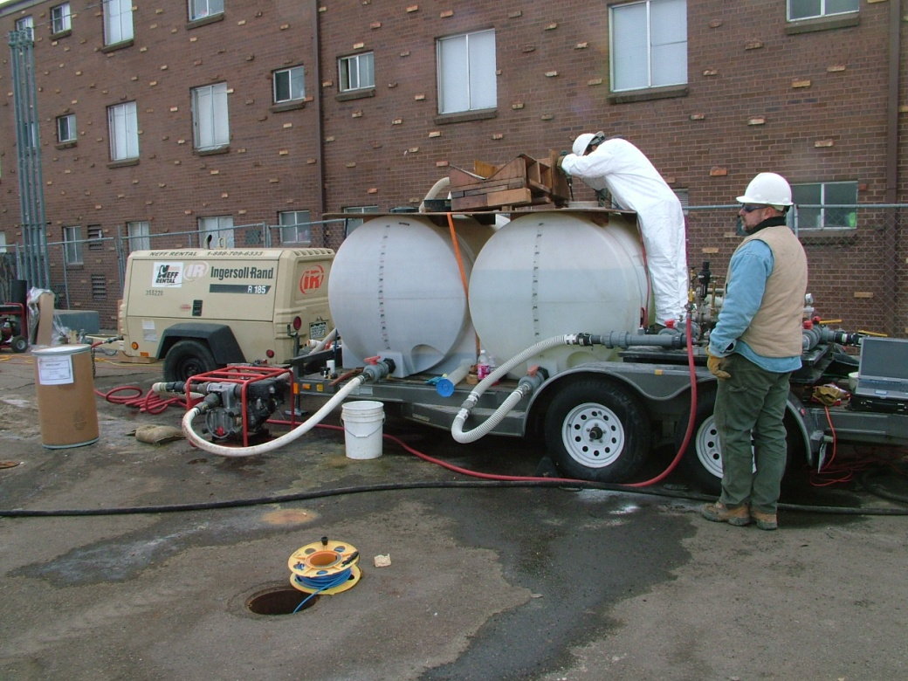
Safe Oxidant Mixing Systems
Caustic/Acid Mixing
In-Line Blending
Spill Control Plans / Containment
Neutralizers on Site
Additional PPE
Stainless or PVC Fittings
Exothermic & Gas Reactions - Temperature Monitoring/Control

Slide 28
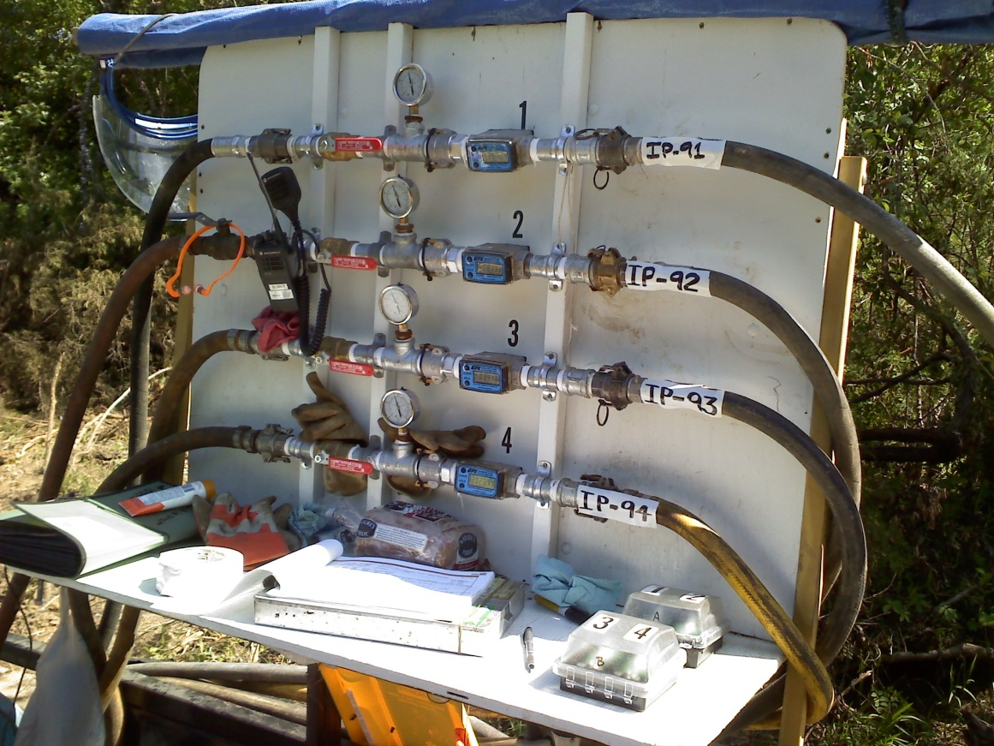
Simultaneous Injection Points for High Volume Applications

Slide 29
Hydraulic Fracturing Emplacement
For Injection of Suspended Solids Treatments in Tighter Formations or Bedrock
To Increase Permeability or Create Permeable Treatment Zones, Barriers or Cells.

Slide 30
Hydraulic Fracturing Emplacement
Remediation Applications
Air Sparge (AS) or Soil Vapor Extraction (SVE)
  Sand or Synthetic Proppant Support
Bio-Remediation Treatment Flow Cells
  Sand or High Surface Area Synthetic Proppants
  Nutrient Additives, Organic Carbon,
  Activated Carbon + Nutrients
Chemical Treatment Flow Cells
  Optional Proppant Fracture Support
  Solid Chemical Slurry Injections

Slide 31
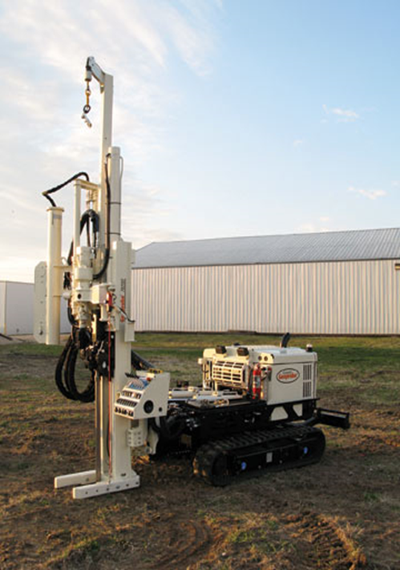
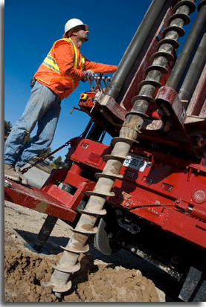
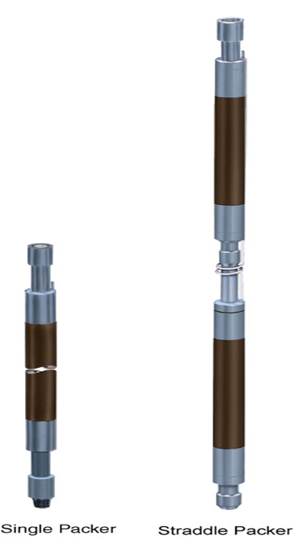

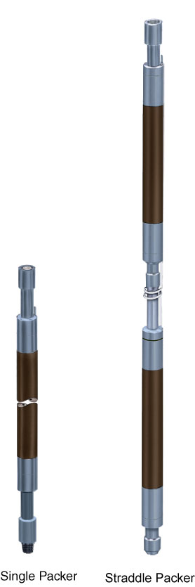
Direct Push (DPT) or Auger/Rotary Hole + Packers for Hydraulic Fracture Installations

Slide 32
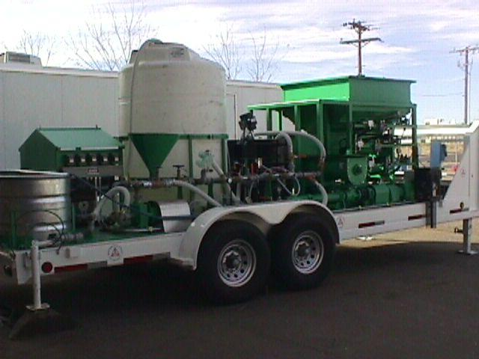
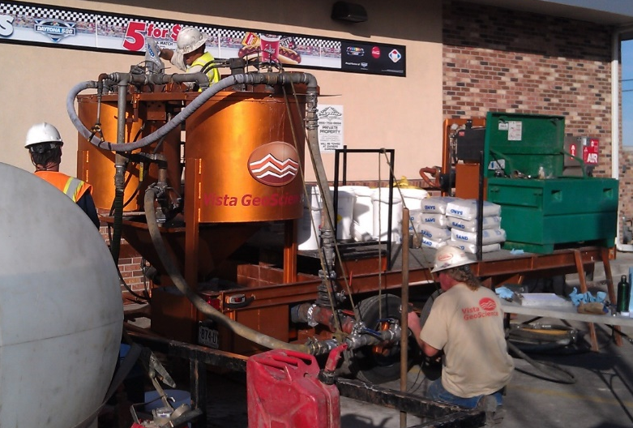
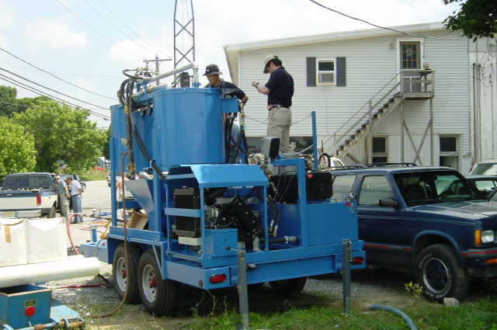
In-Situ Fracture Injection/Pump Rigs

Slide 33
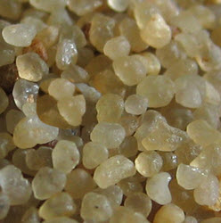
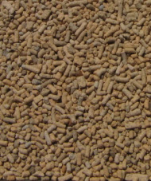
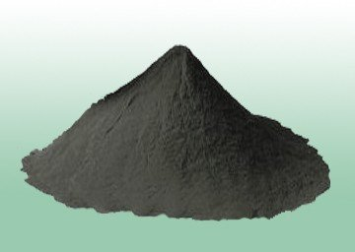
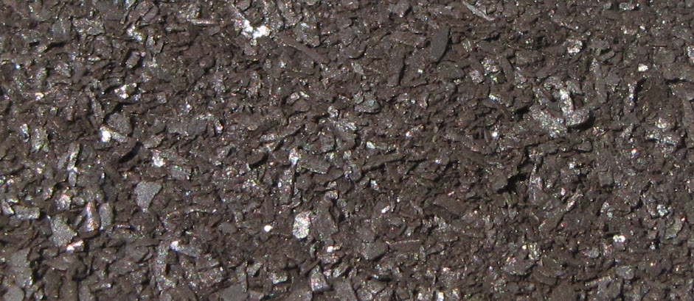
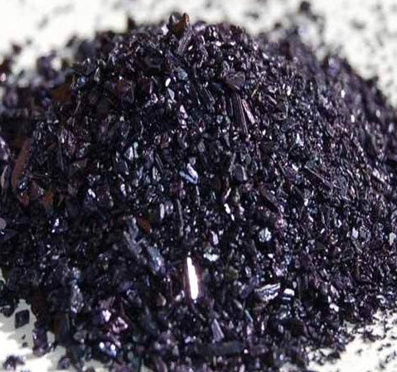
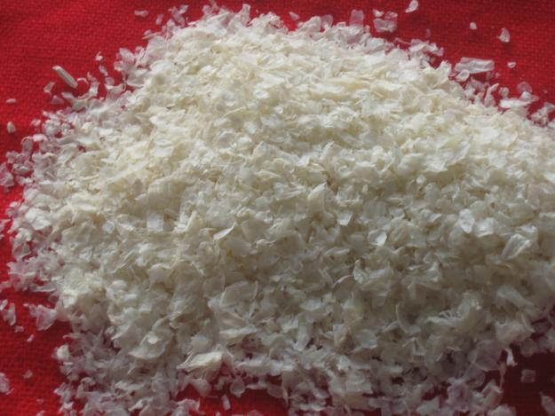
Proppants
Inert or Reactive
Mixtures of:
  Silica Sand
  Porous Ceramic (Isolite™)
  Activated Carbon +?
  Zero Valent Iron
  Potassium Permanganate
  Chitin (Polysaccharide)
  Bacteria Augmentation

Slide 34
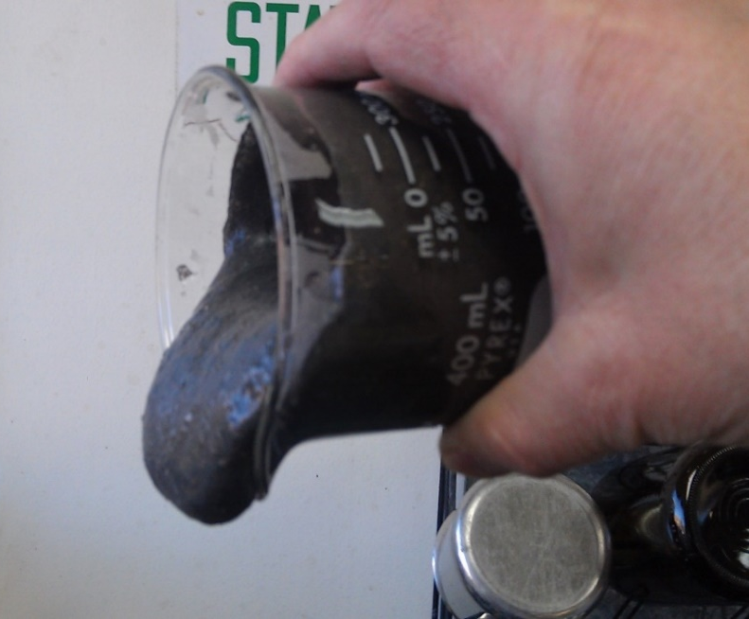
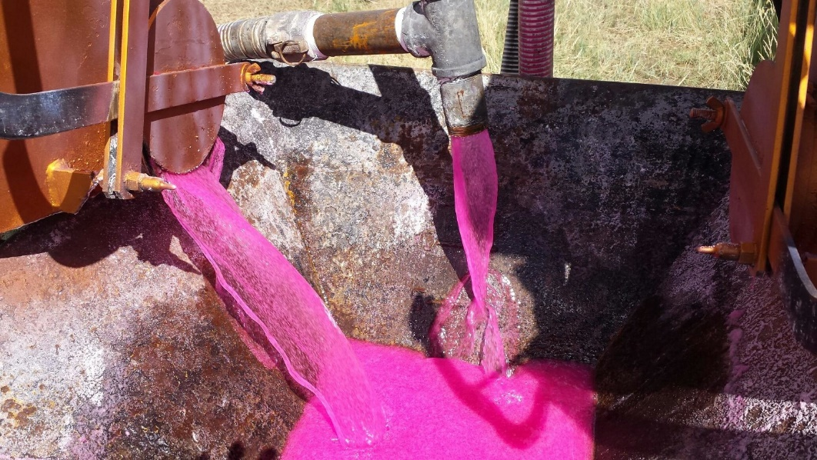
When Proppants are Used, Cross-Linked Guar-Gum is Used to Suspend the Proppant

Slide 35
Performance Monitoring
Monitor Injection Pressure & Flow during injections
Monitor Temporary Piezometers & Monitor Well Levels
Post Injection Confirmation Coring – ROI – Where did it go?
Adding Dye Tracer to Injection Fluids
OIP Visual Logging to Map Distribution of Visible Slurries
Performance Monitoring should be part of the Game Plan.
Allow for adjustments on the fly during the treatment phase on larger scale projects.
Combined Methods or Phased Approach may be appropriate for some sites.

Slide 36


Ex. #1: 3400 York Street; Denver,
Former Gas Station
CDLE-OPS Event No. 11494
Release Discovered During Tank System Removal, August 2011
2nd Tank System Removed July 26, 2012; No Release Detected.
Co-Mingled with PCE Plume from Upgradient Dry Cleaner Site
New 7-Eleven Store Built Over Part of Plume Prior to Remediation
Relatively Deep (Groundwater at ~45’)
Team Partners:

Slide 37
3400 York Street; Phases of Work
Site Developer: “NOT WAITING,” New Building Going In
Chosen Remedy: Remediation Products BOS 200® (Activated Carbon, Nutrients, Bacteria Augmentation)
    RDC Sampling & Treatment Design
    Pilot Injection Test Conducted Near MW-1R, Former Tank Pit Area (May 2013)
    Full Scale Site Injection on Balance of Site (Nov. 2013)
    Post Injection Well Cleaning and Redevelopment
    Post Injection Sampling & Monitoring

Slide 38
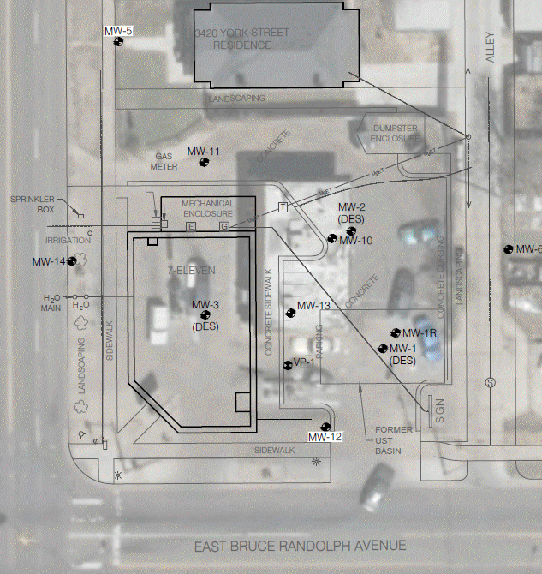

Overlay of New Building Plan on Former Gas Station Site
Courtesy CGRS Inc.

Slide 39
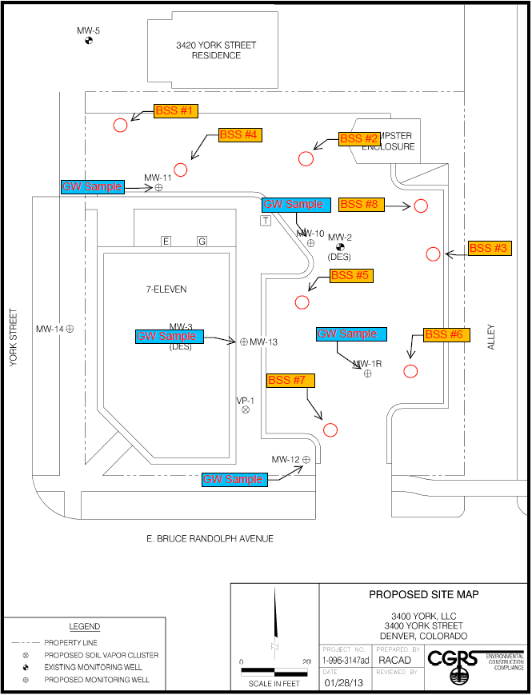
RDC Event
8 Continuous Soil Cores 5’ – 50’ in Treatment Area
  56 soil samples collected at 2’ composite intervals.
5 Monitor Wells Sampled in Treatment Area.
Analysis of 56 Soil & 5 Ground Water Samples:
  8260 VOCs (BTEX, MTBE, TVPH, PCE & Daughters)
  Sulfate, Chloride, Nitrate, Nitrite, Acetate (waters only)
Identified Shallow Vadose Contamination in Former Tank Pit Area.
Courtesy CGRS Inc.

Slide 40
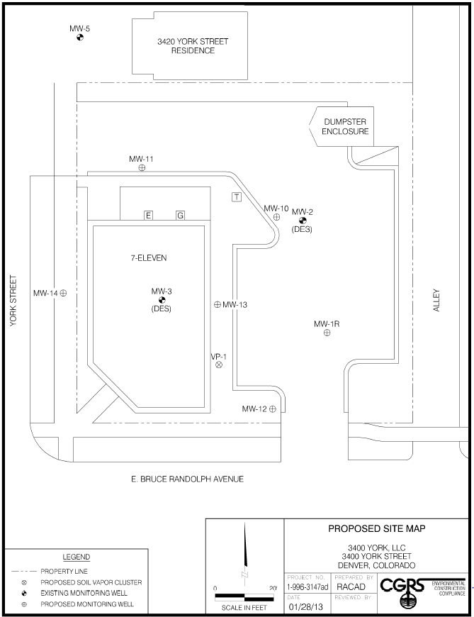
Injection Design
PILOT TEST: (May 2013)
Area A: MW-1R, former tank pit/source area; 12 pts, 15lbs/ft. 40’-50’
Total 1,800 lbs BOS200
FULL SCALE: (Nov 2013)
Area B1: 15pts, 10 lbs/ft, 40’-50’
Area B2: 16 pts, 7.5 lbs/ft, 40-50’
Area C: 42 pts, 5 lbs/ft, 40-50’
Total 4,650 lbs BOS200
Area C
Area B
New Building
Area A
Courtesy CGRS Inc.

Slide 41
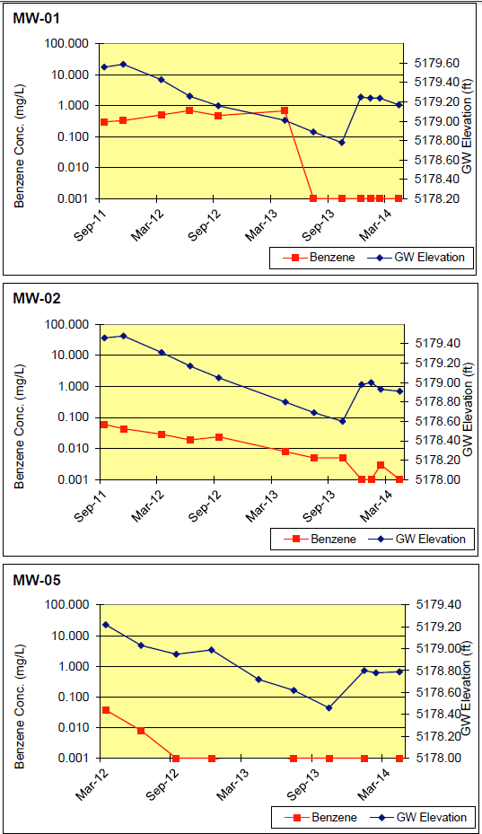
Results (Benzene ppb)
Source Well: Pilot Injection May 2013
SOURCE
MW-1R: 310-688 ➔ ND
  (PCE: 3330 ➔ ND)
MID-PLUME
MW-10/2: 8-60 ➔ ND-3
  (PCE: 6270 ➔1830)
MW-11: 2-3 ➔ ND
  (PCE: 2710 ➔ 11)
MW-12: 5-12 ➔ ND-3
  (PCE: 13900 ➔12900)
MW-13: 23-47 ➔ 3-6
  (PCE: 595 ➔ 1080)
NFA achieved in 2015 after post injection monitoring requirements
Mid-Plume Well: Full Scale Inj. Nov 2013
Off Site Compliance Well, No Treatment
Courtesy CGRS Inc.

Slide 42
Cost to Our Client (Labor & Materials)
$5,000
$16,000
$57,000
$78,000
RDC Sampling
Pilot Test
Full Scale
TOTAL:
= Cost Effective Cleanup – The First Time!!

Slide 43
Summary
In-Situ Treatment Success Rates are Significantly Improved by:
Performing a RDC phase to create a 3D CSM and design.
Applying Treatments Using Decision Units -Targeted Dosing.
Understanding ROI and Hydraulic Fracturing in Tighter Formations.
Utilizing Pilot Testing, Performance Monitoring Tools and Methods to Monitor Progress and Make Adjustments
= The Goal of Clean Up – The First Time!
It’s a Contact Sport, AND A TEAM SPORT !
Notes:
The above slide summarizes the preceding discussion.

Slide 44
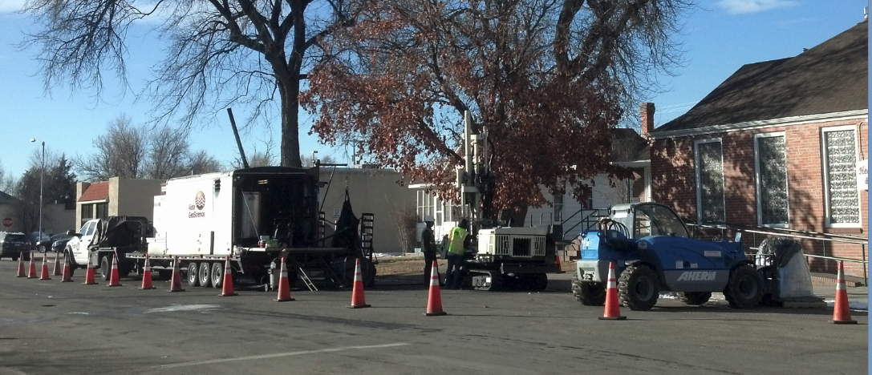
Questions ?
Improved Results for In-Situ Remediation Projects by Utilizing High Resolution Data, Injection, and Hydraulic Placement Treatment Methods – It’s a Contact Sport
Gulf Coast Region
Houston, Texas
(281) 310-5560
John Fontana, PG
JFontana@VistaGeoScience.com
Rocky Mountain Region
Golden, Colorado
(303) 277-1694
25th International Petroleum Environmental Conference Denver, Colorado
Oct 30 - Nov 1, 2018
Notes:
Numerous companies have provided information for this presentation and we’d like to thank all of them.

