Slide 1
ITRC’s TPH Risk Evaluation at Petroleum Contaminated Sites guidance - preview
Presenter / Team Program Advisor
  Roy Thun, P.G., ENV. SP. – GHD
  roy.thun@ghd.com
  Office: (661) 287-3855
Team Leaders
  Thomas F. Booze, Ph.D. – California Department of Toxic Substances Control
  Office: (916) 255-6653
  Michael Kwiecinski, P.G. – Colorado Division of Oil and Public Safety
  Office: (303) 318-8546

Slide 2
What is ITRC?
ITRC is a state-led coalition working to advance the use of innovative environmental technologies and approaches.
ITRC’s work translates good science into better decision making.
New Technology
Better Environmental Protection
Environmental Regulations

Slide 3


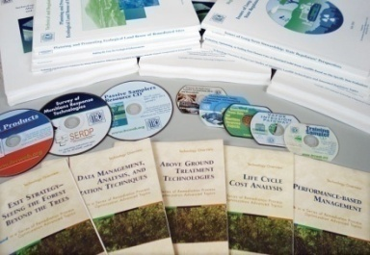


What ITRC Does
Implement solutions
Conduct training and outreach
Develop documents, trainings, and other products
Since 1995:
124 documents (including guidance documents, fact sheets, and case studies); 84 training topics and 859 classes
Form
teams
Select projects

Slide 4
ITRC TPH Risk Team Stats
235 members
130 Private Sector (industry & consultants)
56 State (25+ states)
21 Federal (DOD, DOE, EPA, USGS)
15 Academia
5 Public Stakeholder
5 International
2 City Government
1 Tribal Stakeholder

Slide 5
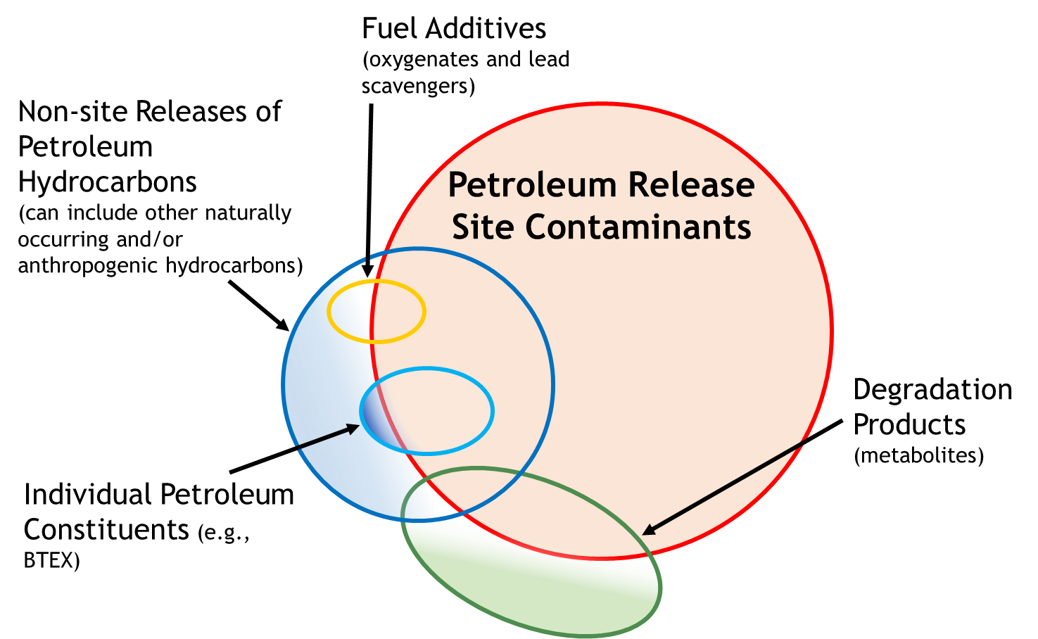
Contaminants at Petroleum Release Sites

Slide 6
Understanding TPH Risk
TPH is comprised of thousands of chemicals that are not yet well understood
Many states’ use Benzene, Toluene, Ethylbenzene, and Xylene (BTEX) to derive cleanup standards or evaluate risk
  Use of BTEX may not accurately identify the total risk associated with TPH

Slide 7
Purpose and Goal of ITRC TPH Risk Guidance
Purpose
  Facilitate better informed decisions for regulators and consultant project managers, who may not be skilled in risk assessment.
Goal
  Create better TPH risk guidance to help states develop consistent methodology.

Slide 8
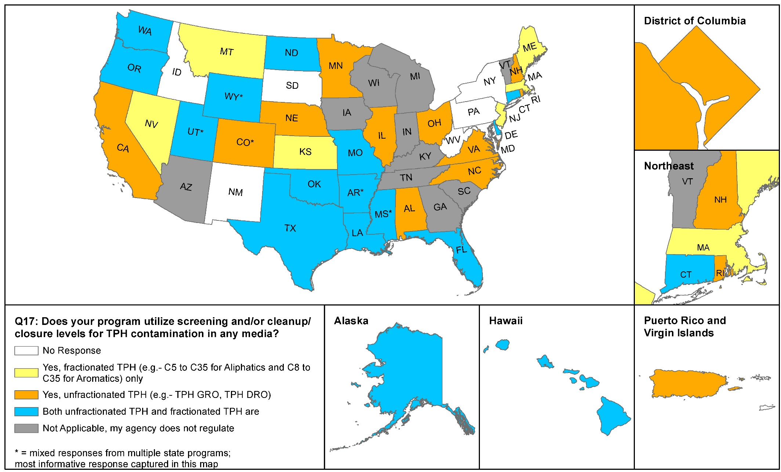
TPH is treated differently between states and within states

Slide 9
TPH Risk Guidance Table of Contents
INTRODUCTION
REGULATORY FRAMEWORK
TPH FUNDAMENTALS
CONCEPTUAL SITE MODELS AND INVESTIGATIVE STRATEGIES
HUMAN HEALTH RISK
ECOLOGICAL RISK ASSESSMENT
RISK CALCULATORS
SPECIAL CONSIDERATIONS FOR MANAGING TPH-CONTAMINATED SITES
STAKEHOLDER CONCERNS
TPH RISK CASE STUDIES
6 FACT SHEETS
APPENDICIES

Slide 10
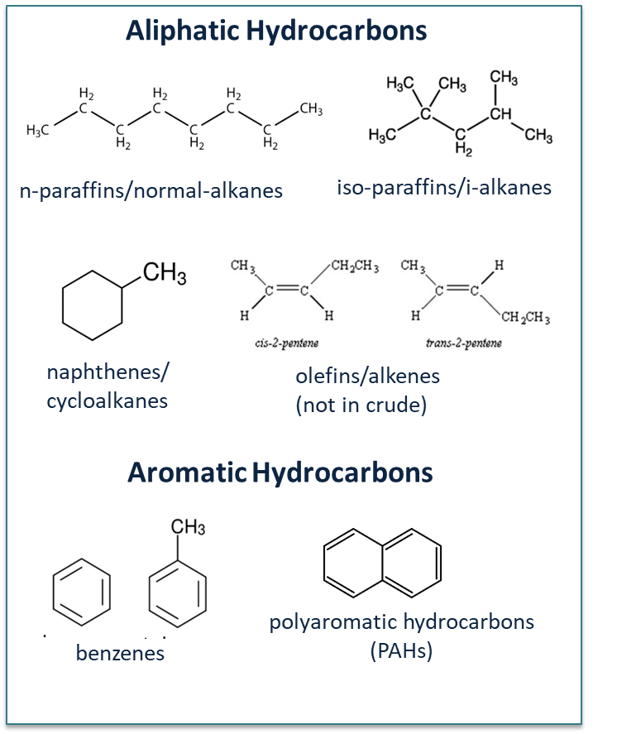
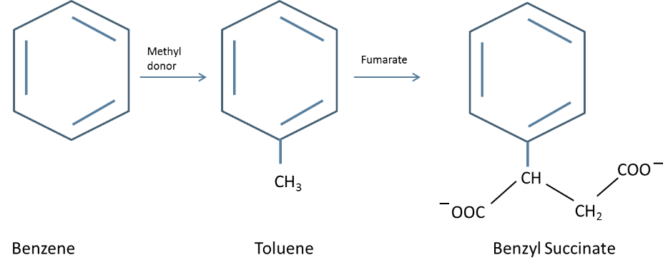
TPH Fundamentals
Two main groups of petroleum hydrocarbons
Metabolites are polar molecules with significantly different properties than hydrocarbons
Metabolite

Slide 11
TPH - Defined
TPH is defined as the known or assumed aliphatic and aromatic hydrocarbon mixture (e.g., crude oil, fuel type, mixture of fuel types) originally released to the environment, or the remaining aliphatic and aromatic hydrocarbon mixture after weathering thereof, for LNAPL in soil, and sediment sample matrices, and the dissolved hydrocarbons that have partitioned from the hydrocarbon mixture into groundwater or surface water for the water matrix, and the volatilized hydrocarbons that have partitioned from the hydrocarbon mixture or the dissolved phase to the soil vapor for the air matrix.

Slide 12
TPH - Defined
For the purposes of this guidance TPH is defined by the analytical method used to measure it.

Slide 13
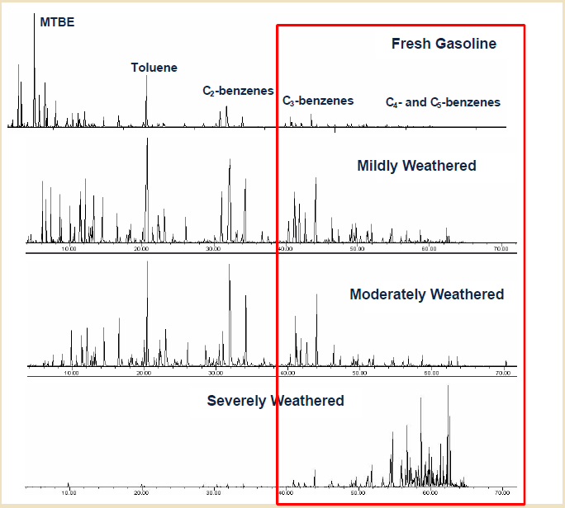
TPH – What’s in that number?
Weathering of Gasoline
Metabolite influence

Slide 14
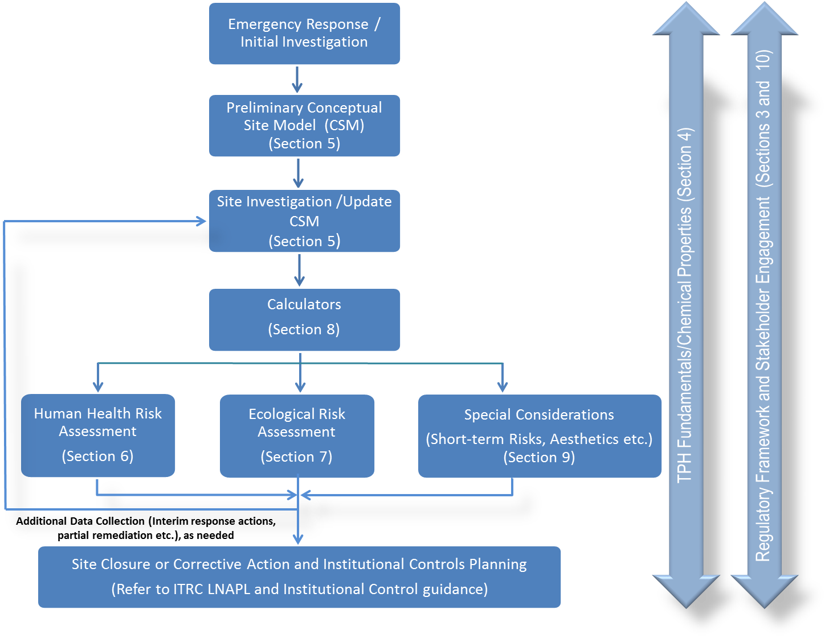
Decision Framework

Slide 15
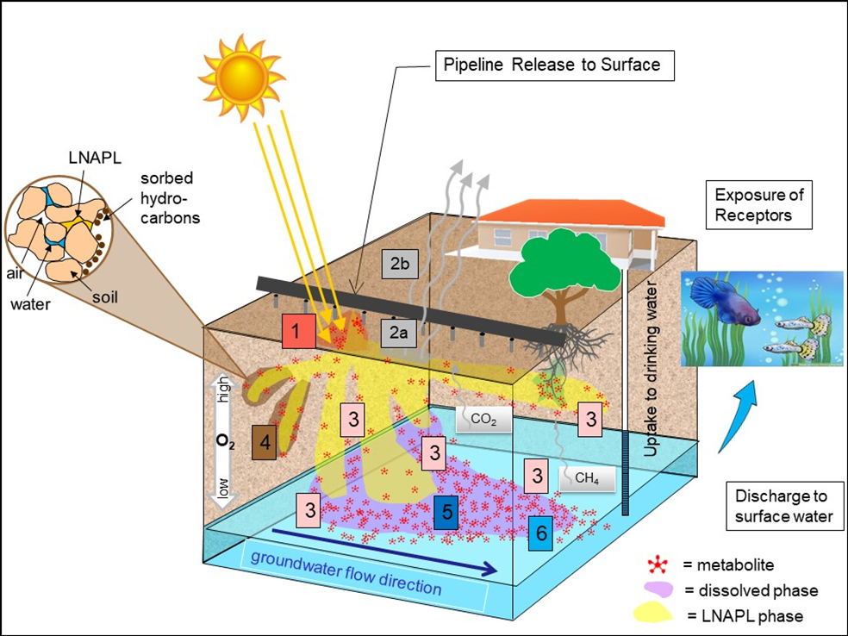
Conceptual Site Model
TPH is a complex mixture
  Weathering from chemical, physical and biological processes changes composition over time
  Composition affects risk

Slide 16
Analytical Methods vs Toxicity Values
 |  | Aliphatic |  |  |  |  |  |  |  |  |  |  |  |  |  |  |  |  |  |  |  |  |  |  |  |  |  |  |  |  |  |  |  |  |  |  | Aromatic
Carbon Chain Length |  | 5 | 6 | 7 | 8 | 9 | 10 | 11 | 12 | 13 | 14 | 15 | 16 | 17 | 18 |  | 19 | 20 | 21 | 22 | 23 | 24 | 25 | 26 | 27 | 28 | 29 | 30 | 31 | 32 |  | 33 | 34 | 35 | 36 |  | 5 |  | 6 | 7 | 8 | 9 | 10 | 11 | 12 | 13 | 14 | 15 | 16 | 17 | 18 | 19 | 20 | 21 | 22 | 23 | 24 | 25 | 26 | 27 | 28 | 29 | 30 | 31 | 32 | 33 |  | 34 | 35 | 36
USEPA 8015B | TPH-g | TPH-g |  |  |  |  |  |  |  |  |  |  |  |  |  |  |  |  |  |  |  |  |  |  |  |  |  |  |  |  |  |  |  |  |  |  | TPH-g
 | TPH-d |  |  |  |  |  | TPH-d |  |  |  |  |  |  |  |  |  |  |  |  |  |  |  |  |  |  |  |  |  |  |  |  |  |  |  |  |  |  |  |  |  |  |  | TPH-d
 | TPH-mo |  |  |  |  |  |  |  |  |  |  |  |  |  |  |  |  |  |  |  |  | TPH-mo |  |  |  |  |  |  |  |  |  |  |  |  |  |  |  |  |  |  |  |  |  |  |  |  |  |  |  |  |  |  |  |  |  |  | TPH-mo
Fractionation | VPH
 | EPH
MA Toxicity Category |  | Aliphatic C5-C8 |  |  |  | Aliphatic C9-C18 |  |  |  |  |  |  |  |  |  |  | Aliphatic C19-C36 |  |  |  |  |  |  |  |  |  |  |  |  |  |  |  |  |  |  |  |  |  |  |  |  | Aromatic C9-C10 |  |  |  |  |  |  |  | Aromatic C11-C22
US EPA Toxicity Category |  | Aliphatic Low |  |  |  | Aliphatic Medium |  |  |  |  |  |  |  |  |  |  | Aliphatic High |  |  |  |  |  |  |  |  |  |  |  |  |  |  |  |  |  |  |  |  | Aromatic Low |  |  |  | Aromatic Medium |  |  |  |  |  |  |  | Aromatic High
Analytical fractions intervals do not coincide with TPH toxicity categories

Slide 17
Calculating Risk
Discussion of calculators for assessing risk and developing screening values
Includes a discussion and comparison of several calculators
Narrow-down Site Specific Target Levels (SSTLs) for TPH; avoid remediating to Tier 1 values

Slide 18
Human Health and Ecological Risk Uncertainties
TPH risk evaluations considerate of uncertainties:
  CSM accuracy
  Data quality
  Toxicity assumptions
  Exposure assumptions

Slide 19
Inform public stakeholders
Stakeholder Communication
Tools on communicating risk issues with the public
Provides contextual framework of risk relative to common products that contain petroleum compounds

Slide 20
Fact Sheets
6 fact sheets included in guidance
  Definition TPH – Don’t Let the Name Fool You
  Silica Gel Cleanup (SGC)
  TPH Analytical Methods
  Chemistry of Weathering Processes
  Chromatograms: A Wealth of Information
  TPH Fractionation Methods

Slide 21
The “Go To” guidance for TPH Risk
  Regulators
    Decision-making framework specific to TPH
  Consultants
    Simple screening to robust TPH focused CSM
  Industry
    Better informed liability management
  Stakeholders
    Tools and communication techniques

Slide 22
Internet Based Training
  Learn ITRC’s approach to evaluate TPH Risk
    Select the appropriate analytical methods and recognize their pros and cons
    Effectively develop and evaluate a TPH focused CSM
    How to evaluate Polar Metabolites
    Toxicity considerations for Human Health and Ecological Risk Assessments

Slide 23




Thank You!
Stay updated on ITRC’s activities:
itrcweb.org
facebook.com/itrcweb
@ITRCWEB
linkedin.com/
company/itrc

