Slide 2
Horizontal System Advantages in Sampling and Remediation
.
Overhead obstructions or subsurface utility issues
Client concerns over
Business disruption or site security
Physical limitations related to the built environment, or natural terrain

Slide 3
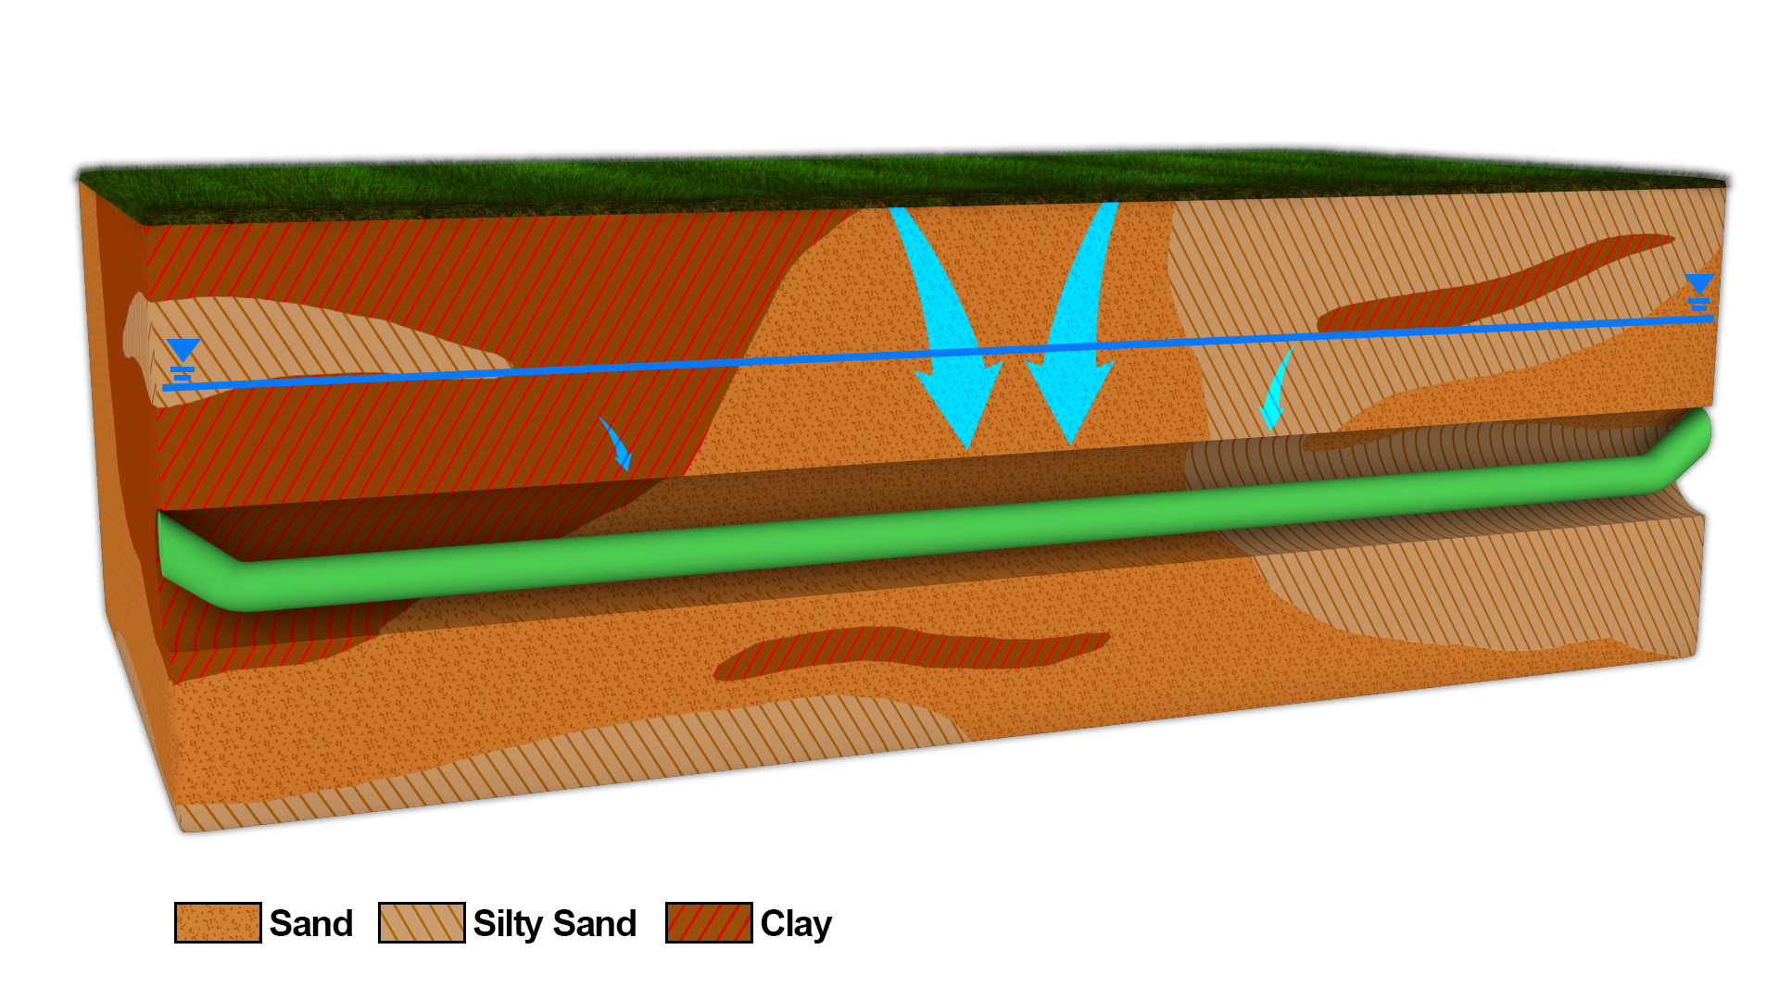
Single horizontal units are very susceptible to preferential flow path influences.

Slide 4
Subsurface Variability is a Challenge
Subsurface is highly variable and permeability can vary many orders of magnitude.
Small changes in permeability can have major impacts on fate and transport of contaminants in liquid and gaseous phases.
It follows suit that treatment involving reagent distribution are likewise impacted.
Sand
Silt
Clay

Slide 5
VertebraeTM Definition and Overview
Nested Horizontal Wells
Segmented design/isolated wells
Investigation Technology
Sample soil gas and groundwater
Remediation Technology
Sparge and/or inject liquid reagents
Extract soil gas and groundwater

Slide 6
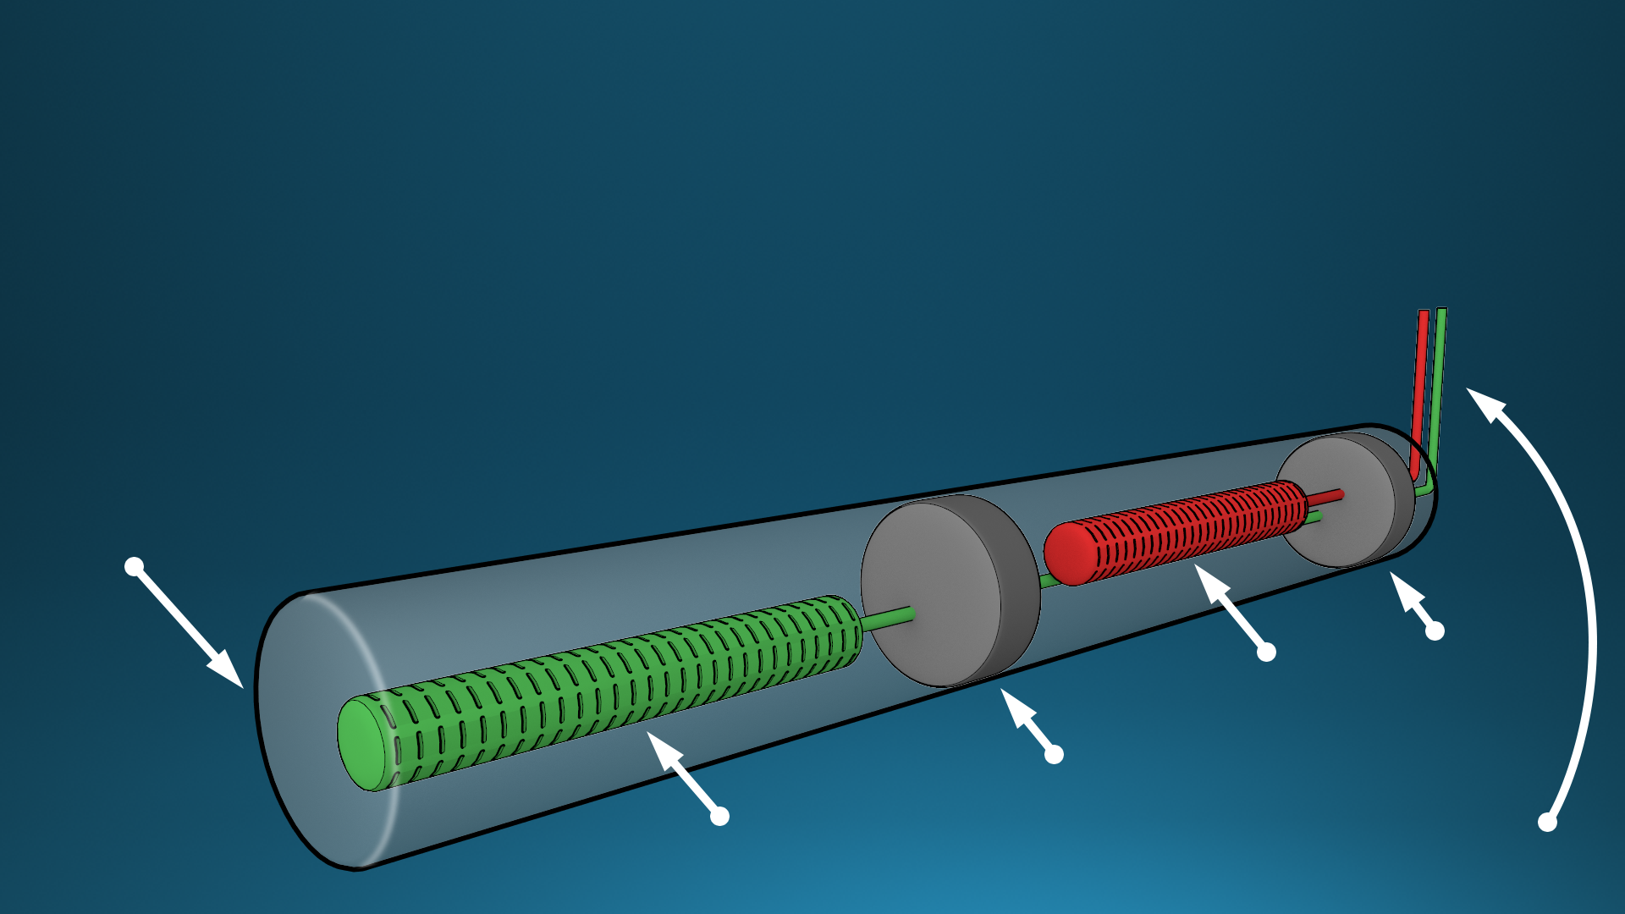
VertebraeTM Simplified Subsurface Model
Nested wells are discrete, using grout-based isolation, but still communicate
Assessment and treatment becomes independent of preferential flow
HDD Boring
Grout
Well Screen
Grout
Wells Individually
Plumbed to Surface
Well Screen

Slide 7
Nested wells avoid these complications.

Slide 8
Site Assessment
VertebraeTM Well Systems address data gaps generated by conventional vertical well assessment.
The need for accurate assessment cannot be overemphasized, as it is not practical to begin a journey without a proper map.
The use of segmented horizontal wells allows the creation of new and unique Conceptual Site Models, which is invaluable.
Best of all, VertebraeTM Well Systems “hit from both sides of the plate” in that after assessment they can function as a reagent delivery mechanism.

Slide 9
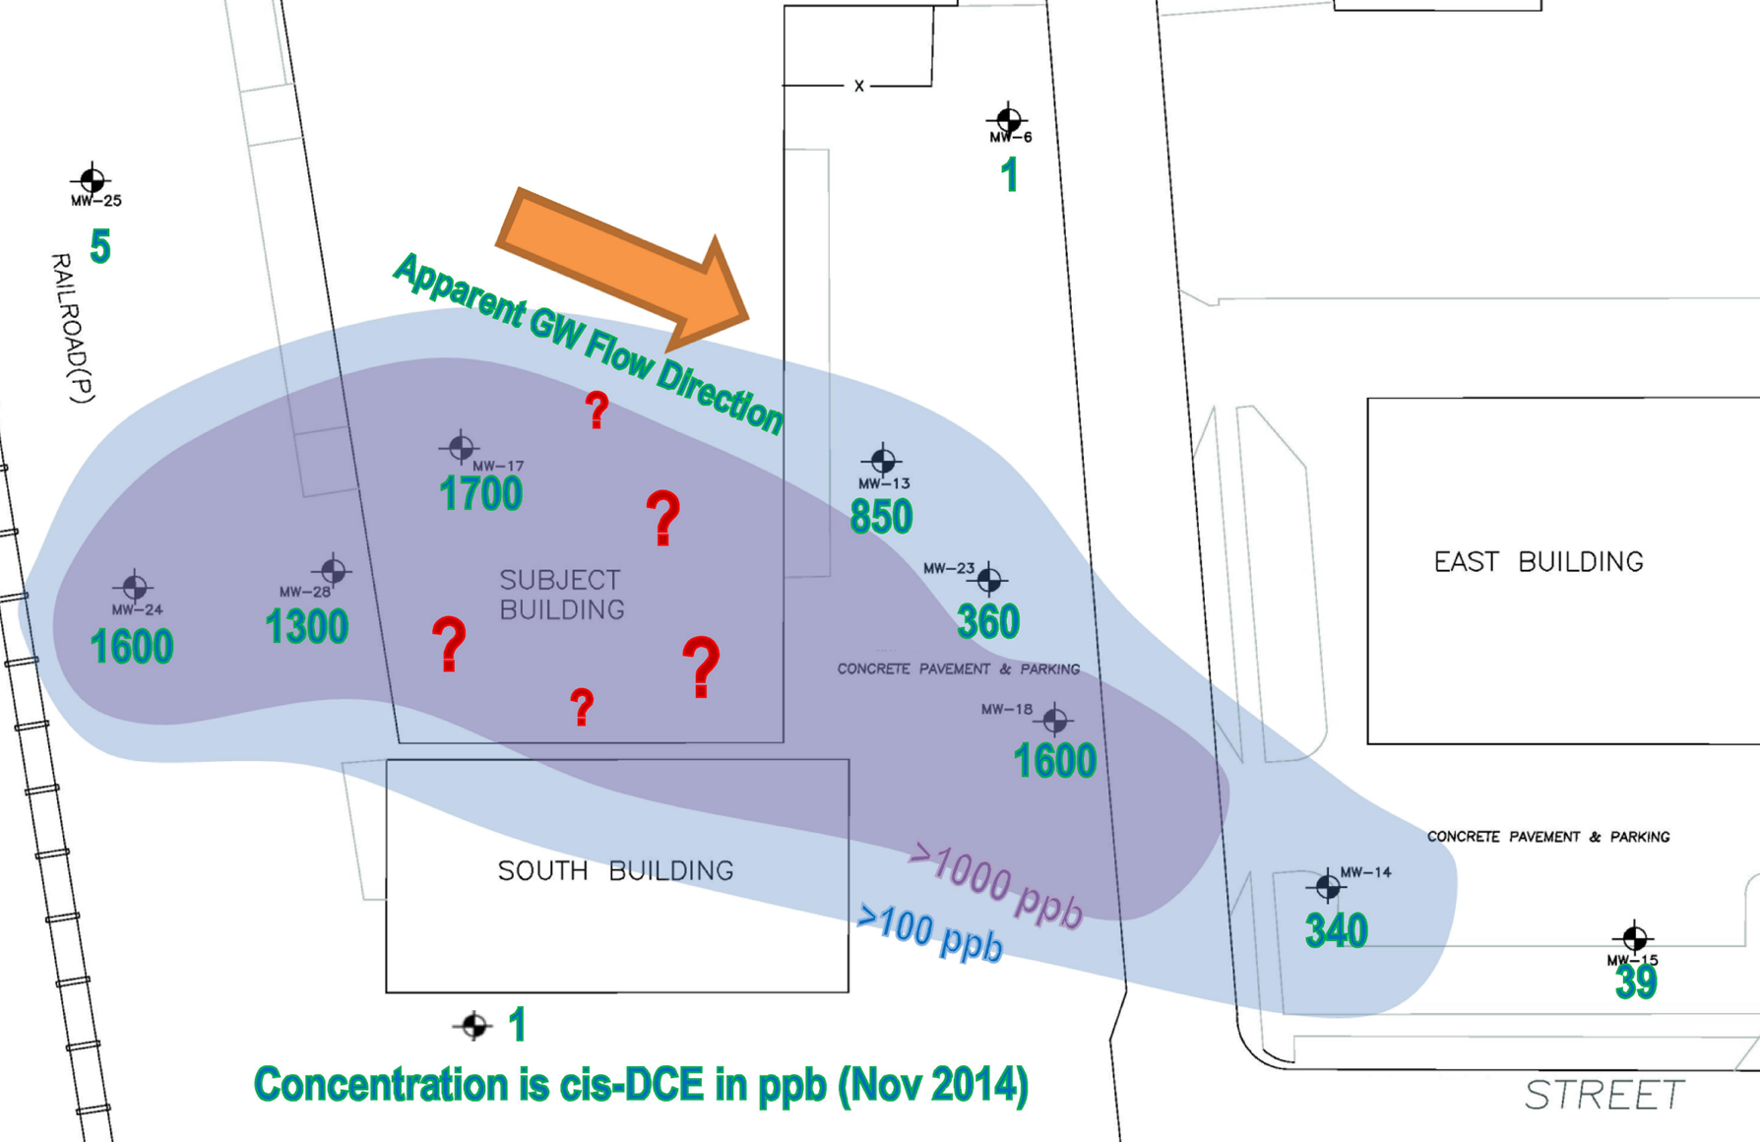
Case Study 1. Assessment of Data Gaps
Often the data gap
is in the area of highest
concentration.

Slide 10
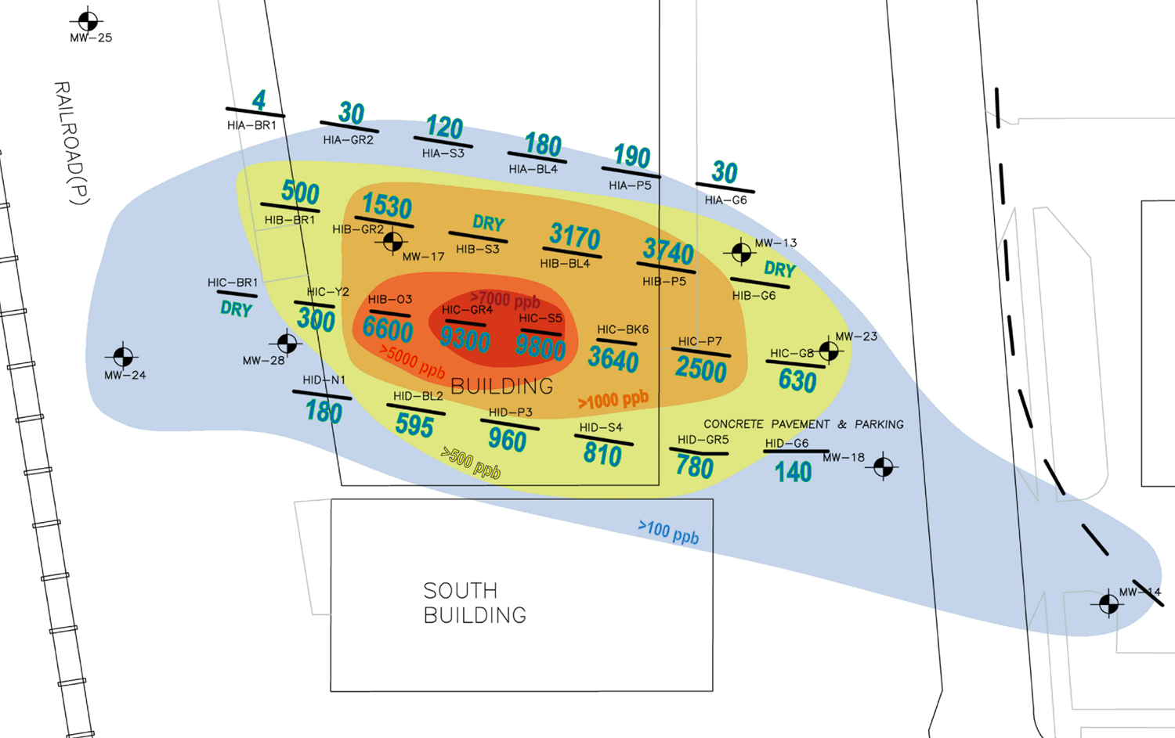
Case Study 1. Assessment of Data Gaps
Sampling nested wells identified 400% more contamination.
Note how the data supports how the wells are effectively isolated.

Slide 11
Case Study 2. Data Gaps
One Vertebrae™ Well System installed in 20’ sections to assess source of a dissolved phase hydrocarbon plume at a naval base.
Fuel Tank
The assumption that the tank was leaking was refuted. The problem was shown to be related to adjacent piping infrastructure.
Well System
The situation was simplified and a huge relief to the operators.

Slide 12
Technology Comparison
 | VertebraeTM | Horizontal Remediation Wells | Vertical Wells Monitoring & Extraction
ADDRESS DIFFICULT ACCESS ISSUES
FOR ASSESSMENT AND REMEDIATION
FILLS IN DATA GAPS
REPEATABLE SAMPLING
SEGMENTATION GIVES FLEXIBILITY AROUND PLUME VARIABILITY
EASY TRANSITION FROM ASSESSMENT TO TREATMENT
WELL SUITED TO LONG, NARROW PLUMES
HIGH VALUE FOR LOW COST

Slide 13
Additional Considerations
HRSC - High Resolution Site Characterization produces vertical profiles with varying degrees of “granularity.” Vertebrae TM Well Systems add a dimension to the process. With horizontal assessment we are able, in essence, to create the field of what we are calling High Resolution Contaminant Distribution (HRCD).
PFAS - polyfluoronated alkylsubstances, has compliance criteria in parts per trillion therefore, created serious sampling concerns. Many common materials such as well components, personal care products, food packaging and clothing can have traces of PFAS. We are working towards providing VertebraeTM Well Systems that are certified free of contaminants.
Notes:
These are new concept notes that still need work to some degree – messages shortened or extended beyond one slide. Now I am thinking of an advanced feature such as voice over suitable for web sites and tape loops at conferences.

Slide 14
Site Remediation
Vertebrae™ Well Systems can deliver reagents that drive oxidative and/or reductive contaminant remediation.
The segmented configuration allows the engineer to maximize efficiency by adapting to plume dynamics.
The only limitation is the physicality of the reagent such that it can pass through a well screen effectively.
The Systems can also be used for air sparging or soil vapor extraction (SVE).

Slide 15
Case Study 3. A Complex Problem
Impacts under tanks, adjacent roadway and parking lot
Resistant adjacent property owners
Four Vertebrae Well SystemsTM
installed for treatment
First application made. Shading
indicates relative intensity of dosage
A very important feature of a segmented well system is that it offers unique flexibility not found in conventional horizontal well applications.

Slide 16
Case Study 3. A Complex Problem
Subsequent assessment indicated a recalcitrant area toward the rear of the plume, requiring further treatment
Adjustments were made with simple reproportioning of the treatment scheme to match the plume dynamics.
Engineer is able to surgically control the treatment in real time.
Adaptive Application made and closure achieved

Slide 17
Case Study 4. Remediation
AS Segments (29)
SVE Segments (19)

Slide 18
VertebraeTM Sampling Capabilities
In-well Monitoring
Small and probes can be deployed
Surface Monitoring
Up to 18 channels per unit can be sampled
All wells can be assessed simultaneously
Only one set of probes to upkeep
Active sampling
Gradient driven

Slide 19
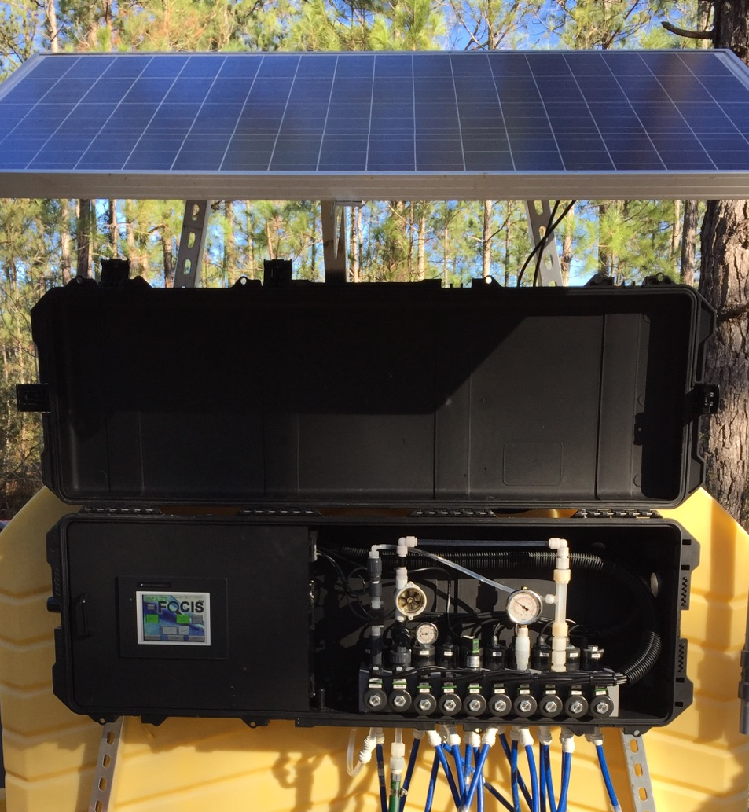
FOCISTM Data Collection
FOCISTM pulls samples sequentially from the different well segments.
Flow Through Cell – Insitu®Aqua Troll 600.
Only one analyzer (per unit of 18 channels) require calibration
18 channel capacity.
PLC operated and data logged.
Data can be viewed on the FOCISTM touch screen remotely.

Slide 20
FOCISTM Touch Screen
15.9
47 %
1524
-125 mV
8.6
Remote Communication Capable.

Slide 21
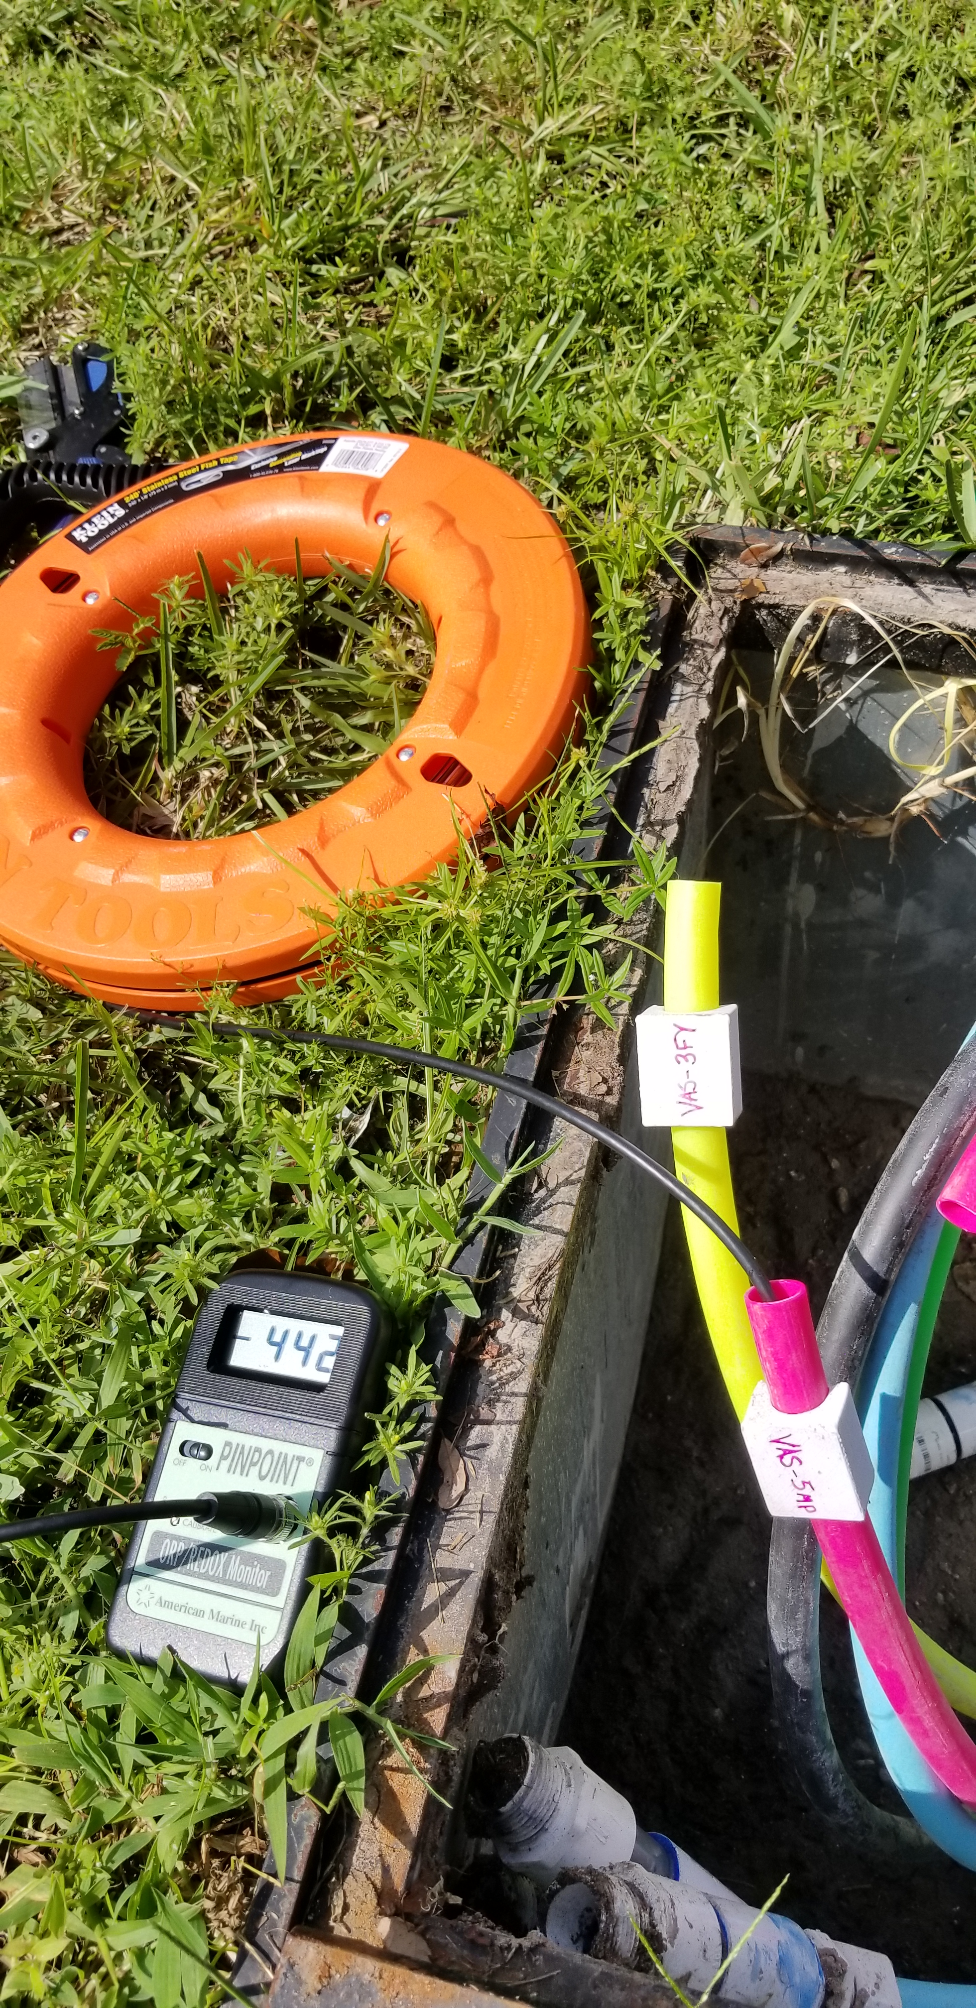
In-Situ Water Quality Assessment
Engineered for easy insertion and removal of probes given the need for calibration battery replacements.
Currently use - standard probes with capability to be upgraded with new advancements.
Probe deployment is not restricted by depth.

Slide 22
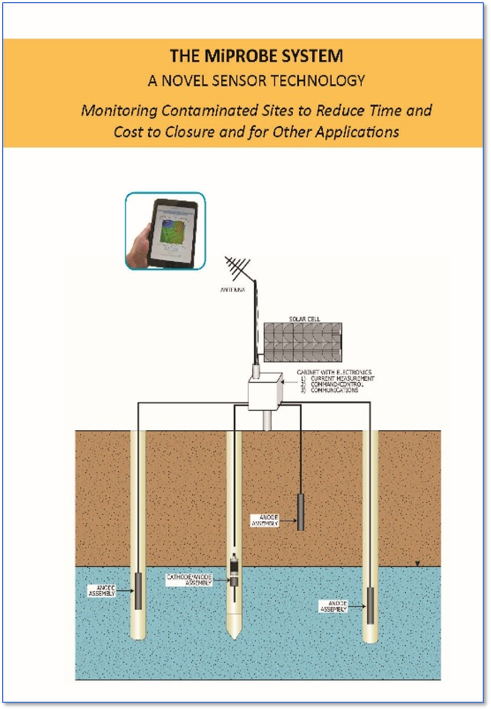
In Development
EN RX is aligned with Burge Environmental for deployment of MiProbe.
Investigating other contaminant detection technologies, e.g., fiber optic interferometry.

Slide 23
Design Considerations
Water Extraction Vertical Lift ► Depth to GW ~20 ft..
Water and Vapor Extraction Volume ► ½ to 1.5 inch OD tubing to surface
HDD Length ► Over ~800 ft. additional cost
HDD Requires Set-Back ► Rule of thumb 3 to 1
Blind Installations` ► Additional Cost

Slide 24
Additional Considerations
Vertebrae TM Well Systems can be factored into permeable reactive barrier (PRB) designs, both to explore the best transect for placement and to provide a safety factor for more treatment should the PRB underperform.
There is a growing belief that monitoring wells should be restricted to what they are designed to do – monitor. The task of site characterization assessment is better served by HRSC and HRCD operations.
There are other applications for VertebraeTM Well Systems, worthy of exploration, including but not limited to:
- Landfills
- Sediment Management
- Vapor Intrusion (as an extraction process)
Notes:
These are new concept notes that still need work to some degree – messages shortened or extended beyond one slide. Now I am thinking of an advanced feature such as voice over suitable for web sites and tape loops at conferences.

Slide 25
Summary
Vertebrae TM Well Systems, represent a next generation advancement in site assessment and remediation practices; where needed, site access issues can be overcome.
Nested, discrete horizontal profiling brings great accuracy to assessment and provides more directed treatment operations with a unique flexibility feature to manage dynamic systems.
Site Conceptual Models can be significantly enhanced and, on a case by case basis, there can be significant economic advantages.
Creates a new paradigm: High Resolution Contaminant Distribution.

Slide 26
Erik R. Piatt
(877) 747-ENRX (3679)
www.vertebraewells.com
www.enrxinc.com

