Slide 1
Heat Recovery Technologies for Combined Heat and Power in Oil Field
Fanxu Meng, PhD, PE - Research Associate
DOE Upper-West CHP TAP
Houston Advanced Research Center (HARC)
Denver, CO
October 31th, 2018

Slide 2
In Today’s Presentation:
DOE CHP Technical Assistance Partnerships (TAP)
Overview of Combined Heat & Power (CHP)
Heat Recovery Technologies in Oil Field
Working with US DOE CHP TAPs

Slide 3
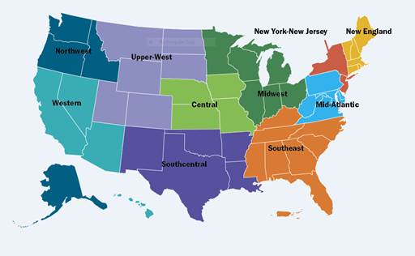
CHP Technical Assistance Partnerships (CHP TAPs)
End User Engagement Partner with strategic End Users to advance technical solutions using CHP as a cost effective and resilient way to ensure American competitiveness, utilize local fuels and enhance energy security. CHP TAPs offer fact-based, non-biased engineering support to manufacturing, commercial, institutional and federal facilities and campuses.
Stakeholder Engagement Engage with strategic Stakeholders, including regulators, utilities, and policy makers, to identify and reduce the barriers to using CHP to advance regional efficiency, promote energy independence and enhance the nation’s resilient grid. CHP TAPs provide fact-based, non-biased education to advance sound CHP programs and policies.
Technical Services As leading experts in CHP (as well as microgrids, heat to power, and district energy) the CHP TAPs work with sites to screen for CHP opportunities as well as provide advanced services to maximize the economic impact and reduce the risk of CHP from initial CHP screening to installation.
www.energy.gov/chp

Slide 4
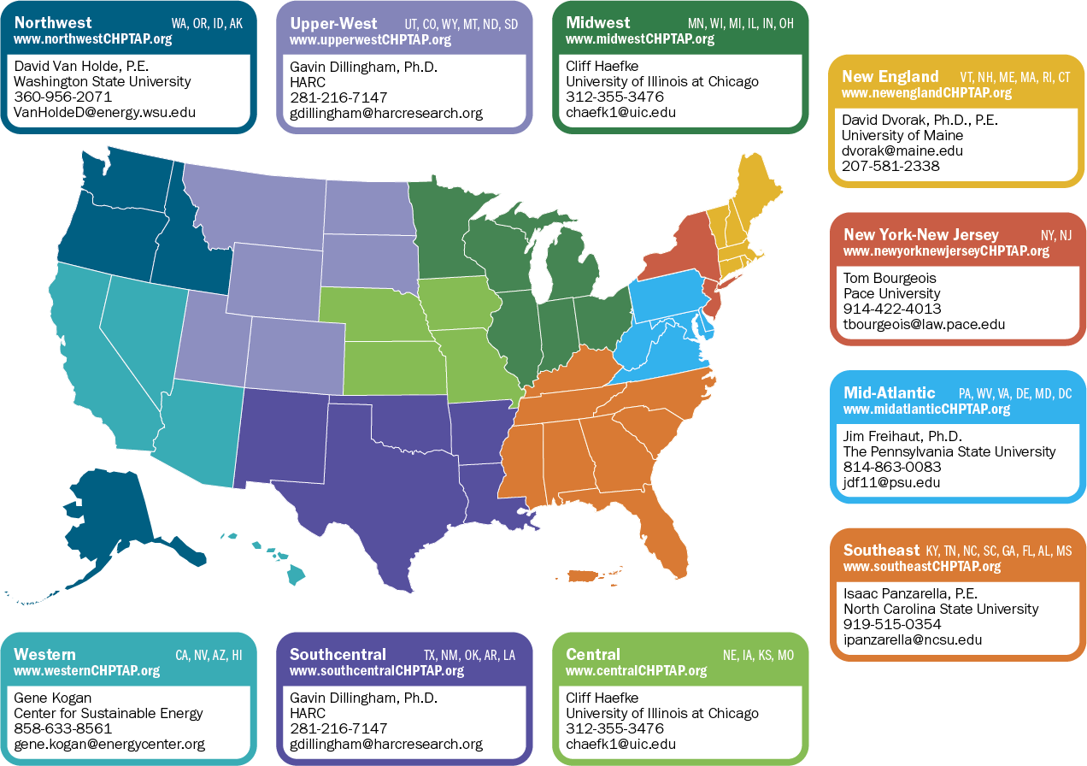
DOE CHP Deployment Program Contacts www.energy.gov/CHPTAP | Tarla T. Toomer, Ph.D. CHP Deployment Manager Office of Energy Efficiency and Renewable Energy U.S. Department of Energy Tarla.Toomer@ee.doe.gov | Patti Garland DOE CHP TAP Coordinator [contractor] Office of Energy Efficiency and Renewable Energy U.S. Department of Energy Patricia.Garland@ee.doe.gov | Ted Bronson DOE CHP TAP Coordinator [contractor] Office of Energy Efficiency and Renewable Energy U.S. Department of Energy tbronson@peaonline.com

Slide 5
CHP Overview

Slide 6
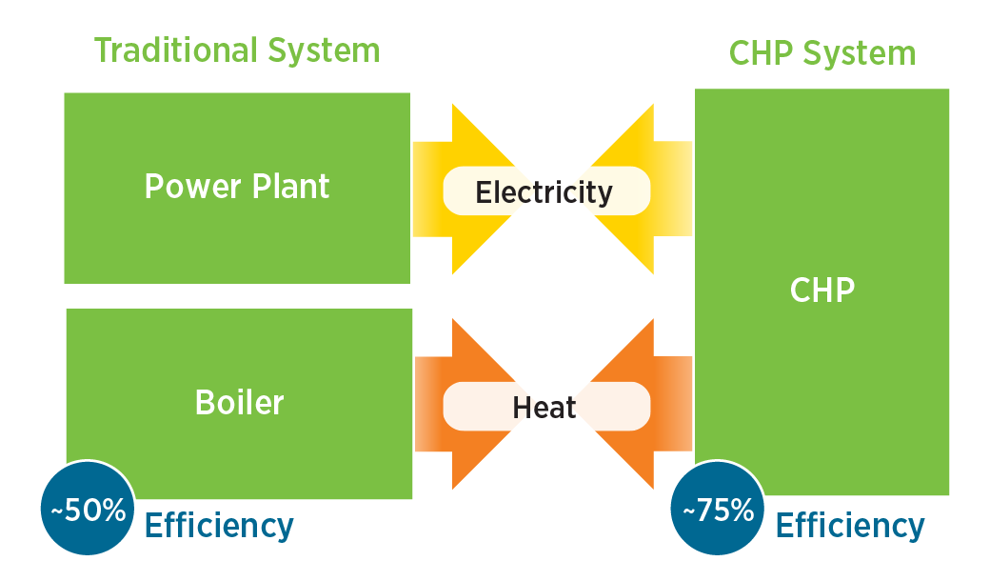
CHP: A Key Part of Our Energy Future
Form of Distributed Generation (DG)
An integrated system
Located at or near a building / facility
Provides at least a portion of the electrical load and
Uses thermal energy for:
Space Heating / Cooling
Process Heating / Cooling
Dehumidification
CHP provides efficient, clean, reliable, affordable energy – today and for the future.
Source: www.energy.gov/chp
Notes:
Single, double and triple effect
Mcogen and Tecogen

Slide 7
CHP Recaptures Heat of Generation, Increasing Energy Efficiency, and Reducing GHGs
30 units
Power Plant
32% efficiency
(Including T&D)
94 units
CHP
75% efficiency
Fuel
Electricity
Fuel
100 units
Onsite Boiler
80% efficiency
56 units
Fuel
Heat
45 units
Total Efficiency
~ 50%
Total Efficiency
~ 75%

Slide 8
What Are the Benefits of CHP?
CHP is more efficient than separate generation of electricity and heat
Higher efficiency translates to lower operating cost, (but requires capital investment)
Higher efficiency reduces emissions of pollutants
CHP can also increase energy reliability and enhance power quality
On-site electric generation reduces grid congestion and avoids distribution costs

Slide 9
Attractive CHP Markets
Industrial
Chemicals
Refining
Food processing
Petrochemicals
Natural gas pipelines
Pharmaceuticals
Rubber and plastics
Pulp and paper
Commercial
Data centers
Hotels and casinos
Multi-family housing
Laundries
Apartments
Office buildings
Refrigerated warehouses
Restaurants
Supermarkets
Green buildings
Institutional
Hospitals
Schools (K–12)
Universities & colleges
Wastewater treatment
Correctional Facilities
Agricultural
Dairies
Wood waste (biomass)
Concentrated animal feeding operations

Slide 10
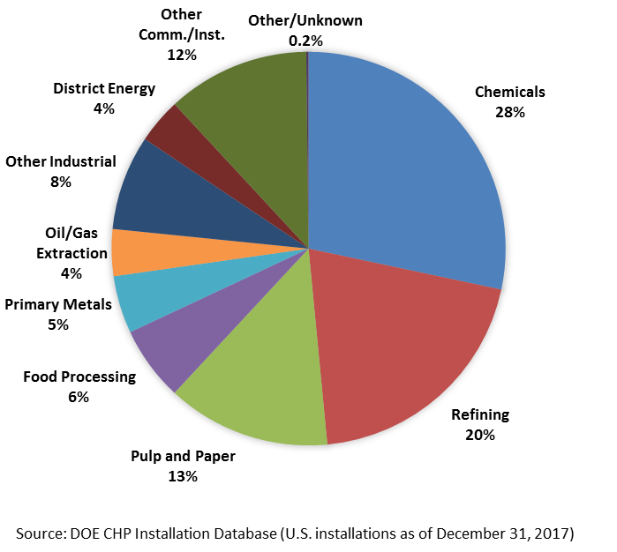
CHP Today in the United States
Existing CHP Capacity
81.3 GW of installed CHP at more than 4,400 industrial and commercial facilities
8% of U.S. Electric Generating Capacity; 14% of Manufacturing
Avoids more than 1.8 quadrillion Btus of fuel consumption annually
Avoids 241 million metric tons of CO₂ compared to separate production

Slide 11
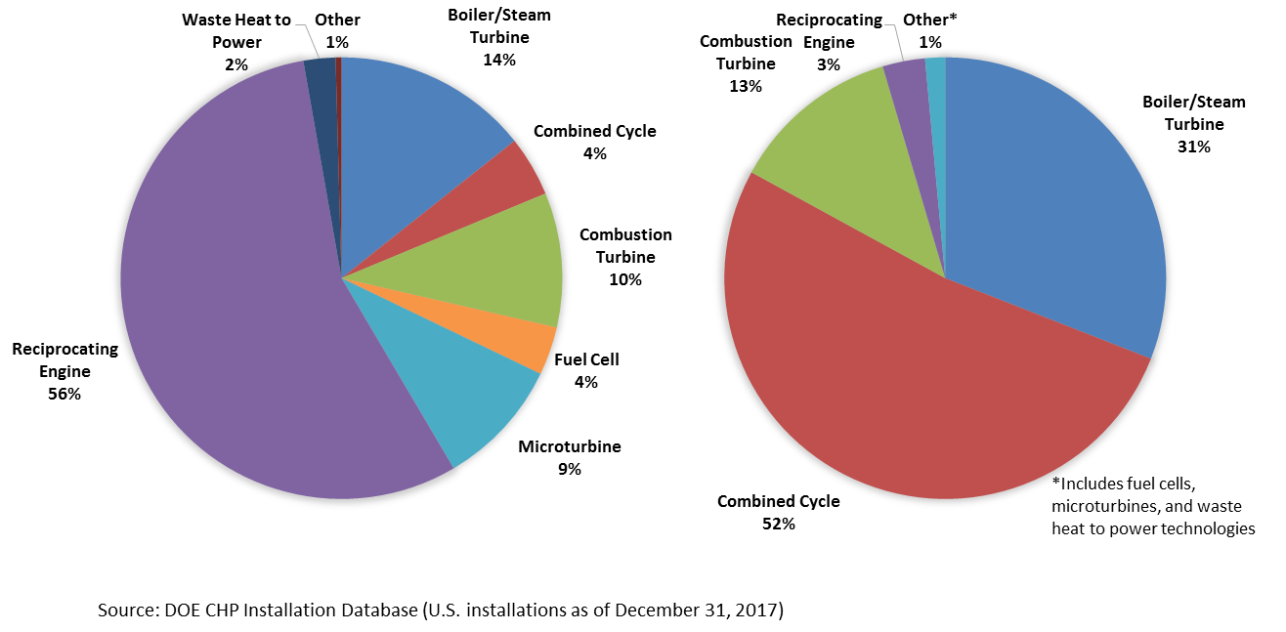
CHP in the U.S. by Technology
By Site – 4,434 Sites
By Capacity – 81.3 GW

Slide 12
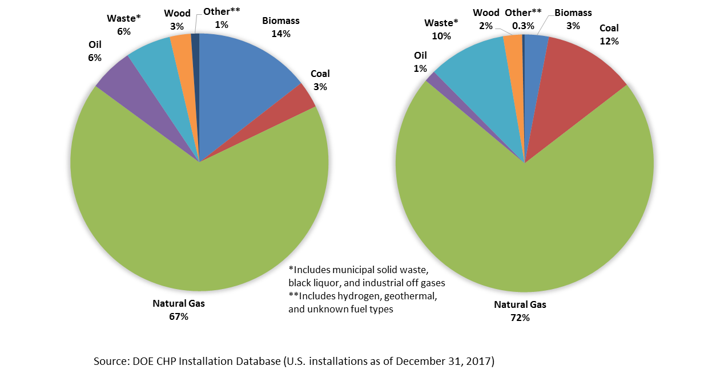
CHP in the U.S. by Fuel Type
By Site – 4,434 Sites
By Capacity – 81.3 GW

Slide 13
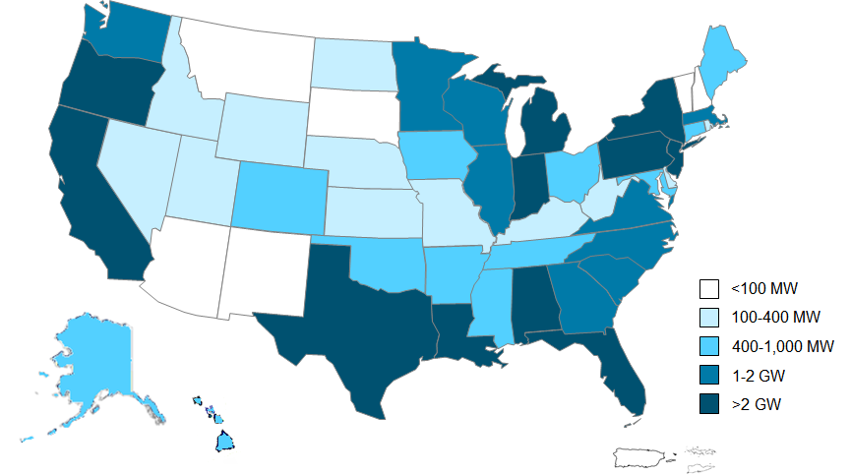
CHP in the U.S. by State
Source: DOE CHP Installation Database (U.S. installations as of December 31, 2017)

Slide 14
Finding the Best Candidates: Some or All of These Characteristics
High and constant thermal load
Favorable spark spread
Need for high reliability
Concern over future electricity prices
Interest in reducing environmental impact
Planned facility expansion or new construction; or equipment replacement within the next 3-5 years

Slide 15
CHP Heat Recovery Technologies

Slide 16
CHP System Schematic
Electricity
On-Site Consumption
Sold to Utility
Fuel
Natural Gas
Propane
Biogas
Landfill Gas
Coal
Steam
Waste Products
Others
Prime Mover
Reciprocating Engines
Combustion Turbines
Microturbines
Steam Turbines
Fuel Cells
Generator
Thermal
Steam
Hot Water
Space Heating
Process Heating
Space Cooling
Process Cooling
Refrigeration
Dehumidification
Heat Exchanger

Slide 17
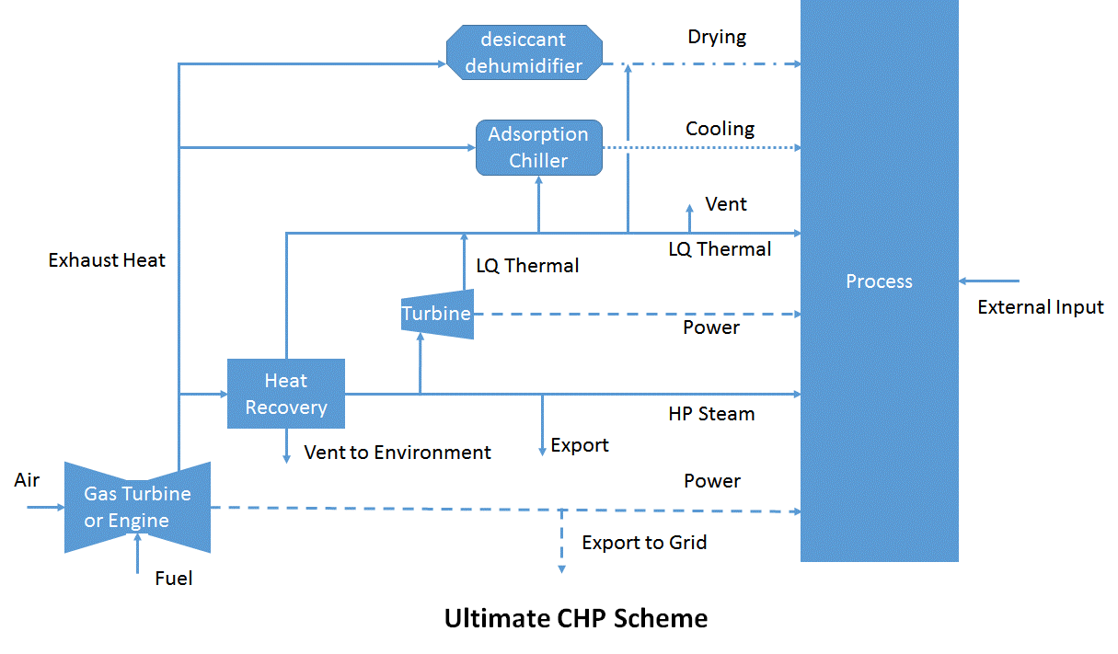
CHP Top Cycle

Slide 18
Temperature Classification
High, > 1,200 °F (650 °C)
Advantages:
High-quality energy, diverse range of end-uses
High-efficiency power generation
High heat transfer rate per unit area
Barriers:
Thermal stresses on heat exchange materials
Typical Recovery Methods:
Preheat, steam generation
Transfer to med-low temperature processes
DOE, Waste Heat Recovery: Technology and Opportunities in U.S. Industry (2008)

Slide 19
Temperature Classification
Medium, 450 - 1,200 °F (230 - 650 °C)
Advantages:
More compatible with heat exchanger materials
Practical for power generation
Typical Recovery Methods:
Preheat, steam generation
Organic Rankine cycle for power generation
Transfer to low temperature processes
DOE, Waste Heat Recovery: Technology and Opportunities in U.S. Industry (2008)

Slide 20
Temperature Classification
Low, < 450 °F (< 230 °C)
Advantages:
Large quantities in numerous product streams
Barriers
Few end uses, low efficiency power generation
Acidic and exchanger corrosion with low-temperature combustion exhausts
Typical Recovery Methods:
Space heating, domestic water heating
Organic Rankine cycle
Adsorption chiller
DOE, Waste Heat Recovery: Technology and Opportunities in U.S. Industry (2008)

Slide 21
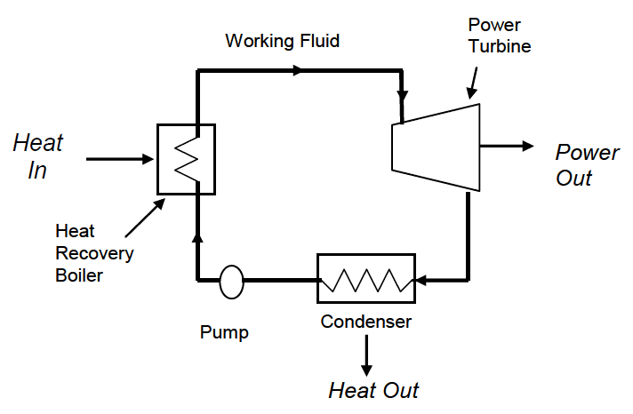
Rankine Cycle Heat Engine
Steam Rankine Cycle
SRC is a proven-technology
50 kW – 100 MW
ICF, Waste Heat to Power Market Assessment, (2015)

Slide 22
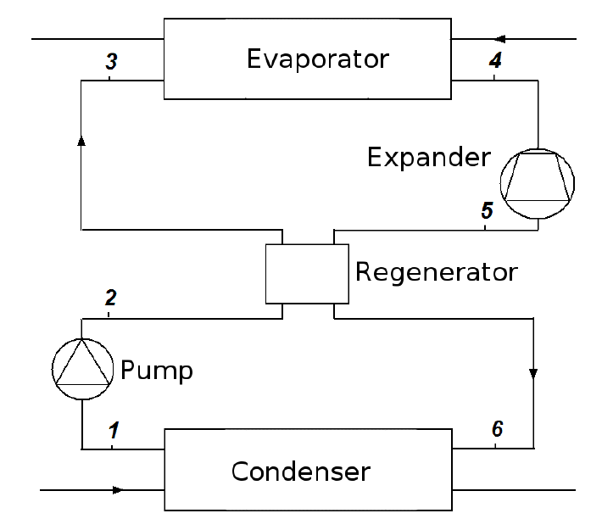
Organic Rankine Cycle
ORC operates with low temperature heat sources, as low as 200 °F or below
ORC has higher installed capital cost and O&M cost
ICF, Waste Heat to Power Market Assessment, (2015)

Slide 23
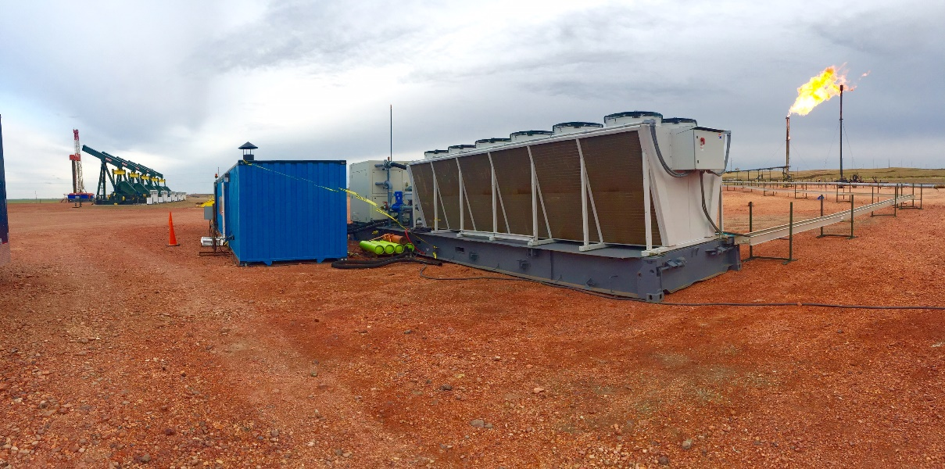
Upstream Project Snapshot
Flare Gas to Electricity, Bakken, ND
ElectraTherm partnered with Hess Corporation
Application/Industry: Oil and Gas Upstream
Capacity (MW): 65 kW
Equipment: Organic Rankine Cycle Power +, hot water boiler
Fuel Type: Flare Gas
Recoverable heat temperature: 170-252°F
Thermal Use: Electricity generation
Installation Year: 2015
Environmental Benefits:
CO, NOx and VOC reduction
ElectraTherm’s Waste Heat to Power Technology Reduces Flaring at Hess Oil Well
https://electratherm.com/

Slide 24
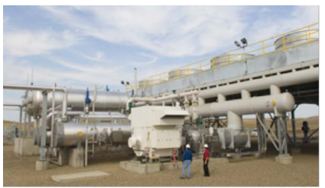
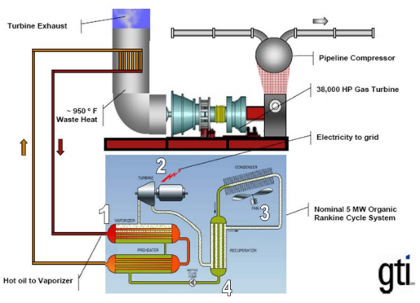
Mid-Stream Project Snapshot
Power from Compressor Station Waste Heat
Northern Border Pipeline
St. Anthony, ND
Application/Industry: Natural Gas Pipeline
Capacity: 5.5 MW
Prime Mover: Gas turbine
Fuel Type: Recovered waste heat
Thermal Use: Unknown
Installation Year: 2006
Energy Savings: $600,000/yr
Highlights: In 2006, the Northern Border Pipeline (NBP) installed a waste heat to power (WHP) CHP system at their compressor station in St. Anthony, ND. The 5.5 megawatt system converts waste heat from the compressor into electricity using an Organic Rankine Cycle based power plant. ORMAT Technologies, Inc. owns and operates the plant, purchasing the waste heat from NBP and selling the electricity to nearby electric cooperatives. Following the success of the WHP system, NBP has worked with ORMAT to adopt similar WHP systems for other compressors along its pipeline, with systems now at 10 of the 16 compressor stations.
Source: http://www.midwestchptap.org/profiles/ProjectProfiles/NorthernBorderPipeline.pdf

Slide 25
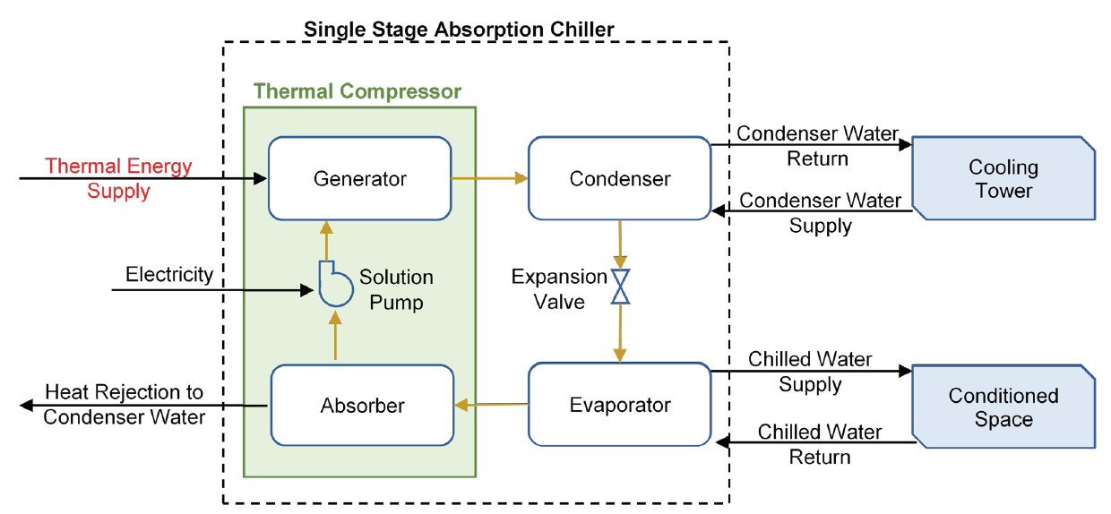
Adsorption Chiller
Typically operates with hot water (200-240 °F) or low pressure steam (15 psig)
DOE, Combined Heat and Power Technology Fact Sheet Series: https://www.energy.gov/sites/prod/files/2017/06/f35/CHP-Absorption%20Chiller-compliant.pdf

Slide 26
Desiccant Dehumidifier
Uses a special humidity-absorbing material called a desiccant
“Recharged" to drive off the humidity, typically by heating it
Suitable for high humidity levels at low temperatures
Widely utilized in such as supermarket sector
http://www.northeastchptap.org/Data/Sites/5/documents/profiles/Waldbaums_CHPProjectProfile.pdf

Slide 27
Increasing Opportunities in Oil and Gas
Need for reliability
Legislations and Regulations on GHG emissions and flaring
Increasing energy intensity
Growing power demand for expansions
Social Responsibility

Slide 28
More Insights
“Determining Opportunities for Combined Heat and Power (CHP) in the Oil Field”
Andra Wilcox, Research Scientist at HARC
Session “Clean Power in the Oilfield”
11:15 am, Oct 31st

Slide 29
Summary
CHP is a proven technology in industrial facilities
It provides energy savings, reduced emissions, and opportunities for resiliency
Proven technologies are commercially available and cover a full range of sizes and applications

Slide 30
Thank You! Questions?
Fanxu Meng, PhD
Research Associate
Houston Adv. Research Center
8801 Gosling Rd
The Woodlands TX 77381
281-364-6048
fmeng@harcresearch.org
Gavin Dillingham, PhD
Program Director
Houston Adv. Research Center
8801 Gosling Rd
The Woodlands TX 77381
281-216-7147
gdillingham@harcresearch.org

