Slide 1
Get OUT! WHAT WILL IT TAKE TO USE PRODUCED WATER OUTSIDE OF THE OIL AND GAS INDUSTRY?
Jeri Sullivan Graham
Katie Zemlick
University of New Mexico
Center for Water and the Environment
ejsgraham@unm.edu; katie.Zemlick@live.com
IPEC Denver, October 29-November 1, 2018

Slide 2
OUtline
What does the recycling data look like in New Mexico?
What do we know about real recycling uses at this time?
Policy evolution in New Mexico
What’s going on elsewhere? (New Mexico Conference, GWPC report….)

Slide 3
Note: District I recycled = 5,883,381 bbls District II recycled = 4,589,031 bbls Total = 1,350 acre-ft

Slide 4
Water production from oil and gas wells is increasing, because of increased drilling activity
Disposal capacity is becoming limited, because of disposal well pressure increases and concern about seismicity
Water use is increasing for drilling because of increased use of hydraulic fracturing methods (>1 M gallons/frac)
Fresh water sales to oil and gas from agricultural and commercial sources is increasing (we think…..!)
Price of freshwater sold is increasing
UPSHOT: More water in circulation, fewer places to put it

Slide 5
Recycling Facilities in Operation by District
Produced Water Reuse Rule instituted in 2015.
Graph courtesy Katie Zemlick, University of NM, katie.zemlick@live.com

Slide 6
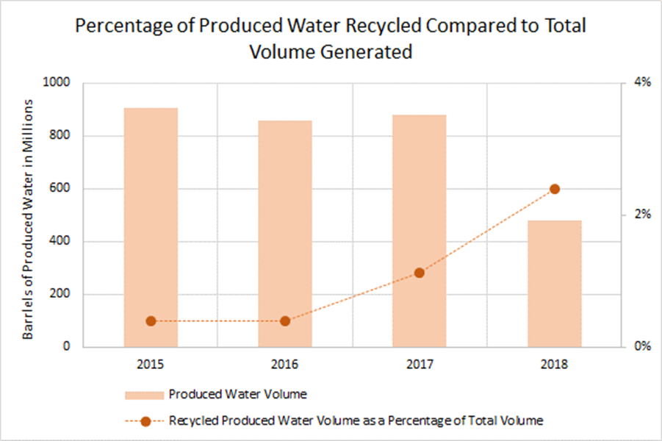
Percentage recycled in NM
Gra
900 million BBLs = 116,000 acre feet
2% of 116,000 ac-ft = 2,320 ac-ft
Graph courtesy Katie Zemlick, University of NM, katie.zemlick@live.com

Slide 7
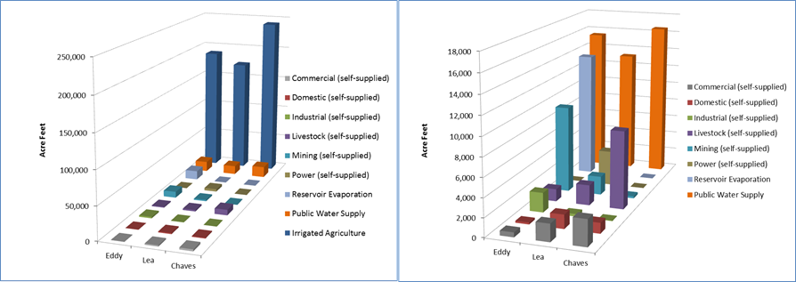
How much fresh water does oil and gas use?
Not much compared to agriculture.
But, note that 2000 ac-ft of recycled water is about ¼ of the fresh water used for mining (Eddy Co.)

Slide 8
Permitted Reuse of Produced Water
We looked at documented or permitted uses of produced water outside of the oil and gas industry across the U.S.
We asked where the water was used, and for what it was used. Sometimes other information was available (research results, volumes, etc.)
We distinguished 4 main types of uses
Land Application
Water Application
Industrial Use
Agriculture and Wildlife (98th Meridian rule)

Slide 9
Drivers for Use of PW
Two “Use Phases”:
Research phase/still undergoing testing (lab/bench/pilot phases)
Active use in the environment
Uses are a response to localized factors:
Low-salinity produced water available
Dilution or environmental buffer used
High incidence of drought or water shortages/need for resource
Limited local disposal options
High transportation and disposal costs
Economic opportunities
Users willing to accept the water

Slide 10
Use | Type | # Examples | Type | States
Land | Rangeland rehab/forage Road Application | 4 2 | Pilot Full scale | NM, WY CO, PA
Water | Surface Water Augmentation Surface Water Discharge# Aquifer Storage and Recovery Algal Biofuel Production | 1 10 1 3 | Research Full scale Full scale Research | NM PA, OH, WV CO NM
Industrial | Cooling Tower Augmentation | 2 | Pilot scale | NM,NC, IL
Ag and Wildlife | Livestock Watering Irrigation-food crop* Irrigation-Non-food crop | 2 8 1 | Field obs. Full scale Pilot scale | TX, WY CA TX
#EPA study
*includes alfalfa
NOTE: Some examples are pilots or research projects, some are active, full-scale projects. Some waters are treated, many are low salinity sources (CBM and oil-produced)

Slide 11
Some Key factors to promote reuse Waste ➔Resource
Within oil and gas:
Location/Volume specification and tracking
Permitted transport
Permitted recycling facilities/processes
Tailored treatments
Sometimes, Regulation/Policy changes
Sometimes, agency handshake
Outside of oil and gas:
Ownership/rights definition
Regulation/policy adaptation
Handshake between agencies (e.g. Oil Conservation to Environment Dept. in NM)
Permitted transport
Permitted treatment
Permitted discharge (NPDES, etc)
Analysis and Risk Assessment

Slide 12
Well conversion
Conversion of gas wells to water wells has occurred in New Mexico (and vice versa!)
Water can be fresh enough for stock watering in remote regions
Transfer involves both the Office of the State Engineer and the Oil Conservation Division
OSE Brackish water rules apply if formation top is >2,500 ft bgs AND salinity is >1,000 mg/L-NO right required but permit application must be made.
OSE Fresh water rules apply if the supply is not brackish. Application for a permit/right must be made.
OCD removes well from oil and gas permitting process.

Slide 13
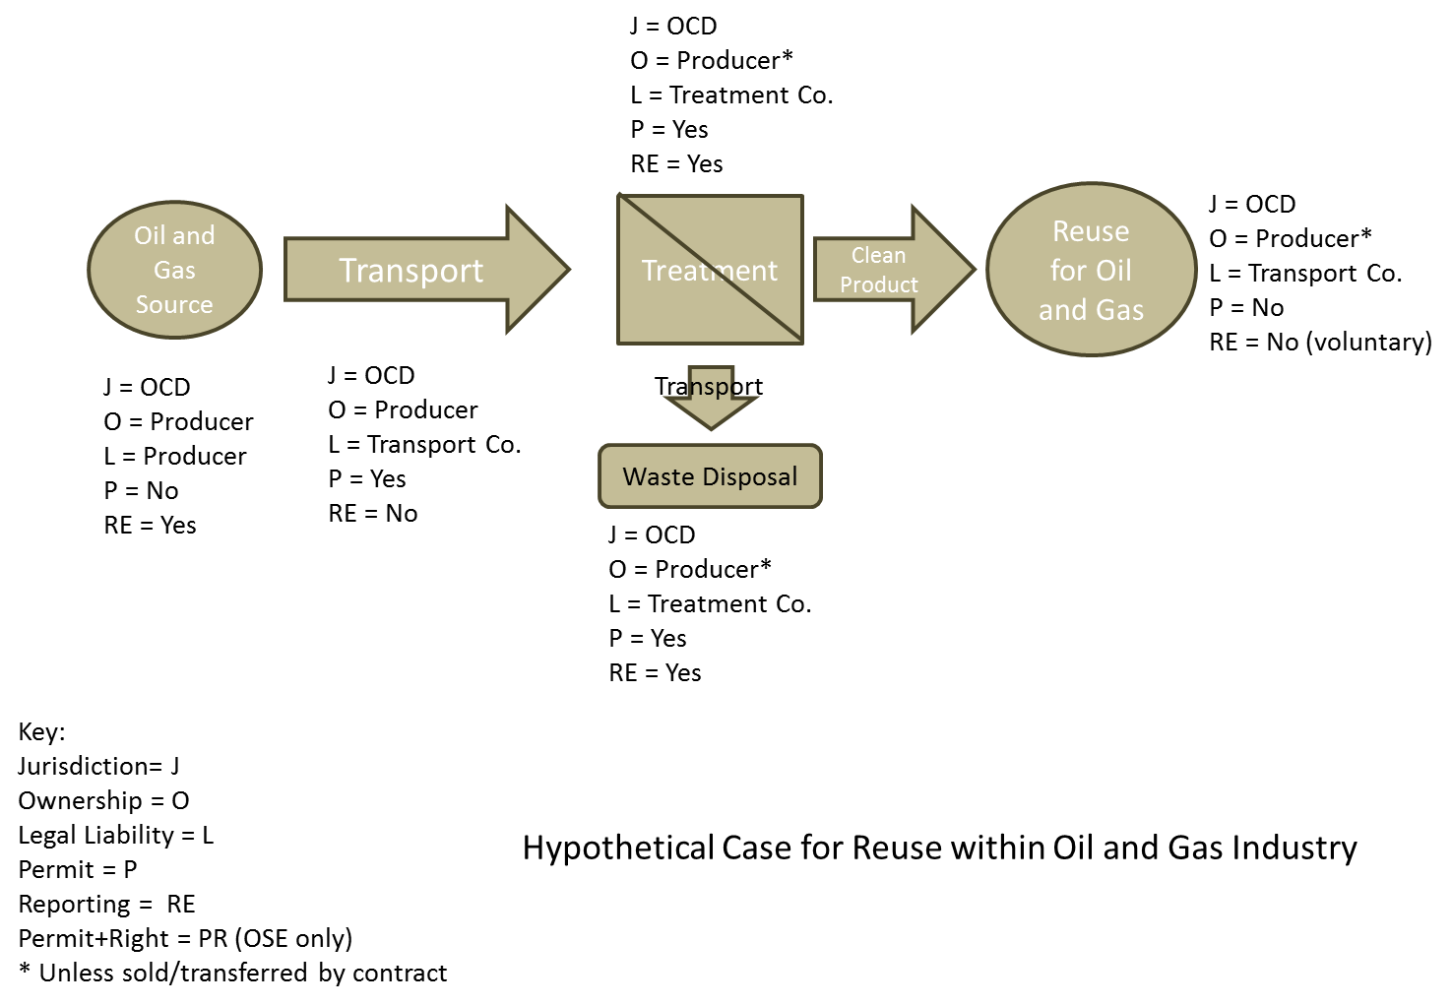
Hypothetical Use Case 1

Slide 14
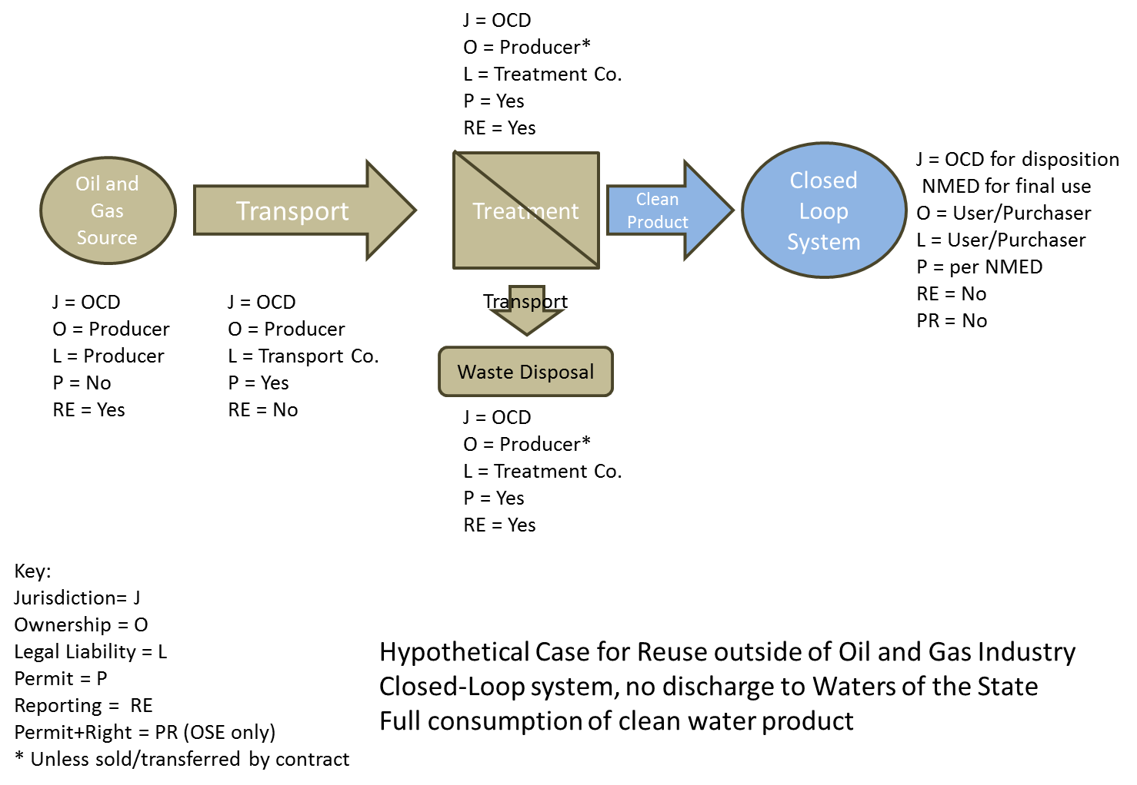
Hypothetical Use Case 2

Slide 15
Hypothetical Use Case 3

Slide 16
Multi-institutional studies
Funding from EPA via NMED; institutional funds
Participants: NMWRRI, NMPRRC, NMT, NMSU, NMOSE
Sources: https://nmwrri.nmsu.edu/produced-water/reports/
More information: Bob Sabie, rpsabie@nmsu.edu

Slide 17
upcoming events
GWPC Report on Produced Water
Overview and Regulatory Framework;
Uses of PW within Oil and Gas Industry;
Needed Research for Uses Outside Oil and Gas Industry – Risk and Analysis
Due out mid 2019
Produced Water Conference in New Mexico
Santa Fe, November 15-16
Promoting feasible uses for Produced Water to reduce injection disposal volumes and provide alternative water supplies for many uses
Organized by NM Desalination Association (NM Desal)
https://nmdesalassociation.com
https://nmdesalassociation.com/news-events/

Slide 18
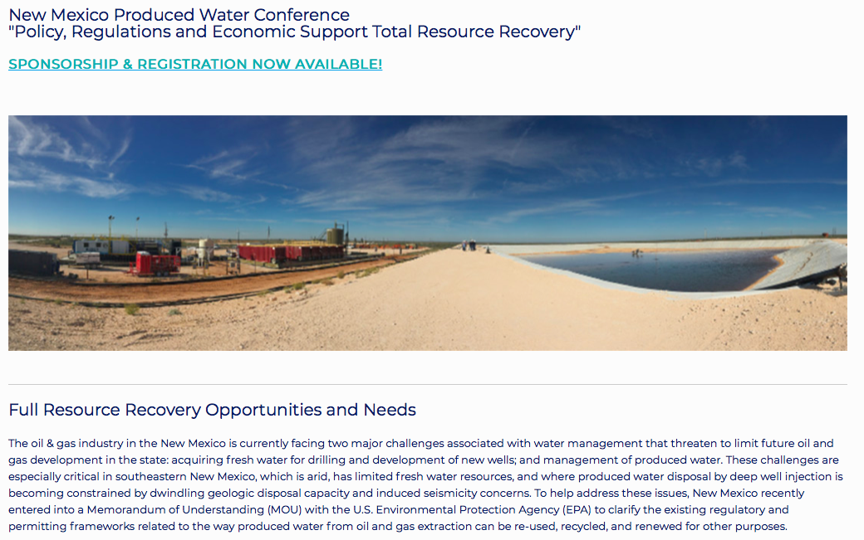
Hotel Santa Fe, November 15-16, 2018
https://nmdesalassociation.com/news-events/

Slide 19
Contact information
Jeri Sullivan Graham
Research Professor
University of New Mexico
Center for Water and the Environment
ejsgraham@unm.edu
Katie Zemlick,
Post Doctoral Research Associate
University of New Mexico
Center for Water and the Environment
Katie.zemlick@live.com

