Slide 1
Generating Clean Power from Waste Heat at Oil & Gas Sites: Policies, Incentives, Case Studies
Susan Brodie
Heat is Power Association
susandbrodie@gmail.com

Slide 2
Agenda
About Waste Heat to Power (WHP) / Recycled Energy
Case Studies in the Oil and Gas Industry
Incentives and Financing
Additional Information and Resources to Evaluate WHP / Recycled Energy Opportunities
Notes:
Recycled Energy Overview
Definition
Benefits
Example Projects
Colorado Economic Potential
Waste Heat Streams
Case Studies in the Oil and Gas Industry
Gas Processing
Natural Gas Compression
Flare Elimination
Coke Calcining
Is Recycled Energy a Good Fit at Your Facility?
Options for building, owning, leasing, operating
Incentives
Financing mechanisms
Policy and Regulatory Considerations
Technical Assistance
Waste Heat Worksheet
Resources

Slide 3
About HiP and CEO
The Heat is Power Association is working in partnership with the Colorado Energy Office to provide education and information on CHP and recycled energy in Colorado to companies that have waste heat producing facilities and thermal energy needs, with the goal of expanding the use of these technologies in the state.
Heat is Power Association (HiP)
National association for waste heat to power (WHP) industry
Outreach and educate regarding WHP opportunities, policies, technologies
Advocate for parity for WHP with other clean energy sources
Susan Brodie | 630.292.1304 | susandbrodie@gmail.com
Colorado Energy Office (CEO)
Mission: To deliver cost-effective energy services and advance innovative energy solutions for the benefit of all Coloradans
Expanding deployment of recycled energy and CHP in Colorado
Lindsey Stegall | 303.866.2594 | lindsey.stegall@state.co.us
Notes:
Alternate to slide 3

Slide 4
About WHP / Recycled Energy

Slide 5
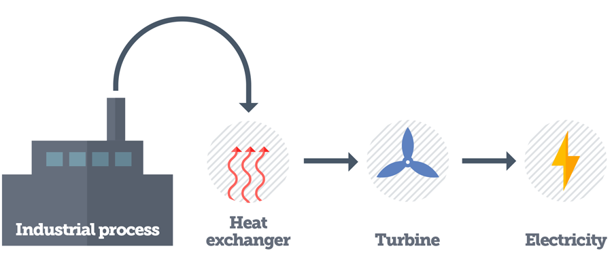
Recycled Energy & Waste Heat to Power (WHP)
The process of capturing heat discarded by an existing process and using that heat to generate electricity. Goes by several names:
“Waste heat to power” (WHP) in federal programs
“Recycled energy” in CO, SD, ND
“Waste gas or waste heat capture or recovery system” in UT
Graphic: Pew Charitable Trusts

Slide 6
Sources of Waste Heat Streams
Category | Processes | Oil and Gas Examples
Thermal Process | Heat recovered from energy intensive processes | Furnace Oven Kiln Coker Calciner
Mechanical Drive | Energy recovered from compressors | Compressor stations Gas processing
Other | Byproduct waste heat recovered from industrial or other processes such as exothermic reactions, incineration, pressure reduction | Flares Co-produced water
Illustrations only, not intended to be all inclusive
Temperature °F

Slide 7
WHP & CHP Basics
Fuel is 1st used to generate electricity.
Left-over heat is used for heating, cooling or other thermal process.
Eg: engine or turbine
Fuel is 1st used to make energy for a thermal purpose.
Leftover heat is used to generate electricity.
Eg: furnace, oven, kiln
Waste heat is the energy used to generate electric power. Useful thermal energy not required. Eg: compression, exothermic rxn, incineration, pressure reduction
Conventional CHP
aka Topping Cycle Cogeneration
WHP
aka Bottoming Cycle Cogeneration
Other WHP
CHP: generation of electric power and thermal energy from one fuel source
WHP: electric power generation from waste heat

Slide 8
WHP & CHP Basics (cont’d)
Electricity
Electricity
Electricity
Fuel
Engine or Turbine
Useful Thermal Energy
Generator
Generator
Generator
Waste heat / exhaust gases
Heat Exchanger
Heat Exchanger
Heat Recovery Unit
Heating or Cooling System
Waste heat
Waste heat
Steam or hot water
Industrial process that uses thermal input
Waste or byproduct heat from process
Fuel
Product
Conventional CHP
aka Topping Cycle Cogeneration
WHP
aka Bottoming Cycle Cogeneration
Other WHP
CHP
WHP

Slide 9
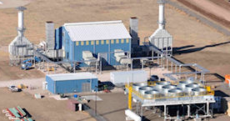
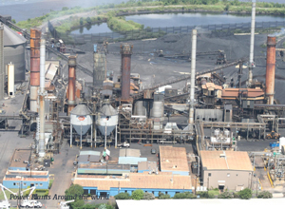
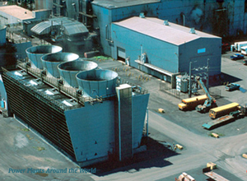
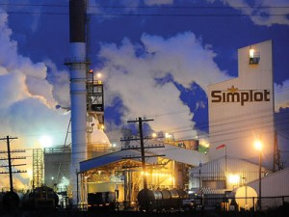
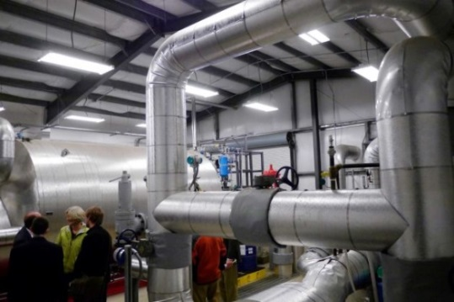
Project Examples
Waste heat from Trailblazer pipeline compressor station powers 4 MW WHP system. Saves $10M over 20 yrs (CO)
The 40 MW (equiv.) Port Arthur Steam Energy system produces process steam and 5 MW power from kiln exhaust. Saves < $5M million annually (TX)
Primary Energy generates 50 MW, 90 MW and 95 MW at its WHP plants in steel mills (IN)
JR Simplot uses excess heat from exothermic chemical reactions to drive a steam turbine that generates 16 MW (ID)
Williams gas processing uses compressor waste heat in 6 MW WHP, can island to reduce risks associated with power outage, and sells RECs (CO)
Albany County Sewer District utilizes exhaust gas from sludge incinerators to generate 925 kW (NY)

Slide 10
WHP Technical Potential by State
Number of Sites
Capacity

Slide 11
Colorado Waste Heat Produced and Recycled Energy Potential
Energy Consumption
by End Use Sector
1,480 trillion Btu / 433.7 million MWh
Recycled Energy
Economic Potential
> 50 sites > 100 MW
25%
Other
Industries
Commercial
Industrial
20-30% lost
as waste heat
Residential
75%
Oil & Gas
Transportation
9
Source: https://www.eia.gov/state/?sid=CO#tabs-2 (2015 data)
Source: Colorado Recycled Energy Market Overview Report, Updated May 2017
Notes:
30% of all energy consumed in the U.S. is consumed by industry
20% to 30% of this energy is lost as waste heat
~ 5-13 quadrillion BTU/yr at a cost of $20B-$60B/year1
A report by the Colorado Energy Office updated last spring estimates that there are more than 50 sites in Colorado where recycled energy projects are economically feasible, with the potential to generate more than 100 megawatts of clean energy. More than 75% of these potential sites are oil and gas facilities.
Compressor stations are located every 40-100 miles on the more than 300,00 miles of natural gas pipeline in the U.S. 320 are in CO
Industrial process heating accounts for approximately 70% of manufacturing

Slide 12
Benefits of Recycled Energy
Operational
Improves industrial energy efficiency
Power can be used onsite or delivered to the grid
Improves electric service reliability onsite
Can provide power to remote locations
Economic
Offsets costs of purchased power and fuel
Sale of excess power may provide a revenue stream
Environmental
Uses a waste resource from existing process to generate electricity with no additional fuel, combustion or emissions
Reduces overall greenhouse gases, SOx, NOx

Slide 13
Case Studies
Recycled Energy in the Oil and Gas Industry: Colorado Opportunities, Incentives, Assistance

Slide 14
Trailblazer Pipeline Compressor Station
Power Generation: 4 MW system; 27,600 MWh/yr
Waste Heat: 900°F turbine exhaust
Key Benefits
All power and RECs sold to local co-op
Saves >$600,000/yr, >$10mil over 20 yrs
Replicable; 13 in U.S.
Virtually no emissions
Uses no water
Reduces carbon footprint
Key Players: Ormat, Highline Electric Assn, Tri-State, Kinder Morgan (now Tall Grass)
Notes:
320 compressor stations on Colorado’s network of natural gas pipelines
Only one has a recycled energy system
More than 1,400 compressor stations on the interstate and intrastate natural gas transmission pipeline network nationwide
Only 13 (less than 1%) have recycled energy: N Border pipeline (10), Kern River pipeline (1), Cayne compressor station (1), Trailblazer pipeline (1)
Sources: http://cogcc.state.co.us/data.html#/cogis, http://www.southwestchptap.org/industrial-naturalgas

Slide 15
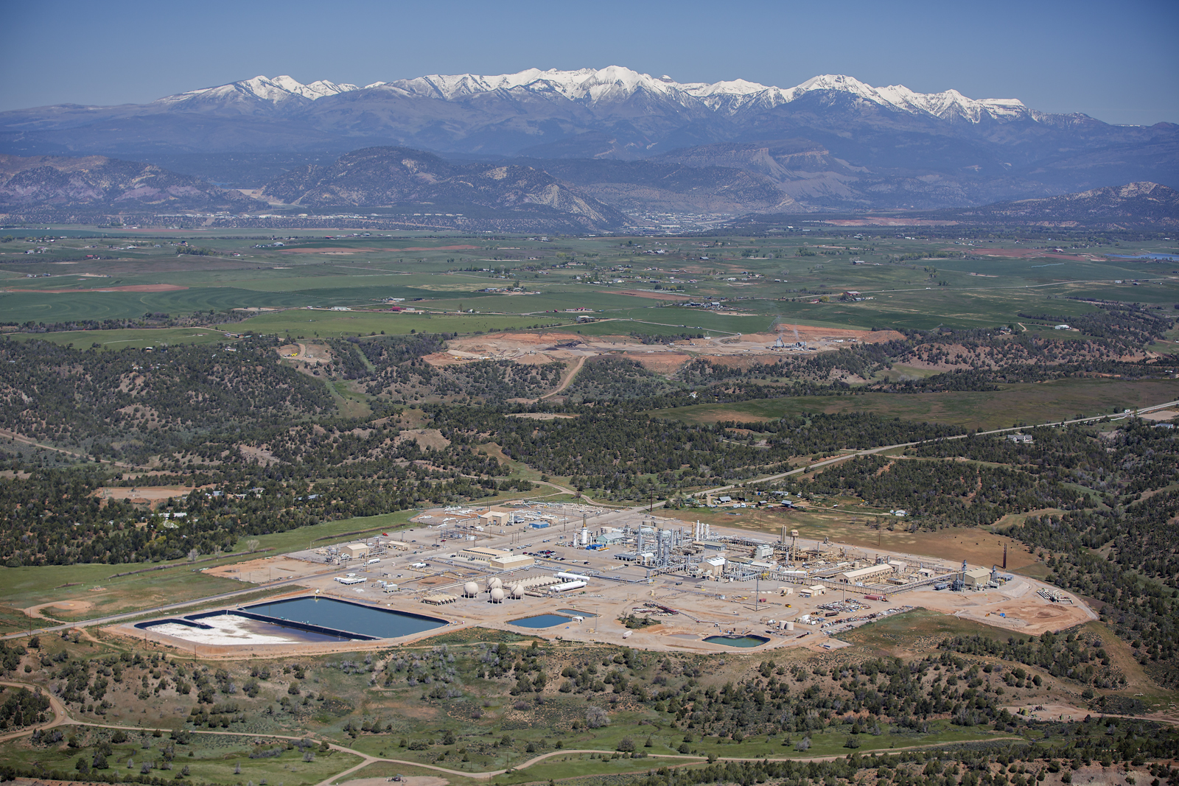
Recycled Energy at Gas Processing Plant
Thermal Oxidizers
heat
Local co-op
Waste Heat
Boilers
steam
Steam turbine
5 MW
Turbine Compressors
heat
heat
Process
cryogenic turboexpander
Power Generation
6.2 MW / 43,800 MWh/yr
Key benefits
All power and RECs sold to local co-op
Risk management
Electricity reliability
Ability to island
Significantly reduced plant emissions
NOx88% COx48% VOC82% PM59%
Awards for enviro. excellence, green business
Who: Williams Ignacio Gas Plant, LaPlata Electric Association
Gas sep’n

Slide 16
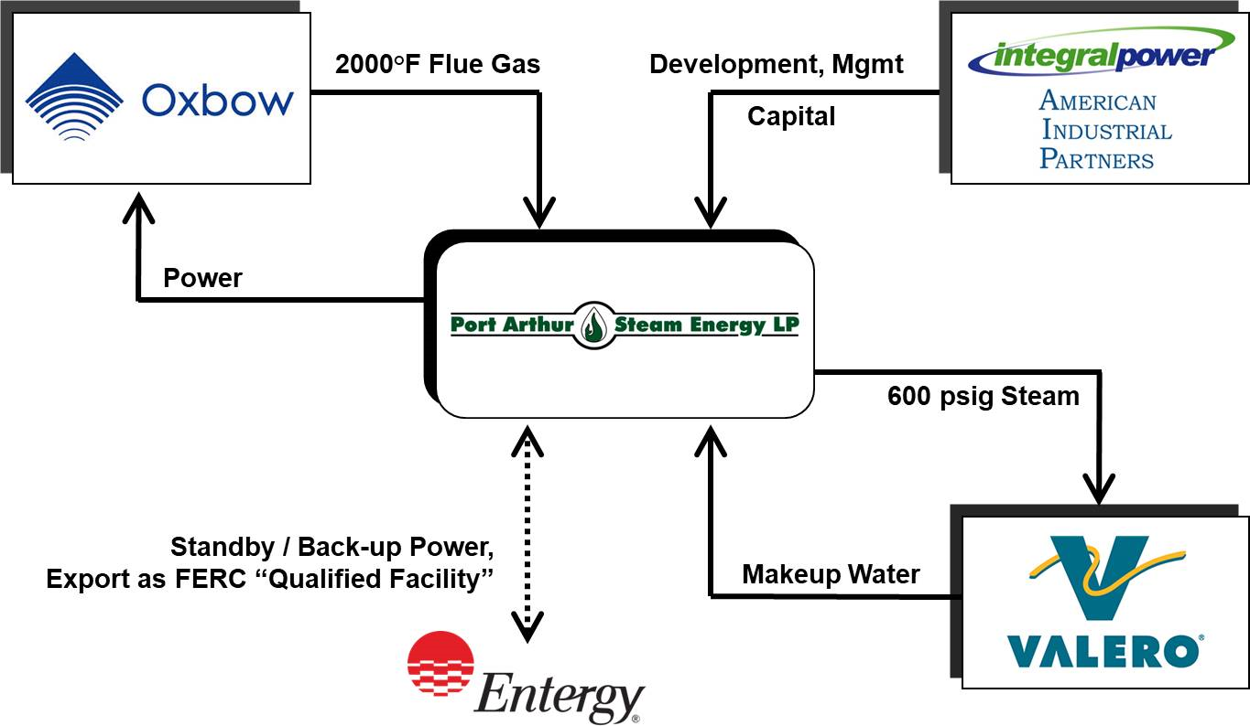
Waste Heat from Pet Coke Calciners
Waste Heat
2,000°F kiln exhaust
Power Generation
5 MW plus 450,000 pph steam
32,000 MWh + 3.6 trillion BTU steam annually
Used onsite; excess sold to utility
Key Benefits
Saves $2.5-$5 million/yr in electric and natural gas costs
Replaces ≈3.6 trillion BTUs/yr fuel
CO₂ emissions reduced ≈159,000 tons/yr
EPA Energy Star Award 2010
Can operate in island mode, power critical processes
15 full time jobs
Key Players
Oxbow – 3 pet coke calcining kilns
PASE – uses Oxbow waste heat to make steam
Valero – purchases steam for process use
Entergy – provides standby and back-up power, purchases excess power
Integral Power- project developer, owner, operator

Slide 17
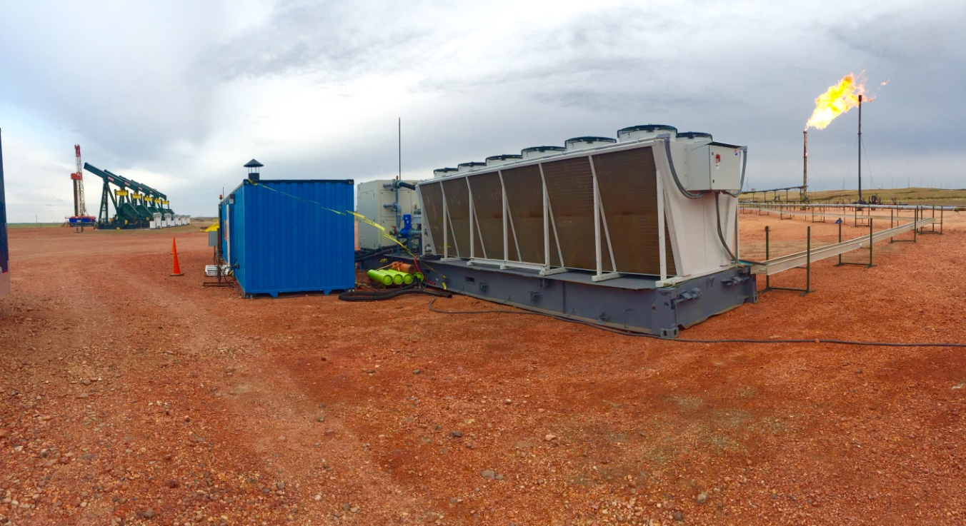
Flare Elimination at Oil Well in Bakken
Flare
Boiler
ORC heat exchanger + generator
hot water
65 kW
Power Generation
65 kW system; 103,500 kWh/4 months
Waste gas bypasses flare
Power used onsite or delivered to grid
Key Benefits
Payout in 1-2 years with mandated oil production curtailment due to flare restrictions
Modular, moveable, remote operation
Emissions vs. flare
CO₂  89%
NOx  48%
VOC  93%
Demonstration project: HARC, Hess, ElectraTherm, Gulf Coast Green Energy, Texas
A&M, Env. Friendly Drilling Program
Notes:
Flared gas can be captured and used to generate electricity
In places where infrastructure does not allow for gas transportation, processing and distribution, generating electricity is a beneficial use that can be used to comply with Colorado’s strict methane rules
Recycled energy can be used anywhere there are flares, including oil and gas production, processing, and refining facilities; petrochemical plants; wastewater treatment plants; landfills

Slide 18
WHP Policies, Incentives, Financing

Slide 19
Renewable Portfolio Standards & Goals
20 states include WHP (various names including recycled energy)
Definitions in the upper west region:
CO: Recycled Energy: converts otherwise lost energy from the heat from exhaust stacks or pipes to electricity and does not combust additional fossil fuel
SD & ND: Recycled Energy System: electricity produced from currently unused waste heat resulting from combustion or another process, that does not use additional combustion
UT: Waste gas and waste heat capture or recovery: energy derived from methane gas from an abandoned coal mine or a coal degassing operation, a waste gas, or waste heat capture or recovery system, whether or not it is renewable
See exclusions on next slide
MT’s RPS does not include WHP
Notes:
CO and MT have RPS
ND, SD, UT have renewable portfolio goals
WHP included CO, ND, SD and UT
CHP systems in CO, MT, ND, SD, and UT are eligible only if they are fueled by a renewable resource such as biomass

Slide 20
Renewable Portfolio Standards & Goals (cont’d)
Explicitly excluded in definition of recycled energy:
Any system whose primary purpose is the generation of electricity - with caveats:
ND allows the use of waste heat from power generation systems to qualify if they consume wellhead gas that would otherwise be flared, vented, or wasted
UT allows the use of waste heat from power generation systems to qualify only if that waste heat is from a combined cycle combustion turbine that uses waste gas or waste heat
Notes:
CO and MT have RPS
ND, SD, UT have renewable portfolio goals
WHP included CO, ND, SD and UT
CHP systems in CO, MT, ND, SD, and UT are eligible only if they are fueled by a renewable resource such as biomass

Slide 21
Recycled Energy Incentives - Colorado
Renewable Energy Standard (RES)
Xcel’s Recycled Energy Incentive Program
$500/kW recycled energy installed capacity paid monthly over first 10 years of production in a 20 year contract
RECs transferred to Xcel
Tri-State
Performance payments made to member co-ops that develop recycled energy projects
RECs transferred to Tri-State

Slide 22
State Tax Incentives
Utah
Alternative Energy Development Incentive
Alternative Energy Manufacturing Tax Credit
SB 12 - offsite, remotely-located renewables including WHP
Montana Property Tax Abatement for Production and Manufacturing Facilities
North Dakota Sales and Use Tax Exemption for Electrical Generating Facilities
South Dakota
Renewable Energy System Exemption
Renewable Energy Facility Sales and Use Tax Reimbursement

Slide 23
Interconnection & Net Metering
All states in the region except South Dakota have net metering policies with varying size and fuel constraints
Standardized interconnection processes are in place in all states in some form except for ND. Wyoming interconnection is limited to biomass and other defined renewables.

Slide 24
Financing Mechanisms - Colorado
C-PACE: Commercial Property Assessed Clean Energy
WY and UT have enabling legislation but no active program
The Green Colorado Credit Reserve (GCCR)
Enterprise Zone Tax credits
TRUE Pioneer Grant and CORE Community Grants
Notes:
C-PACE: Colorado Commercial Property Assessed Clean Energy
Financing for clean energy projects at competitive rates
Loans repaid through the property tax bill, can transfer with the property when sold
The Green Colorado Credit Reserve (GCCR)
Loan loss reserve provides incentives for private lenders to make small commercial loans up to $100,000 for capital improvements that promote energy efficiency and renewable energy
Enterprise Zone Tax credits
Businesses investing in recycled energy (and other sources that qualify for the RES) in Enterprise Zones can take a refund of 80% of the credit earned
TRUE Pioneer Grant and CORE Community Grants
Grants that support projects that reduce carbon emissions and promote renewable energy and energy efficiency in the Roaring Fork Valley
Bank Financing
Traditional loans; some banks offer special rates to encourage deployment of renewable energy and energy efficiency as part of their social responsibility efforts

Slide 25
Financing for Direct Ownership
Direct Ownership
Internal Funds
Debt Financing
Equity Financing
Bonds
Loans
C-PACE

Slide 26
Financing for Third Party Ownership
Third Party Ownership
Lease Financing
Capital
Operating
Contract Financing
Power Purchase Agreement (PPA)

Slide 27
Is WHP / Recycled Energy a Good Fit for Your Facility?
Recycled Energy in the Oil and Gas Industry: Colorado Opportunities, Incentives, Assistance

Slide 28
Worksheet to Identify Heat Resources
Key info needed to evaluate site-specific potential
Plant data
waste heat source(s)
electricity consumption
energy costs
typical operating hours
frequency and duration of outages
Waste heat data
flow rate
temperature
composition

Slide 29
Upper-West CHP Technical Assistance Partnership (TAP)

Slide 30
HiP & CEO Resources
CEO Recycled Energy Fact Sheet
Oil & Gas Case Studies:
Flare Elimination
Gas Processing
Pipeline Compressor Station
Coke Calcining
All Colorado materials available here:
https://www.colorado.gov/energyoffice/recycled-energy - scroll down to “Recycled Energy for Oil and Gas Facilities”
Heat is Power one-pager about WHP

Slide 31
WHP / Recycled Energy
Questions?
Susan Brodie
Heat is Power
susandbrodie@gmail.com
630.292.1304

Slide 32
EXTRA SLIDES BELOW

Slide 33
Colorado Definition of Recycled Energy
Recycled energy is defined in Colorado’s renewable energy standard (RES):
Energy produced by a generation unit with a nameplate capacity of not more than fifteen (15) MW that converts the otherwise lost energy from the heat from exhaust stacks or pipes to electricity and that does not combust additional fossil fuel.
Recycled energy does not include energy produced by any system that uses energy, lost or otherwise, from a process whose primary purpose is the generation of electricity, including, without limitation, any process involving engine-driven generation or pumped hydroelectricity generation.
Colorado Revised Statutes Title 40 Utilities § 40-2-124

Slide 34
Colorado’s Renewable Energy Standard
RES is the key policy driver for renewable and recycled energy projects in Colorado
Requires electricity providers to obtain a minimum percentage of their power from “eligible energy sources,” including recycled energy and renewable energy, by 2020:
30% for investor-owned utilities (IOUs)
20% for co-ops serving > 100,000 meters
10% for co-ops serving < 100,000 meters and municipal electric utilities serving > 40,000 meters
3% of electricity must come from distributed renewable energy

