Slide 1


GENERAL OVERVIEW OF PFAS
PER- AND POLYFLUOROALKYL SUBSTANCES
25th International Petroleum Environmental Conference November 1, 2018

Slide 2
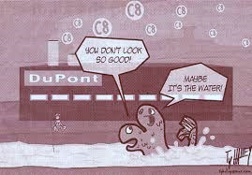
Today’s Topics
PFAS Naming Conventions
Physical/Chemical Properties of PFAS
Sources of PFAS and Potentially-affected Sites
AFFF
Sampling Issues and Quality Control
Regulatory
Treatment

Slide 3
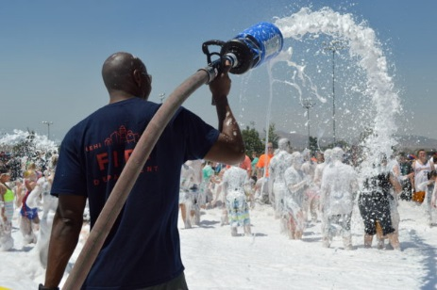
PFAS Naming Conventions

Slide 4
Quick Chemistry Lesson #1
  Remember: PFAS are Per and Polyfluoroalkyl substances
  Per-fluoroalkyl substances: fully fluorinated alkyl tail
  Perfluoroalkane carboxylates (or carboxylic acids): PFCAs
F
F
F
F
F
F
O
COOH = Head
F
C
C
C
C
(PFOA)
C
C
C
C
OH
F
PFAAs
F
F
F
F
F
F
F
Alkyl tail, fully fluorinated
  Perfluoroalkane sulfonates (or sulfonic acids): PFSAs
F
F
F
F
F
F
F
F
F
C
C
C
C
(PFOS)
C
C
C
C
SO₃H
SO₃H = Head
F
F
F
F
F
F
F
F

Slide 5
Quick Chemistry Lesson #2
  Remember: PFAS are Per and Polyfluoroalkyl substances
  Poly-fluoroalkyl substances: non-fluorine atom (typically hydrogen or oxygen) attached to at least one carbon atom
Fluorotelomer Alcohol (8:2 FTOH)
F
F
F
F
F
F
F
F
C
C
C
C
C
C
C
C
C
C
OH
F
F
F
F
F
F
F
F
F
Non-fluorine atom on one or more carbons.
Polyfluoroalkyl substances may also be degraded to perfluoroalkyl substances (e.g., PFOS or PFOA): PRECURSORS

Slide 6
What Are PFAS?
  Poly- and per-fluoroalkyl substances
    Generic family of chemicals
    Manmade and do not occur naturally
    Used since 1940 (Critical for the Manhattan Project)
    Can be branched or unbranched
    Short chain or long chain
    Used to make products that resist heat, oils, grease, stains, and water
Most prevalent and researched: PFOA and PFOS

Slide 7
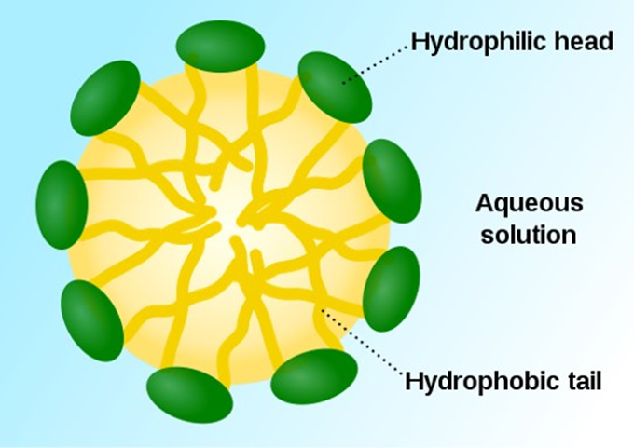
Chemical Properties of Perfluoroalkyl Substances
A PFAS Micelle
C-F: Strong bond
Chemically and thermally stable
Water soluble and mobile in groundwater
Surfactant properties
Recalcitrant in environment

Slide 8
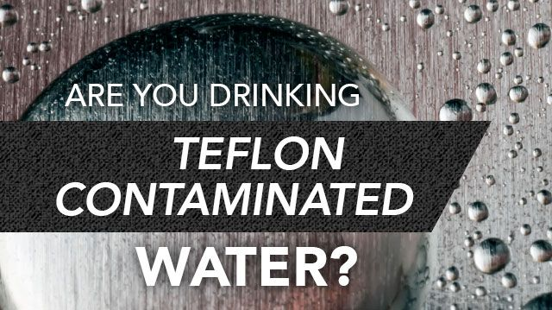
Sources of PFAS and Potentially Affected Sites

Slide 9

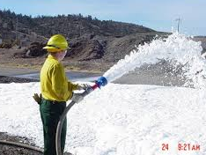
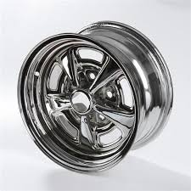

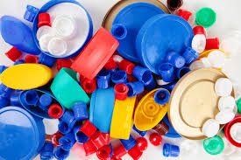



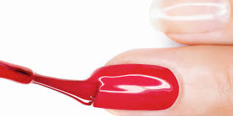
Where Are PFAS Used?

Slide 10
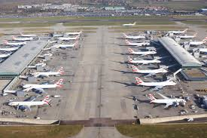
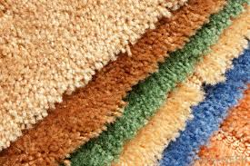
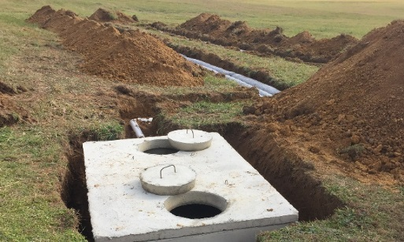
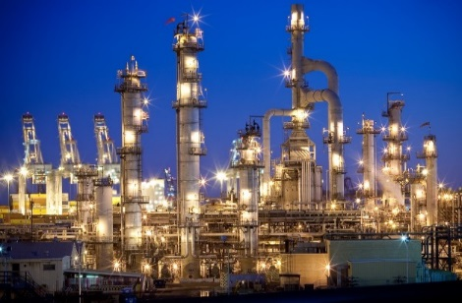
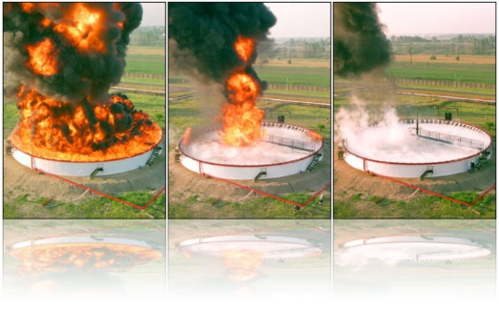
What Types of Sites Can Be Sources of PFAS?
Fire training facilities
Fire stations
Refineries
DoD sites/Military bases
Commercial and private airports
Landfills (leaching from consumer products)
Biosolids land application
Rail yards
Chemical facilities
Plating facilities
Textile/carpet manufacturers
Residential areas with septic systems

Slide 11
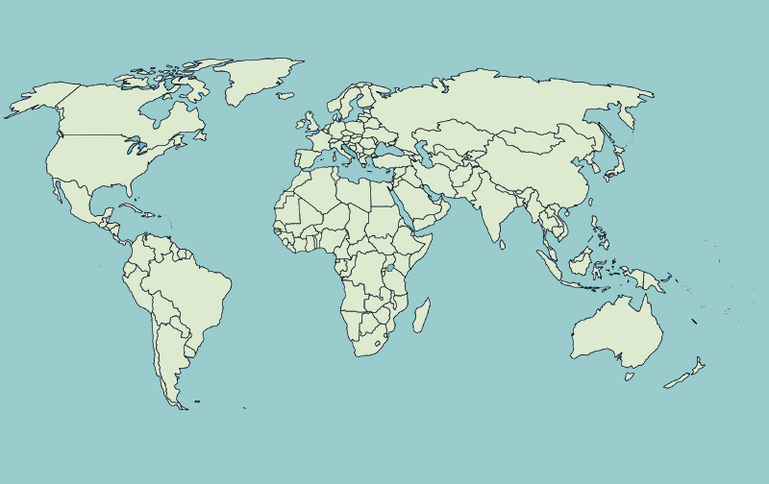

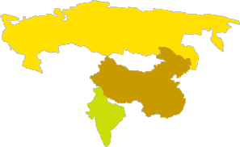




Global Manufacture and Use of PFAS
Banned Sale, Use and Import of PFOA
Prohibits Import, Manufacture,
Use & Sale of PFOS/PFOA
Class B AFFF with
PFAS Banned
PFOA & PFOS No Longer Produced
Restrict Manufacture, Import, Export, and Use of PFOS
Increased Production of PFOA
EtFOSA Produced on Industrial Scale
PFAS Manufactured Globally

Slide 12
  Aqueous Film Forming Foam (AFFF)
Notes:
So, let’s get into the fire fighting foams that is of most interest to the fuel and petrochemical manufacturers.

Slide 13
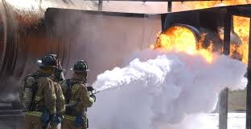
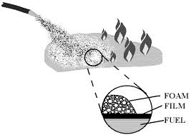
What is AFFF?
Highly effective fire-fighting foam
Used for hydrocarbon fuel fires
AFFF acts as:
  An aqueous foam: primary fire extinguishing agent
  An aqueous film former: a fuel vapor suppressor

Slide 14
Where is AFFF Used?
Airports (military/domestic)
Petrochemical Facilities
Municipal Fire Dept.
Industrial Fixed Systems
Military / Government
Marine – Off Shore Fire Protection
Where:
  Historical Use (where used to fight a fire)
  Fire Training Areas
  Nozzle Testing Areas
  Storage Areas

Slide 15
Types of Fluorine-Based AFFF
Legacy 1st Generation AFFF
2nd Generation Fluorotelomer & Precursors AFFF
Modern Fluorotelomer AFFF
PFOS based (80%)
Telomer based (20%)
Developed in 1960s
Production ended in 2002
Inventory remains in many locations
Contain or breakdown to PFOS & PFHxS and possibly PFOA
Sold from 1970s - 2016
Telomers
PFOR compounds (R= cationic and anionic heads) “precursors”
PFOR – transformation to sulfonates and carboxylates
Long-chain fluorotelomers (8:2 FTS) can breakdown to PFOA
Most foam mfrs transitioned to this
No PFOS and no breakdown to PFOS
Short-chain fluorotelomers
(6:2 and 4:2 FTS)
May contain trace amts of PFOA and PFOA precursors
Considered lower in toxicity and reduced BAP
Notes:
The original fluorinated AFFF was made with PFOS, by 3M. Of course others got into the business with other compounds. The fluorotelemers are these polyfluoro substances that can degrade to other perfluoro substances. Currently the fluorotelomer AFFF are using shorter chain polyfluoro substances. These changes in the types of AFFF can be used to fingerprint different sources of AFFF and to fingerprint multiple sources (e.g., separating a landfill PFAS from an AFFF PFAS source).

Slide 16

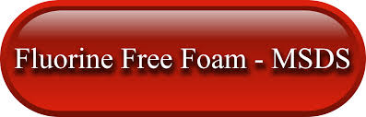
Fluorine-Free Foams
Alternative to AFFF in some applications
Being used at some airports and industrial facilities in Europe, Australia, and other countries
Do not contain PFAS or other persistent chemicals
Contain hydrocarbon surfactants, solvents, and stabilizers
Fluorine-Free Foams available since early 1900s

Slide 17

PFAS Sampling Issues and Quality Control

Slide 18
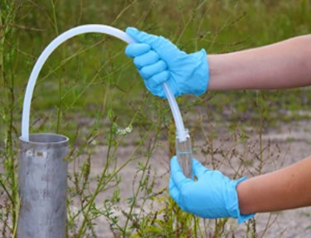
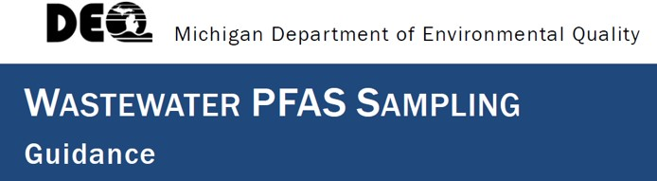
How Do We Sample PFAS?
Similar to conventional sampling
(e.g., low-flow techniques, direct push, etc.)
Special care required to prevent cross contamination
Use of and exclusion of specific sampling equipment and materials

Slide 19
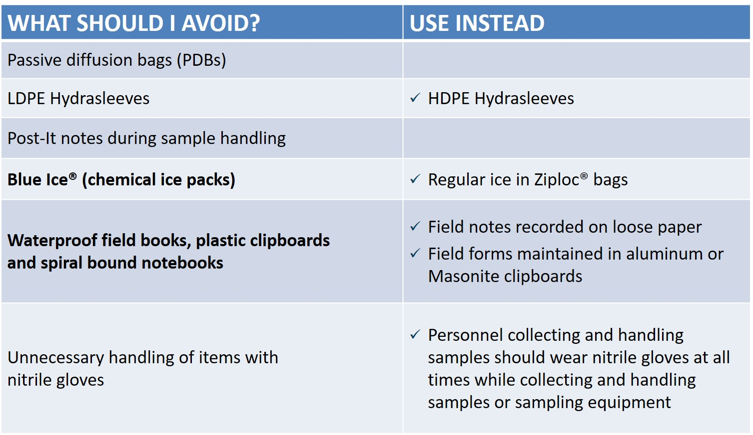
PFAS Sampling Dos and Don’ts

Slide 20
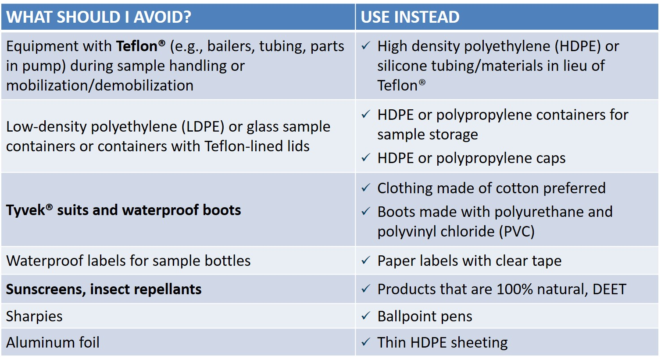
PFAS Sampling Dos and Don’ts continued

Slide 21
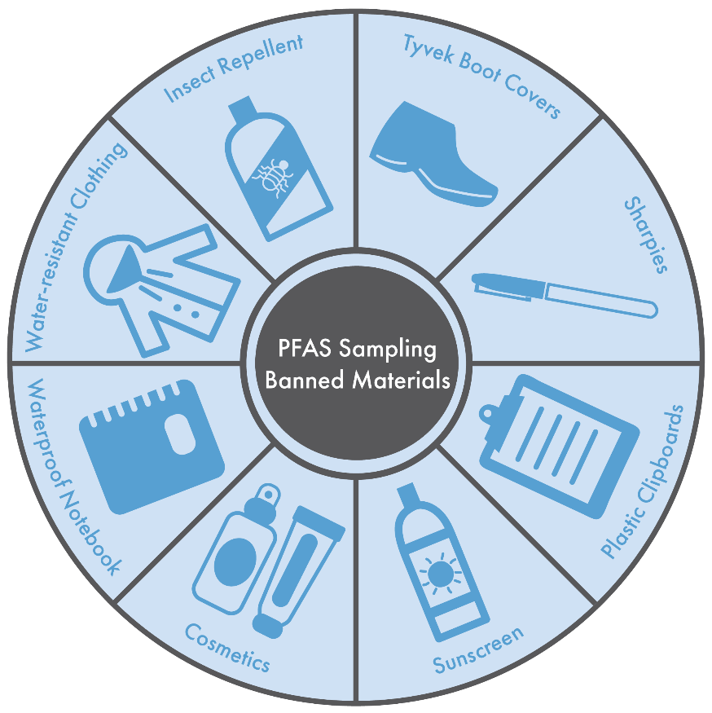
Other Special Considerations
Field QC
Decontamination of sampling equipment
No pre-wrapped food or snacks
Avoid cosmetics, moisturizers, hand creams
on day of sampling.
Do not filter aqueous samples.
Visitors to site must remain at least 30 feet from sampling area.
Wash hands with water after leaving vehicle before setting up on a well.
Partitioning of PFAS to surface in wells and reservoirs

Slide 22

  PFAS Fate and Transport
Notes:
PFAS compounds are soluble in water, are not strongly adsorbed to soils, and have very low standards, and the Per fluourinated compounds are stable, not biodegradable. So, they are mobile in surface water and groundwater. But how mobile?

Slide 23
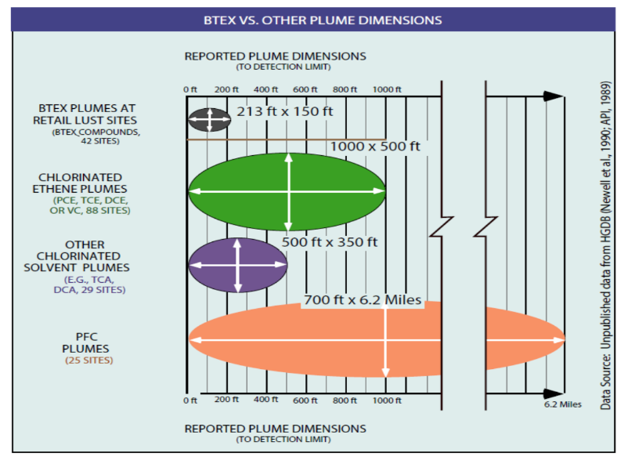
PFAS Mobility
BTEX Plumes
BTEX Plumes
BTEX Plumes
BTEX Plumes
Chorinated Ethene Plumes
Chorinated Ethene Plumes
Chorinated Ethene Plumes
Other CVOC Plumes
Other CVOC Plumes
PFAS Plumes
Q
Theses PFAS sites are owned by DoD and are mostly Airforce bases
Notes:
BTEX plumes are typically pretty small because of their biodegradation. Chlorinated VOC plumes can be much larger, extending out up to 10,000 ft. But for comparison, PFAS plumes can be much longer because they don’t degrade AND because the standard is so much lower. For CVOCs you’re looking at detection limits of say 1 ug/L, but for PFAS your detection limits are <0.07 ug/L.

Slide 24
  PFAS Environmental Regulations
  What is Occurring? – What to Expect?
Notes:
Let’s jump over to the regulatory programs. What is going on around the country, and what can you expect?

Slide 25
PFAS: The Rapidly Changing Regulatory Landscape
Follow ITRC for updates
https://pfas1.itrcweb.org/fact-sheets/
State | Year | Type | Promulgated? | PFOA | PFOS | PFNA | Other PFAS | Gen-X
 |  |  |  | (µg/L)
Alaska (AK) | 2016 | GW | Y | 0.40 | 0.40
Connecticut (CT) | 2016 | GW |  | 0.07 | 0.07 | 0.07 | Y
Colorado (CO) | 2017 | DW |  | 0.07 | 0.07 |  | Y
Delaware (DE) | 2016 | GW |  | 0.07 | 0.07 |  | N
 | 2016 | GW |  | 0.07 | 0.07 |  | Y
Iowa (IA) | 2016 | Protected GW | Y | 0.07 | 0.07 |  | N
 |  | Non-protected GW | Y | 0.7 | 1 |  | N
Maine (ME) | 2016 | DW |  | 0.07 | 0.07 |  | N
 | 2016 | GW |  | 0.13 | 0.56 |  | N
 | 2016 | RW |  | 0.05 | 1.2 |  | N
Michigan (MI) | 2015 | SW | Y | 0.42 | 0.011 |  | N
 | 2018 | GW | Y | 0.07 | 0.07 |  | N
Minnesota (MN) | 2017 | GW |  | 0.035 | 0.027 |  | Y
 | 2017 | GW |  | 0.035 | 0.027 |  | Y
 | 2017 | GW |  | 0.035 | 0.027 |  | Y
Nevada (NV) | 2015 | DW |  | 0.667 | 0.667 |  | Y
New Hampshire (NH) | 2016 | GW | Y | 0.07 | 0.07 |  | N
New Jersey (NJ) | 2015 | GW | Y |  |  | 0.010 | N
 | 2017 | GW | P |  |  | 0.010 | N
 | 2017 | DW | P |  |  | 0.013 | N
 | 2017 | DW | Y | 0.014 |  |  | N
North Carolina (NC) | 2006 | GW | Y | 2 |  |  | N
 | 2017 | DW |  |  |  |  | N | 0.14
Oregon (OR) | 2011 | SW | Y | 24 | 300 | 1 | Y
Texas (TX) | 2017 | GW | Y | 0.29 | 0.56 | 0.29 | Y
Vermont (VT) | 2018 | DW/GW | Y | 0.02 | 0.02 | 0.02 | N
State | Year | Type | Promulgated? | PFOA | PFOS | PFNA | Other PFAS | Gen-X
 |  |  |  | (µg/L)
Alaska (AK) | 2016 | GW | Y | 0.40 | 0.40
Connecticut (CT) | 2016 | GW |  | 0.07 | 0.07 | 0.07 | Y
Colorado (CO) | 2017 | DW |  | 0.07 | 0.07 |  | Y
Delaware (DE) | 2016 | GW |  | 0.07 | 0.07 |  | N
 | 2016 | GW |  | 0.07 | 0.07 |  | Y
Iowa (IA) | 2016 | Protected GW | Y | 0.07 | 0.07 |  | N
 |  | Non-protected GW | Y | 0.7 | 1 |  | N
Maine (ME) | 2016 | DW |  | 0.07 | 0.07 |  | N
 | 2016 | GW |  | 0.13 | 0.56 |  | N
 | 2016 | RW |  | 0.05 | 1.2 |  | N
Michigan (MI) | 2015 | SW | Y | 0.42 | 0.011 |  | N
 | 2018 | GW | Y | 0.07 | 0.07 |  | N
Minnesota (MN) | 2017 | GW |  | 0.035 | 0.027 |  | Y
 | 2017 | GW |  | 0.035 | 0.027 |  | Y
 | 2017 | GW |  | 0.035 | 0.027 |  | Y
Nevada (NV) | 2015 | DW |  | 0.667 | 0.667 |  | Y
New Hampshire (NH) | 2016 | GW | Y | 0.07 | 0.07 |  | N
New Jersey (NJ) | 2015 | GW | Y |  |  | 0.010 | N
 | 2017 | GW | P |  |  | 0.010 | N
 | 2017 | DW | P |  |  | 0.013 | N
 | 2017 | DW | Y | 0.014 |  |  | N
North Carolina (NC) | 2006 | GW | Y | 2 |  |  | N
 | 2017 | DW |  |  |  |  | N | 0.14
Oregon (OR) | 2011 | SW | Y | 24 | 300 | 1 | Y
Texas (TX) | 2017 | GW | Y | 0.29 | 0.56 | 0.29 | Y
Vermont (VT) | 2018 | DW/GW | Y | 0.02 | 0.02 | 0.02 | N
International:
Australia
Canada
Denmark
Germany
Italy
Netherlands
Sweden
UK
Residential soil and soil leaching standards exist also.
Notes:
Here’s a short summary of state’s with PFAS standards. Note the dates of these standards – 2015, 2016, through 2018. They’re all very recent. For example, look at Mich – their drinking water and gw remediation standards are 0.07 ug/L. Here in Texas, the standards are quite a bit higher, at 0.25 ug/L. These are both really low compared to the typical CVOC standards of 5 ug/L.
An easy way of keeping track of changes in state standards is through the ITRC guidance documents for PFAS.

Slide 26
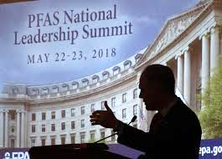
PFAS: The Rapidly Changing Regulatory Landscape
Examples over the last several months
Congress (Oct. 2, 2018) passed a bill to allow discontinuation of PFAS in airport fire fighting foams
EPA PFAS Summit – May 2018
  Initiate steps to evaluate need for MCLs
  Groundwater cleanup standards by fall of 2018
  Liability under CERCLA – PFOS/PFOA as haz. substances
  Held 5 PFAS listening sessions around the country (NH, PA, CO, NC, KS)
Michigan: Since the end of 2017 MI DEQ has:
  Set standards for:
    Drinking water and Groundwater Remediation
    WWTP discharge standards
    Air emission standards
  Required all POTWs to evaluate their industrial influents as PFAS sources
New Hampshire has required all landfill groundwater monitoring programs to analyze for PFAS
Community Action Groups analyzing for PFAS (e.g., A New York Landfill expansion permit)
Notes:
The regulatory landscape is rapidly changing. For example: just this month, congress passed a bill to allow discontinuation of PFAS in airport AFFF.
Mr. Pruitt hosted an EPA PFAS summit meeting in May 2018, in which he committed EPA to:
Start evaluating whether
NYSDEC environmental sites sampling for PFAS, PFOA and PFOS are now on the hazardous substance list, and fire fighting foams that contain PFOA or PFOS are prohibited
Colonie LF opposition group collected nearby surface water samples, detecting PFOA in stormwater (68 ppt), in seeps near the Mohawk River (519 ppt), and in samples from the River (1-3 ppt)
California potentially identifying carpets with PFAS as “priority products” with special requirements.
Wisconsin has soil standards for PFOA and PFOS, but no groundwater standards yet.

Slide 27
  PFAS Environmental Regulations
  How to Manage?

Slide 28

PFAS – Sampling and Analysis
When, Where, What, Why and How?
Know where your PFAS-use sites are and their risk.
  With respect to water supplies – especially those with PFAS
  Adjacent surface water bodies
AFFF Inventory
Change out legacy AFFF
Develop SOPs for cleanup after use of AFFF
Inventory of historical use, training, storage & testing sites
Assess potential sensitive receptors
Review state inventories
Notes:
Know where your PFAS use sites are located. You’re bound for surprises if you don’t know where are how you’ve used these compounds. Does this a records search? Done under Attorney privilege? You can prioritize actions on sites until you know what you have.
PFAS Analytical methods:
Analysis of PFCs can be limited to just the two with standards or include a wider range of PFCs. The value of including a wider range is to fingerprint the source of PFCs.
Potential for precursors?
State requirements?
Other PFAS for forensics?
Data validation can be critical – examples: a private well with a positive VC dete
Sampling protocols, especially for PFCS need to consider things as sub

Slide 29
PFAS Remediation Alternatives - Water
Fate and Transport/ Remediation Challenges
Low Volatility (rules out stripping)
Moderate solubility
Strength of C-F Bond
Treatment efficiency must be very high because of low (ppt) remediation objectives
Ex-Situ Technologies
Sorption/Ion Exchange
  Carbon (can be effective for some PFAS, but can be inefficient)
  Ion Exchange Resins (costly)
Emerging technologies:
  Reverse Osmosis
  Membrane filtration
  Thermal Treatment
  SAFF – Surface Activation Foam Fractionation
In Situ Technologies
Emerging(?) technologies:
  Carbon injection
    PRB or Source Area
  Electro-Chemical Oxidation
  ART In-Well Circulation System
Notes:
Now unfortunately, we don’t have a lot to say about remediation of PFAS in soil, groundwater or surface water. Currently the predominant response is removal and treatment – soil excavation and disposal, or groundwater extraction and treatment. There’s a lot to be discussed on what the best carbon treatment method should be used for groundwater treatment, but its still a pump and treat. There are some emerging technologies, for instance discussed at the Battelle conference in April. There’s a carbon injection method that can potentially sequester the PFAS, and there’s a electro-chemical oxidation technology that has positive bench scale studies that can destroy PFAS.

Slide 30

Plug for ITRC PFAS Team
Includes >350 members: industry, academia, DOD, regulatory, consulting, analytical labs and vendors
Seven PFAS Fact Sheets:
  AFFF Introduction
  History and Use
  Naming Conventions and Chemical Properties
  Regulations and Guidance
  Fate and Transport
  Site Characterization, Sampling, Lab Methods
  Remediation Technologies and Methods
2018 – Technical Guidance Document

Slide 31
Elizabeth Denly, ASQ CMQ/OE
P: (978) 656-3577 | E: EDenly@trcsolutions.com
www.trcsolutions.com
Acknowledgements:
Ken Quinn, TRC Technical Director
Mike Eberle, TRC Program Manager

