Slide 1
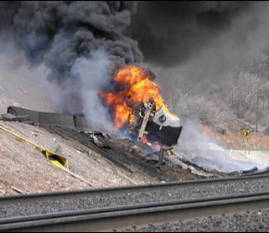
From Tanker Roll-Over to NFA
Theresa Sorrells
Alpine Remediation, Inc.
Golden, CO

Slide 2
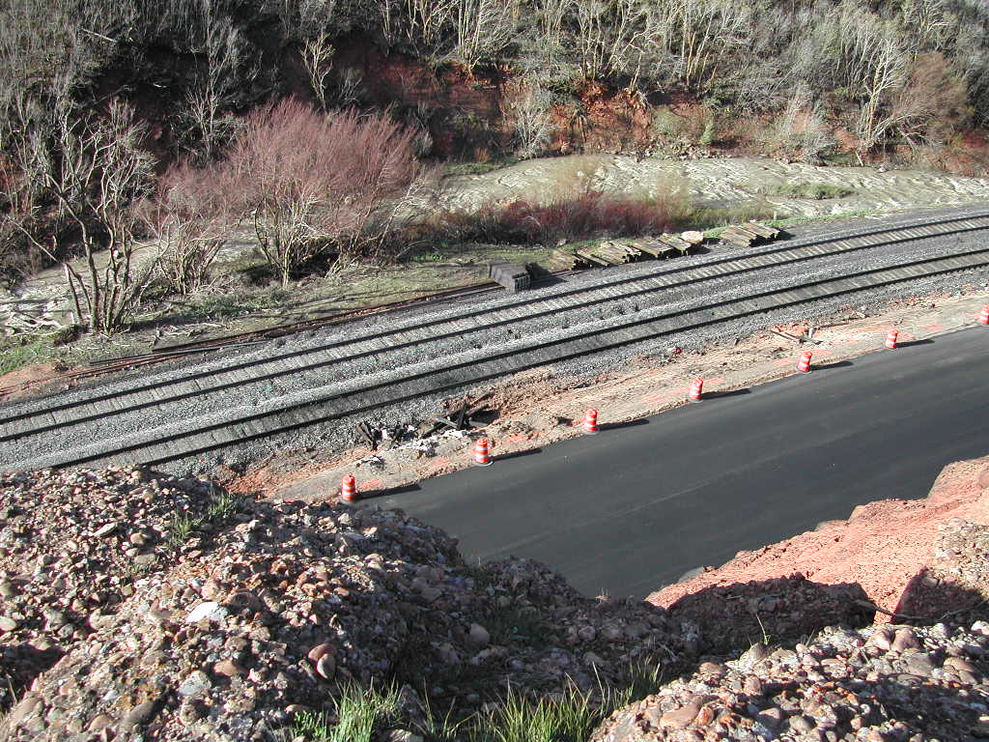
Remote Location in Utah State with Many Obstacles
Railroad Tracks
Creek
Sloping Shoulder

Slide 3
Remediation Considerations
Remoteness of Site
No Access to Power
Ruled Out Mechanical Systems
Spill Occurred 60 feet from Creek
Needed Immediate Results
Remedy Could Not Negatively Impact Water Quality
Ruled Out Surfactants & Nutrients
Sloping Roadway Shoulder
Large Trucks Could Not Access
Ruled Out Excavation
Active Railroad Tracks with Two Way Traffic
Also Ruled Out Excavation

Slide 4
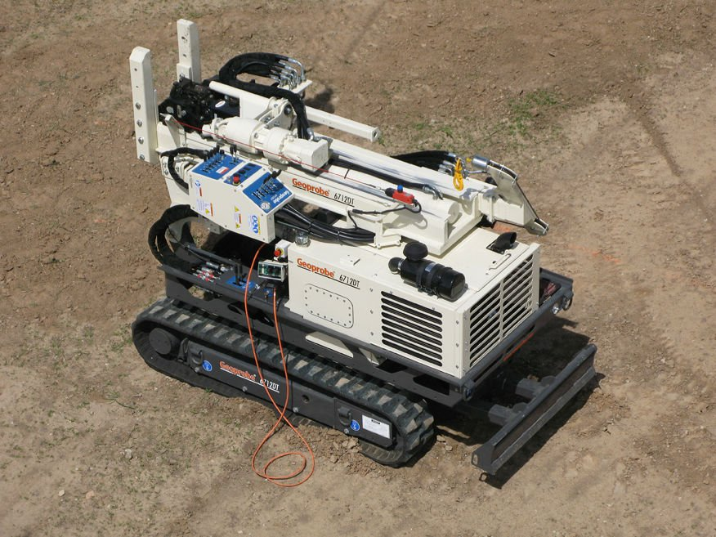
Solution Chosen
In Situ Injections of BOS-200®

Slide 5
BOS 200®
A Carbon/Biological based product consisting of:
Activated Carbon
Calcium sulfate
Nitrate
Micro and macro nutrients
Consortium of facultative bacteria
Two primary treatment mechanisms take place with BOS 200®:
The first mechanism is the “Trap”: BOS 200® uses activated carbon to adsorb petroleum hydrocarbons.
Biodegradation, the “Treatment”, is the second mechanism of BOS 200® remediation
An ideal environment for the biological process, where hydrocarbons are adsorbed on to BOS 200® particles

Slide 6
Work/Design Considerations
Spill consisted of several thousand gallons of fuel
Site lithology was sand & gravel with bedrock starting between 12 & 18 feet
Groundwater benzene concentrations were as high as 14 mg/L
Spill impacted approximately 7,000 square feet
Spill impacted both sides of railroad tracks
Trains had Right of Way
Work had to be halted & equipment moved for oncoming trains
All non-essential equipment had to be parked on shoulder of road
Essential equipment had to be hauled across the railroad tracks, which involved disassembling & reassembling the injection system
Not able to take any soil samples to aid in design because of access restrictions by the railroad

Slide 7
Grid Based Design
Injection boreholes located throughout 7,000 square foot treatment area
Used 10 foot triangular grid pattern to locate 70 boreholes
Injection boreholes on both sides of railroad tracks- 62 on south side and 8 on north side
IMP-1
IIMP-3
MW-1
IMP-2
IMP-4
GW Flow Direction

Slide 8
Treatment Depths
Treatment depths were based on the depth to groundwater and the depth to bedrock
Treatment on the south side of the tracks occurred between 8 and 15 feet
Treatment on the north side of the tracks occurred between 8 and 12 feet
Change in final injection depth was due to the depth to bedrock
Top-down injections critical to success
Injectate
24”

Slide 9
Timeline
Injections were performed in June of 2010 and again in October of 2010
Groundwater was sampled in November of 2010, March of 2011, & October of 2011
BTEX and TPH-gasoline were below MCLs in all wells
NFA issued by the Division of Water Quality of the State of Utah in January 2012

Slide 10
And Again
Apr. 2012
In April of 2012, a second truck rolled over onto the railroad tracks 200 yards past the original accident.
July 2012
The same procedure was used to design the clean up the contamination. Injections occurred in July of 2012.

Slide 11
Colorado Mountain Pass
A similar technique was also used for a tanker truck rollover accident on a mountain pass in Colorado. Snow and extreme cold exist at the site from October through May, limiting access to the site.
The bulk of the spill was removed by excavation. During the excavation, an old french drain was discovered that had ultimately transported the contamination approximately 200 feet from the original spill site.
Groundwater benzene concentrations before the injections were as high as 4 mg/L and were ND after the installation.
The spill was closed shortly after installation.

Slide 12
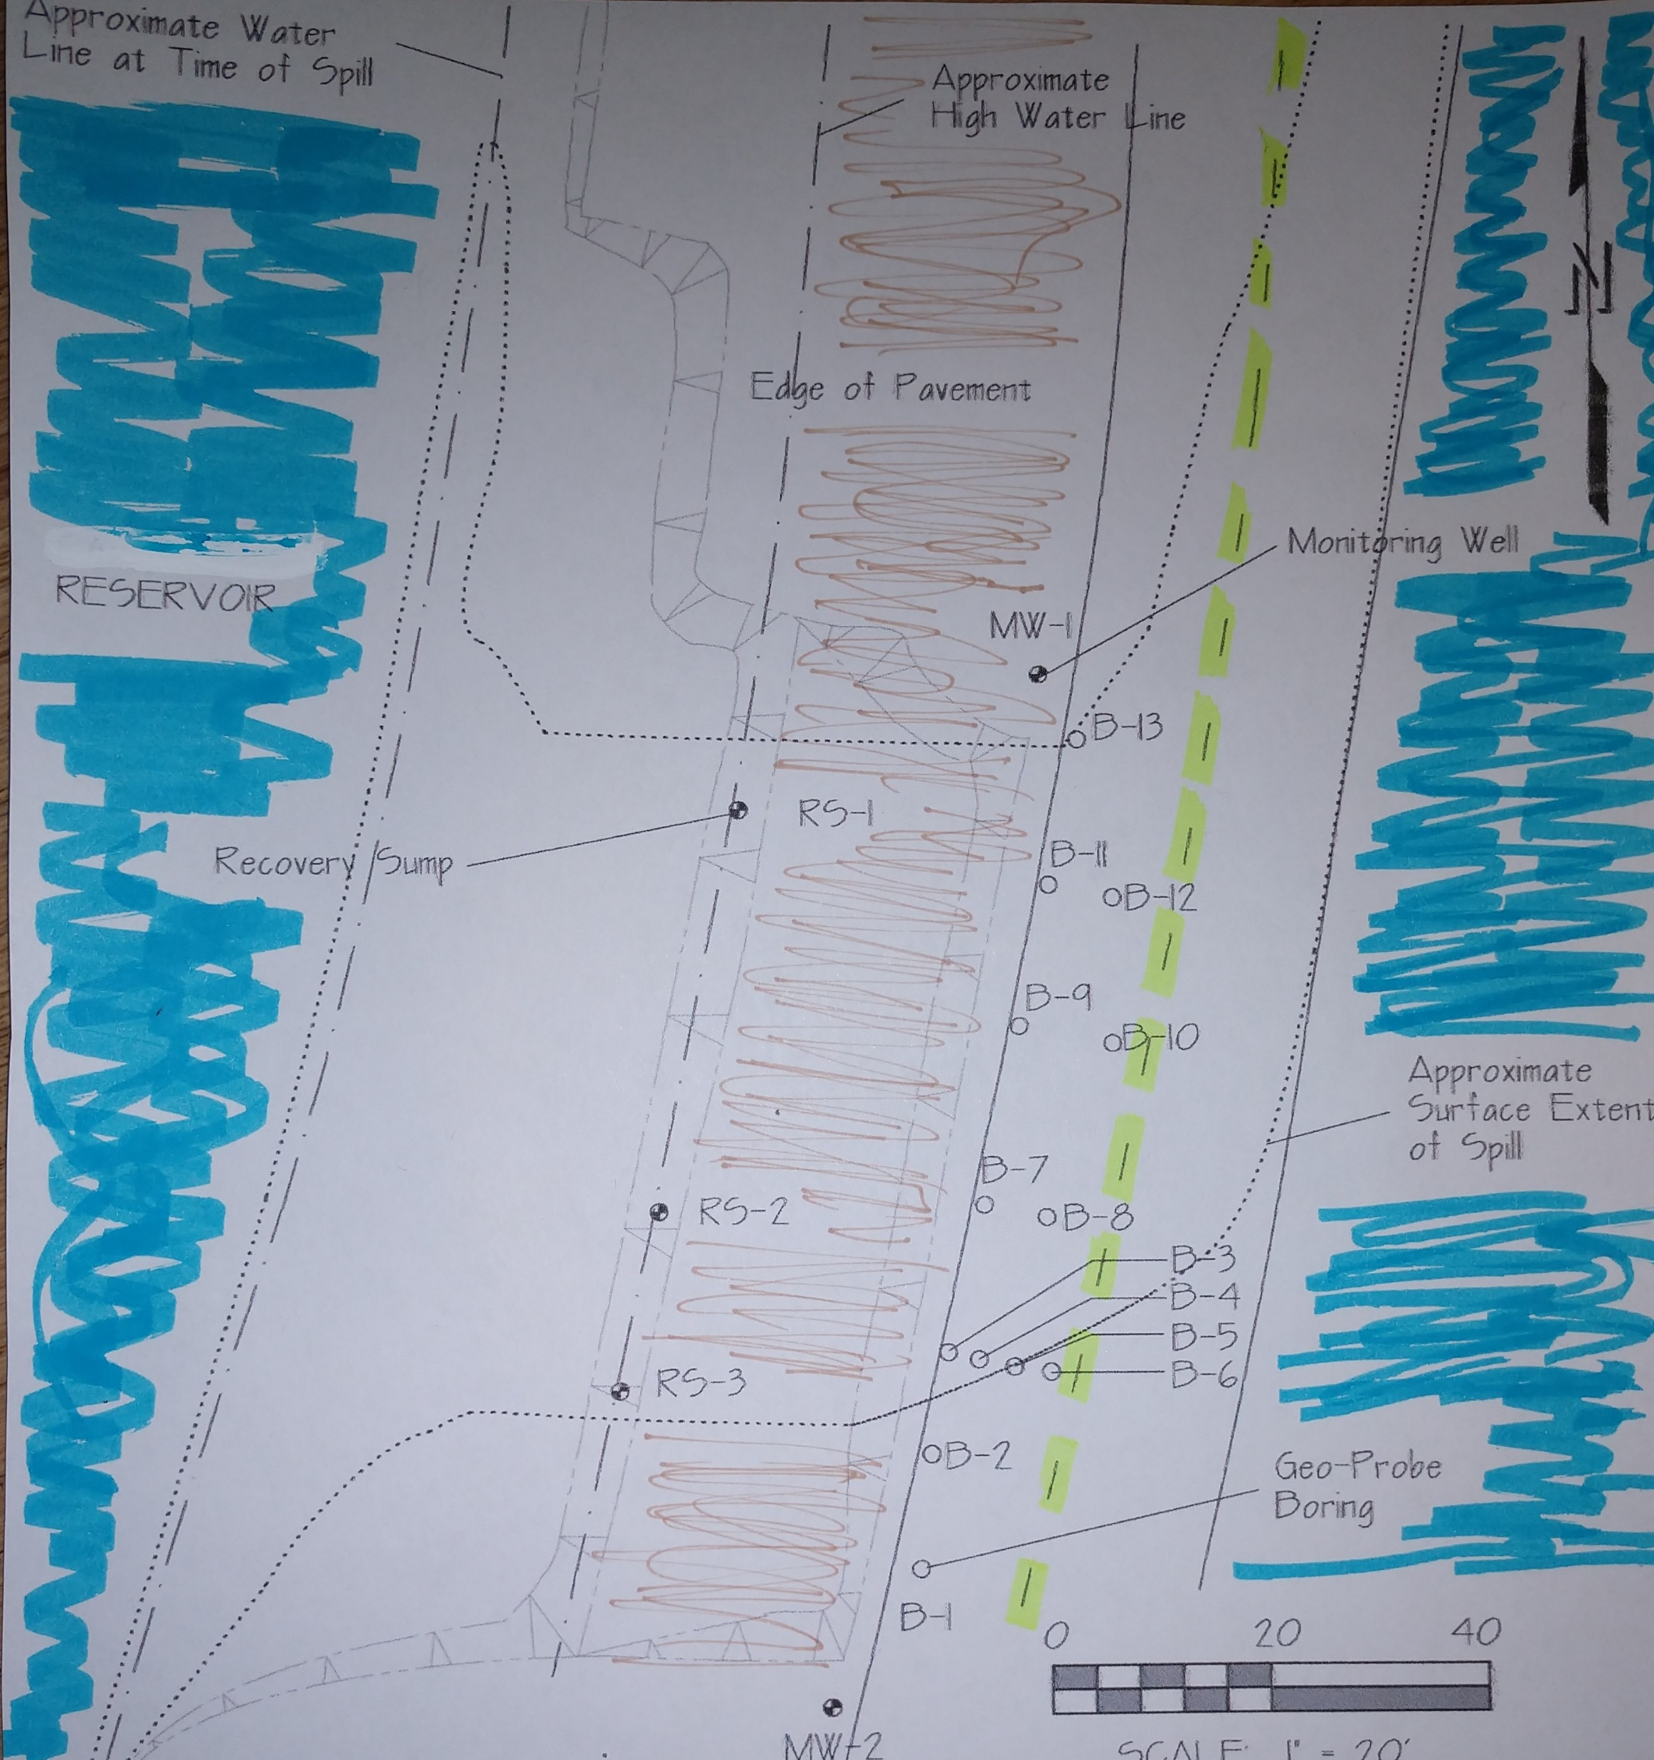
Reservoir in Idaho
Raised highway through a reservoir
Another overturned truck
6,500 gallon spill that impacted the reservoir & the surrounding area
Immediately excavated
Remaining contamination migrated down from highway level when the surface water levels dropped in the winter, danger of more impacts to reservoir
Groundwater benzene as high as 12 mg/L

