Slide 1
Findings from a Machine Learning Approach to Site Characterization
Funded in part by the National Science Foundation
US Patents Pending

Slide 2
The NSF I-Corps process
It’s not a technology looking for a purpose.
They start with practitioners in science and engineering and learn about industry challenges through dozens of interviews
Through the program we conducts over 40 interviews with people in the industry to find out ‘what bugs them the most’

Slide 3
1-on-1 interviews with industry experts
Conducted interviews with regulators, service providers, researchers, property owners, scientists, and engineers, yielding 100s of candid insights about the remediation industry
Areas suggested multiple times for improvement by both consultants and regulators:
Merging data from different sources is essential but time consuming and not budgeted
Data is collected too late to influence decisions
Projects are almost always over budget (80-100% of time)
Regulators can’t allocate enough resources to examine and approve process checkpoints
Cutting corners on site investigation leads to bad decisions
> 60% of site remedial actions are unsuccessful
Industry is slow to accept new technologies
Charging by the hour doesn’t incentivize efficient success
There is a lack of confidence in less proven technologies
The overwhelming consensus across the interviews was that incomplete site assessments lead to cost and time overruns. Better investigations can cut the total cost of remediation by half

Slide 4
Conceptual Site Model is the biggest challenge. Why?
“The quality and quantity of the data is not there when you begin a site assessment”
“If we had more information we would have a better idea of where to drill”
“In about 1/3 of projects there is something missed during the site assessment phase that hinders the remediation process”
“The CSM is incomplete”
“Lots of uncertainties”

Slide 5
Cost exceeding budget is a challenge. Why?
“It’s very common to go over budget on projects during the remediation step”
“Almost 100% of projects go over budget”
“There’s a lack of… funding at the regulator level”
“We’re always going over budget on soils projects during remediation”

Slide 6
Life cycle of a remediation project
Site Assessment/
Conceptual Site Modeling
Site Closure/
O&M
Remedial Action
Cost/Time Invested
Site Assessment/
Conceptual Site Modeling
Site Closure/
O&M
Remedial Action
Life Cycle with Envimetric

Slide 7
Machine Learning Basics
A method of data analysis that automates analytical model building
Computationally draw inferences or commonalities from large data sets, often for predictive or classification purposes
Unsupervised learning- learns structures from untagged or classified data

Slide 8
How can we apply machine learning to improve contaminated site characterization?
How could a machine learning approach fit into the existing site assessment process?

Slide 9
39,000 EPA sites
52,000 State DEQ sites
1136 sites today with 3D annotation

Slide 10
Extracting features from Reports

Slide 11
Method: extract data that matches the site in question
Match with records with the same
Contaminant type
Physiographic region
Ecological region

Slide 12
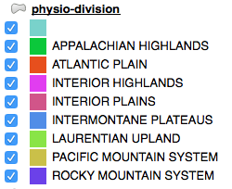
Physiographic Divisions

Slide 13
Physiographic Divisions

Slide 14
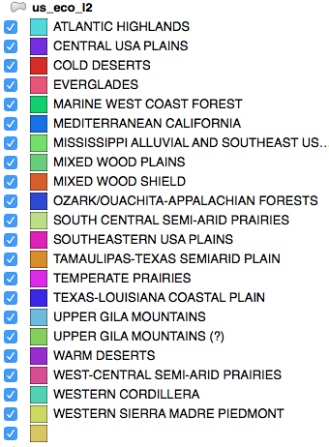
Level 2 Ecological Regions

Slide 15
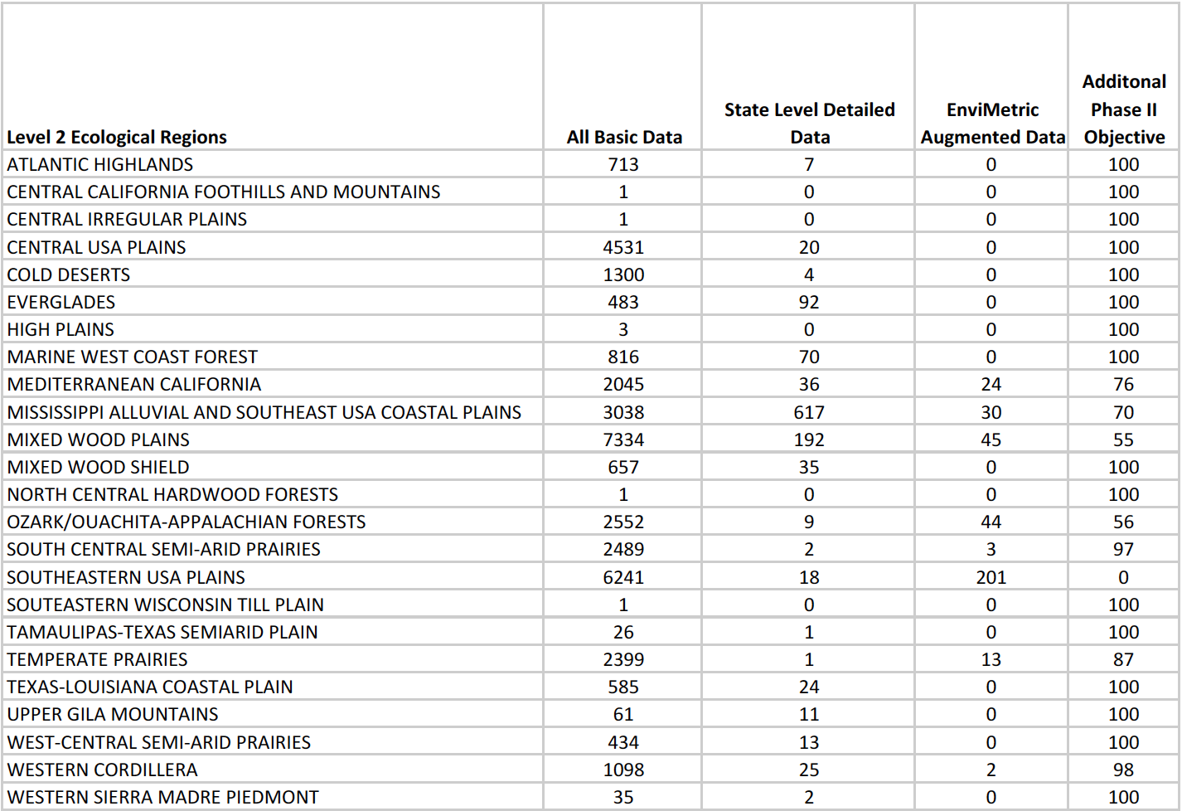
Level 2 Ecological Regions

Slide 16
Method: Preparing data for ML
Original
Medial Axis
Remove gradient effects
Measure plume outer volume

Slide 17
Method: Translate coordinates to a contaminant origin and rotate all plumes to a common orientation

Slide 18
Method: Train the machine learning model and perform cross-validation testing
100%
Area reduction
0%
0%
Capture Rate
100%

Slide 19
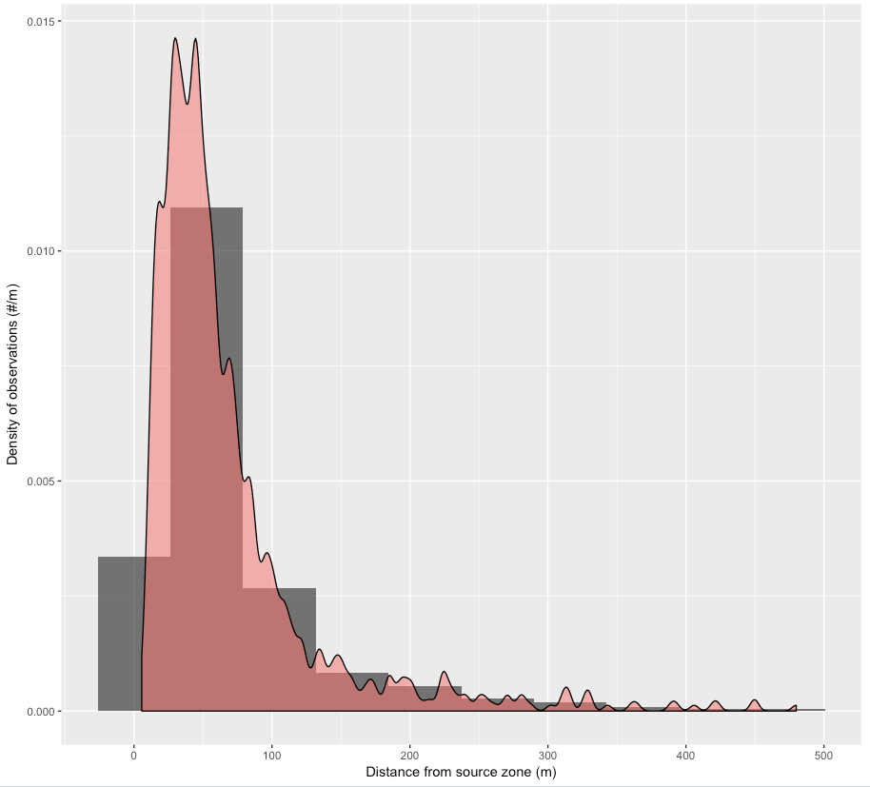
Results: distribution of downgradient distances
LNAPL signature at contaminated site in NC- lateral distance from source
Candidate Source Distance (m) | Probability (%)
0 - 50 | 23.853
50 - 100 | 20.183
100 - 150 | 18.349
150 - 200 | 11.927
200 - 250 | 8.257
250 - 300 | 3.670
300 - 350 | 6.422
350 - 400 | 1.835
400 - 450 | 1.835
450 - 500 | 1.835

Slide 20
Results: Unknown contamination destination model
Contaminated volume kernel model

Slide 21
Results: Unknown contaminant origin model
Contaminated volume kernel model

Slide 22
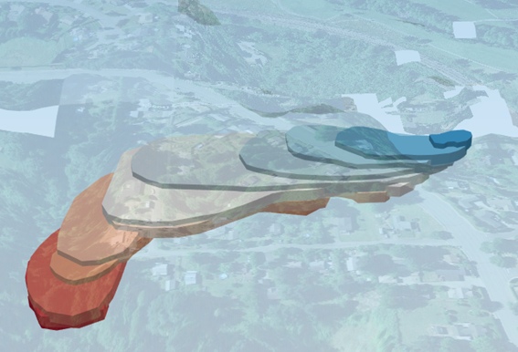
Results: the model output is then transferred onto contaminated site

Slide 23
Continuing work
We were recently awarded a Phase 2 grant from NSF to continue data collection and refinement of the model
Through further automation we can reduce the time to produce our statistical site assessment
We are looking for pilot areas for current projects that can test the EnviMetric results.

Slide 24
THANK YOU TO OUR INTERVIEWEES!

Slide 25
THANK YOU

