Slide 1
Factors Promoting and Affecting Produced Water Recycling in the Permian Basin
Presented by: Richard Bost, P.E., P.G. (Texas)
and Don Whitley, P.G., multiple states
I2M Associates

Slide 2
Co-Authors and Acknowledgements
Many thanks to
Don Gorber and Lloyd Torrens, Independent Environmental Consultants
Jennifer Warfield, ERM & Lori Magyar, Auradon Consulting
Resourses at Texas Railroad Commission
Produced Water Society – Permian Basin
Our clients, TCEQ, CDC, and RCT and Andrew Fono, formerly of Winstead and Haynes & Boone

Slide 3
Produced Water is a New Source of Water Depending on Locale

Slide 4
Several States and Regions Have Produced Water Reuse Initiatives That Have Borne Fruit

Slide 5
Pennsylvania Case Study
Pennsylvania continues to set the pace for recycling produced water for frac-ing in the Marcellus shale versus other states in the play, with
More than 60% of the 25 million barrels produced are being stored and treated for multiple applications.
At the close of 2016, reported wastewater production from Pennsylvania’s 6,538 permitted wells declined 54% to 11.8 million barrels from a historical high of 25 million barrels in the second half of 2014.
Data based on information for over 6,500 horizontal wells

Slide 6
Produced Water Society – Technical Committee for Permian Basin
Munib Ahmad, AAA Resources Tyler Hussey, Apache Devesh Mittal, Aquatech John Walsh, Cetco Drayton Bryant, Cetco Michael Dunkel, CH2M Cheng Chen, Chevron Sheri Simpson, Chevron Kushal Seth, Gradiant Energy Services Wally Georgie, Maxoil Solutions Steve Roeder, Mustang Energy Services Matthew Goysich, MYCELX James Robinson, Oxidane Engineering Rajendra Ghimire, PFP Industries Brad Nelson, Produced Water Solutions Gregory Hallahan, ProSep Robert Bruant, Red Tree Energy
Cindy Pena, Rockwater Energy Solutions Jim Patterson, RyKor Hani Al Khalifa, Saudi Aramco Daniel Shannon, Schlumberger Michael Grossman, Scinor Water America Chris Catalanotto, Siemens Dustin Brownlow, Texas Water Solutions Management Group Ming Yang, TUV Emily Sappington, University of Houston Duane Germenis, Veolia Lisa Henthorne, Water Standard Valentina Llano, Water Standard Xandra Turner, Water Vision John Durand, WaterBridge Jay Keener, Xedia Process

Slide 7
SPE Water Handling & Management Technical Section
Water sourcing
Chemicals
Produced water and flowback water treatment
Water disposal
Operations best practice
Environmental and sustainability issues
Cooperation with other professional societies
Industry standards
US and international regulations
The SPE is currently restructuring the Water Handling & Management Technical Section and redefining its scope.
There are over 1,300 SPE members registered in the Water Handling and Management Technical Section. Any SPE member may join a technical section
SPE has envisaged that the scope of the technical section would include water management issues in both conventional and unconventional fields, such as:

Slide 8
Produced Water Re-Use: Technological Developments Help Sustain Shale Oil & Gas Well Drilling & Production Increases
Overview of Economic, Logistical, Geo-Chemical & Other Factors Affecting Water Reuse
Projections of Produced Water by 2025
Seismicity Issues
Availability of Freshwater and Demands for Water
Ground water aquifer depletion with population growth
Increasing agricultural and commercial/industrial demand
Horizontal well fracturing most with freshwater
Or with blending in freshwater
Produced Water Chemistry Issues
Had limited utility for reuse in fracturing
Produced Water Management Options
Deep Well Disposal-historical method of choice
Direct Filtration and Reuse
Advanced Treatment for Reuse
Treatment and Discharge
Experience with Water Reuse/Recycling

Slide 9
Overview of Economic, Logistical, GeoChemical & Other Factors Affecting Water Recycling in Permian Basin
Economic: Huge increase in drilling & production with water-to-oil ratios of up to 5:1 is driving up demand and Injection Well disposal costs for Produced Water making recycling more affordable
Economic: Water flooding EOR is less economical
Economic & Produced Water Projections: Water costs are expected to double to $22 Billion by 2025 ($1/bbl to $6/bbl)
Logistical: Increased length, density and number of horizontal wells means greater volumes of injection in a single location: increasing injection pressures
Seismicity Issues: recent monitoring reveals increased frequency of low-energy events and potential for significant seismic events
Availability of freshwater: fewer source opportunities vs demand, increasing economic costs and political pressure

Slide 10
Texas BEG Study

Slide 11
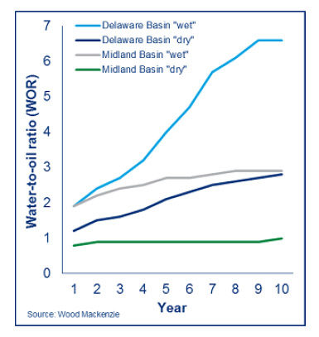

Slide 12
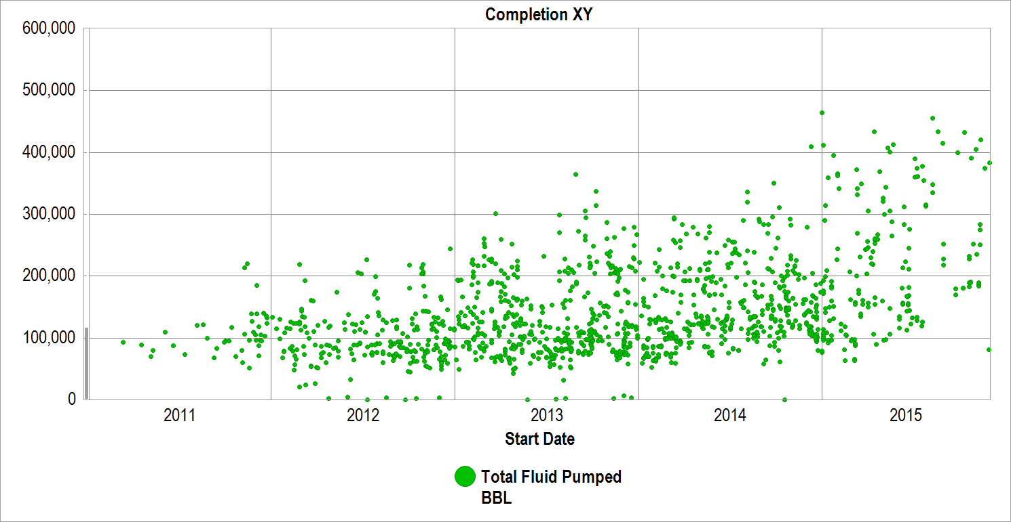
Factor: Trends Toward Longer and Clustered Horizontal Wells and Larger Hydro-fracturing Water Volumes

Slide 13
2016 One-Year Seismic Hazard Forecast for the
Central and Eastern United States from Induced and Natural Earthquakes
By Mark D. Petersen, Charles S. Mueller, Morgan P. Moschetti, Susan M. Hoover, Andrea L. Llenos, William L. Ellsworth, Andrew J. Michael, Justin L. Rubinstein, Arthur F. McGarr, and Kenneth S. Rukstales
Open-File Report 2016–1035

Slide 14
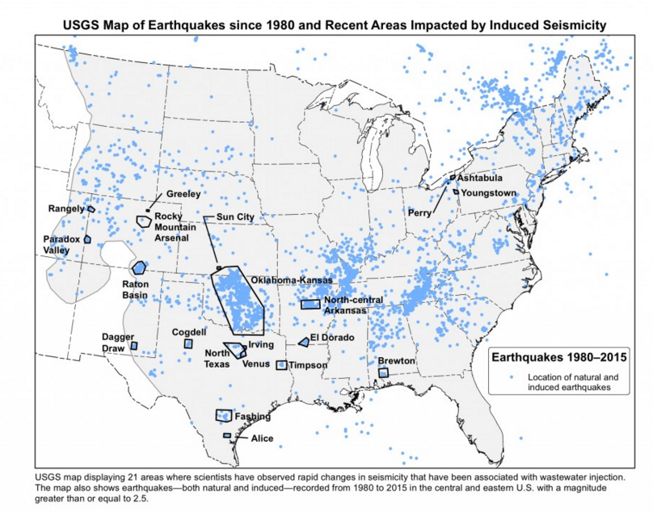

Slide 16
Produced Water
Produced Water is water that is returned to the surface through a well borehole
Made up of water injected during fracture stimulation process and primarily of natural formation water (consequently quantity and quality will vary)
Typically is produced for the lifespan of a well (quantities vary significantly)
Produced water requires chemical analysis prior to reuse / recycling or disposal to assess treatment requirements, compatibility with reuse
Analyzed for hydrocarbons, metals, and naturally occurring elements
Water quality varies:
“Brackish” (5,000 to 35,000 ppm TDS)
“Saline” (35,000 to 50,000 ppm TDS)
“Brine” (50,000 to 150,000+ ppm TDS)

Slide 17
Produced Water Recycling:
Factor Technological Developments
Historical Preference for Freshwater amenable to chemical treatment to inhibit formation issues
Produced Water Chemistry Issues have limited reuse for horizontal well fracturing
Scaling and Fouling
Friction (fracture effectiveness) and Damage to Formation (softening rock/reduced conductivity)
Produced Water Management Options
Deep Well Disposal
Direct Filtration and Reuse
Advanced Treatment for Reuse
Treatment and Discharge

Slide 18
Factor – Freshwater vs Produced Water Treatment Advances allow Fracturing with Produced Water
EXAMPLE FROM HALLIBURTON
Produced water: high TDS up to 285,000 ppm.
At such levels, developing stable crosslinked fluid systems becomes difficult, so operators use fresh water for fracturing.
Halliburton developed a customized frac fluid for high-TDS produced water. The fluid is designed to crosslink using the operator’s produced water.
Halliburton treated eight wells with the formulation. It worked as effectively as fluids mixed with fresh water.
Halliburton CleanWave treatment service, an electrocoagulation process that removes hydrocarbons, heavy metals and suspended solids.
Even though dissolved solids remained, the water was clean enough to work effectively with the new customized fluid additive system
On site treatment reduces the cost of water transportation via trucking by 1,400 loads, saving money and infrastructure.
Historically, using produced water for fracturing has been cost-prohibitive.
The cleanup costs necessary to create an effective crosslinked frac fluid were just too high compared to the cost of fresh water.
Estimated savings of eight million gallons of fresh water and $500,000 to $700,000 in total cost of operations.

Slide 19
Factor – Technologic Water Treatment Advances allow Fracturing with Produced Water
EXAMPLE FROM CONOCO.
Developed new test methods for evaluation potential for formation damage
Screens alternative fluid treatment and additive systems for potential damage to the proppant conductivity of fractured shale formations.
A fluid damage test helped distinguish between the effectiveness of different fluid and breaker systems, and a rock softening test was developed to evaluate the impact of fluid interaction on the surface using a Nanovea Micro Hardness tester.
Sharma and Bjornen (2018) wrote that the amount of potential residue filtered by a thin proppant pack of small proppant was potentially damaging.
With another, the iron-stained residue was eliminated but the hardness remained.
The best fluid reduced risk of damage significantly when a high pH produced water fluid was considered.
The treated produced water was also shown to have a less negative impact on rock hardness.
Sharma and Bjornen (2018) wrote that this finding “makes sense” – inject water similar to water already in the formation to reduce formation damage
Conoco treatments should make properly designed produced water less prone to proppant embedment. It should also result in more conductive fractures than with freshwater alternatives.

Slide 20
Produced Water vs. “Slick” Water Volumes
Feasibility of Produced Water Reuse is dependent on 3 factors:
Not only dependent on quality, but also Quantity and Duration
Produced Water Generation by Shale Play Varies Widely:
Initial Produced Water vs. Quantities and Rates of Water Production and Demand
Important for Reuse: require large volumes over short time period for “frac”ing
“Initial” defined here as first 10 days of Flowback and Production Process
Barnett, Fayetteville, and Marcellus Shales
500,000 to 600,000 gallons per well in first 10 days
~ 10% to 15% of total water needed to “frac” a new well
Haynesville Shale
250,000 gallons per well in first 10 days
~ 5% of total water needed to frac a new well

Slide 21
Geo-Chemistry of Produced Water
Blending for Reuse - TDS
Chlorides and Total Dissolved Solids (TDS)
Generally not looking at removal, TDS determines freshwater blending ratios
Very high TDS increases friction in hydraulic fracturing process (bad)
Counter: Freshwater can damage a formation
Filtering Prior to Reuse - TSS
Turbidity and Total Suspended Solids (TSS)
Can determine filtration rates, size of filter, performance
High solids can plug well and decrease biocide effectiveness
Other Parameters of Concern
Water “hardness” compounds (e.g. Calcium and Magnesium) create mineral precipitation
Sulfates can be used by bacteria to create hydrogen sulfide & corrosion issues
Barium can combine with sulfates to create scale
High iron can drop out creating emulsions and plugging, induces fouling
Bacteria is always a concern

Slide 22
Filtration Process with new Additive Systems for Reuse
Filtration Process:
Produced water during “ flowback” process collected and stored in holding tanks onsite.
Produced water pumped from tanks through a 100-micron filter followed by a 20-micron filter
Filter is designed to remove suspended solids in fluid (not salts) .
Filtered fluid is pumped into a clean storage tank and transported to next well to be hydraulically fractured
Filters and solids collected are disposed of by a licensed contractor and sent to an approved landfill
Reuse Process:
Prior to use in frac, the water is tested for remaining constituents
(TDS/Salts, Scaling Compounds) that were not removed in filtration process
Test results determine blending ratios
Robust scale inhibition and bacteria elimination programs implemented which require substantial management and testing prior to frac
Fresh or brackish “make-up” water is blended in to meet quality and quantity requirements

Slide 23
Advanced Technologies: Thermal Distillation & Reversed Osmosis
Thermal Distillation and/or Advanced Reverse Osmosis
Ability to treat produced water and recapture the water
Beneficial if an end user for water: e.g., electric power plants and discharge to rivers for ag and municipal use
Previously energy intensive (and costly)—requires regulatory changes !!!!!!!! Both OK and TX are seeking approval to permit
Most distillation/advanced RO systems are designed for treatment of large volumes of water
Centralized treatment facilities & long transportation distances
Five of 8 larger water management companies plan new plants
In Use in West Texas: E.g., El Paso treats brackish water and “recharges” its drinking water aquifer with ~27 mgd of freshwater

Slide 24
Advanced Technology; Reverse Osmosis and Chemical Treatments
Membrane Systems (Reverse Osmosis)
Historically prone to scaling without comprehensive pretreatment
Need very experienced operators
Technology much improved with advanced multi-membrane systems and membrane washing
Advanced coatings
Energy requirements have decreased with membrane advances
Increased use in Texas
Chemical Precipitation and Electro-Coagulation
Less expensive
Still requires relatively experienced operators
Used more with alternative sources of water such as municipal waste water

Slide 25
In Summary: Economic and Social Contract Drivers Are Encouraging Recycling in Permian
Reduction in the volume of wastewater
Less sent offsite for disposal
Less risk of seismic activity
Less fresh water needed for hydraulic fracturing operations
Reduced impact on local supplies
Reduced truck traffic on public roads (less fresh water hauled)
Less impact on public roads, noise, air quality
Filtration process used is inexpensive and does not require substantial amounts of energy
Processes that remove salts (i.e. reverse osmosis membranes, distillation)
Are helping to reduce the cost of operations
Reduces wastewater disposal costs, water supply costs, and transportation costs

Slide 26
Discharge Plans Being Opposed
Concerns of the so called permanent removal of water from the effective hydrologic cycle vs impact on surface water quality
Concerns will reduce water available for human consumption
Most water used in shale gas development either remains in the formation or returns as produced water
Environmentalists oppose both water used in fracturing as well as water reuse
Concerns with “re”use of treated municipal waste water
All water use is reuse; many river flows are nearly all treated waste water !!!!!!!!
The conventional method for disposal of produced water is through permitted Class II Salt Water Disposal Wells which have been associated with increased seismicity
Argument that this is a different type of “consumption” than the evaporation of water from a power plant and other types of “consumption”
Agricultural production is by far largest consumer of water
Oil and gas very small in comparison

Slide 27
Conclusions
Technological advances are benefiting and addressing environmental concerns and facilitating increased production and effectiveness
Injection for disposal has been associated with releases & seismicity.
Economic and Social Contract Incentives are Increasing Produced Water Recycling in the Permian

Slide 28
Questions and Answers

