Slide 1
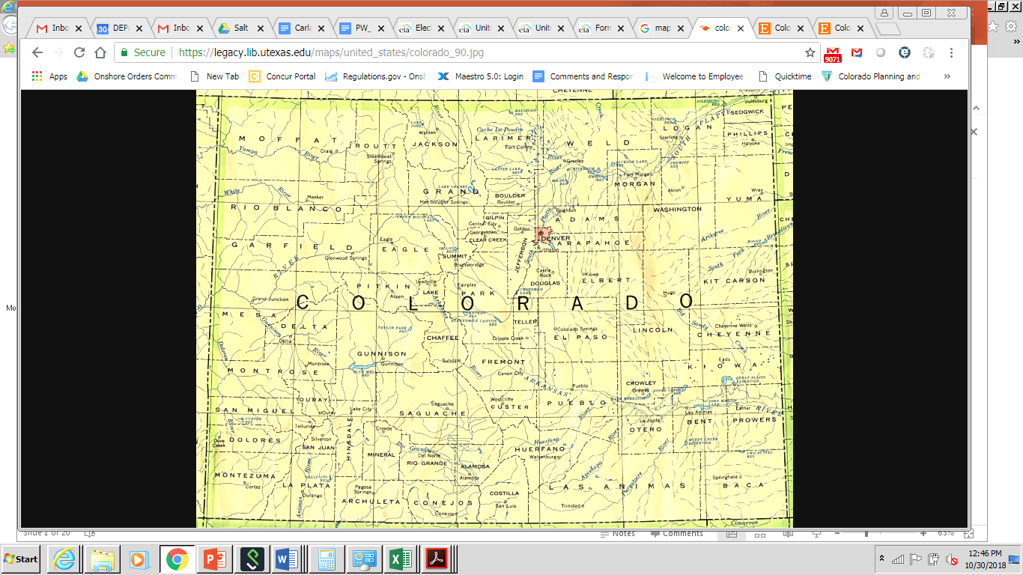
FROM BANE TO BOON: HOW ALTERNATIVE PRODUCED WATER REUSE CAN SUPPLEMENT
FRESHWATER IN THE SOUTHWEST
Michael Ford*
International Petroleum Environmental Conference
October 31, 2018
*This presentation is done in my capacity as a private individual and does not reflect the views of my employer, the Bureau of Land Management.

Slide 2
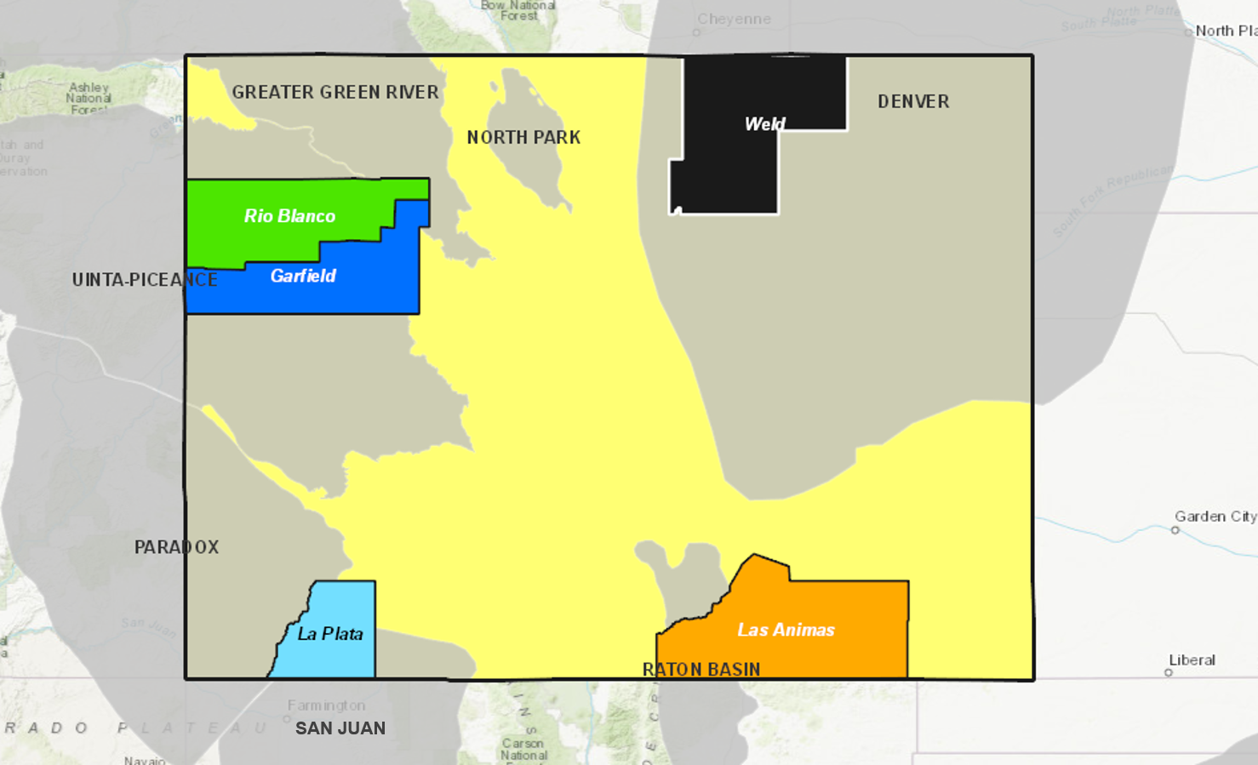
Top-five produced water counties in Colorado
Tight oil
Weld County – Denver-Julesburg
Conventional Gas
Rio Blanco County – Uinta/Piceance
Garfield County – Uinta/Piceance
Coal Bed Methane / Conventional gas
La Plata County – San Juan/Fruitland
Las Animas County – Raton/Vermejo
Denver
Basins layer from U.S. Energy Information Administration (EIA), U.S. Shale Plays Map.

Slide 3

Produced water / well completion water ratios
Number of Colorado wells entering into first production by county, 1999-2017
Basins layer from U.S. Energy Information Administration (EIA), U.S. Shale Plays Map.
Graph info from Colorado Oil and Gas Conservation Commission, county data and FracFocus data
Imported from the EIA and Ground Water Protection Council’s National Oil and Gas Gateway Initiative.
*Water volumes for hydraulic fracturing include only freshwater and recycled water used for well completions. They do not include acids, foam, carbon dioxide, or other materials.

Slide 4
Produced water / well completion water ratios
Much more PW than needed for fracking
311x
Steady PW volumes in Fruitland, Raton CBM fields despite almost no new wells since 2014; goes against the narrative from Powder River Basin
1,762x
Basins layer from U.S. Energy Information Administration (EIA), U.S. Shale Plays Map.
Graph info from Colorado Oil and Gas Conservation Commission, county data and FracFocus data
Imported from the EIA and Ground Water Protection Council’s National Oil and Gas Gateway Initiative.
*Water volumes for hydraulic fracturing include only freshwater and recycled water used for well completions. They do not include acids, foam, carbon dioxide, or other materials.

Slide 5
Cost of inaction
“At present, however, water coproduced with CBM has been largely neglected for beneficial use, even where concentrations of dissolved solids and other contaminants are within regulatory guidelines for potable agricultural or livestock use.”
“The societal and economic costs that may be incurred by not considering CBM water for beneficial use in an arid part of the United States are not usually discussed with regard to CBM produced water management.” (National Academy of Sciences, 2010)

Slide 6
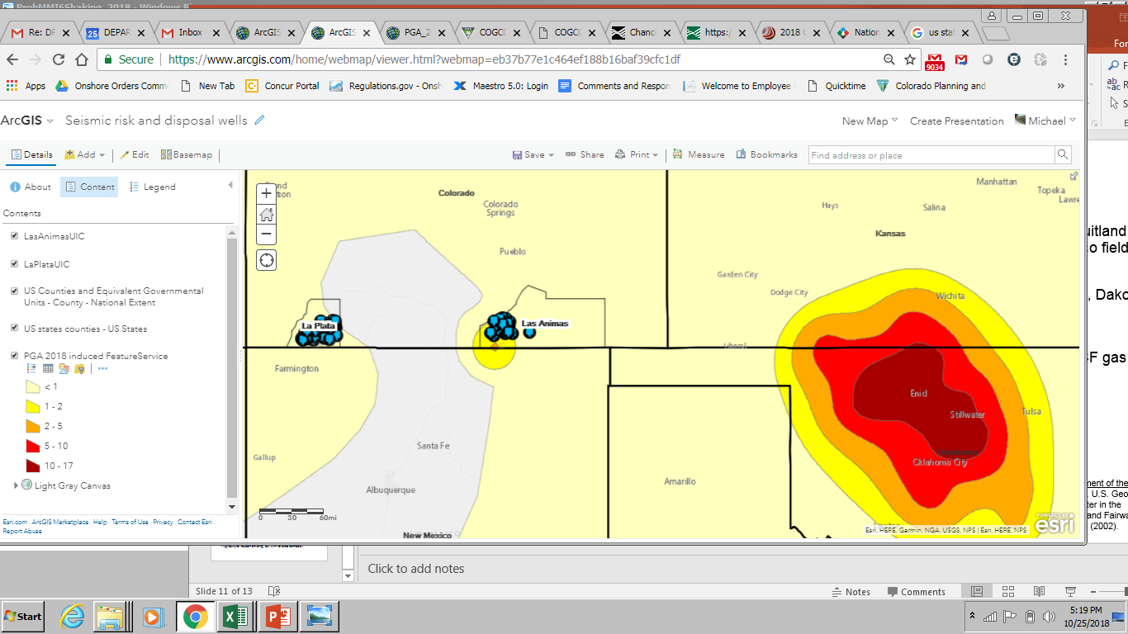
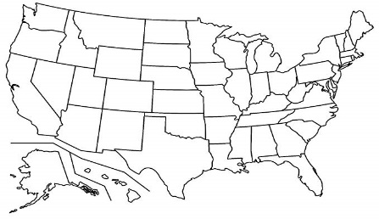
Seismicity, economics could drive supply
Raton Basin: 1 M≥4 quake from 1972-July 2001, 12 from August 2001-2013; Linked to deepwell injection – no damages (Rubinstein, Ellsworth, McGarr, and Benz, 2014)
One-year chance of potentially minor-damage ground shaking forecast (%)
a
Sources: Well data imported from imported from the EIA and Ground Water Protection Council’s National Oil and Gas Gateway Initiative. Layer showing one-year chance of potentially minor-damage ground shaking forecast from the U.S. Environmental Protection Agency’s Earthquake Interactive Maps, with data provided by Petersen, Mark D., et. al. “2018 One-Year Seismic Hazard Forecast for the Central and Eastern United States from Induced and Natural Earthquakes”. U.S. Geological Survey, March 2018.
Economic drivers: CBM injection, disposal costs $1-$4/bbl (Plumlee, Debroux, and Taffler, 2014).
Energy for transportation, injection: Zemlick, Kahlor, Thompson, et. al. (2018) – see bonus slide.
Legal drivers: Rule 904, Vance v. Wolfe (2009) – see bonus slide.

Slide 7
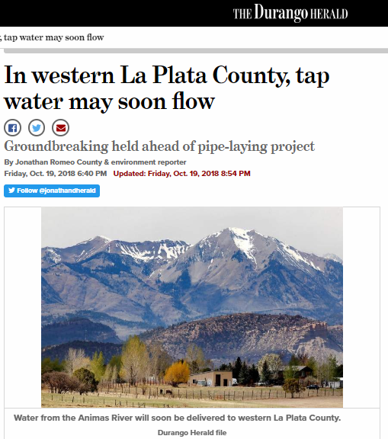
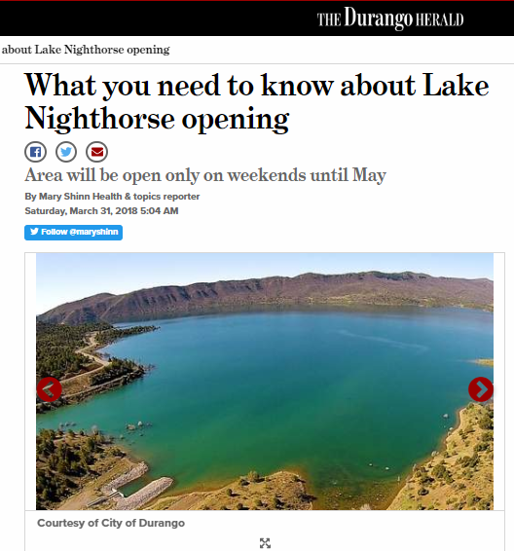
Drought risk drives demand
Western La Plata County – Potable and recreational (Animas – La Plata) pipelines
La Plata River District (San Juan/Dolores Basing: Rapid growth, localized water shortage programs, like the Drought Response Information Program (CWCB, 2015).
$5 million pipeline to deliver water to 150 homes west of Durango next year ($30k/home).
Authorized in 1968, delayed decades and scaled back to just serve Ute reservations. FSEIS in 2000, construction in 2001, $500MM (Rogers, 2013). Completed in 2013.

Slide 8
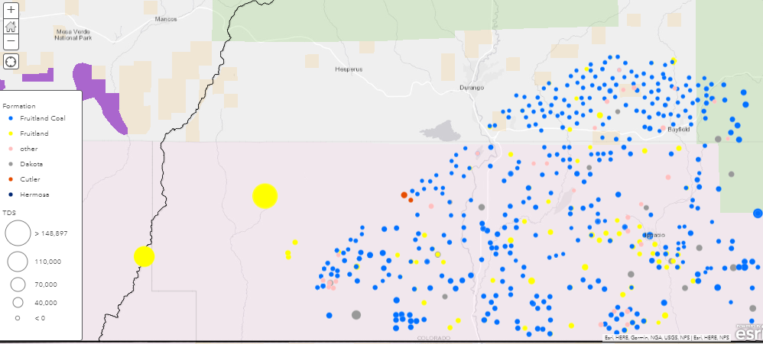
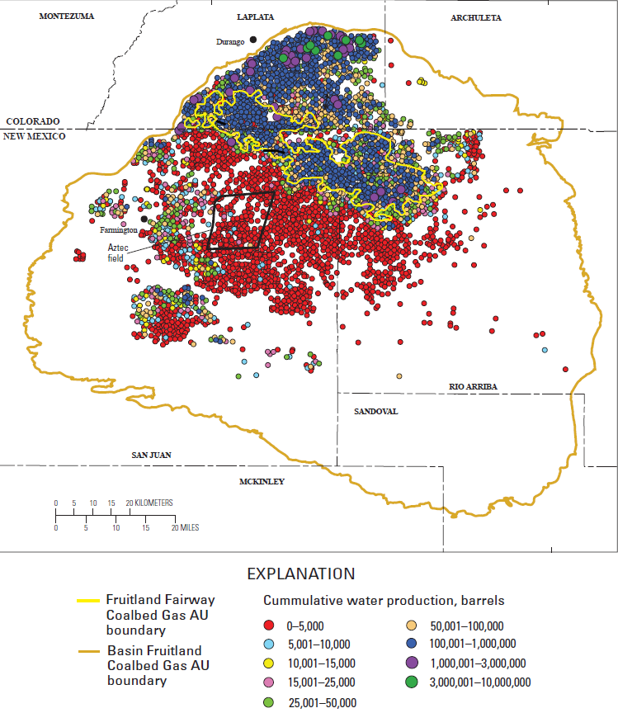
La Plata water has promise for reuse
USDA
Forest Service
Interior
NPS
Interior
BLM
Interior
NPS
Interior
BLM
Montezuma
County
La Plata
County
Interior
BIA
Montezuma
County
La Plata
County
Interior
BIA
Southern Ute
Ute
Mountain
Southern Ute
Ute
Mountain
Source: U.S. Geological Survey Produced Water Database.
Ridgely, J.L., S.M. Condon, and J.R. Hatch. Geology and Oil and Gas Assessment of the Fruitland Total Petroleum System, San Juan Basin, New Mexico and Colorado. U.S. Geological Survey, 2013. Figure 34. Production data from IHS Energy Group (2002).
Approximately two-thirds of 3,300 wells in Fruitland Coal formation.
Additional conventional gas wells in Fruitland, Dakota, Hermosa, and Cutler.
TDS<10,000 mg/l in 85% of well samples, <5,000 mg/l in 56% of samples.

Slide 9
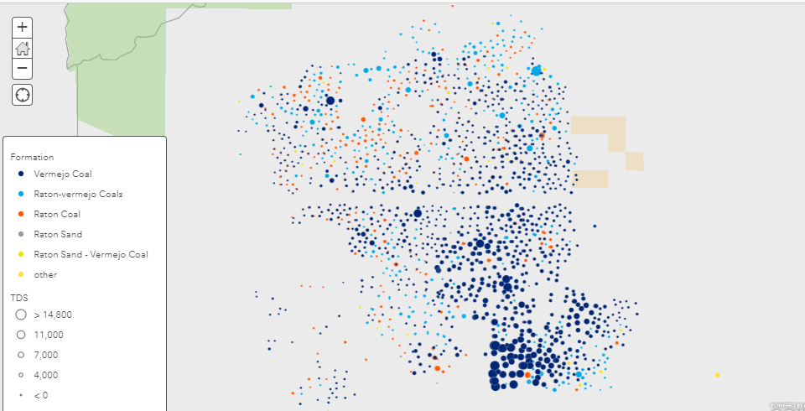
Las Animas water even more promising
Huerfano
County
Las Animas
County
USDA
Forest
Service
Costilla
County
Interior
BLM
Source: U.S. Geological Survey Produced Water Database.
TDS<10,000 mg/l in 99% of well samples, <5,000 mg/l in 92% of samples.
Fresher towards center of Raton Basin – (Upper Cretaceos – Lower Tertiary).
Often directly discharged into Purgatoire River.

Slide 10
Realistic reuse possibilities
Agriculture irrigation
  Alternative Transfer Mechanism?
Livestock watering
  Lessons from Powder River Basin in Wyoming?
Power plant cooling towers
  Time to revisit in San Juan Basin?
Chlor-alkalai processes for sodicity?
  See bonus slide

Slide 11
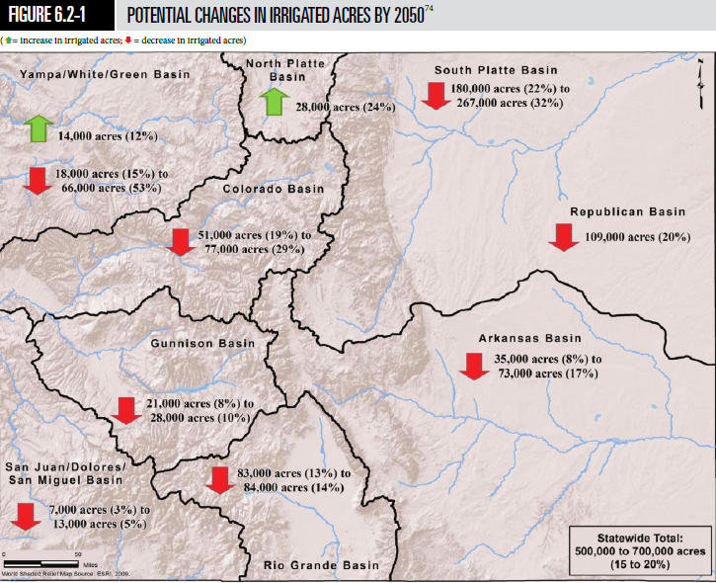
Agricultural irrigation provides an opportunity
Alternative transfer methods (ATMs): Ways to free up volumes for growing municipal, industrial users without buy-and-dry transfers. CBM produced water reuse could help.
3.9-billion-barrel projected agricultural water supply gap by 2050 (CWCB, 2015).
Surface-drip irrigation with CBM water works in PRB (National Academy of Sciences, 2010).
Dolan, Cath, Hague (2018): Full CBM water treatment train for Raton, San Juan:* $0.37/barrel.
*Includes deoiling, air stripping, nanofiltration, sodium adjustment, evap ponds, brine disposal.
Source: “Colorado’s State Water Plan”. Colorado Water Conservation Board, 2015.

Slide 12
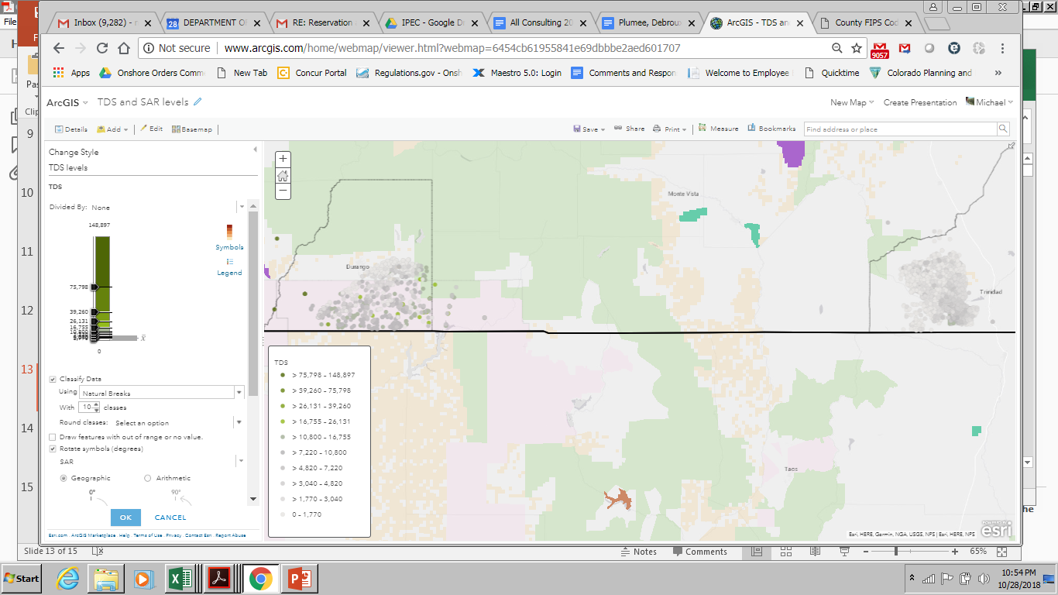
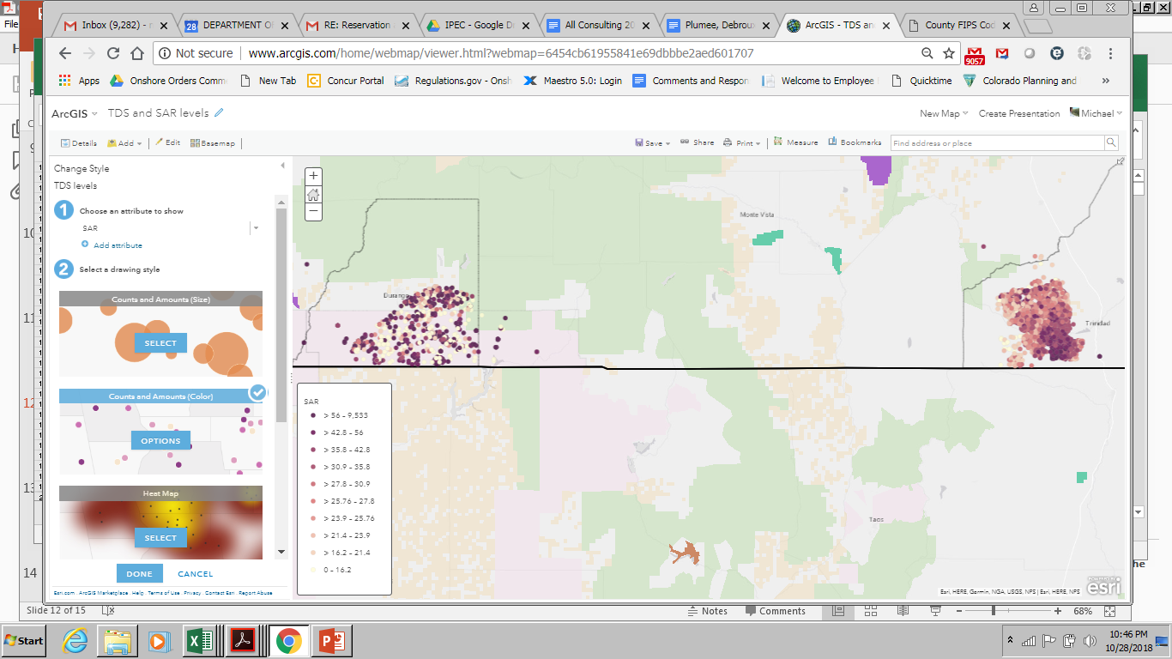
Beyond TDS: Chemical makeup matters
TDS (mg/L)
Green = issue
SAR*
Purple = issue
*Sodium Adsorption Ratio
[Na] / {[(Ca+Mg)/2]^(½)}
Source: U.S. Geological Survey Produced Water Database. SAR calculations done with USGS produced water data.

Slide 13
Reuse options: Livestock watering
Sodicity (SAR) not an issue.
TDS <1,000 mg/L best, but can be up to 7,000 mg/L (National Academy of Sciences, 2010).
La Plata County: 2nd statewide in horse, pony, mule, burro sales. Las Animas 13th in livestock sales (USDA-NASS, 2012).
Done for years in Powder River Basin; benefits for land and cattle (ALL Consulting, 2003).
Tire tank used for stock watering. Overflow of treated CBM produced water can supply livestock over greater area.
Source: ALL Consulting, Handbook on Coal Bed Methane Produced Water: Management and Beneficial Use Alternatives. July 2003.

Slide 14
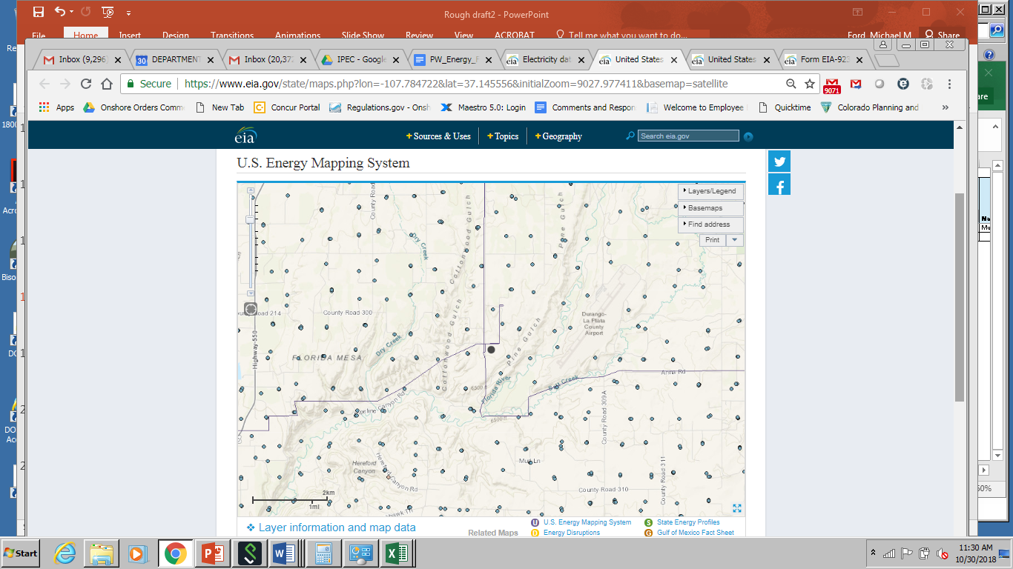
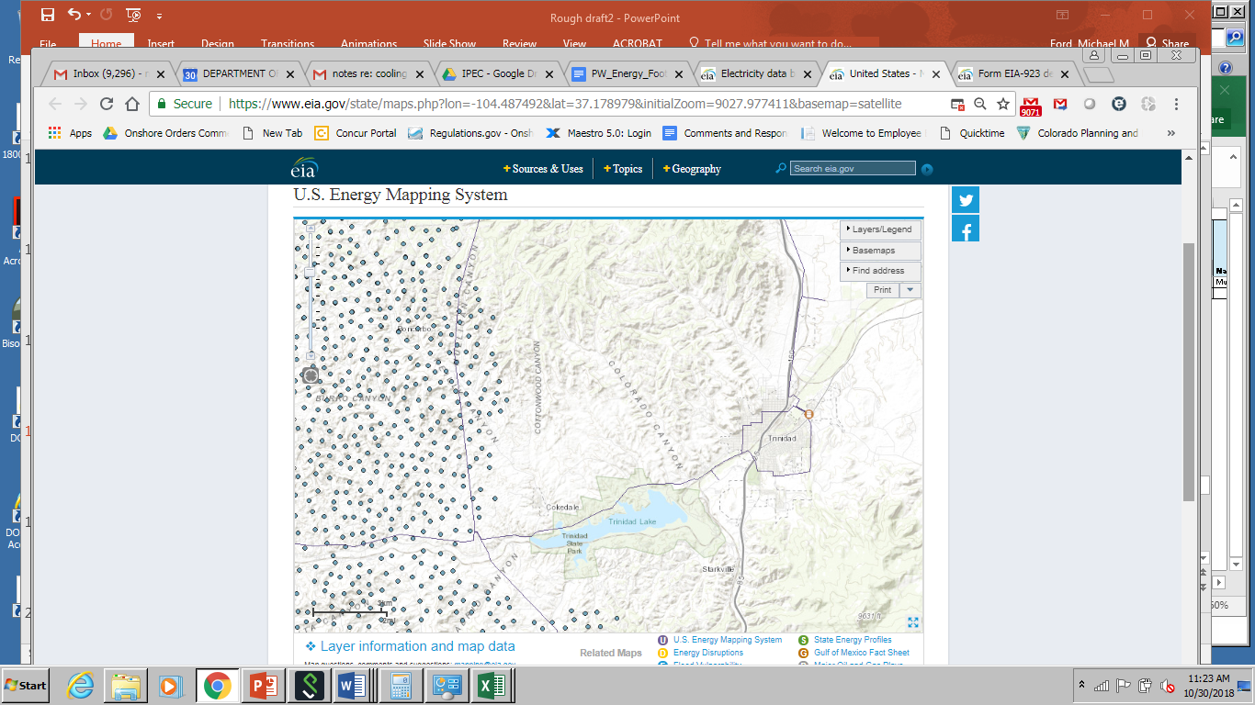
Power plant reuse
Ignacio combined heat and power (CHP) plant at Harvest Midstream processing plant – presents great possibility.
San Juan Generating Station (National Energy Technology Laboratory, 2006): Worked for Burlington Resources, PNM with tax credit.
La Plata County: Treatment, augmentation of Florida River’s instream flow to Ignacio CHP.
Ditch recharge an option in Las Animas (Morgan Ditch/Xcel energy model).
Ignacio CHP
Trinidad (CO)
Source: U.S. Energy Information Administration, Energy Mapping System.

Slide 15
Questions?

Slide 16
Bonus Slides

Slide 17
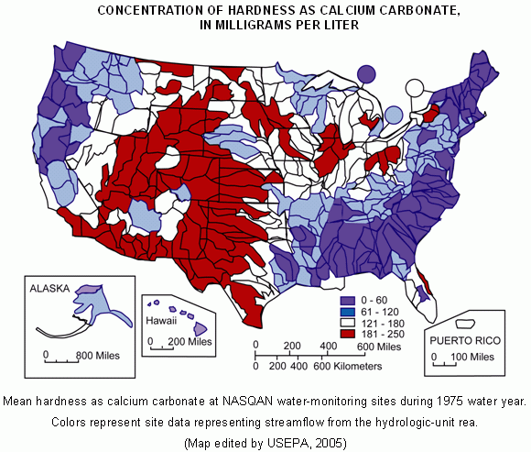
Handling sodium through chlor-alkalai
Electrolysis reaction transforms NaCl, H₂0 into chlorine and caustic soda.
Many uses for caustics: Paper/aluminum making, flue gas desulfurization, cleaning, water treatment.
Can add a hydrochloric acid resin that will absorb excess sodium, make use of all TDS and leave behind fresh water for agricultural, other uses.
Question of whether TDS is high enough: may be in parts of the Fruitland.
Amec Foster Wheeler (2017) recommends against chlor-alkalai with Paradox Valley brine – prefers roadspreading. Worth revisiting.

Slide 18
Legal / Regulatory issues
2 CRR 404-1 907: Management of E&P Waste (Rule 907)
  Beneficial uses require “waste minimization” plan approval from the Colorado Oil and Gas Conservation Commission (COGCC).
  Does not affect methods of disposal:
    Discharge into state waters with Water Quality Control Act, COGCC approval;
    Evaporation ponds, production pits / impoundments, Class 2d and commercial wells;
    Roadspreading (on-lease, outside of sensitive areas, <3,500 TDS, w/SO permission).
Vance v. Wolfe, 2009 (Colorado Supreme Court)
  Dewatering of a coal bed is a beneficial use:
    If tributary, requires water well permit, augmentation plan (CDPHE);
    State engineer can determine as non-tributary, can dewater to extinction;
    For tributary wells, can drive reuse; ?s on SO/operator revenue split (Dalton, 2017).

Slide 19
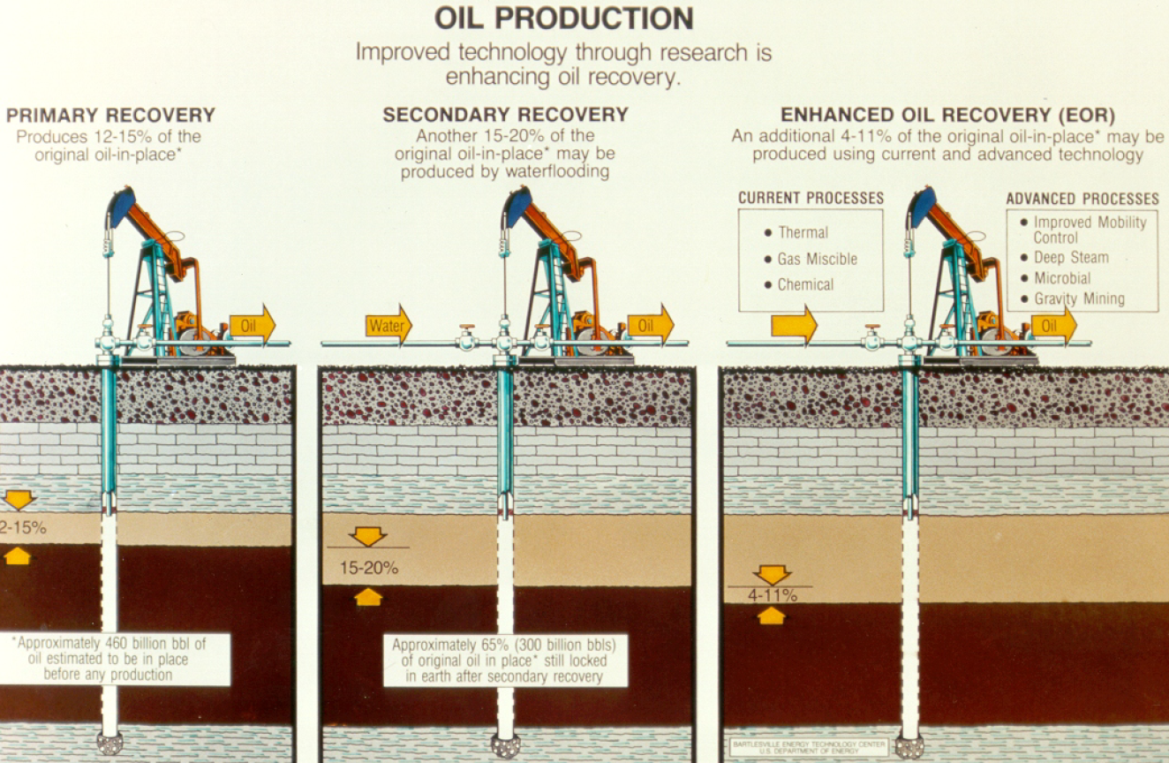
Rio Blanco County – secondary recovery
Largely conventional gas in Uinta/Piceance.
~92% of produced water recovered used for secondary recovery (Chevron-Rangely).
WAG (water-alternating gas): counted as produced water each time it reaches the wellbore.
Much less actually available outside of lease operations.
Lindley, Joe R. National Institute for Petroleum Research.
Republished in public domain by U.S. Department of Energy, National Energy Technology Laboratory.

Slide 20
Properties of prime farmland soils
La Plata
Las Animas
Symbol | Name | Acres | Parent material | Specifications
76 | Witt loam, 3 to 8 percent slopes | 52,421 | Calcareous silty loess | Salinity, maximum in profile: Nonsaline to very slightly saline (0.0 to 2.0 mmhos/cm)
66 | Tefton loam | 6,151 | Mixed alluvium
Symbol | Name | Acres | Parent material | Specifications
Hn | Hoehne fine sandy loam, 0 to 2 percent slopes, occasionally flooded | 2,636 | Sandy alluvium | Sodium adsorption ratio, maximum in profile: 1.0
MoA | Mauricanyon loam, 0 to 2 percent slopes | 3,970 | Loamy alluvium derived from sandstone and shale | Salinity, maximum in profile: Nonsaline to very slightly saline (0.0 to 2.0 mmhos/cm) Sodium adsorption ratio, maximum in profile: 2.0
WC | Plughat-Villegreen complex, 1 to 4 percent slopes | 124,087 | Loess over residuum weathered from sandstone | Gypsum, maximum in profile: 2 percent Salinity, maximum in profile: Nonsaline to very slightly saline (0.5 to 3.0 mmhos/cm)
WV | Almagre-Villedry complex, 1 to 4 percent slopes | 119,341 | Loess over residuum weathered from sandstone | Gypsum, maximum in profile: 4 percent Salinity, maximum in profile: Nonsaline to slightly saline (1.0 to 4.0 mmhos/cm) Sodium adsorption ratio, maximum in profile: 6.0
WyB | Wilid silt loam, 0 to 3 percent slopes | 135,462 | Loess and/or eolian deposits | Gypsum, maximum in profile: 2 percent Salinity, maximum in profile: Nonsaline to slightly saline (0.5 to 4.0 mmhos/cm) Sodium adsorption ratio, maximum in profile: 4.0
Source: U.S. Department of Agriculture, Soil Surveys for La Plata County Area (CO669) and Las Animas County Area, Parts of Las Animas and Huerfano Counties (CO628).

Slide 21
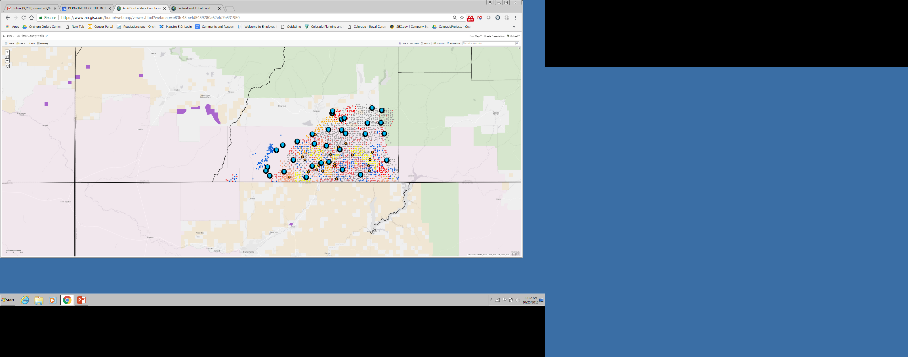

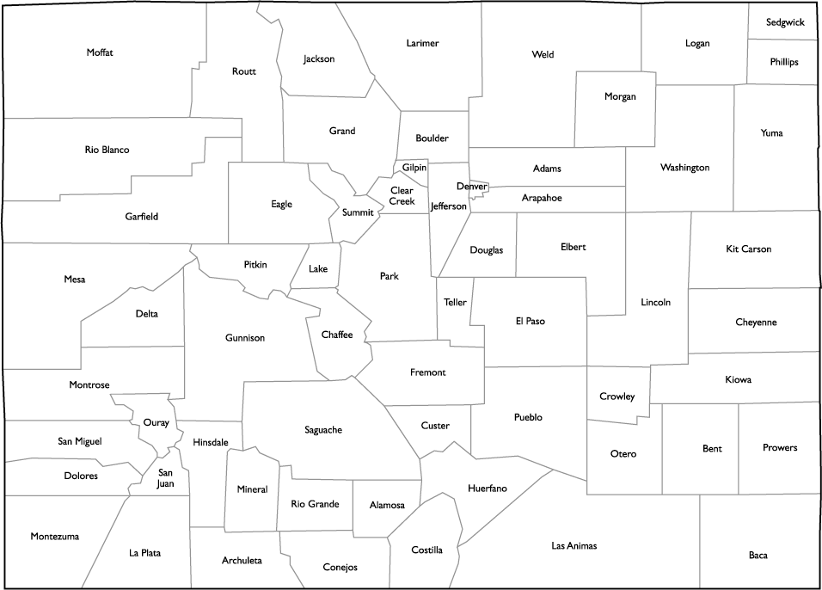
La Plata County – Disposal Options
UIC Class 2 disposal wells
Oil and gas production wells
Interior
BLM
USDA
Forest Service
Interior
NPS
Interior
BLM
Montezuma
County
La Plata
County
Interior
BIA
Southern Ute
Ute
Mountain
Source: Well data imported from imported from the EIA and Ground Water Protection Council’s National Oil and Gas Gateway Initiative.
34 active, injecting C2d wells, none being permitted. No known capacity constraints.
Most pipe PW to their own UIC wells.
Some smaller operators truck PW to SWD wells; can be expensive: $.03/bbl/mile (Coday, 2015).

Slide 22
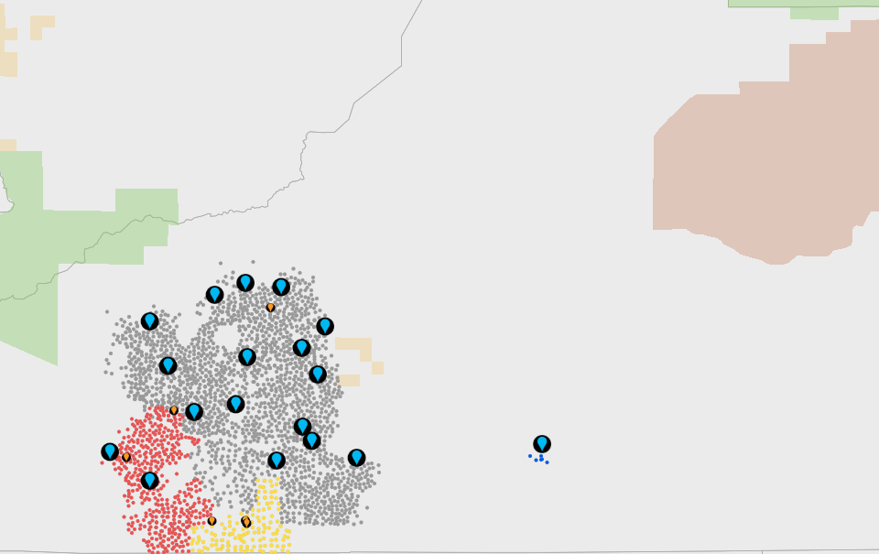
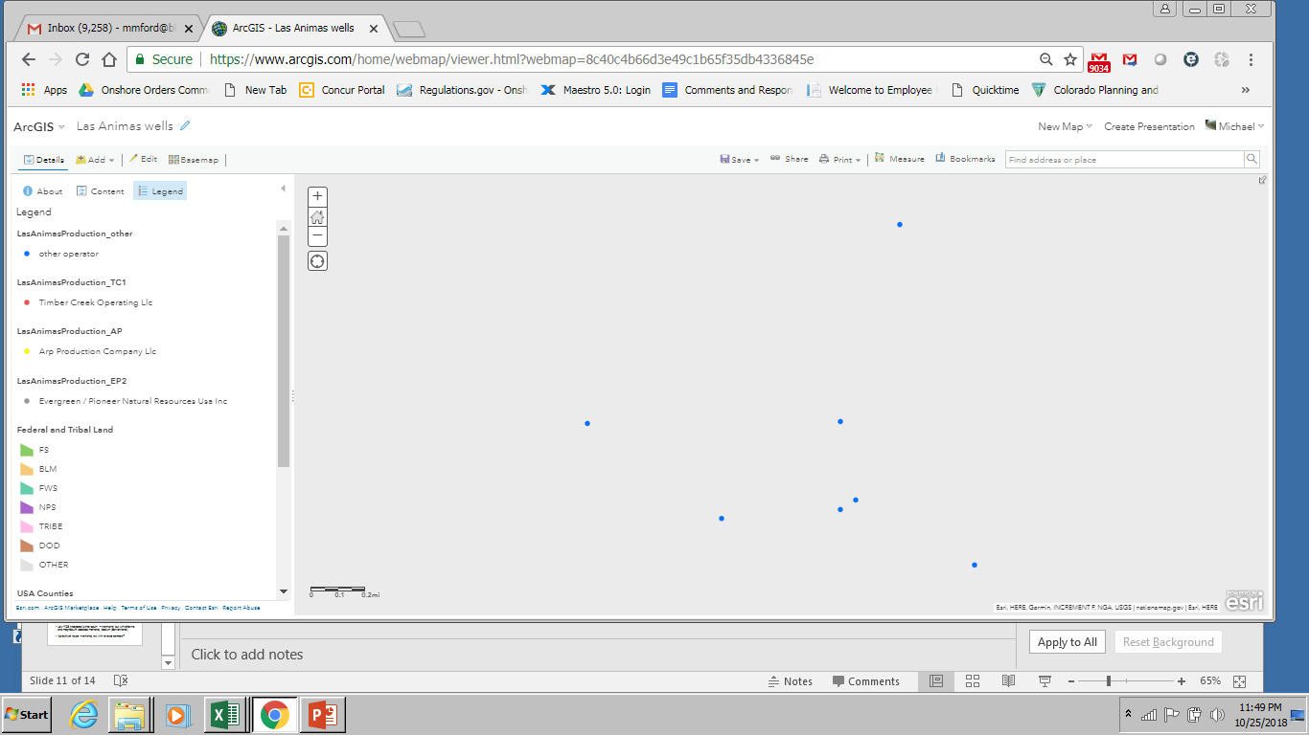
Las Animas County – Disposal Options
UIC Class 2 disposal wells
Oil and gas production wells
USDA Forest Service
Huerfano
County
DOD
U.S. Army
USDA
Forest Service
Las Animas
County
Interior
BLM
Source: Well data imported from imported from the EIA and Ground Water Protection Council’s National Oil and Gas Gateway Initiative.
18 active, injecting C2d wells, none being permitted. No known capacity constraints.
Water often clean enough to treat and discharge with NPDES permit; some also trucked to disposal ponds.
Potential issue: Induced seismicity.

Slide 23
Supply-side strong driver in Las Animas
Raton Basin: 1 M≥4 quake from 1972-July 2001, 12 from August 2001-2013; Linked to deepwell injection – no damages (Rubinstein, Ellsworth, McGarr, and Benz, 2014)
One-year chance of potentially minor-damage ground shaking forecast (%)
a
Sources: Well data imported from imported from the EIA and Ground Water Protection Council’s National Oil and Gas Gateway Initiative. Layer showing one-year chance of potentially minor-damage ground shaking forecast from the U.S. Environmental Protection Agency’s Earthquake Interactive Maps, with data provided by Petersen, Mark D., et. al. “2018 One-Year Seismic Hazard Forecast for the Central and Eastern United States from Induced and Natural Earthquakes”. U.S. Geological Survey, March 2018.
Well capacity less an issue than cost: Operators still must pay for de-oiling, filtration & chlorination, injecting.
Plumlee, Debroux, and Taffler (2014): CBM injection, disposal costs $1-$4/bbl ($0.75/bbl surface discharge).
Zemlick, Kahlor, Thompson, et. al. (2018): Transportation and injection of produced water require .63 kWh/bbl in San Juan, .34 kWh/bbl in Raton Basins (New Mexico side, excludes freshwater pumped & transported for new fracs).

Slide 24
Weld County needs more than it’s producing
Produced water (million barrels per day)
Denver
Water volumes for hydraulic fracturing* (million barrels per day)
Basins layer from U.S. Energy Information Administration (EIA), U.S. Shale Plays Map.
Graph info from Colorado Oil and Gas Conservation Commission, county data and FracFocus data
Imported from the EIA and Ground Water Protection Council’s National Oil and Gas Gateway Initiative.
*Water volumes for hydraulic fracturing include only freshwater and recycled water used for well completions. They do not include acids, foam, carbon dioxide, or other materials used for enhanced recovery.

Slide 25
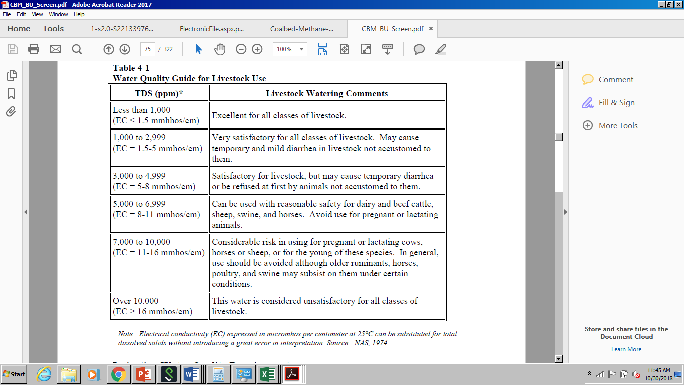
Guide for livestock watering TDS
Source: ALL Consulting, Handbook on Coal Bed Methane Produced Water: Management and Beneficial Use Alternatives. July 2003.

