Slide 1
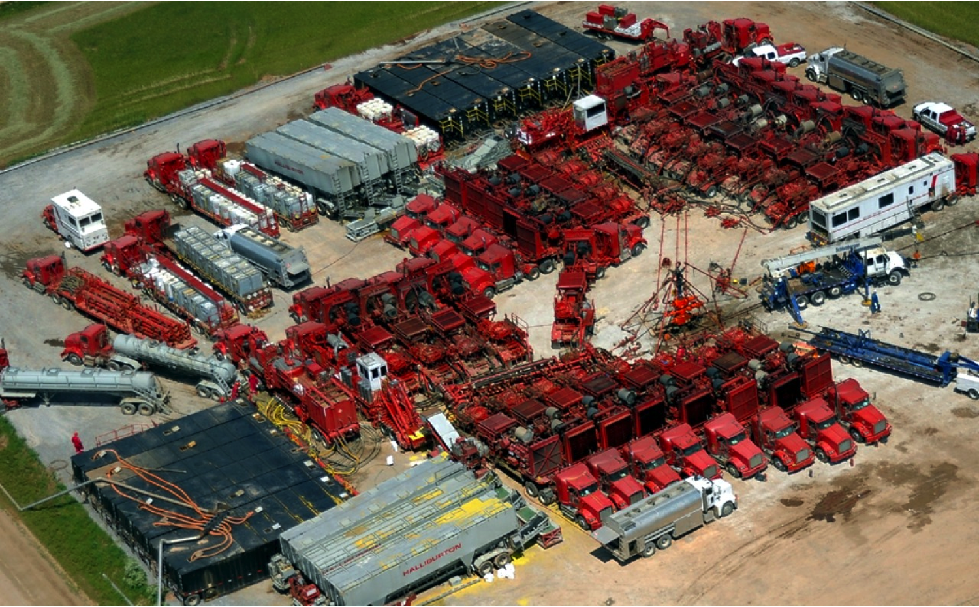

Effective Treatment of Shale Oil and Gas Produced Water by Membrane Distillation Coupled with Precipitative Softening and Walnut Shell Filtration
Cristian Robbins, P.E.
Department of Civil & Environmental Engineering,
Colorado State University
10/31/2018

Slide 2
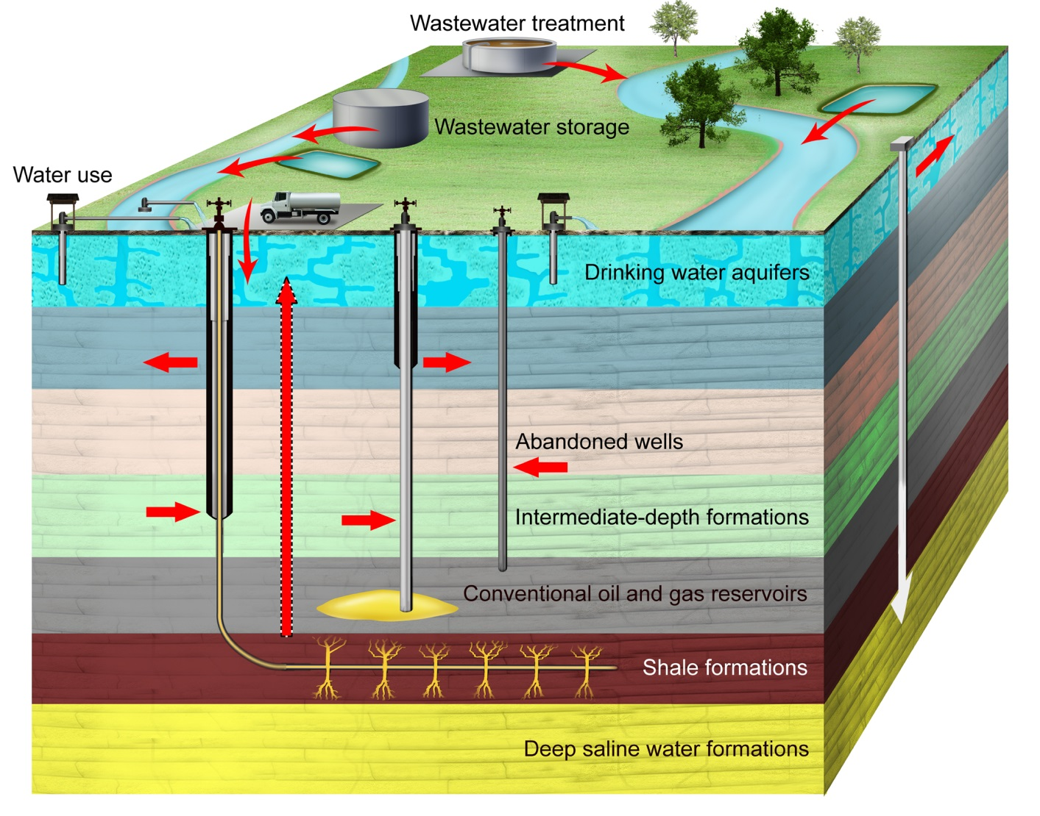
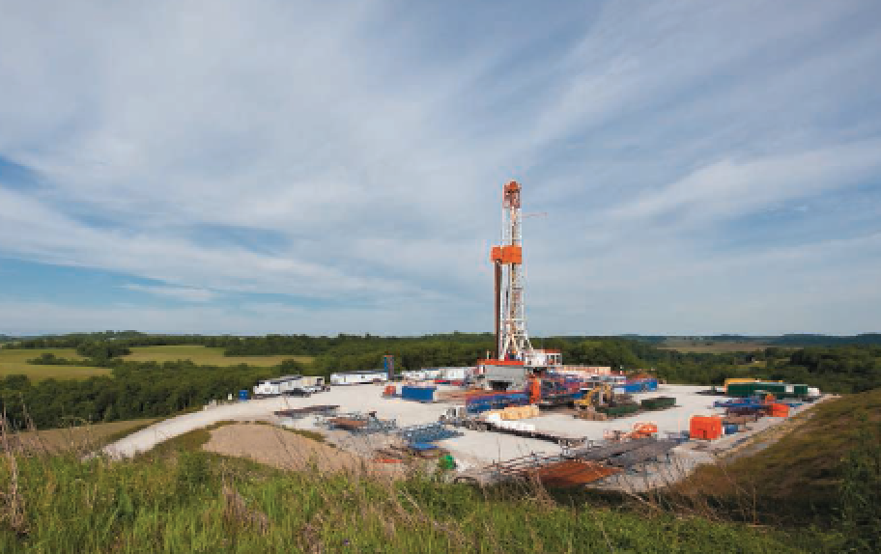

Treatment and Reuse of Shale Oil and Gas Produced Water by Membrane Distillation
Water consumption
Wastewater production
Shale oil and gas wastewater: High salinity (not applicable for RO treatment), complex and hazardous (dangerous to dispose).
http://sites.nicholas.duke.edu/avnervengosh/; Vidic et al., 2013, Science, 340, 1235009

Slide 3
Wastewater Treatment Options
Tong and Elimelech, 2016, Environ. Sci. Technol., 50, 6846-6855

Slide 4
Wastewater Treatment Options
Shale oil and gas wastewater
RO
favorable
Limited by affordable
hydraulic pressure
Tong and Elimelech, 2016, Environ. Sci. Technol., 50, 6846-6855

Slide 5

Wastewater Treatment Options
Shale oil and gas wastewater
RO
favorable
Other technologies?
Tong and Elimelech, 2016, Environ. Sci. Technol., 50, 6846-6855

Slide 6
Our Core Technology – Membrane Distillation
Tolerance of high salinity
Less costs than mechanical vapor compressor
Use of low-grade thermal energy
60-80°C
Hydrophobic,
microporous membrane
20°C

Slide 7
Research Endstate
An on-site and cost-effective wastewater treatment package tailored to the shale oil and gas industry
Integrated treatment process

Slide 8
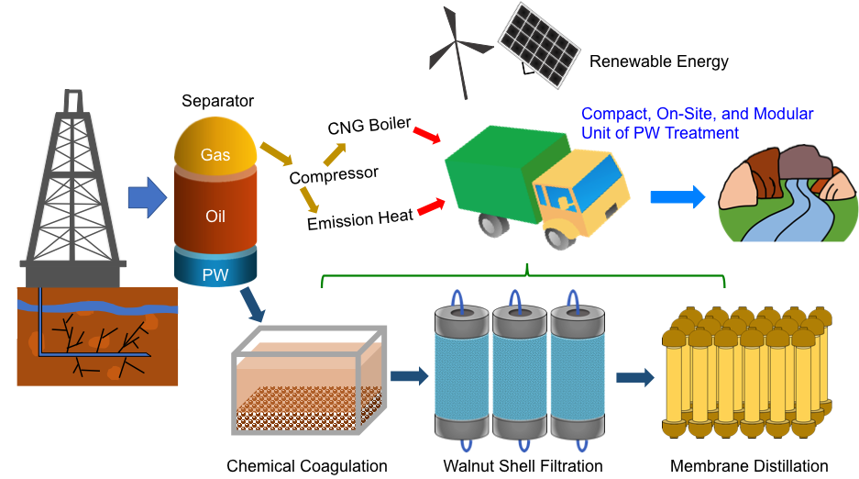
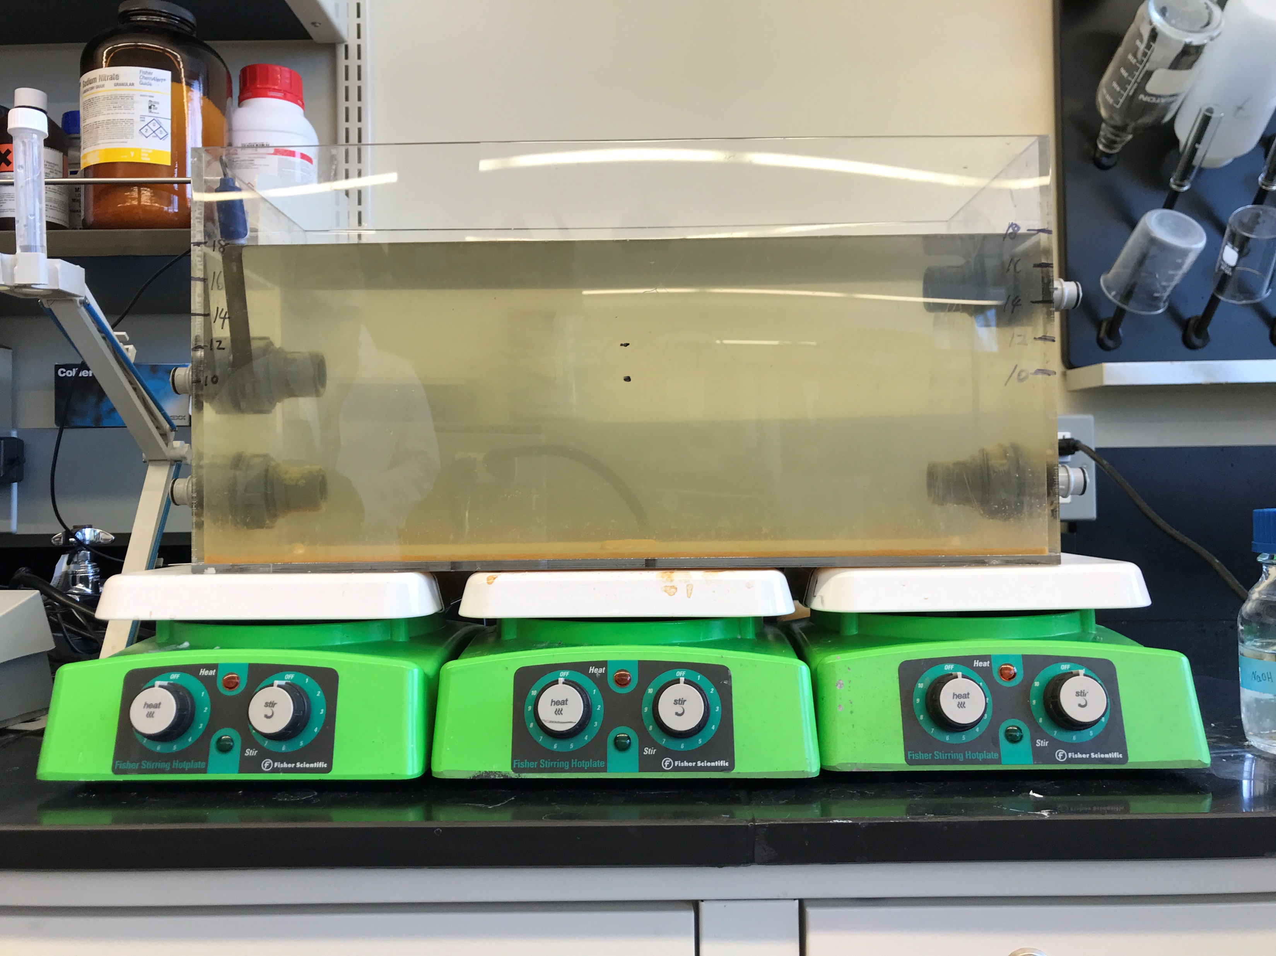
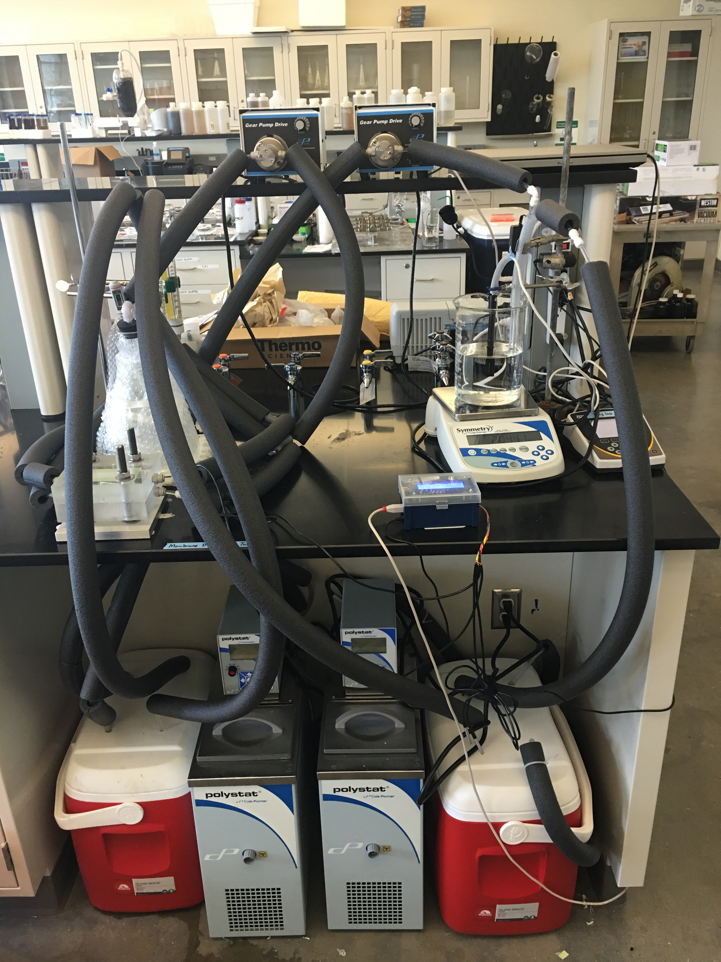
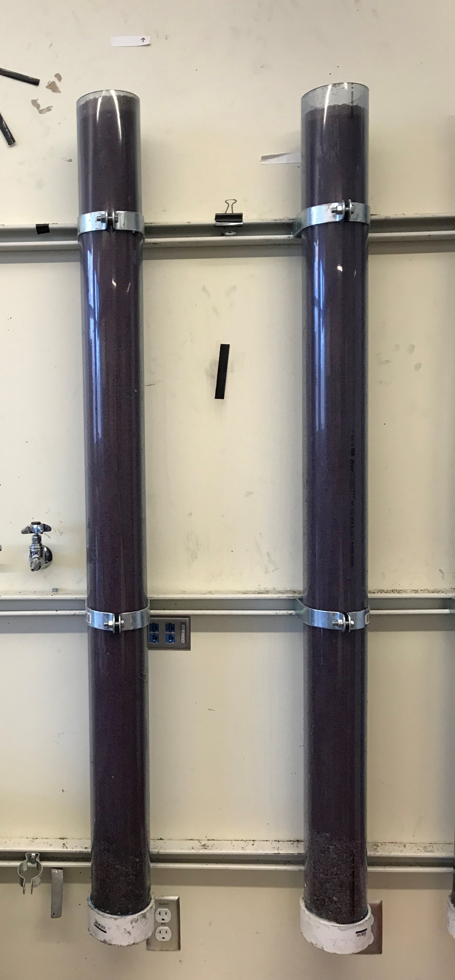
Research Endstate
An on-site and cost-effective wastewater treatment package tailored to the shale oil and gas industry
Precipitative Softening
Membrane distillation
Walnut shell filtration

Slide 9
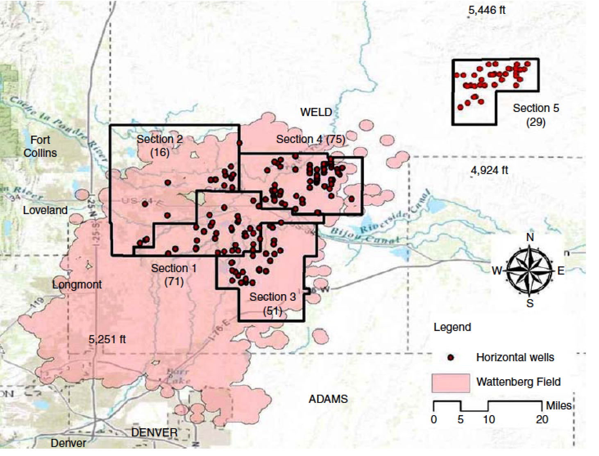
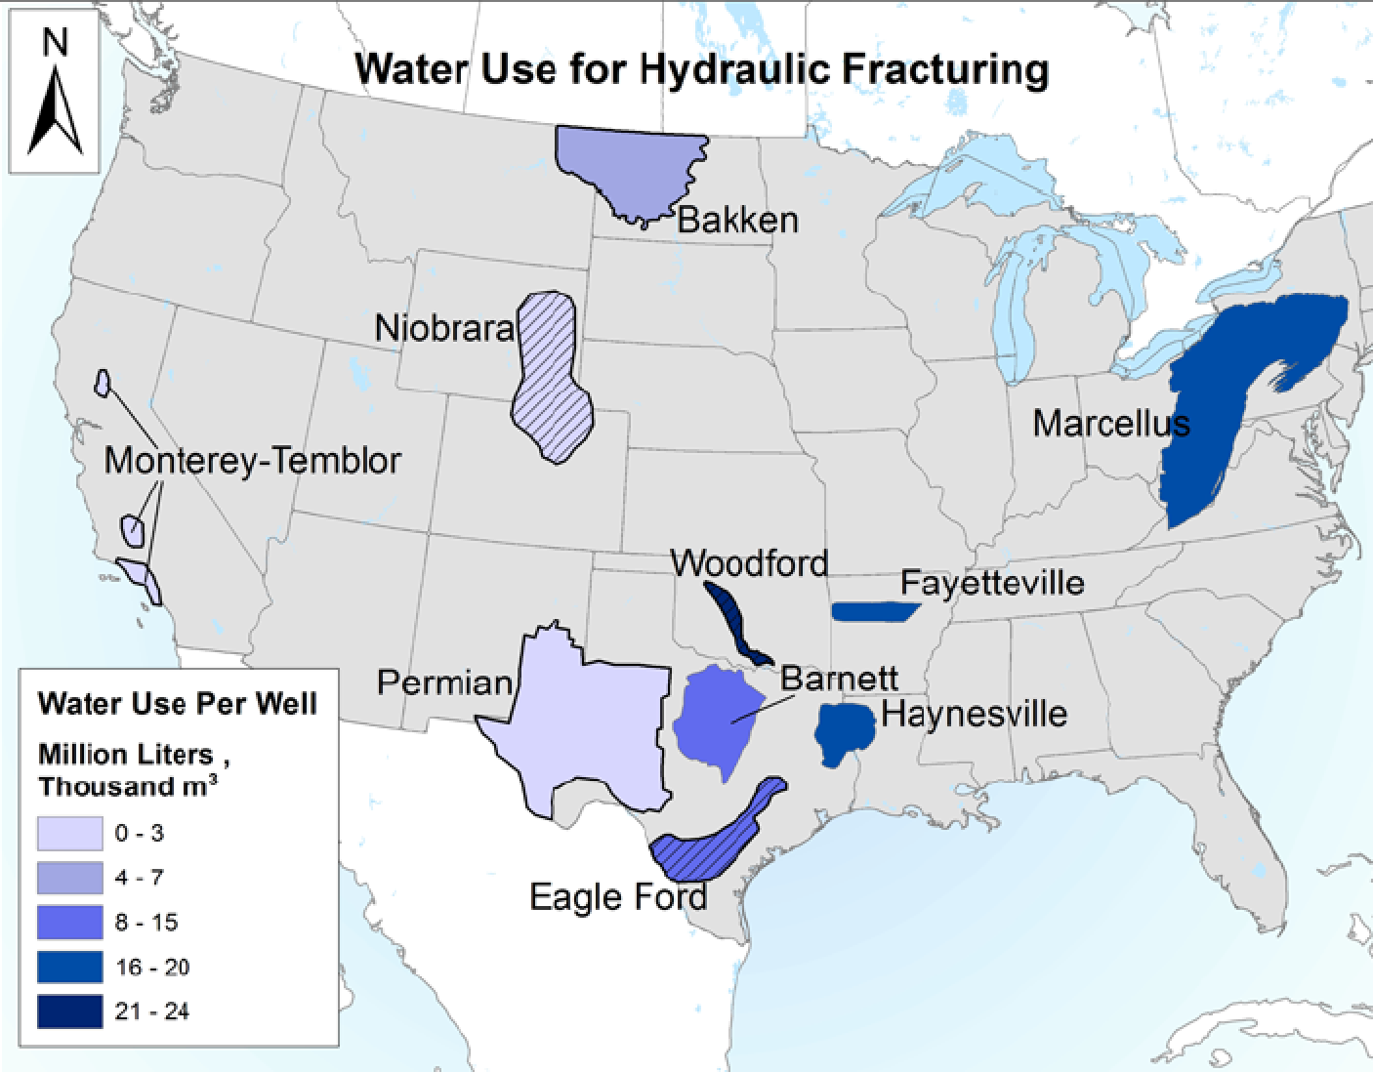
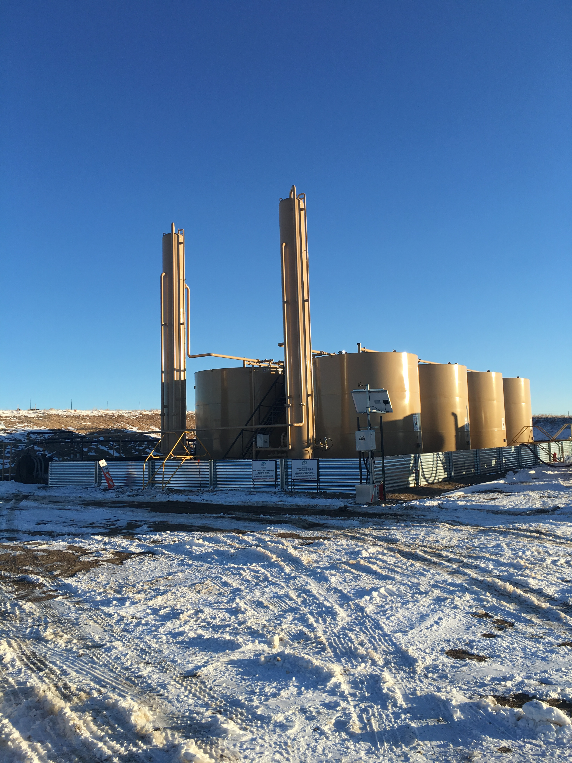
Treatment and Reuse of Shale Oil and Gas Produced Water by Membrane Distillation
Bai and Carlson, Oil and Gas Facilities, 2016, 5 (06).
Kondash and Vengosh, Environ. Sci. Technol. Lett. 2015, 2, 276-280

Slide 10
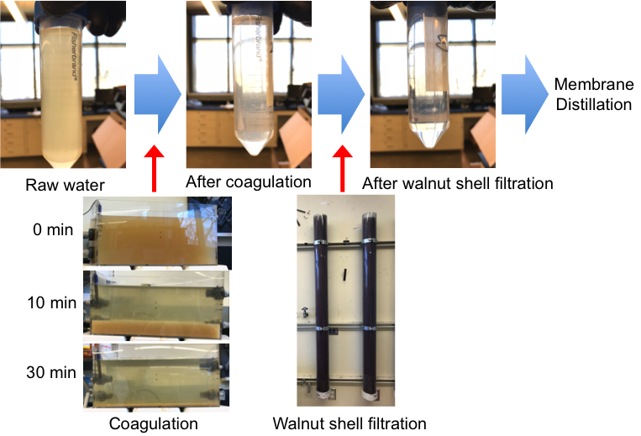
Pretreatment by Precipitative Softening and Walnut Shell Filtration is Effective.

Slide 11
Pretreatment by Precipitative Softening and Walnut Shell Filtration is Effective.
 | Before Pretreatment | After Pretreatment | Removal efficiency
Ca²⁺ | 878 mg/L | 601 mg/L | 32%
Alkalinity | 555 mg/L | 183 mg/L | 67%
Sr²⁺ | 99.7 mg/L | 55.7 mg/L | 44%
Silica | 26.1 mg/L | 11.9 mg/L | 54%
TVPH | 55.8 mg/L | 4.1 mg/L | 93%
Benzene | 9 mg/L | 0.412 mg/L | 95%
Toluene | 4.29 mg/L | 0.103 mg/L | 98%
Ethylbenzene | 0.479 mg/L | 0.009 mg/L | 98%
Xylene | 1.67 mg/L | 0.034 mg/L | 98%
* TVPH: total volatile petroleum hydrocarbons
Saturation index of calcite, silica, and strontianite decreased from 1.25, 0.37, and 0.62 to 0.03, -0.14, and -0.70 after pretreatment (after 80% water recovery of MD)

Slide 12
Pretreatment Improved Desalination Performance of Membrane Distillation
Salt removal > 99.9%

Slide 13
Pretreatment + Membrane Distillation Produced High-Quality Distillated Water Product
Met irrigation regulation
1 – Raw Produced Water
2 – PS Only
3 – PS + WSF
4 – MD Only
5 – PS + MD
6 – PS + WSF + MD
TRPH: total recoverable petroleum hydrocarbons; TVPH: total volatile petroleum hydrocarbons

Slide 14
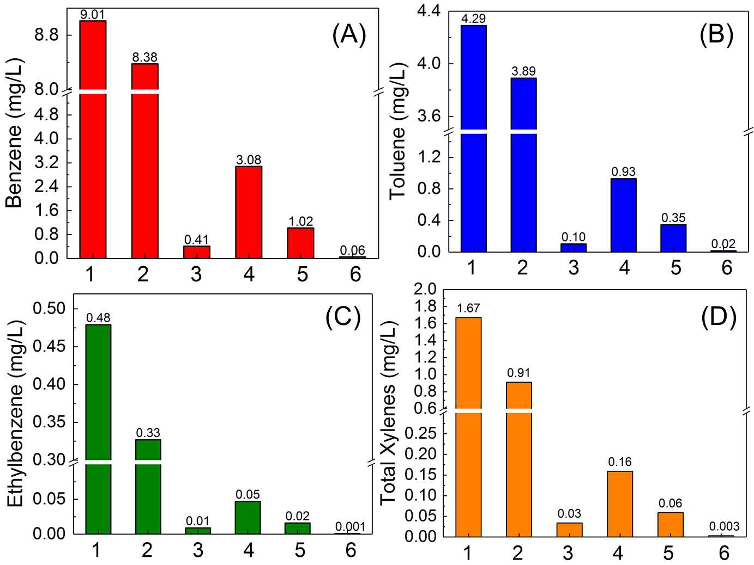
Pretreatment + Membrane Distillation Produced High-Quality Distillated Water Product
BTEX concentration after chemical coagulation + walnut shell filtration + MD meets the discharge requirement regulated by U.S. EPA

Slide 15
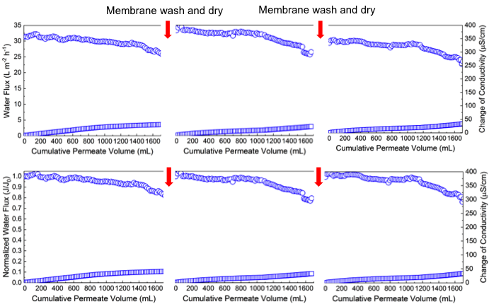
Pretreatment + Membrane Distillation Resulted in Robust Membrane Performance
MD showed exceptional membrane reusability for 3 treatment cycles:
Water Recovery > 80%, water flux decrease < 20%,
salt removal efficiency > 99.9%

Slide 16
Conclusions
Membrane distillation is a promising technology for shale oil and gas produced water treatment, but it is constrained by membrane fouling/scaling and low removal of volatile toxic compounds.
Pretreatment using precipitative softening and walnut shell filtration effectively reduced scaling potential and removed volatile organics in the produced water.
Our treatment train demonstrated exceptional salt and pollutant removal, as well as robust membrane performance.
Our treatment train has the potential to achieve cost-effective and on-site wastewater treatment systems.

Slide 17
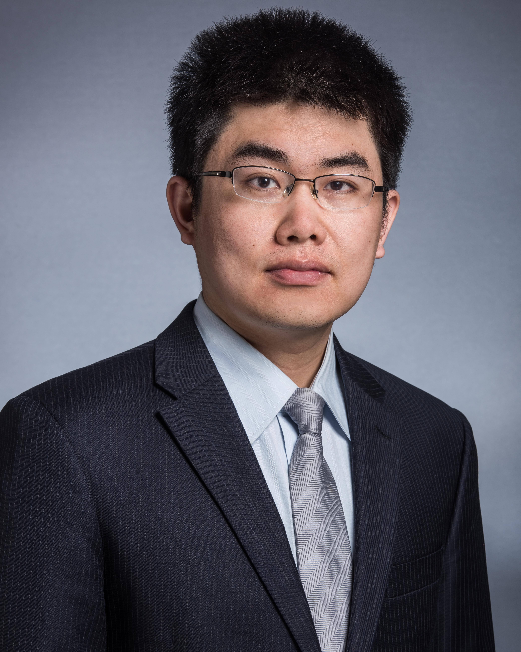

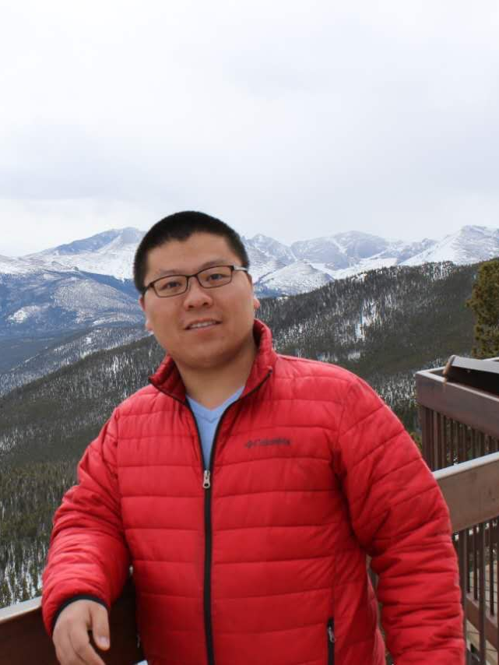
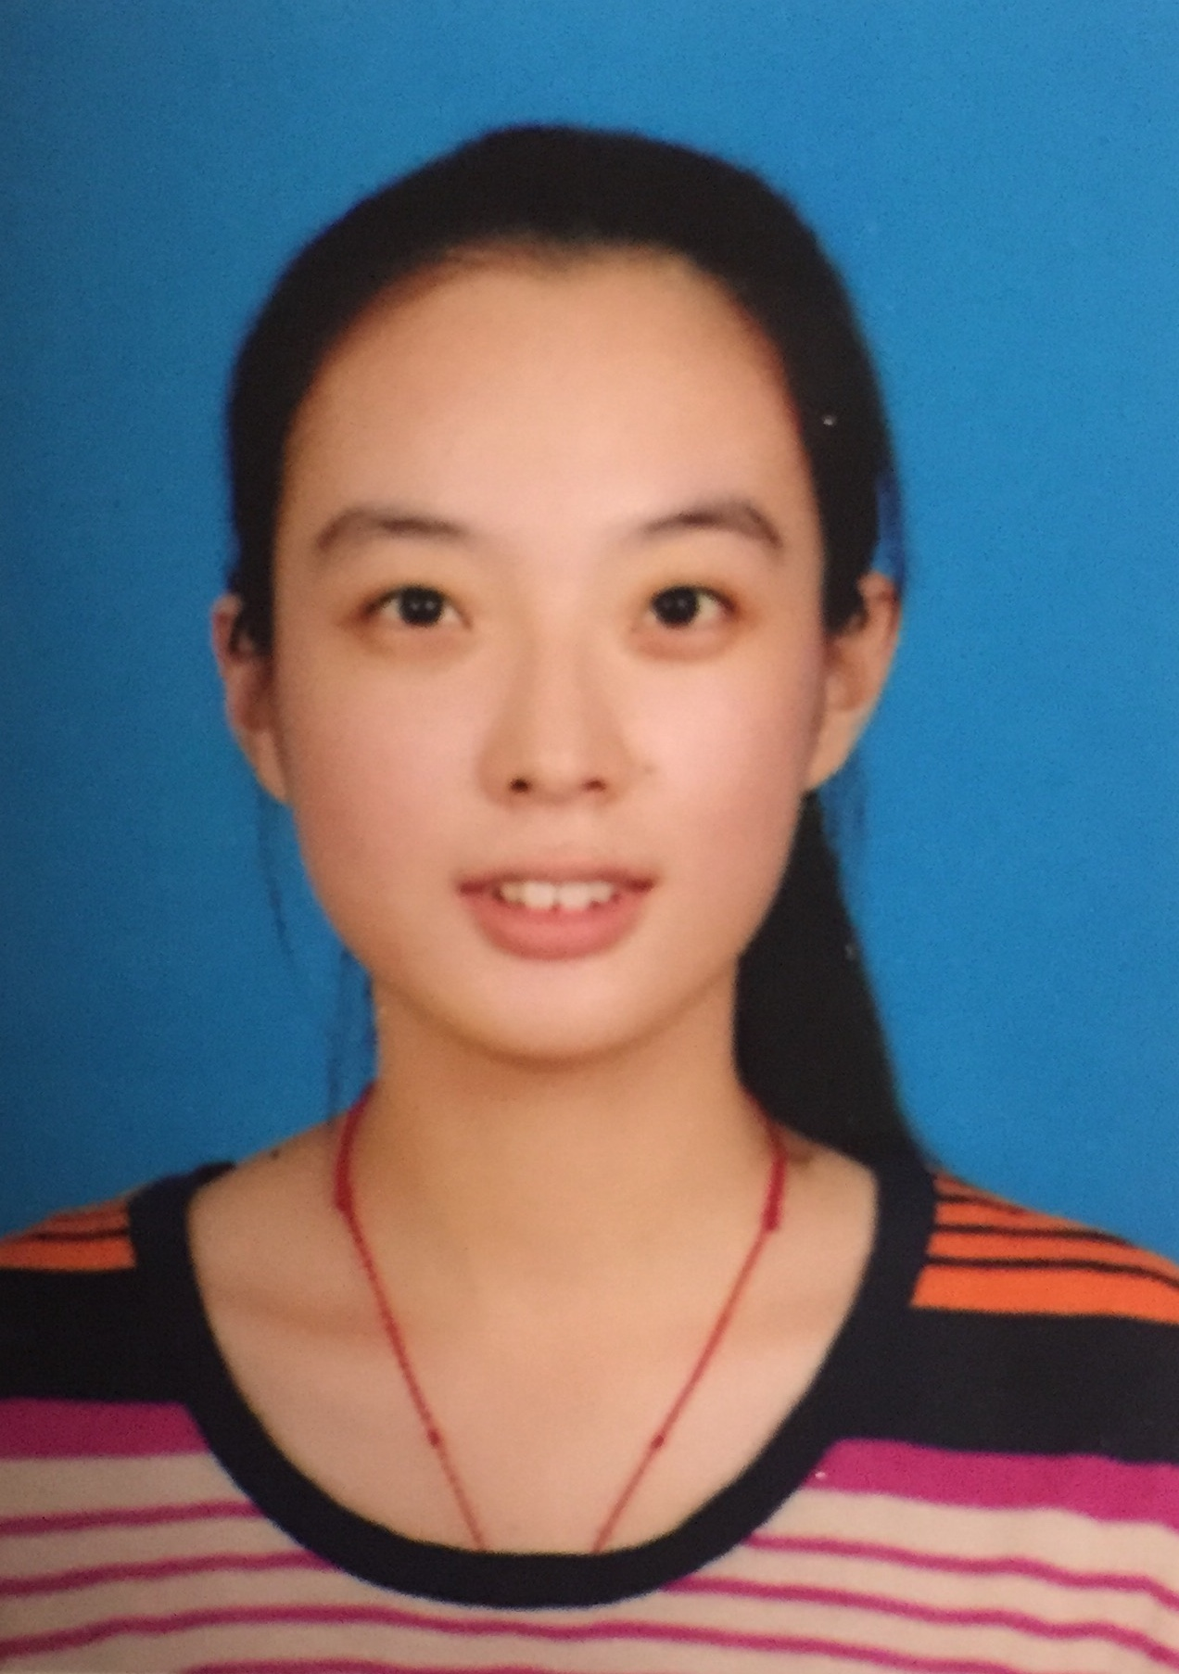


Acknowledgements
Dr. Tiezheng Tong
CSU
Dr. Ken Carlson,
CSU
Zuoyou Zhang,
CSU
Xuewei Du,
CSU

Slide 18
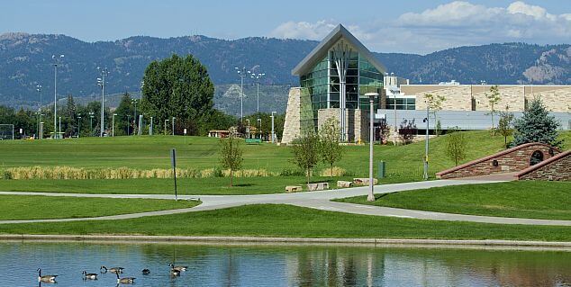
questions?
Email: tiezheng.tong@colostate.edu
kenneth.carlson@colostate.edu
cristian.robbins@colostate.edu

