Slide 1
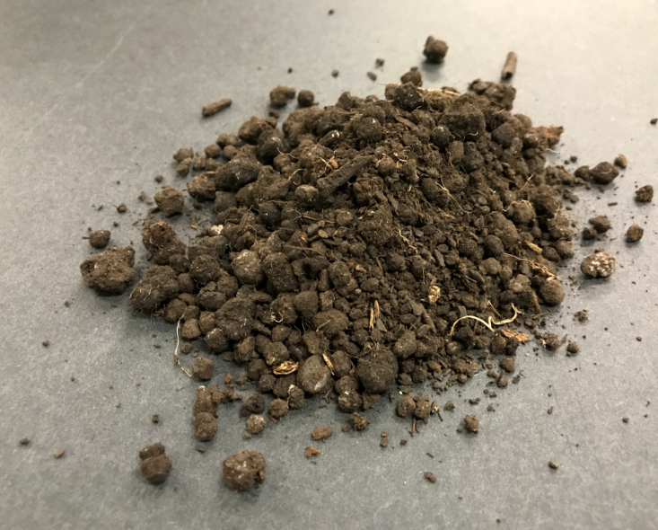
Effective Measurement and Monitoring of Total Petroleum Hydrocarbons with Field Equipment
Patrick Tyczynski
M-I SWACO, a Schlumberger company

Slide 2
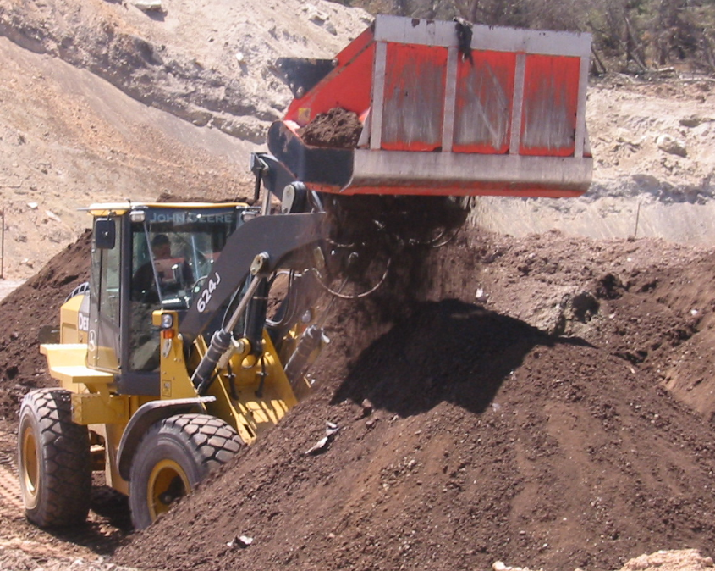
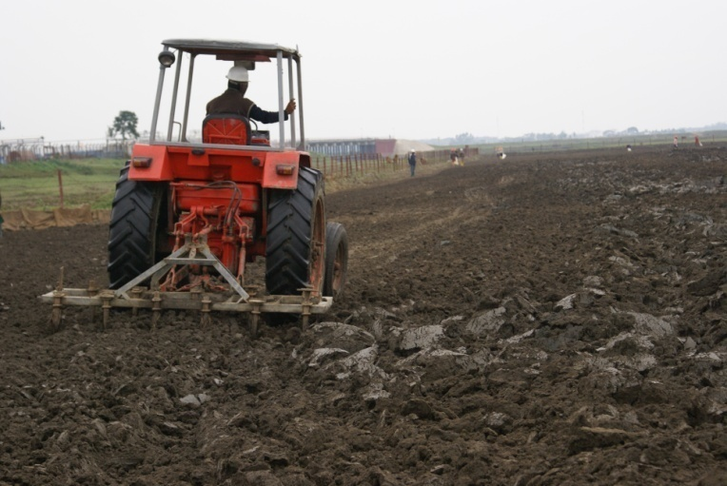
Reduction of Hydrocarbon Concentrations in Drill Cuttings
Thermal desorption
Solvent extraction
Bioremediation
Overview | Instruments | Results | Troubleshooting

Slide 3
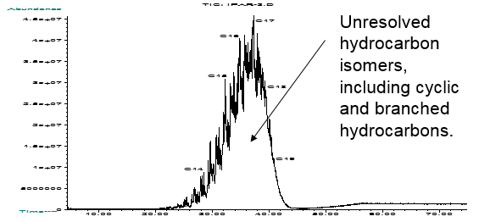
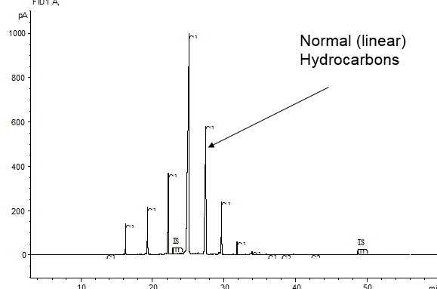
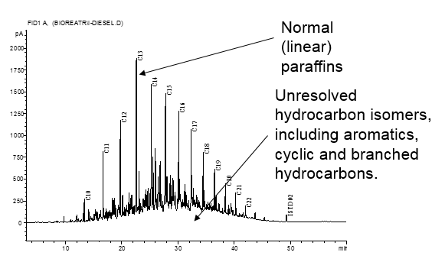
Hydrocarbons
Overview | Instruments | Results | Troubleshooting

Slide 4
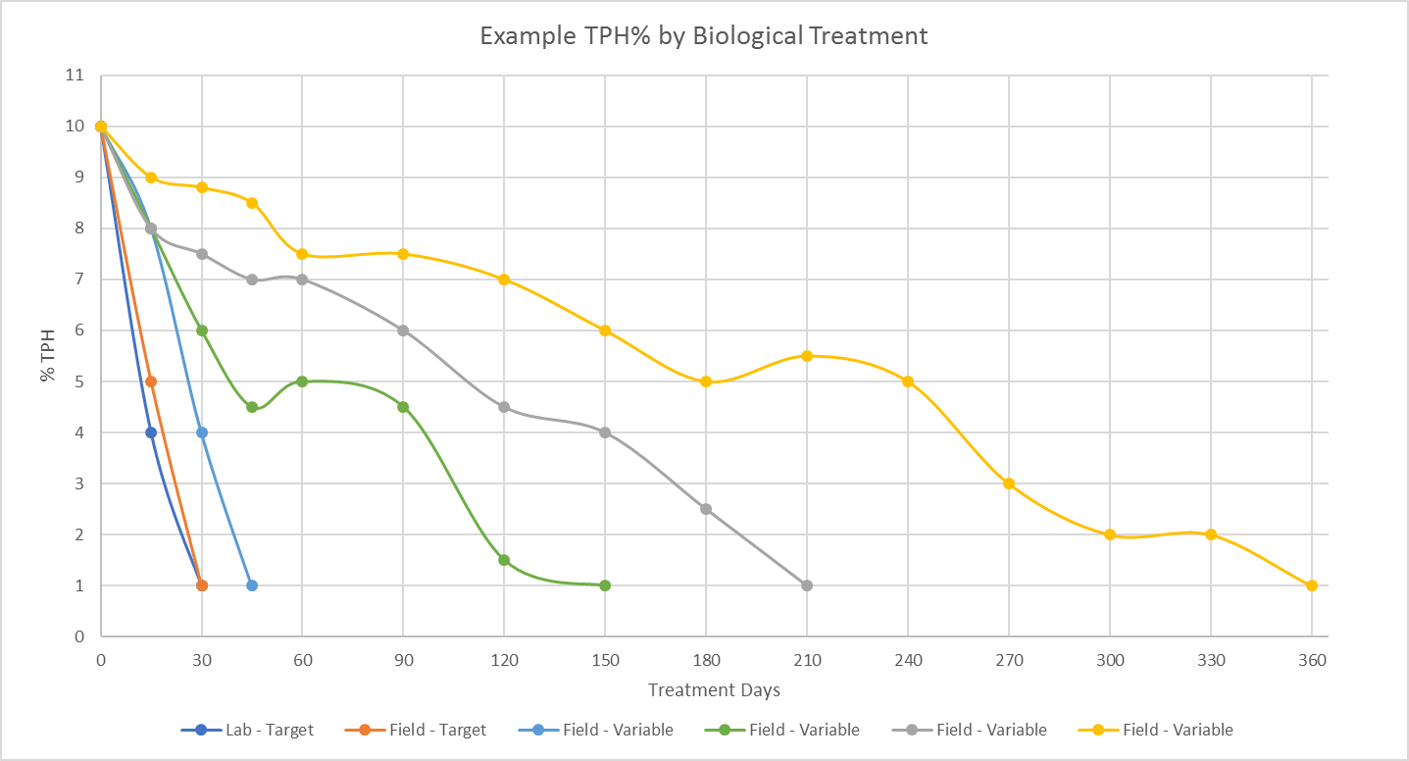
Relationship Between the Lab and the Field
Optimal treatment to reach target
Variables with potential to extend process
Overview | Instruments | Results | Troubleshooting

Slide 5
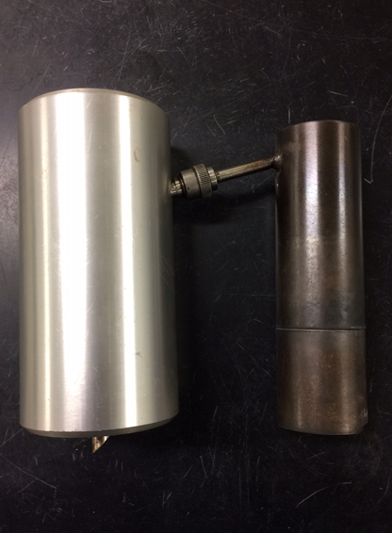
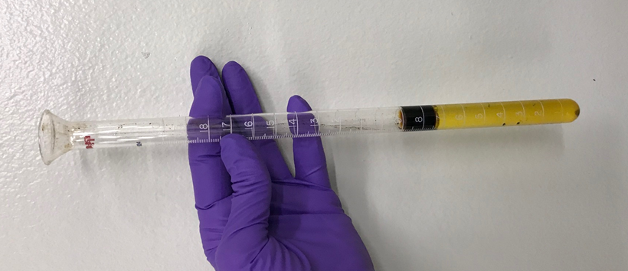
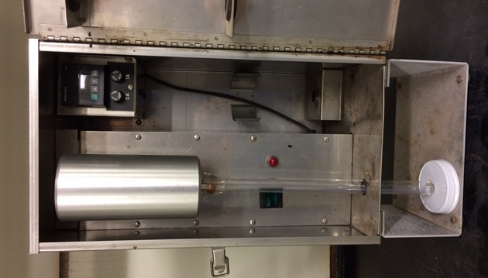
Retort - ROC
Overview | Instruments | Results | Troubleshooting

Slide 6
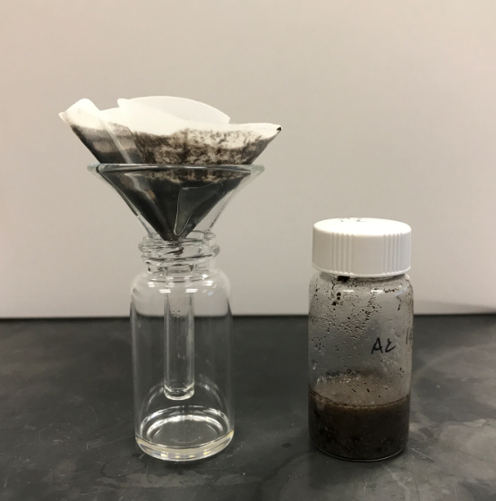
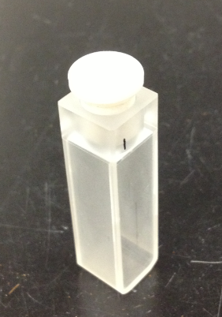
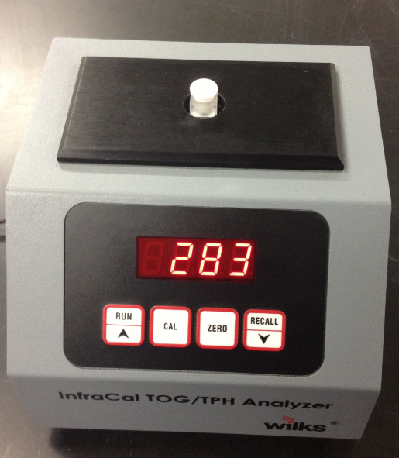
INFRACAL - TPH
Overview | Instruments | Results | Troubleshooting

Slide 7
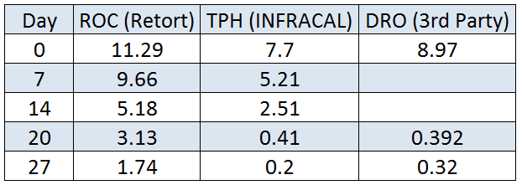
Result Comparison
Overview | Instruments | Results | Troubleshooting

Slide 8
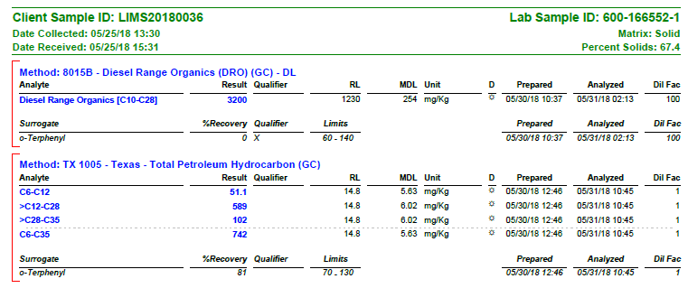
Result Comparison
Overview | Instruments | Results | Troubleshooting

Slide 9
Result Comparison
Detection Limits
Extraction Efficiency
Correlation
Sampling
Equipment and Techniques
Substrate
Calibration
Overview | Instruments | Results | Troubleshooting

Slide 10
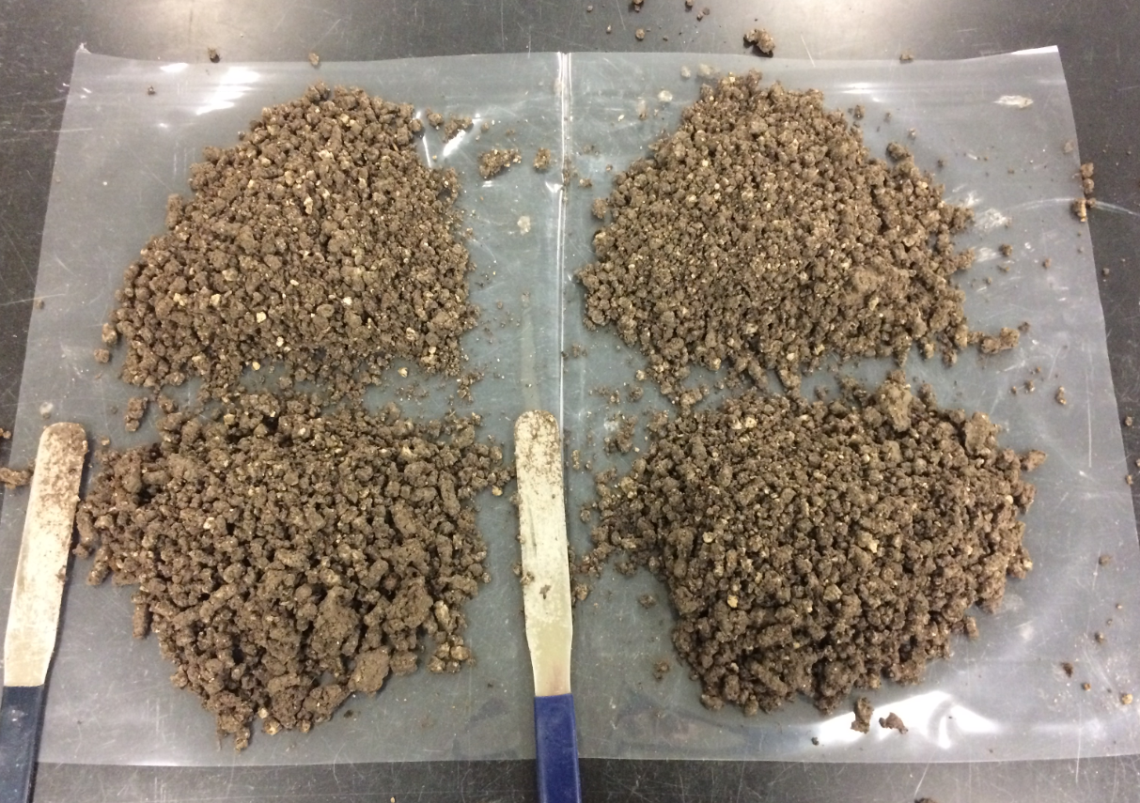
Sampling
Overview | Instruments | Results | Troubleshooting

Slide 11
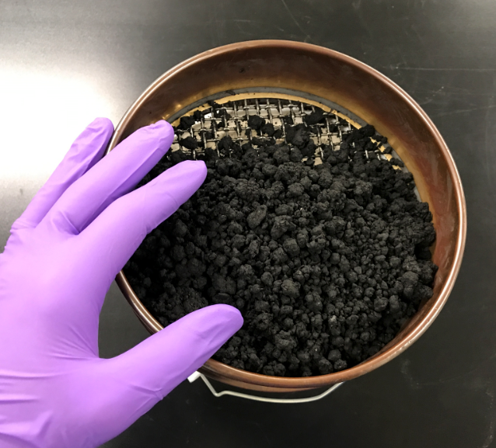
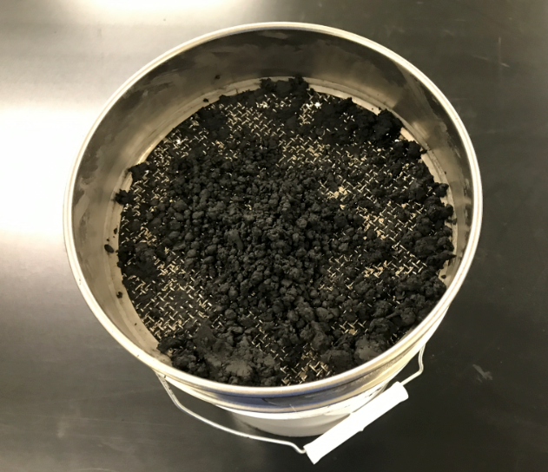
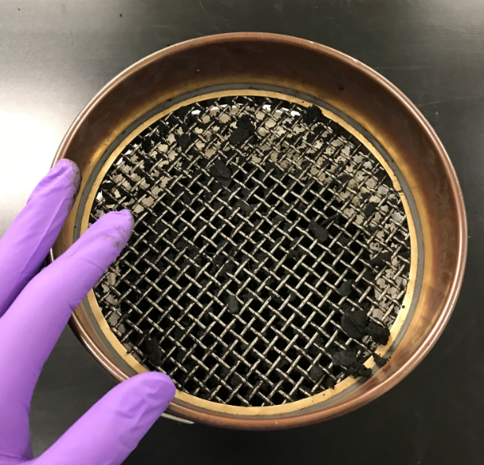
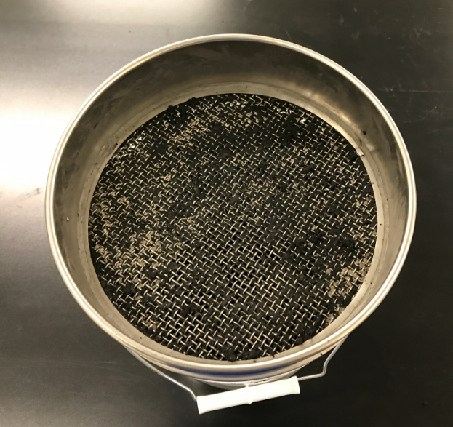
Sampling
Overview | Instruments | Results | Troubleshooting

Slide 12
Equipment and Techniques
Overview | Instruments | Results | Troubleshooting

Slide 13
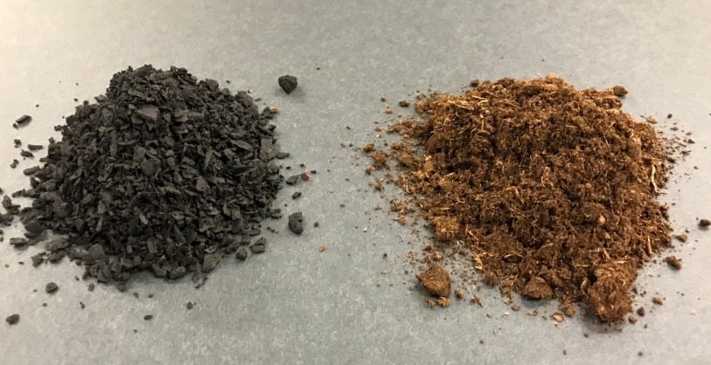
Substrate
Overview | Instruments | Results | Troubleshooting

Slide 14
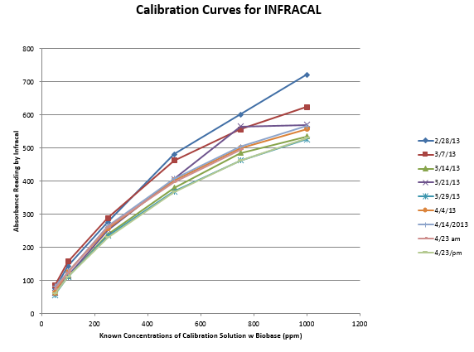
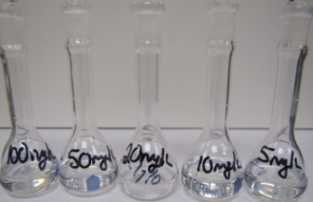
Calibration
Overview | Instruments | Results | Troubleshooting

Slide 15
Correlation
Overview | Instruments | Results | Troubleshooting

Slide 16
Correlation
Understanding the difference between precision and accuracy
Good Precision
Good Accuracy
Poor Precision
Poor Accuracy
Good Precision
Poor Accuracy
Poor Precision
Good Accuracy
Overview | Instruments | Results | Troubleshooting

Slide 17
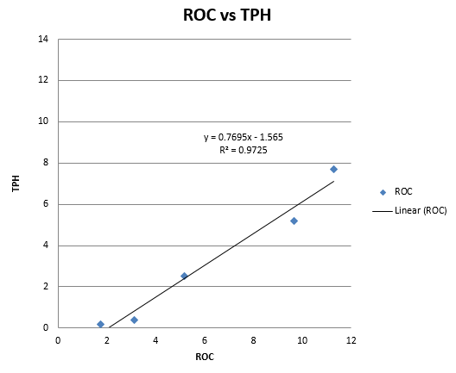
Correlation
Overview | Instruments | Results | Troubleshooting

Slide 18
Optimization
Overview | Instruments | Results | Troubleshooting

Slide 19
Optimization
Overview | Instruments | Results | Troubleshooting

Slide 20
Optimization
Overview | Instruments | Results | Troubleshooting

Slide 21
Optimization
Overview | Instruments | Results | Troubleshooting

Slide 22
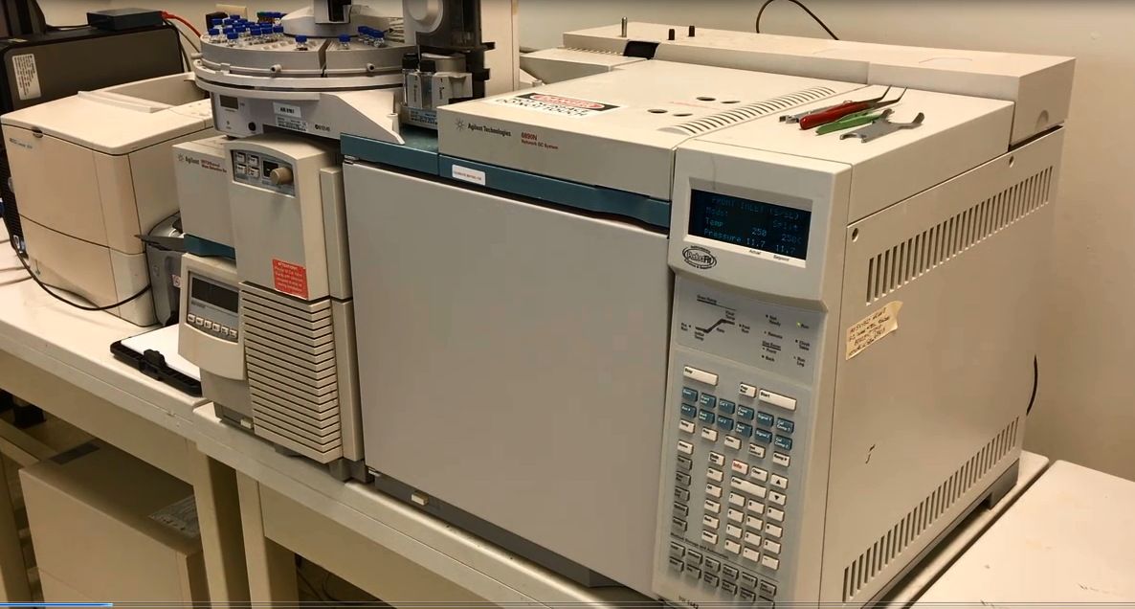
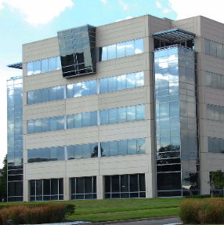
Optimization
Overview | Instruments | Results | Troubleshooting

