Slide 1
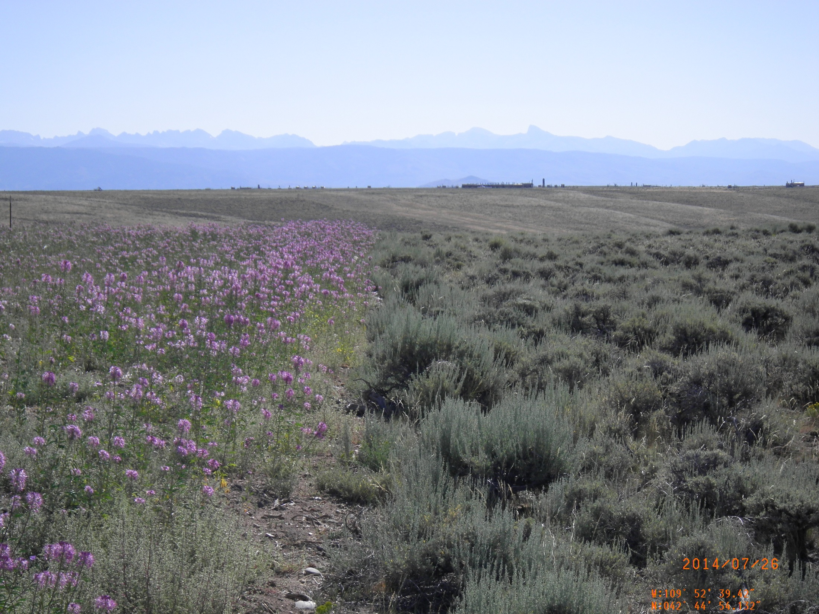
j
Ecosystem Service Response to Interim Reclamation on Oil and Gas Well Pads in Wyoming
Michael Curran ^{abc} and Dr. Peter Stahl ^{abc}
a- Department of Ecosystem Science and Management, University of Wyoming
b- Program in Ecology, University of Wyoming
c- Wyoming Reclamation and Restoration Center

Slide 2
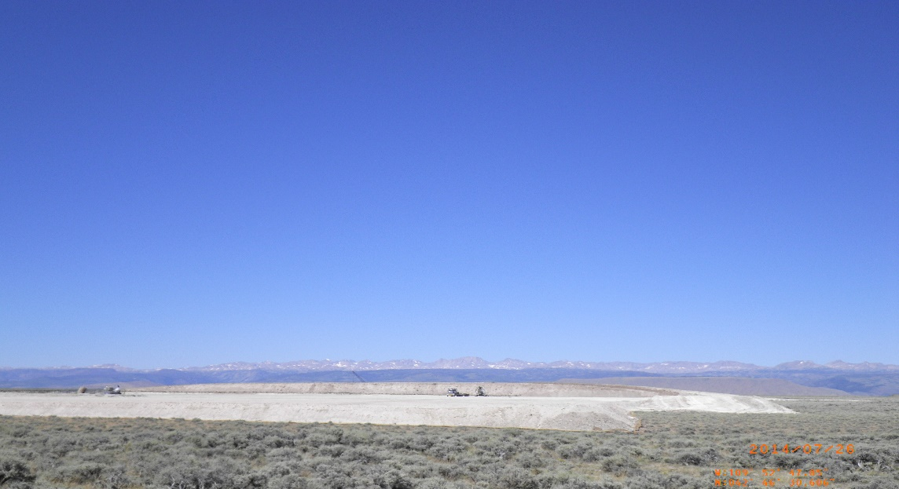
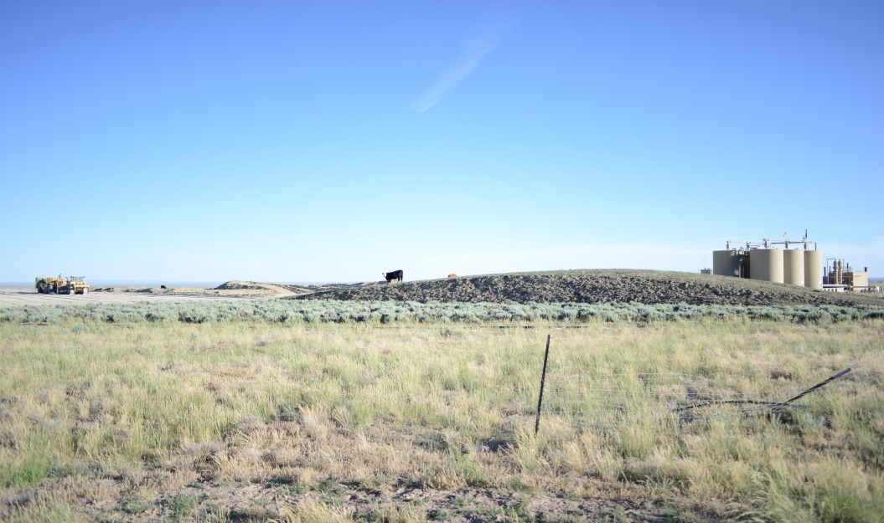
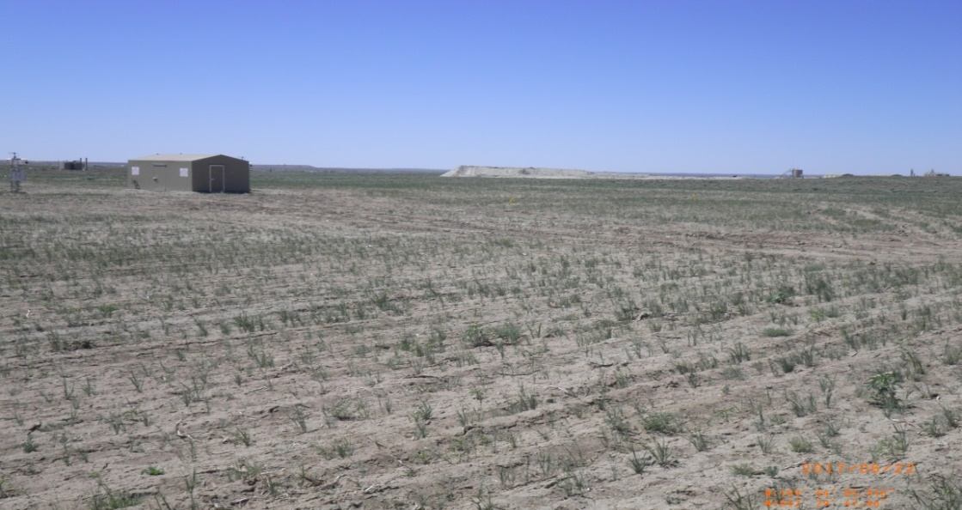
Reclamation as a process

Slide 3
Land Reclamation and Ecosystem Restoration in Oil and Gas Fields
May be viewed as ‘assisted succession’ (McCann 2007, Walker et al. 2007)
Typically focused on structural, not functional, end points
Regulatory Criteria – Roll Over/Bond Release
Lack of attention on native annual forbs (Prasser 2015)
Difficult (species dependent) to obtain commercial seed mixes (Curran et al. 2015)
Vary among agencies and on private land
Reclaimed sites compared to adjacent, undisturbed cultural reference sites (BLM Gold Book 2007)

Slide 4
Ecosystem services as ‘functional end points’
Soil Recovery
Accumulate, stablize and store carbon
Prevent erosion
Vegetation
NPP
Cover/diversity
Insect abundance/diversity
Used as indicators of reclamation success in the past
Most work done with pollinators in crop systems

Slide 5
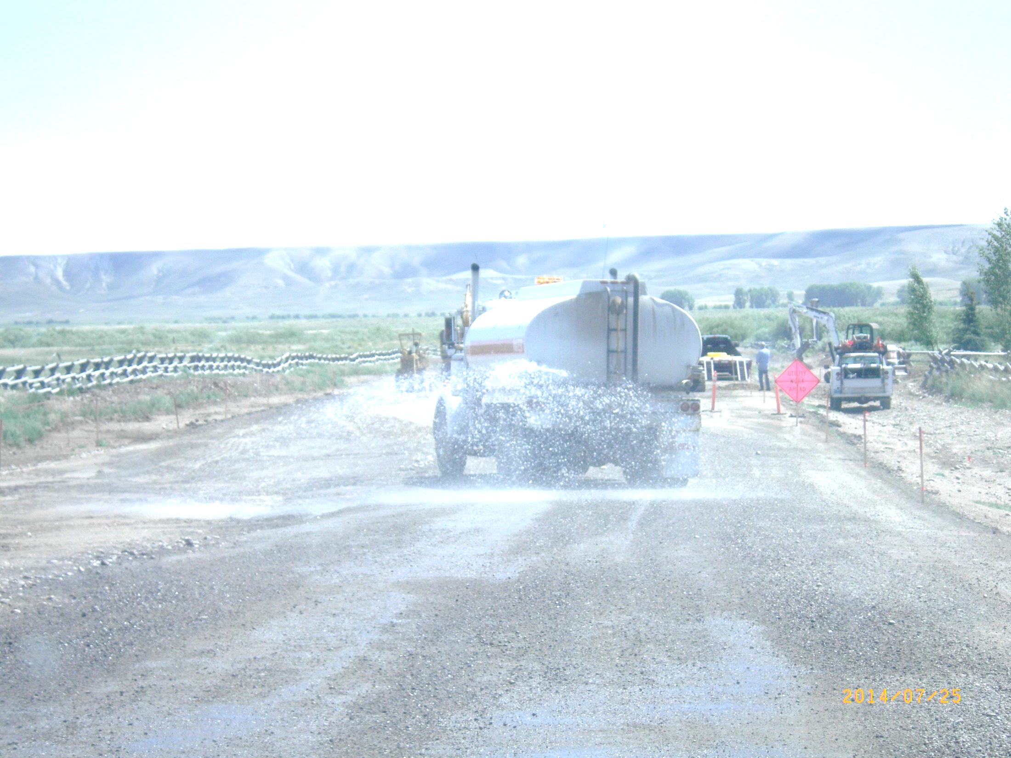
Challenges of restoring a ‘cold desert’
Arid/semi-arid environment
Low, unpredictable precipitation
Cold climate
Average <50 frost free days
Sagebrush steppe ecosystem
Sagebrush often takes many years to reestablish
Soil conditions, environmental quality, erosion
Stripping and stockpiling soil may introduce unsuitable growing medium to surface

Slide 6
Wamsutter

Slide 7
* Dr. Jay Norton (UWYO)

Slide 8
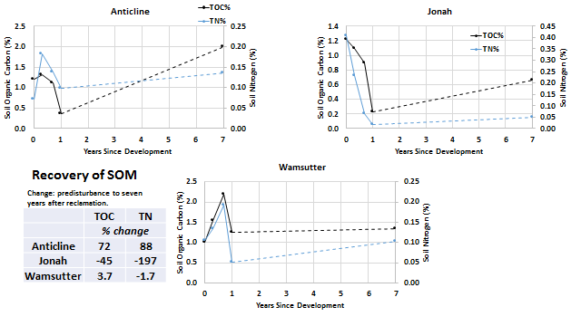
*Dr. Jay Norton (UWYO)

Slide 9
Conclusions? (* Dr. Jay Norton (UWYO))
Compared with degraded reference sites, reclaimed sites seem to recover or exceed original SOM levels within seven years;
Possibly due to increased herbaceous vegetation
Potentially mineralizable carbon recovers more slowly;
Possibly due to loss of soil structure, which protects labile SOM from mineralization, and continued accelerated mineralization, lack of woody species…
Interest in reclamation research is as variable as annual rainfall.

Slide 10
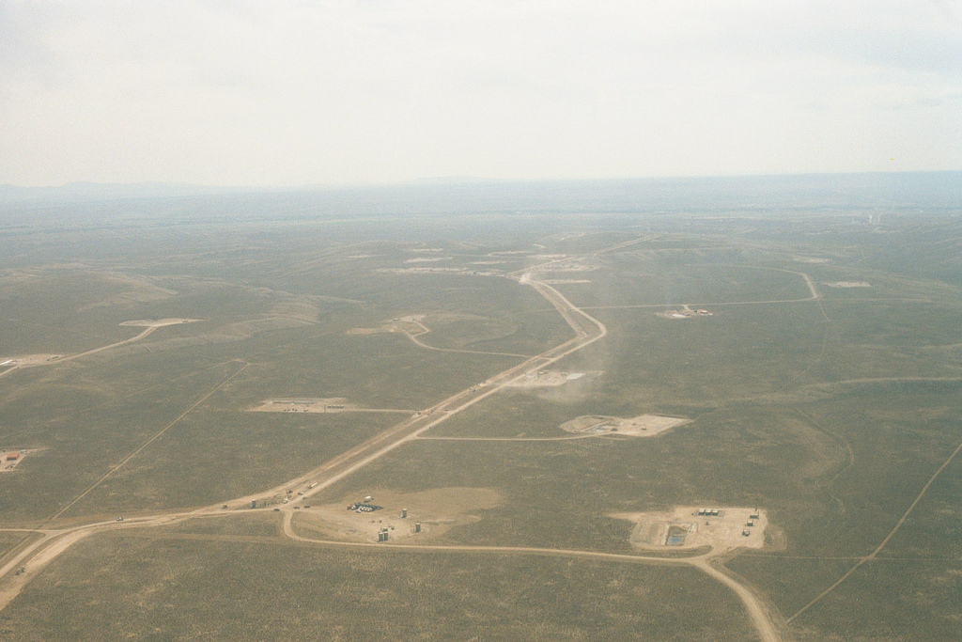
Study Area (Vegetation and Insects)
Pinedale Anticline natural gas field (Pinedale, WY, USA)
High daily and annual temperature fluctuations
~2,100 m elevation
42 day frost-free period
Low (254-356 mm) and unpredictable precipitation
Highly fragmented
5,289 acres of initial disturbance with 3,668 acres undergoing active reclamation (69.3%)
Subject to domestic livestock grazing dating back to 1871
All sites selected in study fall in ESD R034AY222WY
Historic climax plant community of mixed grass, big sage

Slide 12
Vegetation Sampling Results
Beeplant reclaimed well pads
19-33% bareground, 23-35% beeplant, 15-31% Russian thistle, <1% sagebrush, 17-23% herbaceous litter, <1% bunch grass, <1% rhizomatous grass)
Reference sites adjacent to beeplant pads
43-59% bareground, 20-31% sagebrush, 3-9% herbaceous litter, 8-14% woody litter, 1-5% bunch grass, 0-2% rhizomatous grass, 0% forbs
Native grass reclaimed well pads
55-72% bareground, 0-6% sagebrush, 18-29% bunchgrass, 1-3% rhizomatous grass, <1% forbs, 2-10% herbaceous litter
Reference sites adjacent to native grass pads
53-59% bareground, 17-27% sagebrush, 3-10% bunchgrass, 0-3% rhizomatous grass, 0% forbs, 0-6% herbaceous litter, 6-11% woody litter

Slide 13
NPP/NDVI

Slide 15
Ain b

Slide 16
Insects and Ecosystem Services
Provisioning Services
Food, raw materials, fresh water, medicinal resources
Regulating Services
Local climate and air quality, carbon sequestration and storage, moderation of extreme events, waste-water treatment, erosion control/soil fertility, pollination, biological control
Habitat or Supporting Services
Habitat for species (food, shelter, water), maintenance of genetic diversity (high species diversity often means high genetic diversity), nutrient cycling
Cultural Services
Recreation (mental & physical health), tourism, aesthetic appreciation and inspiration for culture, art, and design, spiritual experience
www.teebweb.org

Slide 17
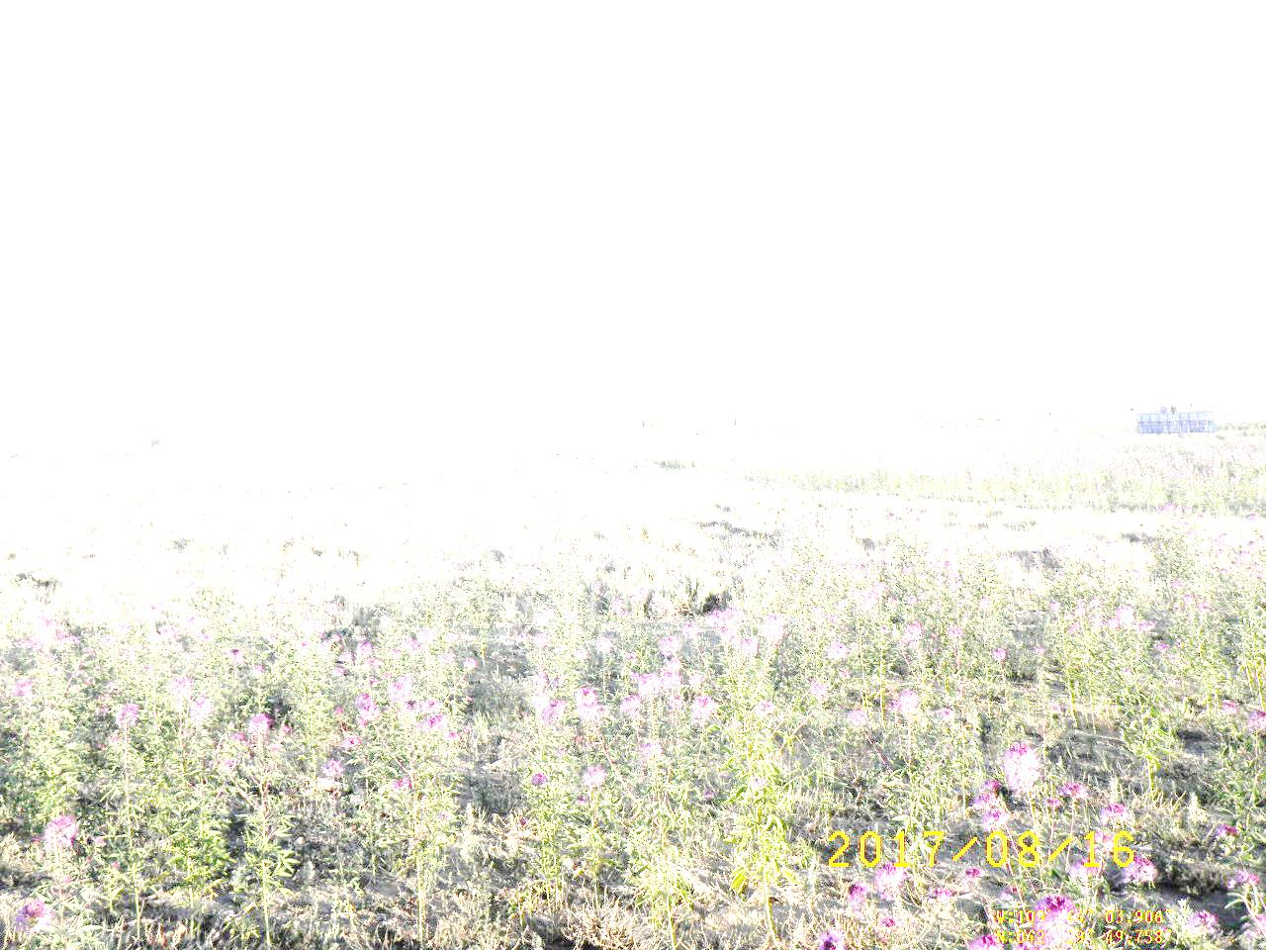
Information about Insects from previous literature
Plant-vigor hypothesis (Price 1991)
Mass-flowering hypothesis (Westphal et al. 2003)
Many insects avoid terpenoids (produced by old sagebrush) and very few insect families eat wood
Not many studies have been conducted to see how grazing impacts insects, but most show negative impact (Fleischer 1994)
Not much is known about wild pollinators in rangelands (Harmon 2011)

Slide 18
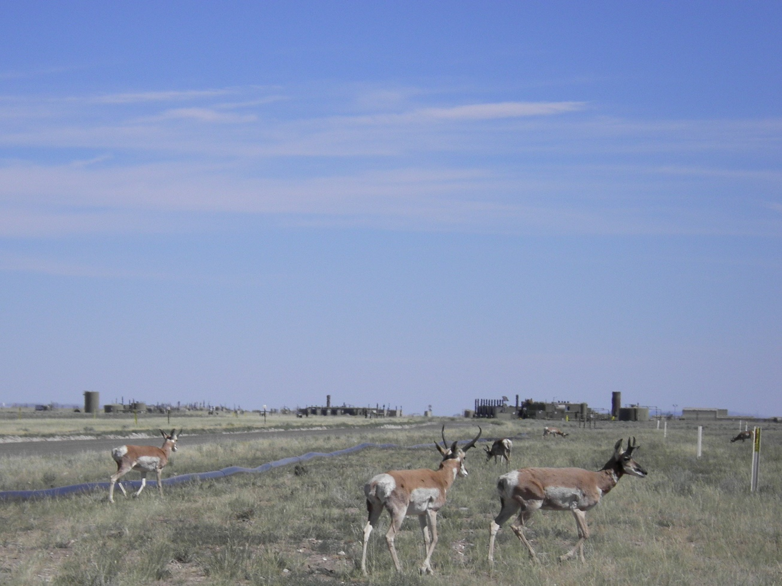
Hypotheses
Insect abundance and family richness (2015 and 2016) would be higher on reclaimed well pads with mass-flowering Rocky Mountain beeplant than on reference sites adjacent to them (mass-flowering hypothesis)
Insect abundance and family richness (2015 and 2016) would be higher on reclaimed well pads with native grasses than on reference sites adjacent to them (plant-vigor hypothesis, insect avoidance to terpenoids)
Insect abundance and family richness (2015 and 2016) would be different on RMBP reclaimed sites and native grass reclaimed sites
Insect abundance and family richness (2015 and 2016) would be different on reference sites adjacent to RMBP reclaimed sites and reference sites adjacent to native grass reclaimed sites

Slide 19
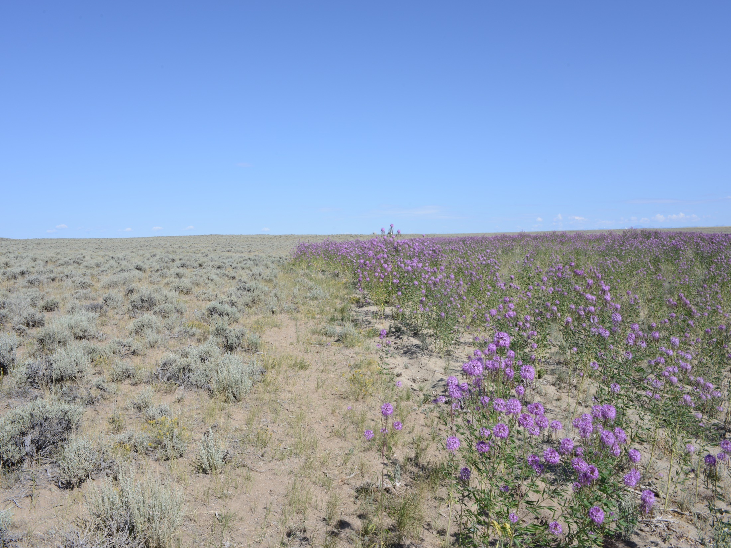
Vegetation Sampling Methods
In 2015 and 2016, 40m transects were placed parallel to edge of well pads at distances of 5m and 10m away from the edge on both reclaimed and reference sites.
0.5m² NADIR images were taken every 5 meters along the transect (9 images per transect) using methods consistent with Cagney et al. 2011
40 points within each image were processed using SamplePoint (Booth 2006) software

Slide 20
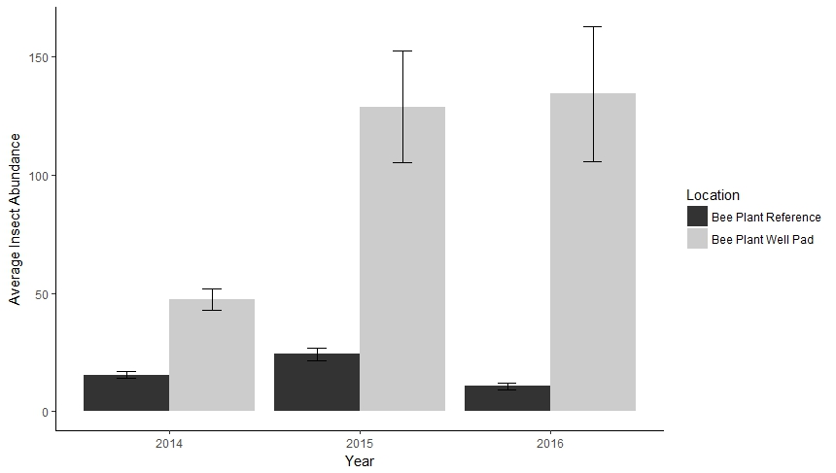
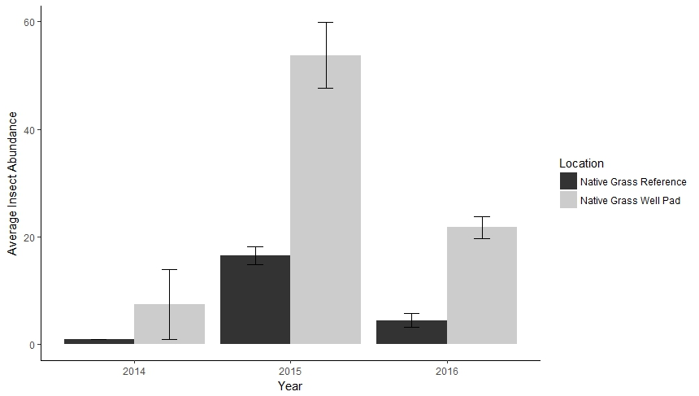
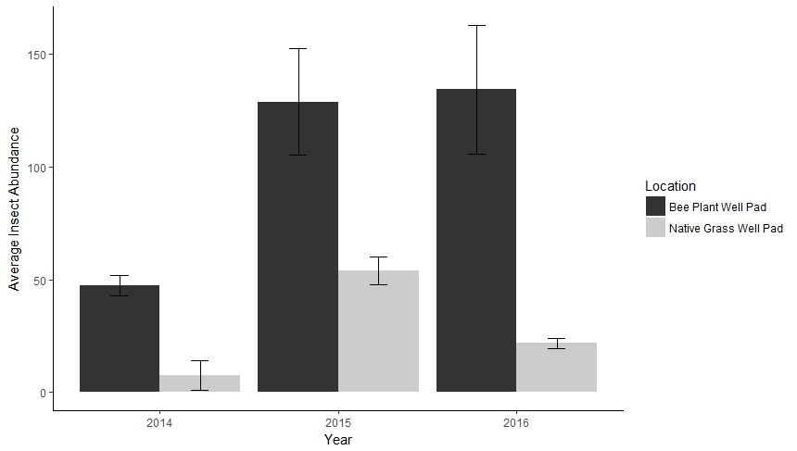
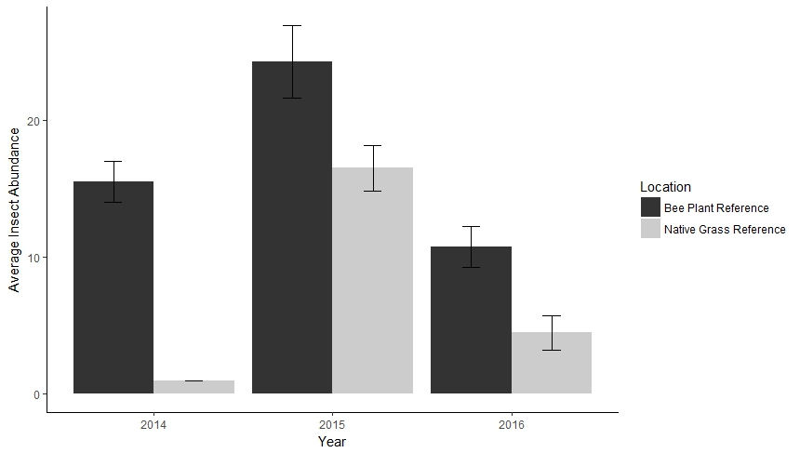
Insect Abundance

Slide 21
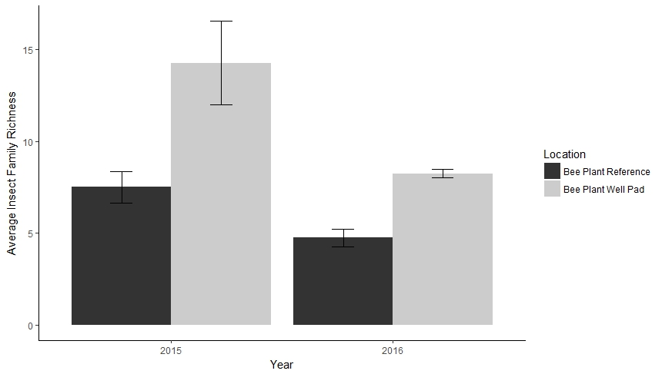
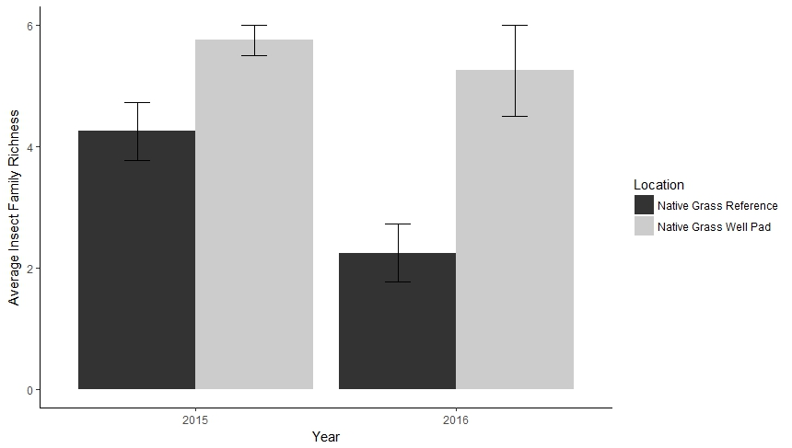
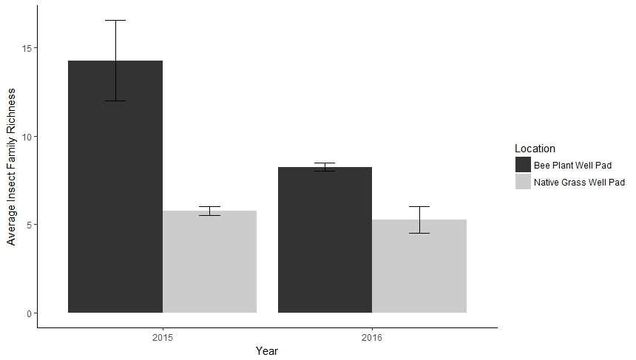
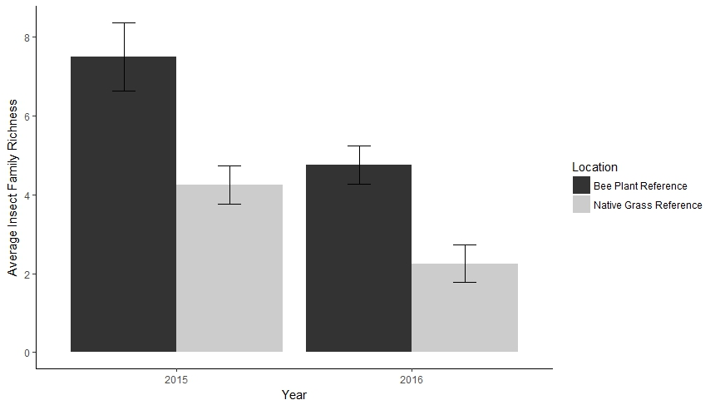
Insect Family Richness

Slide 22
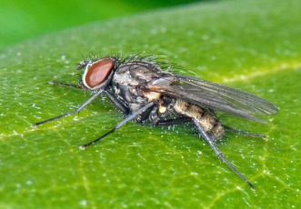
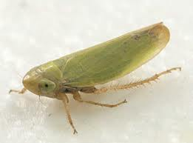
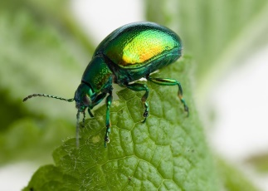
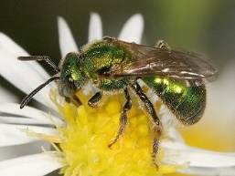
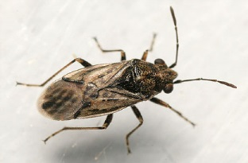
2015 Whittaker Plot

Slide 23
2015 Ecological Role

Slide 24
2016 Whittaker Plot

Slide 25
2016 Ecological Role

Slide 26
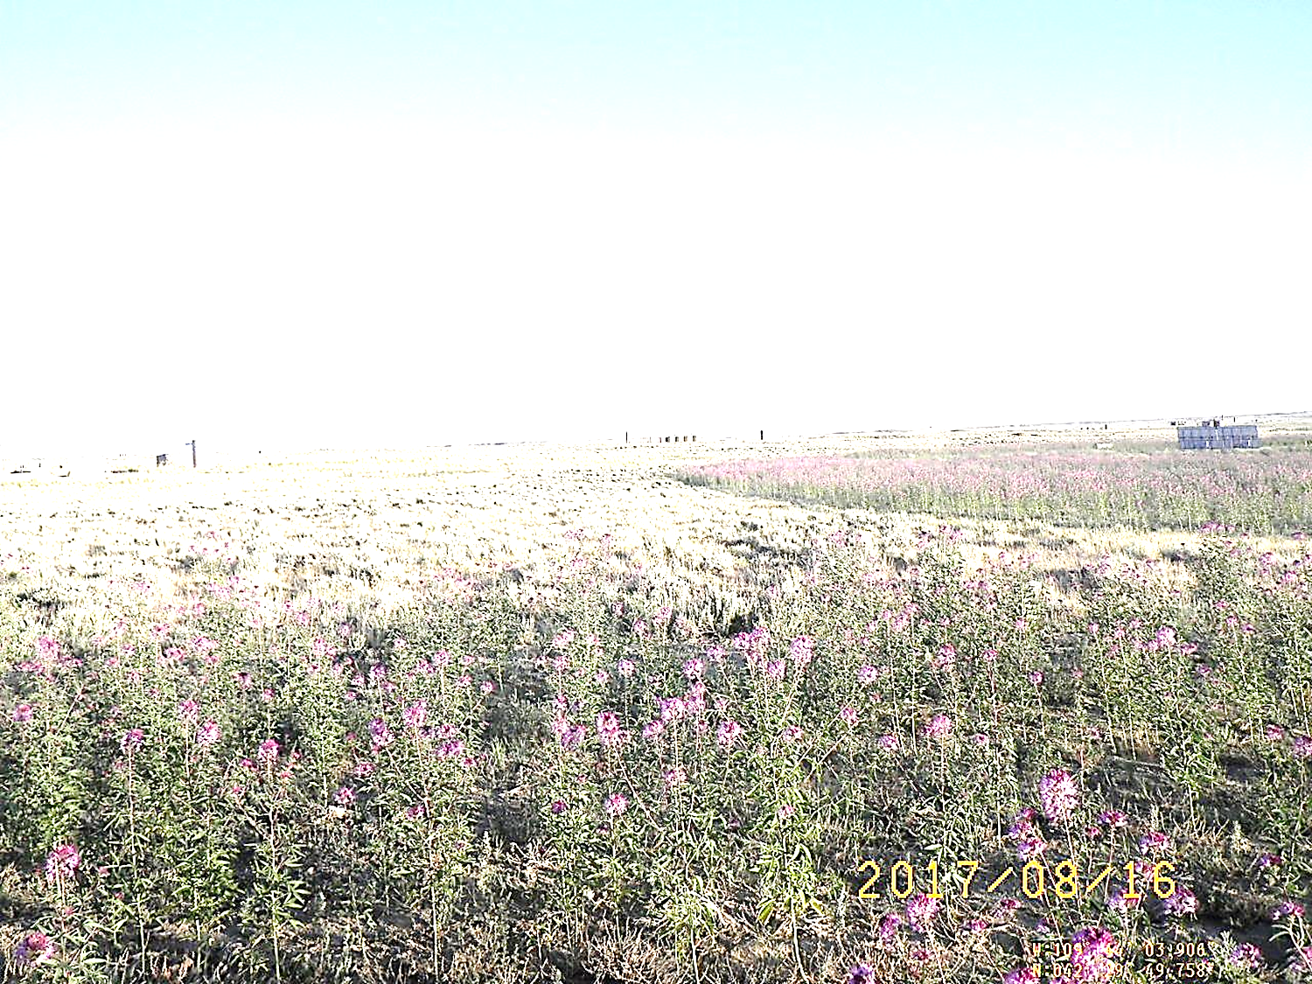
Discussion
In all cases, more insects found on reclaimed sites than reference areas
More insect abundance and richness on reclaimed sites with RMBP than native grasses
More insect abundance and richness on reference areas adjacent to RMBP sites than reference sites adjacent to native grass sites

Slide 27
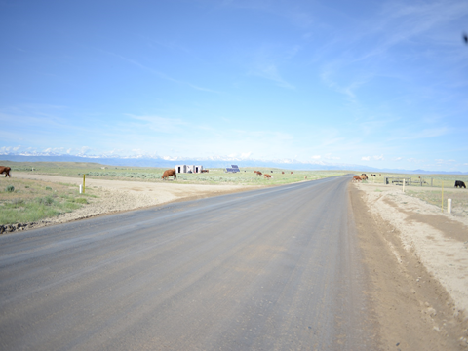
Discussion
Rocky Mountain beeplant is known to perform well in disturbed environments (Cane 2008) and may be a useful tool in combating invasive weeds (Prasser 2015)
Our study shows RMBP also may be a useful tool late in the season to attract pollinators and other insects
Few studies focusing on ecosystem services at early seral stages of reclaimed (drastically disturbed) lands in arid, high altitude environments
Our study shows, at least in terms of insect diversity and abundance, some earlier stages of reclaimed sites are performing better than the ‘historic climax plant community’ or cultural reference sites
Reference site selection in a semi-natural system may be flawed
Do we want to go to a decadent sagebrush sea with little understory in all cases? Patchiness and vegetation diversity on well pads may have some benefits

Slide 28
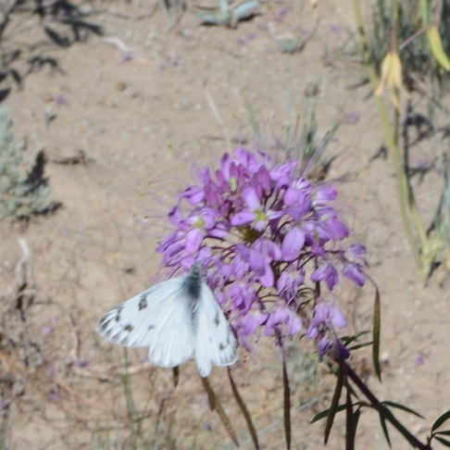
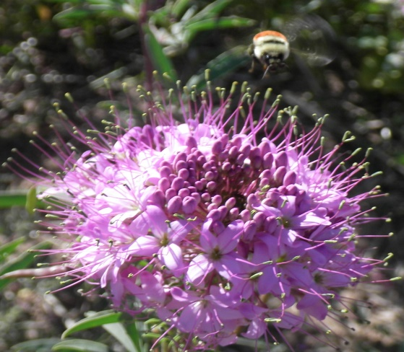
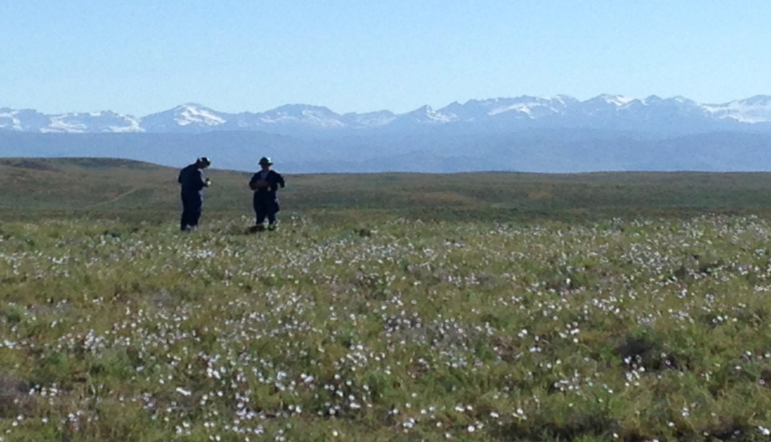
Conclusions
First study to examine insects on reclaimed natural gas well pads
Informs future research regarding wild pollinators (and insects in general) in (high altitude/arid) rangelands
Informs wildlife conservation with more studies
Forbs which attract insects are likely to be beneficial to birds which eat forbs and insects (Curran et al. 2015)
Our study seemingly confirms well-tested hypotheses conducted in other ecosystems
Should we be aiming to restore to a degraded system?
Soil C/N seem to be accruing fast
Insect and plant diversity increase

Slide 29
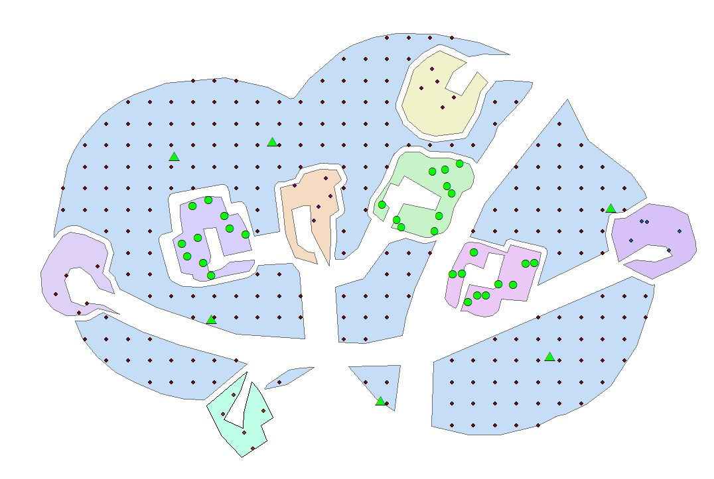
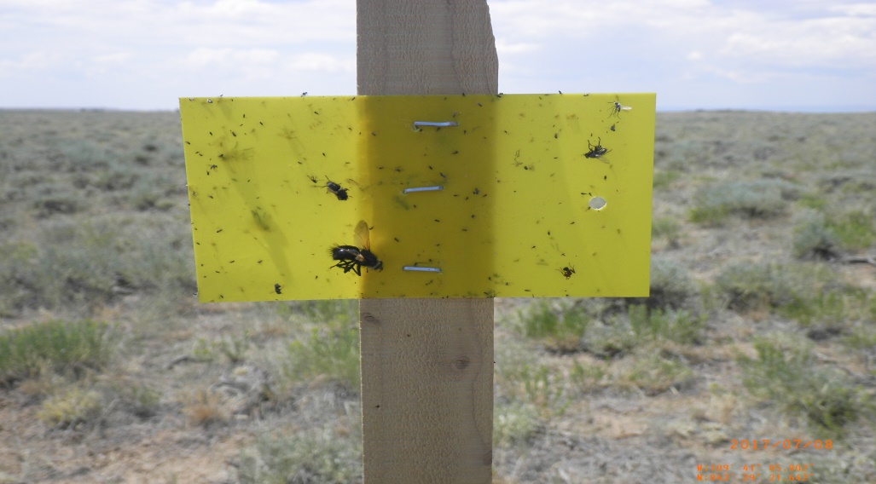
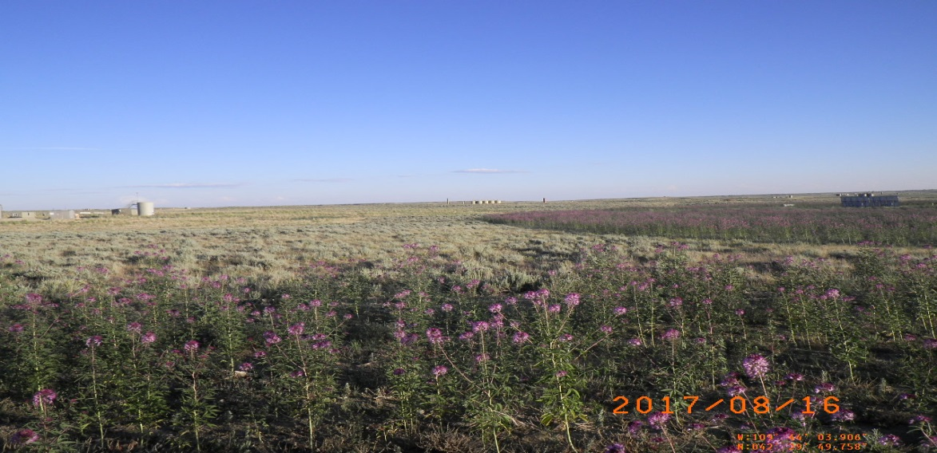
Future Research: Other areas (Jonah), seasons (May, July, August) traps (sweeps and sticky) and monitoring (sticky and mark-capture)

Slide 38
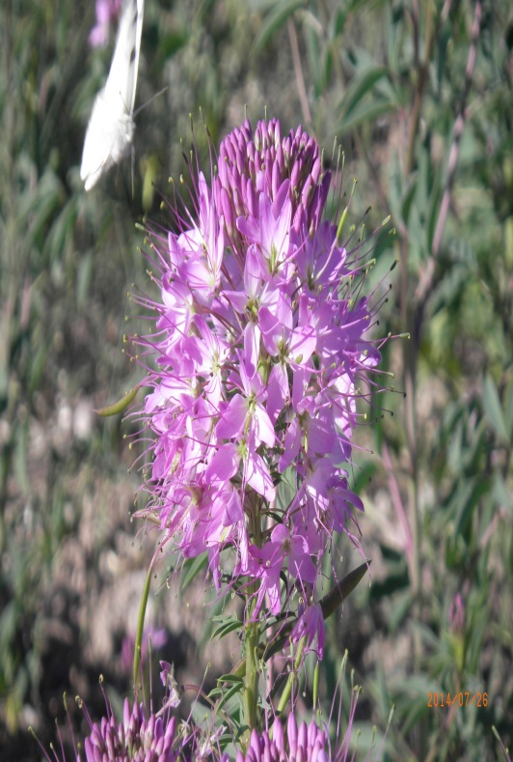
Acknowledgements
Calvin Strom (Assistant Director, WRRC)
Dr. Jay Norton (soil data)
Dr. Doug Smith (insect ID)
Dr. Taylor Crow (help in R)
Dr. David Legg & Dr. Tim Robinson (study design, statistical analysis)
QEP Resources & Anadarko Petroleum Company(field site access)
Jonah Energy, LLC (funding, field site access)

