Slide 1
Drone Magnetometry Applied to Detecting and Mapping Legacy Wells and Pipelines
Ronald S. Bell
Geophysicist & geoDRONEologist
Presented at the:
25th International Petroleum Environmental Conference
Presented on: October 30, 2018 - Grand Hyatt Denver Hotel Denver, CO

Slide 2
A Three Part Presentation
PART 1
Geoscientific mapping by drone
Benefits
Limitations & Restrictions
Drone Mapping workflow
PART 2
The Magnetic Method
The MagArrowTM
Locating abandoned well
Locating a pipeline
EM surveys for pipelines
UAV Flight Services team preparing for drone enabled magnetic survey at and elevation of 12,400 ft
PART 3
What we can do today!

Slide 3
Geoscientific mapping by drone
Visible Light
Color Photographs
up-to-date, high definition color photomosaic base map
digital elevation model / digital surface model
biological species ID and inventory
asset management / project work flow / security
high definition photo-geological mapping
Color Video (4K)
remote sensing
Near Infrared
vegetation stress (NVDI)
soil and rock type \ alteration zones
groundwater seeps
thermal emissions \ extractive process management
contaminant detection & delineation
gaseous emissions
Short Wave Infrared
Thermal Infrared
Multi- / hyper- spectral
LiDAR
elevation point clouds / 3D surfaces
digital elevation model / digital surface model
Gamma Ray Spectrometry
geological mapping
hazard detection
ground surface
geophysics
Magnetic
rock type / alteration zones
geologic structural
buried objects & UXO
infrastructure detection and delineation
contaminant detection and delineation
subsurface
ElectroMagnetic (EM)

Slide 4
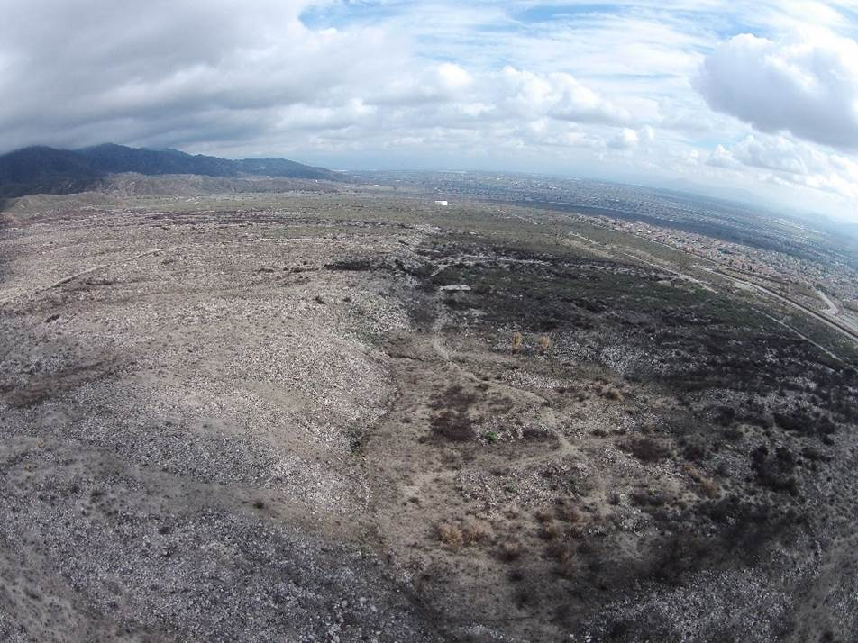
Benefits
obtain “Bird’s Eye” view
higher definition data
lower cost per data point
less time to acquire
access difficult to reach areas
multiple data types
enhances safety of field staff
reduces risk of property damage
low altitude equals more signal
facilitates temporal change detection
fault

Slide 5
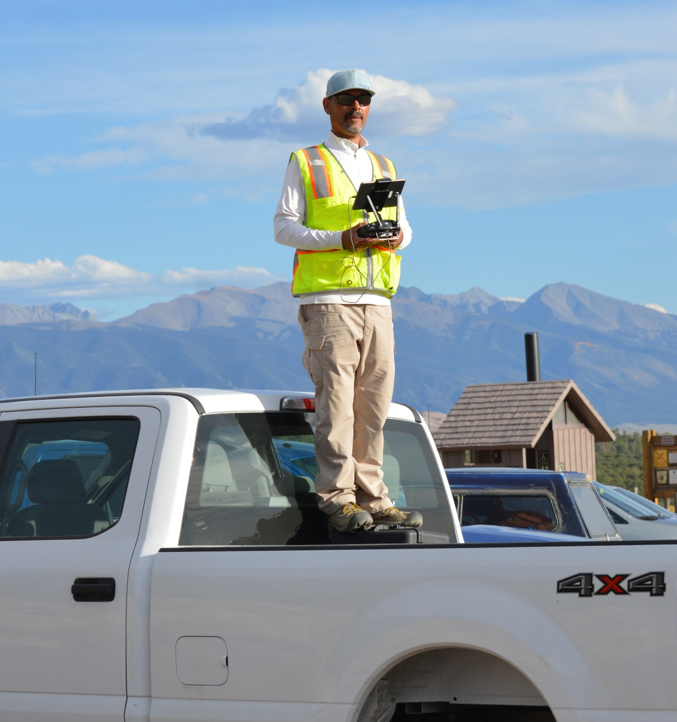
Limitations
weather
vertical structures i.e. trees
short duration flights
small payload (typically < 3 kg)
aircraft flight characteristics
Restrictions
maximum flight altitude: 400 feet AGL
visual line of sight (VLOS)
day time operations only
no operations over people
one operator = one UAS
certified unmanned aircraft pilot

Slide 6
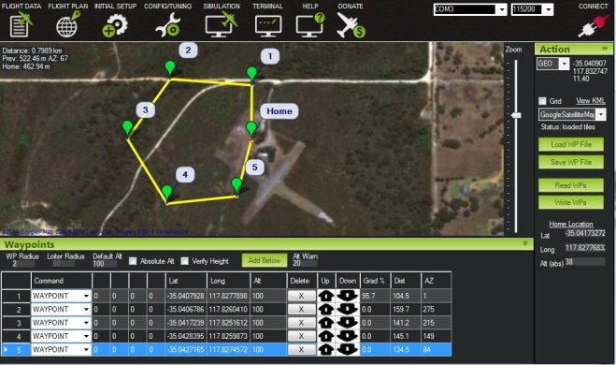
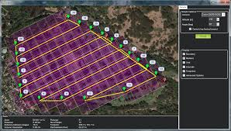
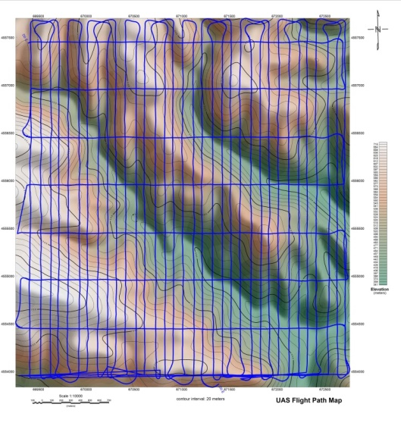
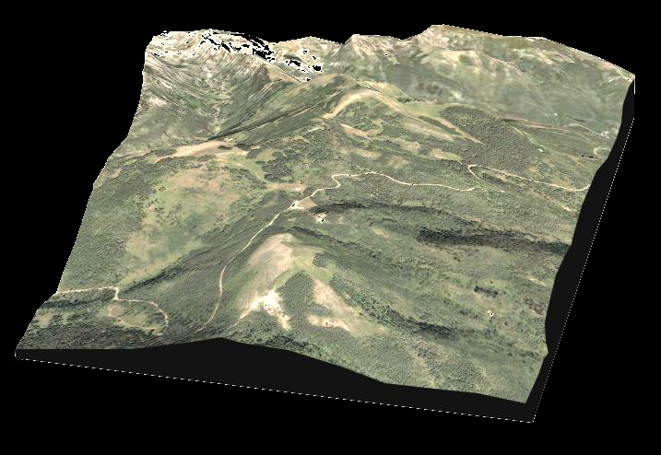
Mapping by Drone – the workflow
2 - Plan, Permit,
& Schedule Mission
1 - Select Area of Interest
3 – Data
Collect
4- Deliver Data
& Information
Color orthophoto on 3D DEM
UAV flight path on DEM

Slide 7
The Magnetic Method
The earth's magnetic field induces magnetization in the rock and buried objects.
Magnetic signature due to the induced magnetization, I, is a function of the direction and intensity of the geomagnetic field.
The intrinsic magnetic susceptibility, k, of the rock or object material controls the degree to which it will be magnetized: I = kT T= inducing field
The size, shape, and orientation of the buried object or rock formation within the inducing magnetic field determines the characteristic anomaly shape.
Objects made of a high magnetic susceptibility material, i.e. steel or iron, will result in significant magnetic anomalies.

Slide 8
Magnetic Survey
Magnetic Field Sensor
The objective of a magnetic survey is to map the spatial and temporal variations in the earth’s magnetic field.
The resolving power of the magnetic method is a function of the proximity of the magnetic field sensor to the source of the magnetic field anomaly and the spatial density of the magnetic field measurements.
GPS
Antenna
Modern magnetometers consist a high sensitivity, high sample rate magnetic field sensor paired with a digital recording data logger and global positioning system (GPS).
Thus, a magnetic survey can be accomplished by a human being walking over the ground surface or by a vehicle of some type. (i.e. airplane, boat, ATV, etc. ). Autonomous operated unmanned aerial vehicles (UAV) extend the effective range of a human being while simultaneously collecting higher resolution data in about 20% of the time.
Control Unit \ data logger

Slide 9
MagArrowTM – a drone enabled magnetometer
Power: 2.5 W per sensor
Weight: less that 2 lbs.
MagArrowTM

Slide 10
What is a plugged and abandoned O&G well?
ground surface
A vertically oriented cylinder made of steel extending into the subsurface.
Typically, the top segment has been cut off ~10 ft below the ground surface.
~10 ft bgs
steel casing
~30 ft bgs
steel pipe
~5000 ft bgs

Slide 11
What is the magnetic signature of a well?
If the well is vertical and shallow, the magnetic signature will a monopole response in profile and a uniquely characteristic circular contour pattern
As the depth to the well increase, the signature will grade into a dipolar response but maintain a circular pattern in contour.
Martinek, B.C., Ground Based Magnetometer Survey of Abandoned Wells at the Rocky Mountain Arsenal, A Case History, (1984), M-TR43, Geometrics, Inc., San Jose , CA
available for download at www.geometrics.com

Slide 12
What is the magnetic signature of a pipeline?
ground surface
A typical pipeline is made up of lengths of individual pipe welded together. The magnetic signature is a series of dipolar anomalies along a linear trend.
steel pipe segments
buried ~ 5 to 10 ft bgs
The response is complicated by variations in the magnetic susceptibility of the steel used in the manufacture of the pipe, the remanent magnetization of the pipe, and the changes in the intrinsic magnetization due to the welding of the segments of pipe together.

Slide 13
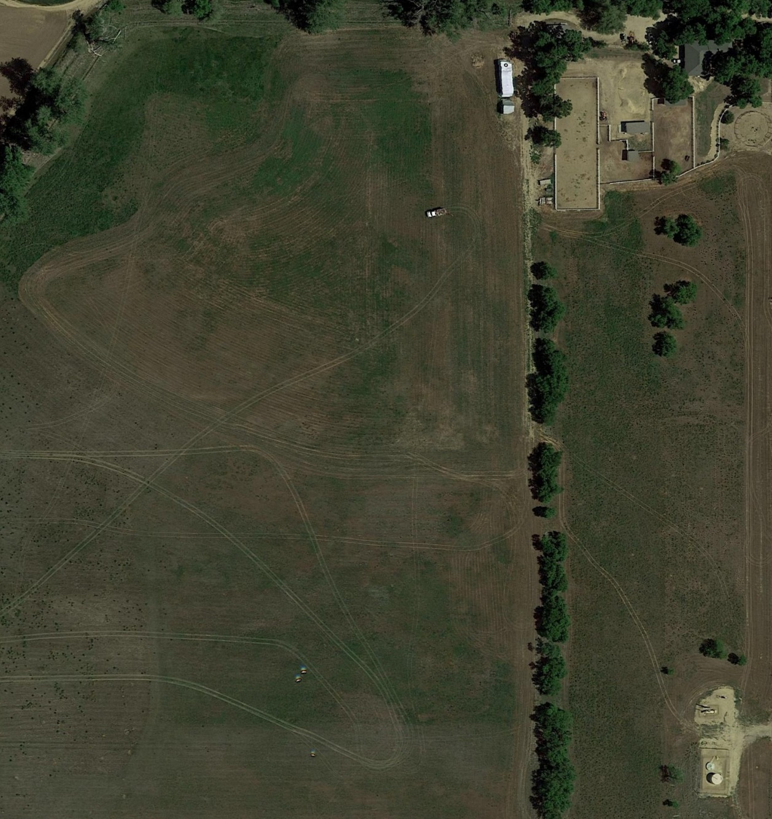
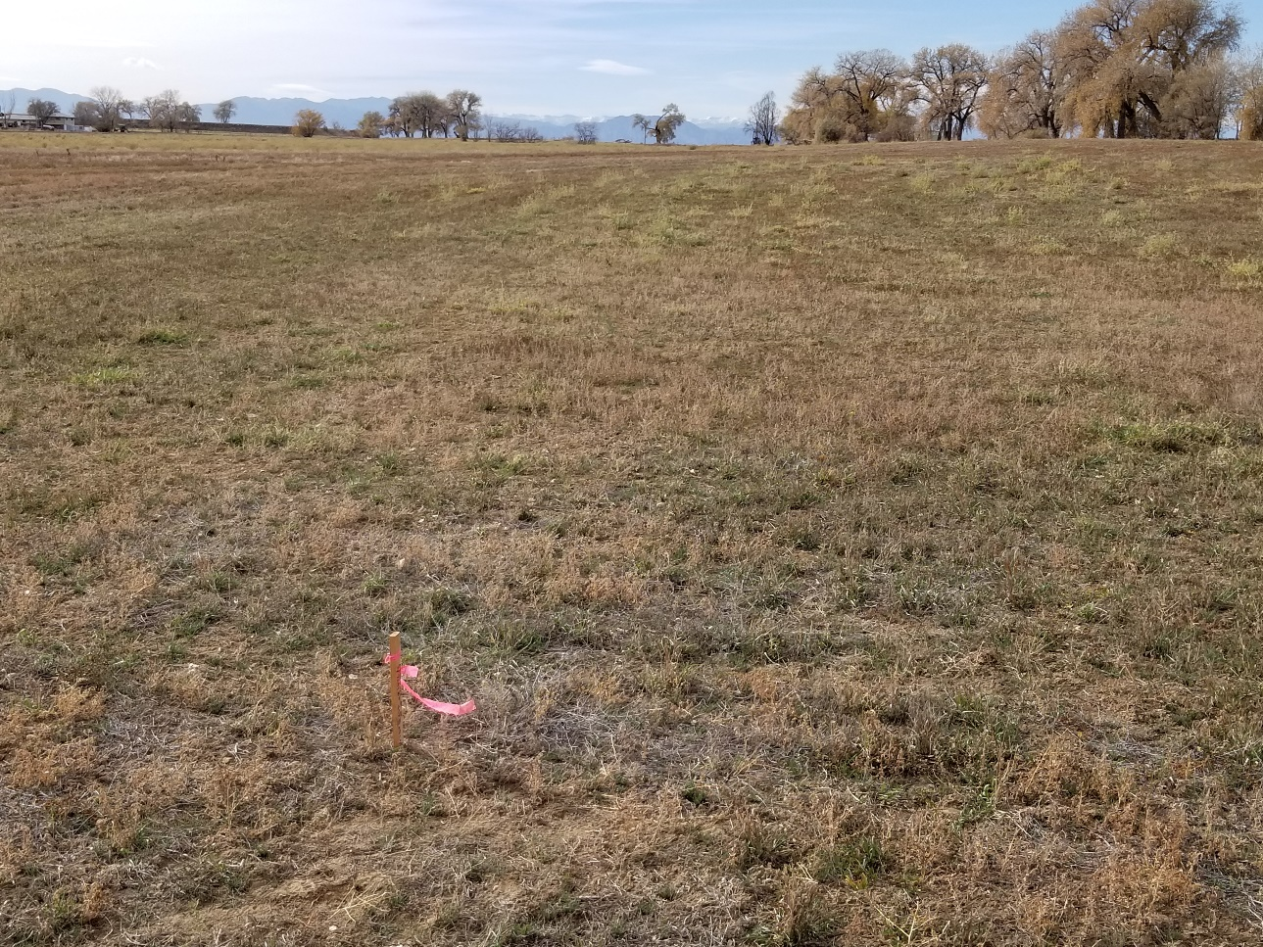
What does a P&A O&G well site look like?
Point A
Looking west from point A
Google Earth Image

Slide 14
Traditional method for locating a well
Query database maintained by the state to obtain information about well
Hire a professional land surveyor to survey in the location based on the description and/or longitude & latitude coordinates listed in the database
Contract with local firm to dig on location marked by land surveyor to verify location.

Slide 15
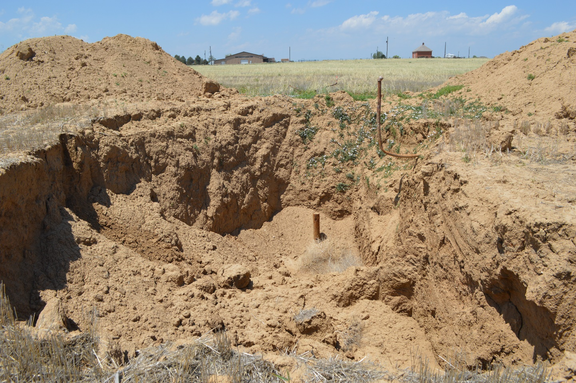
Does the “Traditional Method” work?
Yes, but often the “searching by digging” can be quite expensive if the well is poorly located.
flow pipe
P&A oil well located using the “search by digging” method.

Slide 16
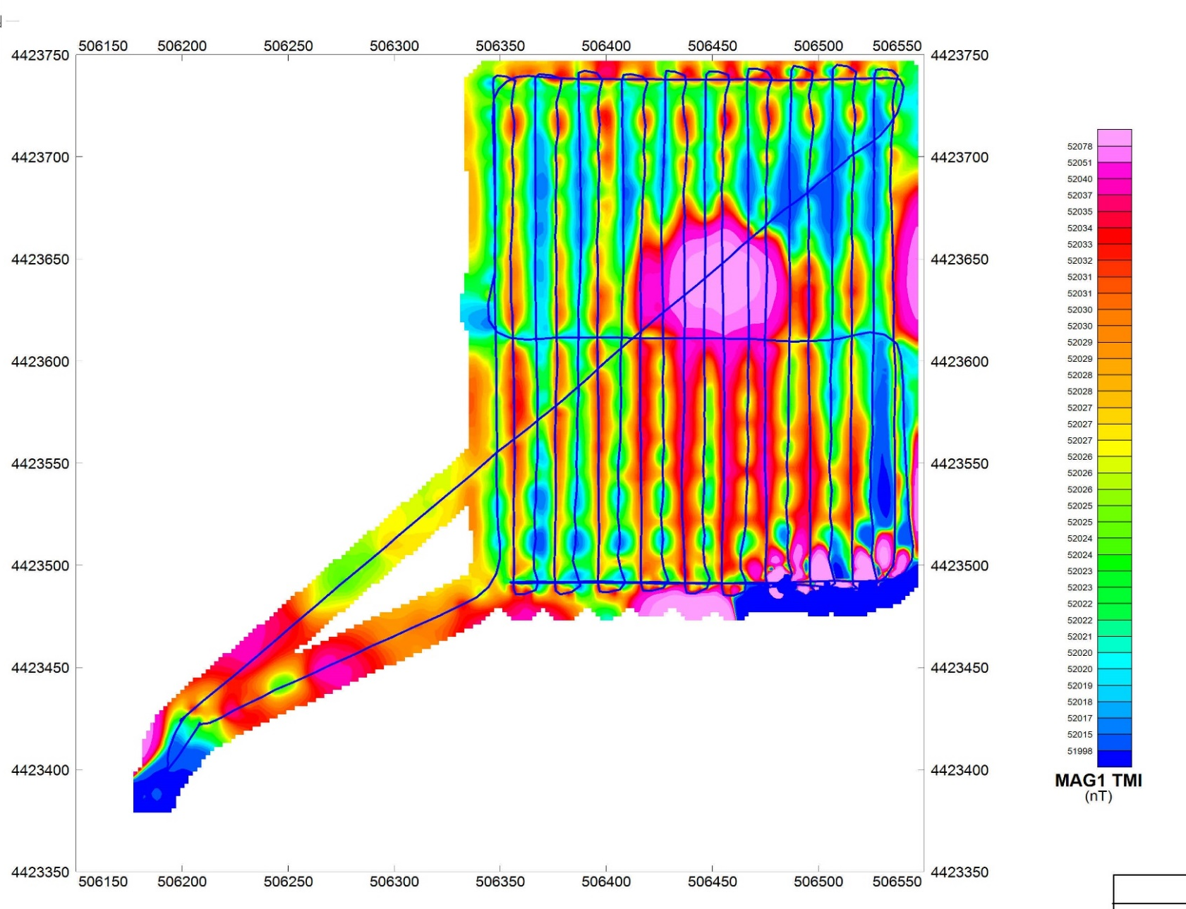
Drone Enabled Magnetic Survey
# flights: 1
time: 15 minutes
UAV altitude: 15 m agl
sensor height: 11.6 m
MagArrowTM

Slide 17
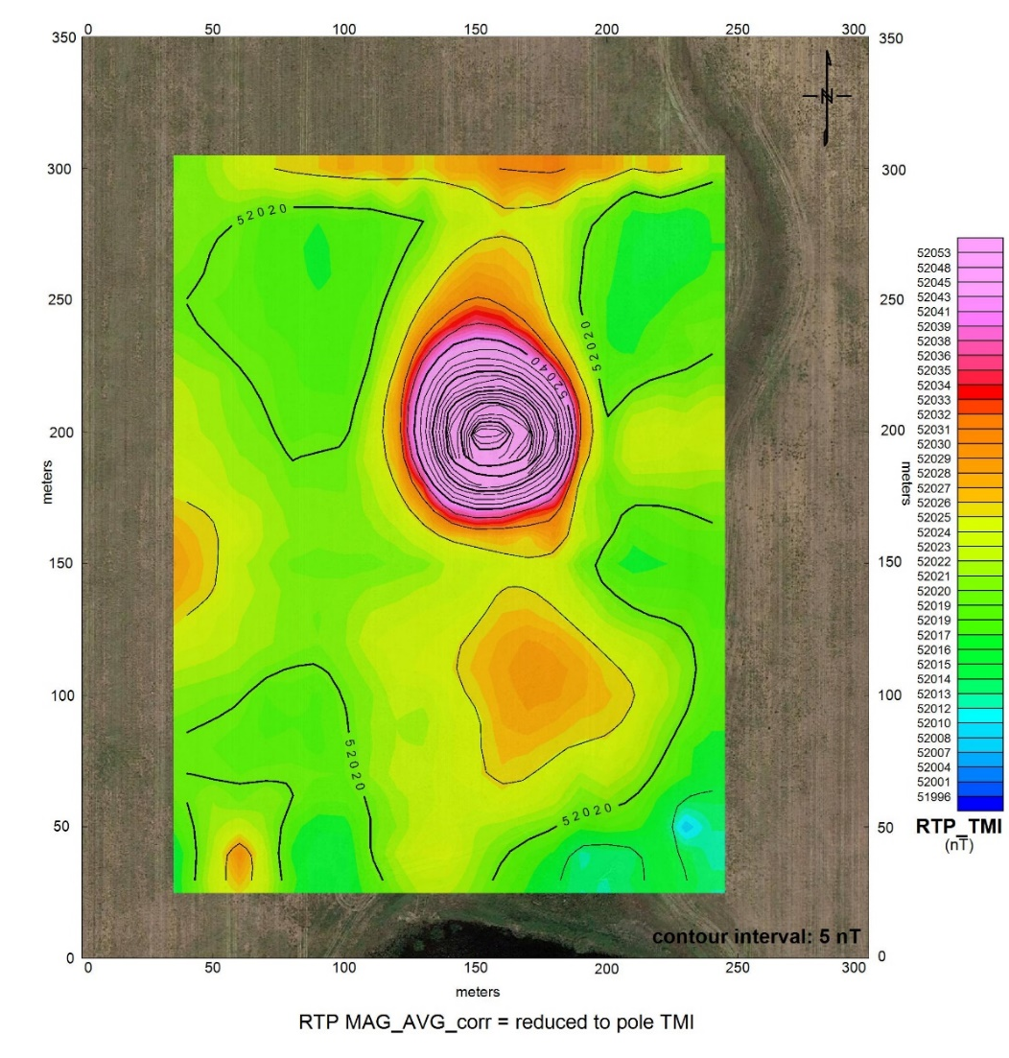
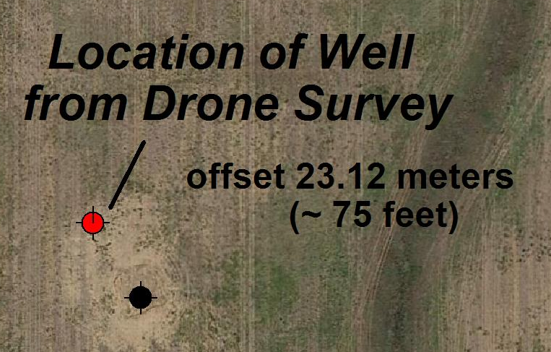
Drone Enabled Magnetic Survey
location from longitude latitude coordinates extracted from COGCC database

Slide 18
Pipeline Mapping Survey
Total Magnetic
Intensity

Slide 19
Pipeline Mapping Survey
MagHeatTM

Slide 20
Pipeline Mapping Survey
located pipelines
located
P&A wells

Slide 21
Factors impacting the success of a drone enabled magnetic survey for locating wells and pipelines.
Line Spacing
Sensor Altitude
Aircraft Speed
Weather
Site Accessibility
Well Construction
Non-vertical well
Casing & pipe integrity
Buried pipe and debris

Slide 22
Electromagnetic (EM) Induction Conductivity Meter
GPS Receiver
Data Logger \ Control Unit
16 feet
CMD Explorer
frequency domain - coplanar loop-loop system
3 coil separations + 2 coil orientations = 6 depths of investigation
horizontal magnetic dipole (HMD): 1.1, 2.1, & 3.3 m
vertical magnetic dipole (VMD): 2.2, 4.2, & 6.7 m

Slide 23
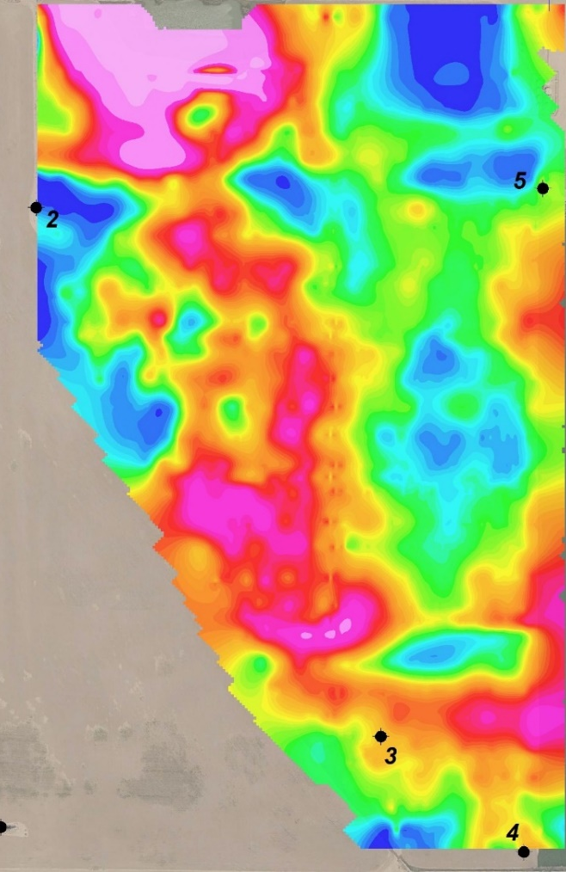
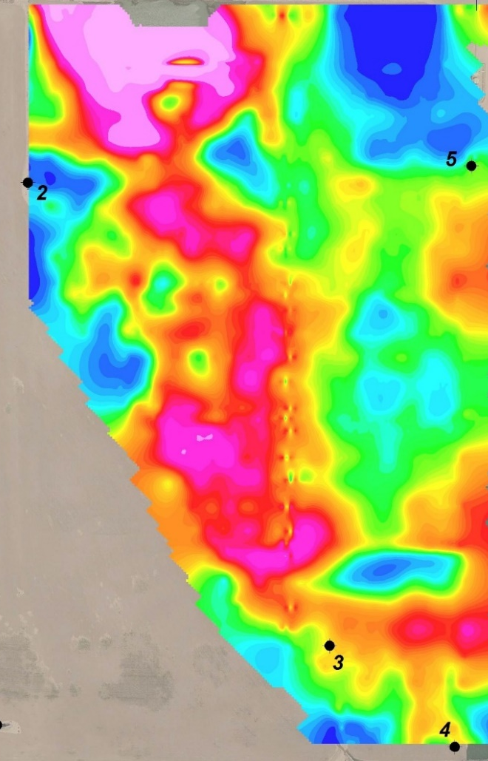
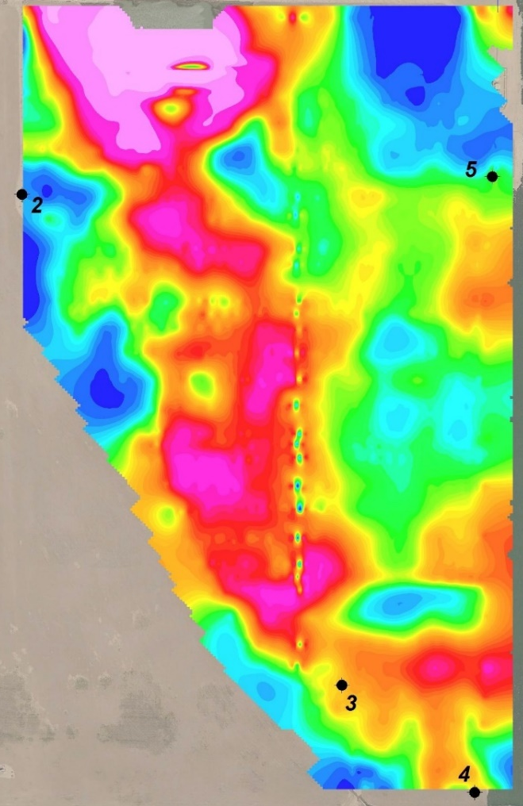
EM Conductivity – multiple depths of investigation
EM Cond 1
EM Cond 2
EM Cond 3
possible contaminated area
~ 1 m
~ 2 m
~ 3 m
buried pipeline

Slide 24
EM COND 3 Profiles
on MagHeatTM
color contours
The disappearing EM anomaly is the result of a break in the electrical conductor ( i.e. pipeline).
The MagHeatTM data indicates the presence of ferromagnetic objects in the subsurface.
Conclusion:
The pipeline was severed and left in place.

Slide 25
What we can do today!
Drone magnetometry to precisely locate P&A oil and gas wells.
Drone magnetometry to detect and delineate legacy steel pipelines.
Ground EM to locate metal (e.g. pipelines, etc.) and characterize the subsurface to detect and delineate pipeline leaks, salt scars, and other contamination.

Slide 26
Acknowledgements
We gratefully thank the following companies for their assistance and support in the acquistion of the drone enabled magnetic data.
UAS Flight Services and Data Analytics
http://juniperunmanned.com/
Geophysical Instruments
http://geometrics.com/

Slide 27
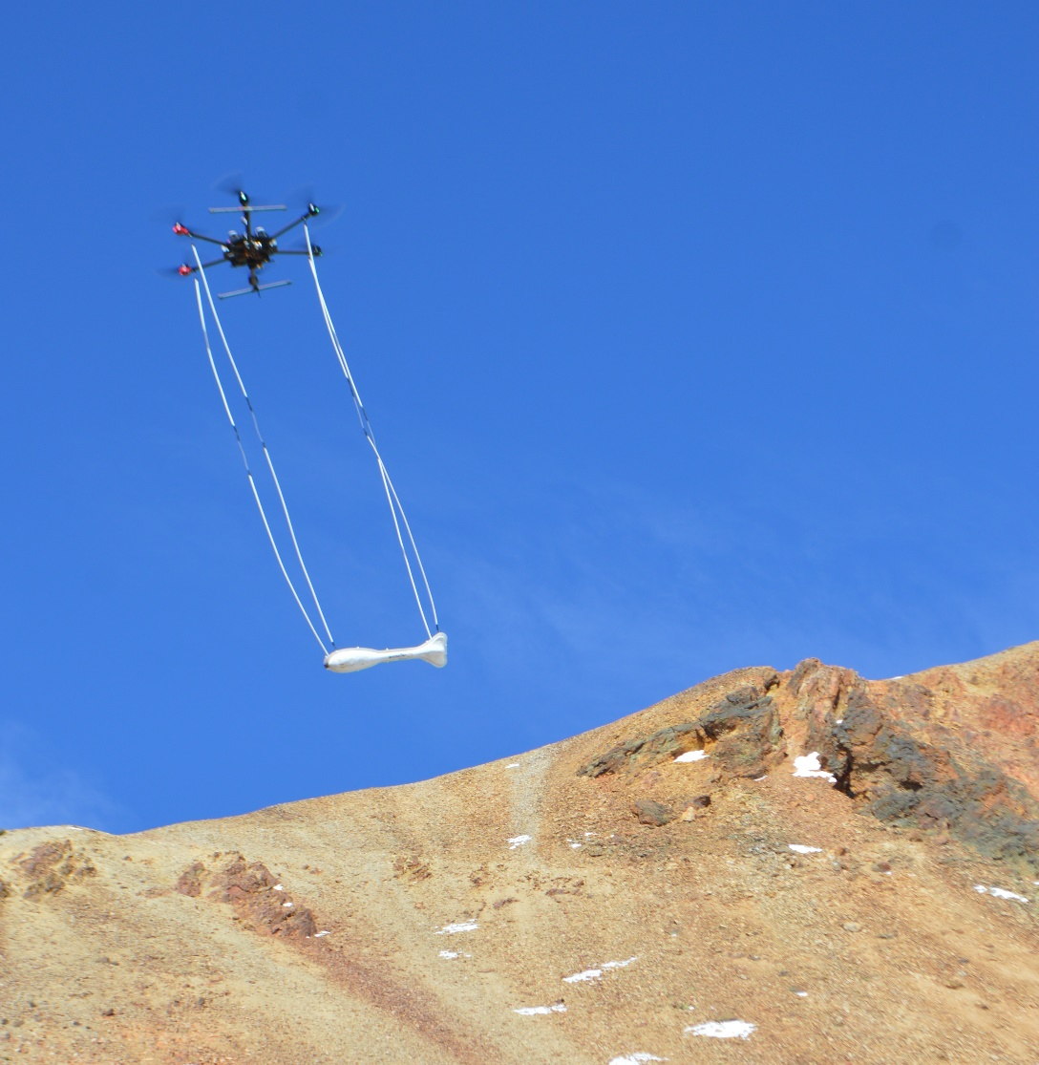
For more information, contact:
Thank you.
Ronald S. Bell
Senior Geophysicist & geoDRONEologist
mobile: 720-220-3596
IGS office: 303-462-1466
e-mail: rbell@igsdenver.com
Questions?
Collier Consulting office: 720-487-9200
e-mail: ron@collierconsulting.com
Collier Consulting Inc.
590 E. South Loop
Stephenville, TX 76401
http://collierconsulting.com/

