Slide 1
Determining Opportunities for Combined Heat and Power (CHP) in the Oilfield
Andra Wilcox, Upper-West CHP TAP
October 31, 2018
Notes:
Intro. The Houston Advanced Research Center is home of the US Department of Energy Southcentral and Upper-West Technical Assistance Partnerships.

Slide 2
Agenda
DOE Combined Heat and Power Technical Assistance Partnerships (CHP TAPs)
CHP Overview
Oilfield CHP Applications
Houston & Denver Workshops
Assistance Options
Notes:
Very briefly cover what the CHP TAPs, (Dr. Meng just covered these topics, if anyone would like more information, please contact one of us) Recap and lessons learned from 2017 Houston and Oct. 29 workshops with O&G. Look at some concepts and benefits of CHP, and potential for CHP applications in O&G facilities. Share examples of oil & gas facilities that have successfully implemented CHP, that others in this session discussing in more detail (Susan, John, etc.)
Finally, I’ll cover a bit about our technical assistance offerings that we provide through this DOE project.

Slide 3
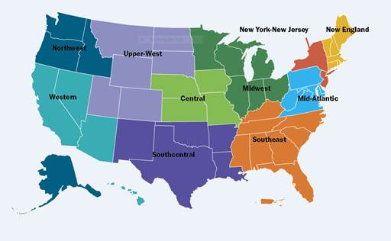
DOE CHP Technical Assistance Partnerships (CHP TAPs)
End User Engagement
Partner with strategic End Users to advance technical solutions using CHP as a cost effective and resilient way to ensure American competitiveness, utilize local fuels and enhance energy security. CHP TAPs offer fact-based, non-biased engineering support to manufacturing, commercial, institutional and federal facilities and campuses.
Stakeholder Engagement
Engage with strategic Stakeholders, including regulators, utilities, and policy makers, to identify and reduce the barriers to using CHP to advance regional efficiency, promote energy independence and enhance the nation’s resilient grid. CHP TAPs provide fact-based, non-biased education to advance sound CHP programs and policies.
Technical Services
As leading experts in CHP (as well as microgrids, heat to power, and district energy) the CHP TAPs work with sites to screen for CHP opportunities as well as provide advanced services to maximize the economic impact and reduce the risk of CHP from initial CHP screening to installation.
www.energy.gov/chp
Notes:
Dr. Meng just discussed the CHP TAPs. If anyone here did not see his talk, the TAPs provide numerous resources for anyone interested in CHP. I’ll be discussing some workshops we held focusing on oil and gas.

Slide 4
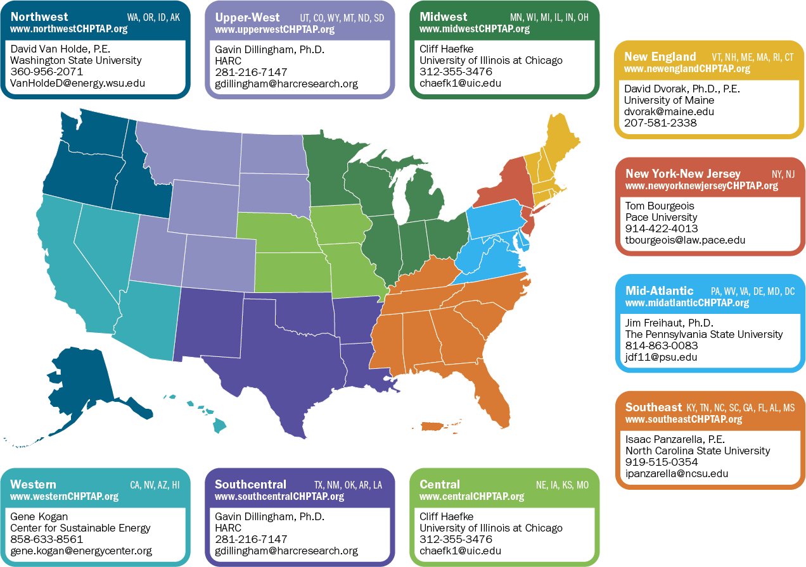
DOE CHP Technical Assistance Partnerships (CHP TAPs)
DOE CHP Deployment Program Contacts www.energy.gov/CHPTAP | Tarla T. Toomer, Ph.D. CHP Deployment Manager Office of Energy Efficiency and Renewable Energy U.S. Department of Energy Tarla.Toomer@ee.doe.gov | Patti Garland DOE CHP TAP Coordinator [contractor] Office of Energy Efficiency and Renewable Energy U.S. Department of Energy Patricia.Garland@ee.doe.gov | Ted Bronson DOE CHP TAP Coordinator [contractor] Office of Energy Efficiency and Renewable Energy U.S. Department of Energy tbronson@peaonline.com
Notes:
DOE CHP TAPs are organized with the same regional structure as EPA Regions 6 and 8. I’m here on behalf of the Upper-West Region, serving Colorado, Utah, Wyoming, Montana, and North and South Dakota. The Southcentral TAP covers Louisiana, Texas, Arkansas, Oklahoma and New Mexico. The other regional programs and contacts are shown here.

Slide 5
CHP Overview

Slide 6
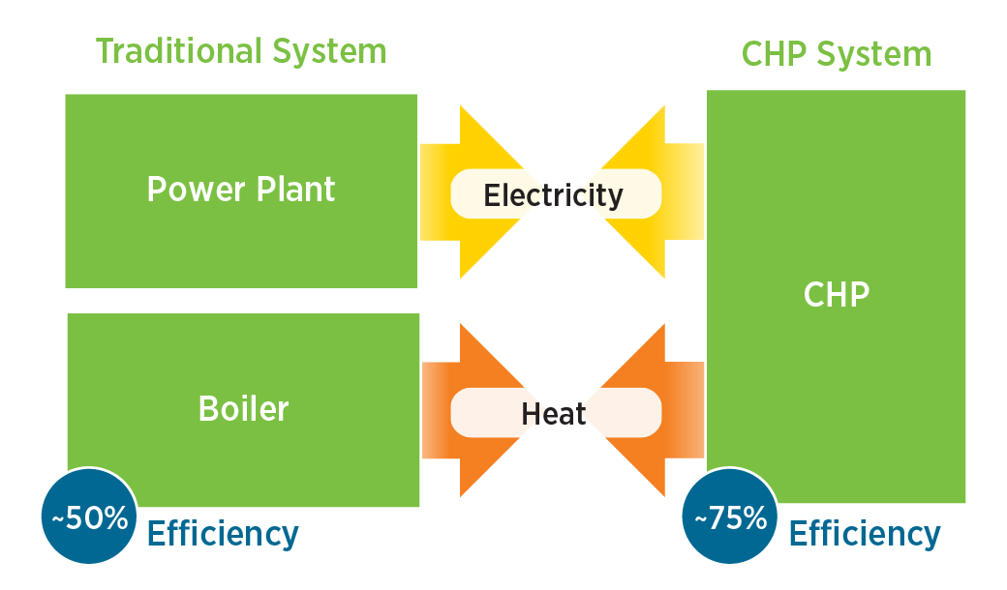
CHP: A Key Part of Our Energy Future
Form of Distributed Generation (DG)
An integrated system
Located at or near a building / facility
Provides at least a portion of the electrical load and
Uses thermal energy for:
  Space Heating / Cooling
  Process Heating / Cooling
  Dehumidification
CHP provides efficient, reliable, affordable energy – today and for the future.
Source: www.energy.gov/chp
Notes:
CHP is a vital part of our energy future due to the efficiencies, cost savings and energy conservation that can be realized by using heat that would otherwise be wasted.
This could be through a form of Distributed Generation where a gas turbine is producing electricity & the heat (thermal power) from the turbine could be recovered for other uses (space or process heating and cooling, etc.)
In O&G, we may see this in use on offshore platforms, FPSs and gas production and processing facilities. When no other source of power generation is available, CHP can be very beneficial.

Slide 7
Combined Heat & Power (CHP)
and
Waste Heat to Power (WHP)
CHP can provide both electric power and thermal energy from a single on-site source.
WHP systems capture waste heat from various processes and utilizes it to generate electricity without additional fuel, combustion, or emissions.
Recovered waste heat can be used to provide additional services to production facilities, including heating for thermal water treatment, EOR, and/or processing.
Notes:
CHP is the simultaneous production of electricity and heat most often in the form of hot water or steam from a primary fuel such as natural gas.
In this instance a fuel is combusted to drive a turbine or reciprocating engine (the prime mover). Prime movers include: recip engines, gas turbines, microturbines, fuel cells and boiler/steam turbines.
Waste Heat (or bottom cycling) was discussed today by Susan Brodie with the Heat is Power Association and I urge you all reach out to Susan for more information on waste heat and the Heat is Power Association. She’s doing great things for industry!

Slide 8
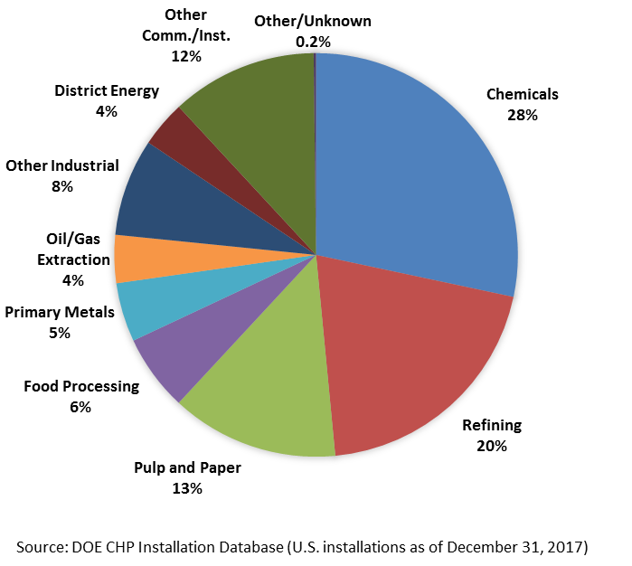
CHP Today in the United States
81.3 GW of installed CHP at more than 4,400 industrial and commercial facilities
8% of U.S. Electric Generating Capacity; 14% of Manufacturing
Avoids more than 1.8 quadrillion Btus of fuel consumption annually
Avoids 241 million metric tons of CO₂ compared to separate production
Only 4% installations in O&G
Notes:
CHP is already proving successful in various industrial sectors. The energy-intensive refining and chemical industries have embraced CHP for efficiency, comprising nearly HALF of the 81 GW of CHP currently installed in the US.
Only 4% of this capacity is in Oil & Gas Extraction. There is opportunity for much more.

Slide 9
CHP for Oil & Gas
Notes:
Now….oil and gas…

Slide 10
Benefits of CHP
CHP is more efficient than separate generation of electricity and heating/cooling
Higher efficiency translates to lower operating costs (but requires capital investment)
Higher efficiency reduces emissions of pollutants
CHP can also increase energy reliability and enhance power quality
On-site electric generation can reduce grid congestion and avoid distribution costs
Notes:
General recognized benefits of CHP.

Slide 11
Why CHP in the Oilfield?
Industry is increasingly taking advantage of the efficiency and optimization available with electrification, there many benefits to integrate CHP to support corporate objectives of LEANER and CLEANER Operations.
CHP technologies are advancing:
Minimal maintenance – cutting maintenance time 80 -90% compared to reciprocating engines.
Air bearings – cut the need for lubricants (which also reduces site footprint).
Turbines and/or microturbines can run on unprocessed wellhead gas that might otherwise be flared.
Notes:
Now….oil and gas…

Slide 12
Why CHP in the Oilfield?
Energy Efficiency
Reduce Energy Costs
Power Reliability
Sustainability/Resilience
Lower Emissions
Economic Incentives
Thermal Energy
Produced Water
Water / Fluid Heating
EOR / Steam Flooding
Space Heating & Cooling
Oil & Gas Processing
Notes:
How the benefits translate to O&G

Slide 13
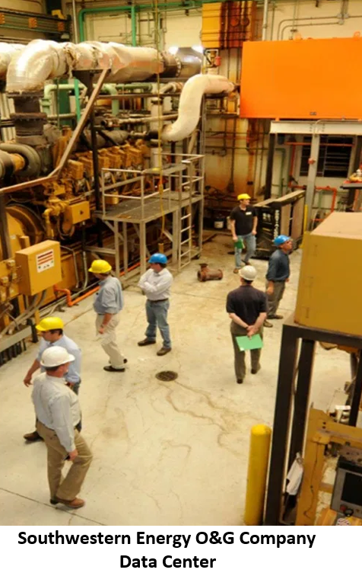
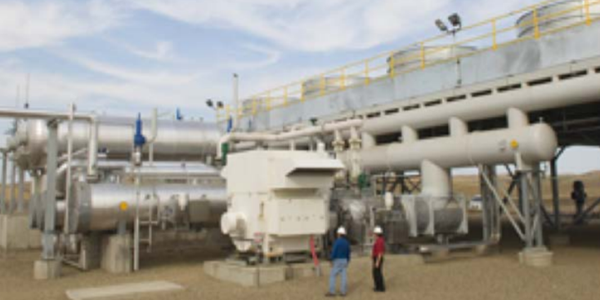
Opportunities in Oil & Gas
Power for Asset Development / Expansion
Reliability / Resilience
Electrification / Automation
Legislation & Regulations
Social Responsibility / Sustainability
Revenue from Power Generation
Cost Savings / Energy Efficiency
Northern Border Pipeline
WHP at compressor stations utilizes unused exhaust heat to generate electricity.
Notes:
O & G could benefit in many of the same ways as other sectors.

Slide 14
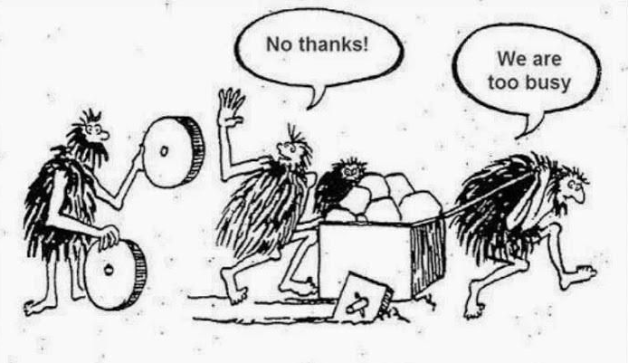
Challenges
Resistance to change
Permitting hurdles
Capital vs. Operating Expenditure
No Industry standard for efficiency benchmarking
Competition with other projects (asset expansion)
Focus on production and safety, not always efficiency
Notes:
Planning focuses on exploration & production projects with high capital cost. The mission is development, which, we know is quite complex as well as costly.
Companies work to meet environmental compliance and need to know systems are reliable.
There is a risk factor in changing the way “we’ve always done it.”
Sometimes, it appears that planning for power tends to fall after the other processes are selected.
Opportunities for energy efficiency often missed in planning & operational models.

Slide 15
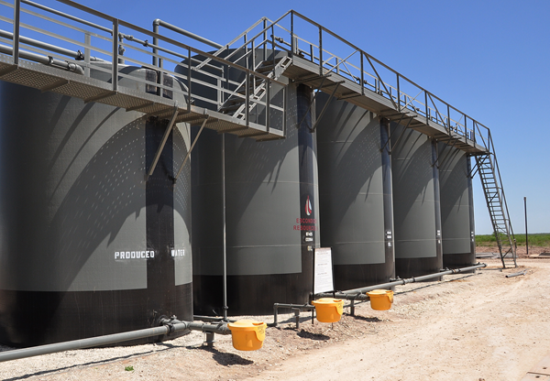
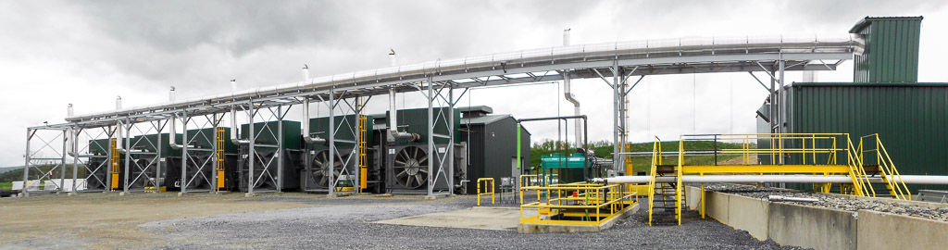
Technology Applications
Recovered Heat
Produced Water Treatment
WHP Power Generation
Oil &Gas Processing
Enhanced Oil Recovery
Building Heat / Cooling
Learn about this system in the Heartland Technologies presentation.

Slide 16
2017 Combined Heat & Power (CHP) for
Oil and Gas Workshop Recap
What Did We Learn?
Notes:
Recap of 2017 and most recent workshops.
Houston: 70+ attended; DOE CHP TAP partnered with Shell to hold CHP in O&G Workshop in Houston.

Slide 17

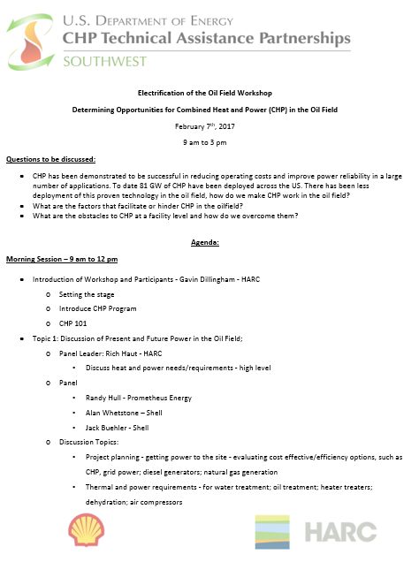
2017 Workshop
CHP TAP partnered with Shell to co-host a workshop in Houston.
70+ participants - Several different operators represented
Purpose:
Initiate dialogue among operators and service providers regarding current and future power needs in operations, power generation, CHP options, and
‘what it might take for CHP to work in O&G operations.’

Slide 18
What did we learn from 2017 Workshop?
Best Opportunities for CHP: Sites that have large Central Processing Facility (CPF) with Large Compression Demand (Gas Processing and/or NGL Plant)
Addition of Heat Recovery to Gas Turbines in Open Cycle to CHP System to Generate Additional Power Improved Thermal Efficiency (Case Study reported from 29% to 44%)
Self Generated Power rather than Grid Purchased May Reduce CO2 by ~20% (Case Study)
Offshore CHP: Requires Both Economic and Environmental Drivers
Several Operators Address Emissions through Dual Fire and/or Burning NG
Notes:
Some of what we learned…. One operator shared case study results: They saw CO2 reduced by 25% (offshore) and dual fire and/or burning NG reduced CO2 emissions by 24% for same firing duty.

Slide 19
Technological Challenges for Consideration of CHP for Upstream
Onshore
Small Power Load at Various Well Pads so Diesel Drives are Often Used
  Average 2 wells/pad – 75 HP for well pad with rod pump
Wells Can Be Spread Out [distance from CPF]
Variance of Production Rates over Life of Field
  Maximum demand of power occurs mid-life
  Calls for Multiple Smaller Drives that can be Taken Offline with Decrease in Demand
3rd Party for Processing, NGL Recovery, HP Compression to Pipeline
Offshore
Weight and Space Requirements of Equipment
Variance of Production Rates over Life of Field
  Need Multiple Smaller Drives that can be Taken Offline with Decrease in Demand
3rd Party to Treat Gas (Onshore)
Notes:
CPF = Central Processing Facility
Considerations to address: Fuel Supply, Logistics and Safety, Hot Fueling or Fueling Related Down-Time, Emissions

Slide 20
Energy Needs and Solutions for Oil and Gas Operations Denver, CO Workshop
October 29, 2018
Notes:
2018 DOE CHP TAP partnered with Colorado Energy Office and Heat is Power Association for the WHP/CHP in O&G Workshop, held workshop on Monday (10/29)

Slide 21
Goal of Workshop
Facilitate discussions to better understand needs in Upper-West States.
Considerations:
  Company A: Barriers such as capital expense and ROI need to be addressed
  Company B: Training of personnel for maintenance needs to be factored into both costs and contracts.
  Company C: How can scalability (footprint required for equipment) be considered?
Questions posed by service providers
  If you could do something with the NG and reduce emissions, could you produce more oil and gas?
  What are flaring limits for states like ND, CO, WY and NM?
  How close are E&Ps getting to state limits?
Notes:
2017 workshop focused mainly on CHP. WHP is feasible in O&G. Asked operators and service companies for their thoughts, questions and/or suggestions.

Slide 22
Results/Discussions
WHP and CHP in Oil and Gas Operations
2 Panels – Midstream and Upstream – 45 Participants
  Midstream panel shared a successful WHP project from multiple stakeholders’ perspectives (Trailblazer Pipeline) .
  Drivers to implement a project may include electricity sales revenue
  Projects may qualify as Renewable Energy Technology (in Colorado)
  Each site has different needs, it’s difficult to standardize systems
  Need to know who off-takers are and how they’re going to get it
  Operational, economical and contractual barriers/issues
  Challenges may include location, cooperation, delivery of energy, etc.
  Learning more from this conference so more to come!
  “What was going up in the air is now making electricity.”
Notes:
Include comments, remove companies’ names
Barriers likely to include:
Capital and ROI
Deviation from SOPs
Equipment Footprint

Slide 23
How to Implement a CHP Project with the Help of the CHP TAP

Slide 24
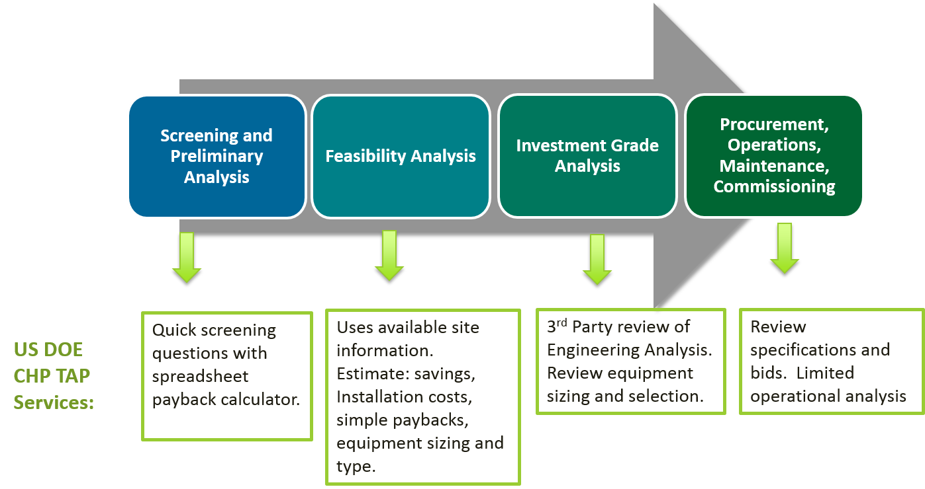
CHP TAP Technical Assistance
Notes:
We can help through quick screenings and provide more further in-depth analyses. We can also provide 3rd party reviews on equipment needs as well as assist with reviewing bids.

Slide 25
DOE TAP CHP Screening Analysis
High level assessment to determine if a site shows potential for a CHP project
  Quantitative Analysis
    Energy Consumption & Costs
    Estimated Energy Savings & Payback
    CHP System Sizing
  Qualitative Analysis
    Understanding project drivers
    Understanding site peculiarities
Notes:
Fanxu is here to provide additional details

Slide 26
CHP in the Oilfield – Early Questions
What power needs are projected over the life of the project, for drilling, field development, water management, oil/gas processing, midstream operations? How are these power needs typically met?
If grid power is available, what is the average price of electricity from the utility?
Can you provide one year’s worth of electric and thermal consumption data?
What is the critical load in power outages?
What sources of waste heat are available (e.g. compressors, turbine generators, reciprocating engines)?
For what operations is heat needed (water treatment, fluid heating, space eating/cooling)?
What special challenges must be addressed? Produced water disposal, enhanced oil recover, produced fluid characteristics?
What drivers exist for emissions reductions, such as air quality concerns, corporate policy?
Are there local opportunities for power generation revenue?
Are there factors that may constrain development, such as power and water availability, infrastructure for disposal of produced water?
Notes:
For operators, here are some early questions to consider to see if there might be a fit for CHP in operations.

Slide 27


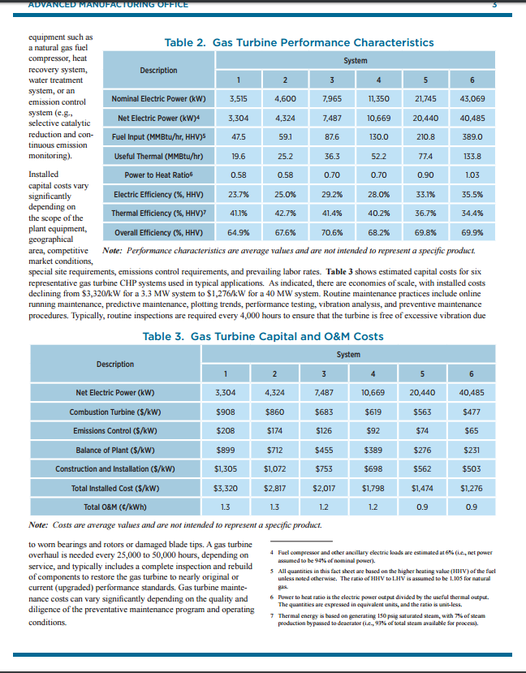
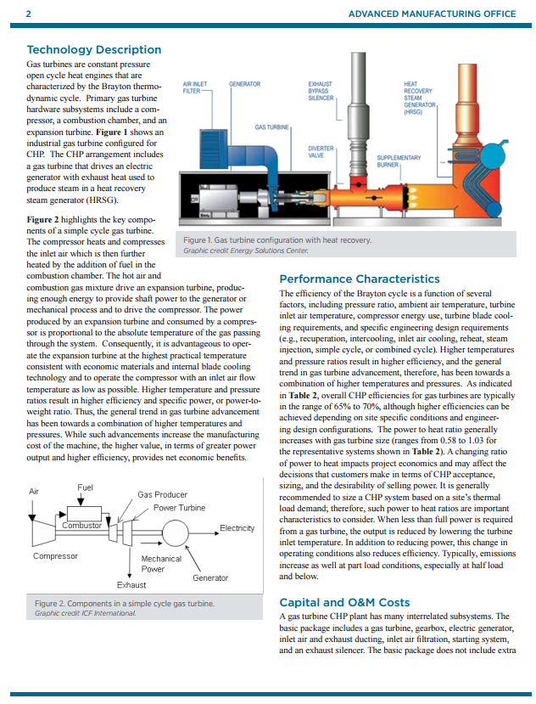
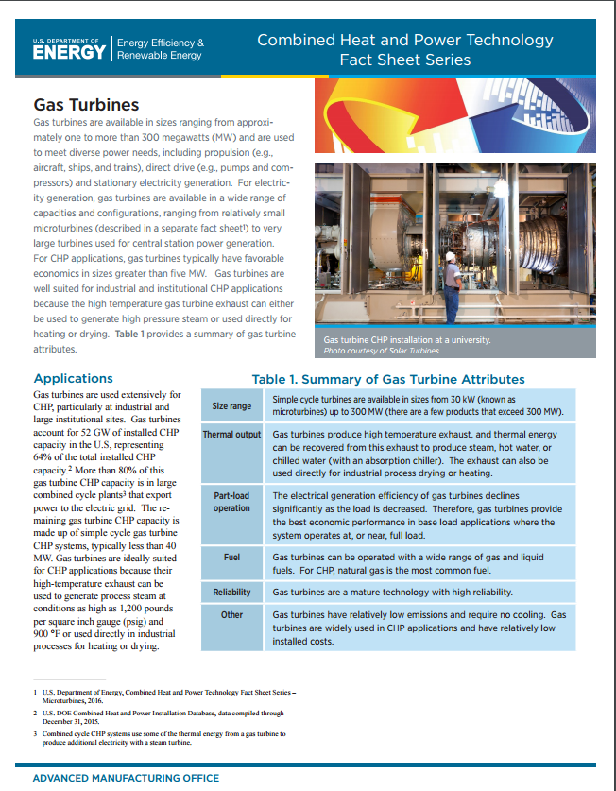
CHP Project Resources
DOE CHP Technologies
Fact Sheet Series
Good Primer Report
www.eere.energy.gov/chp
www.energy.gov/chp-technologies
Notes:
Additional resources

Slide 28
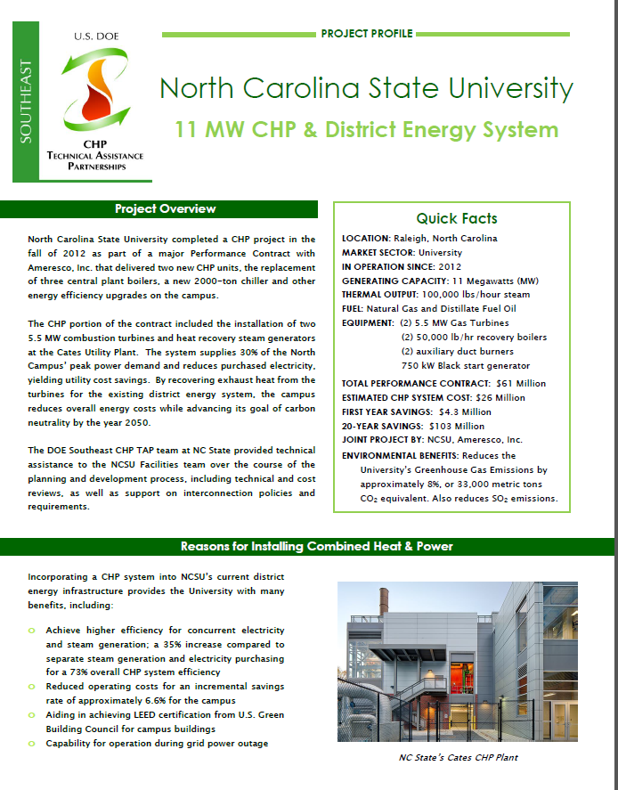
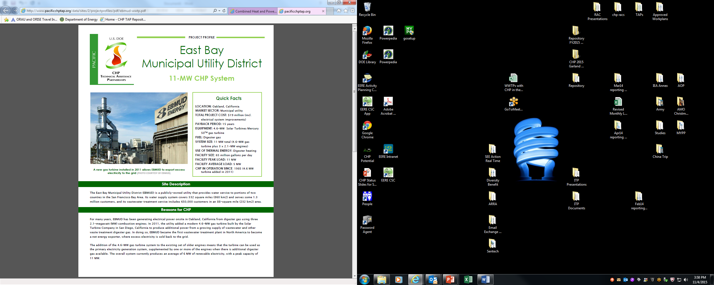
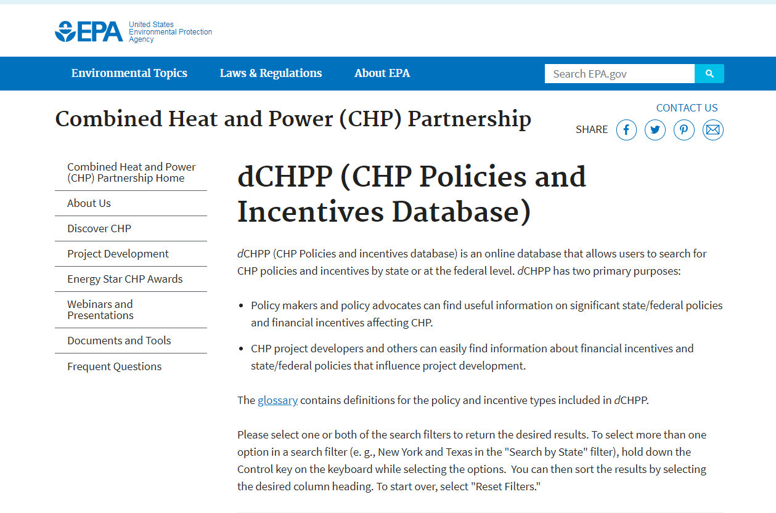
CHP Project Resources
DOE Project Profile Database
EPA dCHPP (CHP Policies and Incentives Database
energy.gov/chp-projects
https://www.epa.gov/chp/dchpp-chp-policies-and-incentives-database
Notes:
More, I highly recommend reviewing the project profiles. Great information and input from the end-users themselves.

Slide 29
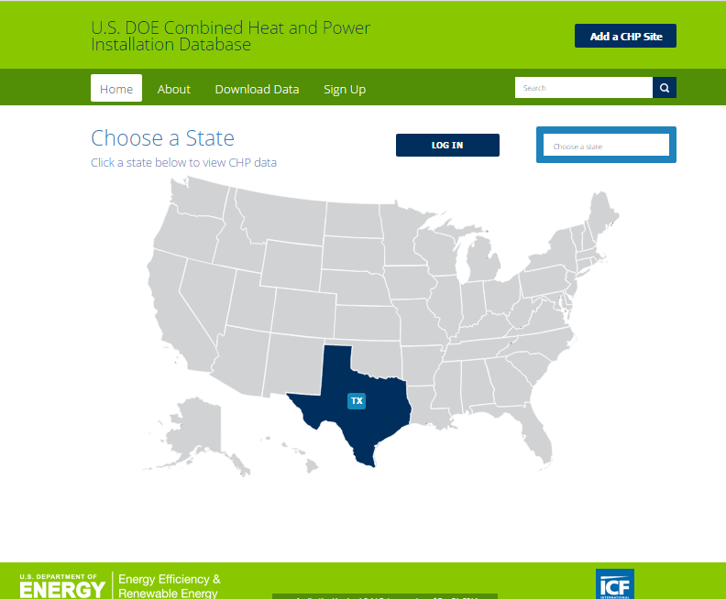
CHP Project Resources
DOE CHP Installation Database
(List of all known
CHP systems in U.S.)
Low-Cost CHP Screening and Other Technical Assistance from the CHP TAP
energy.gov/CHPTAP
energy.gov/chp-installs
Notes:
Last one…

Slide 30
Summary
There are CHP opportunities in the oil and gas industry
There are also challenges to address
CHP TAPs can help – no-cost screenings
CHP gets the most out of a fuel source, enabling
  High overall utilization efficiencies
  Reduced environmental footprint
  Reduced operating costs
CHP can be used in different strategies, including critical infrastructure resiliency and emergency planning
Proven technologies are commercially available and cover a full range of sizes and applications
30

Slide 31
Thank You
Andra Wilcox, MSc, PMP
Upper West CHP TAP
awilcox@harcresearch.org
281-364-6036

