Slide 1

DSI: AN ALTERNATIVE TO WET SCRUBBING FOR SO₂ AND SO₃ REMOVAL
IPEC October 2018
Jon Norman, P.E.

Slide 2
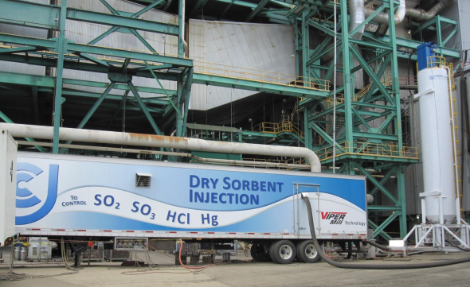
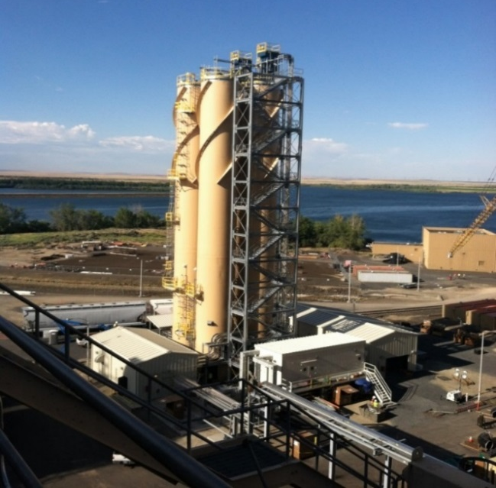
UCC Dry Sorbent Injection Overview
UCC is a 98 year old global firm specializing in engineered
material handling solutions for power and industrial customers
Dry Sorbent Injection (DSI) Experience for Air Pollution Control
    Over 120 full-scale DSI tests and temporary systems
    About 100 permanent systems total
    Approximately 2/3 of the DSI systems used for SO_{X} reduction

Slide 3
What is DSI?
Dry Sorbent Injection (DSI)
  Injection of dry alkali sorbents into the exhaust gas duct to react with acid gases
    Hydrated Lime
    Sodium Bicarbonate
    Trona (sodium sesquicarbonate)
Advantages of DSI vs Wet Scrubbing
  Injection rates variable based on SO_{X} removal needed
  Completely dry; no water use or wastewater produced
  Low capital cost
  No corrosion concerns or exotic materials of construction

Slide 4
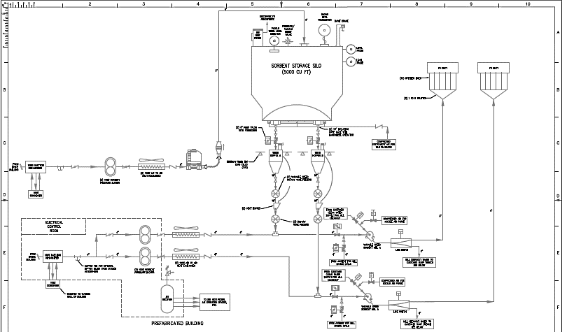
Typical DSI PFD

Slide 5
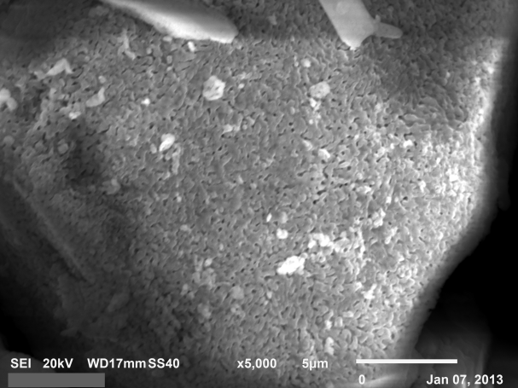
SO₂ Removal – Sorbent Choice
Trona
  Use when:
    Moderate SO₂ removal needed (approx. 80% or less)
    Must be milled
    Optimum temperature is 275F to 1000F
Sodium Bicarbonate
  Use when:
    High removals needed (> 80%)
    Want to minimize waste loading
    Optimum temperature is 275°F to 650°F (135 to 345°C)
Hydrated Lime
  Use when:
    Lower removals needed (<70%)
    Optimum temperature is 100 to 1100°F
    Have baghouse
    Disposal of sodium is a concern

Slide 6
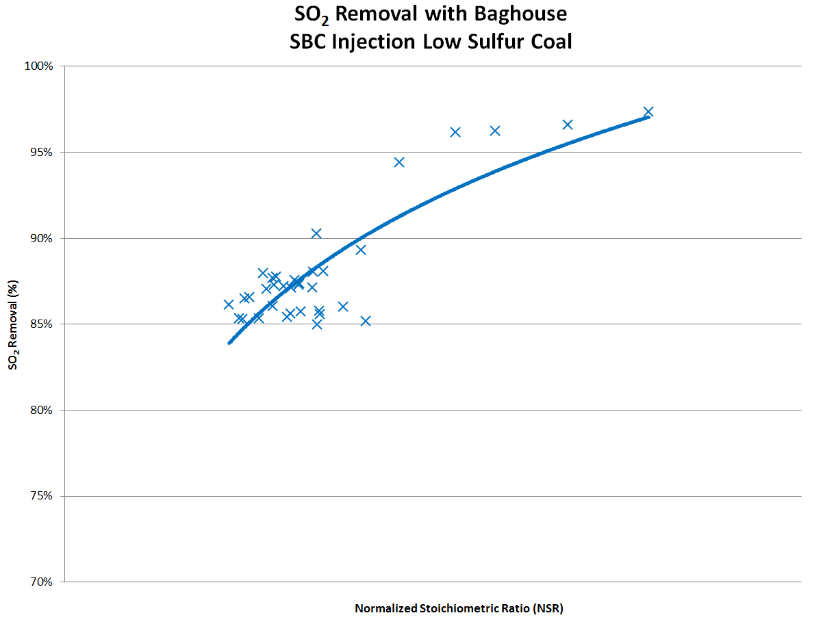
SO₂ Removal - SBC with a Fabric Filter
NSR of 1.0

Slide 7
SO₂ Removal – Hydrated Lime
% SO2 Removal
Hydrated Lime Injection Rate

Slide 8
SO₂ Removal – Sorbent Comparison

Slide 9
Example applications of dsi

Slide 10
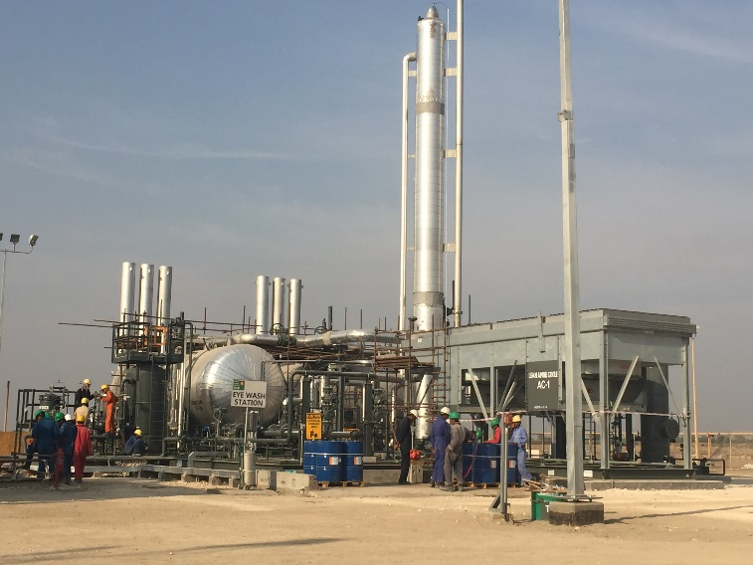
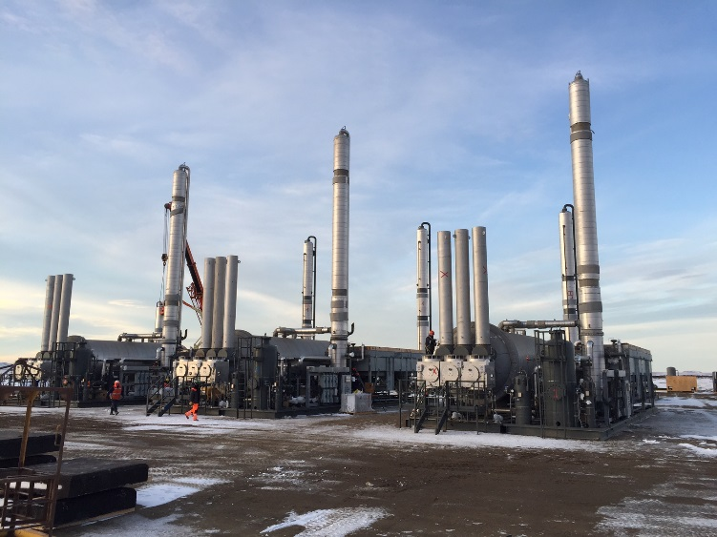
Natural Gas Processing
Joint Technology with Spartan Energy
Spartan Energy is a provider of natural gas treating and processing equipment and services globally
Spartan provides turnkey installation, commissioning, operations and maintenance services
With Patent Pending technology, DSI is used to reduce SO₂ from thermal oxidizer after amine unit regeneration

Slide 11
H₂S Disposal Considerations
H2S emitted from Amine Unit Regeneration System
Oxidation into SO₂
(Flare or Thermal Oxidizer)
Acid Gas Injection
Claus or Liquid Redox Process
Capital Cost | Low | High | Moderate to High
Operating Cost | Low | Moderate | Moderate to Low
Regulatory Burden | Low to High | Very High | Moderate

Slide 12
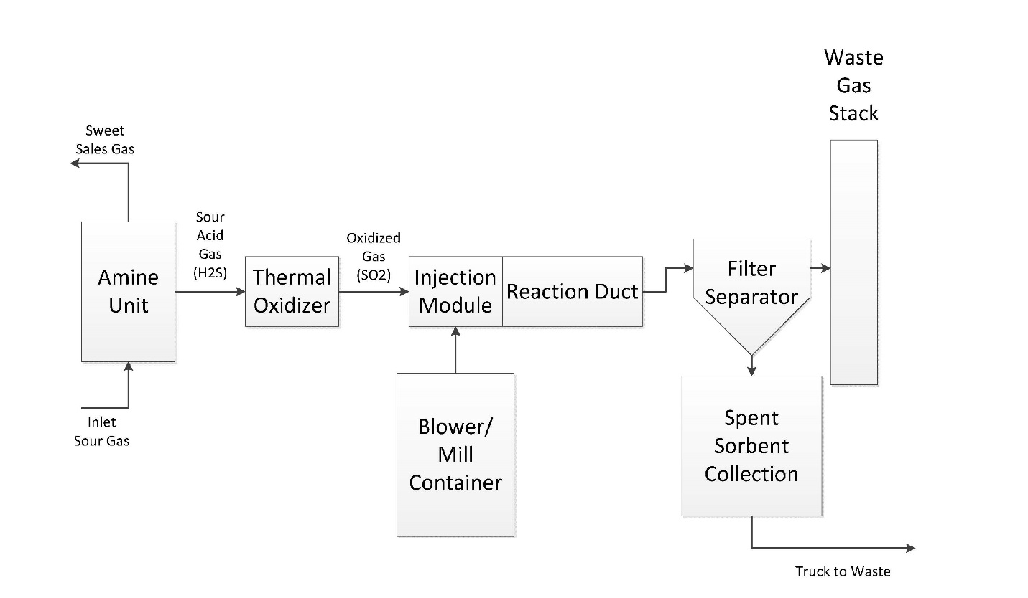
Description of Amine Process with DSI

Slide 13
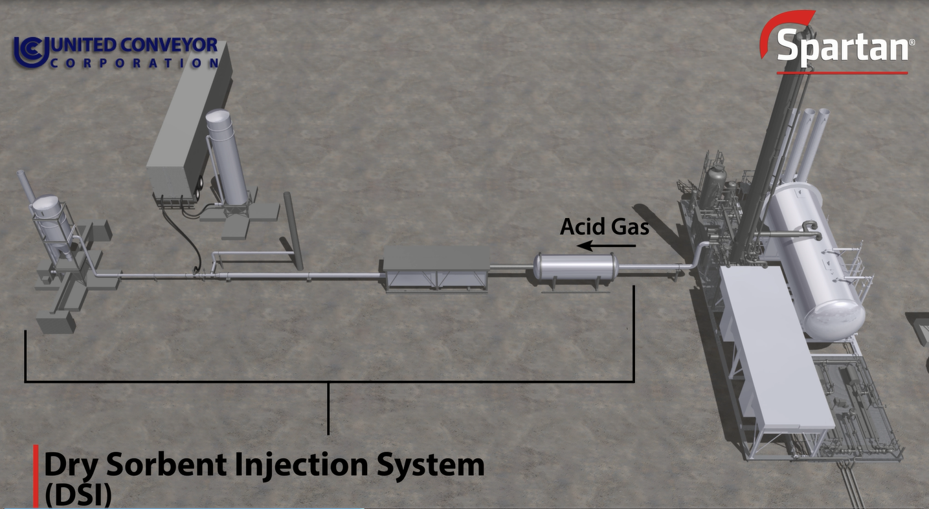
Description of Amine Process with DSI

Slide 14
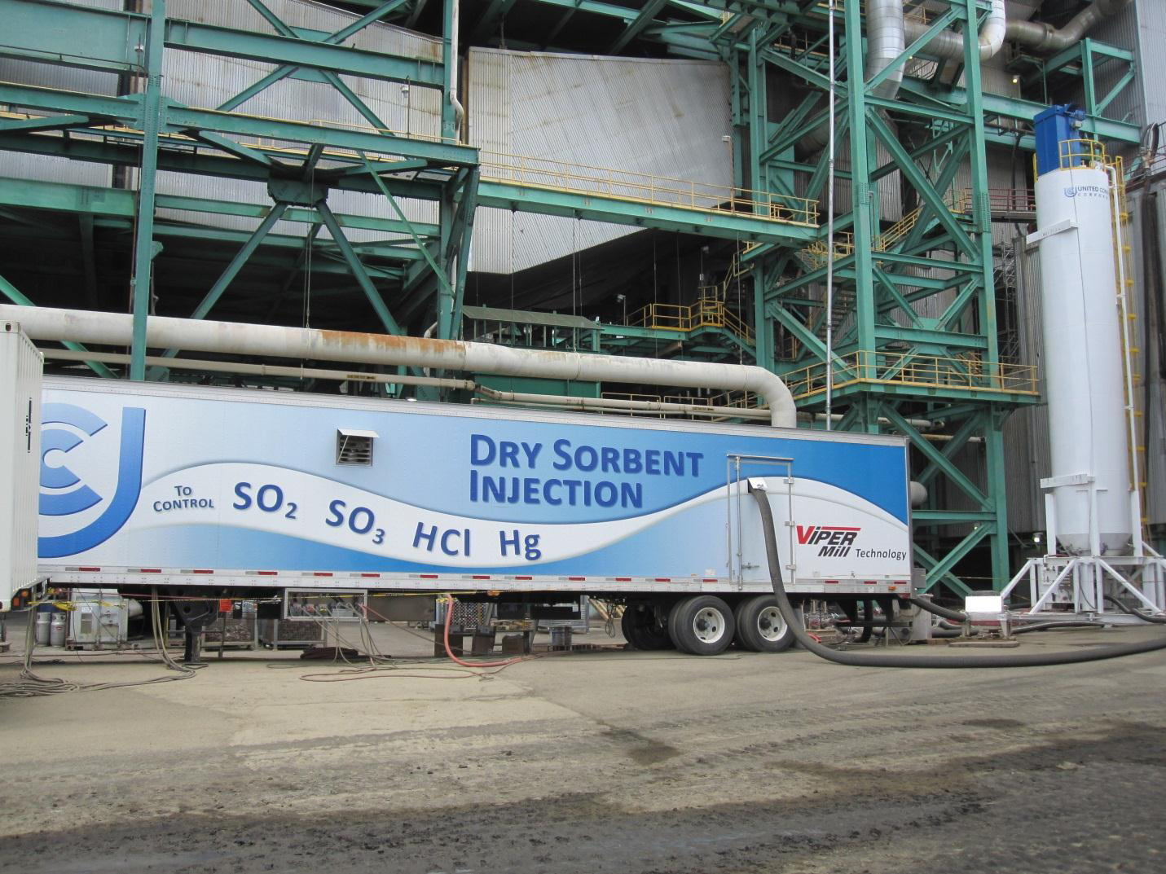
Silo and Blower/Mill Trailer

Slide 15
Production Limits at PSD Permit Limit with DSI

Slide 16
Traditional Sulfur Removal and Disposal
Solution | Scavenger | Liquid Redox | Sulfur Recovery Unit | Acid Gas Injection
Summary | Liquid or Solid media used to remove H₂S from process gas | Removal of H₂S using a reduction/oxidation reaction using a catalyst | Recovers H₂S as elemental sulfur through the Claus Reaction | Injection of H₂S and other acid gases into a non-producing formation to prevent emission into atmosphere
DSI
Sorbent injection to remove SO₂ from an acid gas stream

Slide 17
All Options have Benefits and Drawbacks
Solution | Scavenger | DSI | Liquid Redox | Sulfur Recovery Unit | Acid Gas Injection
Sulfur Removal “Sweet Spot” | <0.5 TPD | 0.3-2 TPD | <15 TPD | >10 TPD | High Volumes
High H2S in gas | ☒ | ☑ | ☑ | ☑ | ☑
Removal of CO2 | Amine Required | Amine Required | Amine Required | Amine Required | Amine Required
Anticipated Life of Production | Short-Long Term | Short-Medium Term | Long Term | Long Term | Long Term
Availability of Existing Infrastructure | Limited Infrastructure Needed | Temporary Equipment | New Facility | New Facility | Great if Available
Operational Complexity | Minimal Complexity | Minimal Complexity | Moderate Complexity | High Complexity | High Complexity
Cost Considerations | Low Capital /High Variable | Low Capital/ Moderate Variable | Moderate Capital / Low Variable | High Capital / Low Variable | High Capital / Low Variable

Slide 18
Case Study

Slide 19
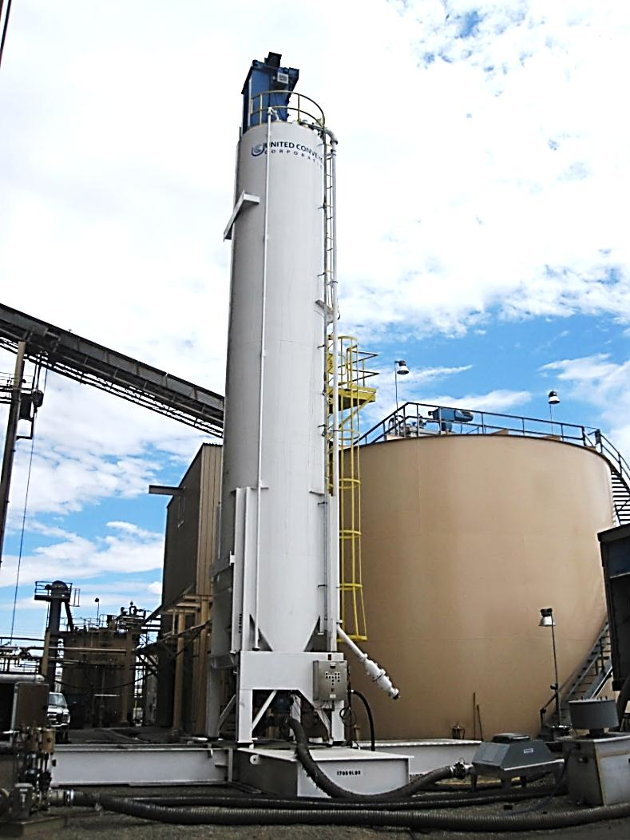
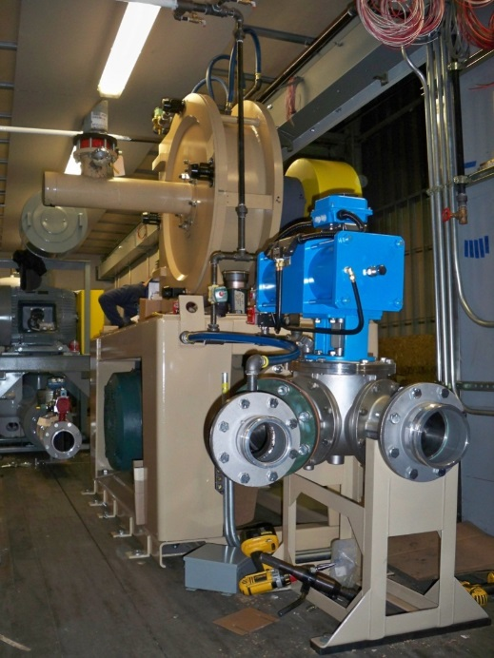
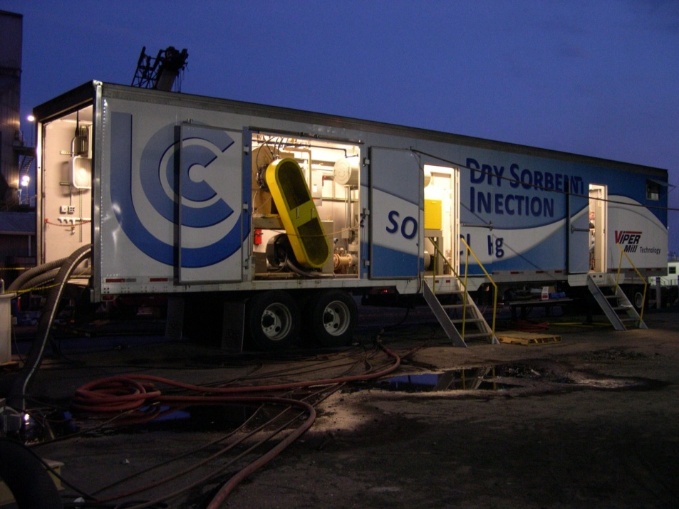
Mobile DSI System for Turnarounds
Mobile system leased for 3 to 6 months to control SO2 during turnarounds

Slide 20

UCC VIPER® Mill
Greatest opportunity for increased performance is to reduce particle size
  Increased surface area for reaction
  Increased number of particles/collisions
  Increased dispersion
UCC VIPER® Mill
(Two Sizes)
2 tph
7 tph

Slide 21
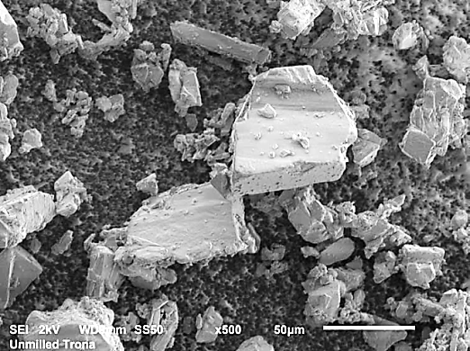
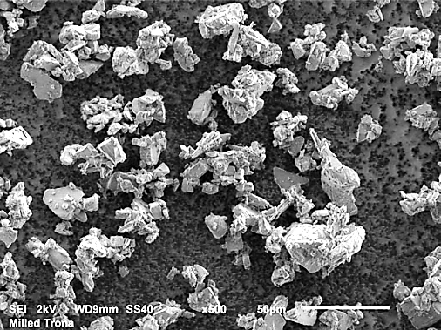
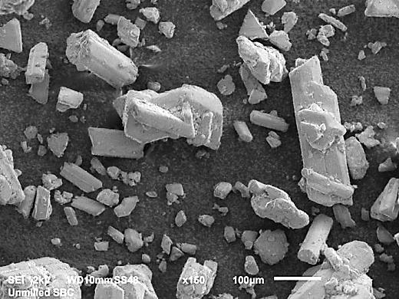
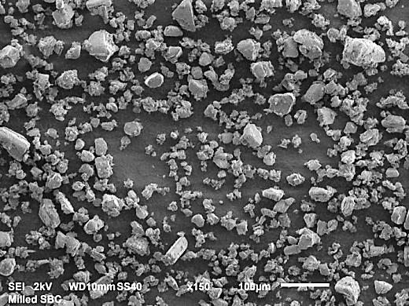
VIPER® Mill
Unmilled Trona
Milled Trona
25-40 μm
12-15 μm
Unmilled SBC
Milled SBC
150-180 μm
15-19 μm

Slide 22
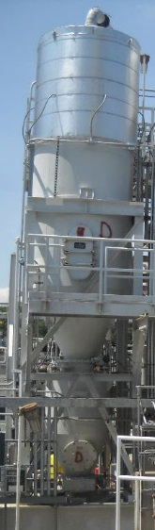
Filter Separator and Waste Handling
Collects spent sorbent
byproduct directed into two disposal containers using screw feeders
Byproduct disposal is non-hazardous

Slide 23
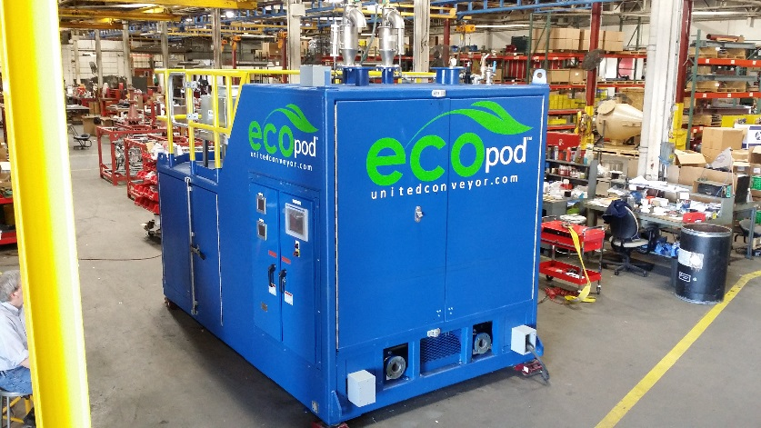
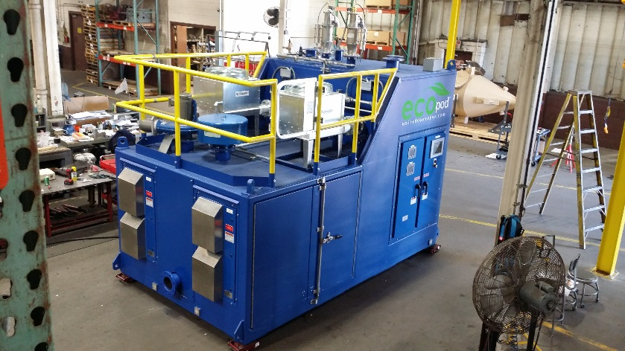
Modular DSI Systems for Misc. SO₂ Streams
Can be used for any SO_{X} stream in Processing or Refining plant
  Recent Example: pet coke calcining
Simplified Approach:
  Skid delivered complete to job site
    Pre-piped and Pre-wired
Field costs are lower
  Modular unit set on pad underneath simple, legged storage silo
  Allows for complete factory acceptance testing

Slide 24
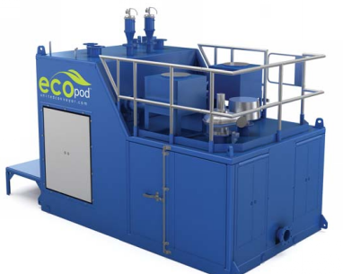
Modular DSI Systems for Misc. SO₂ Streams
Hydrated lime or trona/SBC injection system (Single, Dual, or 3-Feed)
  Up to 2000 lb/hr/train
  PD blowers with VFDs
  Heat exchangers
  Gravimetric or volumetric feeders
  Rotary airlocks

Slide 25
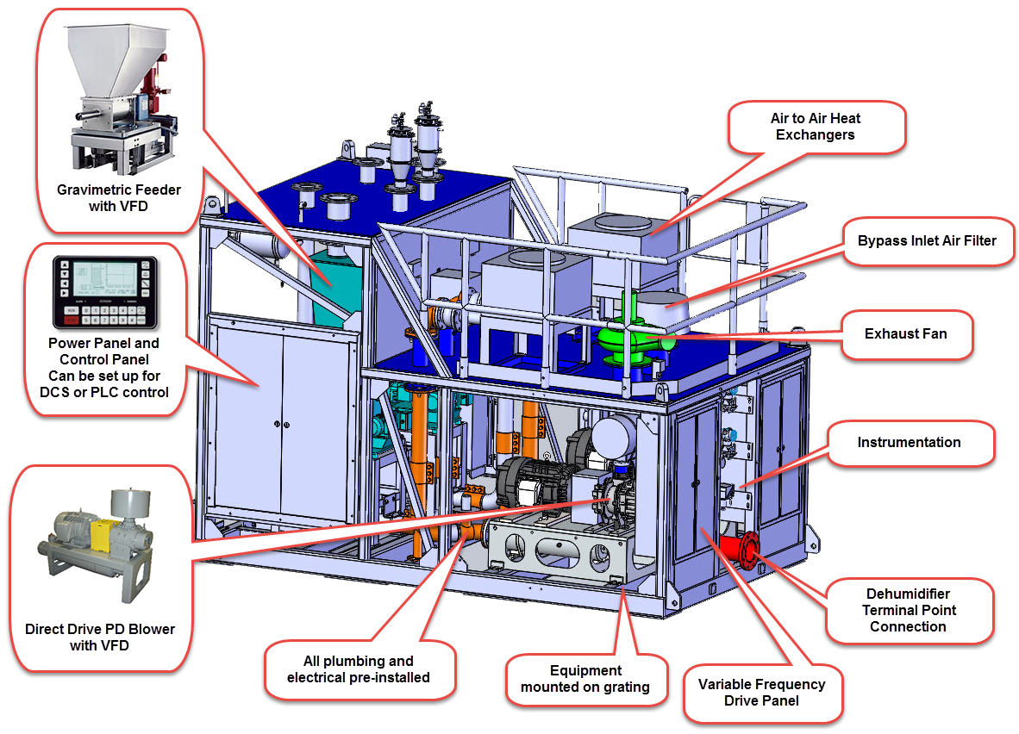
Modular DSI System Design
Overall dimensions for a 2-feed Modular Sorbent Injection skid are approximately: 155” L X 95” W X 107” H

Slide 26
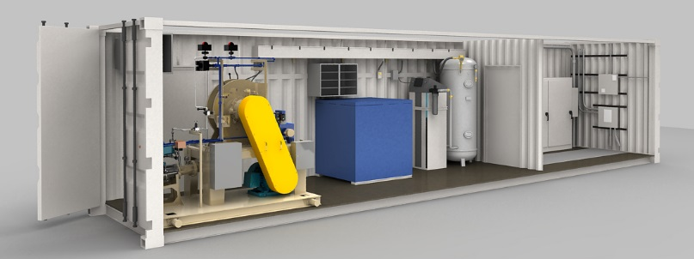
Modular Trona/SBC Injection System
Modular System
  One (1) mill configuration with convey blower and compressed air dryer and receiver. Electrical equipment in separate room.
  Up to 14,000 lb/hr tona or SBC

Slide 27

www.unitedconveyor.com
QUESTIONS?

Slide 28

UCC Dry Sorbent Injection
Jon Norman, P.E.
Sales and Technology Manager
315-440-3244
jonnorman@unitedconveyor.com

