Slide 1
Concerns Over the Use of Geomembrane Liners as an Engineering Control for the Long-Term Storage of Oil and Gas Wastes
IPEC 2018. Denver, CO. Jeff Tyson, P.E.

Slide 2
Outline
Introduction
Waste Characteristics
Potential Impact
Degradation of Geomembrane Liners
Conclusion

Slide 3
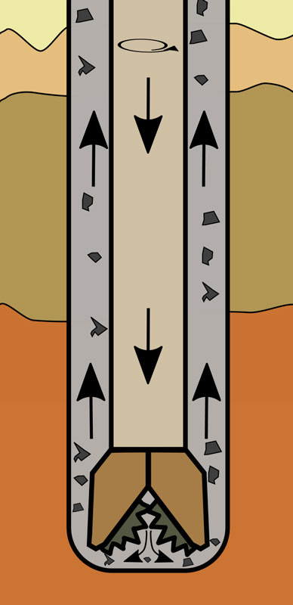
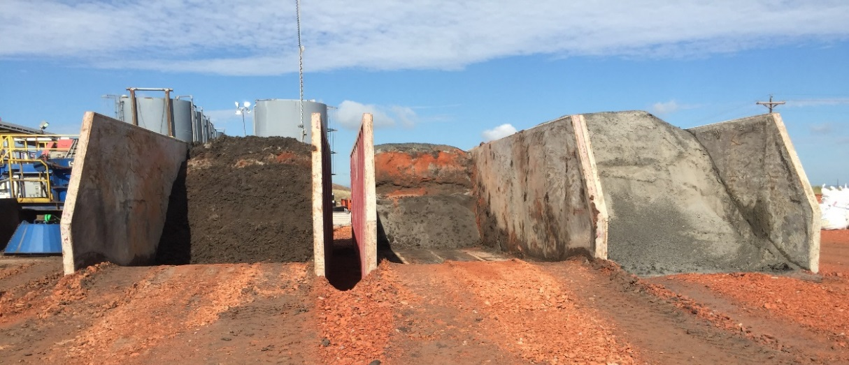
E&P Wastes – Drilling Wastes
Rock cuttings and fluids that are produced during drilling
1.2 barrels of waste generated per foot drilled
Average 50% solids / 50% liquids
392,000,000 bbls generated in 2014
~94.7 million tons
http://canstrat.com/learningcentre/33-what-you-should-know-about-drill-cuttings.html

Slide 4
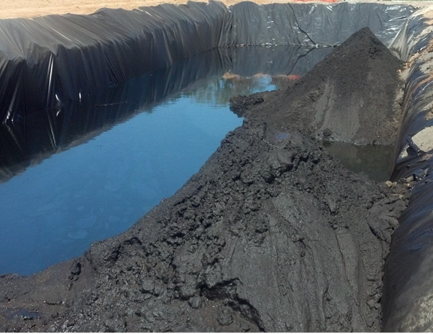
Contaminants in Drilling Waste
Metals
Arsenic
Barium
Cadmium
Chromium
Lead
Mercury
Selenium
Silver
Zinc
Salts
Chlorides
Nitrates
Organics
Hydrocarbons
Benzene
pH
Other Contaminants

Slide 5
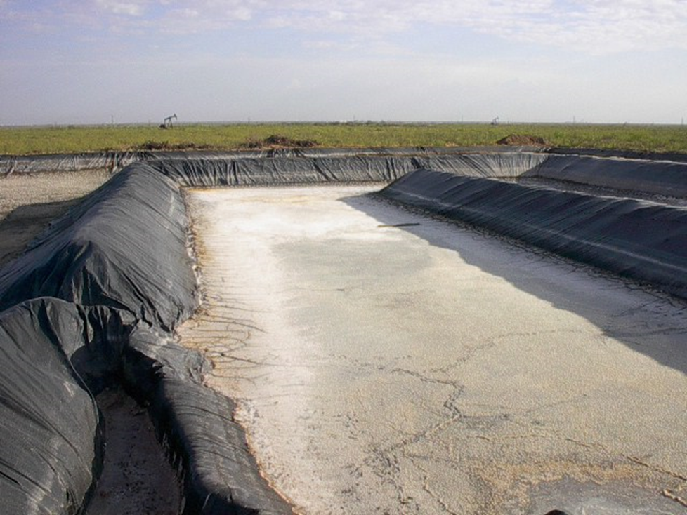
Geomembranes
Common Types of Geomembranes
HDPE = high density polyethylene
LLDPE = linear low density polyethylene
FPP = flexible polypropylene
PVC = polyvinyl chloride (plasticized)
CSPE = chlorsulfonated polyethylene
EPDM = ethylene propylene diene terpolymer
Geomembranes are formulated and selected based on use

Slide 6
Engineering and Institutional Controls
Engineering Control (ITRC)
Physical modifications to a site or facility to reduce or eliminate the potential for exposure to residual contamination (for example, slurry walls, capping, or vapor intrusion liner).
Institutional Control (ITRC)
A legal or administrative restriction on the use of, or access to a site or facility to eliminate or minimize potential exposure to chemicals of concern (such as proprietary controls or governmental controls).
https://institutionalcontrols.itrcweb.org/glossary/

Slide 7
Temporary Storage
~ 1 year

Slide 8
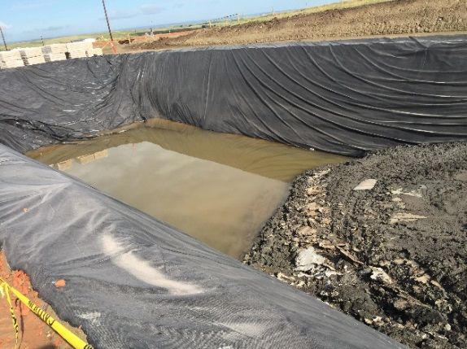
Drilling Waste Burial Pit – Long Term Storage
Forever

Slide 9
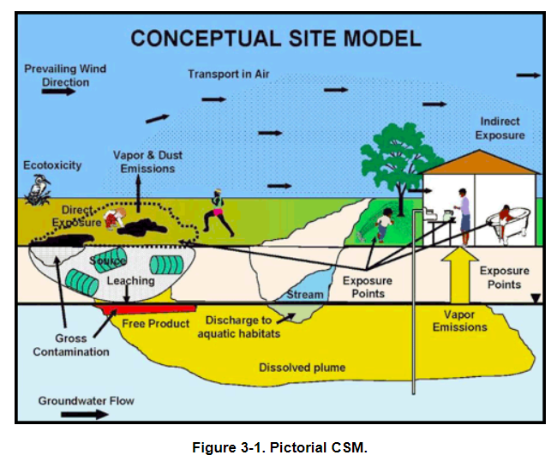
Drilling Waste Burial Pit
ITRC. 2012. Incremental Sampling Methodology.
https://www.itrcweb.org/ism-1/3_1_2_Conceptual_Site_Models.html

Slide 10
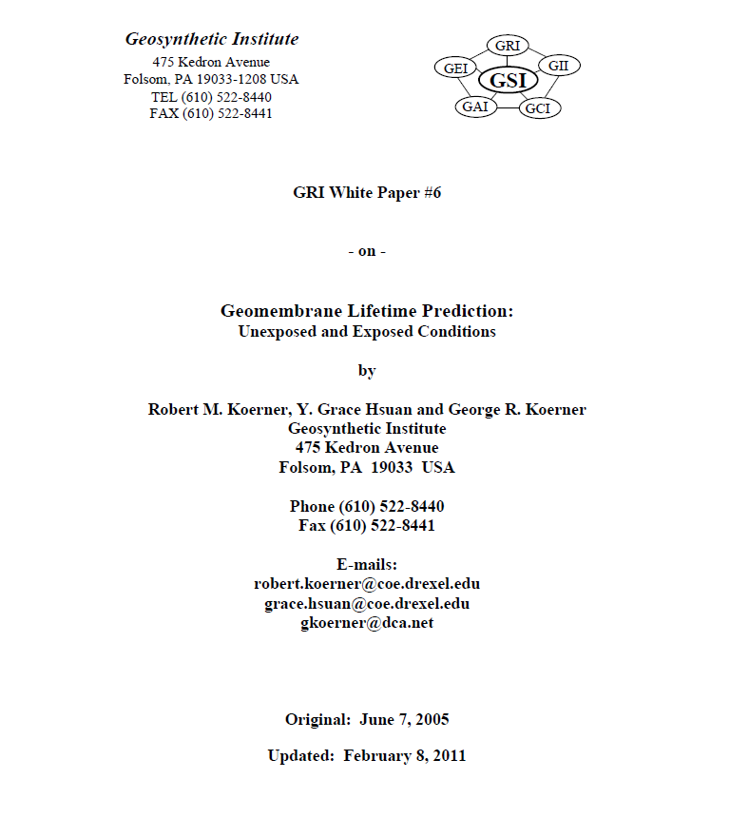
Geosynthetic Institute

Slide 11
Geosynthetic Institute
Degradation Mechanisms
UV Light, Oxidation, Ozone, Hydrolysis, Chemical, Radioactivity, Biological, Stress State, Temperature
Lifetime Stages
Stage A - Antioxidant Depletion Time
Stage B - Induction Time to the Onset of Degradation
Stage C - Time to Reach 50% Degradation (i.e., the Halflife)
(Koerner, et al. 2011.)

Slide 12
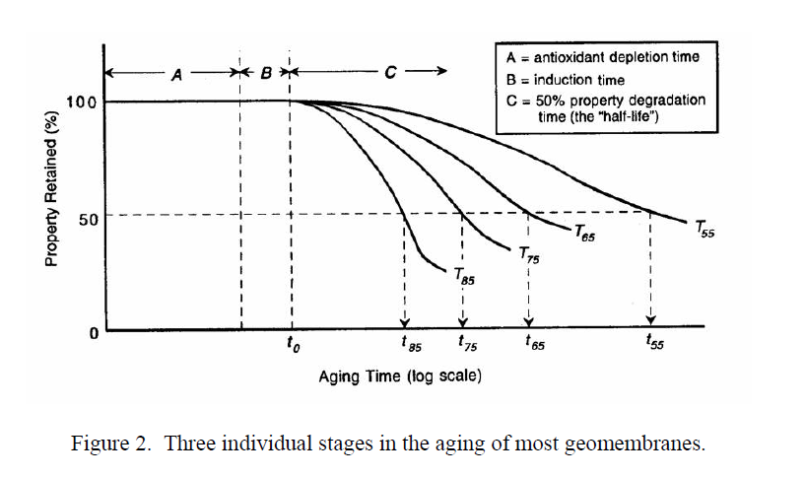
Geosynthetic Institute
(Koerner et al. 2011.)

Slide 13
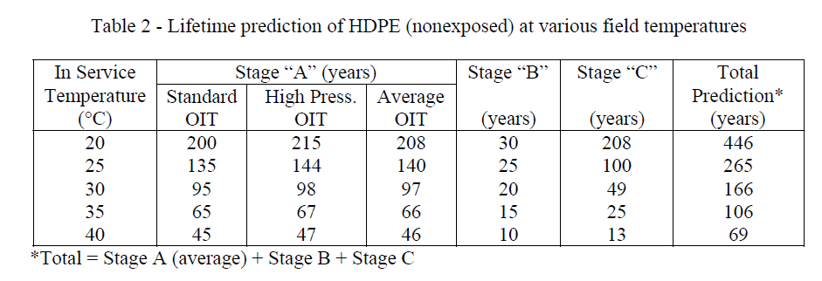
Geosynthetic Institute
(Koerner et al. 2011.)

Slide 14
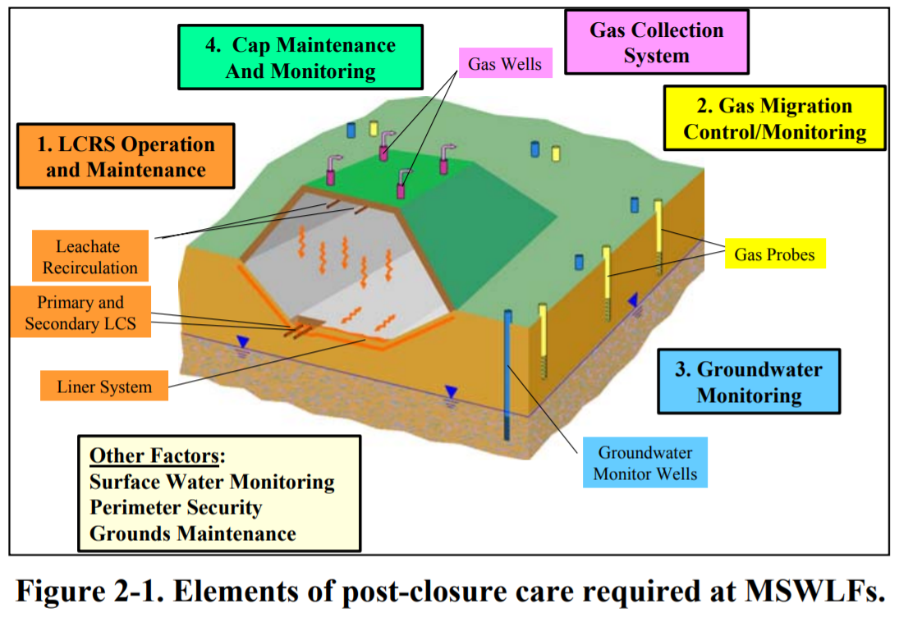
Typical Controls at a Landfill Site
ITRC. 2006. Evaluating, Optimizing, or Ending Post-Closure Care at Municipal Solid Waste Landfills Based on Site-Specific Data Evaluations

Slide 15
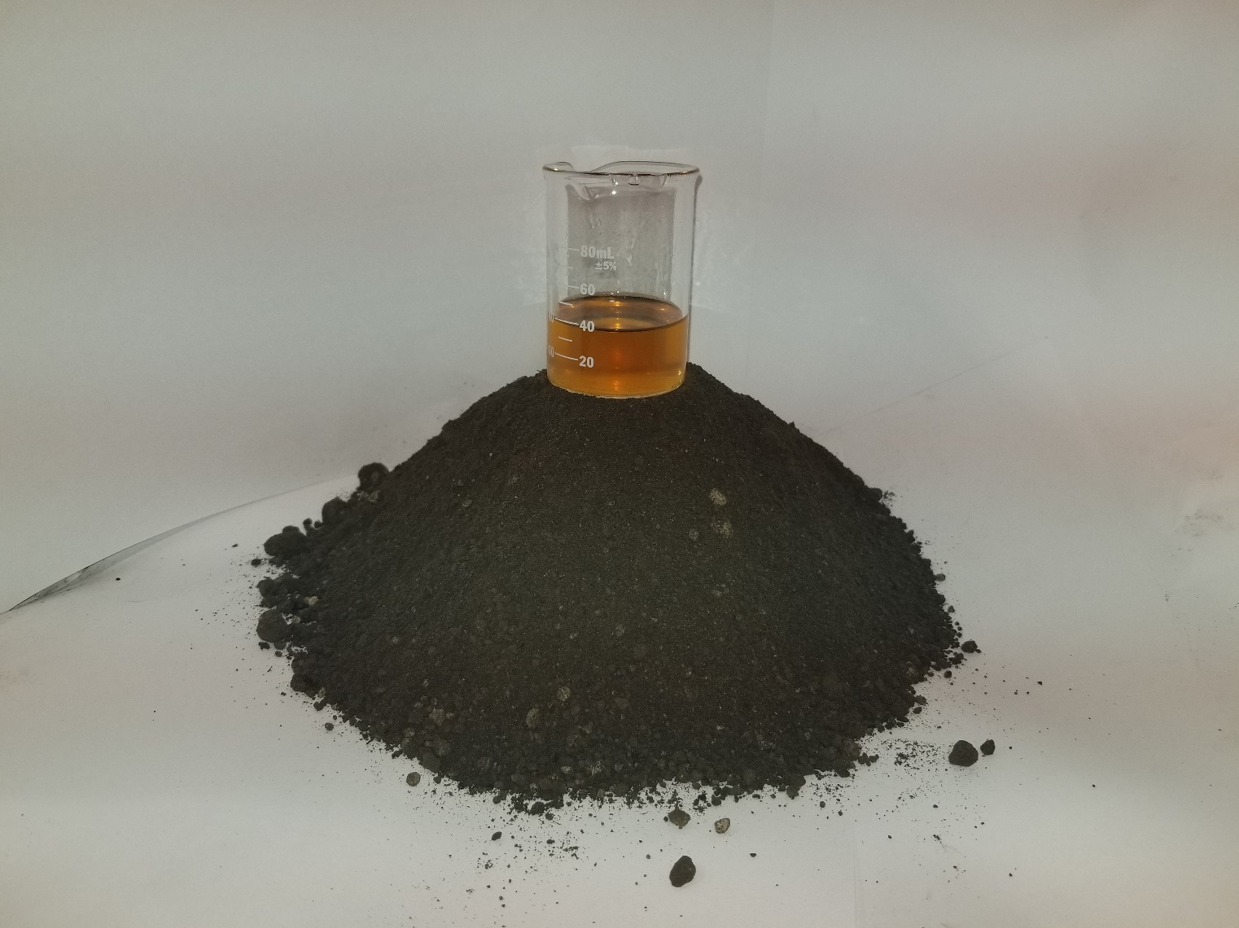
Drilling Waste Burial Pit

Slide 16
Concerns
Geosynthetics will degrade over time according to literature
Some contaminants may degrade over time, but may generate other COCs (metabolites)
Some contaminants will not degrade (salts, heavy metals)
There are typically no long term institutional controls in place at burial sites
Potential for contaminants to migrate from the burial site over long periods of time

Slide 17
Wrap Up
About Scott Energy
Professional Engineering Firm
Oilfield Service Company
Experts in E&P waste management
Sustainable practices based solely on sound science
Questions?

