Slide 1
Characterizing Ground-Water Flow Velocity and Preferential Flow Zones
IPEC 2018

Slide 2
Andrew Lindemann Global Technical Marketing Leader andrewl@geotechenv.com 800-833-7958

Slide 3
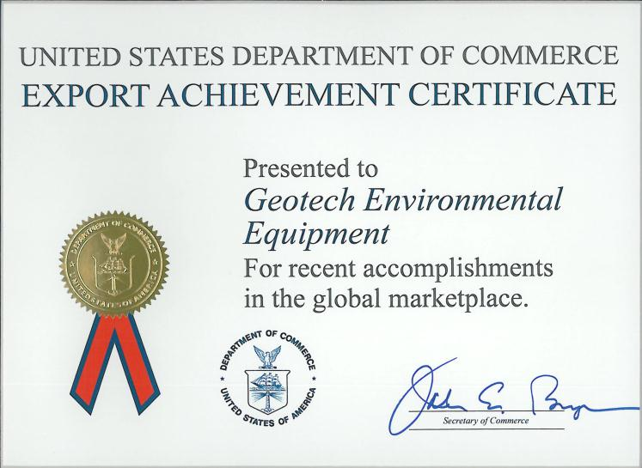
Geotech Corporate Headquarters Denver, Colorado USA
…a world leader in environmental equipment manufacturing and product training since 1978.
www.GeotechEnv.com

Slide 4
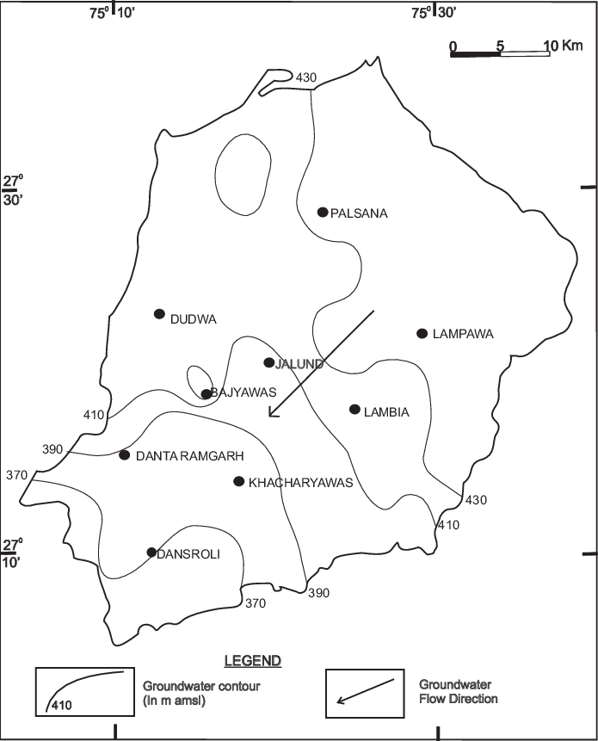
Characterizing Groundwater Velocity and Direction
Conventional Methods
Hydraulic Conductivity
Tracer Studies

Slide 5
In With The Old
Colloidal Borescope
Developed Oak Ridge National Labs
Commercialized by AquaVision LLC.
Manufactured by Geotech Environmental Equipment, Inc.

Slide 6
Where the Technology is Today
Precision Magnetic Compass
AquaLite Software
High Res CCD Camera
140x Magnification Optics
High Intensity Back Light

Slide 7
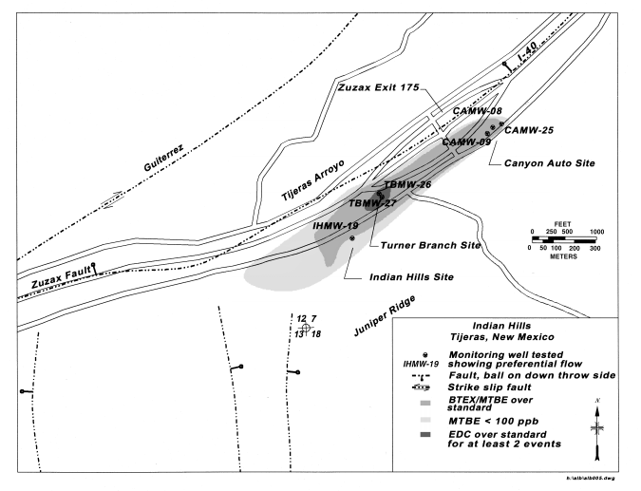
East Mountain Site Study
Bernalillo County Environmental Health Department
Department of Energy Technology Deployment Initiative
MDM Services Corp.

Slide 8
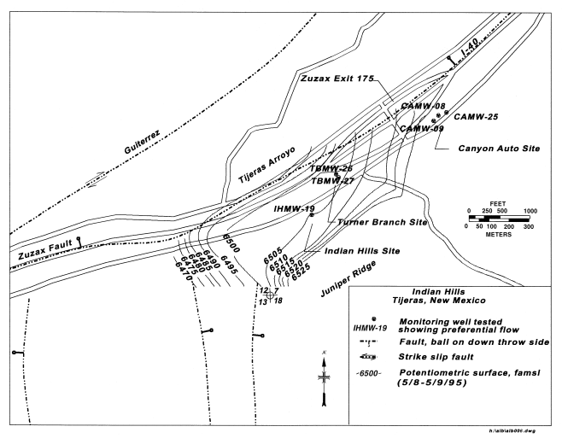
East Mountain Site Study

Slide 10
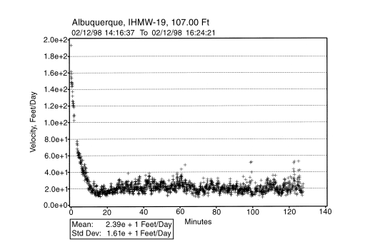
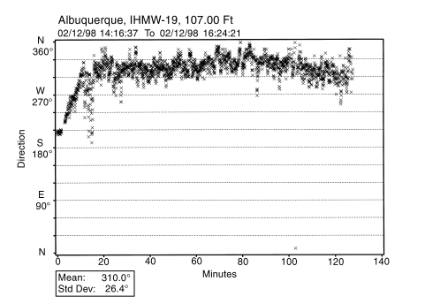
MW-19
Notes:
Field measurement results:
Two distinct flow regimes were identified based on colloidal borescope measurements. Slow flow that trends in a dominant northwest direction was observed in most of the wells tested

Slide 11
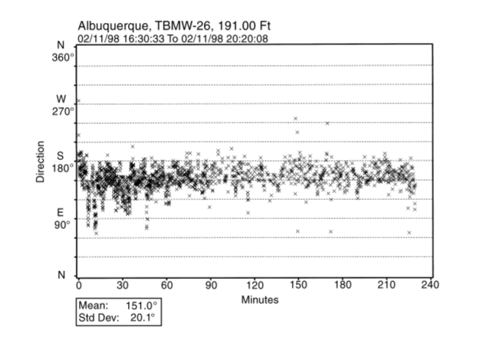
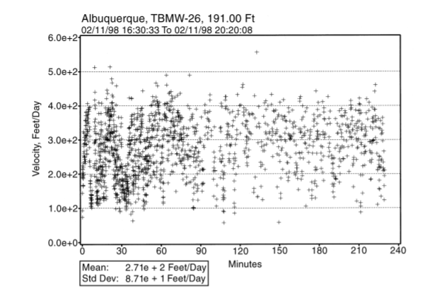
MW-26

Slide 12
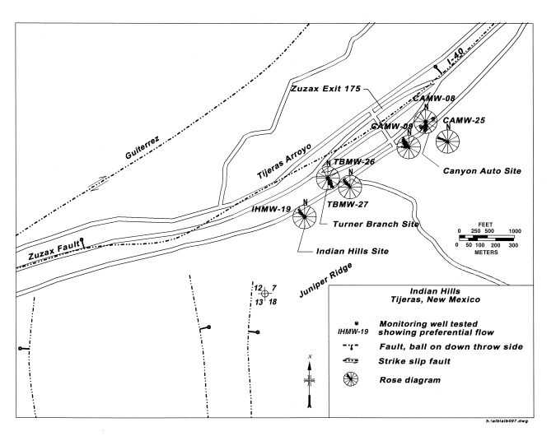

Slide 13
Discussion and Conclusion
Predicted flow velocity towards NW
Discovered dominate velocity towards SE
Colloidal Borescope –
Only method for detecting velocity w/o drilling additional wells
All site information provided clear understanding of influenced groundwater flow

Slide 14
Andrew Lindemann Global Technical Marketing Leader andrewl@geotechenv.com 800-833-7958

