Slide 1
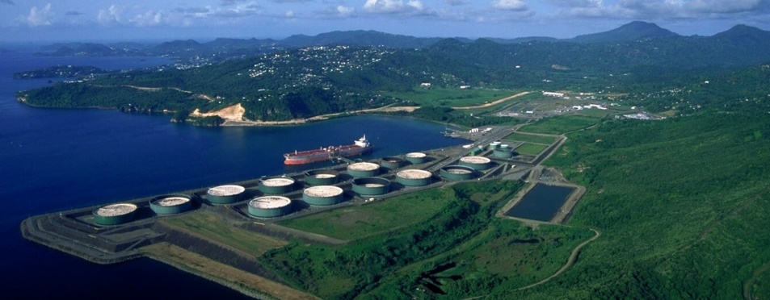
World Bank / International Finance Corporation (IFC) Financing Environmental Update
IPEC 2018 Denver, Colorado November 1, 2018
Presented by: Richard C. Bost, P.E., P.G. (Texas)
I2M Associates, LLC Houston, Texas
Version 1.3

Slide 2
Acknowledgements
Many thanks to those who contributed:
Don Gorber and Lloyd Torrens, Independent Environmental Consultants
Associates & Partners of ERM
Michael D. Campbell, P.G., P.H., I2M Associates, LLC
Lori Magyar, Auradon Consulting
Our clients, the World Bank, J. Teague, and Andrew Fono, formerly of Winstead and Haynes & Boone

Slide 3
Principles and Protocols of the World Bank, IFC, and Equator Principles EFIs
Over Past 15 Years Internationally Funded Projects
Have Encountered Existing Contamination and
other Environmental Issues that Led to Issuance of
New EHS Guidance beginning in 2012 and the adoptions
of Equator Principles by international lending banks
World Bank: loans to countries
IFC: loans to corporations or local entities
Often projects receive both

Slide 4
Example: Bahamas Former Refinery & Terminal

Slide 5
World Bank Group EHS Guidelines
The World Bank Group Environmental, Health, and Safety (EHS) Guidelines are technical reference documents with:
general and industry-specific examples of Good International Industry Practice (GIIP).
specified performance levels and measures that are normally acceptable to the World Bank Group, and that are generally considered to be achievable in new facilities at reasonable costs by existing technology.
They are used by the World Bank and IFC and related funding entities.
Following the 2012 update of IFC's Policy and Performance Standards on Environmental and Social Sustainability, the World Bank Group updated their EHS Guidelines and are adding new Guidelines ….. for example, the Offshore Deep Water Petroleum Industry and Contaminated Land Guidance .

Slide 6
Example: GENERAL EHS GUIDELINES: ENVIRONMENTAL CONTAMINATED LAND
Similar to U.S. EPA Superfund Guidance and Developed to Support Redevelopment “Brownfield” Projects; International Funding Protocols Require:
Basic ESA and Due Diligence following ASTM or similar standards
Reporting of and Addressing Existing Contamination
Risk Screening, and if required
Interim Remediation
Detailed Risk Assessment
Selection of Remediation and Mitigation Goals
Selection of Conceptual Approach
Detailed Review of Remedial Technologies
Selection and Implementation of Preferred Remediation Technologies and Plan

Slide 7
Update: International Bank for Reconstruction and Development (IBRD)
On April 21, 2018, the World Bank Group’s shareholders announced funding increase of $7.5 billion paid-in capital and $52.6 billion callable capital increase for IBRD.
IBRD countries will be classified into one of four Pricing Categories:
Group A: Blends, small states, countries in fragile and conflict-affected situations (FCS) and recent IDA graduates. These countries are exempt from the maturity premium increase regardless of their income levels.
Group B: Countries below-GDI which do not qualify for an exemption listed in Group A.
Group C: Countries above-GDI, but below HIC status (high-income countries), and which do not qualify for an exemption listed in Group A.
Group D: Countries with high income status (HIC) and which do not qualify for an exemption listed in Group A.
Graduation Discussion Income (GDI) is the level of GNI per capita of a member country above which graduation from IBRD starts being discussed, as published annually in the World Bank’s Per Capita Income Guidelines for Operational Purposes.

Slide 8
Environmental Requirements Are Implemented during funding process by World Bank Group or Equator Principles, including:
1. Review and Categorization
2. Completion of Environmental and Social Assessment
3. Identifying Environmental & Social Standards
4. Developing and Implementing Environmental/Social Management System and Action Plan
5. Stakeholder Engagement
6. Grievance Mechanism
7. Independent Review
8. Covenants
9. Independent Monitoring and Reporting
10. Reporting / Transparency

Slide 9
Update: Equator Principles
The Equator Principles Association published a new document: ‘Equator Principles Implementation Note’ with external stakeholders and other interested parties.
The document, written by EPFIs, contains selected information and examples to support the understanding of the requirements in, and implementation of, the Equator Principles.
The document comprises a series of modules supporting the implementation of the requirements contained in the Equator Principles on scope, climate change (Principle 2 and Annex A of the Equator Principles) and reporting (Principle 5, 10 and Annex B of the Equator Principles),
The document includes provisions for reporting and addressing such environmental issues as air quality, carbon impact, existing contamination.

Slide 10
Equator Principles (EP)
Represent a risk management framework, adopted by financial institutions, for determining, assessing and managing environmental and social risk in project lending to commercial entities.
Are intended to provide a minimum standard for due diligence to support responsible risk decision-making and bank loan management.
Currently 87 Equator Principles Financial Institutions (EPFIs) in 36 countries have officially adopted the EP, covering over 70% of international Project Finance debt in emerging markets.
EPFIs have committed to implementing the EP in their internal environmental and social policies, procedures and standards for financing projects.
For example: Encountering Existing Contamination in Several Projects led to momentum to develop a standard guidance for “Brownfield Situations.”

Slide 11
World Bank Group & IFC Commitment to Operate By Example including IFC Office Brownfields
IFC's Footprint Commitment
IFC strives to reduce the environmental impact of day-to-day activities while working to benefit communities wherever IFC has offices.
Wide-ranging program of corporate initiatives, includes:
Reducing poverty and providing electrification while :
Maintaining carbon neutrality,
Reducing our global electricity use in more developed areas & via energy efficiency, and
Reducing waste, paper, and water use.
Supporting green procurement, alternatives to business travel and efficient commuting practices.
Community outreach and volunteering.
This work is lead by a dedicated Program that is governed by a cross-cutting senior-level committee, and supported by a network of 185 Footprint Champions who support IFC's Footprint Commitment within IFC global offices.

Slide 12
Energy Directions Policy and Climate Change Reporting Update
1.2 billion people without electricity (1/6 of world population)
July 2013 World Bank and IFC announced a new directions paper promoting alternative energy except in certain circumstances.
Required reporting of CO2 and GHG emissions
Update: Public Reporting by the Borrower for a Project that emits over 100,000 tonnes of CO₂ equivalent annually:
a) The Borrower shall publicly report Conventional HAPs and Greenhouse Gas Equivalent Emissions during the operational phase on an annual basis, and
b) Quantification of the Green House Gas emissions will be conducted by the Borrower in accordance with internationally recognized methodologies and good industry practice.

Slide 13
Update: Energy Directions Policy and Climate Change
In July 2013 the World Bank also revised its lending policies to rule out new coal projects, except in “exceptional circumstances”.
Its most noteworthy exception to that rule is Kosovo C power plant.
However, it has continued to indirectly support coal through IFC lending to banks and financial institutions.
For example, IFC supplied $563 million in general purpose lending to two commercial banks in the Philippines, which in turn invested $13.4 billion in coal projects over the past five years.
In December 2017, IFC acknowledged the criticisms and said the IFC had changed its policies over the past two years to “vastly reduce” the money reaching coal. It no longer issues general purpose loans, instead refocusing 95% of lending for strategic priorities such as energy efficiency, renewables and women-owned businesses.
As of October 2018, the Kosovo C power plant is no longer receiving funding.

Slide 14
Update on World Bank/IFC Energy Investment Policy Implementation
World Bank dumping of Kosovo plant in October 2018 was said to be an “ending of support for coal worldwide”, culminating a 5-year shift since its policy announcement in 2013.
Economic Reason given: The Kosovo e Re lignite plant could not compete with renewables on price, said bank president Jim Yong Kim
World Bank is now encouraging an end to all funding of coal projects, stating a preference for private banking partners that exit coal funding
Published on 10/10/2018, 10:00am International Finance Corporation will require partners to publish their support for coal and seek those with plans to divest
Under pressure from Germany, last year the World Bank also said it would phase out finance of oil and gas extraction, citing its commitment to fighting climate change.

Slide 15
EHS Guidelines and Equator Principles are Integrated in Funding Process
The Equator Principles apply to four financial products:
Project Finance Advisory Services,
Project Finance,
Project-Related Corporate Loans, and
Bridge Loans.
The loan or “investment” agreement provides Equator Principles Financial Institutions (EPFIs) with the formal opportunity to require the client to address environmental and social issues throughout the Project Cycle, especially following Financial Close and subsequent disbursements or line drawdowns.
An important strength of the Equator Principles is the incorporation of covenants linked to compliance (as outlined in Principle 8) with all relevant host country environmental and social laws, regulations and permits & international standards in all material respects.

Slide 16
Environmental Plan Compliance Required by Loan Documents
The bank will provide a covenant in the financial documentation to:
a) comply with the Environmental and Social Management Plan and Equator Principles Action Plan (including Remediation Plan where applicable) during the construction and operation of the Project in all material respects; and
b) provide periodic reports not less than annually, prepared by in-house staff AND independent third party experts, that:
i) document compliance with the Environmental and Social Management Plan and Equator Principles Action Plan (including Remediation Plan where applicable), and
ii) provide representation of compliance with relevant local, state and host country environmental and social laws, regulations and permits; and
c) decommission the facilities, where applicable and appropriate, in accordance with an agreed Decommissioning Plan.

Slide 17
Loan Agreement Terms
Covenants – the promises made by the Borrower to undertake certain actions (positive covenant) or to refrain from taking certain actions (negative covenant). Compliance with environmental and social laws and regulations, and the Project’s Environmental and Social Management Plan and Equator Principles Action Plan (where applicable), is a key covenant of loan agreements related to a Project. Reporting requirements should also be included as a covenant. Material non compliances with the covenants will normally constitute an Event of Default under the loan agreement.
Event of Default - an event that entitles the Lenders to cancel a commitment, declare all amounts owed by the Borrower to become immediately due and payable, and/or enforce security. For Projects with complex environmental or social issues, the Lenders and Borrower include specific environmental or social Events of Default covenants that may, for instance, refer to specific remedy periods.

Slide 18
Public Reporting & Transparency
A summary of each Environmental and Social Impact Assessment and Operational Information is to be accessible and available online,
Public Reporting by the Borrower for Most Projects, including:
a) Land Contamination with significant impacts, and projects that emits over 100,000 tonnes of CO₂ equivalent and exceeds other emission standards annually,
b) The Borrower shall publicly report HAPs and GHG Emissions during the operational phase on an annual basis with quantification of the Green House Gas emissions.
Monitoring and Reporting of Data and Risk Assessment Findings will be conducted by the Borrower in accordance with internationally recognized methodologies and good industry practice.
Similar requirements for water discharges.

Slide 19
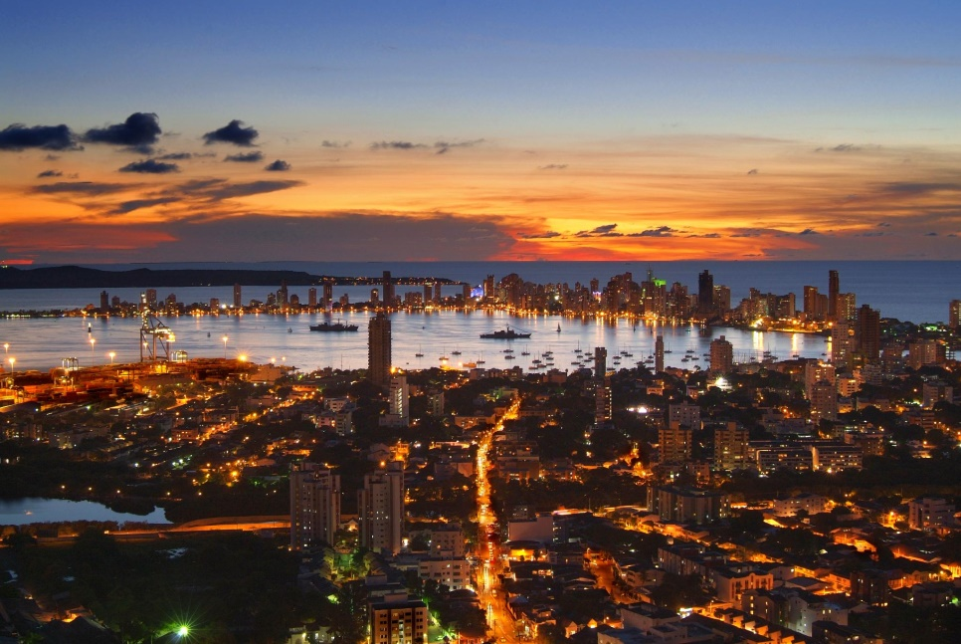
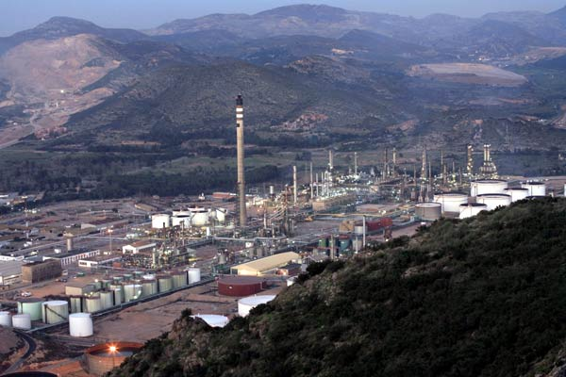
Case Study: Cartagena Refinery Redevelopment

Slide 20
Case Study: Cartagena Refinery Redevelopment
Risk Study identified soil and land contamination as posing a low risk and prioritized funding for sensitive habitat protection and waste water treatment facilities and operations
Engineered controls and containment of contaminated land provided best cost benefit option while meeting Equator Principals and EHS Guidelines of protection environment
Study of River and Bay Quality was expanded to include Groundwater Contaminant parameters
Affected Area Management Area was established that created protocols for activities that could potentially encounter or disturb affected soils and provide pathways for migration to ground water.
More costly options of removal, treatment and/or reuse were not justified.
Investigations were integrated into construction activities and ongoing operation and maintenance activities to meet EHS standard.

Slide 21
Conclusions
World Bank Group EHS Guidelines and Equator Principles are having a major impact on improving environmental and social conditions in our World and advancing goal of cleaning up contamination, preventing pollution and implementing climate change policies.
We can help by Facilitating Our Success Stories.
Checks and Balances in System and Focus on Sustainability and Continuous Improvement and Monitoring have upgraded the integrity of development projects and funding processes.
NGOs also play a role in ensuring integrity to processes and addressing particularly social impacts.
Due Diligence, Risk-Based Remediation, and Climate Change are fully integrated into the process.
Great Opportunities exist for those who choose a mission of contributing to cleaning up and preserving our natural resources for future generations while providing greater opportunities for Today’s World.
Challenges to Our Values: Reducing Availability of Capital and Ceding Funding to Chinese and Russian Oligarchs.

Slide 22
Questions and Answers
Battelle International Brownfield Experience, January, 2017 New Orleans, LA
Thank you for this opportunity to share my perspectives with you. Richard C. Bost, P.E., P.G. President and Chief Engineer Houston, Texas

