Slide 1
Bacteria Behaving Badly
Are Molecular Methods a New Hope?
Vince Sandifer & Mary Eid
University of Oklahoma

Slide 2
Outline
Background on MIC
Picture examples
Case studies
PR nightmares
Sour gas
How is it taken care of?
How do we detect it?
Isnt there something better?

Slide 3
Things we like about bacteria
Biotic factories
Antibiotics, pharmaceuticals
Yogurt, food production
Digestion
Nutrient cycling in environments

Slide 4
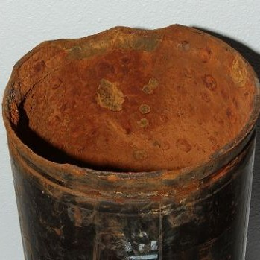
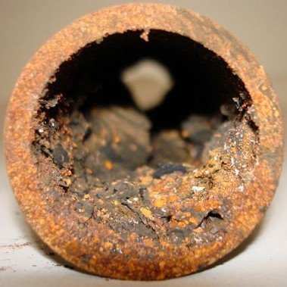
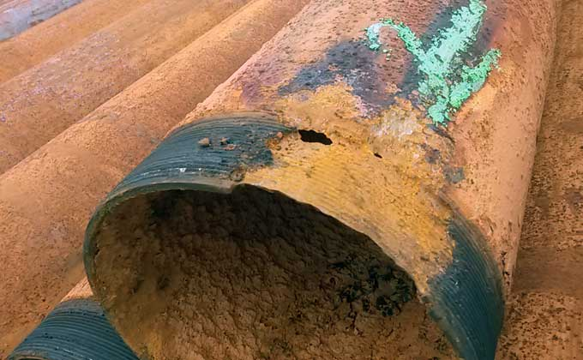
Bacteria Can Damage Steel

Slide 5
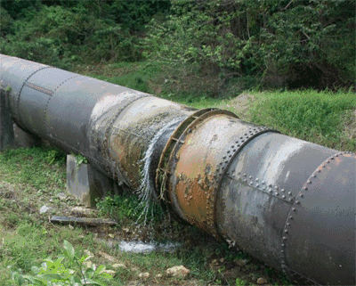
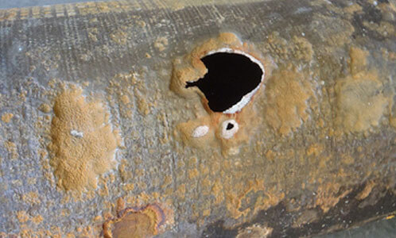
Failures are Not Good
Notes:
Mention sour gas somewhere too?
Photo credit for Right side, InstantLabs

Slide 6
Common Problem Areas
Wells
Heater treaters
Pipelines
Refineries
Weld seams
Connections
Coupon sampling points
Separators
Tanks
Pipes
Connections
Storage tanks

Slide 7
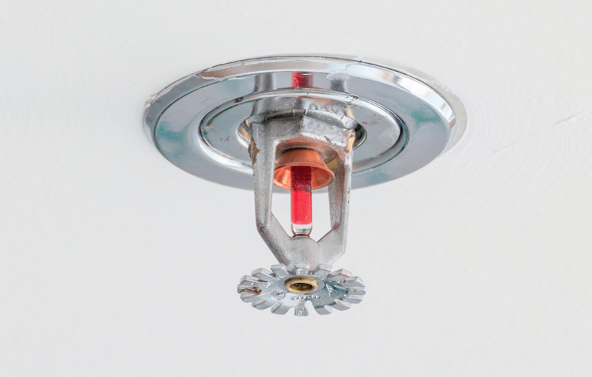
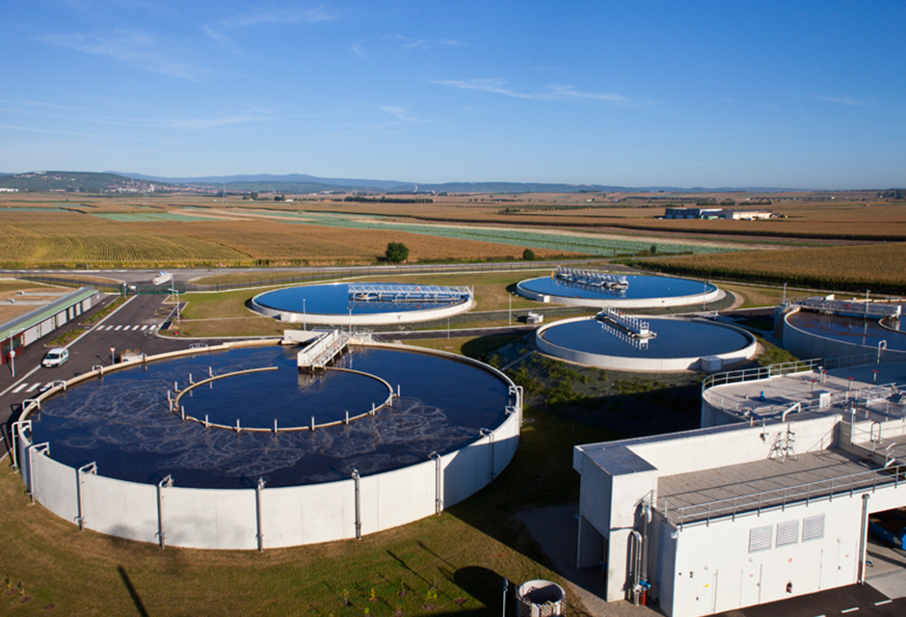
MIC Not Unique to Oil & Gas
Notes:
Highlight with pics Fire sprinklers, other industries in manufacturing

Slide 8
The cost of corrosion
In the U.S. All MIC cost about $50 billion
In the U.S. there is about $2.5 billion in MIC damage annually in oil and gas sectors
Data is From NACE

Slide 9
Culprits?
Sulfate Reducing Bacteria
Acid Producing Bacteria
Iron Reducing Bacteria

Slide 10
Biofilm Attachment

Slide 11
Biofilm Attachment

Slide 12
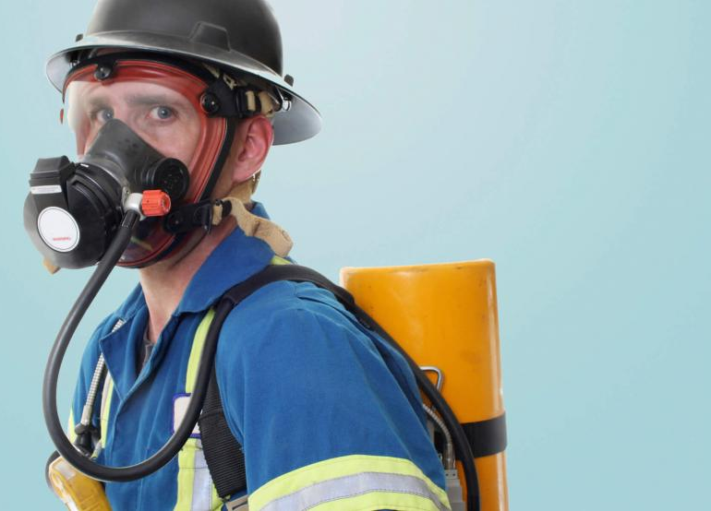
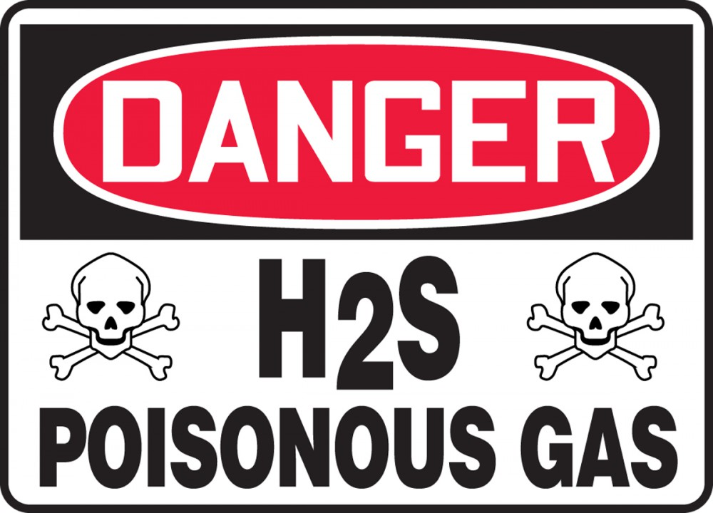
H2S is a Safety Concern
Production of H2S is health hazard and requires additional training of personnel
SRB produce H2S

Slide 13
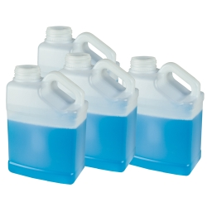
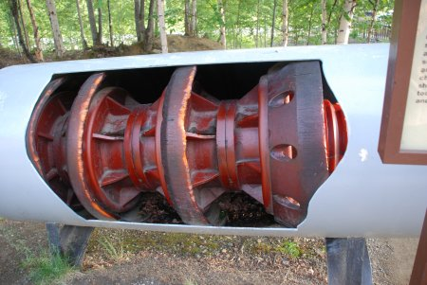
How do we deal with bacteria
Chemical
Mechanical

Slide 14
How do you know you need to treat?
Methods for Detection

Slide 15
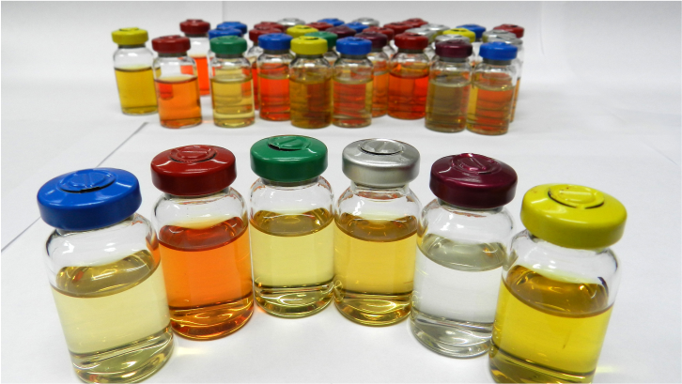
Bug bottles
Pros
Cheap
Easy to interpret results
Low skill
Minimal equipment
Cons
Results take 26 days
Can’t grow everything
Place to incubate bottles

Slide 16
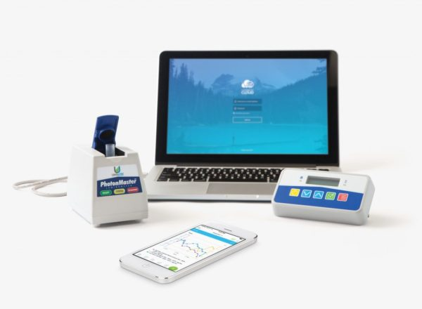
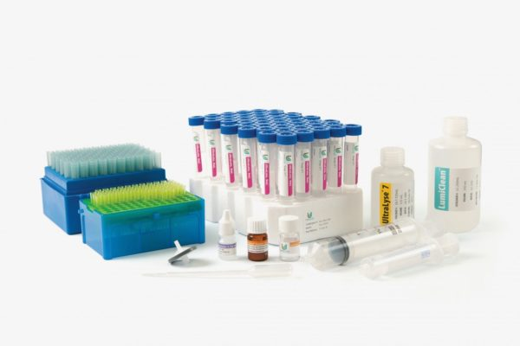
ATP
PROS
Fast
Determines if cells are alive
On site detection
Low skill needed
Cons
Not able to distinguish types of organisms
Extra equipment

Slide 17
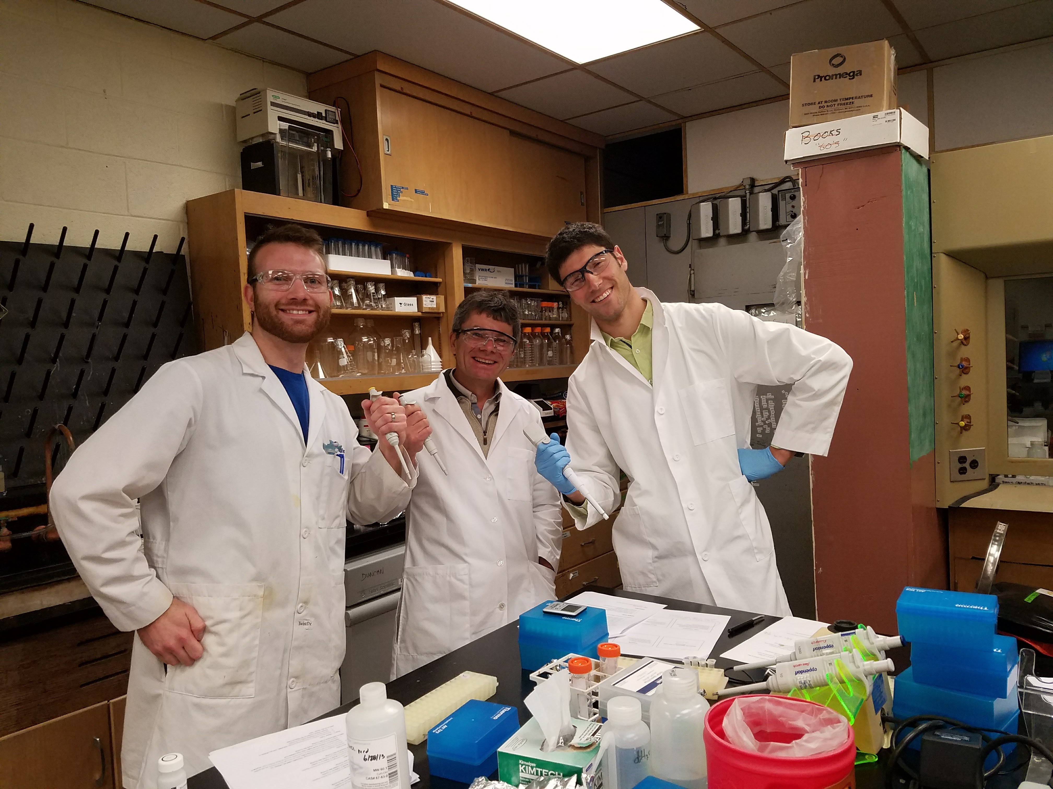
Lab Analysis
Most detailed Results
qPCR
16S sequencing
Metagenome sequencing
Downside:
Have to ship samples
Sample can change while shipping
expensive

Slide 18
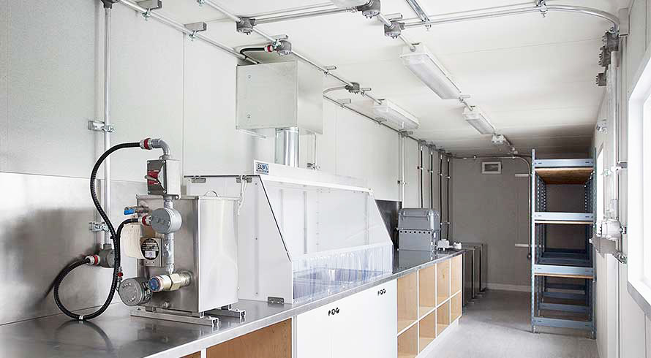
Mobile Lab for in Field Use
Pros
Lab results on site
Cons
Need skilled personnel
Expensive equipment in field is risky

Slide 19
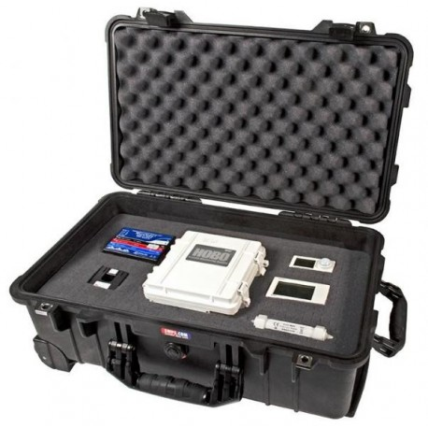
Emerging methods
In field molecular methods using qPCR
New methods using isothermal amplification of DNA
Lab on a chip

Slide 20
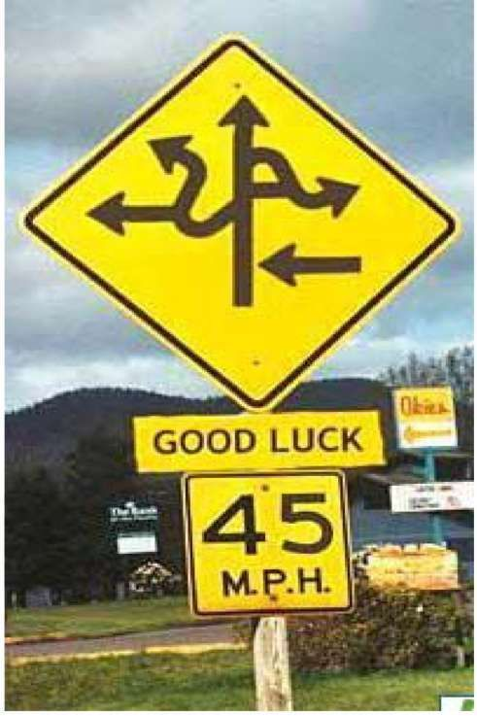
So What Method Should You Use?
Each situation is unique
Use multiple methods to give you a more complete picture

Slide 21
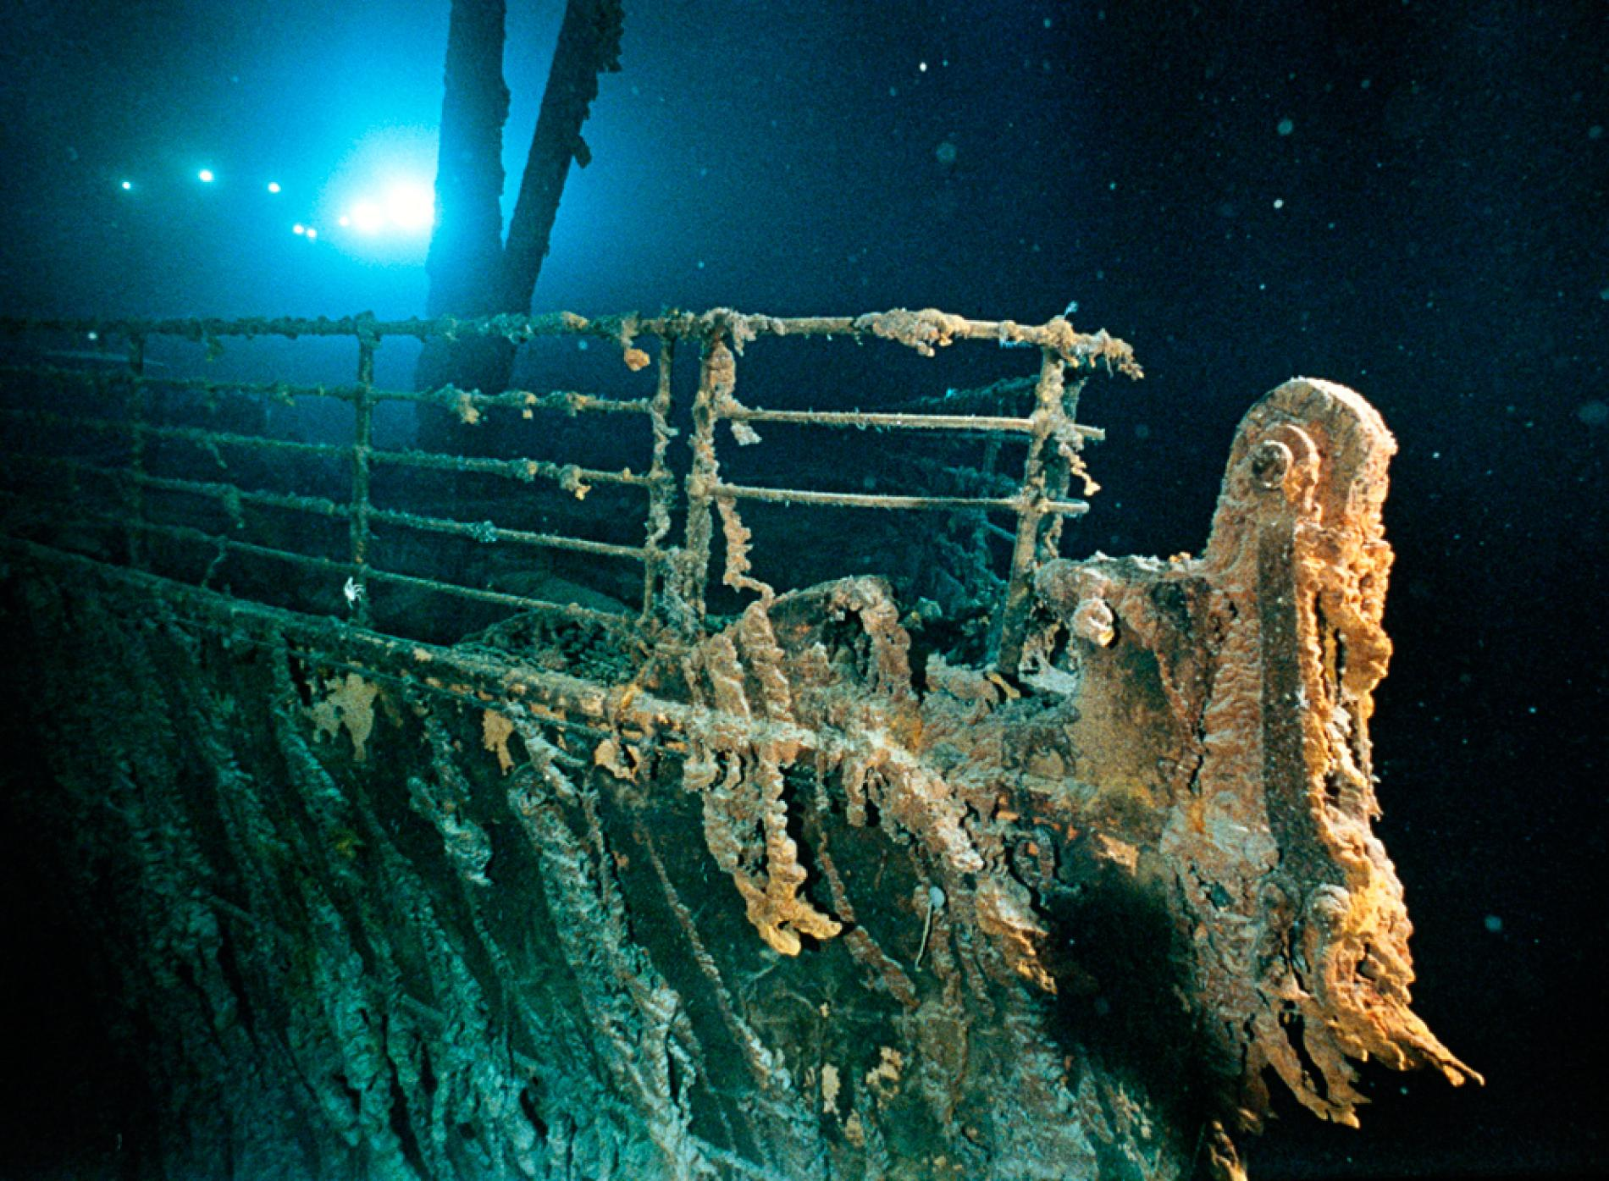
In Summary
Monitoring programs insure infrastructure longevity

