Slide 2
Problems Encountered examples Recommendations
Avoiding the 10 Biggest Mistakes in Ground-Water Remediation (associated with equipment)

Slide 3
Andrew Lindemann Global Technical Marketing Lead Geotech Environmental Equipment, Inc. 800-833-7958 AndrewL@geotechenv.com

Slide 4
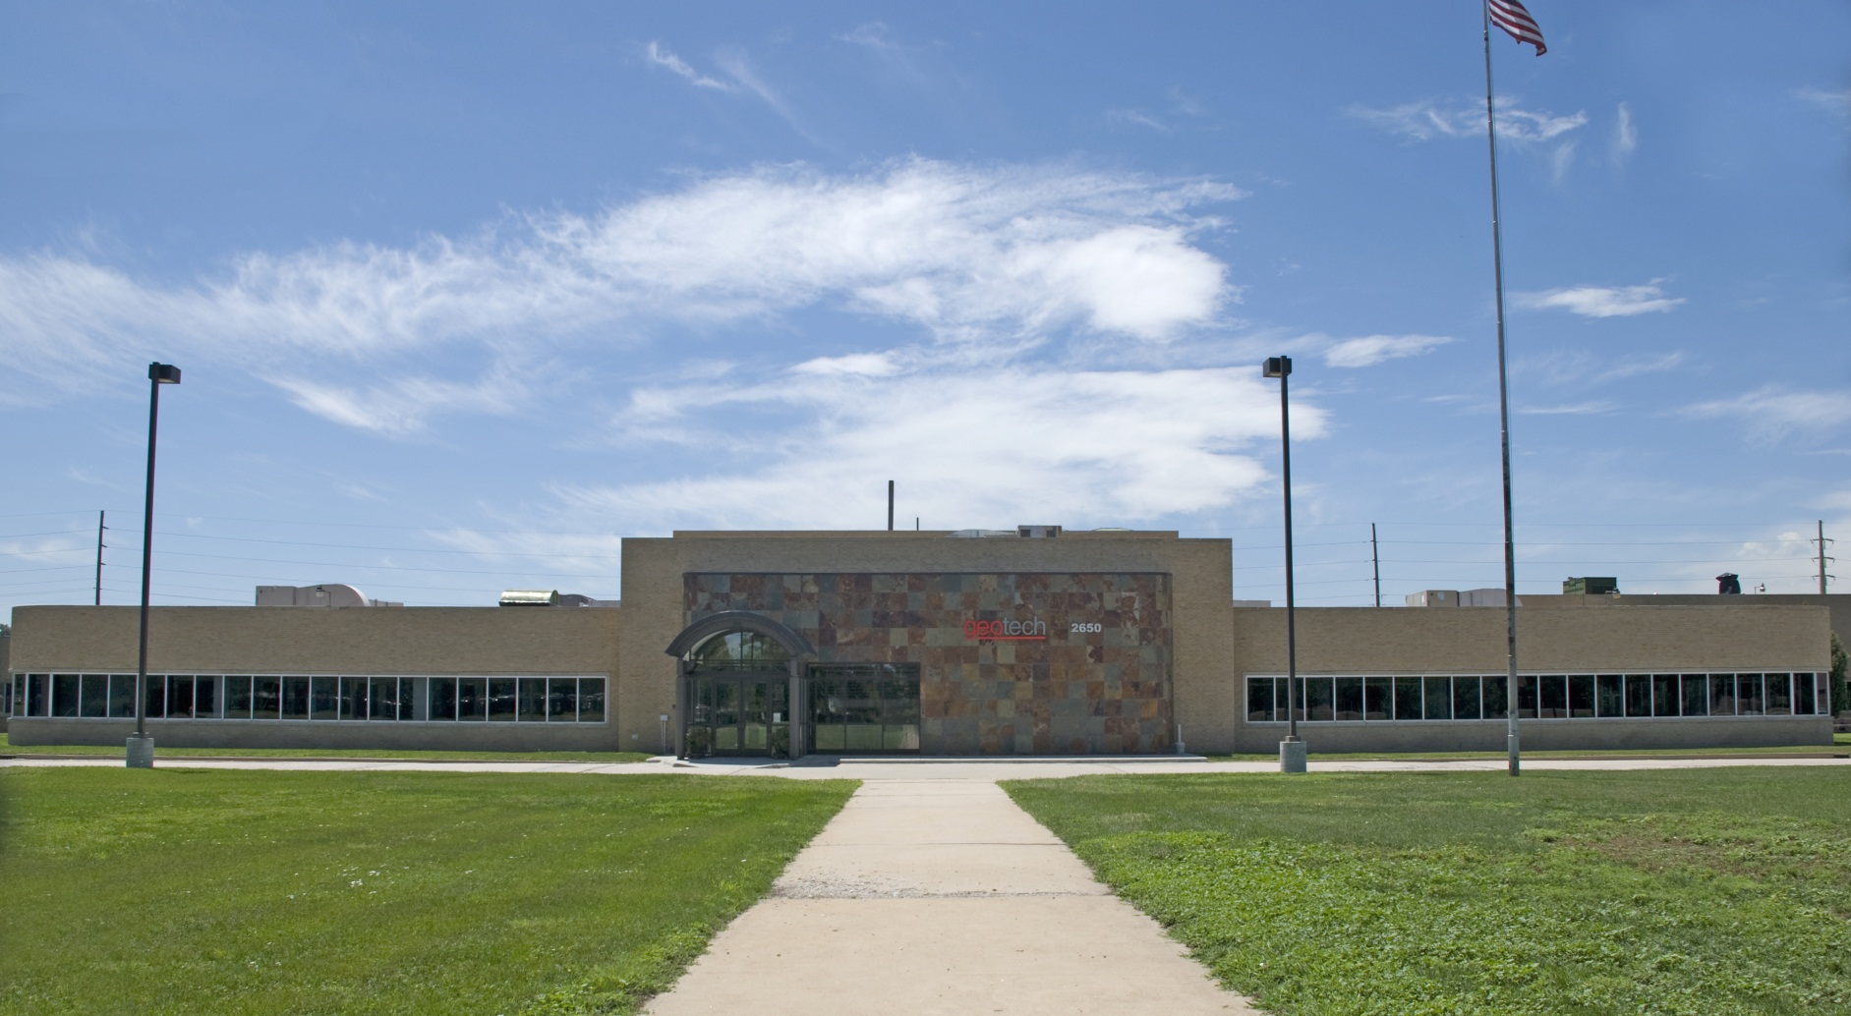
Geotech Corporate Headquarters Denver, Colorado USA
…a world leader in environmental technology, manufacturing and product training since 1978.
www.GeotechEnv.com

Slide 5
Defining the Problem
“If I had one hour to save the world I would spend fifty-five minutes defining the problem and only five minutes finding the solution.”
Notes:
Charles Kettering, the famed inventor and head of research for GM, said “a problem well-stated is half-solved.”

Slide 6
Problem #10 Mineral Build-up
Builds up on air stripper, pumps, well screen, etc. components and pipes
Builds up on electrodes in pump controllers
Shuts off the system
Inhibits conduction
Notes:
For example, Fenton’s Reagant may not be ideal for groundwater with high concentrations of carbonate. The carbonate ion preferentially scavenges the hydroxyl radicals created by Fenton’s Reagant reactions before they have a chance to react with the petroleum contaminants. By contrast, the presence of carbonate minerals in the geologic matrix has generally positive effects on permanganate oxidation.

Slide 7
Recommendation Managing Mineral Build-Up
Upfront laboratory analysis of soil chemistry
Upfront laboratory analysis of water chemistry
Minimize aeration of liquids
Where build-up is anticipated, design in cleanouts for easy maintenance - Cannot really prevent.
Design and budget in for chemical additives to the process stream such as sequestering agents
Plan and budget for system maintenance
Based on costs associated – may need to consider alternate technology

Slide 8
Problem #9 Temperature Issues on Equipment and Operation
Increased temperature can cause increased TDS – Mineral Precipitation
pH probes will freeze and break when too cold
Pumps will freeze and break when too cold
Water discharge lines freeze and shut down operations
If water sampling equipment is not completely purged and dried it can freeze and break, especially in shipment
Hydrocarbon viscosities change and become more or less viscous
PID lamps fog up when moved from warm to cold
FID’s have problems lighting in cold or windy environments
Heat can be problematic, causing equipment to overheat, fail and even be ruined
Temperature affects Henry’s Law Constant (H) {ratio of vapor pressure to aqueous solubility} because it makes contaminants that have an affinity to partition into the vapor phase from the dissolved phase
Notes:
SDFS pumps pulled for cleaning. Didn’t finish work. Left pumps on ground, froze, split water jackets on WTDP. Very expensive mistake.
Uninsulated product lines froze up on a solar sipper. Easy fix was to apply inexpensive pipe insulation to extend cold temperature operating time.

Slide 9
Recommendation Temperature Consideration for the Project -during the entire year
Understand your site characteristics, including temperature; anticipate seasonal variances
Know your equipment’s operating parameters regarding temperature specifications – electronics are heat sensitive
Heat trace water discharge lines where possible
Install water conduit piping below frost line and micro seeps for frost protection from cold ambient air conditions
Provide proper ventilation in equipment sheds
Store equipment in a heated or cooled area, depending on conditions
Don’t leave meters or pumps in sheds or work vehicles if freezing or high temperature conditions are anticipated
Ship equipment with “do not freeze” or empty water from cavities if possible
Consider operating equipment for only part of the year if ability to control temperature within equipment operating range is not feasible economically feasible
Notes:
- Installed controls on south side of shed. Painted black surrounded by black top. Should paint white or light color or install on north side of shed. Had to move controls to north side to prevent over-heating.

Slide 10
Problem #8 Hydrocarbon Viscosity limits or prohibits effective LNAPL/DNAPL Recovery
Hydrocarbon recovery not taking place or inefficient
Viscosity caused low to no flow into recovery well
LNAPL /DNAPL too viscous for equipment to recover
Product characteristics unknown or not considered in equipment purchase
Product viscosity tested at room temperature or worse, at surface temperature in sun
Much less viscous than at actual groundwater temperature
Seasonal temperature changed LNAPL viscosity
Using in-situ GW/Soil heat enhancement excludes electric pumps- (electric pumps are heat limited)
Notes:
Example of Chevron refinery in San Pedro
Crude Oil like shellac
Problem pulling the pump out of the ground
Maintenance
Safety
Fuel Oil/Bunker C
Viscosity of coal tar (used to be used for locomotives)
Solid at 50° F
Gelatinous

Slide 11
Example
Bunker C, #6 Fuel, Creosote are typically too viscous for most pumping systems to operate consistently. Additionally, sensors get coated and can no longer differentiate between water/product. Any “sticky” oil IE: high paraffin, etc. regardless of viscosity can create same problems.
Oleophilic/Hydrophobic Screen technology not functional
New Bio fuels change hydrocarbon characteristics

Slide 12
Recommendations Viscosity Testing
Determine viscosity (and spG) of contaminant to establish best possible equipment for the job
Be sure to confirm actual conditions on-site viscosity numbers from MSDS sheets at 104° F are not realistic when typical GW temperatures are between 50 ° F to 70 ° F
If considering oleophilic/hydrophilic technology for recovery – use Geotech Viscosity Test Kit determine functionality

Slide 13
Problem#7 Elevation Limiting Equipment Capabilities
Air flow required -too low
Vacuum/Pressure required- too low
Electrical motors overheating
Equipment undersized
CFM readings don’t match
Units of measurement – not understood
IE: Altitude not considered

Slide 14
Example Tampa vs. Denver
Tampa - calculated at Sea Level
Temp 68° F
Air pressure 14.7 PSIA
0% RH
100 ACFM (actual CFM)
100 SCFM (standard CFM same as actual at standard conditions)
Denver-calculated at 5,280’
Temp 68° F
Air pressure 12.2 PSIA
0% RH
82 ACFM
100 SCFM
18% difference

Slide 15
Establish CFM CFM is CFM ?
CFM
Standard Cubic Feet per Minute (SCFM): determines the weight of air to fixed or “Standard” conditions
At sea level
14,696 pounds per square Inch (psia)
60 degrees Fahrenheit (°F)
0% relative humidity
Actual Cubic Feet per Minute (ACFM):
Depends on
Pressure
Temperature
Humidity
Usually measured at blower discharge
Inlet Cubic Feet per Minute (ICFM):
Usually measured at blower inlet -When air passes through the filter there will be a pressure drop.

Slide 16
Electric motors need to be de-rated over 3300 FTASL
motors are air cooled – higher elevation = less oxygen therefore less cooling ability same as over-amping when temperature is too high
Consider 3% per every 1000 Foot

Slide 17
Problem #6 GW Pump does not provide anticipated GPM (flow rate) when well recharges as expected
Flow rate is a trickle of what is necessary
Need to replace pump sooner than expected?

Slide 18
Recommendations
Perform pumping test to verify well recharge (GPM to size flow rate of pump)
Calculate for Total Dynamic Head TDH (Pressure Drop)
Include:
Diameter and type of discharge line
Horizontal rises
Vertical length
Fittings: Elbows, Valves, Gauges, etc.
Pressurized trunk line ?

Slide 19
Problem #5 Hydrocarbon Recovery Equipment is inefficient and inconsistent due to product in the well appearing and disappearing caused by:
Water Table Fluctuating
Seasonal
Rain events
Droughts
Tidal influences
Notes:
Example:
Jamaica Bay:
New York tidal influence swamped Small Diameter Filter Scavenger
Different crew on day and night shifts
Perplexed why no product was recovered at night
Low tide would leave the SDFS hanging dry
Several night shifts fired.
Arkansas:
Wells drilled to depth based on seasonal high water.
No water in well half of the year.

Slide 20
Example 2
Dual Pump system at a site with water table fluctuations. Water pump was allowed to cycle on/off based on hi/lo probe that had 1 foot of travel- required resetting of the pump in the well so the desired water drawdown was in middle of probe travel along with adjusting the discharge valve so that the pump rate matched the recharge rate.

Slide 21
Recommendations
Gather data on GW levels throughout an entire year taking seasonal variations in consideration
Keep the water table at a steady drawdown level allowing more product to enter the well and be recovered - need to control water table by pumping water
Periodic well treatment may be required -More regular maintenance
Smear zone and additional mineral precipitation reduce product recovery recharge rate from pore plugging and well casing plugging
May have to change technology to remediate vadose zone vs. capillary fringe or saturated zone or combination of technologies

Slide 22
Problem #4 Salt Water Intrusion
Hydrocarbon recovery equipment and pumps corroded in recovery well. Equipment failed resulting in increased equipment expense and extended clean up time
Salt water intrusion from nearby body of salt water was not anticipated
Notes:
- Borescope for good hydrogeology

Slide 23
Example
Inconclusive results from sample findings occurred when the pumping test is not of a long enough time period to result in true results of water migration into the well bore from a close proximity salt water body of water.
Saltwater /Brackish water can lead to corrosion of equipment when materials of compatibility for salt water applications are not taken into consideration

Slide 24
Problem #3: Unable to Contain and Capture COC Plume

Slide 25
Examples
Monitor wells utilized instead of properly developed recovery wells
Remediation equipment options are limited to well casing size: Cannot reach the deep water table because what fits in a small well won’t pump at high enough capacity
Product recharge rates calculated based on pump test on entire well, not just on product layer thickness. Separate hydrocarbon bail down test required to determine recharge of product only when a ground water extraction pump is utilized to enhance product recovery .
Typical ratios of 10-1 to 100 -1 GW recharge to hydrocarbon recharge

Slide 26
Recommendations
Monitoring Well Placement
Properly locate enough wells necessary for future determination of plume extent
Can be used as a guideline for placement of recovery wells
Use of down hole cameras allow for more accurate representation of groundwater flow and direction (Boroscope)

Slide 27
Basic Well Design and Installation Tips
Wells are unique depending on the hydrogeological, geographical and contaminant-related conditions.
Use appropriate well screen and materials for geology and contaminant characteristics and properly develop wells for recovery.
Monitor wells are not properly developed and typically perform poorly for remediation.

Slide 28
Problem #2 Lack of Thorough Pilot Tests
Cause :
Requiring assumptions made based on similar sites which may or may not be valid
Inconclusive , inaccurate or improper data
Under sizing or Over sizing Equipment -doesn’t allow for accurate readings IE: Not enough flow/pressure or vacuum capabilities for actual geologic conditions “Assume the worse- hope for the best”

Slide 30
#1 Site Characterization
Budget restrictions are probably the biggest factor in limiting proper site characterization
Proper analysis – the right test for the right contaminants of concern (COC)
Full Lab Analysis of water and soil(organics and inorganics)
Viscosity tests for free phase hydrocarbons
Delineation of Contaminant Plume = Amount of contaminant expected to be remediated

Slide 31
Site Characterization
Proper site characterization leads to:
-Determining the correct type of remediation technology
-Speeds up site closure
-Saves money

Slide 32
Summary
Planning will save money in the long-run
Be prepared to change your plans based on accumulating site data. Don’t write yourself into a corner.

Slide 33
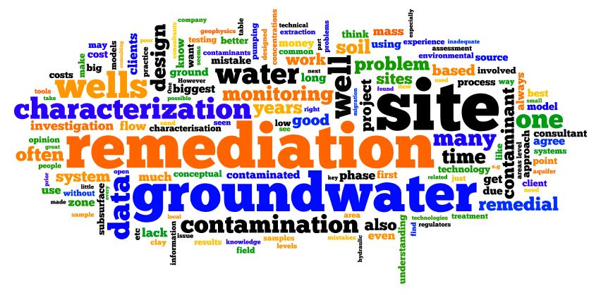
Notes:
This is a word cloud; a visual representation of the results from our informal survey. The size of the words indicates the importance in the conversation.

