Slide 1
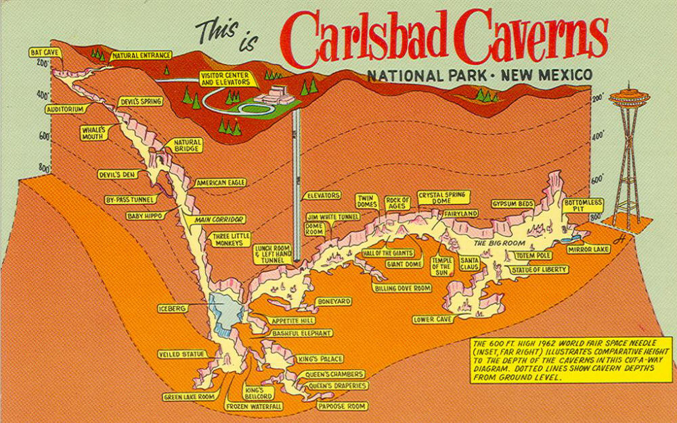
Are There Holes Below Us?
Assessment of Prospective Flowback Water Storage Sites for the Presence of Shallow Karst
J. B. Fisher and Blake Redden
Lithochimeia, LLC
601 S. Boulder Suite 800
Tulsa, OK
λχ
Notes:
Assessment of Prospective Flowback Water Storage Sites for the Presence of Shallow Karst

Slide 3
Karst

Slide 4
Karst – You’re Living on It
About 25% of the Land Area of the United States is Underlain by Karst or Pseudokarst

Slide 5
Karst Evolution

Slide 8
Collapse of Karst is a Significant Geological Hazard to Surface Structures

Slide 9
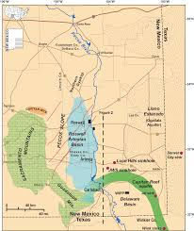
The JWS Sinkhole in Eddy County, New Mexico is over 300 feet across. Caused by deep brine mining of a salt deposit.

Slide 10
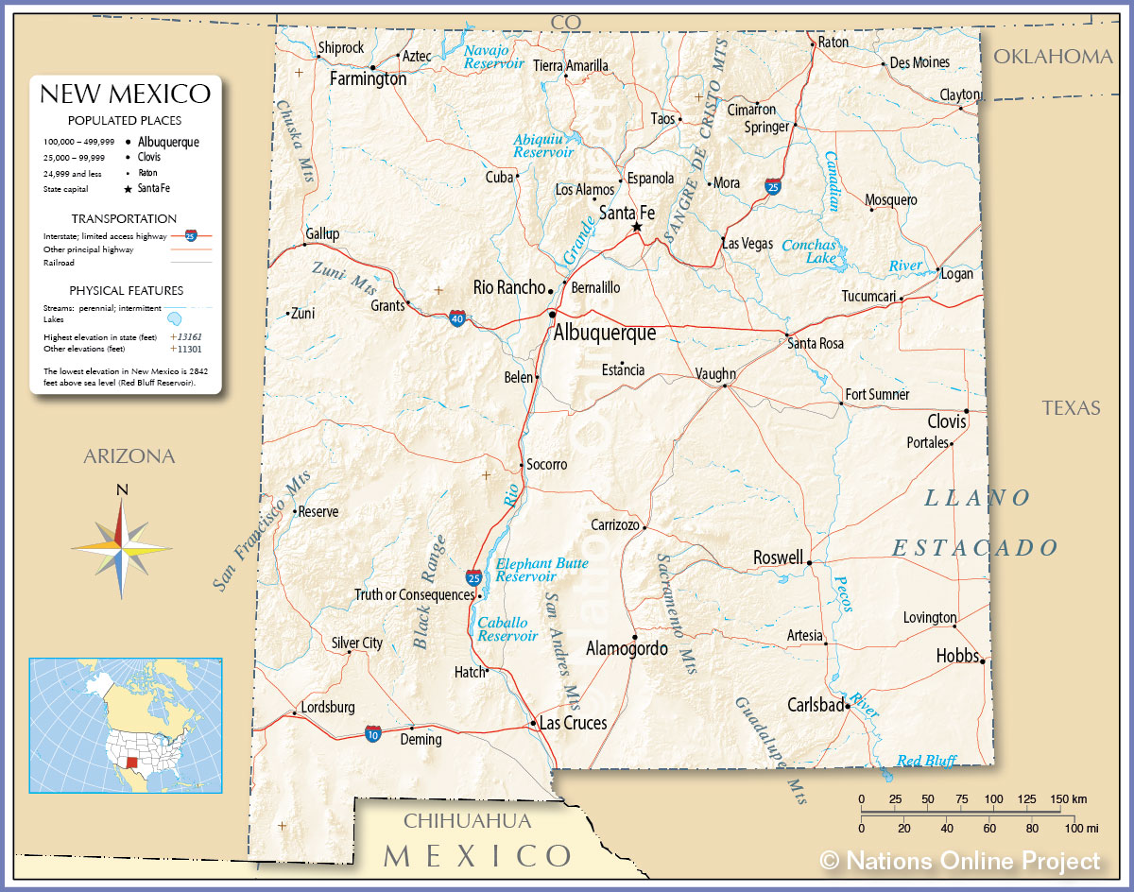
Unstable Area
“Unstable area” means a location that is susceptible to natural or human-induced events or forces capable of impairing the integrity of some or all of a division-approved facility’s structural components.
New Mexico Administrative Code 19.15.2.7 DEFINITIONS: U (6)

Slide 11
Unstable Area
Examples of unstable areas are areas of poor foundation conditions, areas susceptible to mass earth movements and karst terrain areas where karst topography is developed as a result of dissolution of limestone, dolomite or other soluble rock. Characteristic physiographic features of karst terrain include sinkholes, sinking streams, caves, large springs and blind valleys.
New Mexico Administrative Code 19.15.2.7 DEFINITIONS: U (6)

Slide 12
In an unstable area cannot build ---
Temporary pit containing low chloride fluid,
Temporary pit containing fluids that are not low chloride fluids
Permanent pit or multi-well fluid management pit:
Burial trenches
Surface waste management facility.
New Mexico Administrative Code 19.15.17.10 SITING REQUIREMENTS
Notes:
An operator shall not locate a temporary pit containing low chloride fluid:
within an unstable area, unless a variance is granted upon a demonstration that the operator has incorporated engineering measures into the design to ensure that the temporary pit's integrity is not compromised
An operator shall not locate a temporary pit containing fluids that are not low chloride fluids:
within an unstable area, unless the operator demonstrates that it has incorporated engineering measures into the design to ensure that the onsite closure method will prevent contamination of fresh water and protect public health and the environment….
An operator shall not locate a permanent pit or multi-well fluid management pit:
will not compromise subsurface integrity; (h) within an unstable area, unless the operator demonstrates that it has incorporated engineering measures into the design to ensure that the pit's integrity is not compromised;
An operator shall not implement trench or in-place closure:
within an unstable area, unless the operator demonstrates that it has incorporated engineering measures into the design to ensure that the onsite closure method will prevent contamination of fresh water and protect public health and the environment
No surface waste management facility shall be located:
within an unstable area, unless the operator demonstrates that engineering measures have been incorporated into the surface waste management facility design to ensure that the surface waste management facility’s integrity will not be compromised.
Application for exploration and development plan. An operator applying for approval of an exploration and development plan shall file two copies of the application with the division’s Santa Fe office and file a copy of the application with the appropriate division district office or offices. The application shall include:
a map or maps of the area to be covered by the proposed exploration and development plan and one half mile beyond the boundary of that area plotting the following, with global positioning system coordinates to the sixth decimal point for un-surveyed areas:
watercourses, sinkholes, playas and unstable areas;

Slide 13
UNLESS
Operator has incorporated engineering measures into the design to ensure that subsurface integrity is not compromised, that freshwater will not be contaminated, and that public health and safety and the environment are protected.
New Mexico Administrative Code 19.15.17.10 SITING REQUIREMENTS

Slide 14
Types of Sinkholes & Sinkhole Collapse
Notes:
Sinks (closed depressions) and sinkholes develop in areas underlain by limestone bedrock. The conduits that facilitate subsurface soil movement and surface sinkhole formation are erratic and often too random to be mapped by test boring programs alone. Geophysics provides a density of data unobtainable by other methods and can be used to fill-in between existing borings or to screen larger areas to identify anomalous areas that warrant investigation by test borings or wells.

Slide 15
Large Water Pit ~ 14 Miles NW of Jal, NM

Slide 16
Large Water Pit ~ 14 Miles NW of Jal, NM
JWS Sinkhole

Slide 17
Looking for Sinkholes
Topography
Vegetation
Borings
Geophysical
Gravity
Seismic
GPR
Resistivity
Electromagnetic

Slide 18
Resistivity Survey a/k/a Electrical Resistivity Imaging & Resistivity tomography
Depth of investigation
Controlled by
“Spread” of electrode array (10-20% of spread)
Data acquisition protocol
Electrical properties of media
Available energy
Size of target
Resolution controlled by electrode spacing
Cannot “see” anything with dimensions less than ~½ electrode spacing
Resistivity contrast of target(s)
Notes:
Electrical resistivity surveying methods have been widely used to determine the thickness and resistivity of layered media for the multiple purposes.

Slide 19
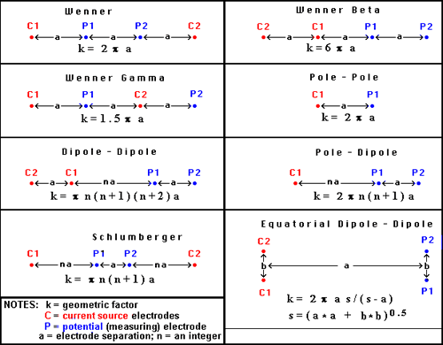
Resistivity Theory of Operation
Wenner Array

Slide 20
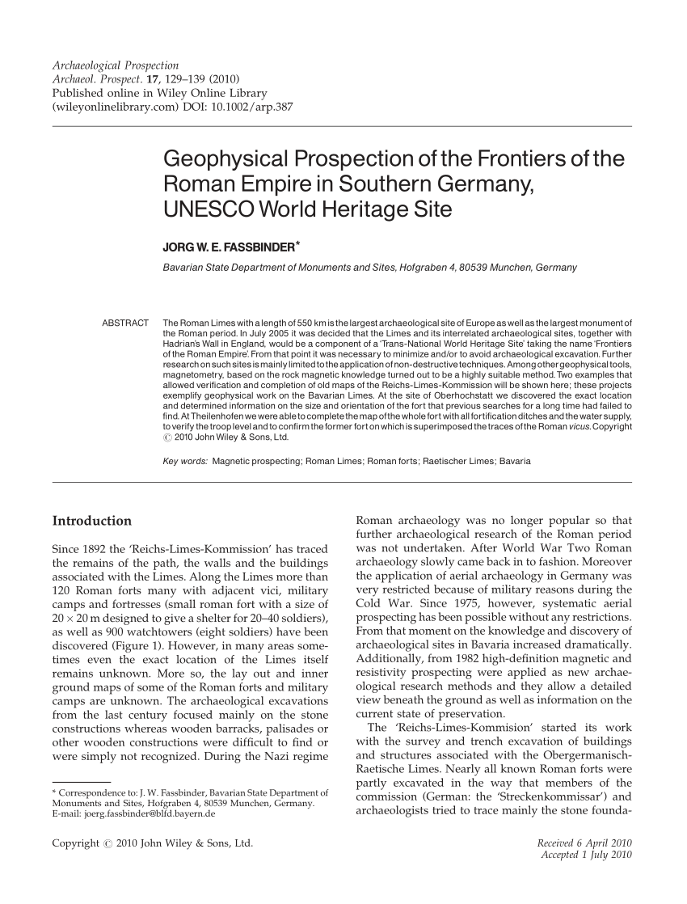
Resistivity survey of the Roman castle Ruffenhofen, Bavaria

Slide 21
Resistivity and Microgravity Survey
Notes:
A combined resistivity tomography and microgravity survey was carried out along a proposed highway route that traversed an area with known solution features.

Slide 22
Resistivity pseudosection of cave's cavity

Slide 23
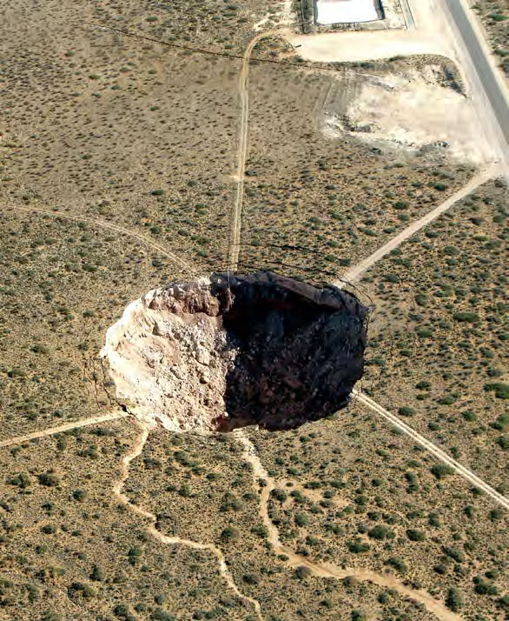
Resistivity section over JWS sinkhole

Slide 24
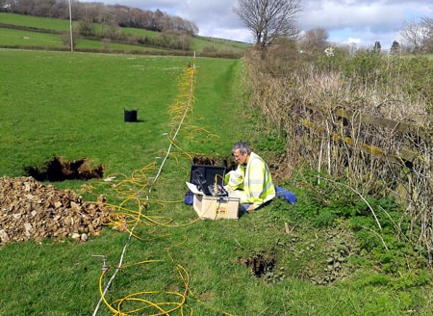
Resistivity Survey
Advantages
Disadvantages
Good vertical resolution; 2D & 3D imaging possible
Can generate virtual logs and horizon slices
Simple operation with modern multi-electrode systems
Can sound great to depths of hundreds of meters with additional energy inputs
Cumbersome and slow to deploy – best deployed with a crew of 3 to 4 people (can be done with 2 people)
Slow data acquisition
Data acquisition time variable; depends on acquisition protocol, local geology and surface conditions; can be an hour or more
Electrode arrays must be moved multiple times to produce a 3D image (or you need a lot of electrode cable)
Lots of great data
Takes a while to get it

Slide 25
Electromagnetic Induction Survey (Terrain Conductivity Survey)
Frequency Domain Survey
Depth of Investigation (generally fixed and shallow)
Controlled by Tx ⇨ Rx distance & Tx frequency
Most commercial instruments have a fixed Tx ⇨ Rx distance & operate at a single frequency
Electrical properties of media
Size of target
Resolution controlled by traverse spacing
Cannot “see” anything smaller than ~ ½ traverse spacing
Conductivity contrast of target(s)
EM-31 – depth of investigation ~ 20-ft

Slide 26
Electromagnetic Induction Survey Theory of Operation

Slide 27
Electromagnetic Induction Survey Theory of Operation

Slide 28
Notes:
Caverns and fissures within bedrock are often more difficult to target.
Size and depth are important considerations when deciding on the most suitable geophysical technique.
Micro-gravity is the most suitable method however, it may also be the most costly.

Slide 29
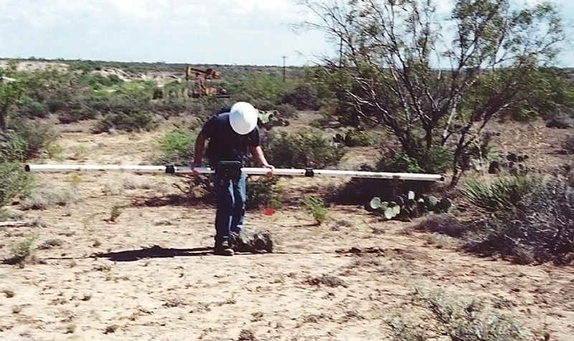
Resistivity Survey
Advantages
Disadvantages
Very fast data acquisition – in some instances can be mechanized – can be airborne; on foot anticipate 1-m/second speed over smooth ground
Very simple operation if system uses coordinated sub-meter GPS and data acquisition
No vertical resolution; only 2D (surface) images can be generated
Depth of investigation fixed by instrument – typically no more than ~20 ft with most commonly used instrument
Can be difficult to advance over heavily vegetated site or difficult topography
Data processing may require extensive filtering if there is conductive infrastructure; unusable data on some developed sites
Lots of great data FAST!
You only know about the near surface

Slide 30
New Mexico Flowback Facility Investigation

Slide 31
Full Site 1,200-ft x 2,500-ft

Slide 33
Actual Survey Area 927-ft x 910-ft
EM-31
8 miles of traverse
~ 40-ft spacing
~ 84,000 data points
2-men – 7 hours

Slide 34
Brighter colors indicate higher terrain conductivity

Slide 36
Questions ?

