Slide 1
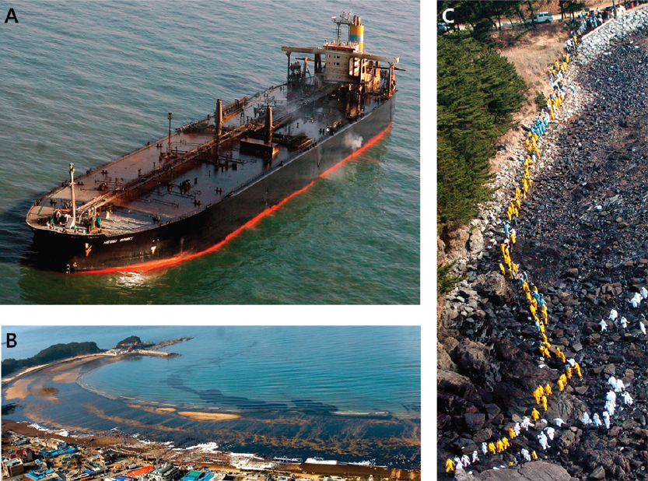
Advances in oil spill forensic using biomarkers and isotope ratio technique.
Harry Behzadi, Ph.D
VP of Business Development North America

Slide 2
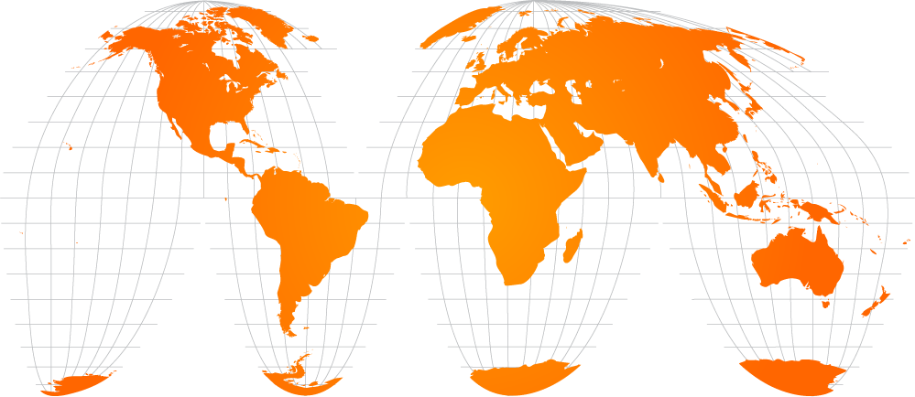
OUR NETWORK GLOBAL REACH WITH LOCAL SERVICE
EUROPE , AFRICA & MIDDLE EAST
1,150 Offices & Laboratories
36,900 Employees
AMERICAS
450 Offices & Laboratories
21,600 Employees
ASIA PACIFIC
400 Offices &
Laboratories
31,500 Employees
90 000¹ EMPLOYEES AND 2 000 OFFICES & LABORATORIES AROUND THE GLOBE ENABLING REACH AND LOCAL SUPPORT
1. Average number of employees in 2016.

Slide 3
Principles and Goal
Environmental forensics is the systematic and scientific evaluation of physical, chemical, and historical information for the purpose of developing defensible scientific and legal conclusions regarding the source or age of a contaminant released into the environment.” (Introduction to Environmental Forensics by R.D. Murphy & J.R. Morrison)
Identifying the unknown, Allocation of sources – provide scientific evidence to link the source to a contaminant in order to help for compensation for economic losses and environmental damage

Slide 4
Environmental Liability
Cause of action is bedrock of environmental litigation
Case alleging environmental contamination must involve a thorough understanding of the science behind the allegations, including the laboratory and statistical methods employed by experts when formulating conclusions about causation or damages.
Much like traditional fingerprint matching done by law enforcement officers to identify an individual, chemical fingerprinting relies heavily on statistics and probabilities to arrive at a measure of the likelihood that a pollutant came, or did not come, from a particular source.
most environmental forensic techniques can allow lawyers to definitively rule out a particular source of contamination, but they cannot affirmatively prove the source of contamination beyond all doubt.
Notes:
Cause of action: set of facts sufficient to justify a righto sue to obtain money.

Slide 5
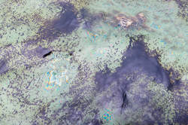
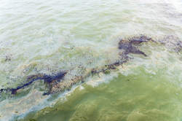
Environmental Liability
More recent cases have recognized stable isotope analysis as a mainstream analytical technique and accepted environmental forensic evidence based on stable isotope analysis as definitive evidence.
The United States EPA recognizes the utility of stable isotope analysis, and says that “[s]table isotope analysis can be used in ecological studies to trace chemical movement through the environment. “
(https://www.epa.gov/eco-research/stable-isotope-mixing-modelspublications, last accessed, April 2, 2017).

Slide 6
Chemistry of Oil
Notes:
Petroleum is family of chemicals both naturally and man made contain up to 10,000 hydrocarbon and non hydrocarbon.

Slide 7
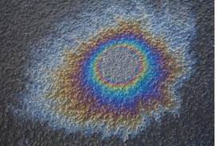
Process
Tiered approach to characterization
Fingerprinting and comparisons to source oils
GC & GC/MS using a combination of methods
Complex SIM GC/MS & GC/FID analysis
Alkyl PAH’s, Parent PAH’s
PIANO Analysis (environmental) (Paraffins, Iso-paraffins, Aromatics, Naphthenes, Olefins
Biomarkers are naturally occurring and stable hydrocarbons present in crude oils and most petroleum products (complex molecular fossils)
Indicator Compounds for Process determination
Biomarkers (hopanes, steranes, terpanes, sesqui terpanes, cholestanes and triaromatic steroids)

Slide 8
Process
3.0 ISOTOPE RATIO MASS SPECTROMETRY
Carbon isotopic ratio can provide useful information with regard to oil spill and oil field fingerprinting
Combined approach with biomarker methodology (EN 15522) leads to increased confidence in the results
Depending on the samples, GC-C-IRMS may be the only reliable technique for fingerprinting in case of the lack of biomarkers.
Stable carbon isotopic composition (¹³C/¹²C) of oils reflects the physical and biological processes that influence oil formation and refinery, for this reason it can be used as a tool helpful in tracing the source of oil spilled in the environment

Slide 9
Case Study 1
Aim of study: to characterize various samples of crude oils, which originated from different geographical locations
Geographic origin of oil samples
Sample name | Oil field | Location | Sample name | Oil field | Location
NS1 | Clair | Northern North Sea | R1 | Unknown | Algeria
NS2 | Forties | Central North Sea | R2 | Unknown | Unknown
NS3 | Gullfaks | Northern North Sea | R3 | Unknown | Libya
NS4 | Brent | Northern North Sea | R4 | Unknown | Bonny, Nigeria
NS5 | Ekofisk | Central North Sea | R5 | Burun | Turkmenistan
NS6 | Unknown | Southern North Sea | R6 | Oyo | Nigeria
NS7 | Grane | Northern North Sea

Slide 10
BIOMARKERS WITH gc-MS Technique
 | NS1 | NS2 | NS3 | NS4 | NS5 | NS6 | NS7 | R1 | R2 | R3 | R4 | R5 | R6
Terpane (hopane) ratios
%27Ts | 43.8 | 44.7 | 62.6 | 56.9 | 57.6 | 51.8 | 49.2 | - | - | - | 45.0 | 45.4 | 42.0
%28ab | 0.0 | 0.0 | 0.0 | 18.2 | 0.0 | 7.9 | 19.3 | - | - | - | 8.0 | 4.1 | 13.3
%25nor30ab | 43.4 | 16.1 | 0.0 | 18.2 | 0.0 | 8.5 | 16.7 | - | - | - | 7.3 | 2.7 | 5.6
%30O | 0.0 | 0.0 | 0.0 | 0.0 | 0.0 | 0.0 | 0.0 | - | - | - | 50.6 | 4.0 | 70.0
%32abS | 55.8 | 58.1 | 58.1 | 57.7 | 59.2 | 57.6 | 58.3 | - | - | - | 57.9 | 58.2 | 59.2
Sterane and diasterane ratios*
%29aaS | - | - | - | 0.0 | - | 41.4 | - | - | - | - | 50.0 | 40.3 | 38.7
%29bb | - | - | - | 68.6 | - | 20.1 | - | - | - | - | 24.8 | 34.8 | 19.0
%27bbSTER | - | - | - | 41.0 | - | 42.9 | 59.6 | - | - | - | 35.1 | 28.7 | 22.5
%28bbSTER | - | - | - | 27.5 | - | 34.1 | 40.4 | - | - | - | 39.2 | 38.5 | 46.4
%29bbSTER | - | - | - | 31.5 | - | 23.0 | 0.0 | - | - | - | 25.7 | 32.7 | 31.1
Triaromatic steroid hydrocarbon ratios
%TA21 | 33.9 | 18.7 | 35.9 | 25.2 | 33.4 | 21.1 | 26.6 | - | 32.9 | - | 13.3 | 15.6 | 10.0
%TA26 | 42.7 | 36.4 | 30.0 | 26.1 | 36.6 | 39.8 | 32.4 | - | 16.2 | - | 29.7 | 36.4 | 19.9
%TA27 | 48.2 | 55.5 | 53.5 | 51.1 | 51.0 | 51.2 | 49.2 | - | 26.8 | - | 50.0 | 55.7 | 48.6

Slide 11
ENVIRONMENTAL FORENSICS – OIL SPILLS BULK CARBON ISOTOPES WITH EA-IRMS
North Sea oils
δ¹³C of bulk crude oil samples (error bars represent ± 1σ of three repetitions)
Considerable differences in bulk stable carbon isotope ratios were found amongst the analysed oils but some of the oils had a similar bulk carbon isotope ratio e.g. R5 and R6, NS1 and R1 or R3

Slide 12
ENVIRONMENTAL FORENSICS – OIL SPILLS CARBON ISOTOPEs IN n-ALKANES WITH gc-c-IRMS
n-Alkane isotope profiles of North Sea crude oils (error bars ± 1σ
of different n-alkanes in selected oils, n=3)

Slide 13
ENVIRONMENTAL FORENSICS – OIL SPILLS
CARBON ISOTOPEs IN n-ALKANES WITH gc-c-IRMS
n-Alkane isotope profiles of other crude oils (error bars ± 1σ of different n-alkanes in selected oils, n=3)
n-Alkanes isolated from sample R5 are significantly enriched in ¹³C compared to those extracted from sample R6 (despite having similar bulk carbon isotope ratio)

Slide 14
ENVIRONMENTAL FORENSICS – OIL SPILLS DUAL TECHNIQUE APPROACH
Significant differences in carbon isotope ratio were found between most of the analysed oils
Isotope n-alkane profile was helpful in discrimination between some of the oils that had a similar bulk carbon isotope ratio
Samples R1 and R3 – none of the biomarkers were found, and in R2 only one group present
NS3 and NS5, impossible to distinguish using biomarker approach alone

Slide 15
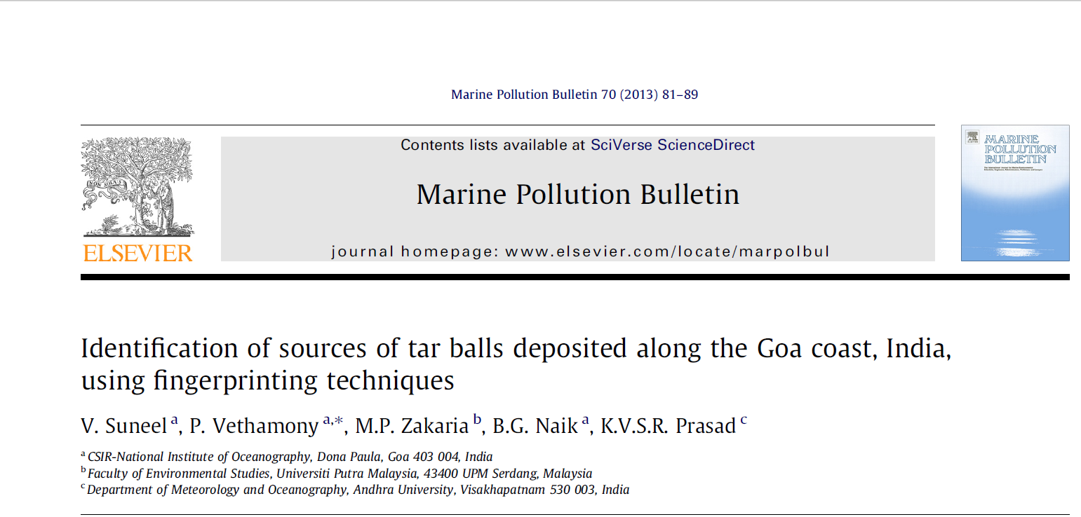
ENVIRONMENTAL FORENSICS – OIL SPILLS
Literature references
Fingerprinting methods used by authors were: individual n-alkanes analysis, isoprenoid hydrocarbons (pristane and phytane), PAHs and biomarkers such as pentacyclic terpanes, additionally stable carbon analyses of n-alkanes were used
3 different crude oils were considered as possible sources of tar balls (South East Asian crude oil (SEACO), Middle East crude oil (MECO) and Bombay High crude oil (BH))

Slide 16
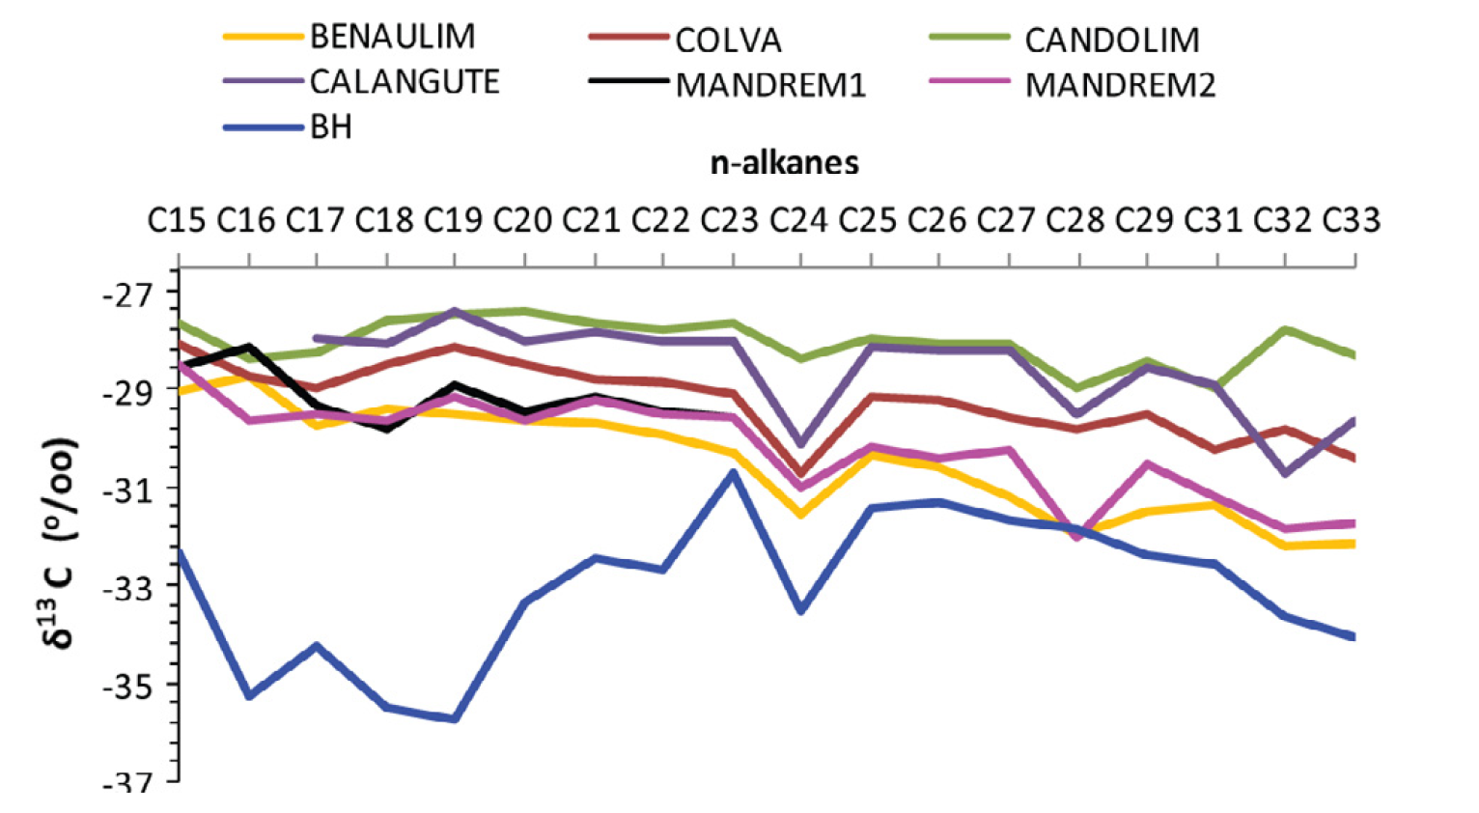
ENVIRONMENTAL FORENSICS – OIL SPILLS
Literature references
RESULTS:
Using biomarker approach, MECO could be excluded as a potential source but results were inconclusive regarding SEACO and BH crude oils
Using stable carbon isotope analysis of n-alkanes in tar balls and BH sample, this crude oil could be excluded as well, thus leaving SEACO as a most probable source

Slide 17
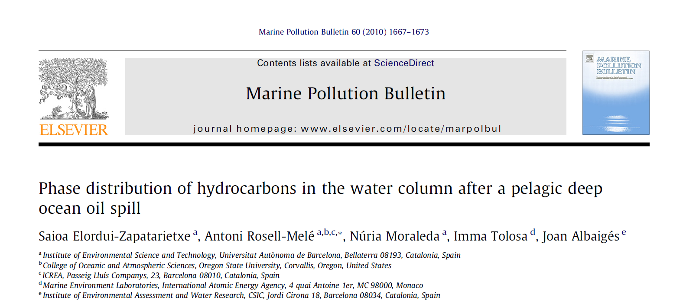
ENVIRONMENTAL FORENSICS – OIL SPILLS
Literature references
Authors sampled oil slicks and tar balls from water above the Prestige oil tanker ship wreck 4 years after the accident
Fingerprinting techniques used were: n-alkane and biomarker indices analysis coupled with stable carbon isotopes analysis of n-alkanes

Slide 18
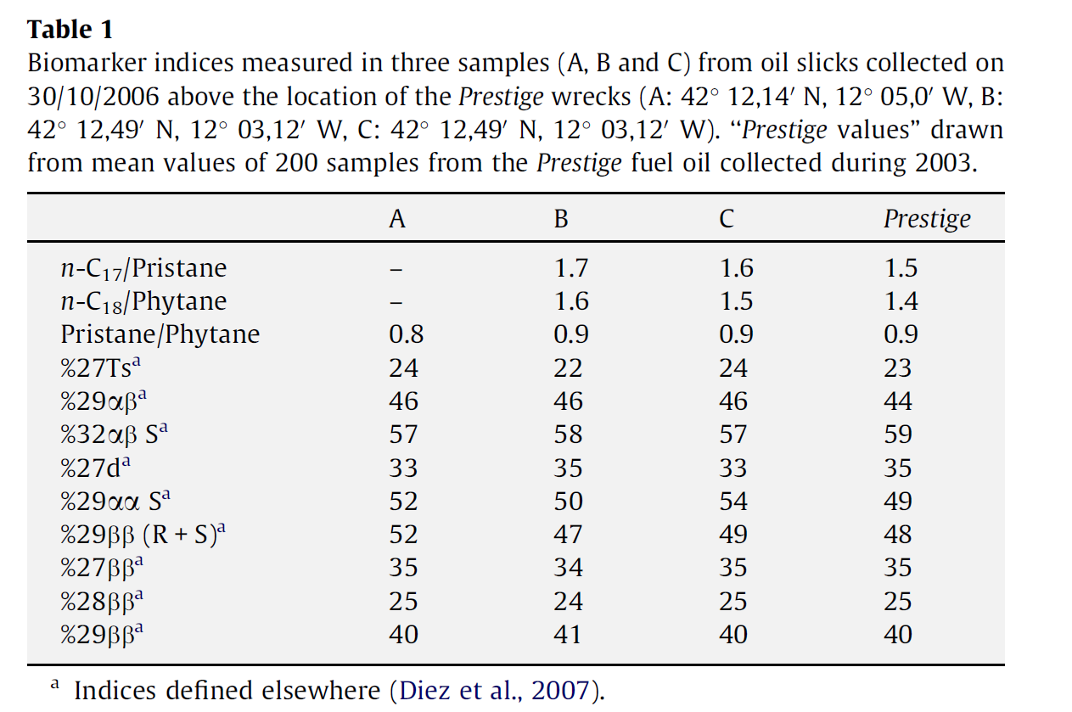
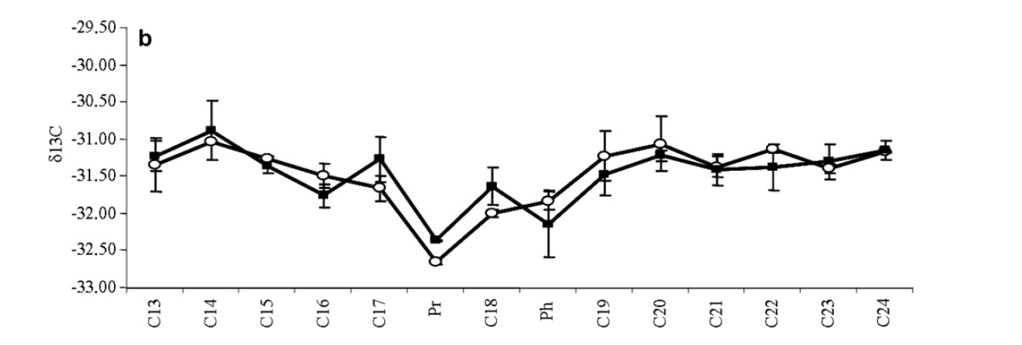
ENVIRONMENTAL FORENSICS – OIL SPILLS
Literature references
RESULTS:
Using n-akanes and biomarker approach as well as stable isotope analysis, the oil slicks were identified as deep sea leaks from the ship wreck despite the sealing of the wreck cracks performed in 2003
Original Prestige fuel oil (sampled in 2003)
Oil slicks
(sampled in 2006)

Slide 19
Environmental forensics – OIL SPILLS
Case study SGS Thailand
Biomarker result: n-alkane distribution plot tar balls

Slide 20
Environmental forensics – OIL SPILLS
Case study SGS Thailand
Biomarker result: n-alkane distribution plot tar balls + sources

Slide 21
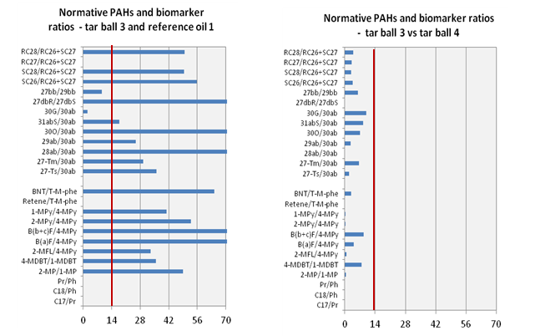
Environmental forensics – OIL SPILLS
Case study SGS Thailand
Biomarker result: Ratio comparison plots
Non-match
Match

Slide 22
Environmental forensics – OIL SPILLS
Case study SGS Thailand
4 tarballs taken from 4 different beaches are compared to 2 possible sources => Exact match between tar balls, non-match with suspected sources

Slide 23
Environmental forensics – OIL SPILLS
Case study 2: SGS Thailand
Biomarker result: n-alkane distribution plot tar balls

Slide 24
Environmental forensics – OIL SPILLS
Case study 2: SGS Thailand
Biomarker result: n-alkane distribution plot tar balls + source

Slide 25
Environmental forensics – OIL SPILLS
Case study 2: SGS Thailand
Biomarker result: Ratio comparison plots
Match
Match

Slide 26
Environmental forensics – OIL SPILLS
Case study 2: SGS Thailand
4 tarballs taken from 4 different beaches are compared to 2 possible sources => Exact match between tar balls and match with the suspected source

Slide 27
SGS OIL GAS CHEMICALS LAB NETWORK
Currently operates 207 labs in 74 countries
37
Eastern Europe and Middle East
27
North America
31 Western Europe
23
Northern, Central
& Southern
Europe
27
North East
Asia
23
Africa
19 South America
20 South Eastern Asia and Pacific
Note: data from Laboratory Excellence System as of 01 February 2017
Notes:
27

