Slide 1
A new tool for Determining subsurface LNAPL Volume and Extent
25TH IPEC: International Petroleum Environmental Conference
October 30 – November 1, 2018 Denver, Colorado
GSI Environmental Inc.
2211 Norfolk St., Suite 1000
Houston, Texas 77098
www.gsi-net.com
Phillip C. de Blanc, Ph.D., P.E.
pcdeblanc@gsi-net.com
Shahla K. Farhat, Ph.D.
skfarhat@gsi-net.com

Slide 2
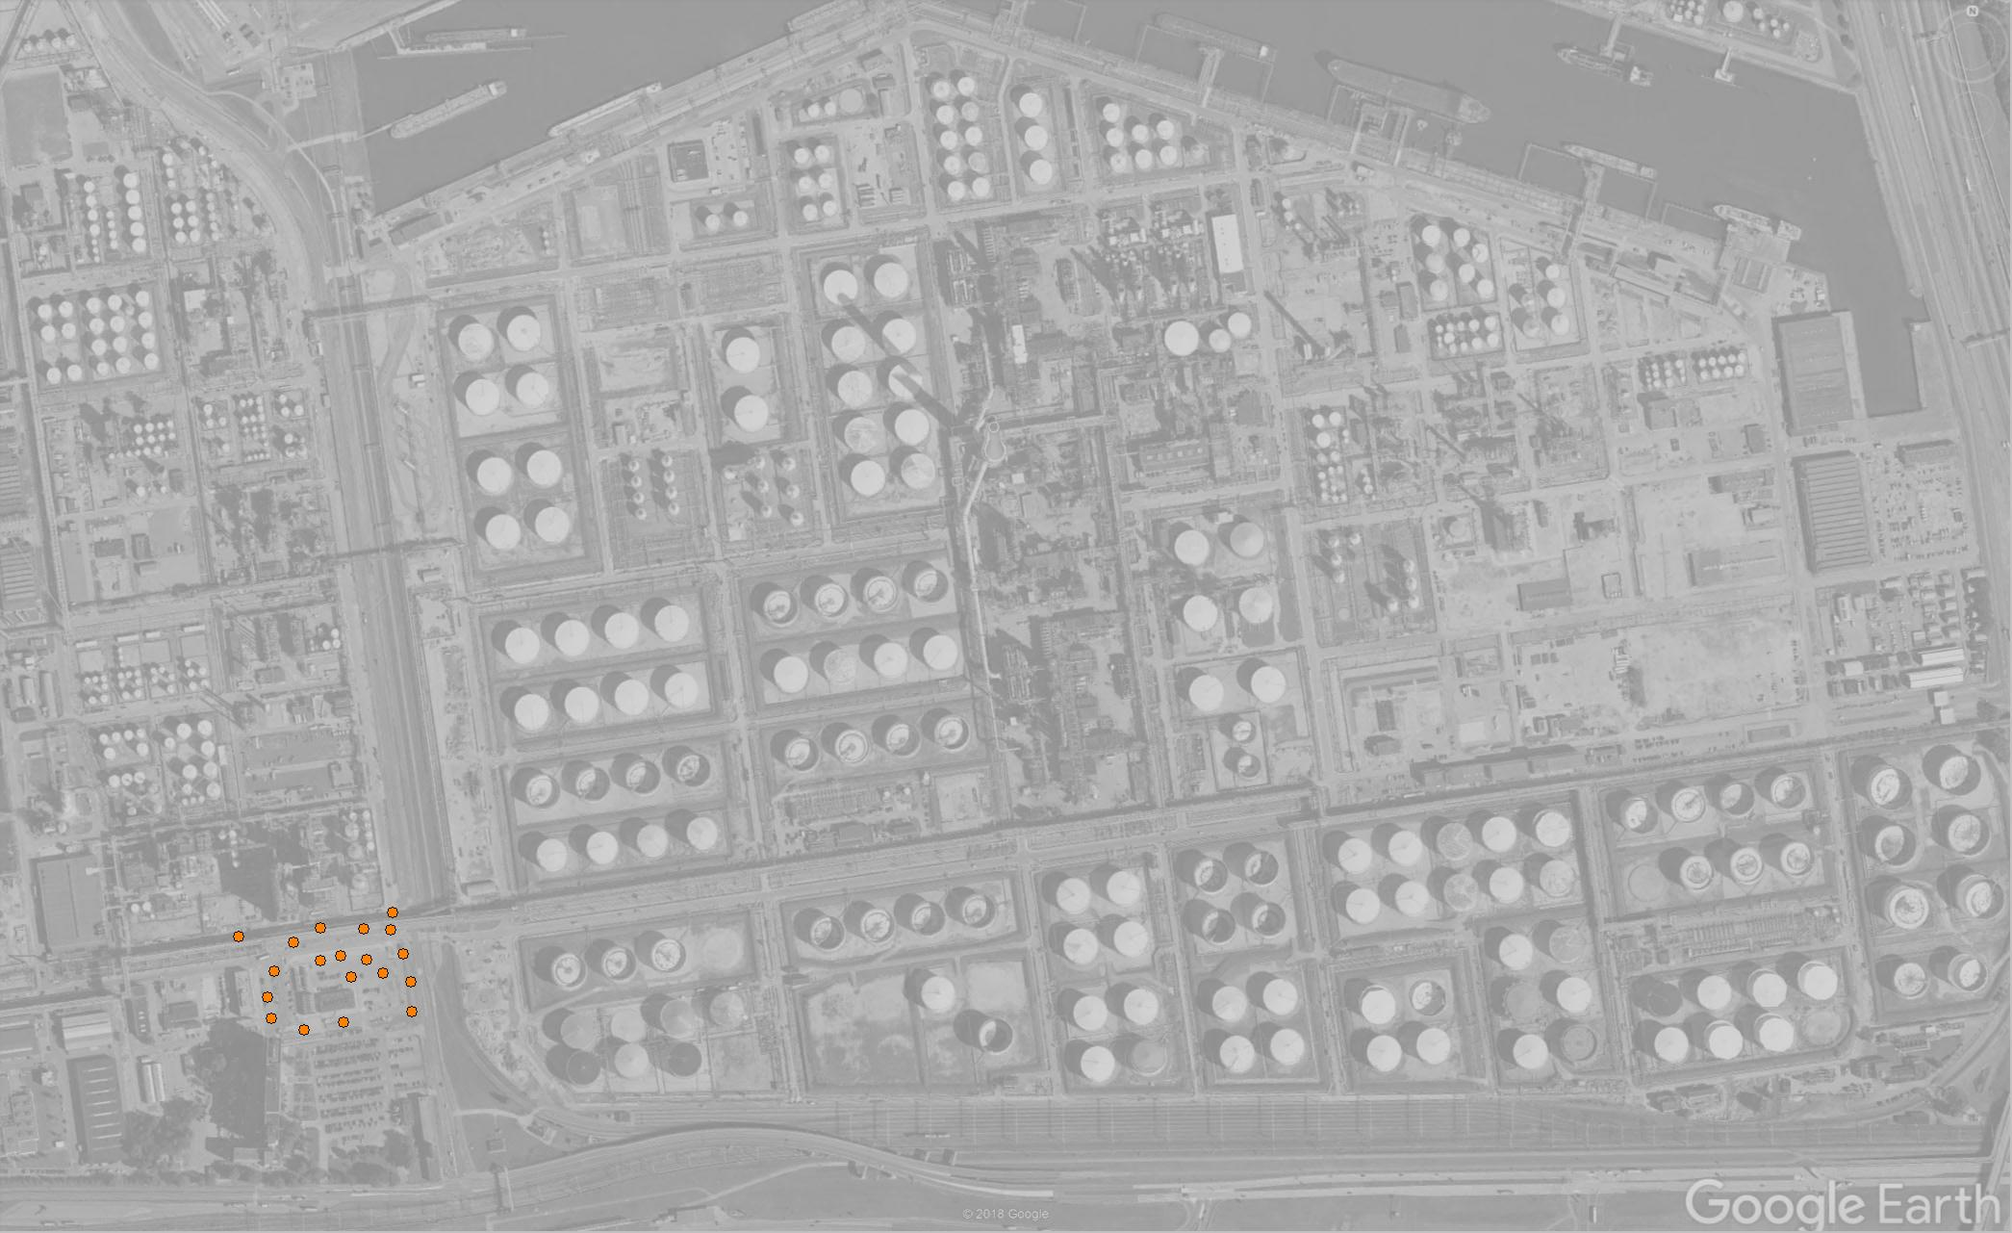
the LNAPL problem…
How much LNAPL is down there?
How much is potentially recoverable by conventional technologies?
If it’s recoverable, where should the recovery wells be located?

Slide 3
LNAPL in formation and a monitoring well
Fraction of
Fluid in Pore Space
Formation
In Well
Oil Water Air
Oil Saturation Curve
0 20 80
5 45 50
Oil/air Interface
60 40 0
bo (apparent
thickness)
30 70 0
Oil/water Interface
10 90 0
0 100 0
0
25
50
75
100
LNAPL Saturation

Slide 4
definition of specific volume
Do: Volume of LNAPL in a formation per unit area.
Do

Slide 5
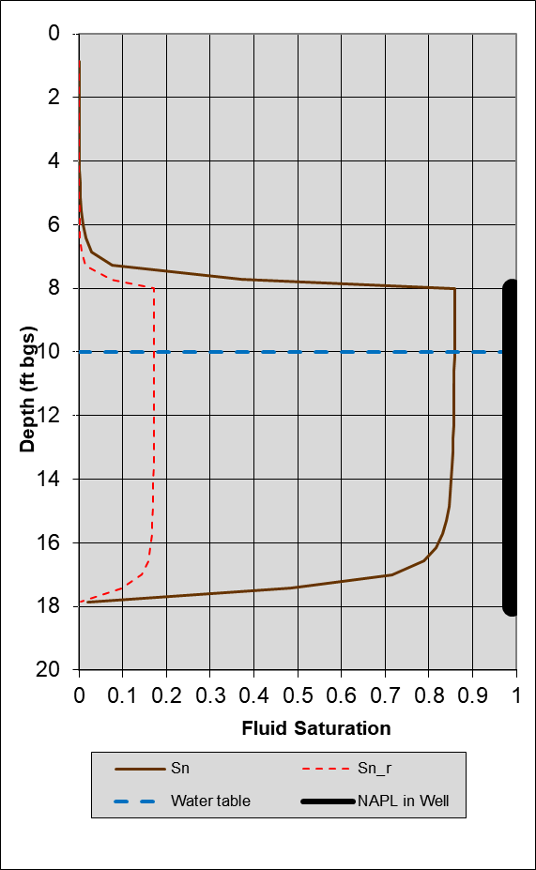
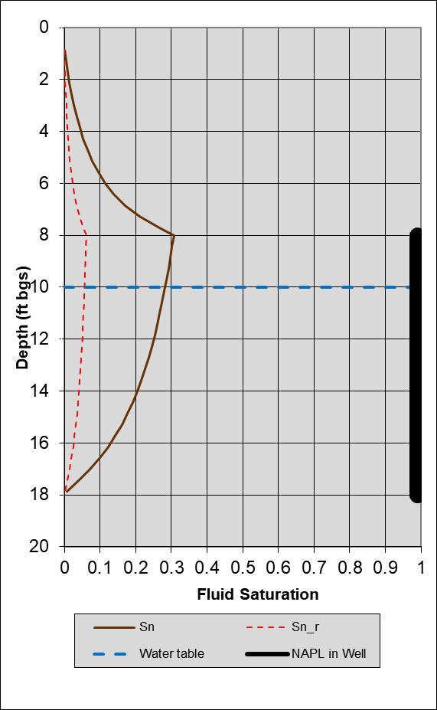
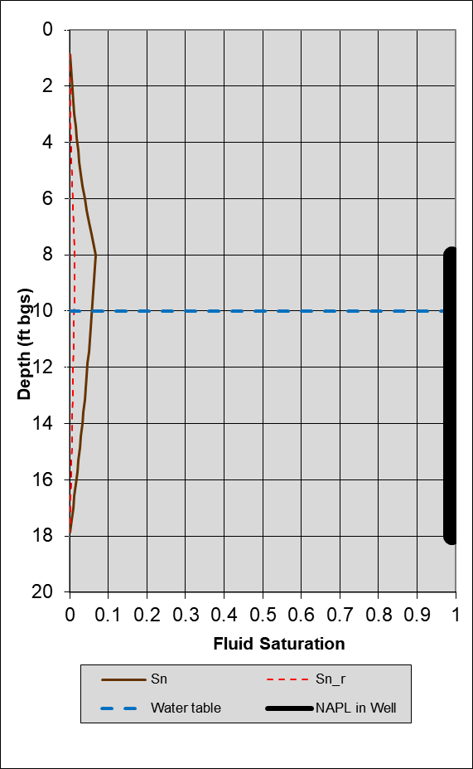
specific volume depends on the soil type
Loamy Sand
Silty Sand
Silty Clay
Residual LNAPL
Mobile LNAPL
☞
Key idea: For the same observed LNAPL thickness in a monitoring well, the volume of LNAPL in the formation depends on the soil type.

Slide 6
Do Calculation - current approach
Calculate specific volume (Do) at each monitoring well
Screen out invalid measurements
Use a tool (e.g., API LDRM) to estimate Do and Tn at each location
Interpolate point estimates of Do using software like GMS, Surfer, etc.
Sum the values within or external to the software to determine total LNAPL volume

Slide 7
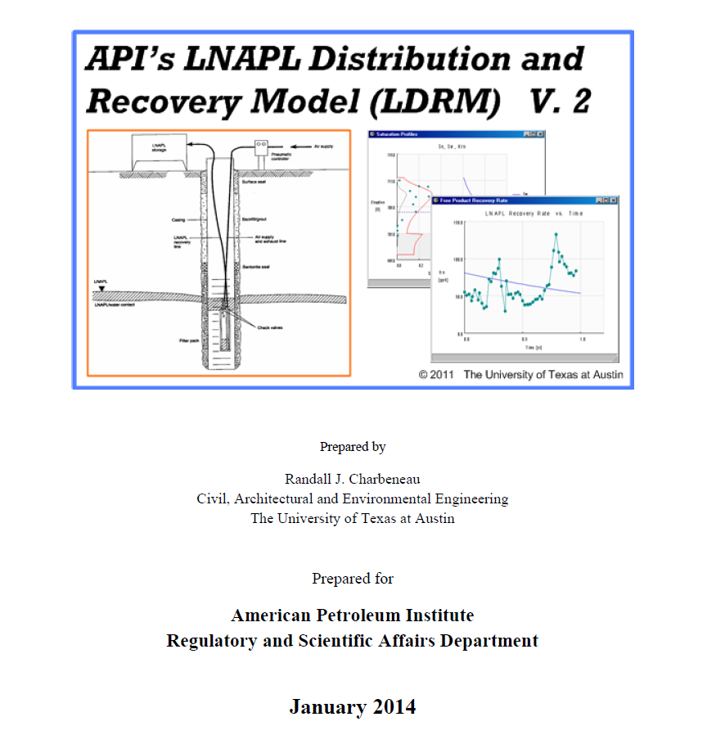
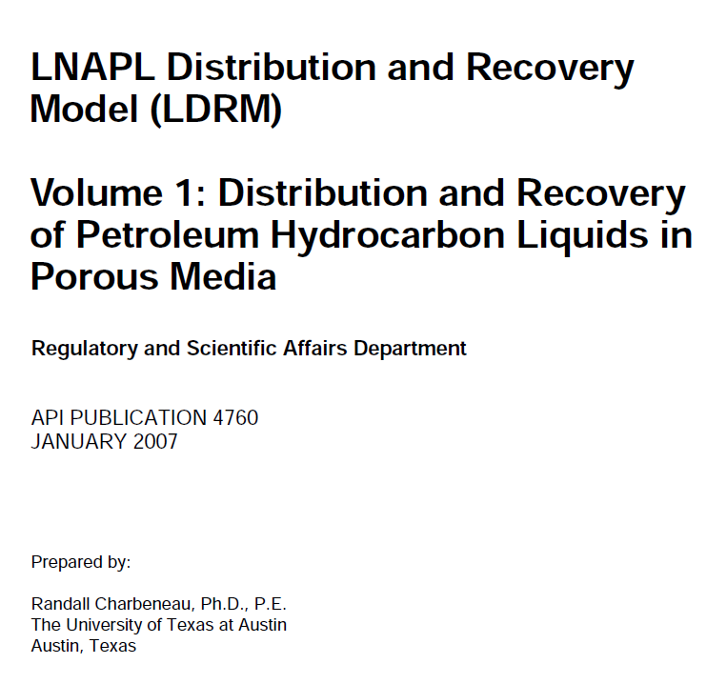
current approach

Slide 8
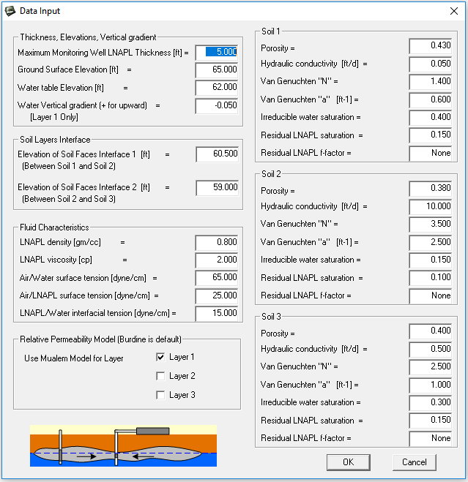
current approach – ldrm interface
User specifies LNAPL and water levels for each location/time/layer
This approach works well when data is limited both spatially and temporally.
User specifies layer interface for up to 3 layers
User specifies soil properties for each location/time.

Slide 9
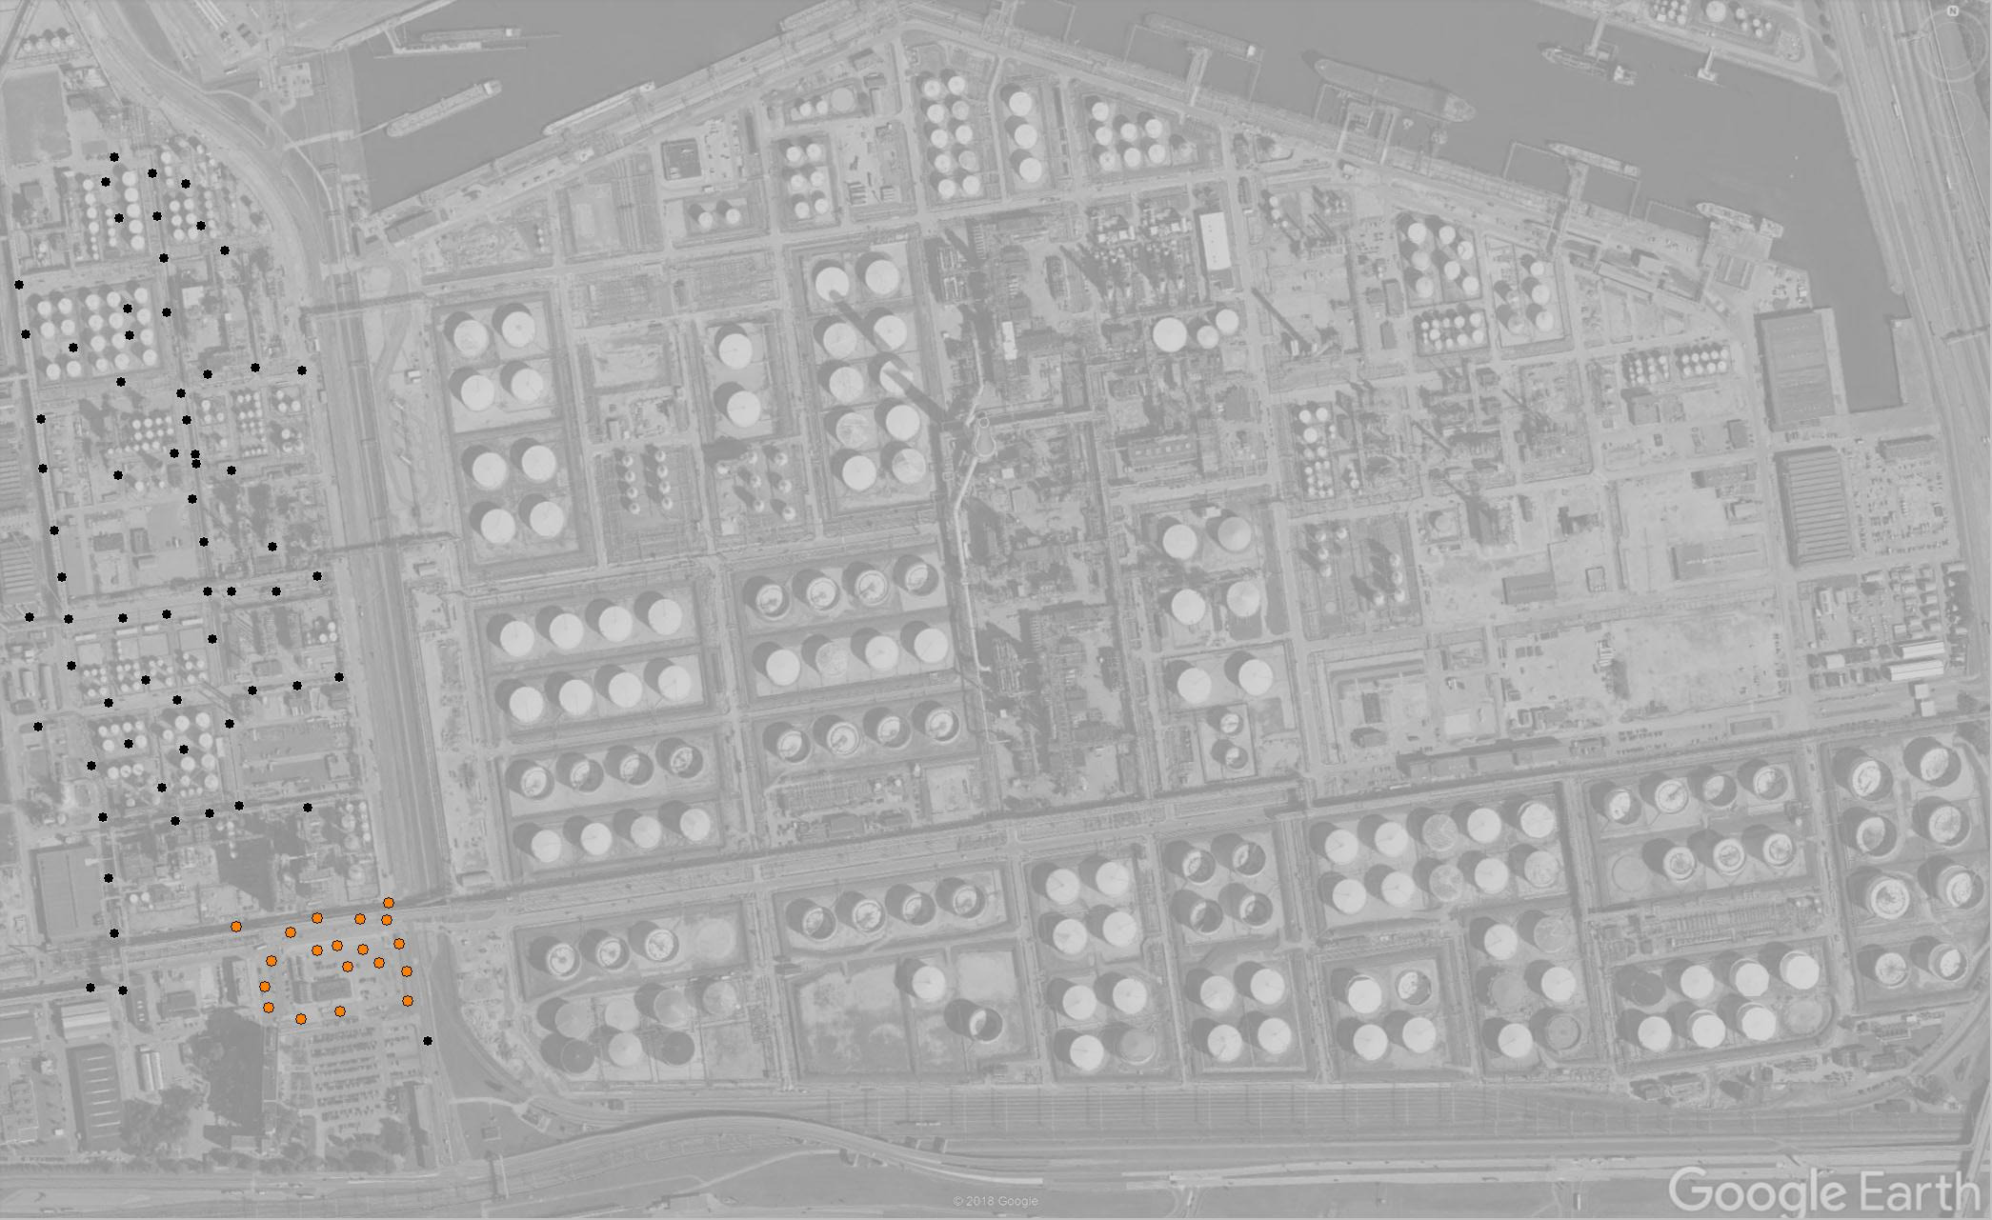
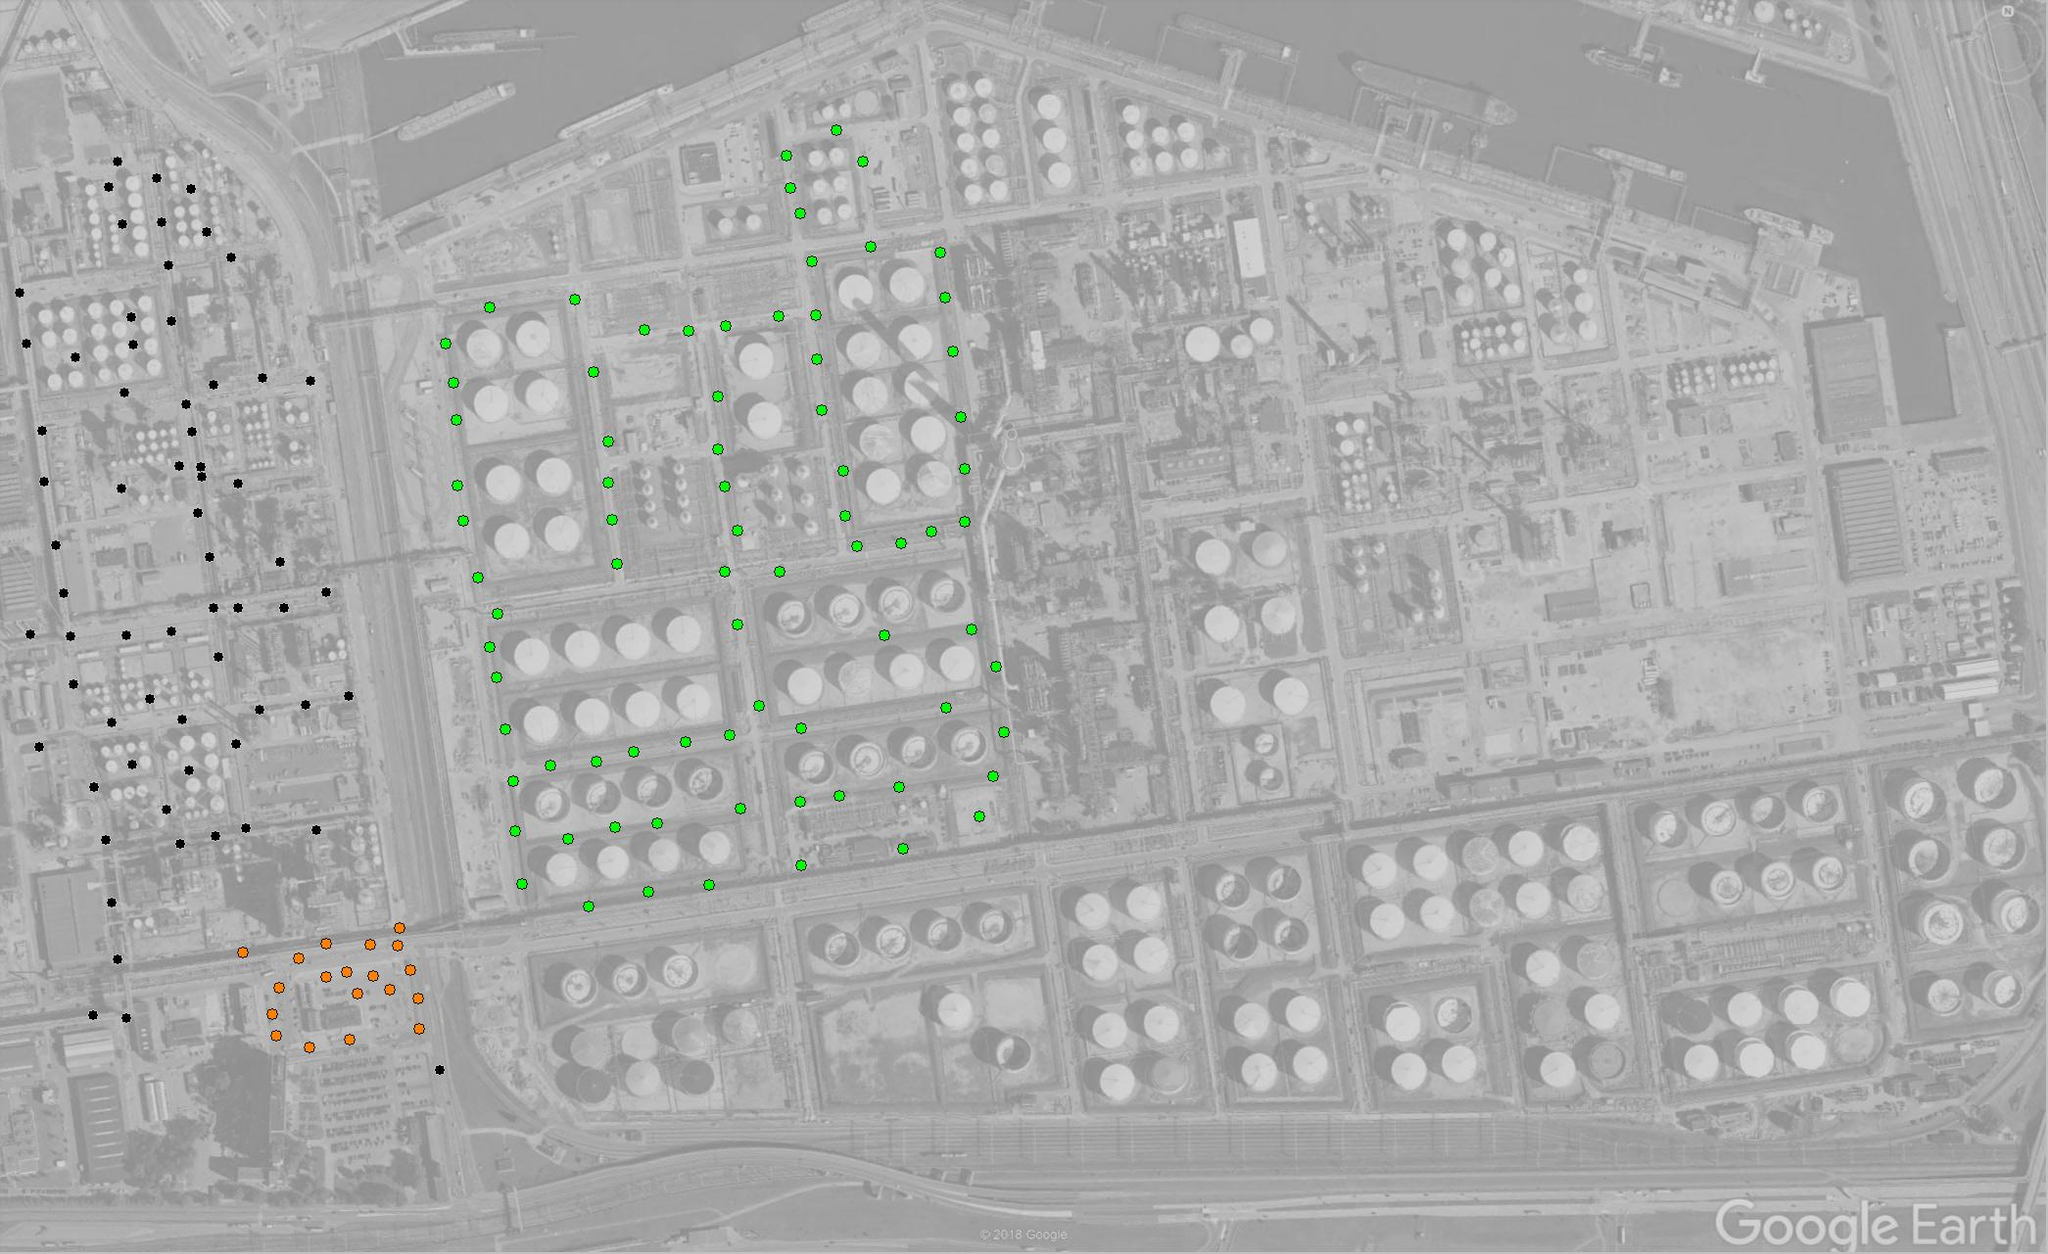
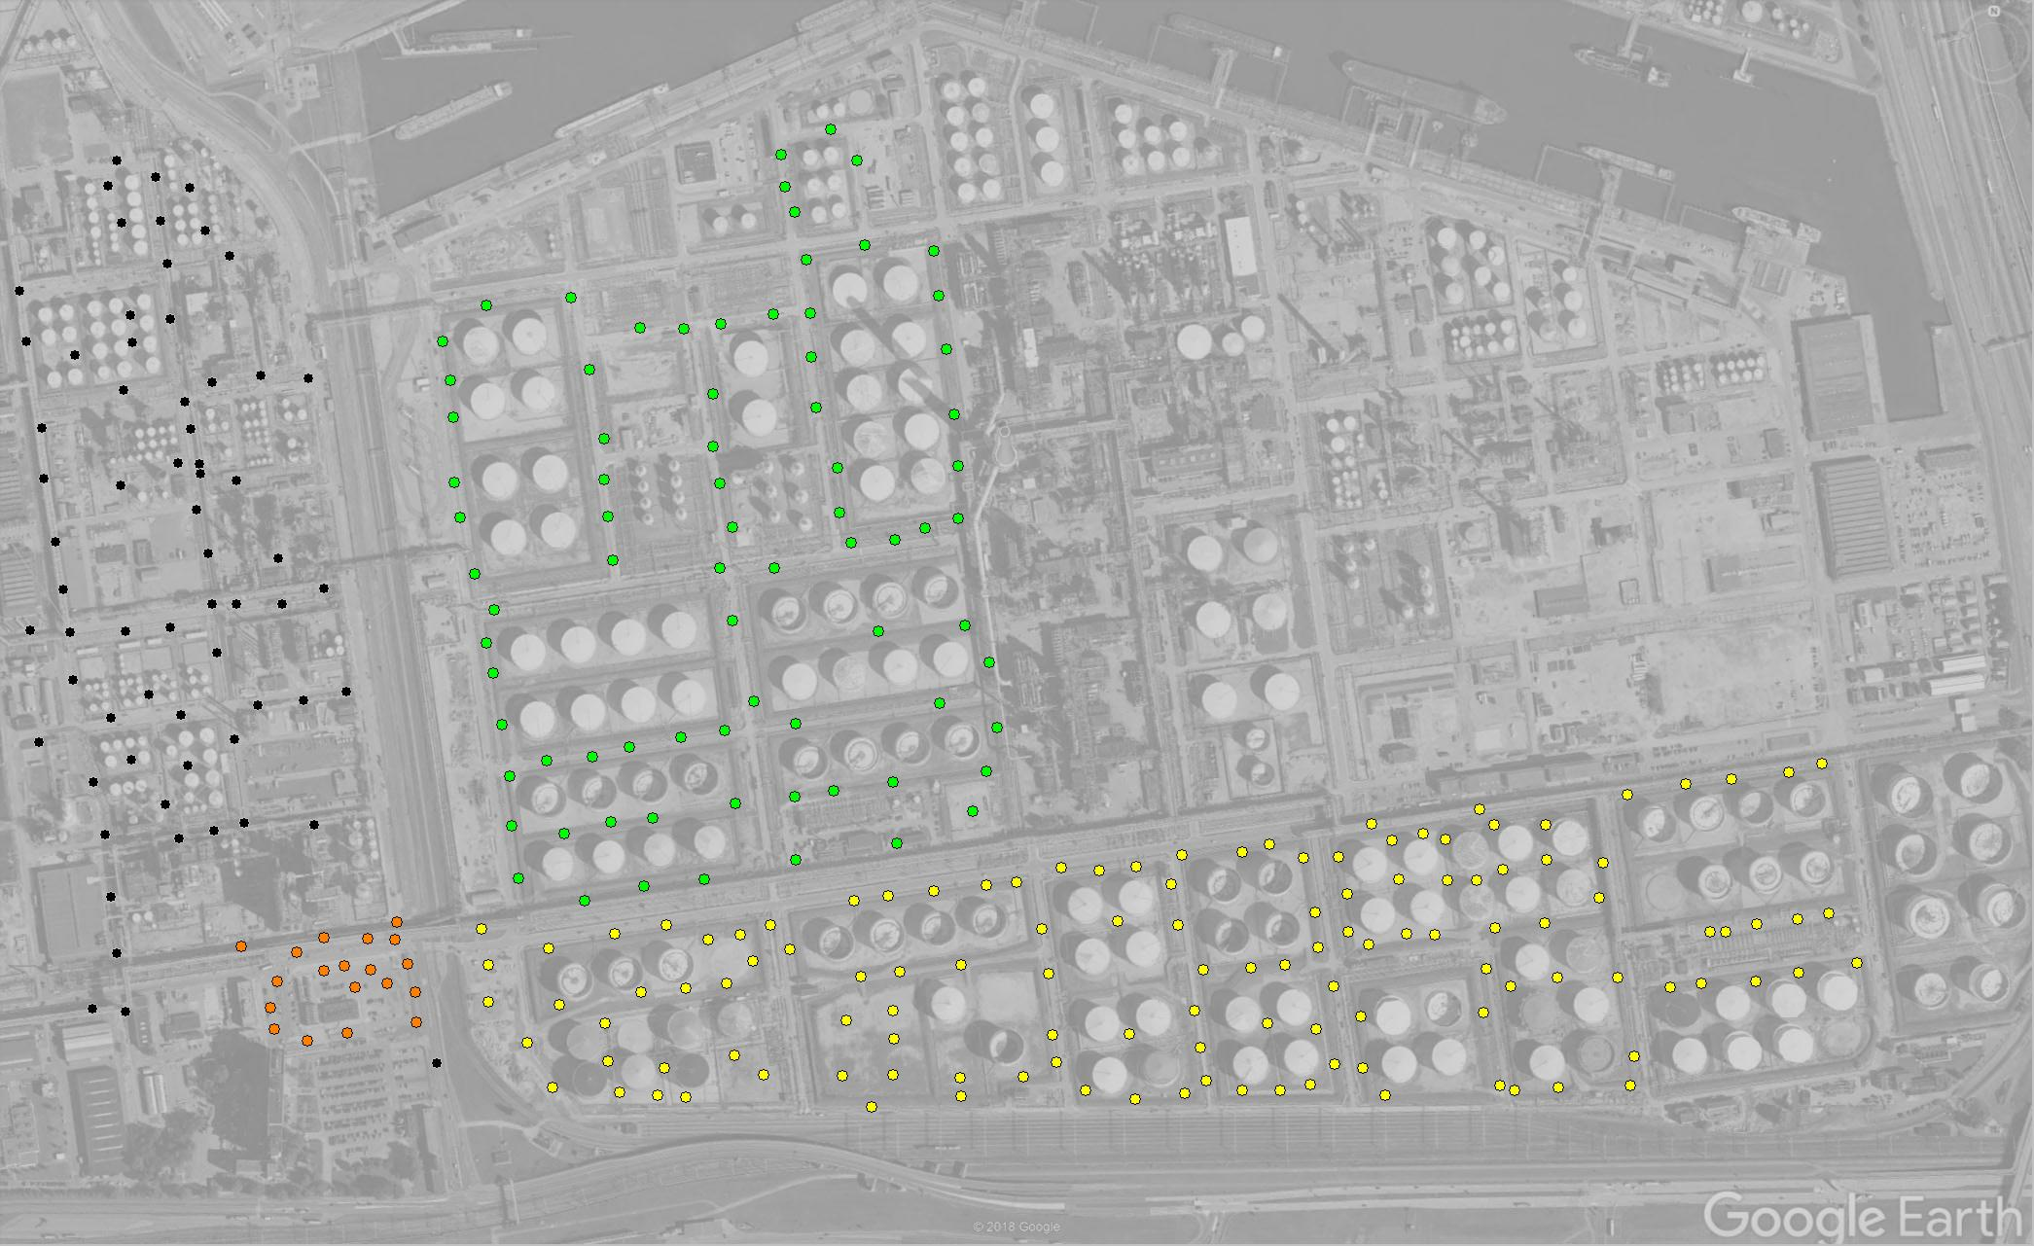
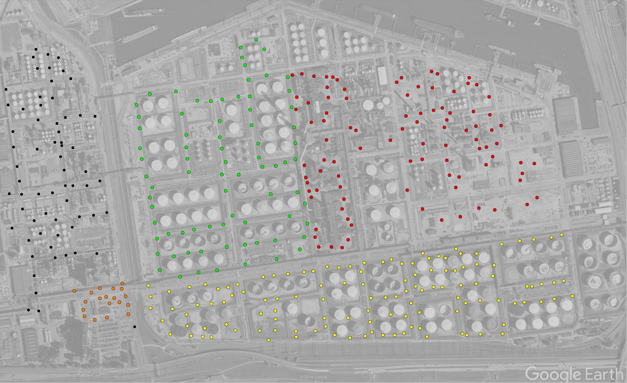
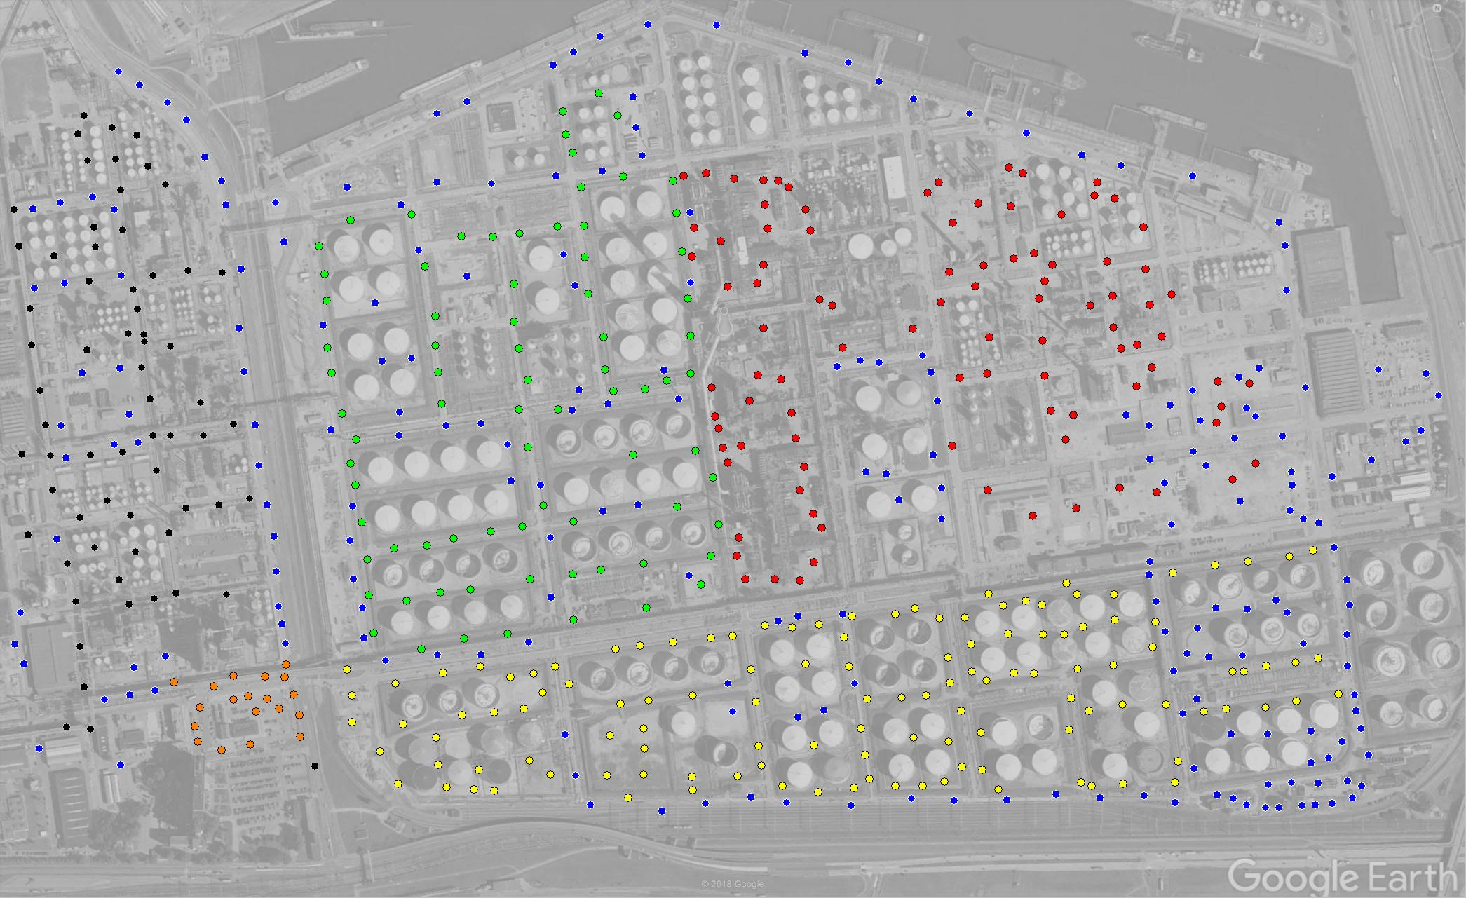
motivation for a different approach

Slide 10
the solution…
Perform same calculations as LDRM in a spreadsheet
Link spreadsheet calculations to data to avoid time-consuming re-entry of data into LDRM
Water levels
Apparent LNAPL thicknesses
Soil types and position of wellscreens
Complete interpolation in spreadsheet to calculate total LNAPL volumes and distribution of Do and Tn

Slide 11
on each row, the spreadsheet brings together:
Stratigraphy Database
Clay
Sand
LNAPL and Water Level Measurements
Database
Silty clay
Sandy silt
Clay
Soil Properties
Database
Sandy silt
Sand
LNAPL
Properties
Well Construction
Database
Silty sand
Clay
Sand

Slide 12
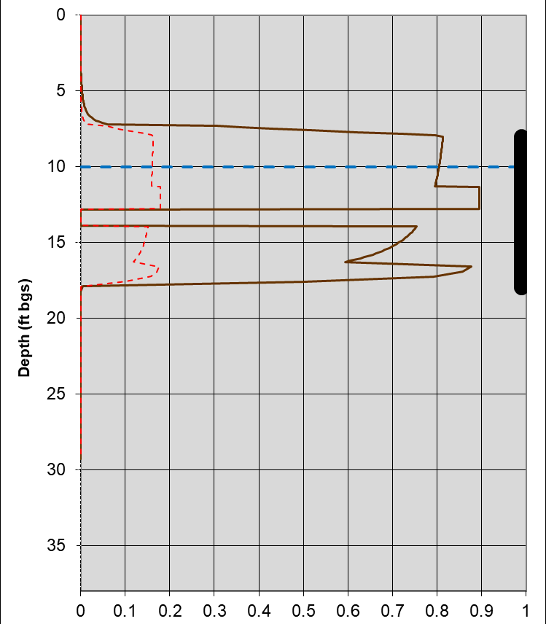
bringing it all together
Stratigraphy Database
LNAPL and Water Level Measurements
Database
Soil Properties
Database
Do, Dom, and Tn are calculated simultaneously on a single row for each measurement event.
LNAPL
Properties
Well Construction
Database
Do = 3 ft; Dom = 2.4 ft; Tn = 31 ft²/d

Slide 13
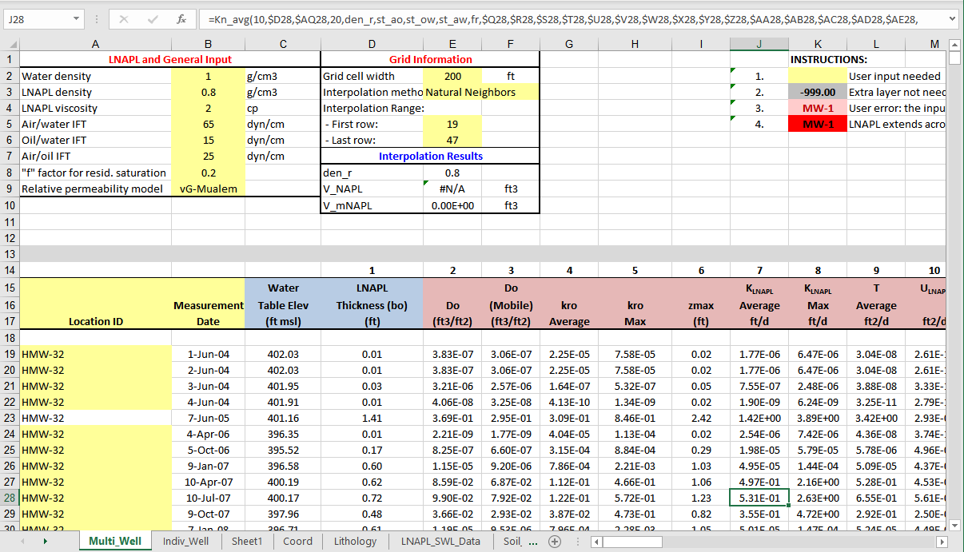
what the spreadsheet looks like

Slide 14
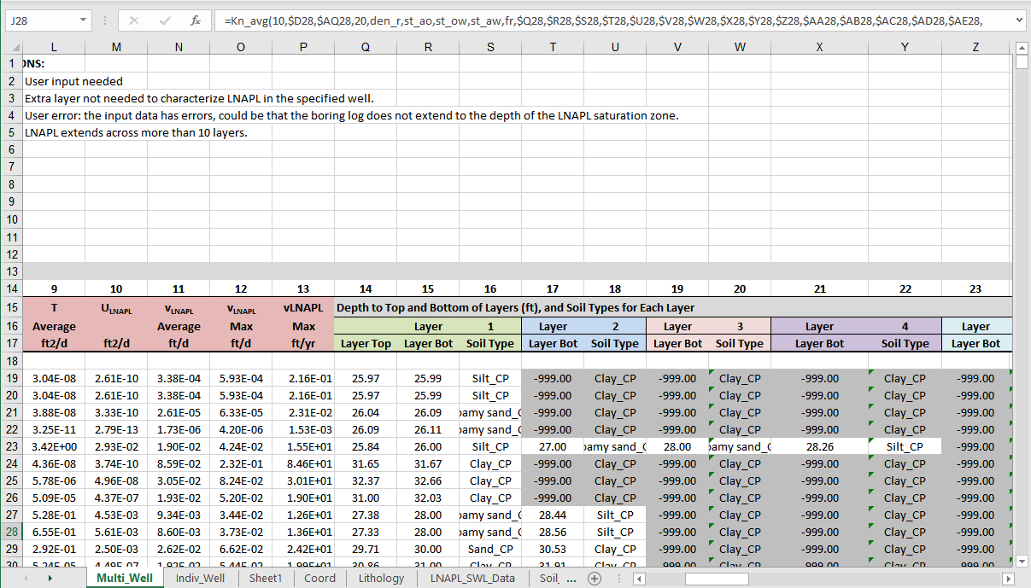
what the spreadsheet looks like

Slide 15
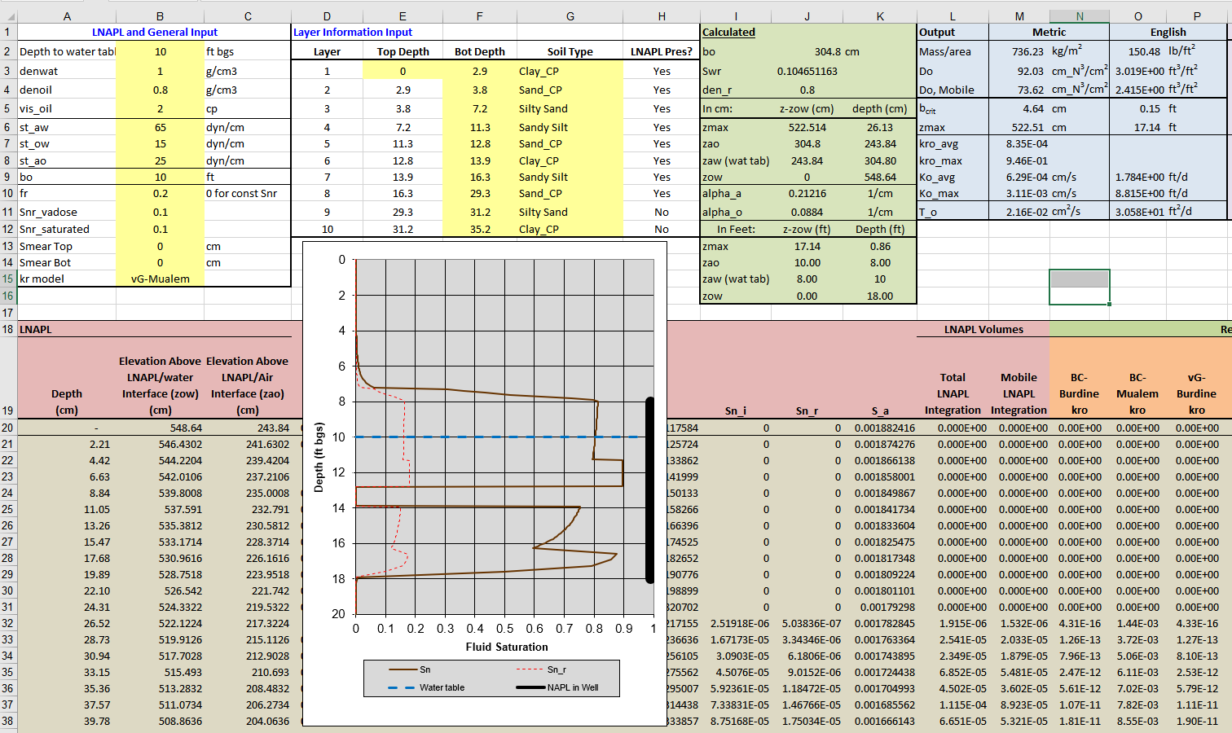
spreadsheet also includes single well evaluation

Slide 16
the calculations (nerd alert!)
Specific Volume:
Mobile Volume:
LNAPL Transmissivity:

Slide 17
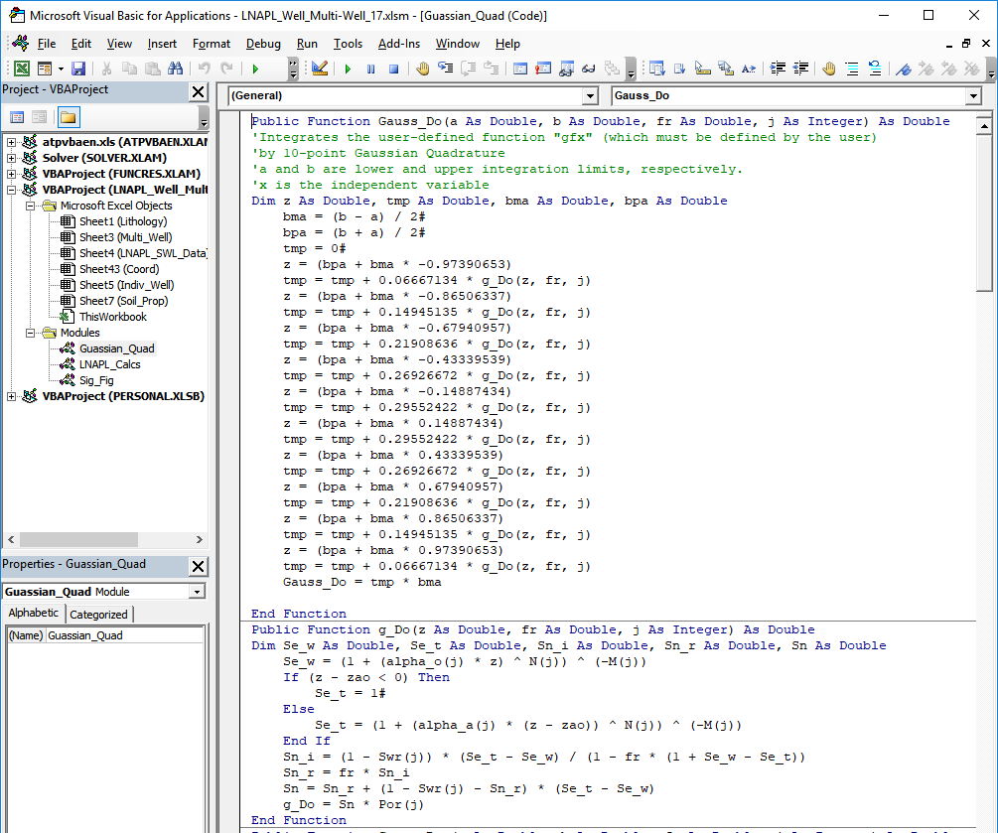
how the calculations are done on a single line: vba code

Slide 18
interpolation of do and Tn
Publicly available module for Excel
XonGrid Interpolation Add-in
http://xongrid.sourceforge.net/
Author: Benjamin Deglo de Besses
Copyright 2010, 2013, 2014
Methods:
Natural neighbor
Inverse-distance weighted
Kriging
Calculated in spreadsheet using array formulas (no separate step is needed)

Slide 19
an example (hypothetical)
How much LNAPL is down there?
How much is potentially recoverable by conventional technologies?
If it’s recoverable, where should the recovery wells be located?

Slide 20
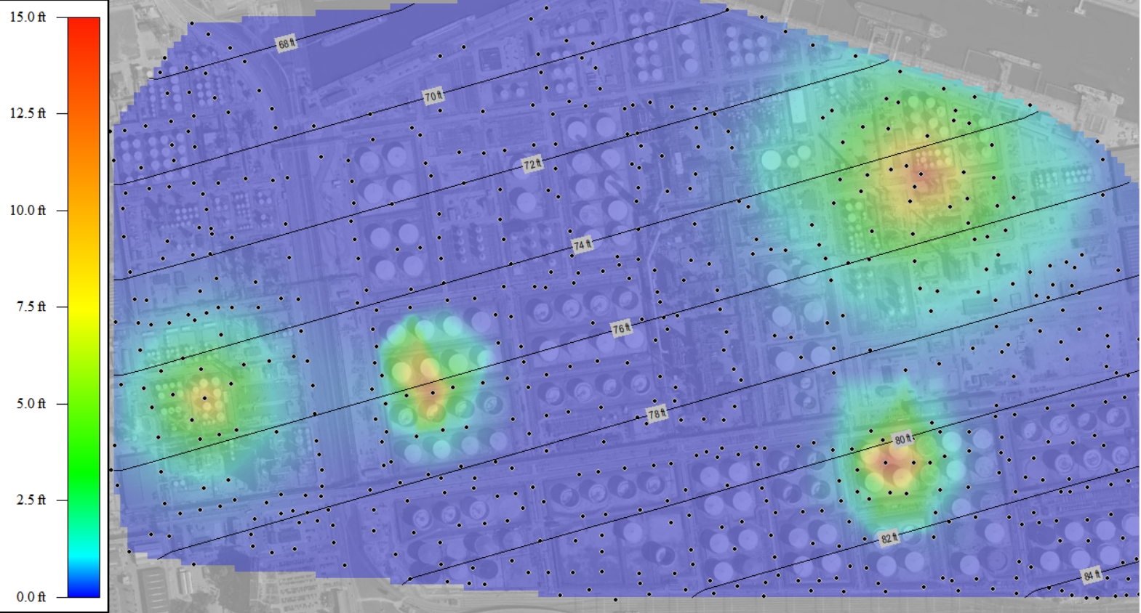
Data from an lnapl investigation and apparent volume
Groundwater elevation contour (ft msl)
LNAPL
Apparent
Thickness
(bo, in feet)
Apparent volume = 980,000 ft³ (7.3 million gal)

Slide 21
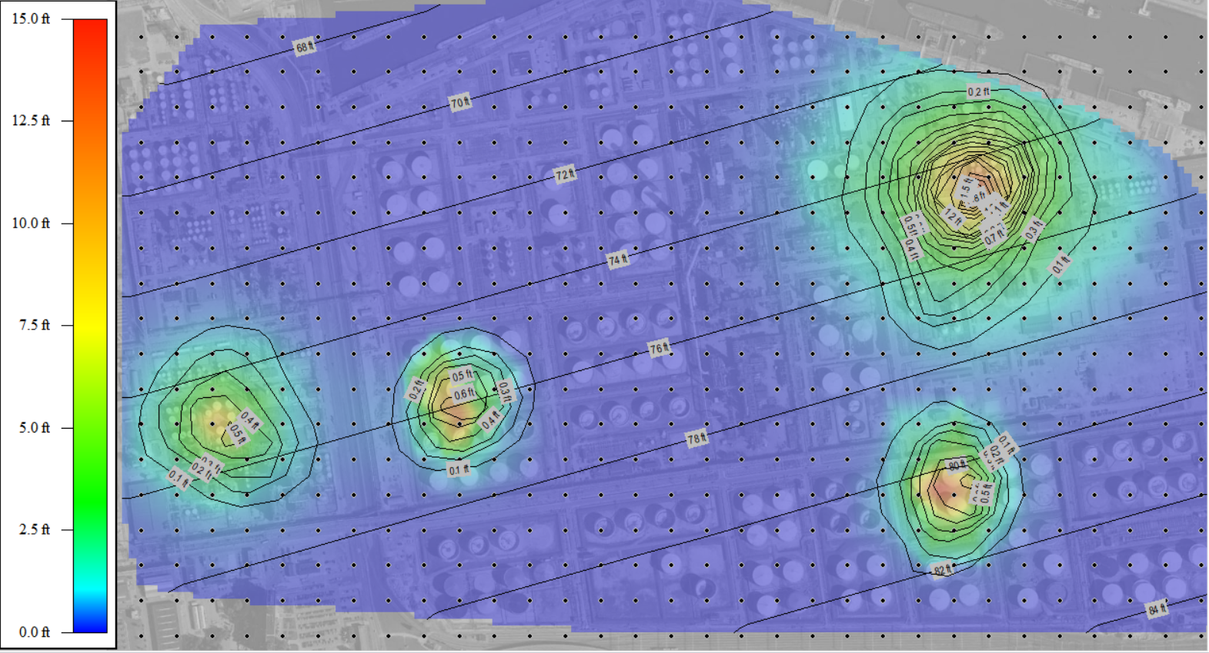
how much is down there?
Use spreadsheet to calculate Do on a regular grid from data in databases.
LNAPL
Apparent
Thickness
(bo, in feet)
Specific volume (Do) contour (ft)
Apparent volume = 980,000 ft³ (7.3 million gal)
Total volume based on Do interpolation = 97,000 ft³ (730,000 gal)

Slide 22
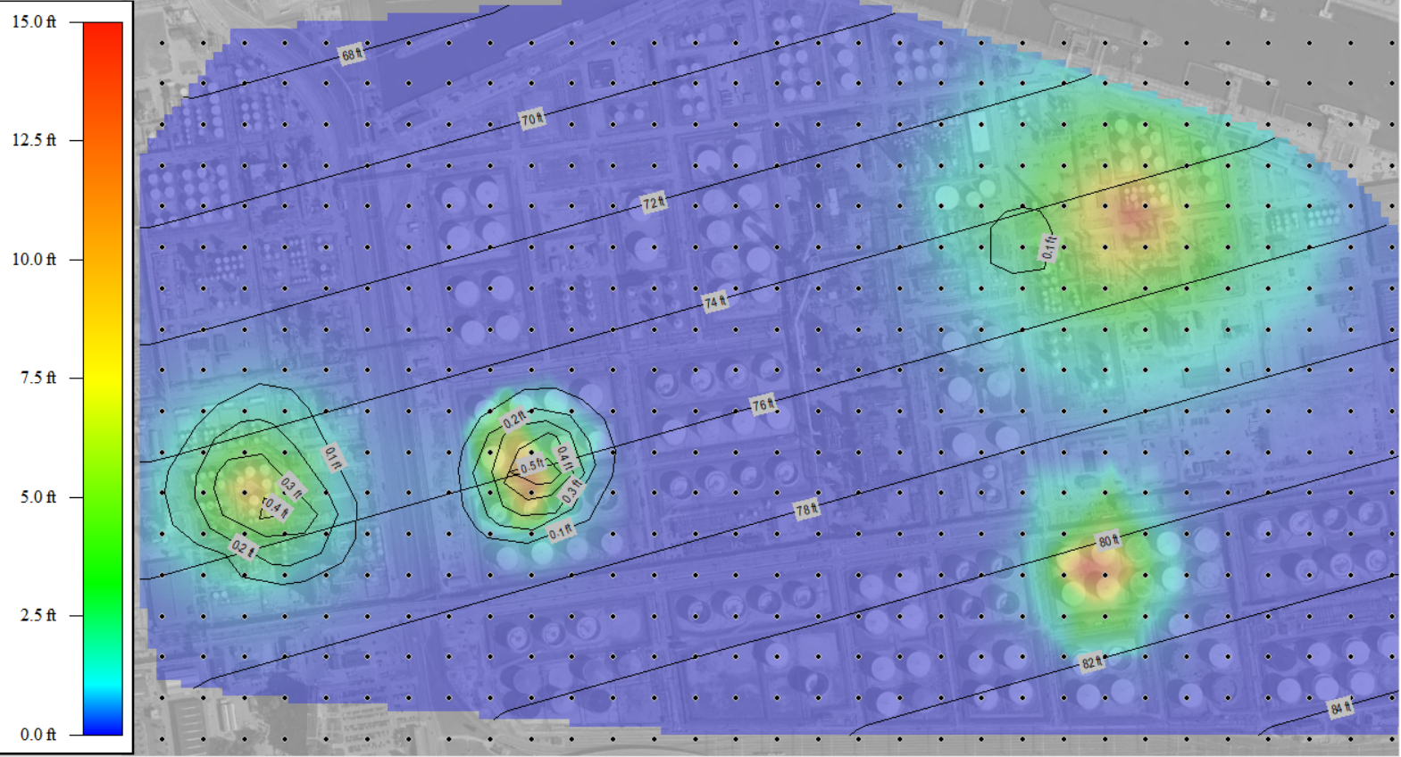
how much is recoverable?
Use spreadsheet to calculate Dom on a regular grid from data in databases.
LNAPL
Apparent
Thickness
(bo, in feet)
Mobile volume (Dom) contour (ft)
Total mobile volume = 25,000 ft³ (190,000 gal)

Slide 23
where should recovery wells be located?
LNAPL Transmissivity calculation
LNAPL
Apparent
Thickness
(bo, in feet)
LNAPL transmissivity (Tn) contour (ft²/day)
☞
Point: Areas of high transmissivity do NOT necessarily correspond to locations of greatest apparent LNAPL thickness.

Slide 24
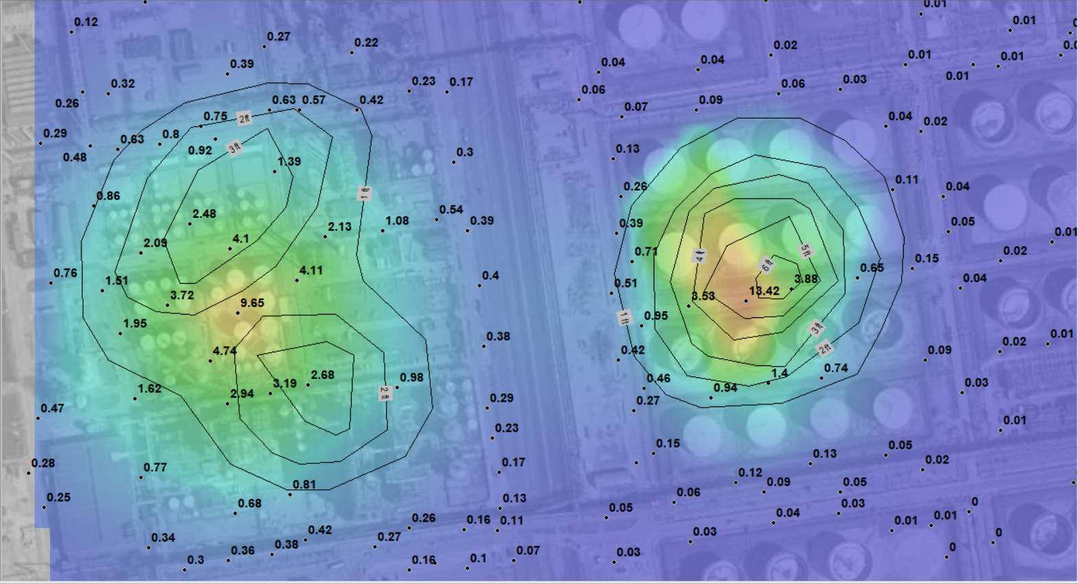
where should recovery wells be located?

Slide 25
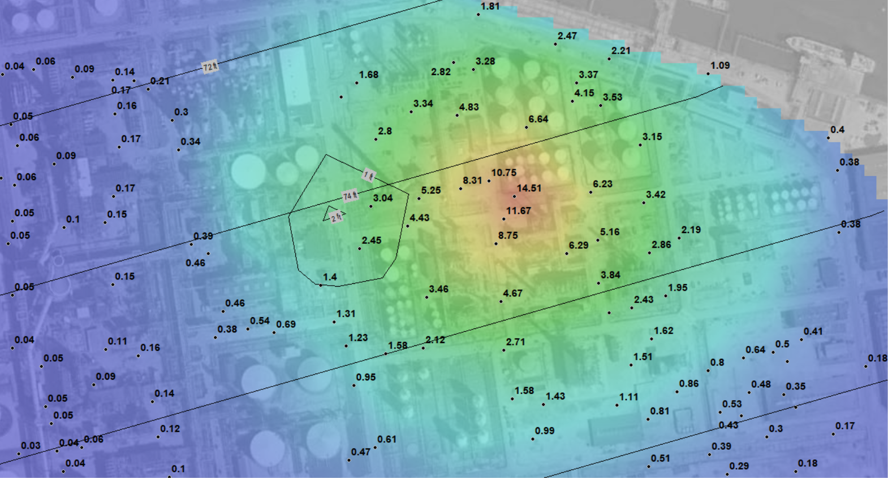
where should recovery wells be located?

Slide 26
other uses of the spreadsheet tool
Compare many measurements at same location to determine maximum specific volume
Use tool to calibrate residual saturations in unsaturated and saturated zones
Rapidly screen out invalid measurements (LNAPL not fully within wellscreen)
Determine where LNAPL is accumulating or decreasing at an individual location

Slide 27
CONCLUSION
Spreadsheet tool offers many advantages over the LDRM in terms of efficiency and capabilities for calculating Do, Dom, and Tn.
Automatic calculation of LNAPL volume and locations of maximum Tn are very helpful in LNAPL remediation projects.
You can spend a lot of time (not) perfecting PowerPoint animations!

Slide 28
END
Phillip C. de Blanc, Ph.D., P.E.
pcdeblanc@gsi-net.com
2211 Norfolk St., Suite 1000
Houston, Texas 77098
713-522-6300
Funding needed for further development!

Slide 29
comparison of new tool to conventional ldrm method
CATEGORY | LDRM | SPREADSHEET TOOL
Efficiency | One-by-one evaluation of each measurement event. | Simultaneous evaluation of an essentially unlimited number of events using information from spreadsheet databases.
Stratigraphy | Stratigraphy must be re-defined for every measurement event if LNAPL falls outside of initial range. Limited to 3 layers. | Stratigraphy is defined only once for each location and covers a much larger depth range. Currently 10 layers with unlimited capability for expansion.
LNAPL and water levels | Each bo and SWL measurement event must be manually entered by location and date. | Once database is created, all LNAPL thickness and SWL measurements are evaluated simultaneously.
Soil characteristics | Soil characteristics must be manually entered. | Spreadsheet database of soil types allows pre-definition of unlimited number of parameter sets.
Calculation results | Calculated Do, Dom and Tn values must be manually entered into other software for further evaluation. | Do, Dom, and Tn values for each measurement event are present in cells that the spreadsheet tool can use immediately for calculations or for export.
Total LNAPL volume calculations | Total LNAPL volume and mobile volume are not directly calculated. | Total LNAPL volume and mobile volume are calculated directly within spreadsheet using the interpolated values.
Interpolation | Calculated Do, Dom, and Tn values must be exported to other software for interpolation. | Interpolation is completed directly in spreadsheet based on user-specified grid and interpolation method.

