Slide 1

THE SEARCH FOR WATER USED IN HYDRAULIC FRACTURING: WATER REUSE AND REDUCING POTENTIAL EARTHQUAKE ACTIVITY
April 8, 2015

Slide 2
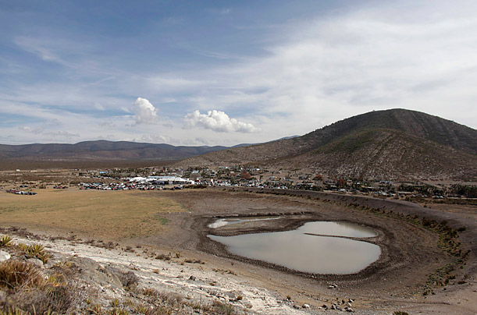
Overview
Slide 2
Energy issues with water and its associated costs for development
  Earthquake activity and its relationship with Class II injection wells
  Drought conditions are requiring the investigation of different water sources
  Water required for unconventional plays for oil and gas – 60,000 to 650,000 gals per well for drilling
What issues need to be solved in the future?
Notes:
2

Slide 3
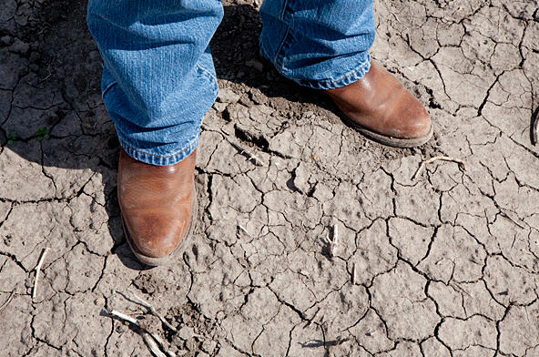
Discussion Outline
Slide 3
Introduction
Discussion regarding earthquake activity and injection wells
Volumes and Quality of water required for energy development
Brackish Water Potential
Treatment Technology
Economics
Summary

Slide 4
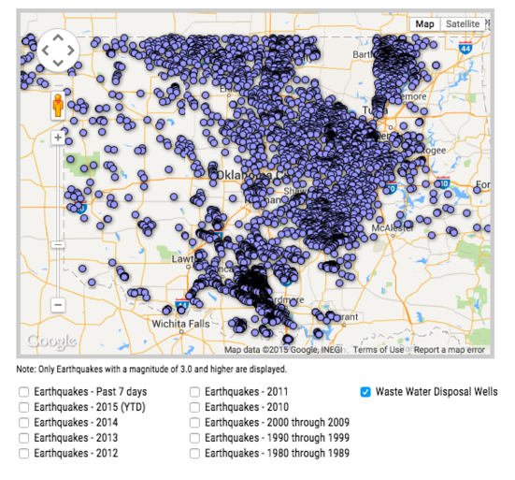
Earthquake Activity in Oklahoma
Hydraulic fracturing increases the use of water
Results in additional Class II injection wells
Regulations are increasing to limit Class II injection wells
Potential closure of wells will decrease E&P activity

Slide 5
Salt Water Injection Wells in Colorado
Interaction of chemistry of injection fluid
Deep well injection in Weld County
  7,000 to 10,000 feet
  Significant injection well capacity – 20,000 bbl/day
  Issues with formation water and receiving well water
    Barium sulfate formation
    Calcium sulfate and calcium carbonate formation

Slide 6
Water Treatment as an Alternative
Removal of scale forming compounds
Removal of sulfate reducing bacteria
Cost of treatment for injection chemistry
Chelating agents – kinetic reaction

Slide 7
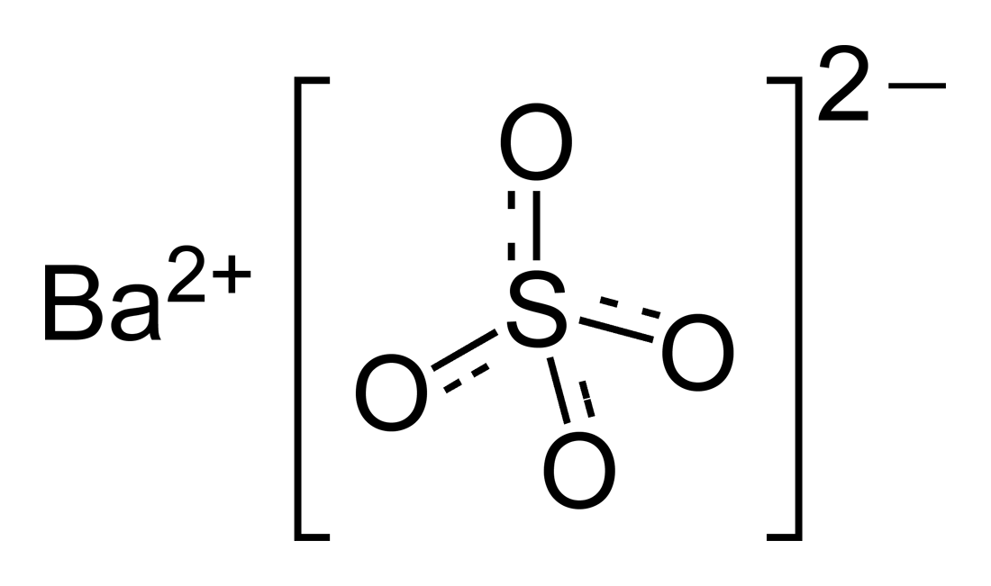
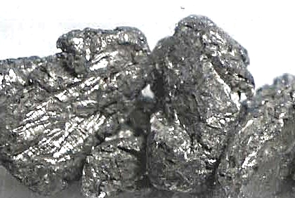
What are the issues with Barium Sulfate and Other Scale Forming Compounds
Barium sulfate formation
  Barium in the injection water
  Sulfate in the formation water
Other compounds
  Calcium
  Strontium
  Silica
Why is this an issue?

Slide 8
Current Technology of Scale Sequestration
Scale “Coupons”
  This indicates scale that will form in the down hole piping, not in the formation
  There is not sulfate in the injection water, only in the formation water
  Are scale coupons a good idea? Yes, but have limited application in this instance for the formation water
  Calcium carbonate can form but only if pH is increased to a level of 9 or above – not likely an issue

Slide 9
Current Technology of Scale Sequestration
Using sequestration agents
  These are organic compounds which will “tie up” the barium, calcium, strontium, etc
  However, these organic compounds break down over pressure and heat, such as down hole conditions
  Once a crystal forms in the formation, the growth of the crystal will accelerate at a very high rate
  Sequestration agents are non-effective once the crystals have formed

Slide 10
Relationship to Brackish Water for Hydraulic Makeup
The produced water and the potential brackish water in the areas of production well activity can provide all the water necessary for hydraulic fracturing – reducing the need for Class II well injection, potential reduction of earthquake activity

Slide 11
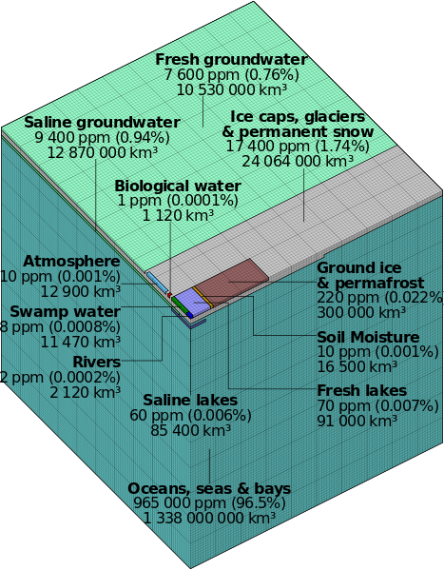
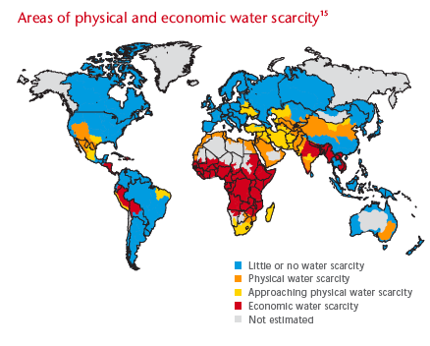
The global situation for water is not improving and will be an impediment to industrialized growth over time.
Slide 11
Brackish Water Supplies Globally
Brackish Water Doubles Fresh Water Supply
Notes:
11
Less than 3% of the world’s water is fresh – the rest is seawater and undrinkable.
Of this 3% over 2.5% is frozen, locked up in Antarctica, the Arctic and glaciers, and not available to man.
Thus humanity must rely on this 0.5% for all of man’s and ecosystem’s fresh water needs.
Where is this 0.5 % of fresh water? How many Olympic-sized swimming pools is that?
10,000,000 km3 stored in underground aquifers. (4,000,000,000,000 swimming pools) Since 1950 there has been a rapid expansion of groundwater exploitation providing:
50% of all drinking water
40% of industrial water
20% of irrigation water.
• 119,000 km3 net of rainfall falling (47,600,000,000 pools) on land after accounting for evaporation.
• 91,000 km3 in natural lakes. (36,400,000,000 pools)
• Over 5,000 km3 in man made storage facilities reservoirs. (2,000,000,000 pools) There has been a 7 fold increase in global storage capacity since 1950.
• 2,120 km3 in rivers – constantly replaced from 848,000,000 rainfall and melting snow and ice.

Slide 12
Water Use as a Function for Energy Development as an Overall Portion of Water Management
Slide 12
What is the percentage of total fracking and energy development = 0.14% of total use in the US typical - (example is Colorado)
Largest use is Agricultural at 85%
Second highest use is Municipal and Industrial at 7%
All others is 8%
This 0.14% equals the amount of water used on an annual basis by the City of Denver.
Notes:
How many AF and/or BBL’s per day

Slide 13

Brackish Water in the US
Slide 13
Efforts to find new untapped water supplies in the US
NAS study on desalination
Constraints are not the technology, but the financial, environmental and social factors
Participation is needed by all in the development of this resource to limit any significant issues associated with this treatment

Slide 14
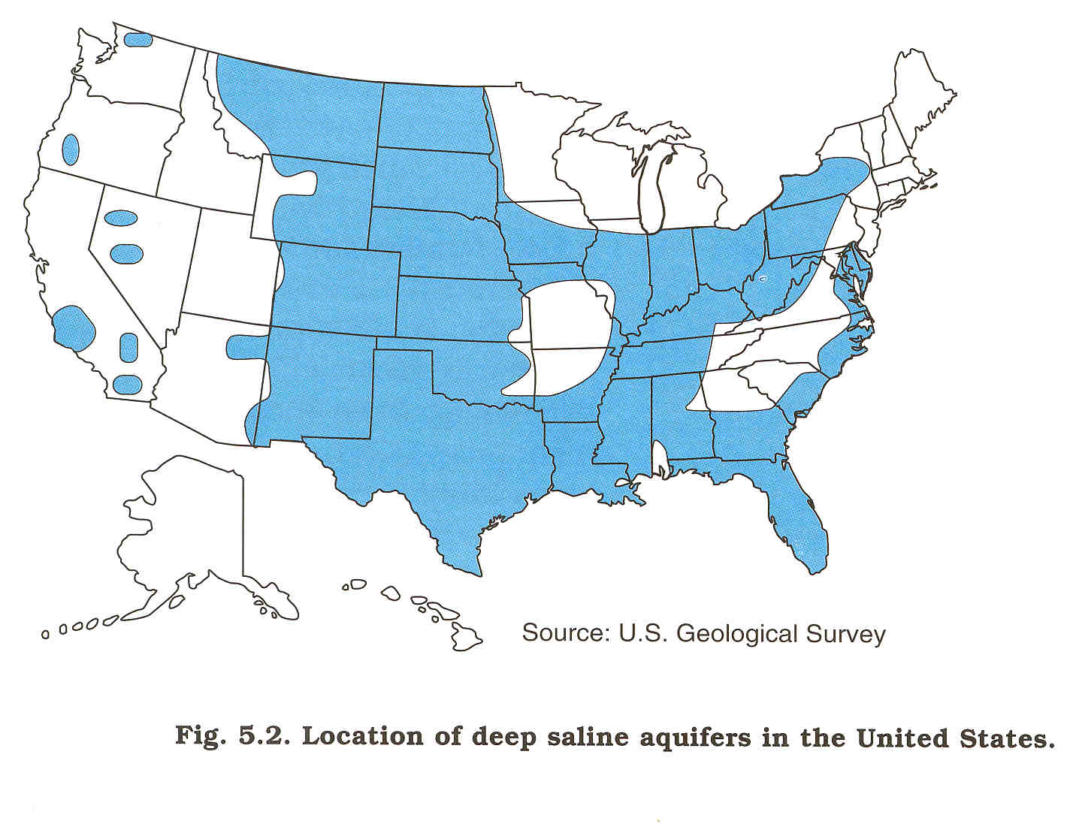
Slide 14
Resources
Inland Desalination a Now-Attainable Solution
Saline Aquifers
These aquifers can provide water for energy development

Slide 15
Slide 15
Resources
Oil, Gas and Coal Basins
Compare to Saline Water Locations
Opportunity to convert brackish water as a new water resource
Will not fight with other entities, such as municipalities and agriculture for this water
Kevin Price, USBR
Notes:
Energy production activities present a great opportunity to develop a new sources of water. The water produced from oil, gas, coal-bed methane is large enough to provide an important supplement to the existing water supplies. The most important needs for this new water source is the development of cost effective pretreatment technologies and cost effective concentrate disposal options. Further, the quality of the upgraded water must by assured for the intended use.

Slide 16
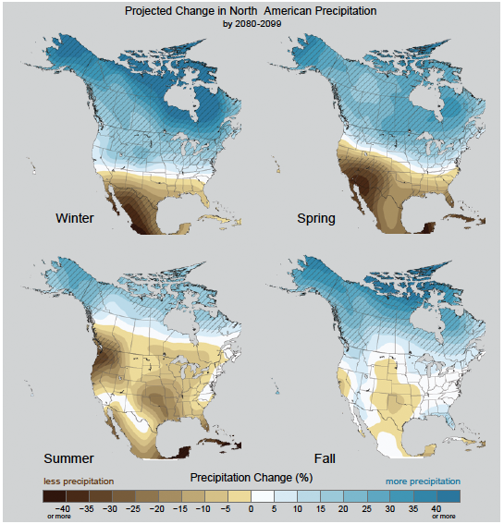
Drought Projections in North America
Slide 16
Data from UN
Note the movement of water to the north due to climate change predictions

Slide 17
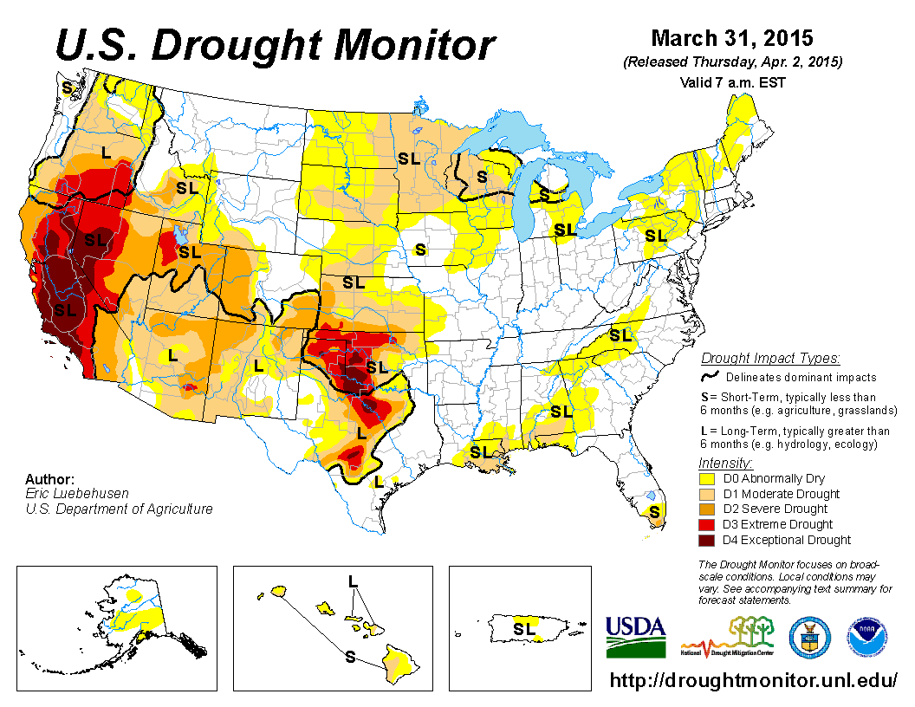
Slide 17
Problem
Drought in the Western US
Drought is still a significant issue in Western US
Energy Development can demand water in short supply
Colorado example of water limitations on energy development

Slide 18
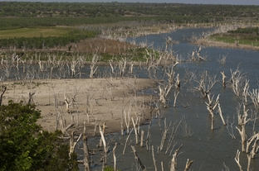
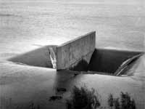
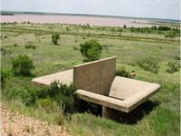
What is the impact of the drought on energy production -Texas Example
Slide 18
Availability of water in Permian Basin with extended drought
  Colorado River basin issues
  Municipal water supplies are stretched already
      Lake JB Thomas 44.0% full (0.1% 3 months ago)
      EV Spence Reservoir 1.8% full
      OH Ivie Reservoir 13.6% full
Requirement for District is to supply water for drinking and public safety – water for E&P operations is not a concern and very limited at this point
“If you don’t have water, you can’t attract industry” – Guy Andrews – Economic Development Director – Odessa Texas
Full Reservoir
Current Conditions

Slide 19
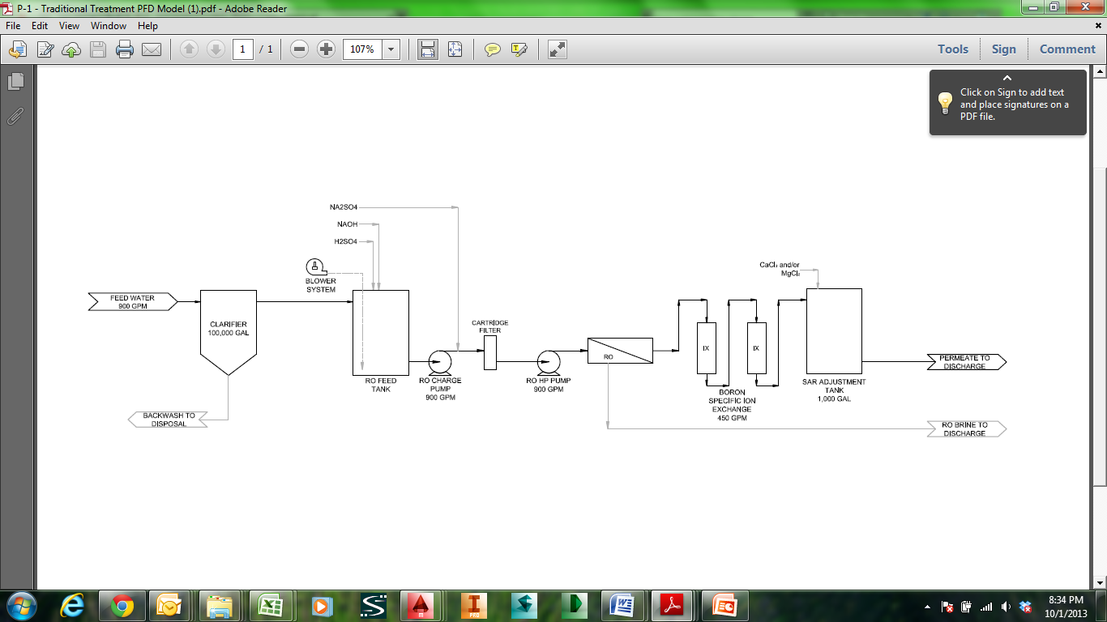
Conventional Brackish Water Treatment Technology
Slide 19
Scale forming compounds will limit recovery of this type of water to 50 to 70 percent
Calcium sulfate and calcium carbonate will cause issues
Scaling compounds can be an issue as the make up water for hydraulic fracturing make up water
Conventional TDS Removal

Slide 20
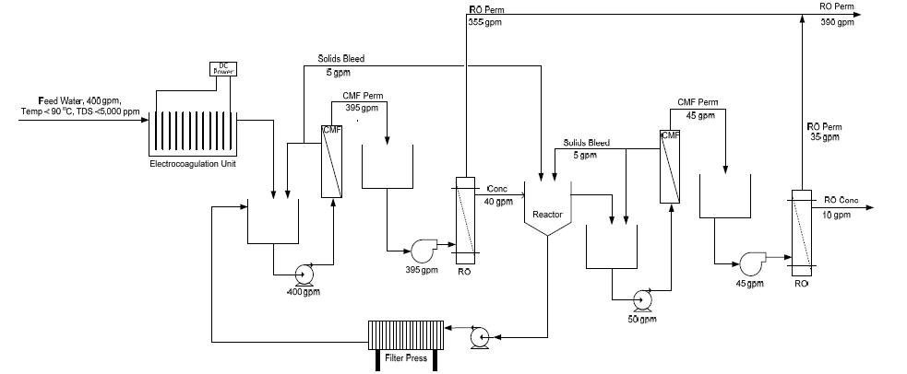
High Recovery TDS Treatment Technology
Slide 20
Removal of scale forming compounds are the key to high recovery systems
Removal of scale forming compounds allow increase of water to 95% to 98%

Slide 21
Presentation of Results from Operating Facilities
Slide 21
Compounds that require removal for treatment
  Barium Sulfate
  Calcium sulfate
  Calcium carbonate
  Silica
  Iron
  Boron
EC/CMF will remove most of the compounds
Boron can be removed utilizing RO with proper pretreatment

Slide 22
Slide 22
Technology
Costs of Water Treatment - Comparison
Water Supply Options | Cost (US $/bbl)
Demand Mgmt/Repair leaks | $0.02 – 0.11
Desalination of Brackish water | $0.03 – 0.30*
Wastewater reuse & Produced Water Reuse | $0.20 – 1.80
Long distance transfer | $0.30 - $1.00
Desalination of Sea Water | $0.20 – 0.50
* Very dependent on chemical make up of brackish water

Slide 23
Technology - Benefits of Desalination
Slide 23
Technology
Increased supply from non-traditional sources
Drought proofing – does not depend on the climate changes that are likely to occur
Local control
Regional redundancy, security
High quality supply
Reduced costs, improved technology
Avoid competition for limited water sources (agricultural, urban, environmental)
Kevin Price, USBR
Notes:
Note that the costs of the technology are coming down in today’s dollars while other supplies are increasing. The non-traditional needs are in-stream flows for endangered species, Native Americans, etc.

Slide 24
Slide 24
Recources
Impaired / Brackish Water – Highest & Best Use
Current Best Uses of Brackish / Impaired Ground Water
Energy Exploration Water
Industry
Power Production
Drought Reserve
Agriculture
Portfolio of Water Rights is the key to success – brackish water can be part of the portfolio
Current Best Uses of Produced Water
Energy Exploration Water
Industry
Agriculture

Slide 25


Inland Impaired Brackish Water vs. Seawater
Slide 25
Technology
Inland Waters are new frontier, seawater is relatively defined
Major differences include:
  Treatment & Recovery Objectives
    Brackish can recover over 90% of the water – 10% brine solution
  Water Chemistry
    Removal of scale formers insitu is the most important item for treatment
  Brine Disposal Options
    Recovery of rare earth minerals such as lithium

Slide 26
Slide 26
Technology
Technical Challenges / Opportunities
Energy Efficiency
  Pressure recovery techniques
Osmotic Pressure
  Future can use Forward Osmosis
Solubility & Scaling
  Understanding high salinity precipitation is very important
Membrane Process adjustment – highest & best use output
Selective sequestration of salts and elements
  Fundamental shift – salts/metals as a resource !

Slide 27
Slide 27
Technology
Biggest Issue is Brine Management
Current Brine Disposal Methods
Inland –
  Surface Water Discharge (reuse for energy and agriculture)
  Evaporation Pond (air pollution issues in the future)
  Class II Well (Deep Injection Well)
  Land Application
  Solid/Hazardous Waste Landfill
Offshore –
  Discharge to ocean (very limited in ability to discharge water to the ocean)

Slide 28
Slide 28
Technology
Beneficial Use of Brine / Recovered Materials
Salt Commodities
  NaCl, Na₂SO₄, Na₂NO₃, K₂SO₄, MgSO₄, KNO₃…..
Industrial Chemicals
  Cl₂, NaOH……
Aquiculture
  California – recovery of gypsum for clay soils
Solar Power
Commodity Metals

Slide 29
Economics
Slide 29
Economics is the key issue
  Transportation costs will trump treatment costs in most cases
  This results in facilities needing to be near the energy development site to reduce costs
  Brackish water is typically found in areas of energy development
  Utilization of abandoned well system

Slide 30
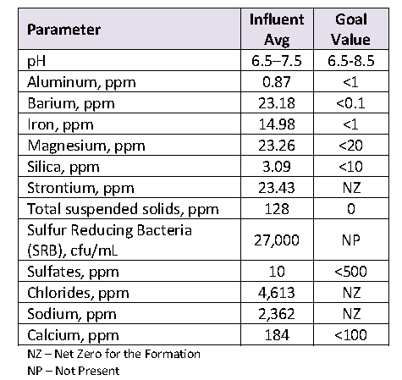
Case Study – Weld County Colorado
Issue with earthquakes and looking to lower the amount of water injected
Goal of energy companies for water reuse
Sulfate in the injection formation
Barium in the produced water/flowback water
SRB a very large issue

Slide 31
Proposed Solution
Treatment proposed:
  Walnut shell filter for any residual oils
  Sodium Sulfate addition for reaction with Barium and Calcium
  Removal of precipitated solids
    Lamella plate clarifier to reduce solids
    Ceramic microfilter for polishing and removal of SRB
Cost of treatment is near $0.20/bbl for O&M
Payback estimated at 18 months
Provide for treatment to remove the barium for injection in the future
Provide a brine for reuse in hydraulic fracturing fluid make up water
  Sodium/Chloride not a large concern – Net Zero for formation goal
  Removal of scale forming compounds

Slide 32
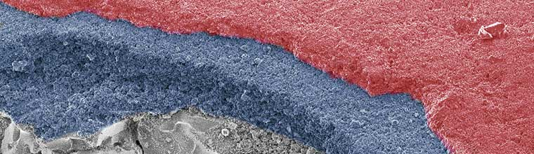
Asymmetric Membrane Crossflow Mode
Ceramic Microfilter
Feed
Reject
Wastewater Flow
0.2 um
0.8 um
5 - 7 um
Permeate
Electron Microscope Picture of Membrane Surface with Depth
Permeate

Slide 33
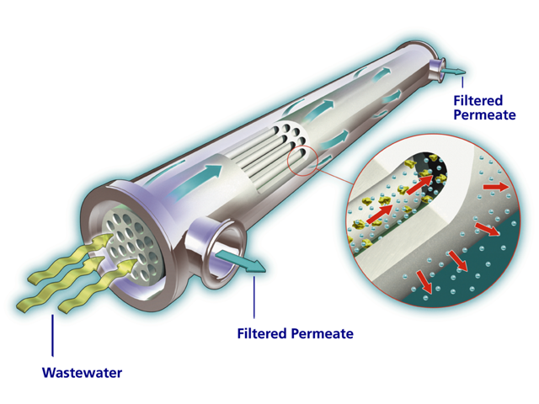
Cross Flow Filtration
Wastewater in one end of the cross-flow filter
Filtered permeate out the side of the filter
Solids need high velocity to keep suspended
Back pulse backwards through the filter

Slide 34
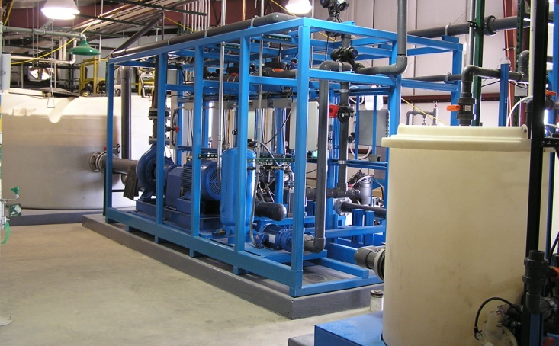
Micro Plant Footprint
Notes:
34
Explain this slide more – show ceramics – square footage – 5000 sf – 5000 bbl/day

Slide 35
Summary
Earthquake activity is being highlighted with it association of injection wells
This can potentially cause the closure of wells and eventually reduce the ability of energy production – water can be the rate limiting step

Slide 36
Summary
Slide 36
Brackish water can supply needed water for energy development
Development and drought pressures will require looking for new water resources
Recovery of this type of water needs to be maximized for recovery
Economics will be determined by cost of treatment and transportation
Brackish water can be treated near the energy development at a lower cost without conflict with other entities such as agriculture and municipalities

Slide 37
Slide 37
Thank You / Questions
Dr. David R. Stewart, PE
970-226-5500
dave.stewart@stewartenv.com

