Slide 1
ipec FracFocus Data: Analysis of the Chemicals used for Hydraulic Fracturing: Are seeing a new trend toward transparency? Stan Belieu, NOGCC

Slide 2
WHY IS HYRAULIC FRACKING NOW A PROBLEM?
Exploration in new geographic areas
Severed Minerals Estates
Highly Technical Process
Misinformation from Press
Incomplete water well testing
Lack of Information from Oil and Gas Companies
Trade Secrets from Service Companies
Notes:
The process of Hydraulic Fracturing has been conducted for over 60 years (in US) I have people tell me in Nebraska tell me they would lease their land because to the HF thing, I tell them
We have had 1000’s of wells frac’d right here in NE, and over one million wells through out the country
(Some of the problems maybe because:
Areas where oil and gas development hasn’t occurred before
The land owner that deals with surface disturbance doesn’t get any royalty
Most people do not understand the complex well design, geology etc.
Press tends to simply this process
Understand the difference between biogenic and thermogenic natural gas
Oil and Gas is very competitive by nature and secretive
Competition for best products services

Slide 3
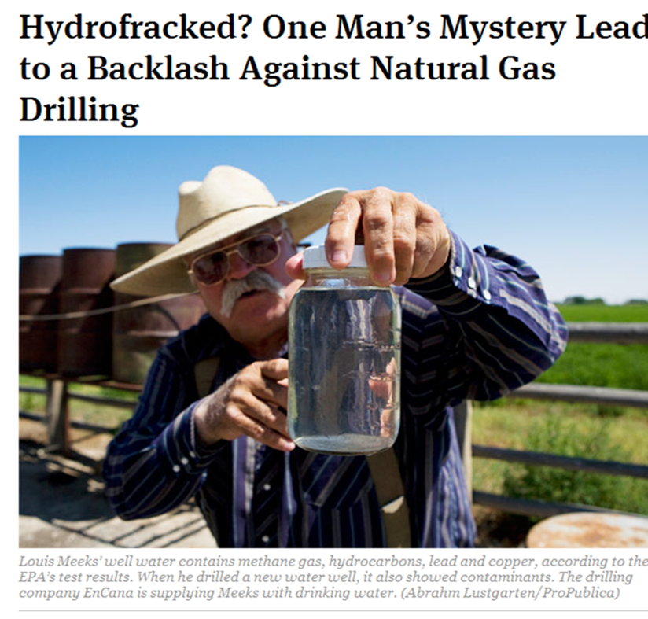
Our Challenge
Show the scientific data
Levels of protection (UIC)
Geologic information
(confining zones)
Engineering data
Chemical composition
of additives
Defined regulations
protecting groundwater
Public outreach
Notes:
We as regulators know the public has real concerns about this shale gas development and hydraulic fracturing process, and our challenge as regulators is show them the data that supports our knowledge that this process, with proper regulation HF will not harm our drinking water

Slide 4
Initiative of the GWPC and IOGCC
Notes:
And to answer this challenge , back in 2011 both the GWPC and the IOGCC have cooperated in the development of FRACFOCUS, This was originally design to except voluntary submissions from operating companies on the chemicals they used in the HF

Slide 5
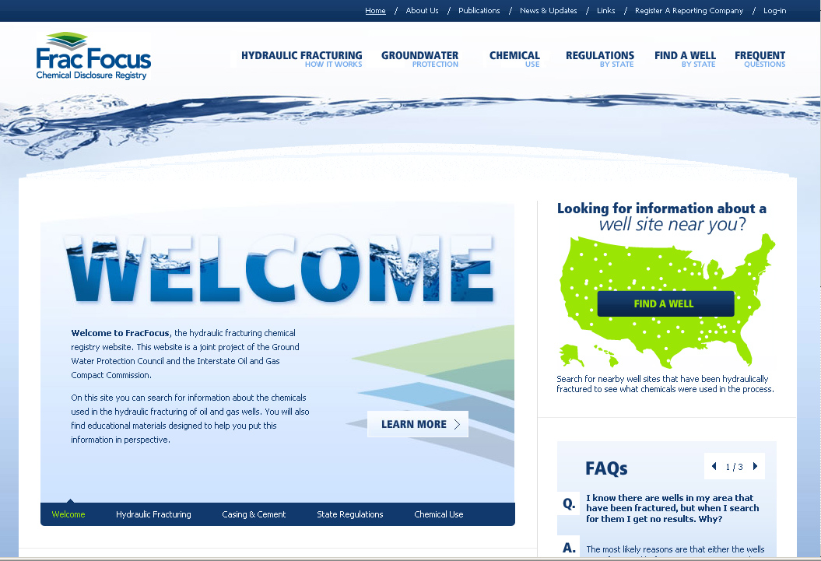
Notes:
And to provide the public with information on the process of HF

Slide 6
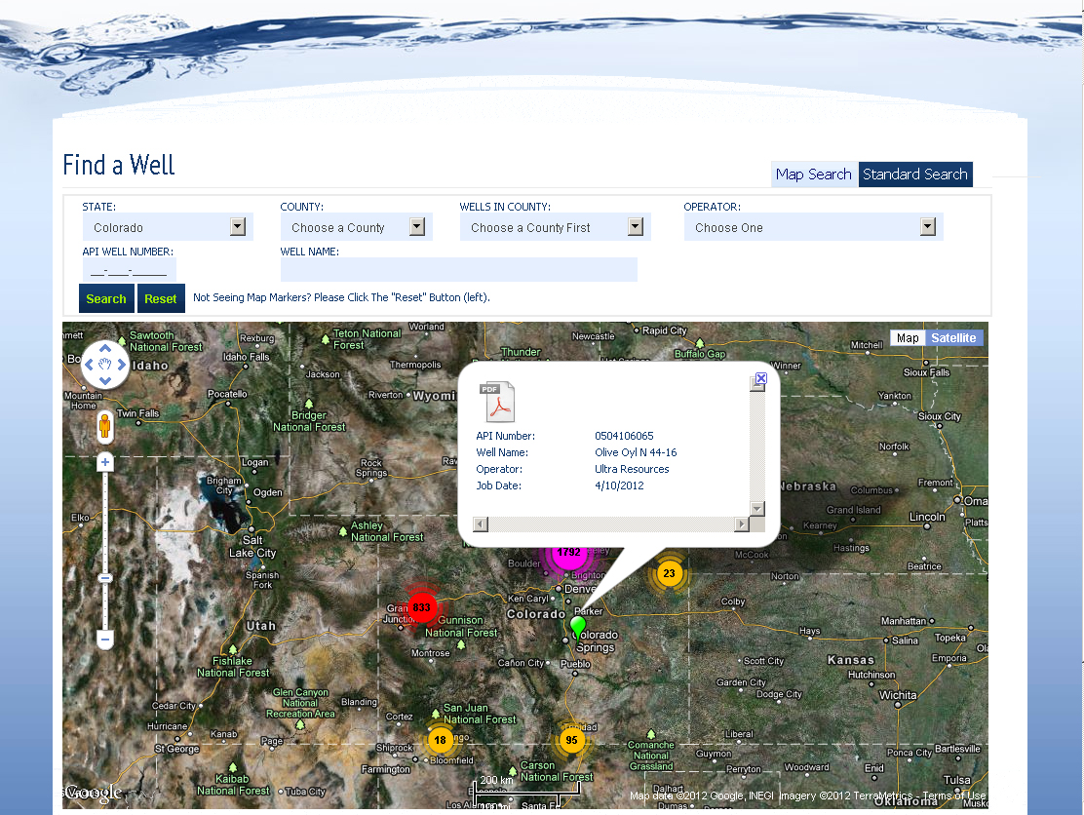
Click on pdf Icon to open the record
Notes:
Soon after the indicial release a GIS search function was added that would allow the a landowner a mechanism to search for and see what chemicals were being pumped @well level in their backyard

Slide 7
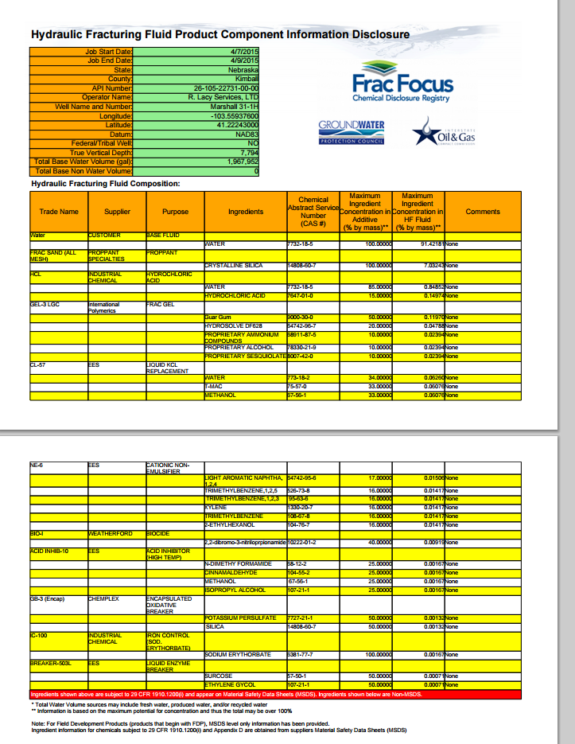
Notes:
This is a copy of the chemical disclosure you would see that saved and stored as pdf file

Slide 8
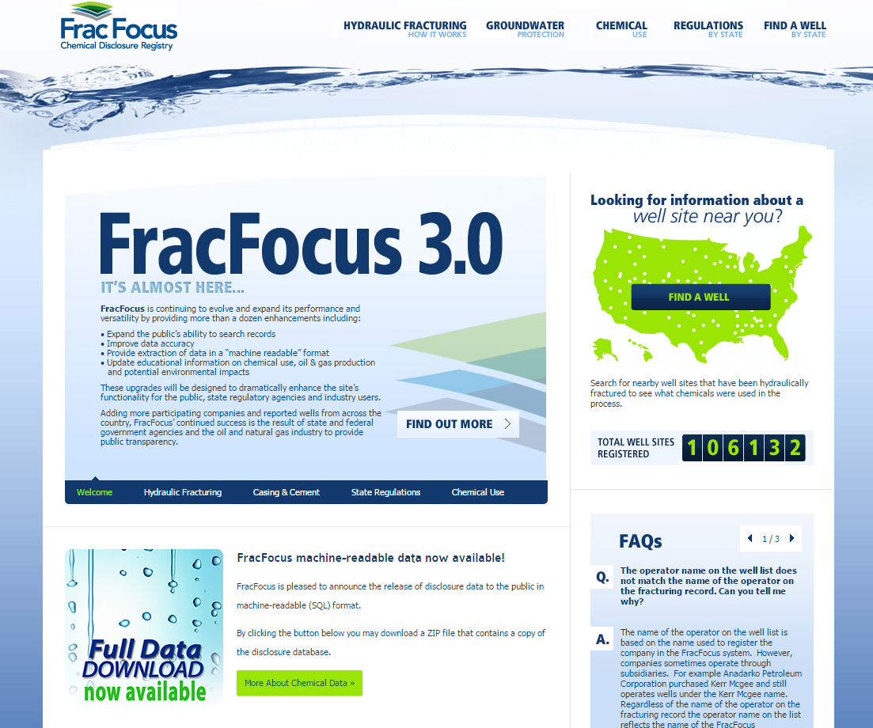
Notes:
We knew back in 2011 that FracFocus would need to have continuous improvement to meet the challenges of helping make this process more transparent and help alleviate the public’s concerns.
So in 2013 FF 2.0 was release and added features such as making it client based system and allow the data submitted to be stored electronically, not pdf files.
23 states and the federal BLM require or recommend disclosure directly to FracFocus  pdf reporting.
The number of disclosures reported to FF has grow to over 106K

Slide 9
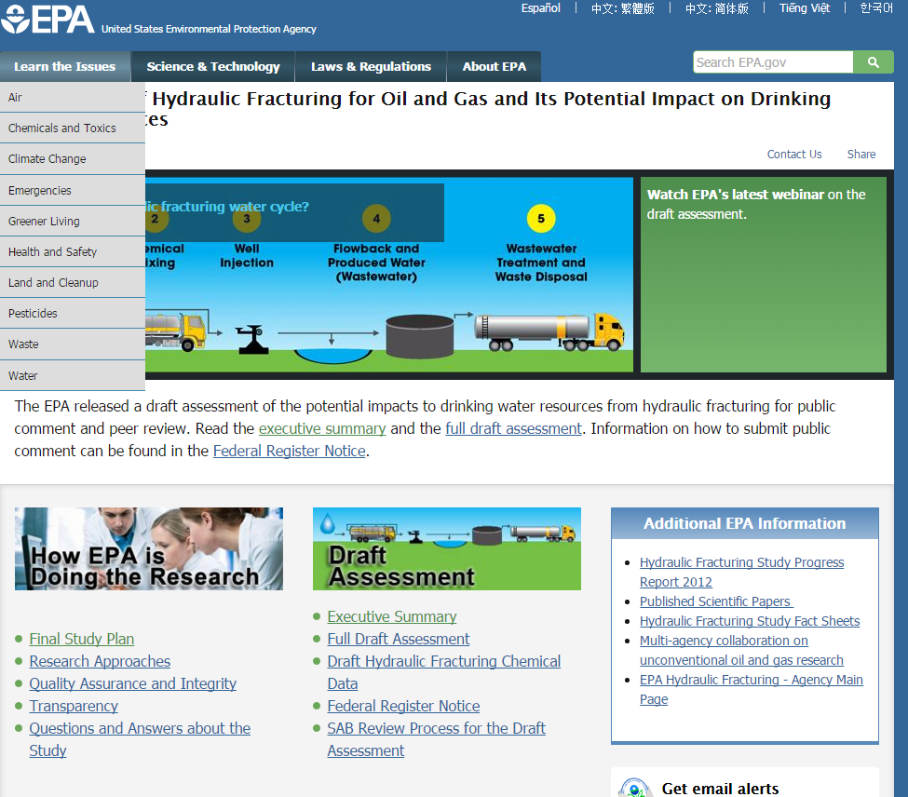
Notes:
With this data availability a number of organizations have analyzed this information.
One report is 4 year long EPA study on HF and impact of Drinking Water

Slide 10
Notes:
As part of this study, 38K FF disclosures were analyzed from over 400 operators in states

Slide 11
Notes:
As part of their analysis, EPA found that 70% of all disclosures at least 1 instance of confidential business information claim
And of the listed chemicals 11% were identified as CBI
Not exactly the transparency and full disclosure we were hoping for.

Slide 12
FracFocus Updates
Improvements to the accuracy of well data disclosed on FracFocus
Establishment of a policy for data custody, management, security, and retention
State validation of compliance
Upgrades to the website to be a more usable and interactive database
BLM requirements
Allow aggregated data downloads
Notes:
In an effort of improve FF, the Administrations Science Advisory Boards tasked FF to continue making enhancements to the system that would:
Accuracy of the data submitted
Reduce the # and occurrence of trade secret claims
Improve the system for greater public confidence and transparency
Provide for aggregated well data for download into the data systems

Slide 13
Data quality – step 1 CAS number validation
Require valid CAS# Format
Error: Invalid CAS#
Notes:
We have instituted a new of project improvements that include:
For a user input require an valid CAS # using an error trapping system

Slide 14
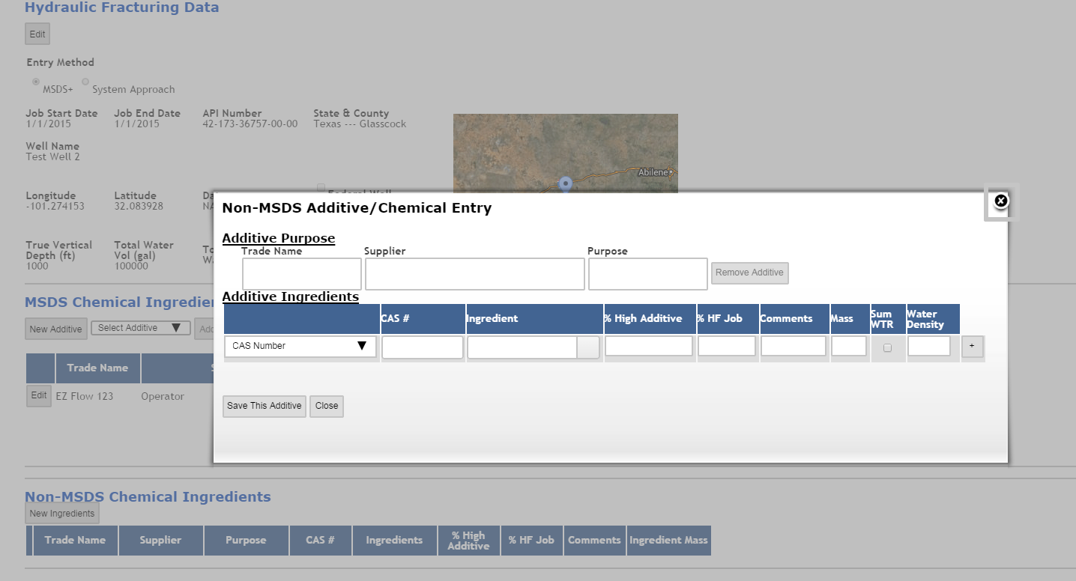
Data quality – step 2 chemical name suggestion
New Google Style Suggest valid CAS #s and possible synonyms > Click synonym and it fills in the Ingredient
Notes:
In a search of the FF 2.0 data there were 97 different occurs of the quartz sand
Help the input by suggesting a chemical name by the typing

Slide 15
Data quality – step 3 Trade Secret, Proprietary, CBI
-Drop down boxes ensure digital data is submitted
- Contact information is required for any ingredient marked as Trade Secret, Proprietary , CBI …
Notes:
To discourage the input of confidential chemicals information, the requirement that if Confidential information is claimed a reason must be given

Slide 16
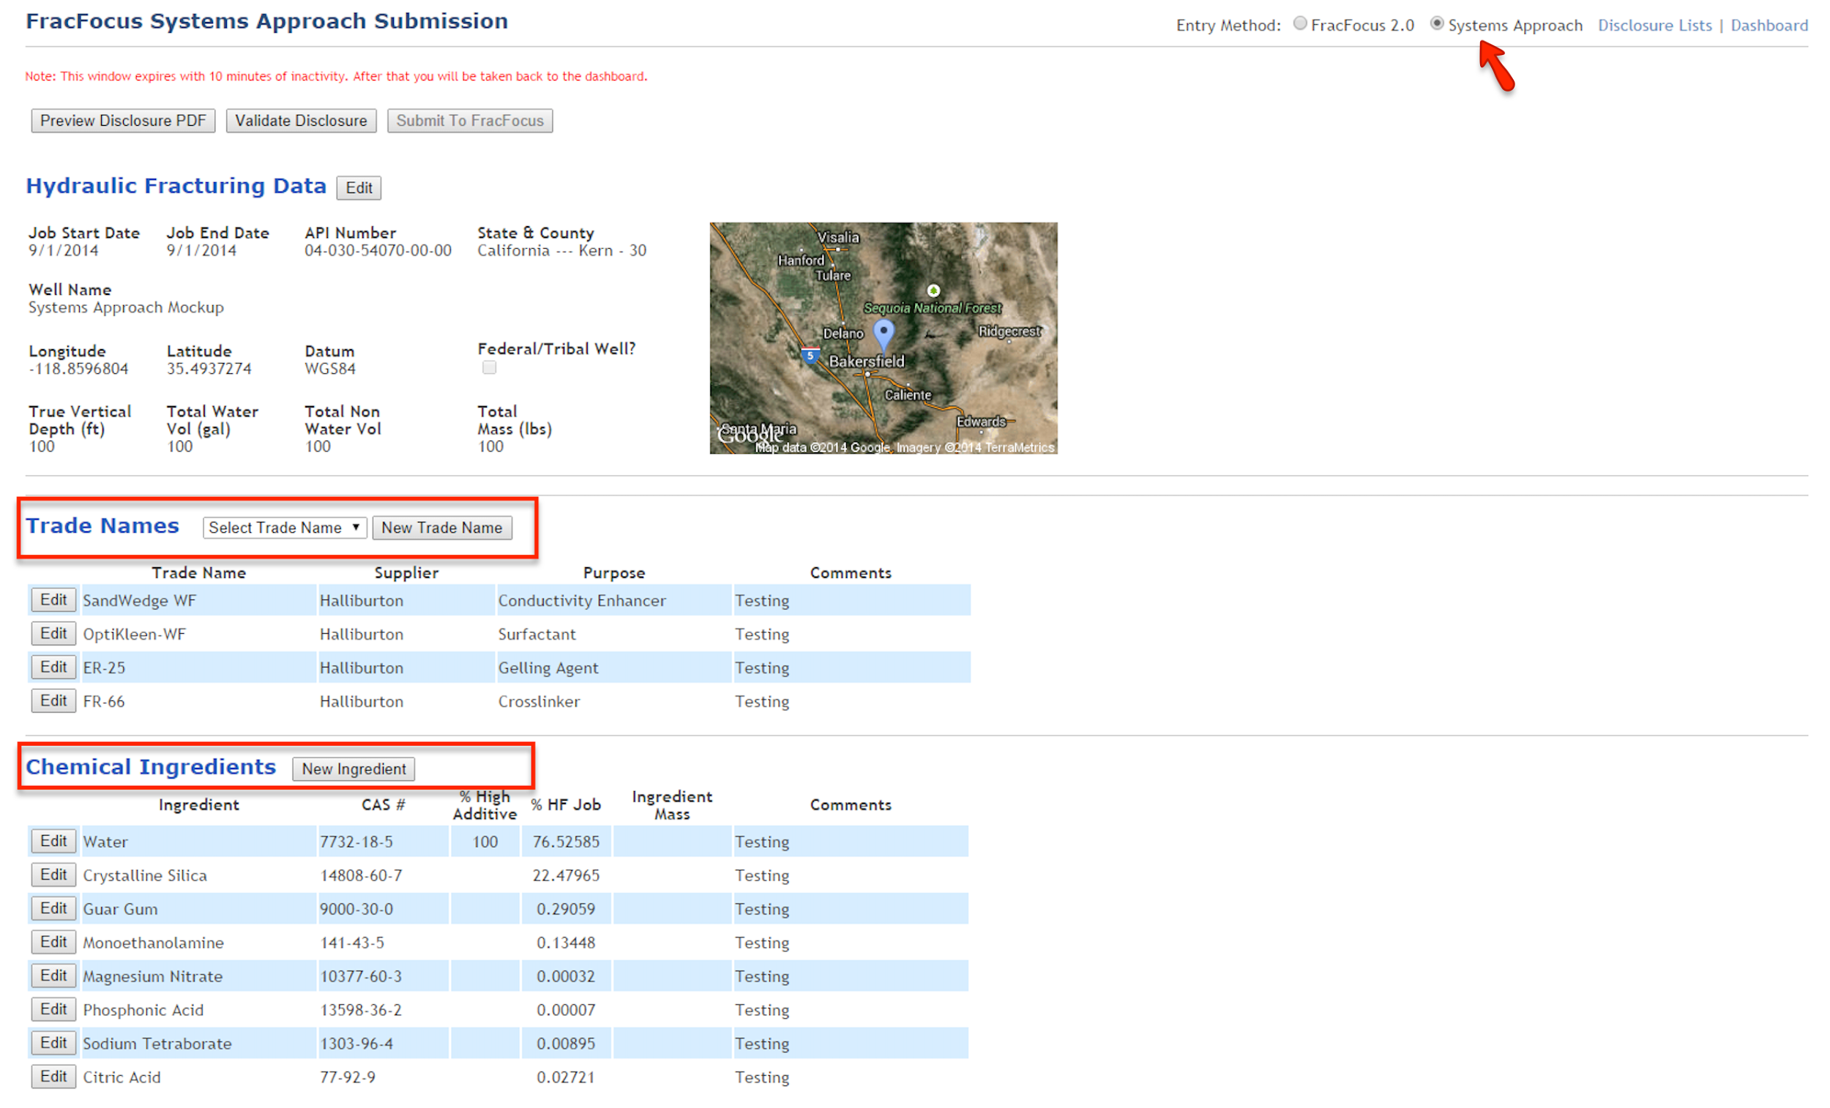
Reducing trade secret claims: The systems approach
Notes:
Also in an effort to deduce the # trade secrets, the systems approach to disclosure is factored , this method decouples the additives so “all the Chemicals that were purposely added to the job can be listed without the fear of reverse engineering of additives

Slide 17
Notes:
So is FF improving? Are we seeing a New Trend toward transparency?
The latest impendent review of FF came from Harvard Law School and environmental policy initiative

Slide 18
Notes:
This review lead by Kate Konschnik and Archana Dayalu looked at the recommendations make by the Science Advisory Board and gauge if FF was making improvements
They begin by looking to see if Well location accuracy is improving

Slide 19
Notes:
And the accuracy of CAS input errors trend is showing improvement.

Slide 20
Notes:
Timeliness, looked at if operators reported to FF in a timely manner and the power of enforcement action from a regulatory agency

Slide 21
Notes:
Thought we were on a roll…but here you see that data withholding claims of trade secrets have increased slightly

Slide 22
Notes:
Our hope is by encouraging the use of the systems approach we can see a dramatic reducing in claims. As you can see in the Harvard this trend

Slide 23
Notes:
In viewing disclosures from my home state of Nebraska, 100% of all disclosure has at least on claim for trade secret
Since systems approach there has we are now seeing 100% of the chemicals used being disclosed… this is based on one record

Slide 24
Conclusion
Notes:
I believe we are seeing a trend toward full chemical disclosure and FracFocus will continuny be improved to meet the need of people looking at the chemicals used in the HF process

